Slide 1
Gr-Spider: Revealing the Power of Greek Text-to-SQL
Panagiotis Korovesis¹, Ioannis Fourfouris¹
¹National and Kapodistrian University of Athens

Slide 2
Contents
Introduction
The Greek Spider Dataset
Translation Pipeline
Challenge of Dataset Translation
Experiments Setup
Experiments Results
Conclusion and Feature work
Demo

Slide 3
Introduction
Text-to-SQL (NL2SQL):
Converts natural language queries into structured SQL queries.
Involves understanding the input text and mapping it to SQL components like SELECT, FROM, WHERE and JOIN.
Importance:
Existing datasets are primarily in English.
Limited resources for other languages, including Greek.

Slide 4
The Greek Spider Dataset
Original Spider:
Created for text-to-SQL tasks.
Annotated by 11 Yale college students.
10,181 questions and 5,693 unique complex SQL queries.
Covers 200 databases with multiple tables across 138 distinct domains.
Objective:
Introduce the first Greek dataset for Text-to-SQL applications.
Adapt the widely known Spider dataset into Greek.

Slide 5
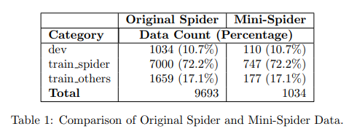
The Greek Spider Dataset
Subset for the Course:
Due to time constraints, utilized a subset of the data.
Split development data into train files to match proportions of the original dataset. → Mini-Spider and Mini-Gr-Spider
Mini-Spider Details:
20 distinct schemas, 81 tables, 441 columns.
1,034 questions.

Slide 6
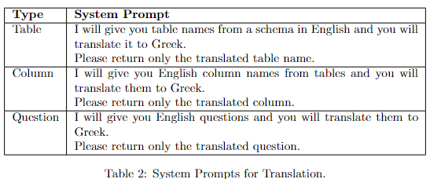
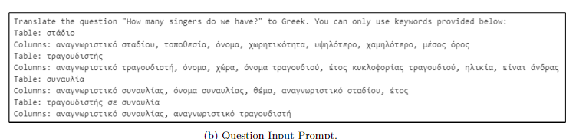
Translation Pipeline
Creation Process:
Translated the English Spider dataset using Large Language Models (LLMs).
First, translate the schema → use it as a reference to perform the question translation.
Two annotators verified and post-edited the translations.
Large Language Models (LLMs):
Chosen for their capability in handling translation tasks.
System Prompts Design.
Input Format for LLMs.
Notes:
System Prompts Design: Specific prompts designed to guide the LLMs in translating the Spider dataset.
Input Format for LLMs: Developed a structured input format to feed into the LLMs for translation.

Slide 7
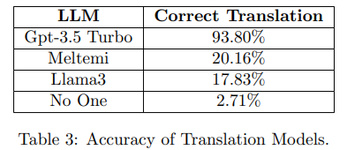
Translation Pipeline: Large Language Models Evaluation
Three models were evaluated for English-to-Greek translation:
Llama 3, Meltemi, GPT-3.5 Turbo.
3 schemas consisting of 18 tables and 89 columns were manually translated into Greek.
The 258 related questions were given to the models for translation → Accuracy validation.
*Answers containing the correct translation along with any other information, were marked as invalid
Notes:
Llama 3 and Meltemi were provided by Ollama, while GPT-3.5 Turbo was accessed via the Microsoft Azure OpenAI Service.

Slide 8
Translation Pipeline: Challenge of Dataset Translation
Ambiguity in Context and Domain Knowledge:
Schema information lacks clarity regarding its intended reference.
Some Abbreviations have unclear meanings → Validation through associated questions helps clarify the intended logic.
Non-1-1 Association:
Some English words lack exact equivalents in Greek.
Entity Polysemy:
Certain words in English have multiple meanings in Greek.
Notes:
Schema information lacks clarity regarding its intended reference. For example, terms like 'Student' could refer to various educational levels (college, school, doctoral candidate).
In English, 'State' typically refers to federal states (like those in the United States), while in Greek, it pertains to the organization of a city-state or a form of government
Certain words in English have multiple meanings in Greek. For example, 'Transcript' could refer to a general written or printed material or a specific record of study in different contexts.

Slide 9
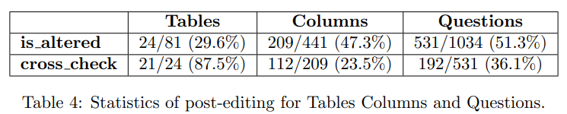
Translation Pipeline: Dataset Analysis
Sentences were reorganized, unnecessary words were eliminated.
Table and column names were corrected where needed.
GPT occasionally did not strictly follow input keywords provided in the prompt, opting instead to translate content from scratch.
*The Mini-Spider translation process required over two days in total for translation and data review.
Notes:
Content within sentences was reorganized, unnecessary words were eliminated In order for sentence structures to be more human like

Slide 10
Experiments
Two baseline Text-to-SQL models were used to evaluate the dataset:
RAT-SQL
DAIL-SQL
A new baseline for each model was needed to make meaningful comparisons.
Notes:
New baseline was required to be able to make comparisons since the existing literature uses the full version of the Spider Dataset.

Slide 11
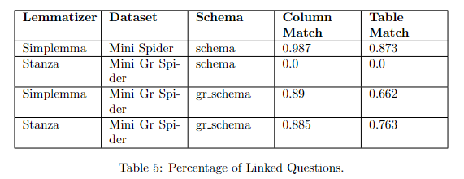
Experiments: RAT-SQL
Encodes the schema along with each question.
Performs schema linking by:
lemmatizing questions, schema info using the simplemma library
similarity search on lemmatized terms.
Incorporates multilingual language models:
mT5-large, mBart
Extensions:
Added support for mT5-base.
Added option for stanza lemmatizer
Notes:
The RAT-SQL [8] framework utilizes relation-aware self-attention to integrate global reasoning across schema entities and question words, alongside structured reasoning over predefined schema relations. This approach excels in generalizing to unseen database schemas by encoding database relations in a manner accessible to semantic parsers
The Simplemma [9] lemmatizer was originally chosen for this framework but exhibited poorer performance in schema linking for the Greek dataset compared to the Stanza [10] lemmatizer

Slide 12
Experiments: RAT-SQL - Setup
Existing studies use the original English schema for experiments, regardless of the language of the questions, resulting in a lack of schema linking for non-English languages.
We introduce a novel approach by translating both column and table names.
Training was performed using mT5-base.
All scores shown are derived by inferencing the dev set.
Notes:
We translate table names and column names, crucial for schema linking, while leaving other fields unchanged to preserve their original values. This ensures SQL queries reference the correct tables and columns. The translated schema is referred to as gr-schema, while the original remains labeled simply as schema.
It's crucial to note that both the training and inference datasets utilize identical databases, significantly enhancing inference scores compared to scenarios where a database not used during training is employed

Slide 13

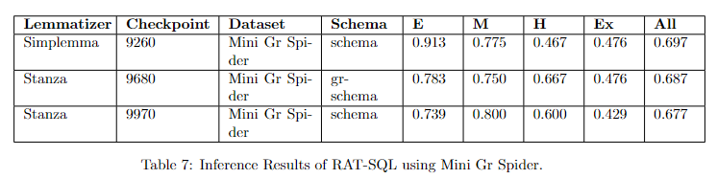
Experiments: RAT-SQL – Results (1/2)
The baseline for our comparisons resulted by training RAT-SQL on Mini Spider.
Optimal Greek
Models trained on Mini Gr Spider dataset performed worse than their English counterpart.
It appears that column/table matching had minimal impact on the accuracy.
We anticipate that the significance of accurate schema linking will become evident during inference with the translated test set
Notes:
BULLET 2: This is because both datasets utilize the same databases. Despite column/table matching not being effective with the original schema, RAT-SQL consistently encodes information from the entire database alongside each question. Given the manageable complexity of connections in the Spider dataset, the model reliably identifies links from available information. Consequently, during training, the model familiarizes itself with databases and successfully predicts questions in the dev set.
BULLET 3: uses different databases unfamiliar to the model. In this scenario, the model will heavily rely on mapping between questions and tables/columns to achieve accurate results.

Slide 14
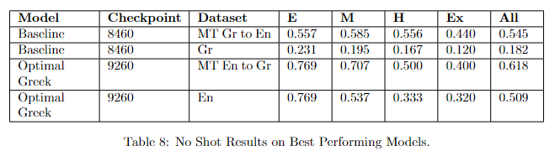
Experiments: RAT-SQL – Results (2/2)
Is manual translation of datasets and training of language-specific models still necessary?
Direct Multilingual Model Approach: Training a multilingual model solely in one language and directly inferring it in the target language.
Machine Translation Approach:
Translate questions using LLMs to the model’s train language.
Inference the model with them.
Notes:
5628.85% More English data than Greek in mt5 training
Models trained with machine-translated data also exhibited inferior performance compared to their counterparts. Despite providing additional context to the LLM for more accurate translation, it failed to produce results comparable to those from human-curated datasets.
The decline in performance can largely be attributed to the polysemy (multiple meanings) of the Greek language and the inability of Language Learning Models to fully grasp the context of questions. Despite access to database information, achieving an ideal translation that aligns perfectly with specified database tables and columns remains unsatisfactory

Slide 15
Experiments: DAIL-SQL
Leverages large open or closed source Large Language Models (LLMs) for the Text-to-SQL task.
Focuses on how to represent question, database information, relevant examples in the prompt:
Question Representation (QA): How to represent the question along with the database.
Example Selection (ES): Similarity metrics between question embeddings.
Initially performs schema linking, using Stanford Core-NLP
Extensions:
Replaced existing lemmatizer with Stanza.
Replaced existing sentence transformer with paraphrase-multilingual-MiniLM-L12-v2.
Notes:
STUDY: QA EXAMPLES
ES EXAMPLES

Slide 16
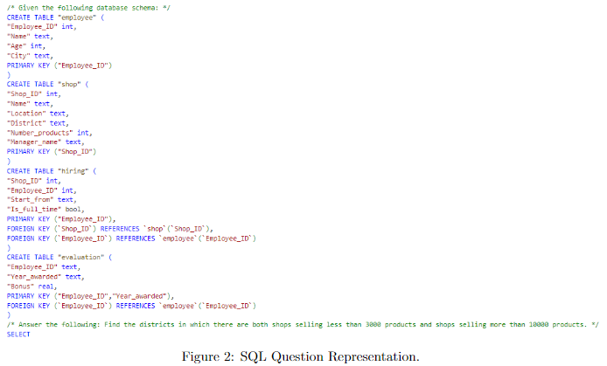

Experiments: DAIL-SQL - Setup
“SQL” question representation method for all experiments.
“Euclidian Distance of Masked Questions” example selection method for all experiments.

Slide 17
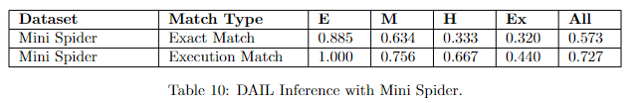
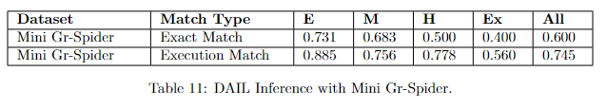
Experiments: DAIL-SQL – Results
Inferencing with Mini Gr-Spider shows marginally better results than the baseline model, contrary to the RAT-SQL experiments.
Greek language is more descriptive and it’s able to convey meanings more effectively than English, allowing the selection of more relevant examples.
This assumption needs further investigation.

Slide 18
Conclusion
Introduced the Gr-Spider dataset by translating the English Spider dataset into Greek with Large Language Models, followed by verification and post-editing for accuracy.
Evaluated the dataset using RAT-SQL and DAIL-SQL, enhanced with Greek language support.
Conducted experiments, analyzed results.

Slide 19
Feature Work
Completing the entire translation for both train and test data.
Training RAT-SQL:
With the large version of selected multilingual pre-trained models.
Using other Greek stemmers.
Evaluating various DAIL-SQL configurations to find the best setup for the Greek dataset.

Slide 20

Demo

Slide 21


