Slide 1
Gr-Spider: Revealing the Power of Greek Text-to-SQL
Panagiotis Korovesis¹, Ioannis Fourfouris¹
¹National and Kapodistrian University of Athens
Notes:
Welcome, we would like to present our work, Gr-Spider. Gr-Spider is theGreek version of the Spider Dataset, commonly to benchmark Text-to-SQL solutions.

Slide 2
Contents
Introduction
The Greek Spider Dataset
Translation Pipeline
Challenge of Dataset Translation
Experiments Setup
Experiments Results
Conclusion and Feature work
Demo
Notes:
First, we will say a few things about the Text-to-SQL task in general and quickly go through the Spider Dataset,
Then we will talk about our modification -> The Greek Spider and the challenges we faced during the translation
After that, we will benchmark Gr-Spider
Finally, we will present a live demo

Slide 3
Introduction
Text-to-SQL (NL2SQL):
Converts natural language queries into structured SQL queries.
Involves understanding the input text and mapping it to SQL components like SELECT, FROM, WHERE and JOIN.
Importance:
Existing datasets are primarily in English.
Limited resources for other languages, including Greek.
Notes:
Text-to-SQL, also known as Natural Language to SQL (NL2SQL), is a task in natural language processing that aims to convert human language queries into structured SQL queries.
This involves analyzing the input text to understand its meaning and then mapping it to the appropriate SQL query components such as SELECT, FROM, WHERE and JOIN clauses.
Why did we choose the Gr-Spider?
Existing benchmark datasets are primarily in English, with a few exceptions
Most Text-to-SQL solutions are designed with the English language in mind, as such there are limited resources for other languages.

Slide 4
The Greek Spider Dataset
Original Spider:
Created for text-to-SQL tasks.
Annotated by 11 Yale college students.
10,181 questions and 5,693 unique complex SQL queries.
Covers 200 databases with multiple tables across 138 distinct domains.
Objective:
Introduce the first Greek dataset for Text-to-SQL applications.
Adapt the widely known Spider dataset into Greek.
Notes:
In order to introduce Gr-Spider, we first have to briefly talk about the original Spider.
Spider is a comprehensive, large-scale dataset for semantic parsing and text-to-SQL tasks, annotated by 11 Yale college students
It’s comprised of 10 thousand questions and 5 and a half thousand unique SQL Queries
SQL queries are categorized into four difficulty levels: Easy, Medium, Hard, and Extra Hard. We will refer to these categories as \textbf{(E), (M), (H) and (Ex)}
It cover 2 hundred databases across 1 hundreend and thirty eight different domanins.
Our objective is to introduce the first, to our knowledge, Greek dataset for text 2 sql apps by adapting the Spider Dataset into Greek.

Slide 5
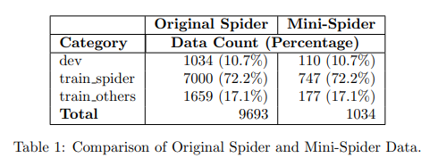
The Greek Spider Dataset
Subset for the Course:
Due to time constraints, utilized a subset of the data.
Split development data into train files to match proportions of the original dataset. → Mini-Spider and Mini-Gr-Spider
Mini-Spider Details:
20 distinct schemas, 81 tables, 441 columns.
1,034 questions.
Notes:
Due to the course’s time constraints, we used only a subset of the data. We split the development data into the required files (train_spider.json, train_others.json, dev.json) to match the proportions of the data in the original files, as shown in Table 1. On the left side of the table, we can see the number of questions in the original Spider dataset and on the right, the data in our version, as well as the corresponding proportions. We will refer to this dataset as 'Mini-Spider' and the equivalent dataset in Greek as 'Mini-Gr-Spider’. Regarding the database details, it consists of twenty distinct schemas, with eighty-one tables and four hundred forty-one columns, along with one thousand thirty-four related questions

Slide 6
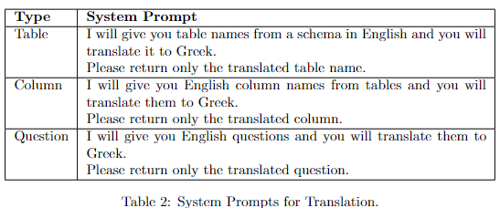
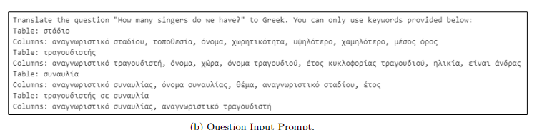
Translation Pipeline
Creation Process:
Translated the English Spider dataset using Large Language Models (LLMs).
First, translate the schema → use it as a reference to perform the question translation.
Two annotators verified and post-edited the translations.
Large Language Models (LLMs):
Chosen for their capability in handling translation tasks.
System Prompts Design.
Input Format for LLMs.
Notes:
The translation process is structured into two steps: First, we translated the schema, including table and column names. Next, the question translation was performed using the translated schema as a reference. To increase efficiency and avoid manual translation of all information, we first used Large Language Models in order to translate the Spider dataset. Then, we correct and post-edit the translations, utilizing any gathered contextual information. The final translation at each stage resultef from a cross-check between ours post-editing efforts. LLMs were selected for their translation capabilities. For the translation task, we designed specific system prompts, which are outlined in Table 2. Also, we created a structured input format to feed into the language models to obtain the translated information. An example of these inputs can be seen in the image.

Slide 7
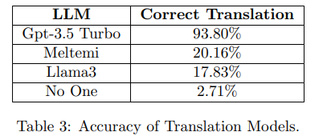
Translation Pipeline: Large Language Models Evaluation
Three models were evaluated for English-to-Greek translation:
Llama 3, Meltemi, GPT-3.5 Turbo.
3 schemas consisting of 18 tables and 89 columns were manually translated into Greek.
The 258 related questions were given to the models for translation → Accuracy validation.
*Answers containing the correct translation along with any other information, were marked as invalid
Notes:
Regarding the Large Language Models evaluation, we examined three models for their suitability for English-to-Greek translation namely Llama 3 , Meltemi and Gpt-3.5 Turbo. To identify the optimal model, we manually translated 3 schemas into Greek, comprising of 18 tables and 89 columns. Subsequently, we fed the 258 relevant questions into the models using the previously mentioned prompts and obtained the translated questions. We then validated these translations to assess their accuracy. As we can see in Table 3, Gpt-3.5 Turbo translated the most questions correctly, leading us to select it for the subsequent translation tasks. The ‘No one’ entry shows the percentage of questions that were incorrectly translated by all the language models. It is worth noting that translated questions produced by LLMs, which included additional text such as explanations for why the question was translated a certain way or definitions of tables and columns, were marked as incorrect. This is caused by the models’ ‘babbling’ behavior, especially in Llama3 and Meltemi. This is the main reason why these models have not achieved good accuracy

Slide 8
Translation Pipeline: Challenge of Dataset Translation
Ambiguity in Context and Domain Knowledge:
Schema information lacks clarity regarding its intended reference.
Some Abbreviations have unclear meanings → Validation through associated questions helps clarify the intended logic.
Non-1-1 Association:
Some English words lack exact equivalents in Greek.
Entity Polysemy:
Certain words in English have multiple meanings in Greek.
Notes:
Based on our initial investigation, we have identified the most common errors that arise when translating the spider dataset covering both schema and questions. The first one is Ambiguity in Context and Domain Knowledge: this means that some schema information lacks clarity regarding its intended reference. For instance, the term ‘Student’ may be relevant to a college attendee, a school-level student or even a doctoral candidate. Additionally, there are abbreviations, especially in column names, whose specific meaning is unclear. In such cases, we refer to the questions that use this information to validate the logic. Next, we have the Non-1-1 Association problem: Some English words do not have exact equivalents in Greek. For instance, the word ’State’ can be translated as ‘Politeia’, but in English, it typically means each of the federal states constituting the United States, whereas in Greek, it refers to the organization of a city-state or the form of government. Finally we have the Entity polysemy challenge: Certain words have multiple meanings in Greek. For example, the word ‘Transcript’ can refer to a general written or printed material, but it can also refer to a record study of a student .

Slide 9
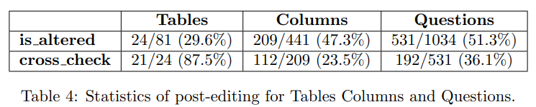
Translation Pipeline: Dataset Analysis
Sentences were reorganized, unnecessary words were eliminated.
Table and column names were corrected where needed.
GPT occasionally did not strictly follow input keywords provided in the prompt, opting instead to translate content from scratch.
*The Mini-Spider translation process required over two days in total for translation and data review.
Notes:
While Gpt-3.5 Turbo performed excellent in the translation process, we continued to refine the schema and the questions. Regarding the adjustments, we reorganized the content within sentences, eliminated unnecessary words and refined the sentence structures to sound more natural. Additionally, we corrected table and column names where needed. This was necessary because Gpt, occasionally, did not strictly follow the input keywords provided in the prompt. Instead, it translated the content from scratch.
Details of the statistics of the post-editing data can be found in Table 4. The is altered information in the table reveals the percentage of questions that were modified between the initial Gpt translation and the final translated version. As mentioned earlier, each annotator verified and post-edited the Gpt translation. The final translation resulted from a verification process of the post-edits. The cross check information indicates the percentage of disagreement between our annotations (based only on the data that were altered).

Slide 10
Experiments
Two baseline Text-to-SQL models were used to evaluate the dataset:
RAT-SQL
DAIL-SQL
A new baseline for each model was needed to make meaningful comparisons.
Notes:
For the experiment, we explored two powerful Text-to-SQL models. RAT-SQL was utilized for a traditional machine learning approach to the Text-to-SQL problem, while DAIL-SQL was chosen to assess its effectiveness, employing advanced prompt engineering to leverage large language models (LLMs). Additionally, since existing work uses the full version of the Spider Dataset while we use the Mini-Spider, we required a new baseline for each model to ensure meaningful evaluations. Therefore, we utilized the Mini-Spider dataset for training, evaluation and metric calculation, establishing the main reference for later analysis.

Slide 11
Experiments: RAT-SQL
Encodes the schema along with each question.
Performs schema linking by:
lemmatizing questions, schema info using the simplemma library
similarity search on lemmatized terms.
Incorporates multilingual language models:
mT5-large, mBart
Extensions:
Added support for mT5-base.
Added option for stanza lemmatizer
Notes:
RAT-SQL is a traditional Text-to-SQL model, which requires train and inference. The model manages to encode the database relations in an accessible way and to map columns and their mentions for a particular question. During the pre-processing phase, schema linking takes place. This is achieved by lemmatizing the questions, as well as the tables and the columns of the database, using the simplemma library. Then the columns and tables are mapped to the questions, where possible. The mRAT-SQL model, incorporates multi-language models like mT5 and mBart, facilitating the training and inference processes across different languages. Regarding our extensions,. Through experimenting we found out that simplemma lemmatizer performed worse at the schema linking process for the Greek dataset, when compared with the Stanza lemmatizer. As such, we added the support for the Stanza library.

Slide 12
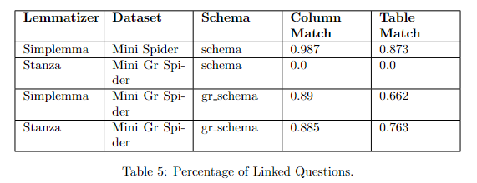
Experiments: RAT-SQL - Setup
Existing studies use the original English schema for experiments, regardless of the language of the questions, resulting in a lack of schema linking for non-English languages.
We introduce a novel approach by translating both column and table names.
Training was performed using mT5-base.
All scores shown are derived by inferencing the dev set.
Notes:
Existing experiments using RAT-SQL for non English languages utilize the original English schema. As a result, the schema linking process explained before, largely fails.
Table 5 shows exactly this case for the Gr-Spider:
1 Using the original schema with either simplemma or stanza results in a total lack of schema linking.
2 When using the translated gr_schema, we can see that stanza achieves a greater percentage, especially in table match.
For our experiments we chose to also train models with the translated, gr_schema, to observe the effect of proper schema linking.
For the next slides we will refere to the translated schema as gr-schema, while the original remains labeled simply as schema.
The training process for all models was conducted using mT5-base, due to hardware constraints.
It's crucial to note that both the training and inference datasets utilize identical databases, significantly enhancing inference scores compared to scenarios where a database not used during training is employed

Slide 13

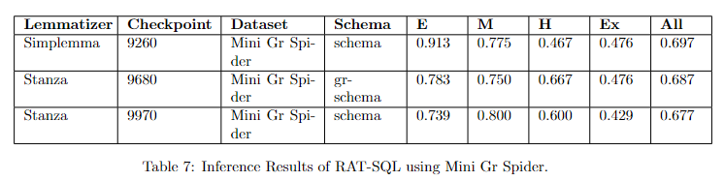
Experiments: RAT-SQL – Results (1/2)
The baseline for our comparisons resulted by training RAT-SQL on Mini Spider.
Optimal Greek
Models trained on Mini Gr Spider dataset performed worse than their English counterpart.
It appears that column/table matching had minimal impact on the accuracy.
We anticipate that the significance of accurate schema linking will become evident during inference with the translated test set
Notes:
Let’s take a look at the results:
The baseline model was trained on Mni-Spider, using the schema. It achieved a total inference score of 0.73 (Again, a reminder, these scores are on the Mini-Spider Dev)
For the Greek models, we opted for different combinations of (1) lemmatizer, (2) schema
The best Greek model proved out to be the one using Simplemma lemmatizer and the original English schema.
In the Stanza case, the model using the curated gr_schema proved to be marginally better than it’s counterpart but still worse the simplemma one.
In total we can see that
1) Models trained on Mini Gr Spider performed worse than their English counterpart.
2) Schema Linking had a minimal impact on the model’s accuracy.
This is because both datasets utilize the same databases. Despite column/table matching not being effective with the original schema, RAT-SQL consistently encodes information from the entire database alongside each question. Given the manageable complexity of connections in the Spider dataset, the model reliably identifies links from available information.
We anticipate that the true effect of schema linking will become apparent when inferencing with the proper test set, which uses different database, In this scenario, the model will heavily rely on mapping between questions and tables/columns to achieve accurate results.

Slide 14
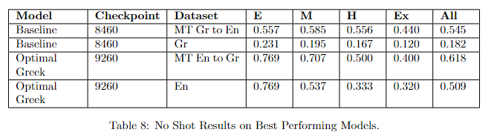
Experiments: RAT-SQL – Results (2/2)
Is manual translation of datasets and training of language-specific models still necessary?
Direct Multilingual Model Approach: Training a multilingual model solely in one language and directly inferring it in the target language.
Machine Translation Approach:
Translate questions using LLMs to the model’s train language.
Inference the model with them.
Notes:
The main questions that rises in these types of papers are
“Why is manual translation necessary, can’t LLMs provide adequate translations, given the appropriate prompt”?
And
“Since the models used are multilingual can’t we train a model in one language and inference it in any supported one?”
To answer these questions, we performed a few “No-Shot” Experiments, using the Baseline English model and the Optimal Greek model.
We inference these models with
Machine Translated datasets
Datasets in a language different from the one used during training.
By observing Table 8 it becomes apparent that:
“Directly Predict scenario”
Inferencing the baseline in the target language resulted in poor performance
Inferencing the Optimal Greek also resulted in lower performance
This large gap between the two can be explained by the fact that the Greek data used to train mT5-base were 5 thousand percent less than the English ones.
“Translate then Predict Scenario”
The models exhibited inferior performance compared to their counterparts.
Despite providing additional context to the LLM for more accurate translation, it failed to produce results comparable to those from human-curated datasets.
The decline in performance can largely be attributed to the polysemy (multiple meanings) of the Greek language and the inability of Language Learning Models to fully grasp the context of questions. Despite access to database information, achieving an ideal translation that aligns perfectly with specified database tables and columns remains unsatisfactory

Slide 15
Experiments: DAIL-SQL
Leverages large open or closed source Large Language Models (LLMs) for the Text-to-SQL task.
Focuses on how to represent question, database information, relevant examples in the prompt:
Question Representation (QA): How to represent the question along with the database.
Example Selection (ES): Similarity metrics between question embeddings.
Initially performs schema linking, using Stanford Core-NLP
Extensions:
Replaced existing lemmatizer with Stanza.
Replaced existing sentence transformer with paraphrase-multilingual-MiniLM-L12-v2.
Notes:
The second set of conducted experiments if performed by DAIL-SQL
The main component of DAIL-SQL is a black box LLM such as GPT4.
As such this solution focuses on how to properly construct a prompt with all the required information, in order for the LLM to give the proper SQL queries.
The first aspect is Question Representation: How can we represent the question along with the database information
The second aspect is Example Selection: How can we find the most similar queries from the train set, in order to add them as examples in the prompt.
Again, DAIL-SQL initially performs schema linking, as described before.
Finally our extensions of the existing code base were:
Replace the Stanford Core NLP lemmatizer with Stanza (which supports Greek text)
Replace the existing setnece transformer used the example similarity search with a multilingual one.

Slide 16
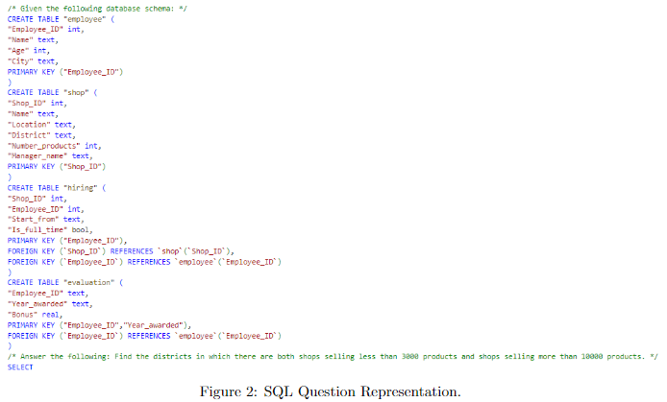

Experiments: DAIL-SQL - Setup
“SQL” question representation method for all experiments.
“Euclidian Distance of Masked Questions” example selection method for all experiments.
Notes:
Many methods are provided for Question Representation and Example Selection.
For the question representation we chose to proceed with the suggested one which is the “SQL Question Representation”
An example can be seen on Figure 2:
The DB is given as valid SQL commands and the question as a comment
Finally, the word SELECT is added at the end to ensure better replies from the LLM
For the question representation method, we chose “Euclidian Distance of Masked Questions”
This method:
Masks domain specific information from the questions
Extracts sentence embeddings
Calculates the Euclidian distance between the embeddings.
This example selection gave the best “Question Quality” score, which is a metric produced by the tool.

Slide 17
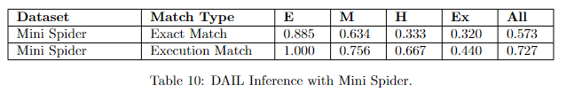
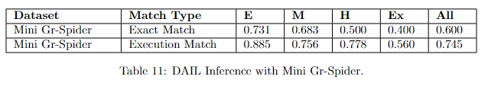
Experiments: DAIL-SQL – Results
Inferencing with Mini Gr-Spider shows marginally better results than the baseline model, contrary to the RAT-SQL experiments.
Greek language is more descriptive and it’s able to convey meanings more effectively than English, allowing the selection of more relevant examples.
This assumption needs further investigation.
Notes:
Ok, lets look at the performance of this model.
As before, a new baseline is required.
By looking at Table 10, we can see that although the exact match of the questions is rather low, the Execution match is on par with the RAT-SQL baseline
Table 11 contains the scores for the Greek version.
What’s interesting here is that both exact match and inference scores are higher than the baseline.
This directly contradicts the results produced by RATSQL.
One plausible explanation for this is that the Greek language is in general, more descriptive and can better convey meaning when compared to English.
This aids the selection of more accurate examples.
However, since the main component is an LLM, this is only an assumption at this point, which certainly requires more investigation.

Slide 18
Conclusion
Introduced the Gr-Spider dataset by translating the English Spider dataset into Greek with Large Language Models, followed by verification and post-editing for accuracy.
Evaluated the dataset using RAT-SQL and DAIL-SQL, enhanced with Greek language support.
Conducted experiments, analyzed results.
Notes:
So, what we have seen. We introduced Gr Spider, the first Greek dataset for text-to-SQL applications. To create this dataset, we translated the original dataset using Large Language Models, followed by our post-editing and verification efforts. We then used both the original and translated spider dataset to train the extended versions of RAT-SQL and DAIL-SQL models and finally, we presented and discussed the corresponding results.

Slide 19
Feature Work
Completing the entire translation for both train and test data.
Training RAT-SQL:
With the large version of selected multilingual pre-trained models.
Using other Greek stemmers.
Evaluating various DAIL-SQL configurations to find the best setup for the Greek dataset.
Notes:
Feature work will include (1) completing the entire translation for both train and test data, (2) training RAT-SQL with the large version of the selected multilingual pre-trained models while utilizing
other stemmers for Greek (like skroutz stemmer) and (3) evaluating different configurations in DAIL-SQL to determine the best ones for the Greek dataset.

Slide 20

Demo

Slide 21


