Slide 1
MultiSpider: Towards Benchmarking Multilingual Text-to-SQL Semantic Parsing
Longxu Dou¹, Yan Gao², Mingyang Pan¹, Dingzirui Wang¹, Wanxiang Che¹, Dechen Zhan¹, Jian-Guang Lou²
¹Harbin Institute of Technology
²Microsoft Research Asia
In Proceedings of the AAAI Conference on Artificial Intelligence (Vol. 37, No. 11, pp. 12745-12753)

Slide 2
Contents
Introduction
MultiSpider
Translation Pipeline
Schema Augmentation: SAVe
Experiment Settings, Results & Discussion
Related Work
Conclusion
Our Approach

Slide 3
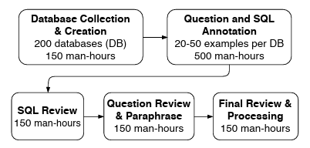
Introduction
Natural Language to SQL (NL2SQL): converting natural language queries into structured SQL queries.
Spider (NL2SQL) Dataset:
Large-scale, complex, and cross-domain semantic parsing and text-to-SQL dataset.
Developed by Yale University.
Consists of 9691 questions and 5263 SQL queries over 166 databases.

Slide 4
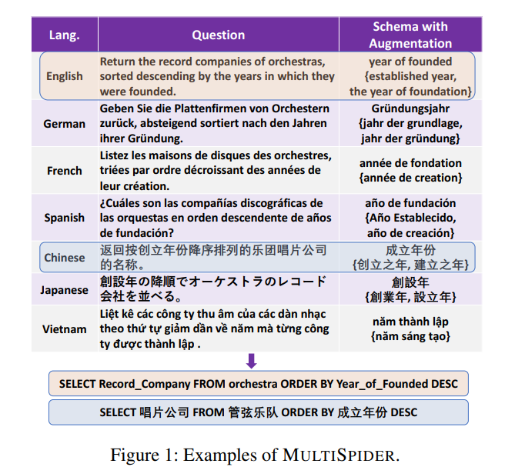
MultiSpider
Multilingual NL2SQL datasets exist* but suffer from low-quality translations and incomplete translations.
Expands the Spider dataset, covering seven main-stream languages.
Introduces a novel schema augmentation method (SAVe)
*Chinese, Vietnamese and Portuguese

Slide 5
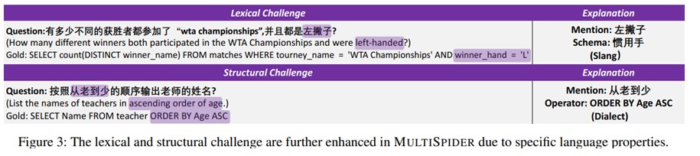
Challenges in MultiSpider
Schema Translation:
Insufficient context and domain knowledge for proper translation.
Lexical Challenges:
The context of the questions might not be enough to cope with entity polysemy.
Structural Challenges:
Complex syntax or logic cause inaccurate translations.

Slide 6
Up to now Work
Two well-known extensions of Spider exist:
Cspider (Chinese): Focuses on translating the schema from Chinese to English, improving existing translation quality.
Vspider (Vietnamese): Re-partitions the dataset to ensure fair comparison with other languages. It retains English values (e.g., location and name) in questions to maintain consistency with the database content.

Slide 7
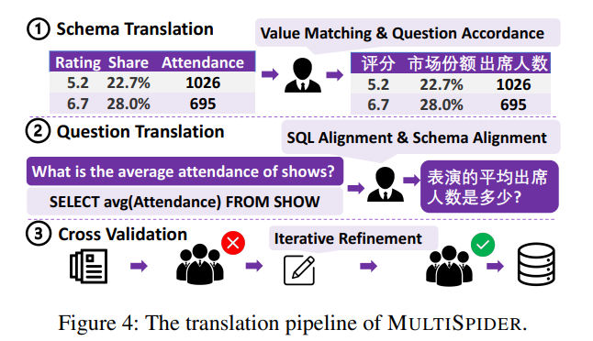
Translation Pipeline
Google Neural Machine Translation (NMT) was first used to translate the Spider.
Highly qualified translators were employed to validate and post-edit the translations.
Translation Order: Schema → Questions.
Final translation occurred with cross validation.

Slide 8
Schema Augmentation: SAVe
Aim: Generate more schema variations to enhance the grounding ability of the parser.
Schema Augmentation categories:
Synonyms with different lemmas.
Morphological variants (i.e. syntactic changes).

Slide 9
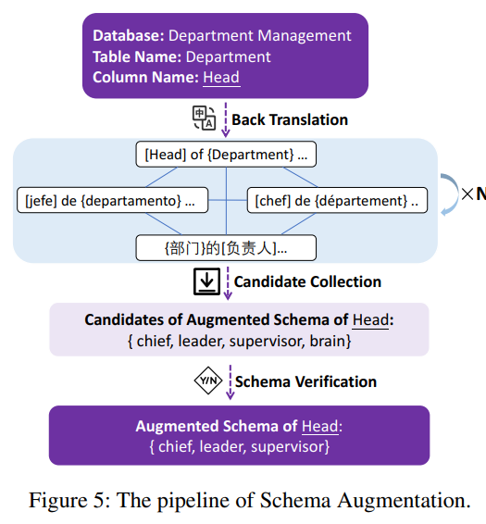
SAVe: Methodology
Back Translation: generates synonym candidates of schema, using a special template to utilize the context of the schema.
Candidate Collection: (K * N)^{[1]} synonyms are generated for each entity.
Schema Verification: Natural language inference model is employed for selecting semantic equivalency candidates.
[1]: K: Languages, N: Rounds of translation

Slide 10
Experiment Setup
Baseline Models:
Task-specific model: RAT-SQL
With the pre-trained multilingual encoder: mBert.
With the pre-trained multilingual encoder: XLM-Roberta-Large.
Pretrained multilingual encoder-decoder: mBart.
Evaluation Metric: exact match accuracy on all examples
For the training process, the augmented data were used in the first epochs. Then the model was finetuned using the translated training data

Slide 11
Experiment Settings
Monolingual: The parser is trained in the human-translated dataset in the target language.
Multilingual: The parser is trained on the concatenation of train data from all languages.
Zero-Shot: The parser is trained only on the English Dataset.
Directly Predict: Predict with question and schema in the target language.
Translate-then-Predict: Translate from Target to English (NMT) → Predict.
Translate-then-Train: Translate from English to Target → Train → Predict.

Slide 12
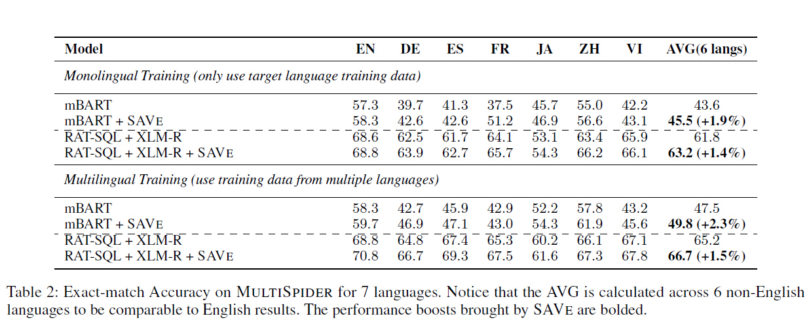
Experiment Results (1/2)
Notes:
Explain Exact match accuracy

Slide 13
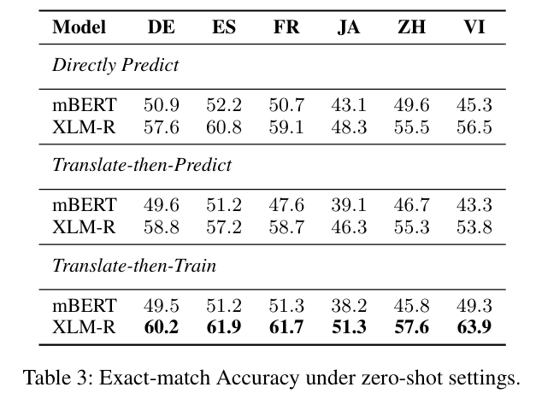
Experiment Results (2/2)

Slide 14
Performance Drop in Non-English Languages
Lexical Mistakes:
Caused by the schema-linking problem (i.e. the syntactic difference between question tokens and schema).
Structural Mistakes:
The languages in MultiSpider contain more dialectal variations than English, resulting to incorrect predictions of SQL Operators.

Slide 15
The effect of SAVe
Performance Gain by 1.8% in all Languages:
Addressing the schema linking problem by synthesizing more schema-token pairs.
Improving the robustness of the text-to-SQL model through varies the schema input.

Slide 16
Related Work
Multilingual Text-to-SQL Datasets:
Vietnamese, Chinese, Portuguese – Spider.
Multilingual Text-to-SQL Systems:
NL2SQL Models:
RAT-SQL: adopts relation-aware transformer. Utilizes multilingual encoders (mBert, PhoBert, XLM-R).
Encoder-Decoders: Attempt to formulate the SQL Translation task as a seq2seq translation problem.
mBart, mT5.

Slide 17
Conclusion
MULTISPIDER Dataset:
Largest dataset covering seven mainstream languages for multilingual text-to-SQL.
Quality ensured through qualified translators and multi-round checking.
Natural, accurate and challenging for text-to-SQL tasks.
Schema Augmentation SAVe:
Expands the training data with schema variations.
Boosts model performance.
Challenges in Multilingual Text-to-SQL:
Exploration of lexical and structural challenges.

Slide 18
Our Approach
G-Spider
Greek version of the Spider Dataset, following the same translation technique (schema + questions).
Utilize Meltemi LLM in place of Google-NMT.
SAVe Implementation will be implemented if there is enough time.
Benchmarking Techniques
Multilingual
Monolingual
Zero-Shot
Benchmarking Tools // in each epoch I save a checkpoint
mRat-SQL
Enoder options: mBert, mT5 (large, base), ??
DAIL-SQL ?
Due to it being few-shot
Seq2Seq
mT5, mBart (???) with finetuning
Backup: Some gpt model with prompt engineering, (question & schema as input).

Slide 19


