Slide 1
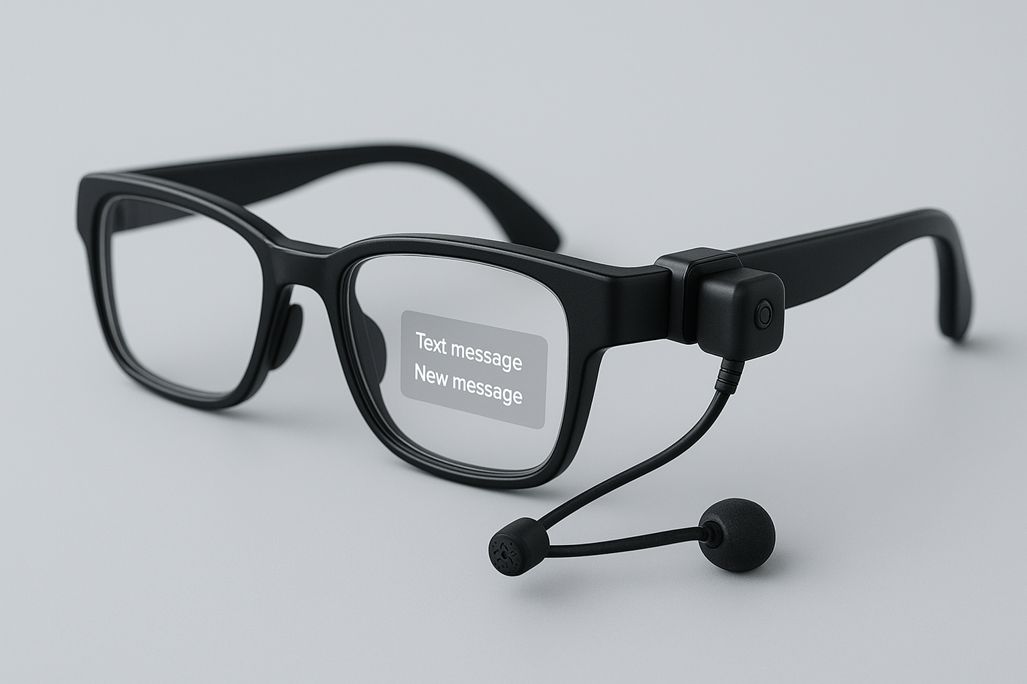
Assistance for people with Disabilities
Architecture & Alpha version
ΟΜΑΔΑ 8
ΚΩΤΣΟΠΟΥΛΟΣ ΙΩΑΝΝΗΣ
ΚΑΡΒΟΥΝΗΣ ΠΑΣΧΑΛΗΣ

Slide 2
Critical Sensors
Camera
Heart Rate Sensor
Gyroscope and Accelerometer
Phone Sensors:
Microphone
GPS

Slide 3
Possible Use Cases
Real-Time Assistance & Navigation from VLM/LLM
Health Monitoring & Early Risk Detection
Emergency SOS & Automatic Alerts in case of emergency
Caregiver Portal-Live communication and intervention

Slide 4





Sensor Streams
HTTP
Grafana
APP
InfluxDB
Glasses
GPS
HTTP
Sensor Streams
VOICE REC
Sensor Streams
HTTPS
TTS
Ingestion point
Wi-Fi
MCP Server
Glasses Controller
MQTT
Backend
Glasses-Client
MQTT
GPS/Text from speech
Sensor Streams
Sensor Streams
HTTP
Front
Sensor Streams
MQTT Broker
VLM/LLM
Local VLM/LLM
HTTP
AI GATEWAY/PROXY
HTTPS
ContextBroker
Node.js
MQTT
Caretaker Messages/AI answers
Front
RT DEPENDENT
MQTT
Caretaker
Messages/AI
answers
MQTT
NGSI
AI Queries
Sensor Streams
Notifications
Minimal health watchdog
MQTT Broker
VIDEO INGESTION
Notifications
Sensor Streams
Users’ Info
VIDEO STREAMING
WebRTC
Frames
Video Stream
SQlite
Video Stream
VMS
WebRTC
Notifications
MQTT

Slide 5
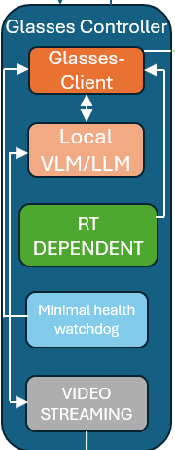
GLASSES CONTROLLER
Glasses-Client
Collects sensors’ outputs
Communicates with Cloud MQTT-Broker
Sends messages to HUD
Local VLM/LLM
Tiny on device models
Used only in offline mode
RT Dependent
Real-time processing of high-frequency sensor data (gyroscope)
Minimal Health Watchdog
Fall Detection
Cardiac Monitoring
Emergency Triggers
VIDEO Streaming
Captures camera frames
Sends frames to VMS

Slide 6
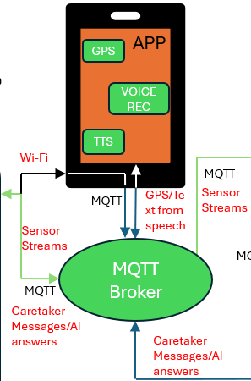

USER’S PHONE APP &
CLOUD ENTRY MQTT BROKER & VMS
Phone App
Publishes GPS data stream to cloud broker
Records voice queries, uses voice to text and publishes text to Cloud broker
Receives AI outputs and uses Text-to-Speech (TTS) to respond audibly
MQTT Broker
Is the central point of communication linking the Edge, the App and the Cloud
Routes the data
Critical for scalability and real time responsiveness
VMS
Receives video from video streaming and routes frames to frontend or backend

Slide 7
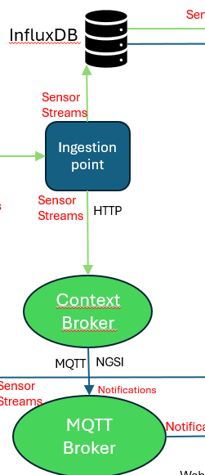
INGESTION & CONTEXT MANAGEMENT
Ingestion Point
Normalizes/Validates data
Forwards data either to InfluxDB for storing or to context broker
Context Broker
Real-Time State Management
Event Subscriptions & Notifications
Standardized API (NGSI/NGSI-LD)
MQTT Broker
Publishes notifications backend and frontend

Slide 8
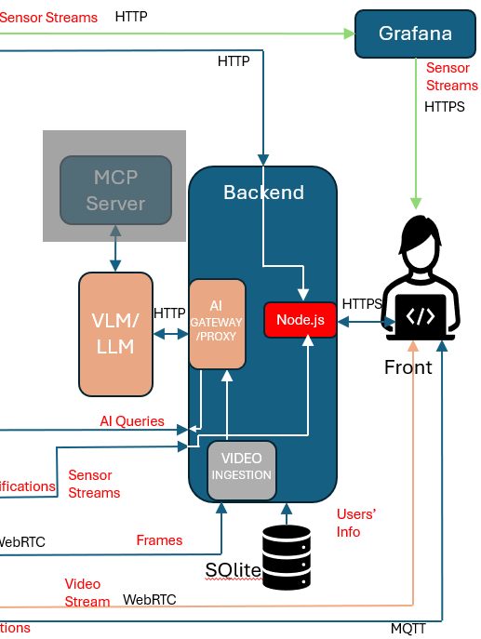
BACKEND-FRONTEND & AI AGENTS
Backend
Processes sensor stream
Connects AI Agents with Cloud via the AI gateway
Forwards frames from VMS to AI gateway via the Video Ingestion point
Includes Care Giver portal backend (Node.js) which receives data from influxDB and notifications
Publishes the AI answers and Care Giver messages to Cloud entry MQTT broker
Stores user’s info in SQlite database
Frontend-Care Giver Portal
Displays graphs received from Grafana
It supports live streaming from glasses camera and live communication through messages
It receives critical notifications send from Cloud
AI Agents
LLM
Acts as logical router deciding to either answer the query itself or send it to VLM
VLM
Answers the queries using frames captured by VMS and communicates with *MCP server, which contains CV, for support to analyze the frames

Slide 9
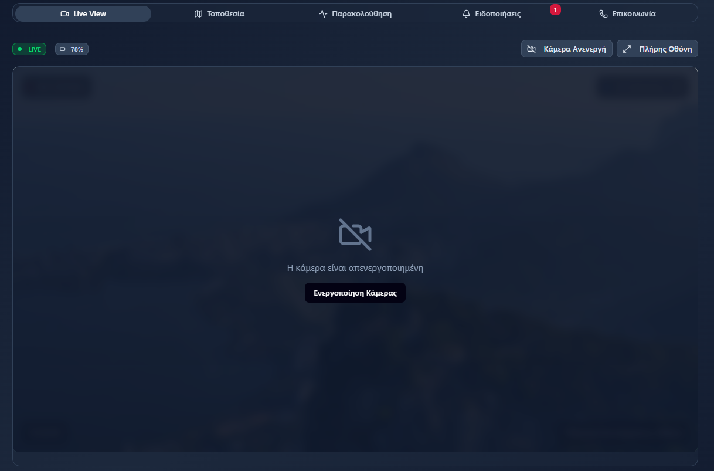
LIVE VIEW PAGE
Access to the glasses’ camera by the caregiver for live monitoring.

Slide 10
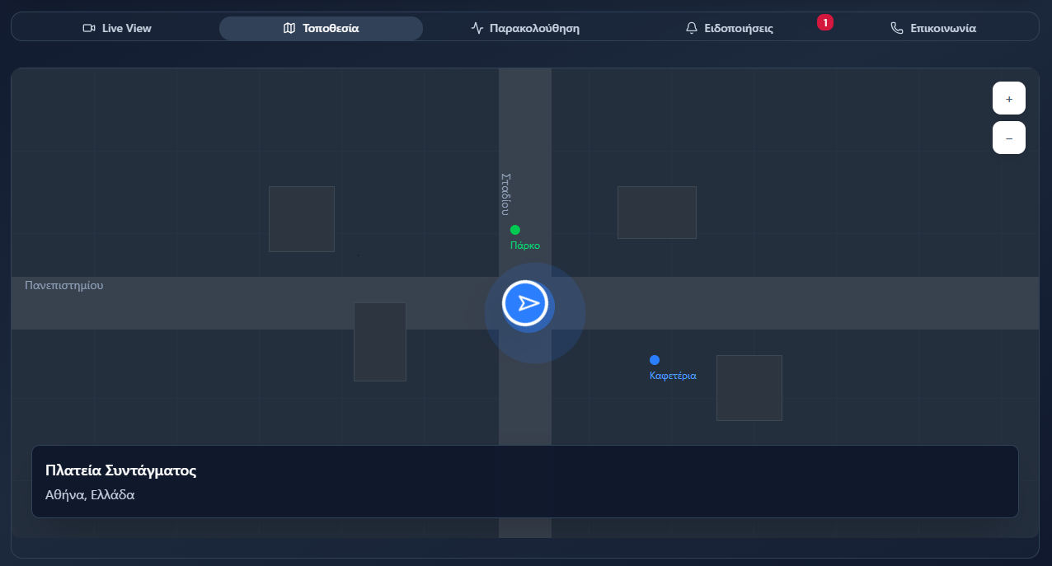
LOCATION TRACKING PAGE
Tracking the user’s location via phone app

Slide 11
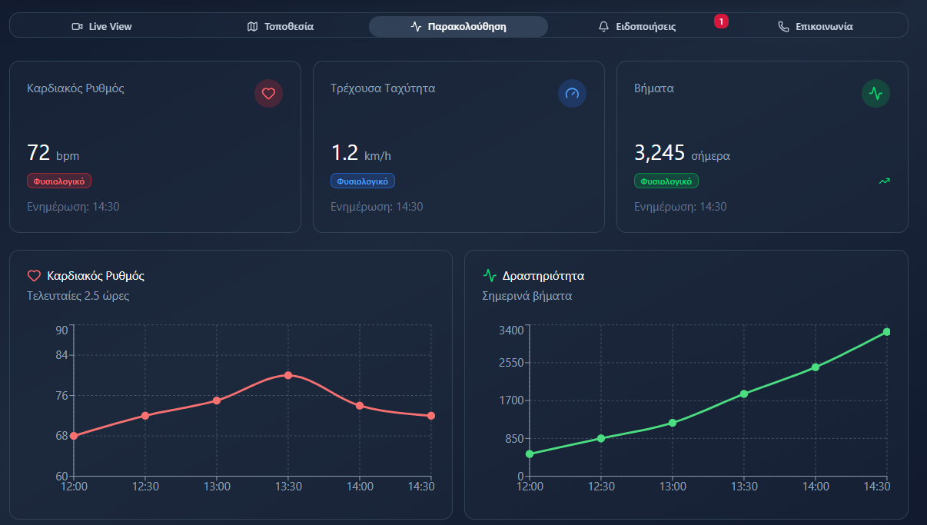
USER’S HEALTH MONITORING
Heart rate
User’s speed
Pedometer

Slide 12
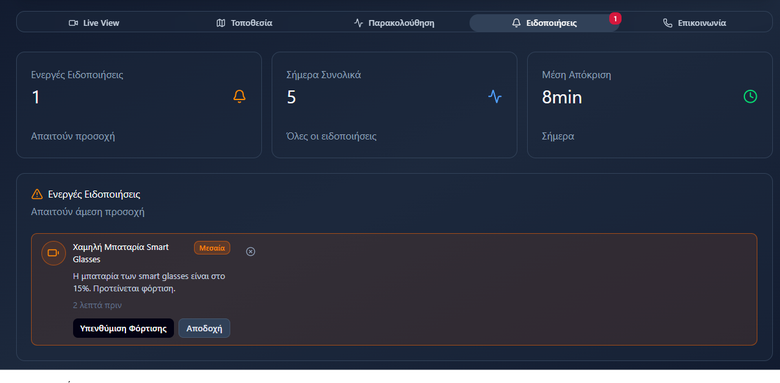
NOTIFICATIONS PAGE
Device status
Important alert for possible emergency

Slide 13
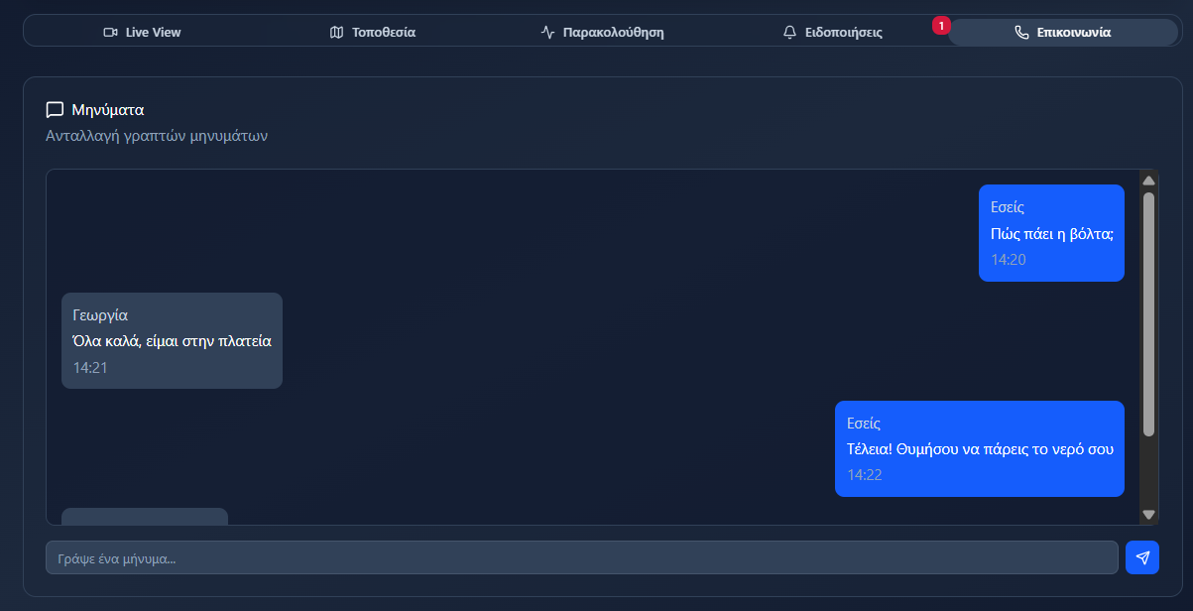
COMMUNICATION PAGE
Messages among user and care giver

Slide 14
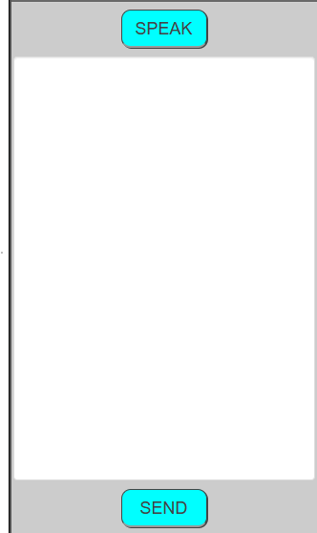
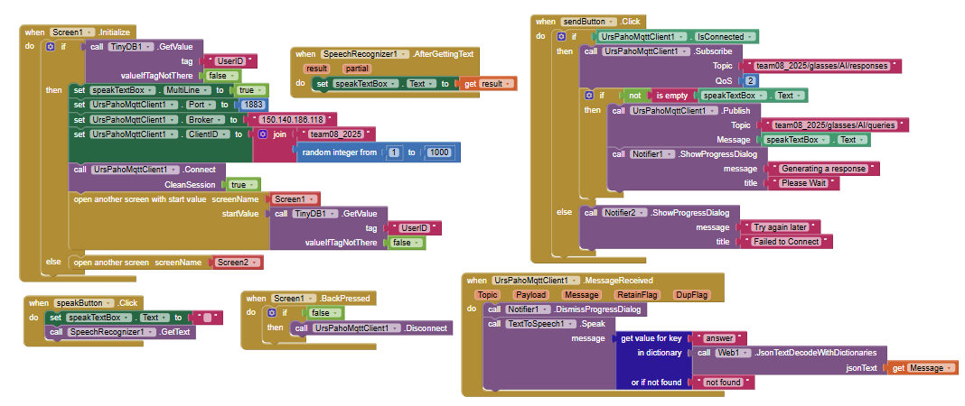
PHONE APP & APP INVENTOR BLOCKS

Slide 15
PROJECT TIMELINE
Glasses Controller
Local VLM/LLM integration (planned)
RT Dependent integration (planned)
Minimal Health Watchdog integration (planned)
Cloud
Phone app (almost completed)
Brokers communication logic (under development)
Video streaming logic (later work)
Databases (influxDB & SQlite) (under development)
Backend & Frontend
AI gateway (Completed)
Video Ingestion (later work)
BFF & Frontend (planned)

Slide 16
THANK YOU FOR YOUR ATTENTION

