Slide 1

A Multilabel Image Classification based Solver for reCAPTCHA v2

Slide 2
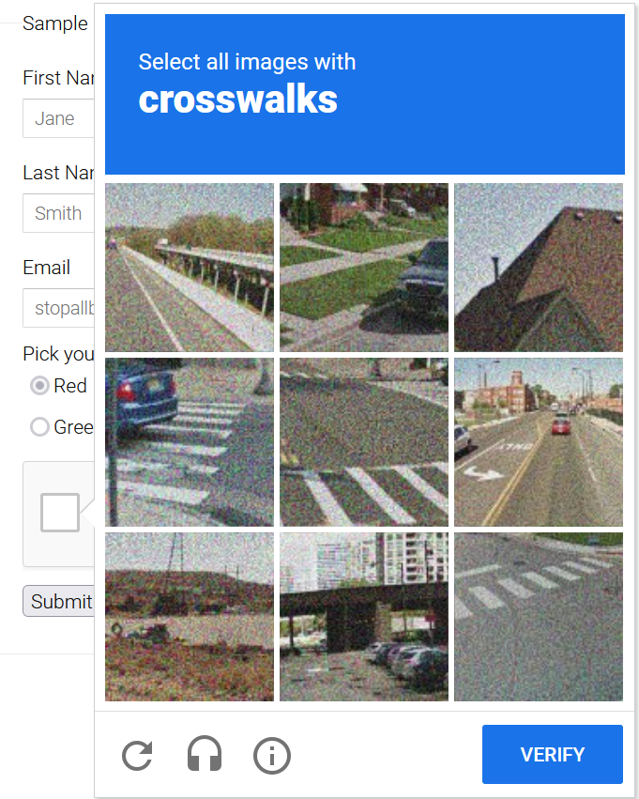
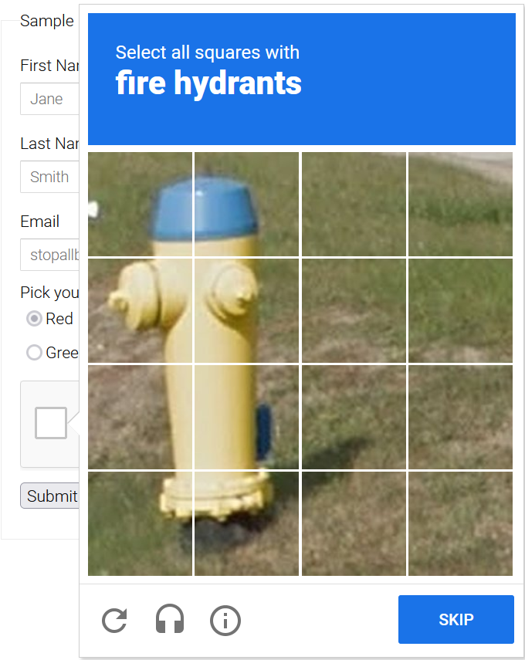
reCaptcha v2 Challenge

Slide 3
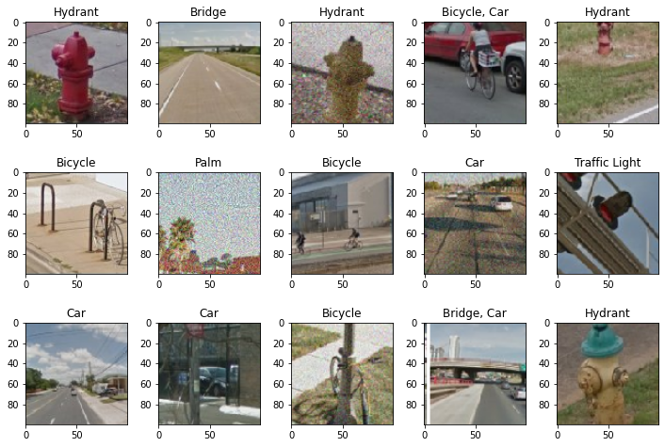
Dataset (1/2)
Selenium bot triggers reCaptcha challenge
Downloads and splits the images
Hand-powered multilabel annotation
Total 4026 images belonging to 11 distinct classes

Slide 4
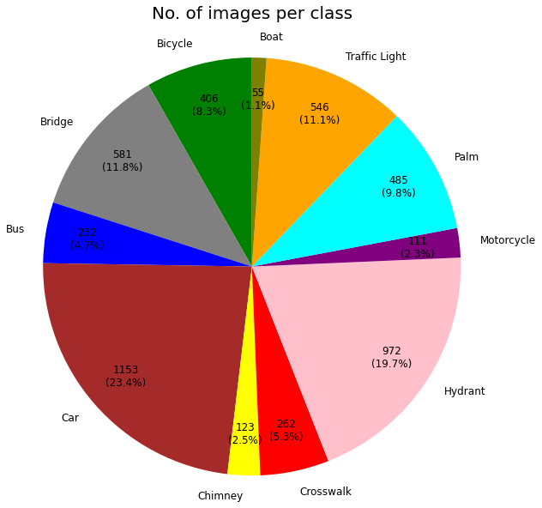
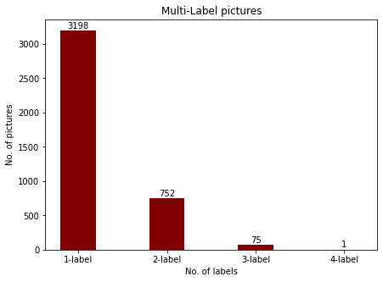
Dataset (2/2)
Classes: bicycle | bridge |traffic light | car | bus | motorcycle | palm tree | crosswalk | chimney | fire hydrant | boat

Slide 5
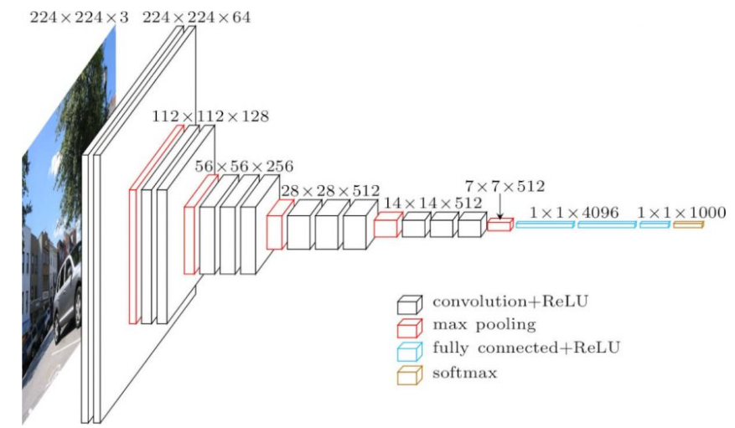
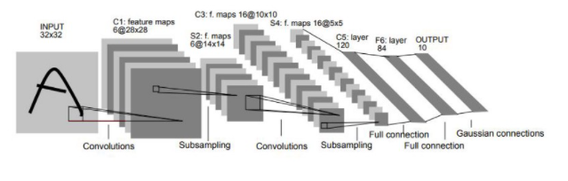
Models
VGG-16
(201.414.475)
LeNet-5
(9.967.371)

Slide 6
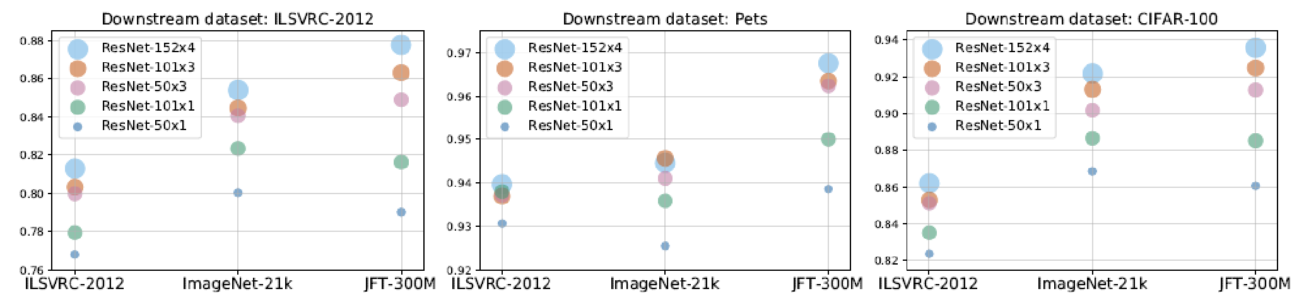
BiT (Big Transfer)
BiT-S (ImageNet-1K) | BiT-M (ImageNet-21K) | BiT-L (JFT)
ResNet-50x1
ResNet-101x1
ResNet-50x3
ResNet-101x3
ResNet-152x4

Slide 7
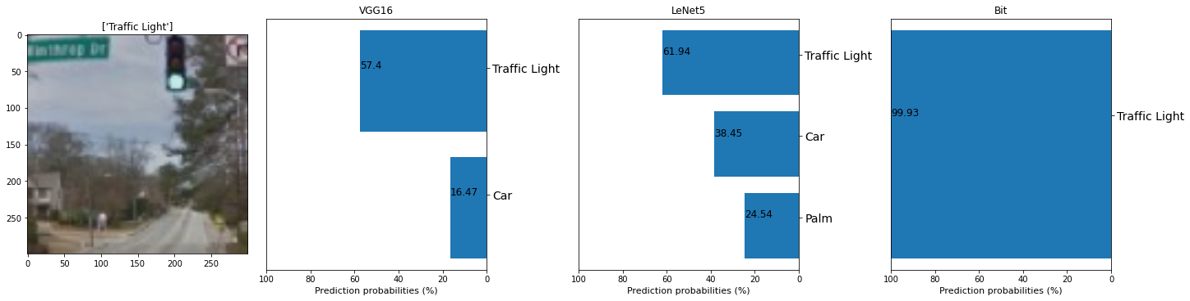
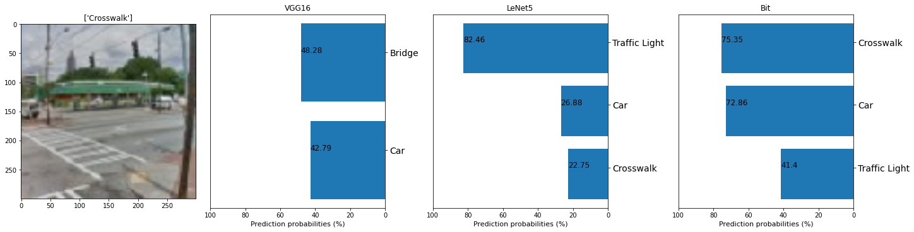
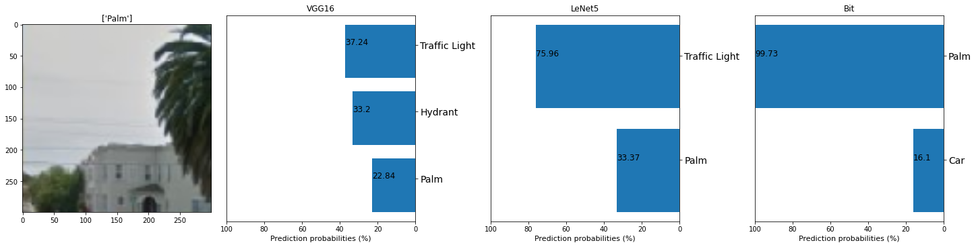
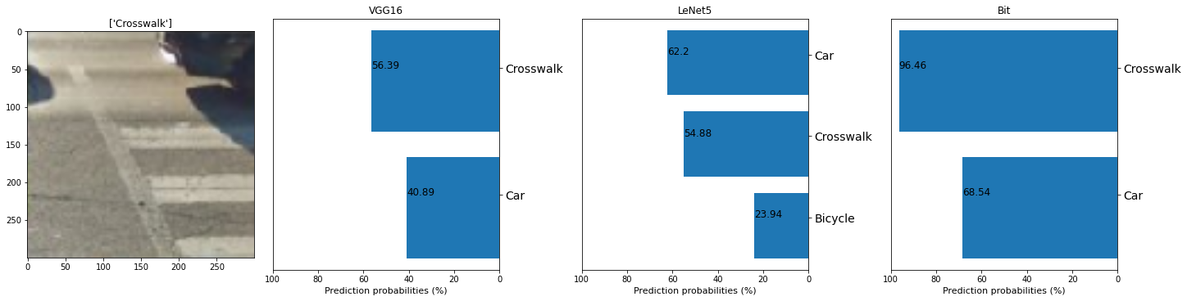
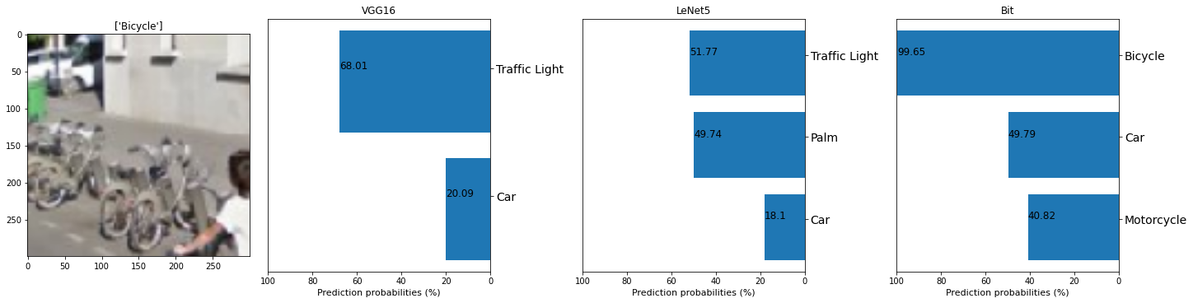
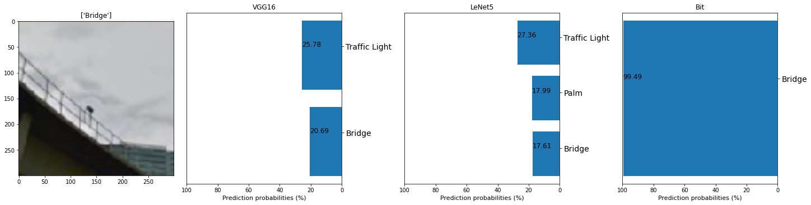
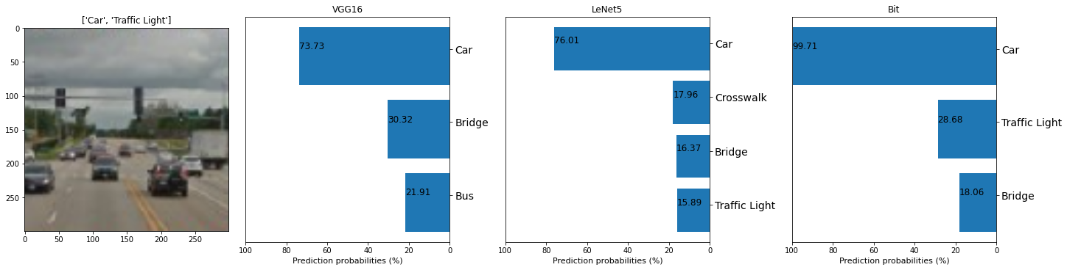
Comparison
 | Precision | Recall | F1-score | Binary Acc.
LeNet5 | 0.77263 | 0.398027 | 0.5658 | 0.9256
VGG16 | 0.83105 | 0.358109 | 0.562925 | 0.9323
BiT | 0.96193 | 0.7296 | 0.86163 | 0.9766
BiT is the Winner!!

Slide 8
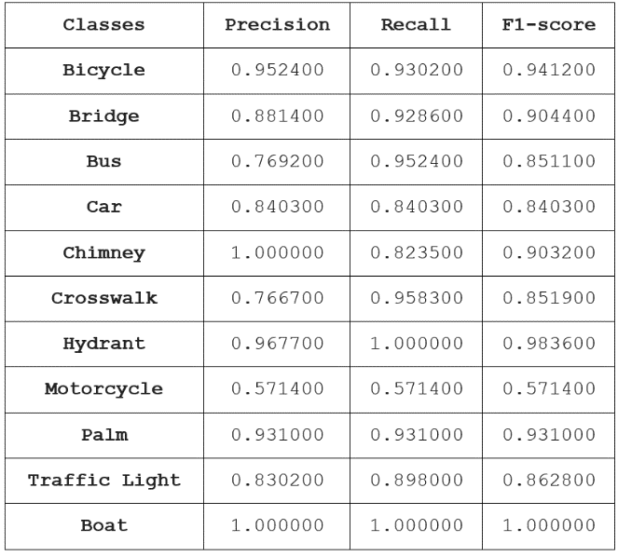
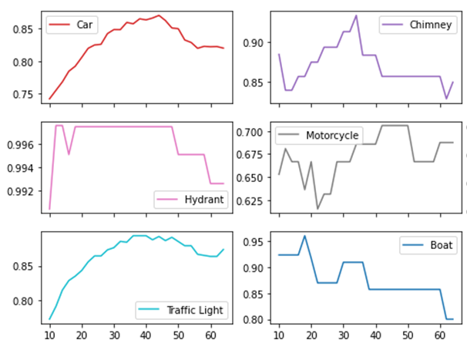
Improve BiT performance
 | Precision | Recall | F1-score
BiT (global thres.=0.5) | 0.96193 | 0.7296 | 0.86163
BiT (thres. per class) | 0.90104 | 0.89381 | 0.89742

Slide 9
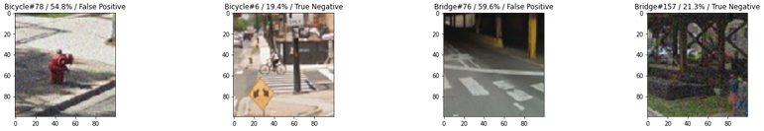
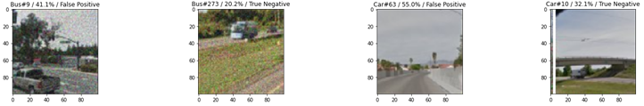
Faulty Predictions

Slide 10
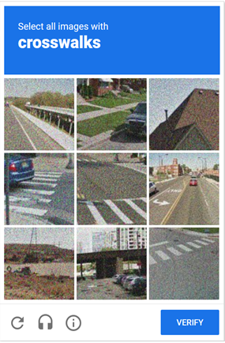
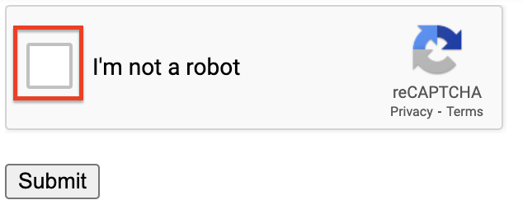
Bot
Title
Skip Button
Verify Button

Slide 11
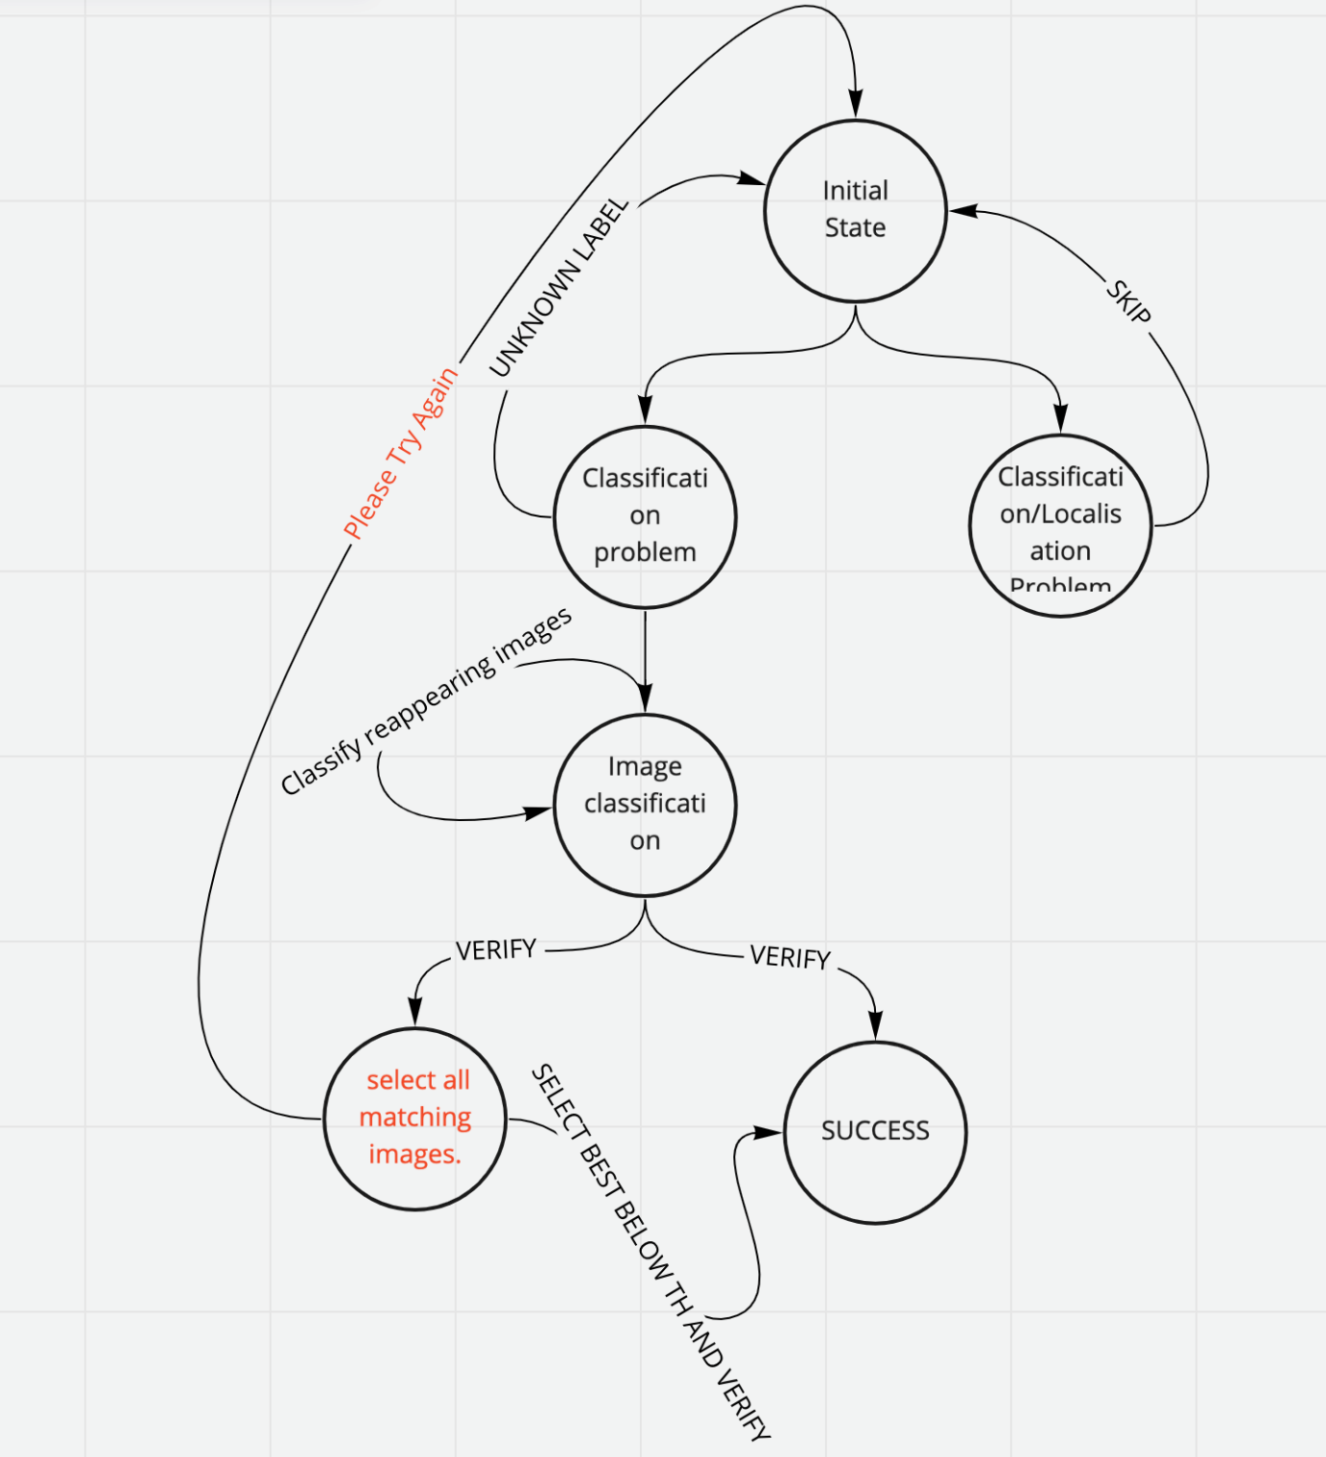
Bot Activity Diagram

Slide 12
Future Work
Train object detection model which can also solve the 2nd type of reCaptcha challenge
Create a Bot which can solve any kind of Captcha challenge

