Slide 1

Ioannis Niozas
Sacchon project
Codehub
Pfizer

Slide 2

Bio
MSc in Computer and Electrical Engineering
Software Developer in Accenture Prague

Slide 3
Project description
Diabetes Management Rest API
Keeps track of the glucose, daily consumed carbohydrates and medication intakes of patients
Based on Hibernate and Restlet Framework

Slide 4

Migration to Amazon Cloud
Step-by-step
Created AWS account
Launched EC2 instance
Installed requirements on the server
Packaged the project with all dependencies into jar file using shade plugin
Uploaded the .jar file using FTP

Slide 5
Creating the Database
Possibilities
Amazon RDS
EC2 with Microsoft Windows Server 2019 with SQL Server 2017 Standard
EC2 Amazon Linux with Microsoft SQL Server
My Solution
Installed and configured MSSQL on the same Amazon Linux machine where my Java project is running

Slide 6
Working on the cloud
Required changes
Enabling the user in order to use SQL Server Authentication
Creating the database
Changing settings in persistence.xml (username,password, jdbc url)
Creating security groups and added rules for the ports needed
Running .jar file on the EC2 instance

Slide 7
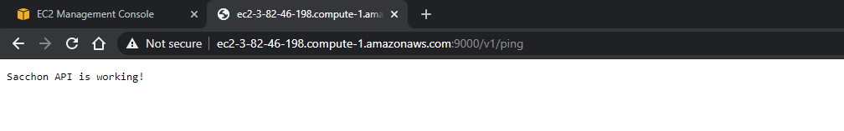
Testing connectivity
Accessing the url from the browser

Slide 8
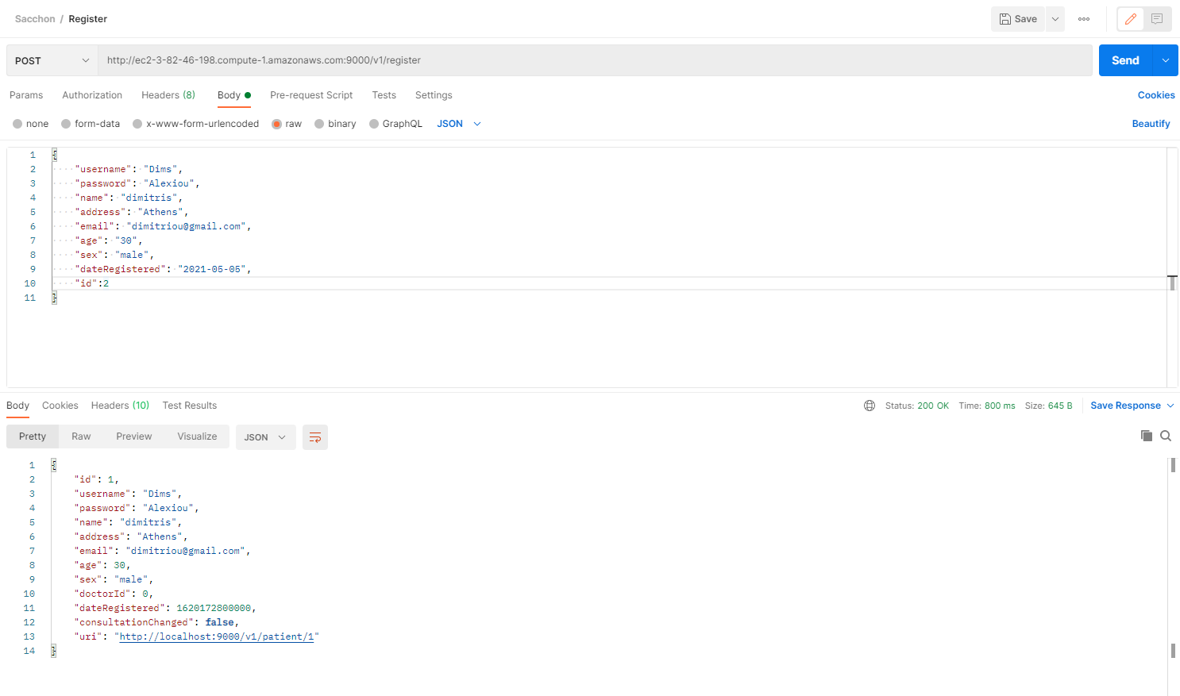
Testing connectivity
Postman requests

Slide 9
Suggested improvements to the code
Change registration method
Each user has to have different permissions to see the data
Unique email and username
Implement relevant response messages for each use.
Redesign endpoint functionality
Implement Junit tests

Slide 10
Personal Goals
Remain in
Remain in developer position working with Java
Move
Move to Java back-end
Be
Be in a team of skilled Developers with strong sense of teamwork so that I can gain knowledge from and be acknowledged for my skills and effort
Work in
Work in a company which cares about quality of product and is consistent
Learn more working with cloud technologies

