Slide 1
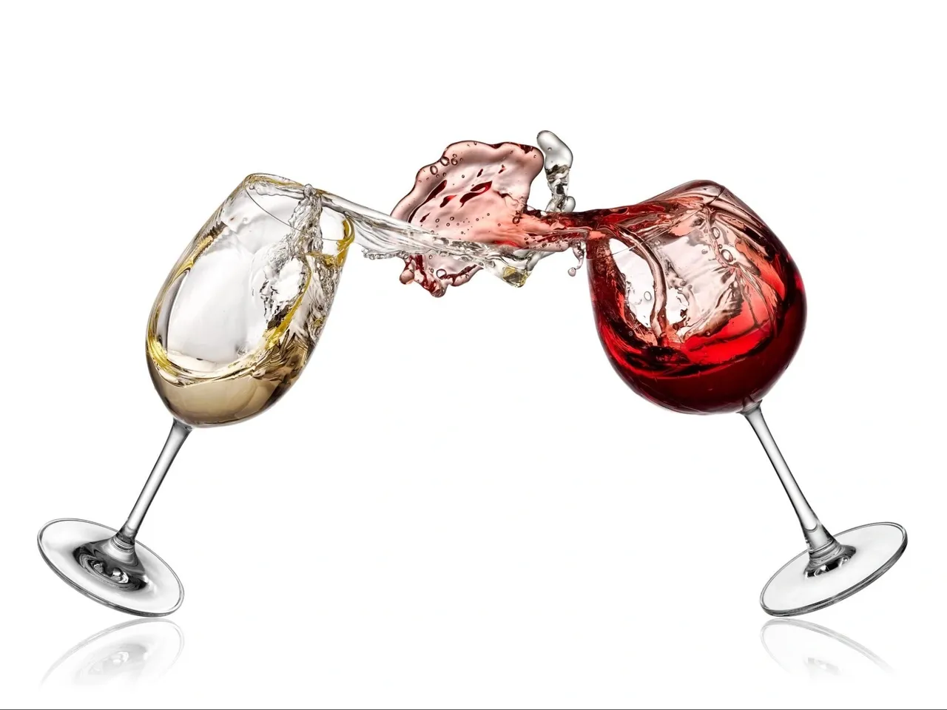
Wine in a million!
Giannis Pierros
Kostas Tsagkaropoulos

Slide 2


Why Vivino?
17.725.482 Wines
102.116.453 Reviews
296.845.474 Ratings
2.095.347 Prices
68.652.373 Users
248.092 Wineries

Slide 3

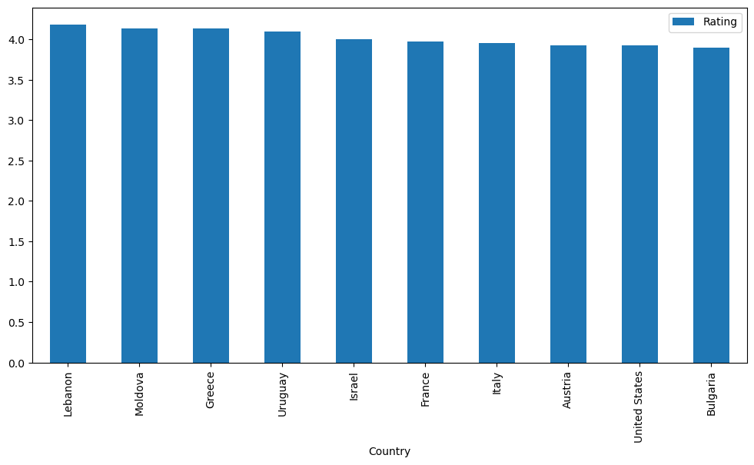
Not what you’d expect!
The Reds
Top 10 ranked countries
The King is Gone – Long live the King!
The Balkans know their winemaking
Strong Mediterranean representation
Greece - Top 3 - Best in Europe

Slide 4

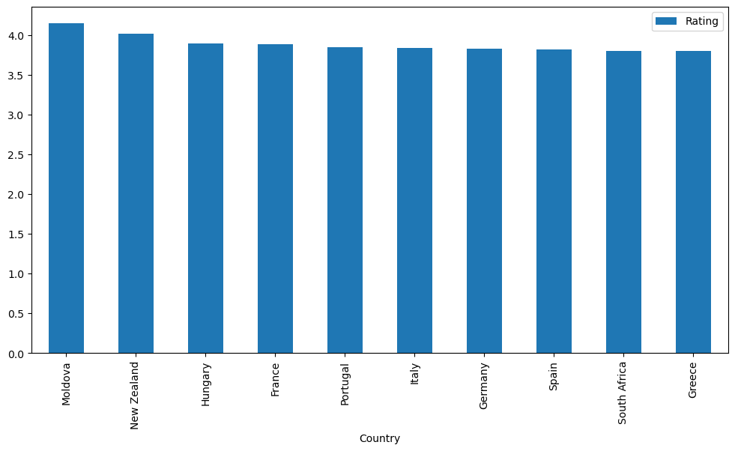
The usual suspects!
And the Whites
All mediterraneans included!
Greece still on top 10
Moldova rules!
European Dominance!

Slide 5
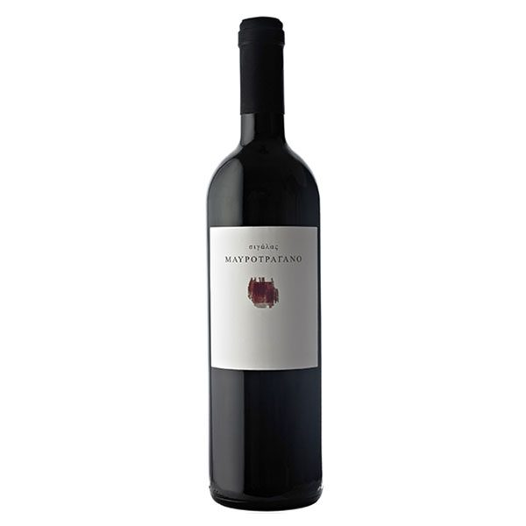
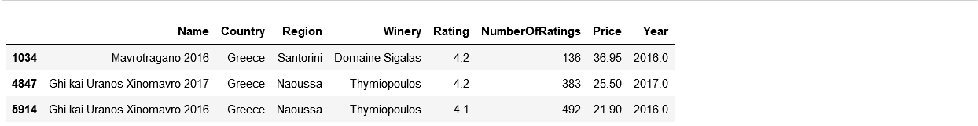

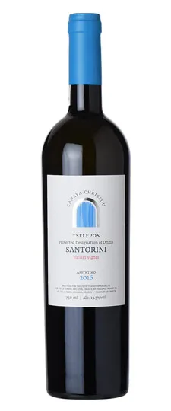
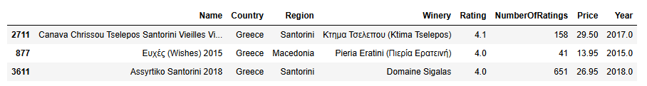
Made in Greece

Slide 6
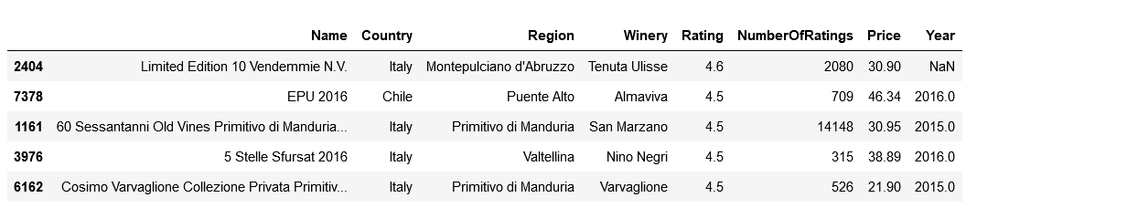
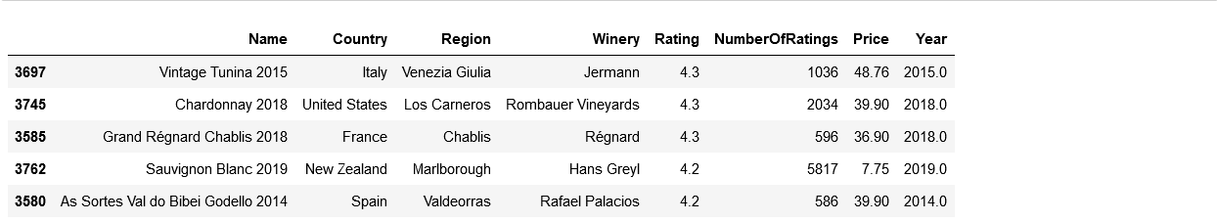
Around the World – Value for Money!

Slide 7
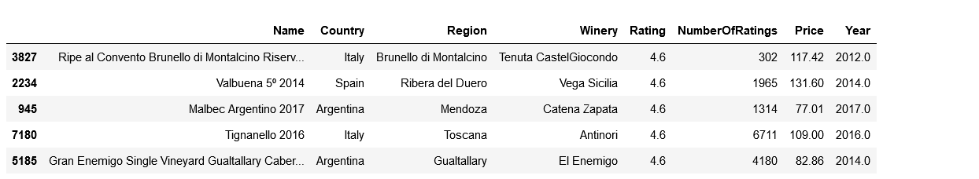
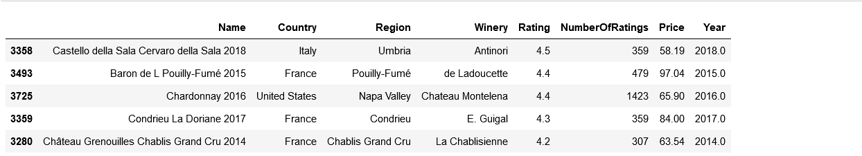
Around the World – For the Explorer

Slide 8
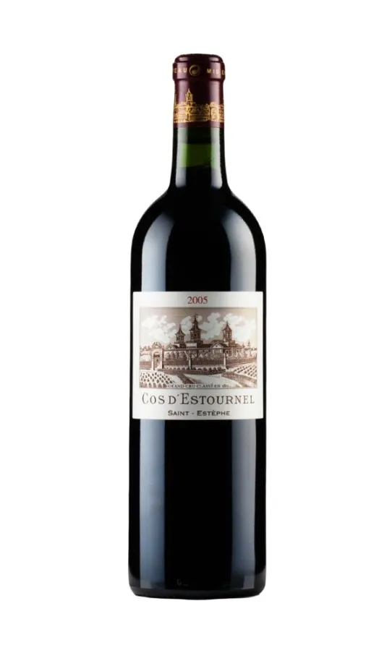
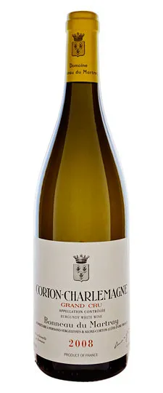
Top of the Tops – For the Connoisseur

Slide 9

Conclusions!
Mediterranean Wines – Still a safe bet
More Expensive doesn’t necessarily mean better
New players in the market – wine not?
Support Greek Wineries – They deserve it!

