Slide 1
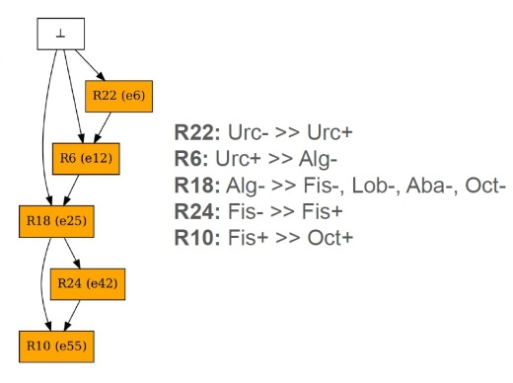






Start
R22: Urc- → Urc+
R6: Urc+ → Alg-
R18: Alg- → Fis-, Lob-, Aba-, Oct-
R24: Fis- → Fis+
R10: Fis+ → Oct+
https://www.phylopic.org/nodes/6f7196cc-31e5-4961-b5cd-4e20e75fd69f/prosthecobacter-silhouettes

