Slide 1
Trending YouTube Videos

Slide 2

Company history
Founded: Feb 14, 2005
Place founded: San Mateo, CA
Headquarters: San Bruno, CA
CEO: Susan Wojcicki (2014)
Founders: Steve Chen, Chad Hurley, Jawed Karim, Eric Skaggs, Martin Pauer
Founder: Jawed Karim, Steve Chen, Chad Hurley

Slide 3
Key Facts
YouTube is an American video-sharing website headquartered in San Bruno, California. The service was created by three former PayPal employees. Google bought the site in November 2006 for US$1.65 billion. YouTube now operates as one of Google's subsidiaries.
YouTube allows users to upload, view, rate, share, add to favorites, report, comment on videos, and subscribe to other users. It offers a wide variety of user-generated and corporate media videos. Available content includes video clips, TV show clips, music videos, short and documentary films, audio recordings, movie trailers, live streams, and other content such as video blogging, short original videos, and educational videos.
Most of the content on YouTube is uploaded by individuals, but media corporations including CBS, the BBC, Vevo, and Hulu offer some of their material via YouTube as part of the YouTube partnership program. Unregistered users can only watch videos on the site, while registered users are permitted to upload an unlimited number of videos and add comments to videos.
Notes:
QuickStarter has created an outline to help you get started on your presentation. Some slides include information here in the notes to provide additional topics for you to research.

Slide 4

Key Facts
Although the most viewed videos were initially viral videos the most viewed videos were increasingly related to music videos. In fact, since recently every video that has reached the top of the "most viewed YouTube videos" list has been a music video. Although the most viewed videos are no longer listed on the site, reaching the top of the list is still considered a tremendous feat. YouTube maintains a list of the top trending videos on the platform.
According to Variety magazine, “To determine the year’s top-trending videos, YouTube uses a combination of factors including measuring users interactions (number of views, shares, comments and likes). Note that they’re not the most-viewed videos overall for the calendar year”. Top performers on the YouTube trending list are music videos (such as the famously virile “Gangam Style”), celebrity and/or reality TV performances, and the random dude-with-a-camera viral videos that YouTube is well-known for.

Slide 5
Inspiration - Goal
Possible uses for this dataset include:
Sentiment analysis in a variety of forms.
Analyze how the users are engaging over time.
Highlight differences between countries.
Per category analysis of videos and user engagement.
Investigate if there is correlation between countries in trending videos.
Distribution and normality check of key metrics
Categorizing YouTube videos based on their comments.
Training ML algorithms to generate predictions.
Analyzing what factors affect how popular a YouTube video will be.

Slide 6

Analysis – The Datasets
2 datasets will be used for the purpose of this project, 2 sets of five files csv and JSON.
One of the datasets used is a daily record of the top trending YouTube videos. The dataset includes several months of data on daily trending YouTube videos. Data is included for the US, GB, DE, CA, and FR regions (USA, Great Britain, Germany, Canada, and France, respectively), with up to 200 listed trending videos per day. Each region’s data is in a separate file. Data includes the video title, channel title, publish time, tags, views, likes and dislikes, description, and comment count.
The second data set (JSON files) includes a category_id field and varies between regions. One such file is included for each of the five regions in the dataset. This dataset is much smaller than the first data set with the videos, it contains just tree columns and 156 rows

Slide 7
Datasets - The headers
The headers in the video files are:
video_id (Common id field to both comment and video csv files)
title
channel_title
category_id (Can be looked up using the included JSON files, but varies per region so use the appropriate JSON file for the CSV file's country)
tags (Separated by | character, [none] is displayed if there are no tags)
views
likes
dislikes
thumbnail_link
date (Formatted like so: [day].[month])
The headers in the comments file are:
video_id (Common id field to both comment and video csv files)
• comment_text
• likes
• replies

Slide 8
Key Questions
What makes a video at YouTube trending?
How are the users engaging over time?
Are there any differences among countries?
Is it possible that the performance of videos in one country affects other counties?
What factors affect how popular a YouTube video will be?
How do engagement metrics correlate to each other?

Slide 9
Data manipulation prosses
Merging the data-sets¶
To create the full dataset the region’s data where uploaded and merged in one data frame. The files with the category information were uploaded and merged into another data set. The category id and category name where stored in a data frame the elements of witch were dictionaries. The column instead of pandas series where iteritems. As a result there were problems to treat the data since there was not a typical pandas series. Below you can have a look of the category table.
After merging the two datasets the final data set created contains 142,000 rows and 30 columns
Formatting¶
The dates columns were formatted to datetime. Also, the hour, day and month info was extracted. Also the views, comments, likes columns were changes to integers.
Data Cleaning¶
In order to make the necessary change in format some rows had to be deleted since there was wrong information stored as date in some cases. Also after merging the two data frames non-available values were replaced with zeros (df_videos.fillna(0, inplace=True)).
Cases where there are 0 likes or comments and a lot of views (i.e. the users has decided to disable those features) have not been removed.
Cases where there were mistakes in the data ex. text in the dates columns have been removed

Slide 10
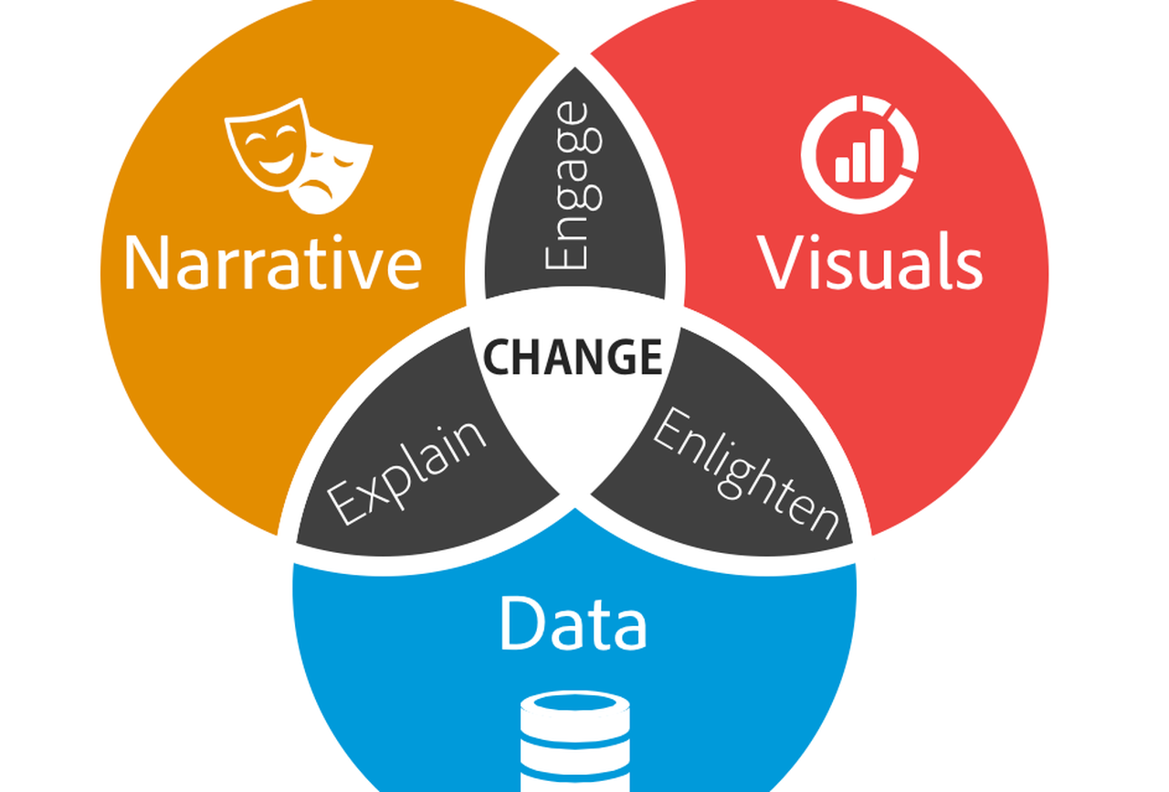
Data Story

Slide 11



Most popular videos in views

Slide 12
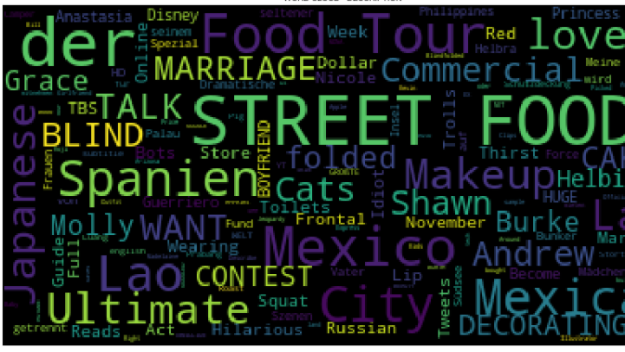
Most common words in videos titles:
Street food , der , food and Mexico are the most popular worlds in video tittles

Slide 13
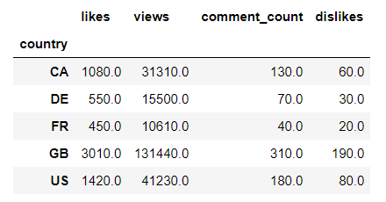
Key dataset metrics in numbers
In millions

Slide 14
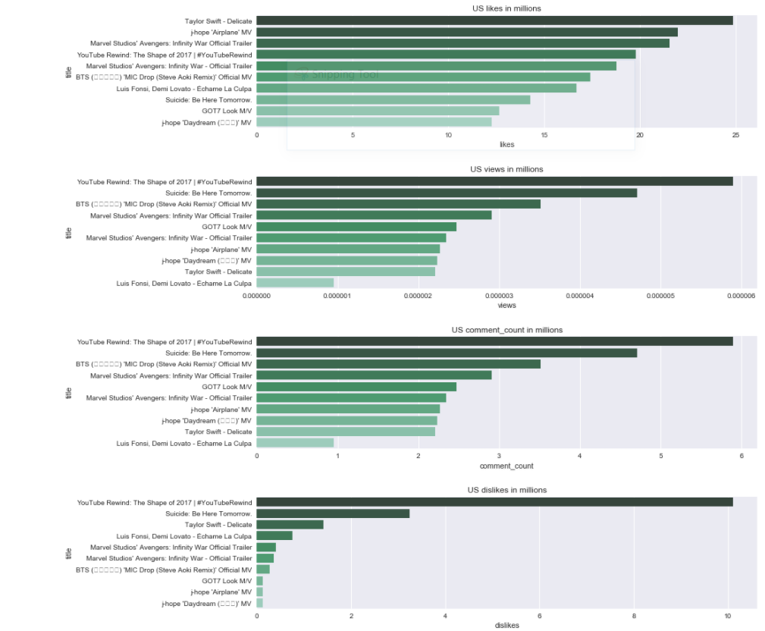
US Top Videos
The tenth video in likes has almost 1/4rth of videos compared to the most liked video. For all countries, with the exception of the US the diff in likes among the first 10 videos is not that big. Actually the tenth most liked video for the US has just half of the likes compared to the most liked one.

Slide 15
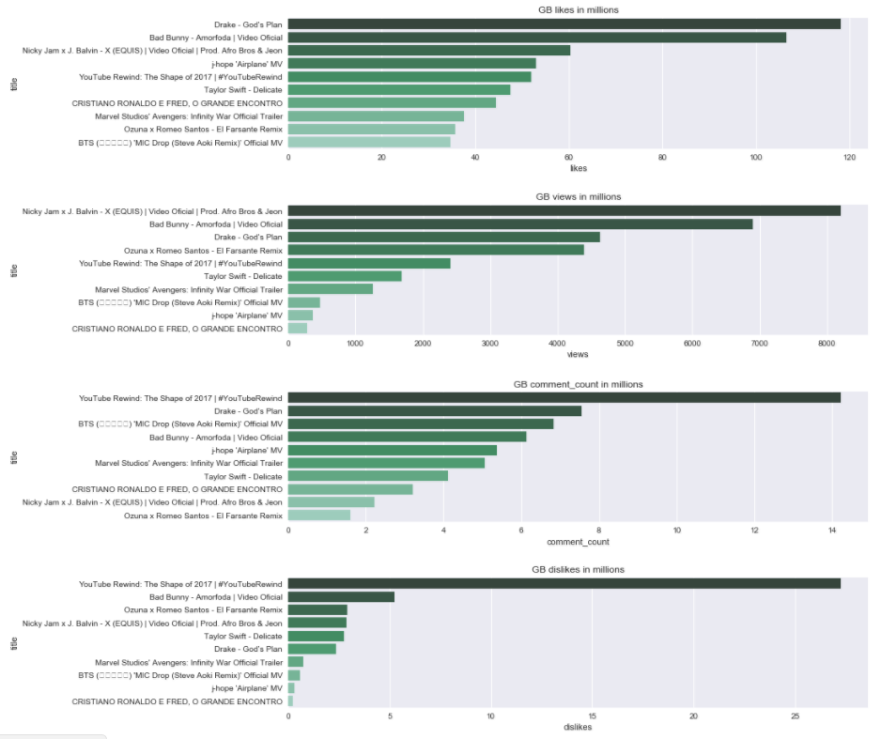
GB Top Videos
GB is the country with most likes, the most liked video has reached 120 mil likes, the second country in likes is the US, the most liked video only has 25 mil likes.

Slide 16
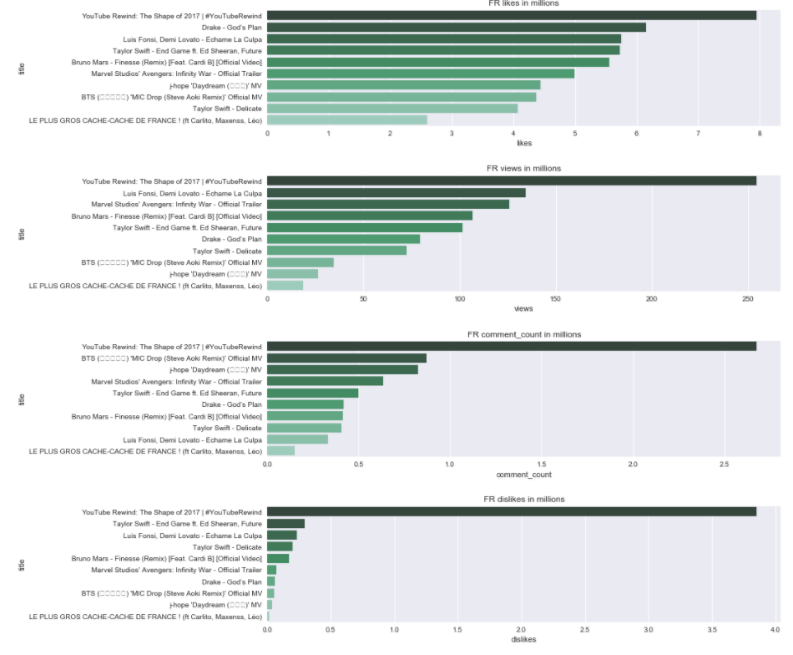
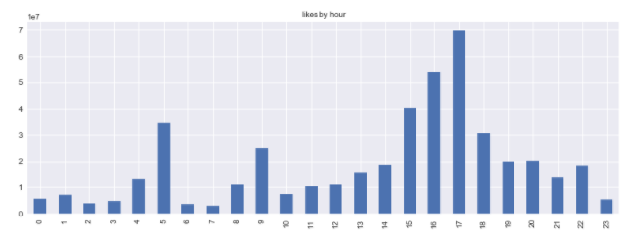
FR Top Videos
Likes for FR are significantly higher for videos published in evening hours

Slide 17
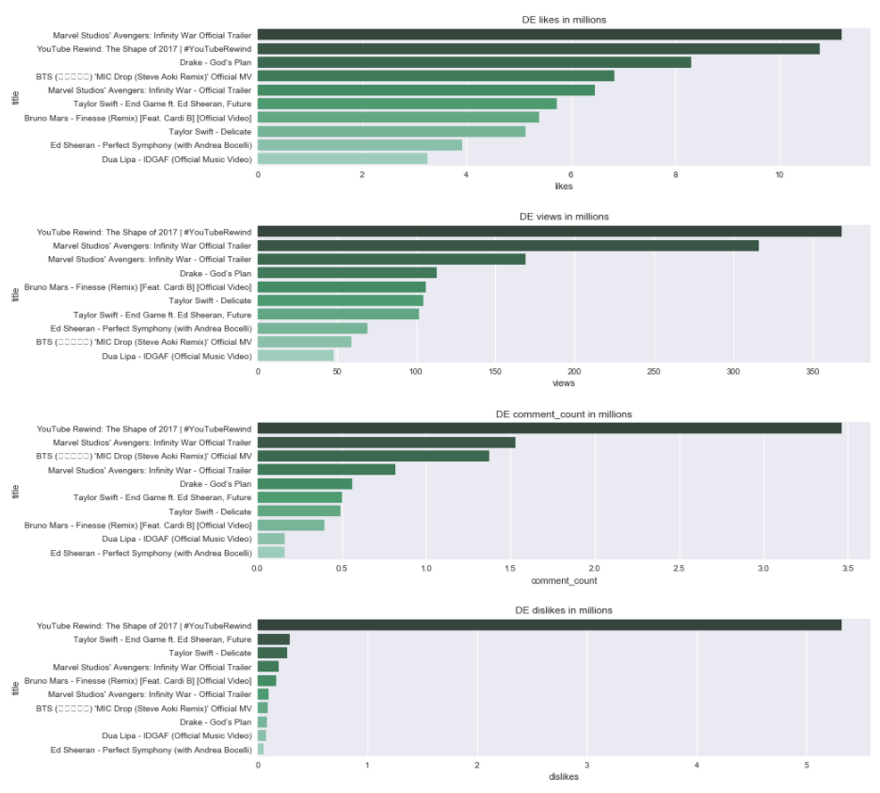
DE Top Videos
For CA and actually for all countries there is one prominent disliked video and for the rest 9 videos the number of dislikes is close to 0mil.

Slide 18
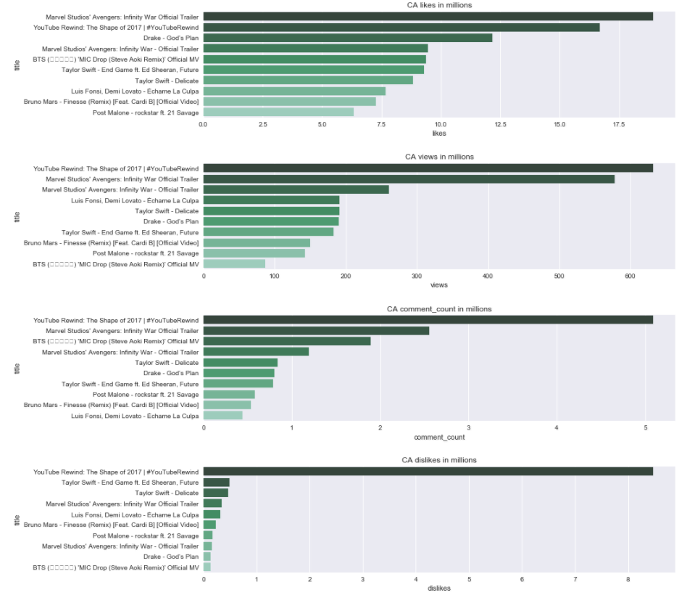
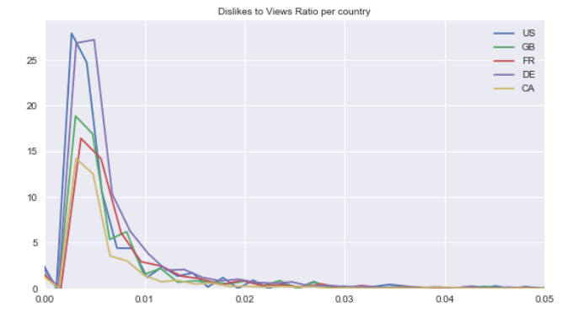
CA Top Videos
Canada is the country with the lower dislikes to views ratio

Slide 19
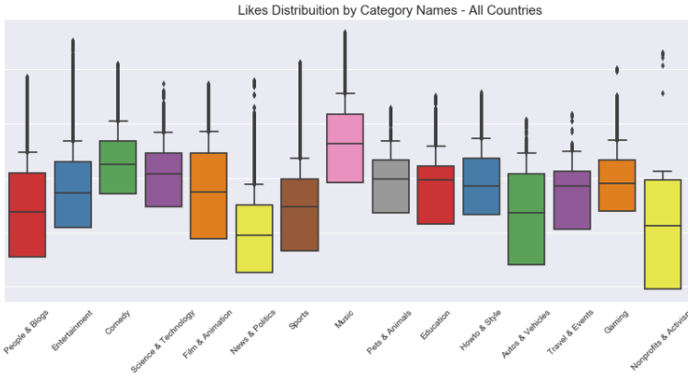
Likes Per Category
Music is the category with the most likes followed by Entertainment.
People have quite different opinions in terms of liking Nonprofits and Activism videos. Variation is quite high for People and Blogs, Autos and Film videos.
Pets and Animals and Education videos are left skewed in term of likes

Slide 20
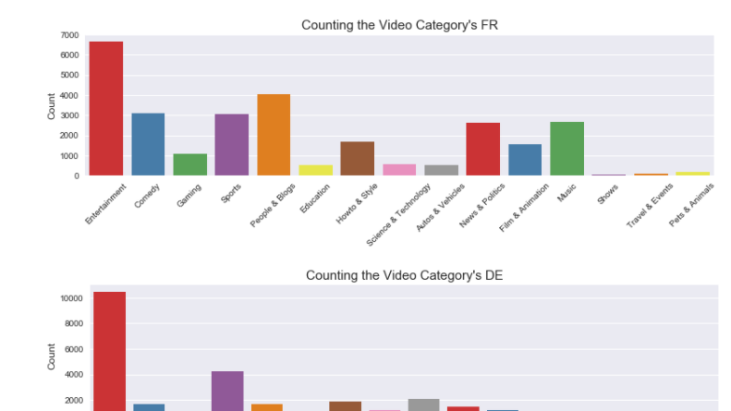
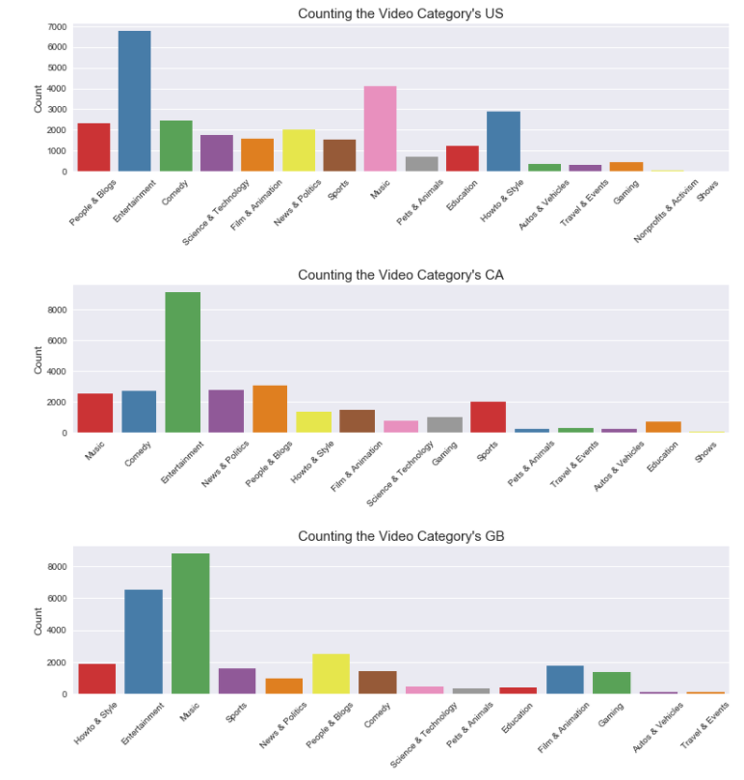
Analysis per category and Country
Top category of all countries except GB is Entertainment. For GB the top category is music
Music's videos ranked insignificantly in Canada, Germany and France compare to US and UK.
Sport's videos are more popular in Canada, Germany and France.
All top 8 categories in United Kingdom are entertainment-related. Show's and Activism's video get the bottom rank in all most countries.

Slide 21
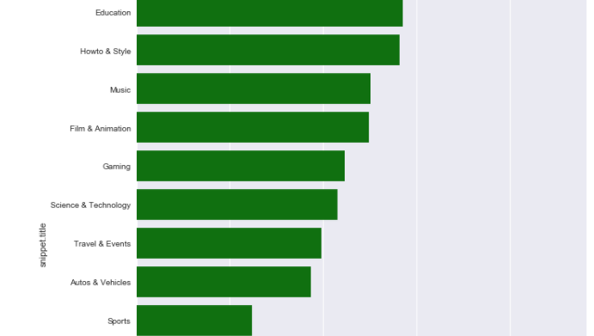
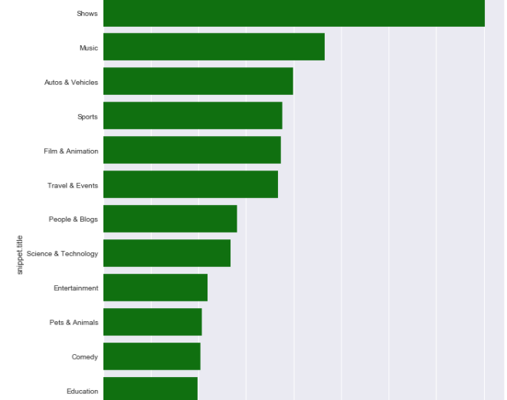
Engagement ratios per category
Pets & Animals videos have highest likes-dislikes ratio. Not surprisingly, people find difficult to hate pets and animals.
Nonprofit & Activism's videos have lowest likes-dislike ratio and views-comments ratio. Shows is the category with most comments-views ratio.
People still prefer implicit feedback than explicit. The ratio of views to comments is so large that only a comment written for hundreds of views.

Slide 22
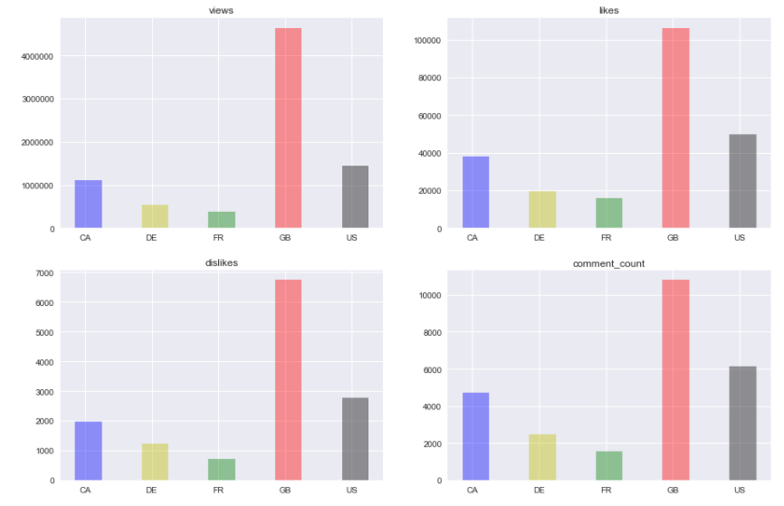
How many likes, dislikes, views and comments get different countries?
All countries share the similar trend in numbers for likes, dislikes, views and comments.
One possible reason to this is due to the video's trending duration.
Enduring trending videos have the advantages in getting more views, likes, dislikes and comments.

Slide 23
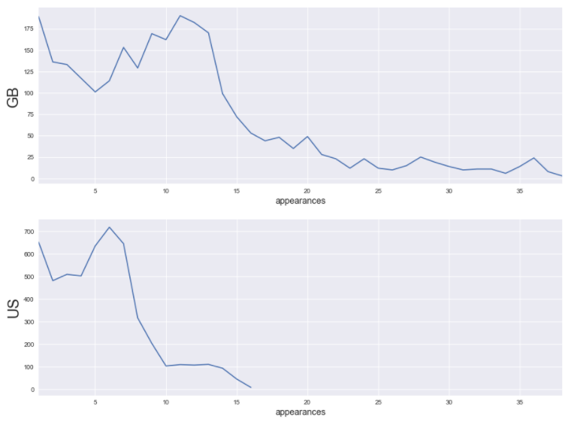
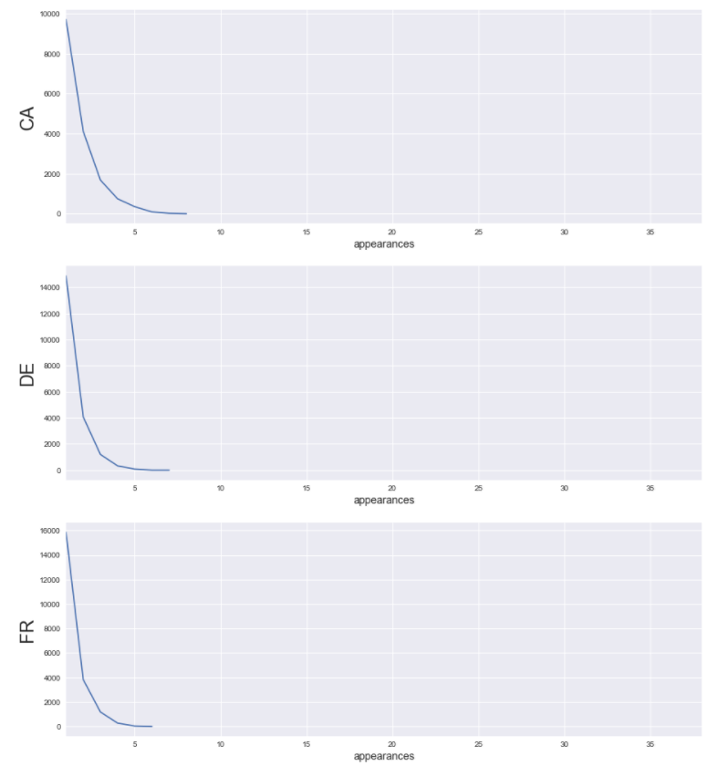
United Kingdom has the most long trended Youtube videos (The greater the number of appearances indicate the long-last the video trend is)

Slide 24
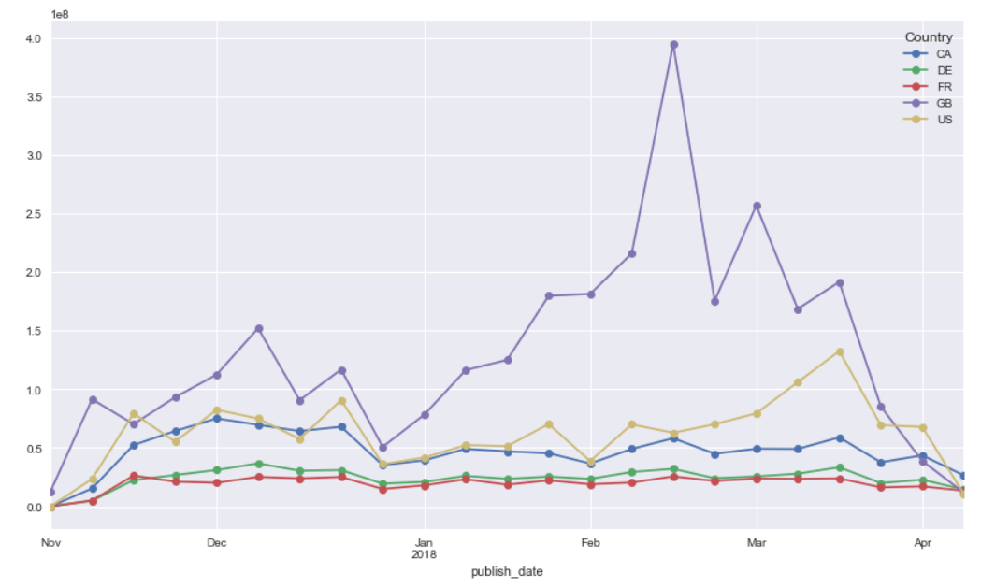
How are likes trending per country?
UK has been the country with the most likes.
There is a huge increase in likes for UK which might be due to data collection.
Canada has shown a decrease in likes for the first months of 2018 compared to November-December 2017.
US has shown a noticeable increase in likes in mid March 2018.
For France and Germany there are not big fluctuations in likes

Slide 25

Inferential Statistics

Slide 26
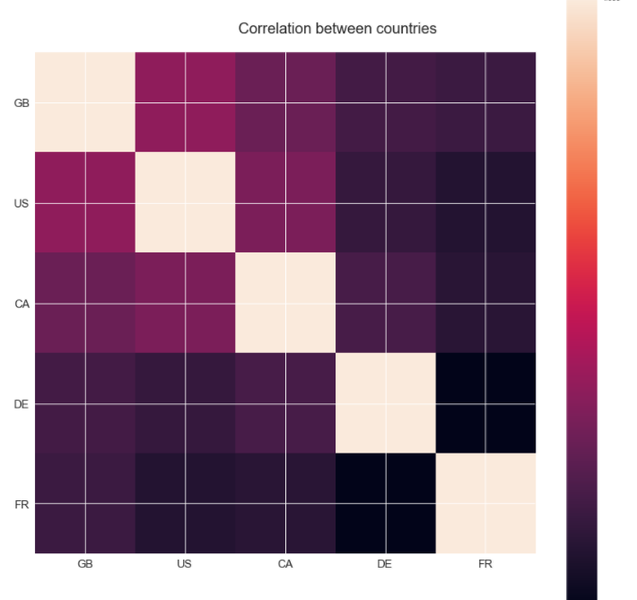
Correlation of Youtube Trending Videos between countries. It does exist!
Not surprisingly, the videos from United Kingdom, US and Canada are highly correlated to each other in comparison with Germany and France.
This might due to the sharing of common language in these countries.
Germany and France seems to be more isolated as they don’t follow the trend from English speaking countries.
This can also explain why UK has the highest number in long-trend videos, as it is contributes by multiple countries at the same time.

Slide 27
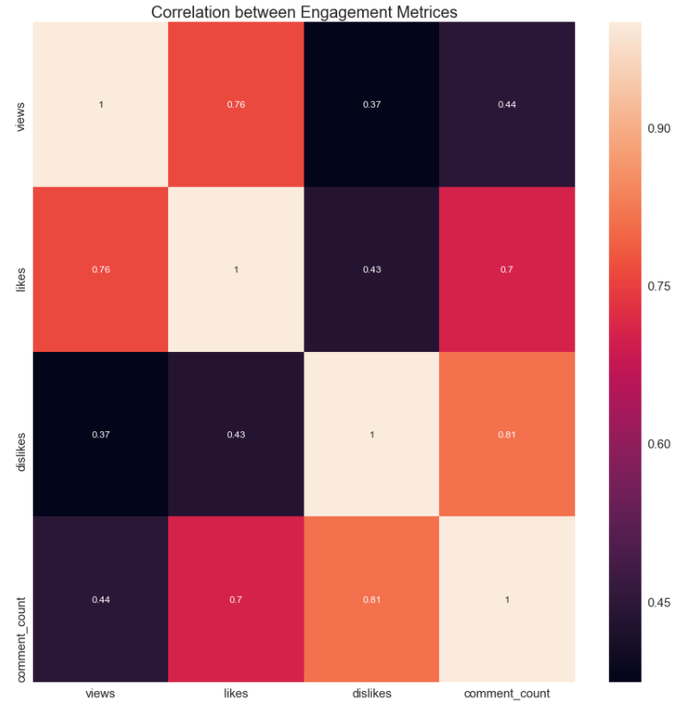
Correlation of engagement metrices of Youtube Trending Videos.
We observe that all engagement metrices are positively correlated
There exist a high correlation between views and comment counts (0.7) and likes and views (0.76)
Views and dislikes have the lowest observed correlation among the engagement metrices
The highest correlation observed is between comment_count and dislikes

Slide 28
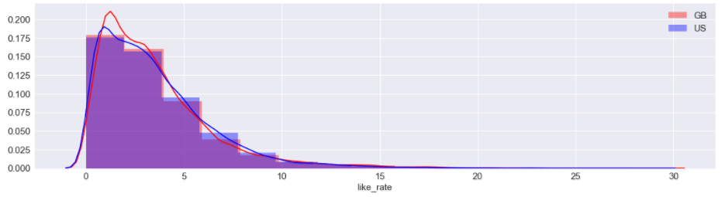
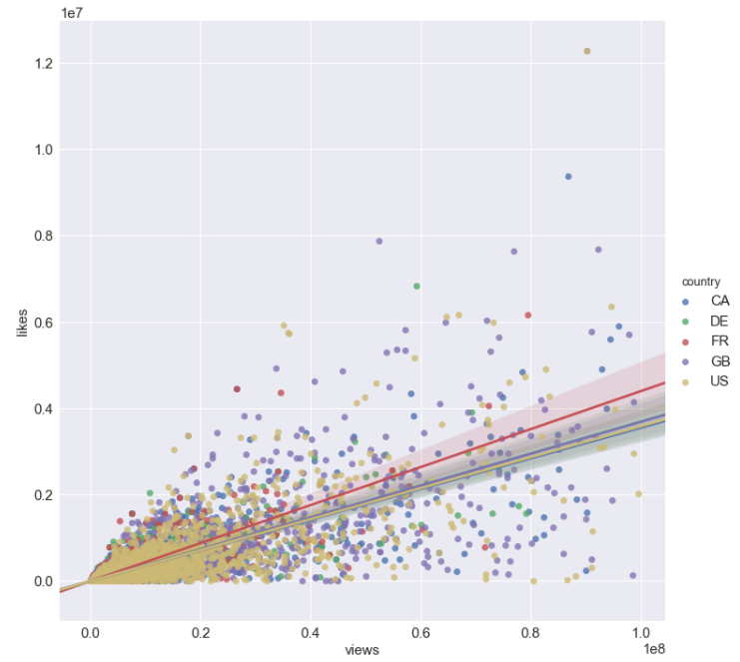
The country with the highest correlation between likes and views is France. For all other countries the correlation between those two metrices is very close
Likes for GB and US follow similar distributions although the mean for GB is higher compare to US

Slide 29
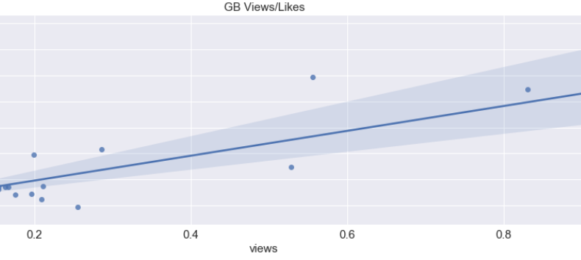
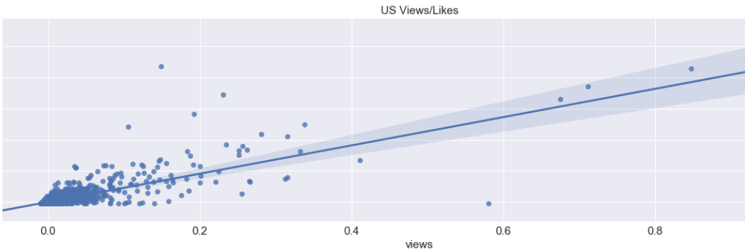
There is significant difference between UK and US like rate means
Mean likes rate UK:3.4
Mean likes rate GB:3.2
t-test results:
p-value 0.001241 < 0.025 (two-tailed hypothesis)
We can reject the null hypothesis that the UK likes rate and GB likes rate means are statistically significant different

Slide 30
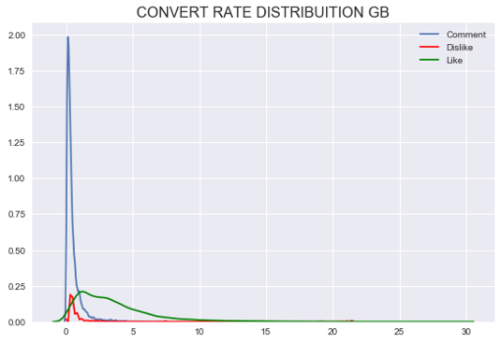
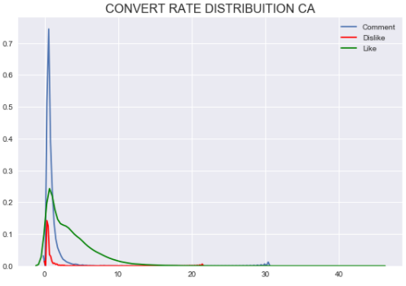
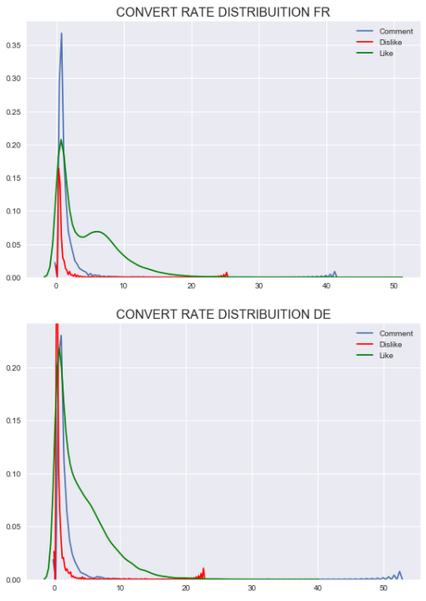
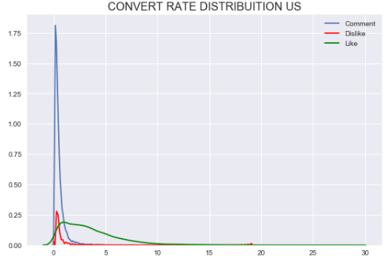
Distribution of engagement metrices per views
The distributions of likes, dislikes and comments to views ratio show that people tend to leave more frequently likes to videos compared to comments or dislikes.
Actually only a comment is written for hundreds of views.
This trend seems that is the case for all countries.

Slide 31
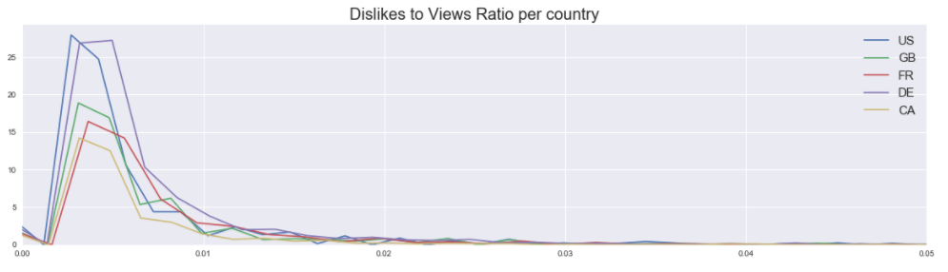
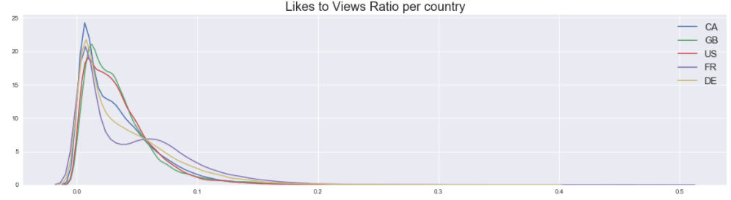
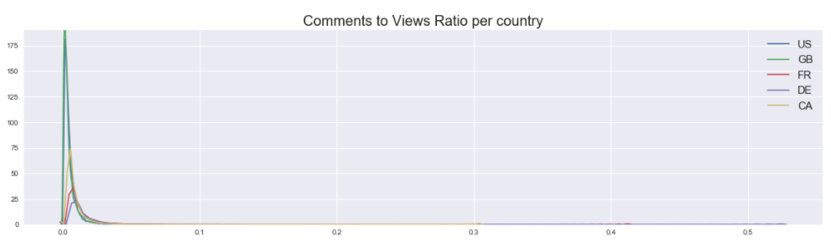
English speaking countries comment more
US and DE more closely resemble each other in terms of dislikes to likes ratio
Comment rates are more evident also in US and in GB. The rest countries do no engage in comments as much.
In all of the cases, ie like rates, comment rates and dislikes to likes, are highly skewed as expected. That is, for high ratios and or high rates of these metrics the cases we observe are very infrequent.

Slide 32

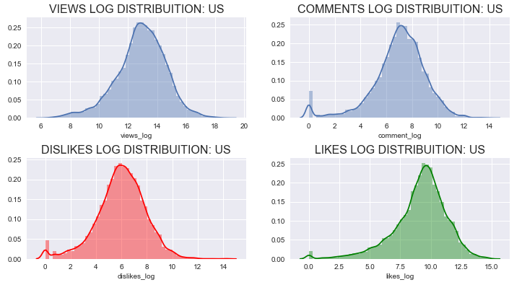
Engagement metrices are not normalized (after Hypothesis test for normalization )
Views quantiles
0.01 3311.49
0.25 154735.25
0.50 440670.50
0.75 1235439.50
0.99 17862758.31
Likes quantiles
0.01 7.00
0.25 3306.25
0.50 12273.00
0.75 36608.50
0.99 657381.93
Dislikes quantiles
0.01 0.00
0.25 134.00
0.50 426.00
0.75 1343.75
0.99 27005.20
Comment quantiles
0.01 0.00
0.25 416.00
0.50 1315.00
0.75 3929.75
0.99 75617.17

Slide 33

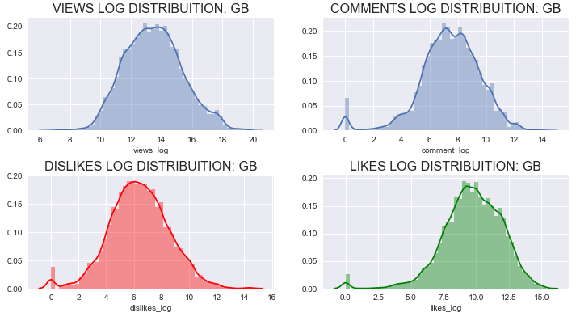
Engagement metrices are not normalized (after Hypothesis test for normalization )
Views quantiles
0.01 15088.70
0.25 183628.00
0.50 691551.00
0.75 2515851.00
0.99 62660661.88
Likes quantiles
0.01 22.00
0.25 4379.50
0.50 18012.00
0.75 80540.50
0.99 1433644.58
Dislikes quantiles
0.01 0.00
0.25 150.00
0.50 583.00
0.75 2482.00
0.99 95940.42
Comment quantiles
0.01 0.00
0.25 508.00
0.50 1797.00
0.75 6848.50
0.99 161593.92

Slide 34

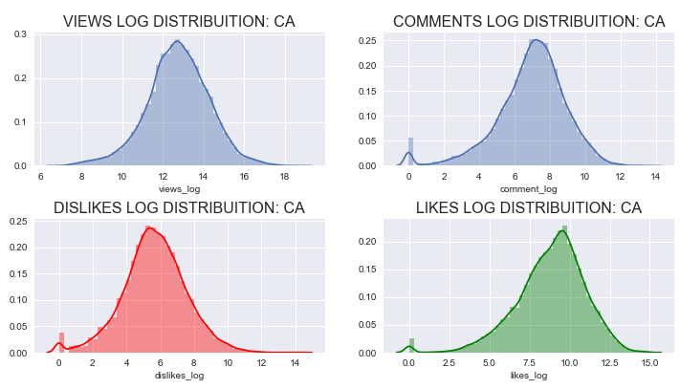
Engagement metrices are not normalized (after Hypothesis test for normalization )
Views quantiles
0.01 5201.59
0.25 136911.75
0.50 347800.50
0.75 924822.50
0.99 13376485.13
Likes quantiles
0.01 15.00
0.25 2047.25
0.50 8650.50
0.75 27955.50
0.99 459986.22
Dislikes quantiles
0.01 0.00
0.25 93.00
0.50 284.00
0.75 929.00
0.99 24576.23
Comment quantiles
0.01 0.00
0.25 386.00
0.50 1261.50
0.75 3601.00
0.99 53005.72

Slide 35

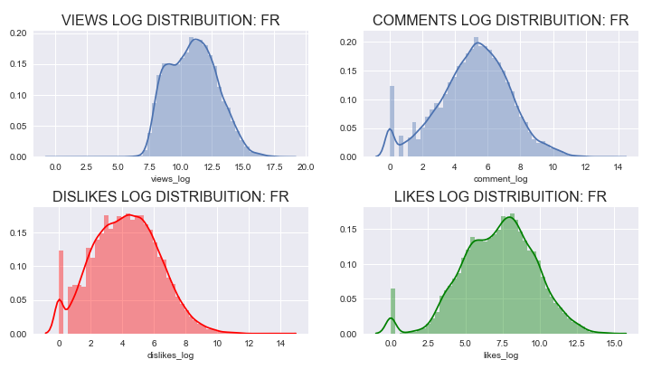
Engagement metrices are not normalized (after Hypothesis test for normalization )
Views quantiles
0.01 1855.75
0.25 12939.25
0.50 59199.00
0.75 229181.50
0.99 4729648.25
Likes quantiles
0.01 0.00
0.25 260.00
0.50 1590.00
0.75 7438.00
0.99 259503.75
Dislikes quantiles
0.01 0.0
0.25 14.0
0.50 68.0
0.75 292.0
0.99 8964.0
Comment quantiles
0.01 0.00
0.25 46.00
0.50 201.00
0.75 761.00
0.99 24531.75

Slide 36

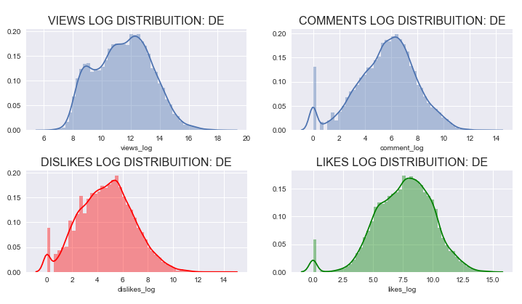
Engagement metrices are not normalized (after Hypothesis test for normalization )
Views quantiles
0.01 2530.47
0.25 21698.25
0.50 100729.50
0.75 387915.25
0.99 7428996.14
Likes quantiles
0.01 0.00
0.25 424.00
0.50 2324.00
0.75 10672.00
0.99 297519.59
Dislikes quantiles
0.01 0.00
0.25 23.00
0.50 115.00
0.75 469.25
0.99 16592.06
Comment quantiles
0.01 0.00
0.25 66.00
0.50 330.00
0.75 1252.00
0.99 33828.14

Slide 37
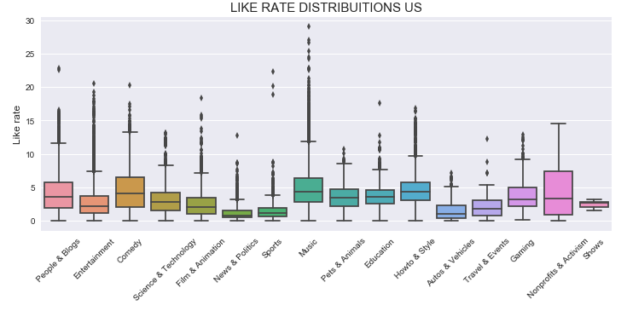
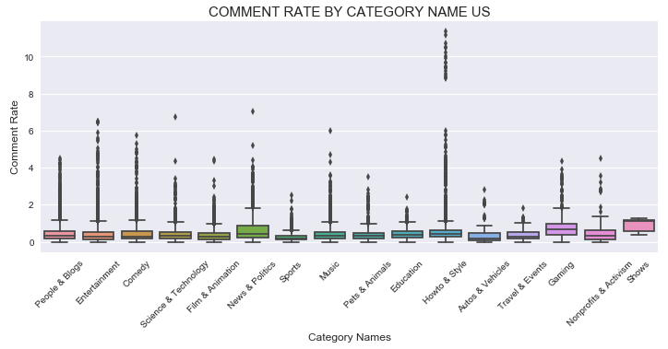
Engagement Rates US
The category with the highest likes/views rate is Nonprofits & Activism followed by Music and Comedy
Nonprofits & Activism category is right skewed in term of like ratio
Shows, Gaming and News & Politics are the categories with the higher comment to views ratio
The Shows category is highly left skewed in comment rate, while News & Politics is right skewed

Slide 38
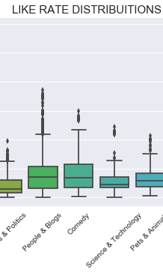
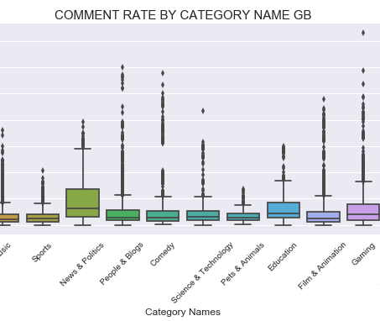
Engagement Rates GB
Comedy, Travel & Events, Travel & Events and Howto and Style are the categories with the highest likes/views rate
Travel and Events and News and Politics categories are right skewed in term of like ratio
Gaming, News & Politics, Travel and Events and Education are the categories with the higher comment to views ratio
News & Politics, Travel and Events and Education are highly right skewed in comment rate

Slide 39
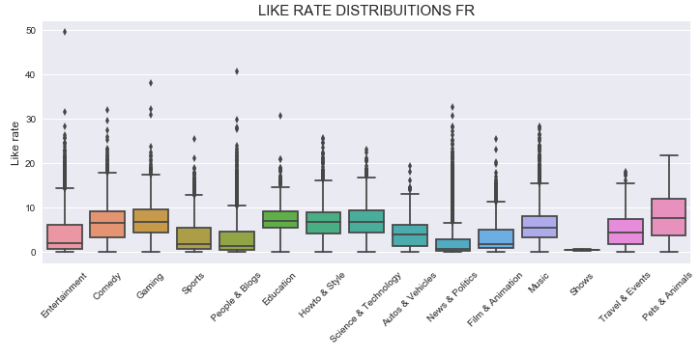
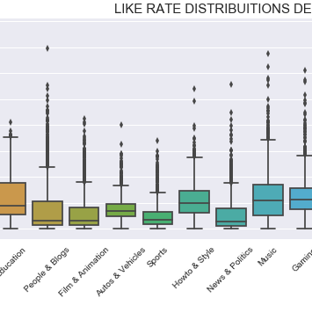
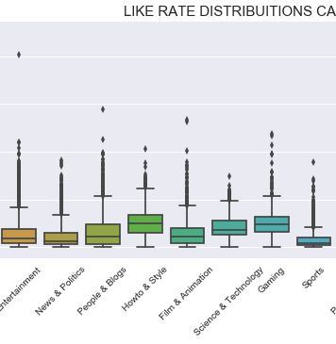
Engagement Rates FR, DE, CA
Pets and animals is the category with the highest likes rate for France
Pets and animals and Sports are highly right skewed for Pets & Animals and Science & Technology are highly right skewed for Canada
Trailers category likes rate for Germany is zero

Slide 40
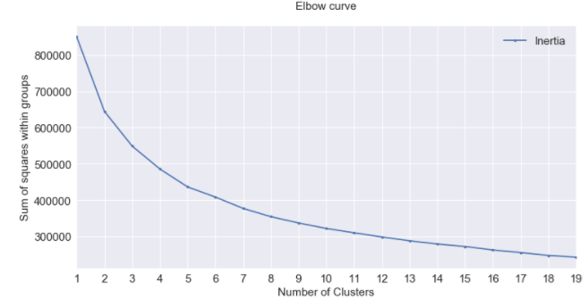
K- means Clustering
Optimal number of clusters :7
Characteristics of the high views cluster videos are long titles, titles with numbers, titles with high percentage of capital letters
The cluster with the higher like rate over indexes with education, gaming and how to & style categories.
The cluster with the least number of views over indexes on the autos and vehicles, spots, news and politics and people and blogs.

