Slide 1
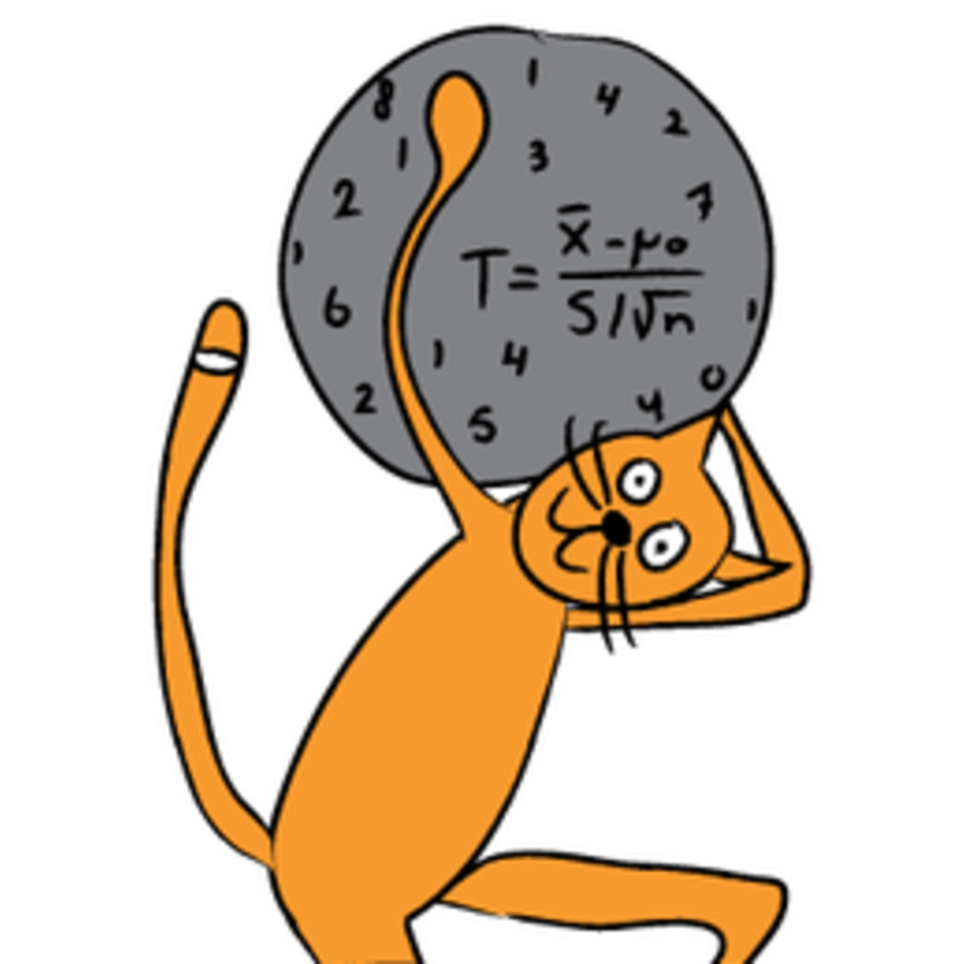
Inferential Statistics

Slide 2
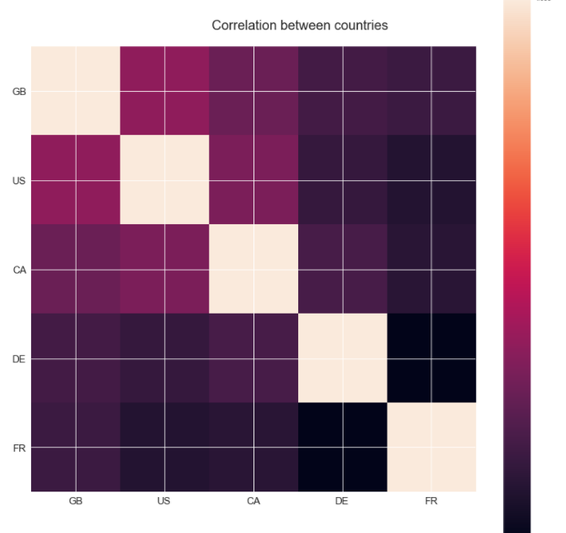
Correlation of Youtube Trending Videos between countries. It does exist!
Not surprisingly, the videos from United Kingdom, US and Canada are highly correlated to each other in comparison with Germany and France.
This might due to the sharing of common language in these countries.
Germany and France seems to be more isolated as they don’t follow the trend from English speaking countries.
This can also explain why UK has the highest number in long-trend videos, as it is contributes by multiple countries at the same time.

Slide 3
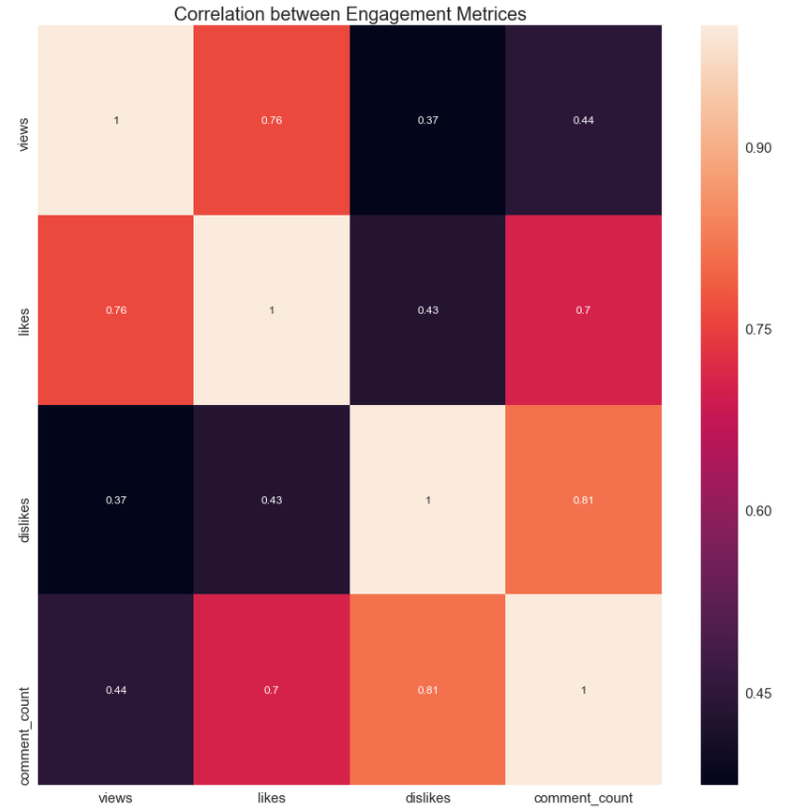
Correlation of engagement metrices of Youtube Trending Videos.
We observe that all engagement metrices are positively correlated
There exist a high correlation between views and comment counts (0.7) and likes and views (0.76)
Views and dislikes have the lowest observed correlation among the engagement metrices
The highest correlation observed is between comment_count and dislikes

Slide 4
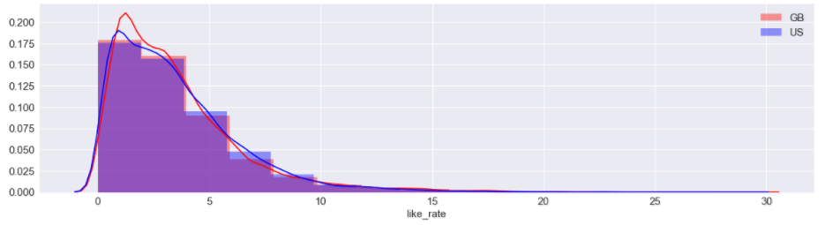
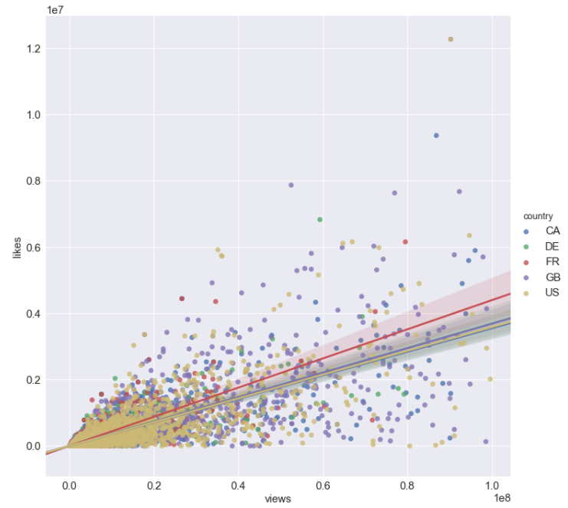
The country with the highest correlation between likes and views is France. For all other countries the correlation between those two metrices is very close
Likes for GB and US follow similar distributions although the mean for GB is higher compare to US

Slide 5
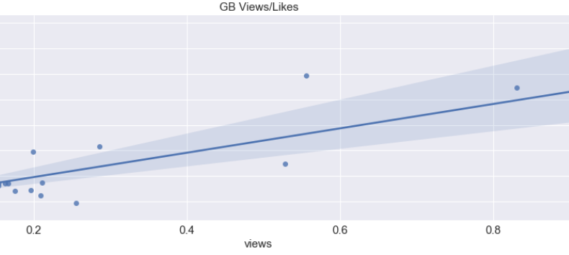
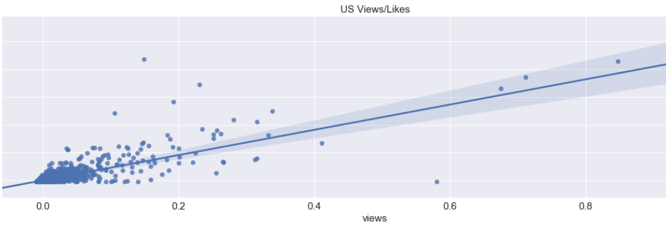
There is significant difference between UK and US like rate means
Mean likes rate UK:3.4
Mean likes rate GB:3.2
t-test results:
p-value 0.001241 < 0.025 (two-tailed hypothesis)
We can reject the null hypothesis that the UK likes rate and GB likes rate means are statistically significant different

Slide 6
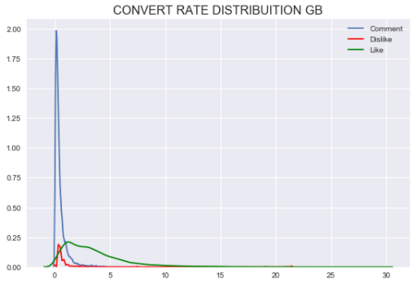
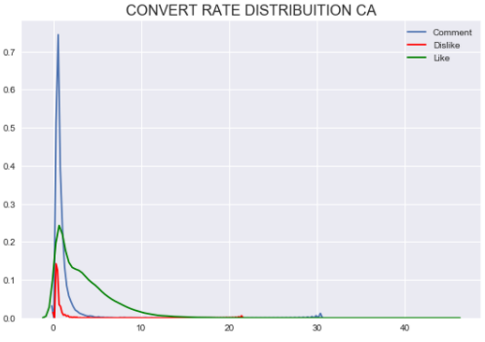
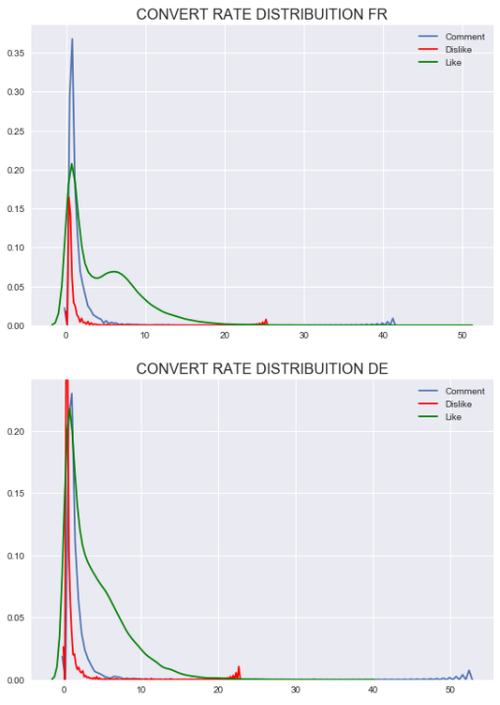
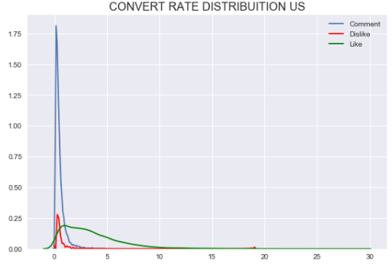
Distribution of engagement metrices per views
The distributions of likes, dislikes and comments to views ratio show that people tend to leave more frequently likes to videos compared to comments or dislikes.
Actually only a comment is written for hundreds of views.
This trend seems that is the case for all countries.

Slide 7
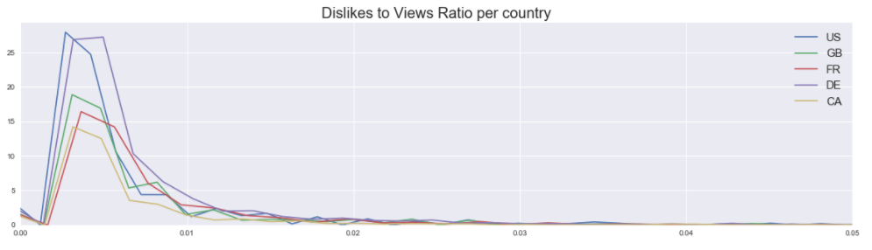
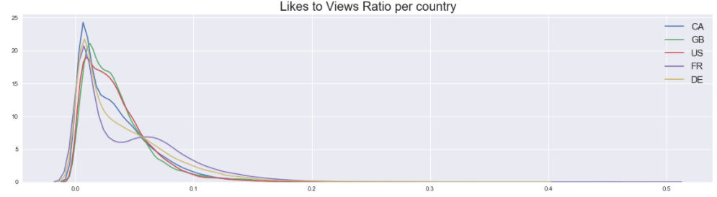
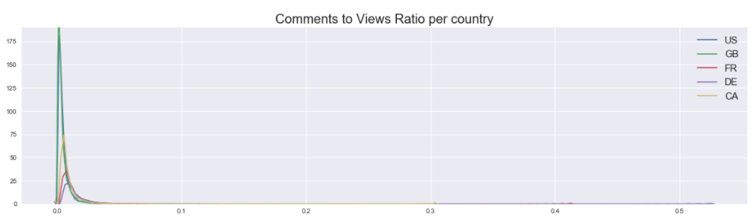
English speaking countries comment more
US and DE more closely resemble each other in terms of dislikes to likes ratio
Comment rates are more evident also in US and in GB. The rest countries do no engage in comments as much.
In all of the cases, ie like rates, comment rates and dislikes to likes, are highly skewed as expected. That is, for high ratios and or high rates of these metrics the cases we observe are very infrequent.

Slide 8

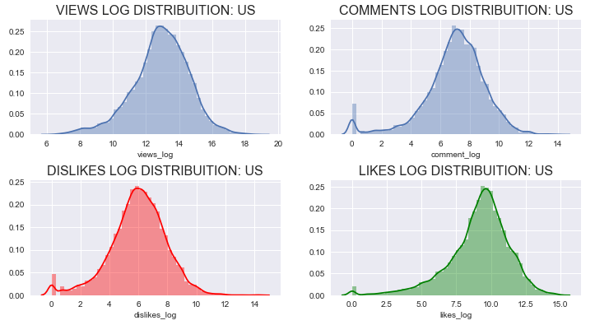
Engagement metrices are not normalized (after Hypothesis test for normalization )
Views quantiles
0.01 3311.49
0.25 154735.25
0.50 440670.50
0.75 1235439.50
0.99 17862758.31
Likes quantiles
0.01 7.00
0.25 3306.25
0.50 12273.00
0.75 36608.50
0.99 657381.93
Dislikes quantiles
0.01 0.00
0.25 134.00
0.50 426.00
0.75 1343.75
0.99 27005.20
Comment quantiles
0.01 0.00
0.25 416.00
0.50 1315.00
0.75 3929.75
0.99 75617.17

Slide 9

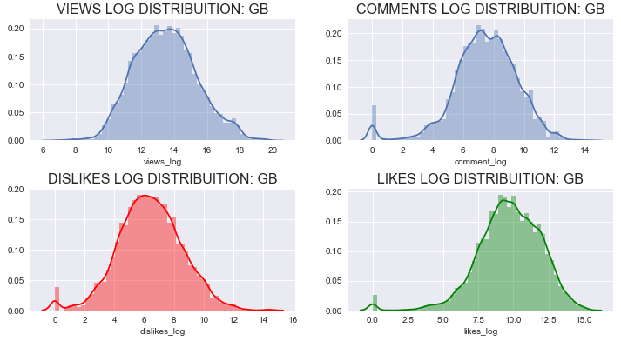
Engagement metrices are not normalized (after Hypothesis test for normalization )
Views quantiles
0.01 15088.70
0.25 183628.00
0.50 691551.00
0.75 2515851.00
0.99 62660661.88
Likes quantiles
0.01 22.00
0.25 4379.50
0.50 18012.00
0.75 80540.50
0.99 1433644.58
Dislikes quantiles
0.01 0.00
0.25 150.00
0.50 583.00
0.75 2482.00
0.99 95940.42
Comment quantiles
0.01 0.00
0.25 508.00
0.50 1797.00
0.75 6848.50
0.99 161593.92

Slide 10

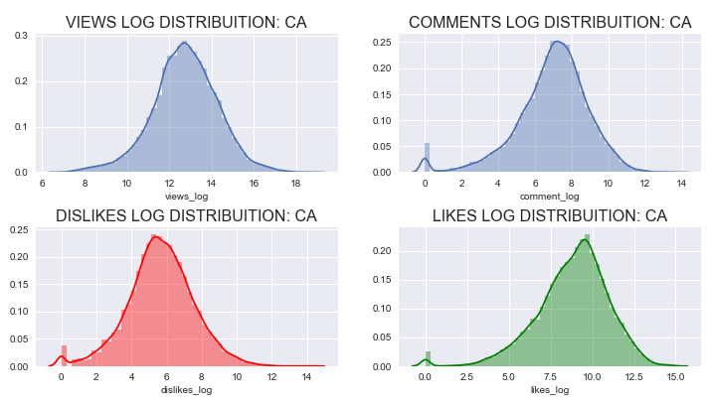
Engagement metrices are not normalized (after Hypothesis test for normalization )
Views quantiles
0.01 5201.59
0.25 136911.75
0.50 347800.50
0.75 924822.50
0.99 13376485.13
Likes quantiles
0.01 15.00
0.25 2047.25
0.50 8650.50
0.75 27955.50
0.99 459986.22
Dislikes quantiles
0.01 0.00
0.25 93.00
0.50 284.00
0.75 929.00
0.99 24576.23
Comment quantiles
0.01 0.00
0.25 386.00
0.50 1261.50
0.75 3601.00
0.99 53005.72

Slide 11

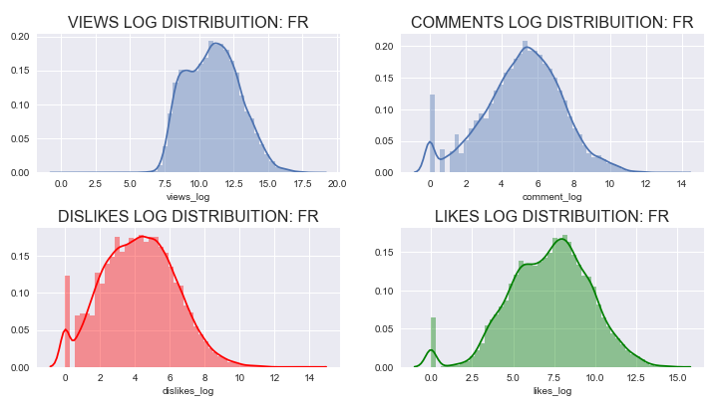
Engagement metrices are not normalized (after Hypothesis test for normalization )
Views quantiles
0.01 1855.75
0.25 12939.25
0.50 59199.00
0.75 229181.50
0.99 4729648.25
Likes quantiles
0.01 0.00
0.25 260.00
0.50 1590.00
0.75 7438.00
0.99 259503.75
Dislikes quantiles
0.01 0.0
0.25 14.0
0.50 68.0
0.75 292.0
0.99 8964.0
Comment quantiles
0.01 0.00
0.25 46.00
0.50 201.00
0.75 761.00
0.99 24531.75

Slide 12

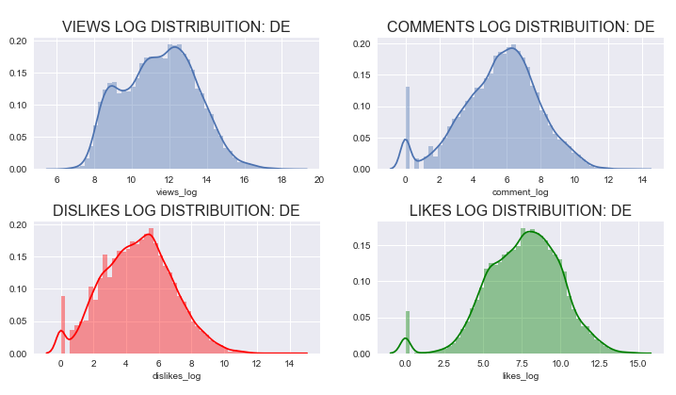
Engagement metrices are not normalized (after Hypothesis test for normalization )
Views quantiles
0.01 2530.47
0.25 21698.25
0.50 100729.50
0.75 387915.25
0.99 7428996.14
Likes quantiles
0.01 0.00
0.25 424.00
0.50 2324.00
0.75 10672.00
0.99 297519.59
Dislikes quantiles
0.01 0.00
0.25 23.00
0.50 115.00
0.75 469.25
0.99 16592.06
Comment quantiles
0.01 0.00
0.25 66.00
0.50 330.00
0.75 1252.00
0.99 33828.14

Slide 13
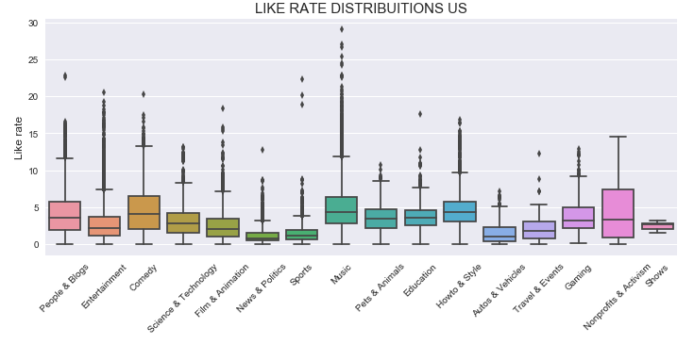
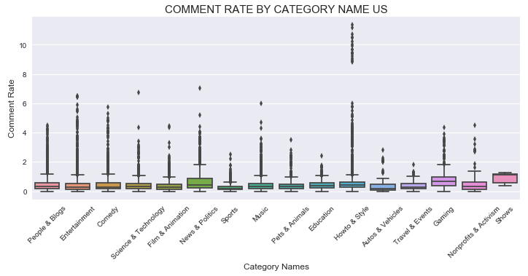
Engagement Rates US
The category with the highest likes/views rate is Nonprofits & Activism followed by Music and Comedy
Nonprofits & Activism category is right skewed in term of like ratio
Shows, Gaming and News & Politics are the categories with the higher comment to views ratio
The Shows category is highly left skewed in comment rate, while News & Politics is right skewed

Slide 14
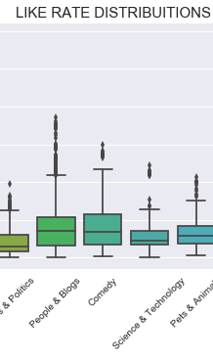
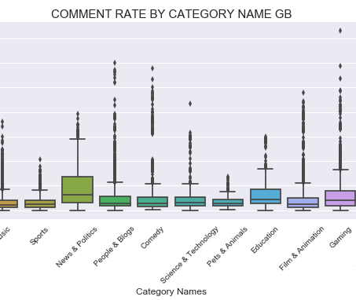
Engagement Rates GB
Comedy, Travel & Events, Travel & Events and Howto and Style are the categories with the highest likes/views rate
Travel and Events and News and Politics categories are right skewed in term of like ratio
Gaming, News & Politics, Travel and Events and Education are the categories with the higher comment to views ratio
News & Politics, Travel and Events and Education are highly right skewed in comment rate

Slide 15
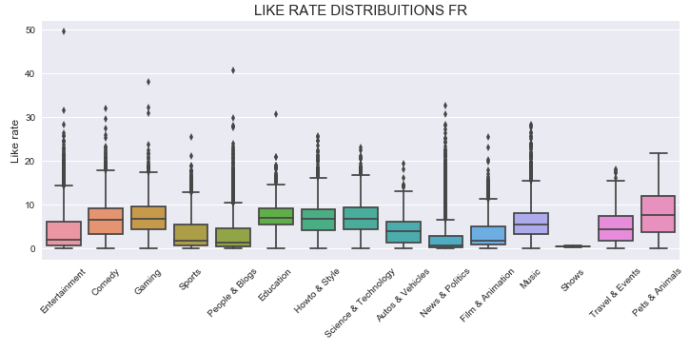
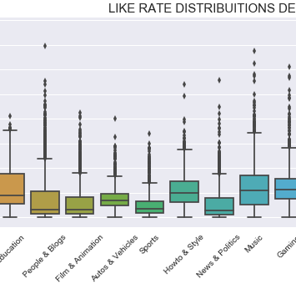
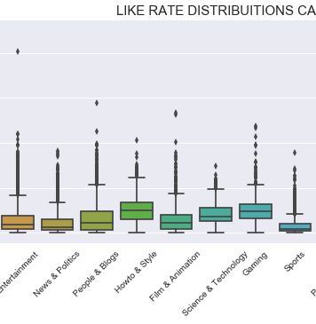
Engagement Rates FR, DE, CA
Pets and animals is the category with the highest likes rate for France
Pets and animals and Sports are highly right skewed for Pets & Animals and Science & Technology are highly right skewed for Canada
Trailers category likes rate for Germany is zero

