Slide 1
Trending YouTube Videos

Slide 2
Contents

Slide 3

Company history
Founded: Feb 14, 2005
Place founded: San Mateo, CA
Headquarters: San Bruno, CA
CEO: Susan Wojcicki (2014)
Founders: Steve Chen, Chad Hurley, Jawed Karim, Eric Skaggs, Martin Pauer
Founder: Jawed Karim, Steve Chen, Chad Hurley

Slide 4
Key Facts
YouTube is an American video-sharing website headquartered in San Bruno, California. The service was created by three former PayPal employees. Google bought the site in November 2006 for US$1.65 billion. YouTube now operates as one of Google's subsidiaries.
YouTube allows users to upload, view, rate, share, add to favorites, report, comment on videos, and subscribe to other users. It offers a wide variety of user-generated and corporate media videos. Available content includes video clips, TV show clips, music videos, short and documentary films, audio recordings, movie trailers, live streams, and other content such as video blogging, short original videos, and educational videos.
Most of the content on YouTube is uploaded by individuals, but media corporations including CBS, the BBC, Vevo, and Hulu offer some of their material via YouTube as part of the YouTube partnership program. Unregistered users can only watch videos on the site, while registered users are permitted to upload an unlimited number of videos and add comments to videos.
Notes:
QuickStarter has created an outline to help you get started on your presentation. Some slides include information here in the notes to provide additional topics for you to research.

Slide 5
Trending Videos
Although the most viewed videos were initially viral videos the most viewed videos were increasingly related to music videos. In fact, since recently every video that has reached the top of the "most viewed YouTube videos" list has been a music video. Although the most viewed videos are no longer listed on the site, reaching the top of the list is still considered a tremendous feat. YouTube maintains a list of the top trending videos on the platform. According to Variety magazine, “To determine the year’s top-trending videos, YouTube uses a combination of factors including measuring users interactions (number of views, shares, comments and likes). Note that they’re not the most-viewed videos overall for the calendar year”. Top performers on the YouTube trending list are music videos (such as the famously virile “Gangam Style”), celebrity and/or reality TV performances, and the random dude-with-a-camera viral videos that YouTube is well-known for.

Slide 6
Inspiration - Goal
Possible uses for this dataset could include:
Sentiment analysis in a variety of forms
Categorizing YouTube videos based on their comments and statistics.
Training ML algorithms to generate their own YouTube comments.
Analyzing what factors affect how popular a YouTube video will be.
Analysis of changes over time etc.

Slide 7
Analysis – The Datasets
2 datasets will be used for the purpose of this project, 2 sets of five files csv and JSON. One of the datasets used is a daily record of the top trending YouTube videos. The dataset includes several months (and counting) of data on daily trending YouTube videos. Data is included for the US, GB, DE, CA, and FR regions (USA, Great Britain, Germany, Canada, and France, respectively), with up to 200 listed trending videos per day. Each region’s data is in a separate file. Data includes the video title, channel title, publish time, tags, views, likes and dislikes, description, and comment count.The second data set (JSON files) includes a category_id field and varies between regions. One such file is included for each of the five regions in the dataset. .
The headers in the video files are:
video_id (Common id field to both comment and video csv files)
title
channel_title
category_id (Can be looked up using the included JSON files, but varies per region so use the appropriate JSON file for the CSV file's country)
tags (Separated by | character, [none] is displayed if there are no tags)
views
likes
dislikes
thumbnail_link
date (Formatted like so: [day].[month])
The headers in the comments file are:
video_id (Common id field to both comment and video csv files)
• comment_text
• likes
• replies

Slide 8
Data manipulation prosses
Merging the data-sets¶
To create the full dataset the region’s data where uploaded and merged in one data frame. The files with the category information were uploaded and merged into another data set. The category id and category name where stored in a data frame the elements of witch were dictionaries. The column instead of pandas series where iteritems. As a result there were problems to treat the data since there was not a typical pandas series. Below you can have a look of the category table.
After merging the two datasets the final data set craeted contains 142,000 rows and 30 columns
Formatting¶
The dates columns were formatted to datetime. Also, the hour, day and month info was extracted. Also the views, comments, likes columns were changes to integers.
Data Cleaning¶
In order to make the nessesary change in format some rows had to be deleted since there was wrong information stored as date in some cases. Also after merging the two data frames non-available values were replaced with zeros. Cases where there are 0 likes or comments and a lot of views i.e. the users has decided to disable those features have not been removed.

Slide 9
Engagement Rates
UK is the country with most likes, the most liked video has reached 120 mil likes, for the US the most liked video only has 25 mil likes.
The tenth video in likes has almost 1/4rth of videos compared to the most liked video for all countries, with the exception of the US there the diff in likes among the firt 10 videos is not that big. Actually the tenth most liked video for the US has just half of the likes compared to the most liked one. Another interesting fact is that for every country there is one prominent disliked video and for the rest 9 videos the number of dislikes is close to 0mil. Views and number of comments follow the same distribution among the 10 first videos.

Slide 10
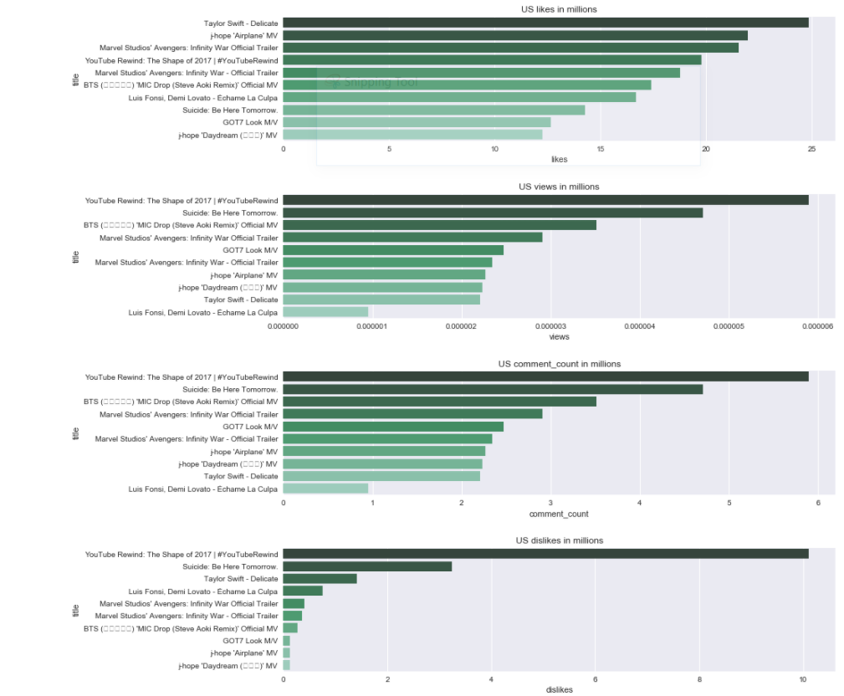
US Top Videos

Slide 11
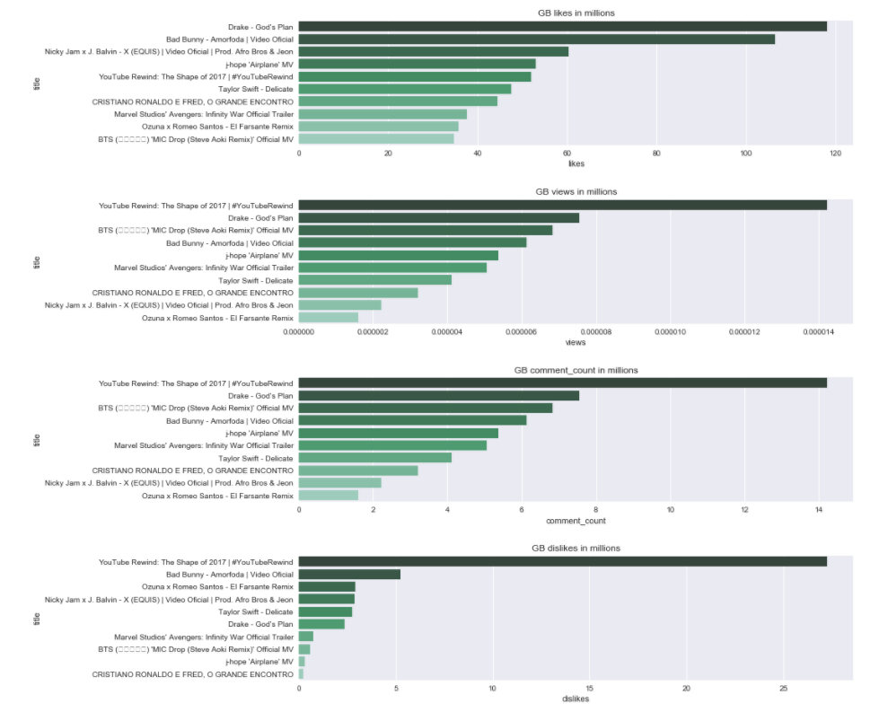
GB Top Videos

Slide 12
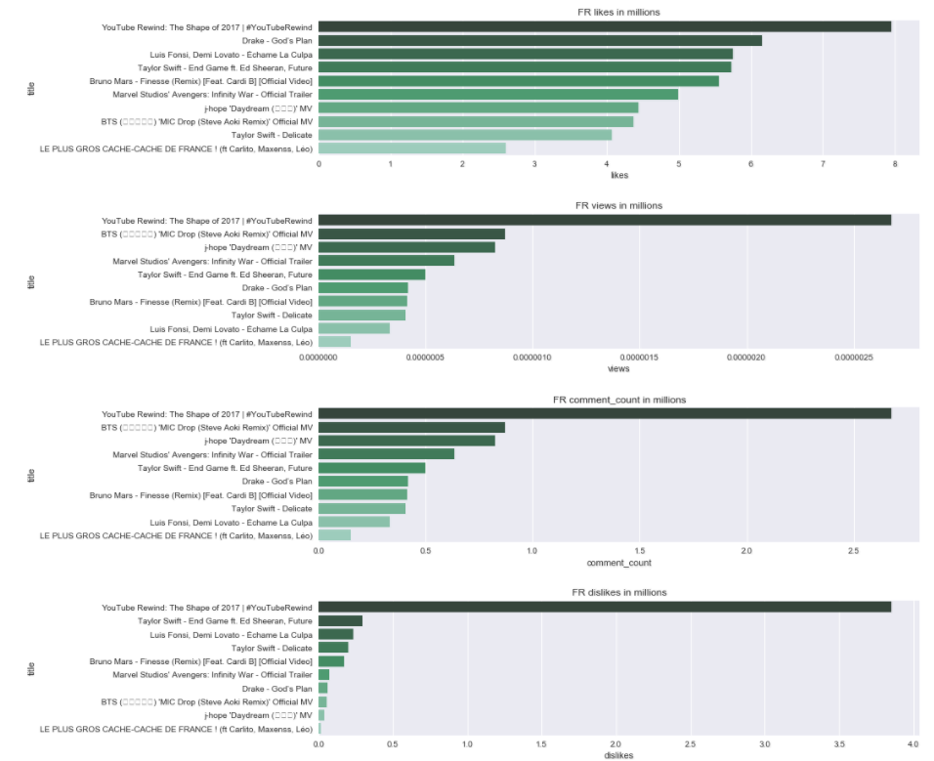
FR Top Videos

Slide 13
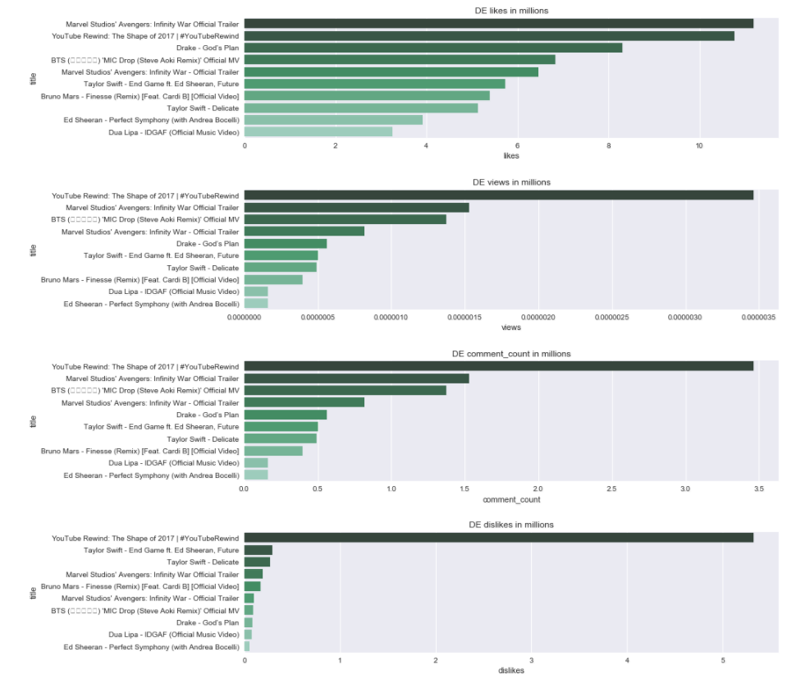
DE Top Videos

Slide 14
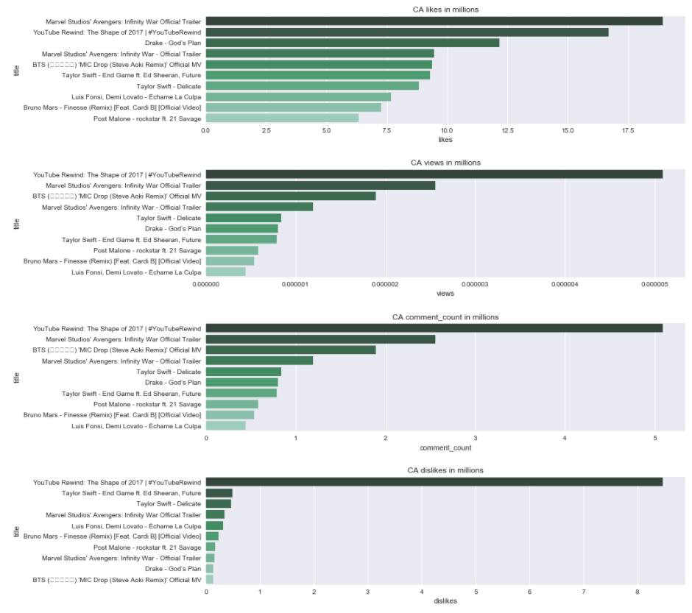
CA Top Videos

Slide 15
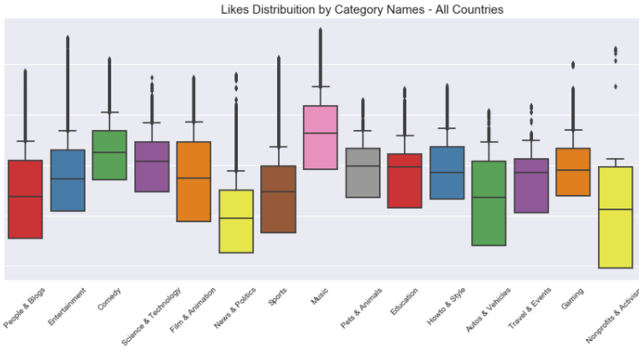
Likes Per Category
Music is the category with the most likes followed by Entertainment.
People have quite different opinions in terms of liking Nonprofits and Activism videos. Variation is quite high for People and Blogs, Autos and Film videos.
Pets and Animals and Education videos are left skewed in term of likes

Slide 16
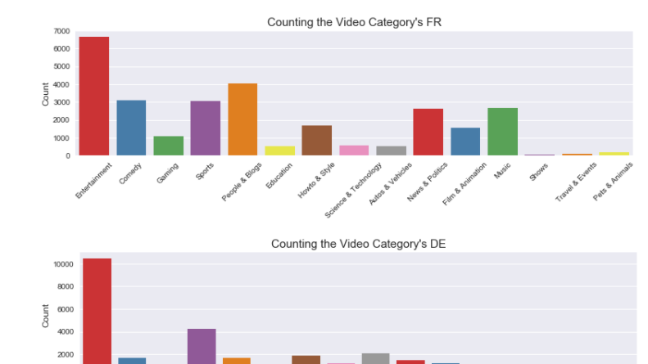
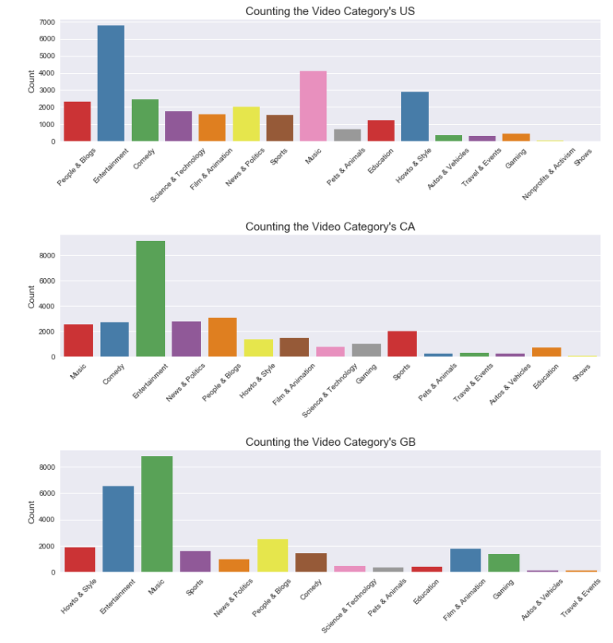
Analysis per category and Country
Top category of all countries except GB is Entertainment.
Music's videos ranked insignificantly in Canada, Germany and France compare to US and UK.
Sport's videos are more popular in Canada, Germany and France.
All top 8 categories in United Kingdom are entertainment-related. Show's and Activism's video get the bottom rank in all most countries.

Slide 17
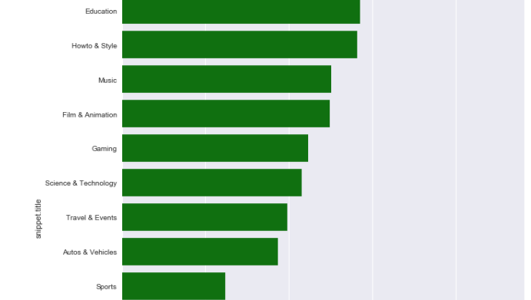
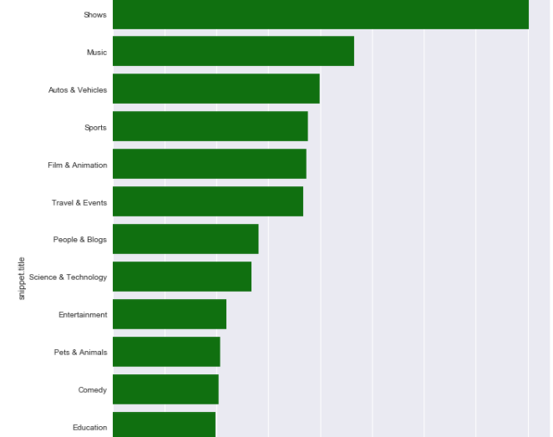
Engagement ratios per category
Pets & Animals videos have highest likes-dislikes ratio. Not surprisingly, people find difficult to hate pets and animals. Nonprofit & Activism's videos have lowest likes-dislike ratio and views-comments ratio. People relatively hate these video and comment a lot. Obviously, people still prefer implicit feedback than explicit. The ratio of views to comments is so large that only a comment written for hundreds of views.

Slide 18
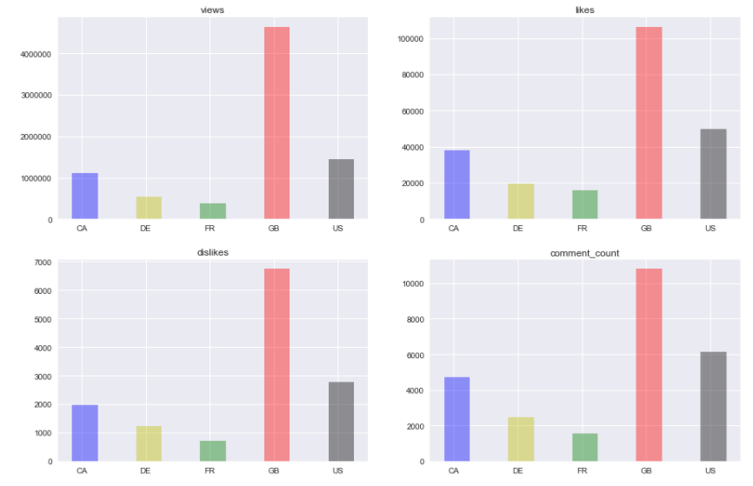
How many likes, dislikes, views and comments get different countries?
All countries share the similar trend in numbers for likes, dislikes, views and comments . One possible reason to this is due to the video's trending duration. Enduring trending videos have the advantages in getting more views, likes, dislikes and comments.

Slide 19
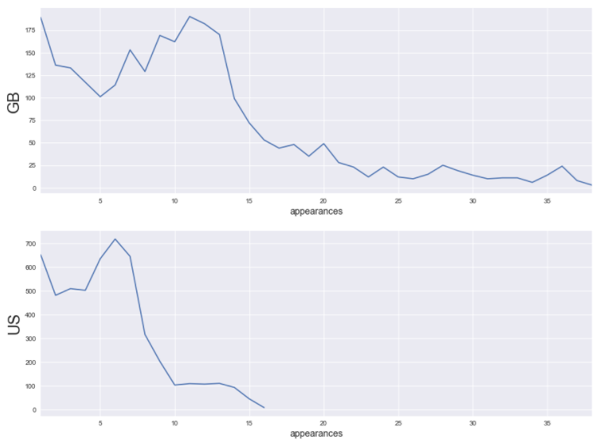
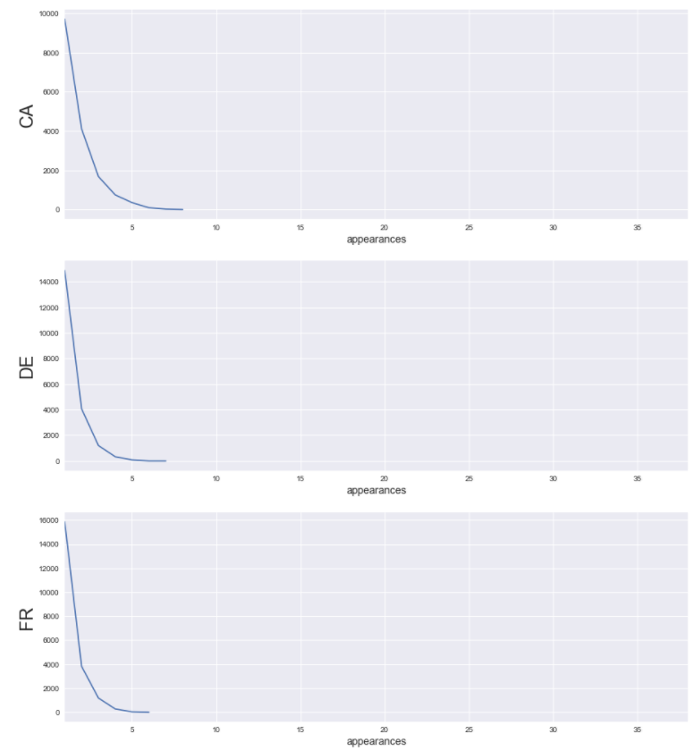
United Kingdom has the most long trended Youtube videos (The greater the number of apperances indicate the long-last the video trend is)

Slide 20
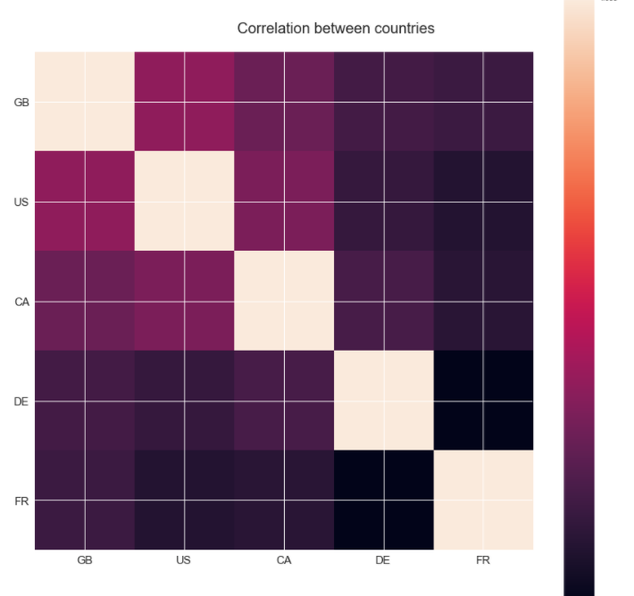
Correlation of Youtube Trending Videos between countries. It does exist!
Not surprisingly, the video from United Kingdom, US and Canada is highly correlate to each other compare to Germany and France. This might due to the sharing of common language in these countries. As compare, Germany and France seems like more isolate where they did not follow the trend from English speaking countries. This can also explain why UK has the highest number in long-trend videos, as it is contributes by multiple countries at the same time.

Slide 21
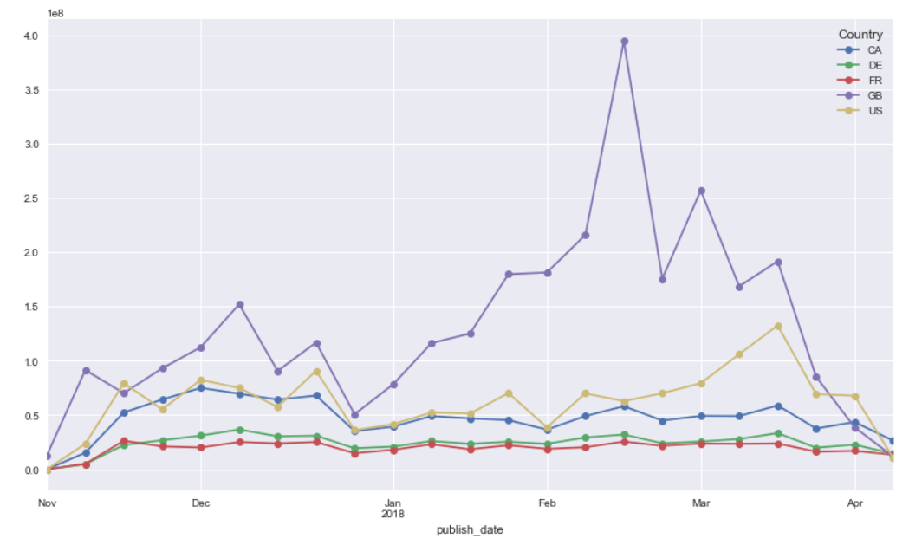
How are likes trending per country?
UK has been the country with the most likes.
There is a huge increase in likes for UK which might be due to data collection.
Canada has shown a decrease in likes for the first months of 2018 compared to November-December 2017.
US has shown a noticeable increase in likes in mid March 2018.
For France and Germany there are not big fluctuations in likes

