Slide 1
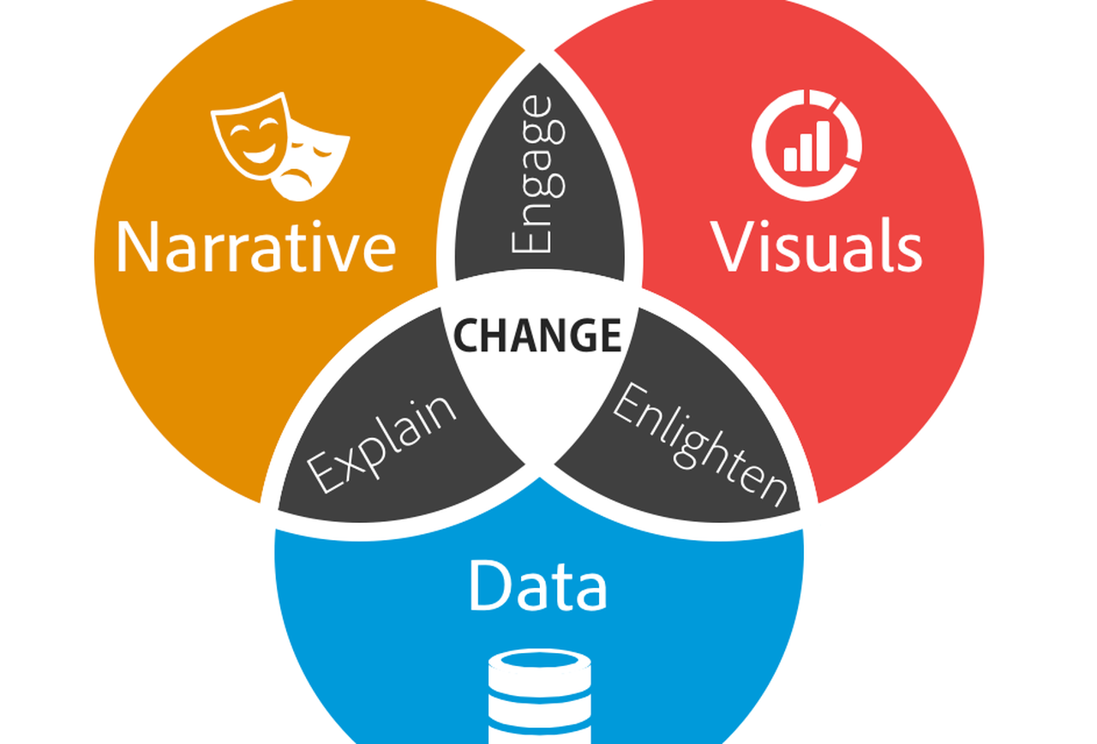
Data Story

Slide 2



Most popular videos in views

Slide 3
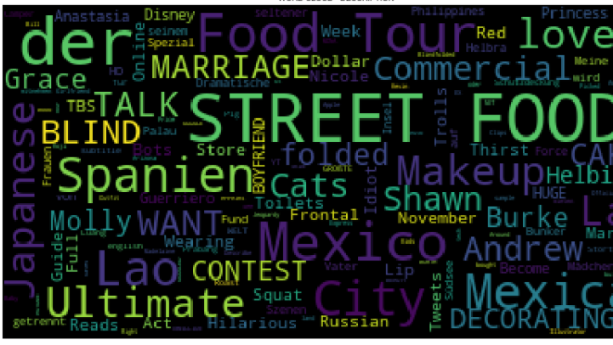
Most common words in videos titles:
Street food , der , food and Mexico are the most popular worlds in video tittles

Slide 4
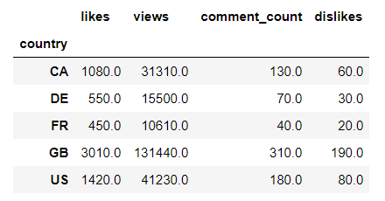
Key dataset metrics in numbers
In millions

Slide 5
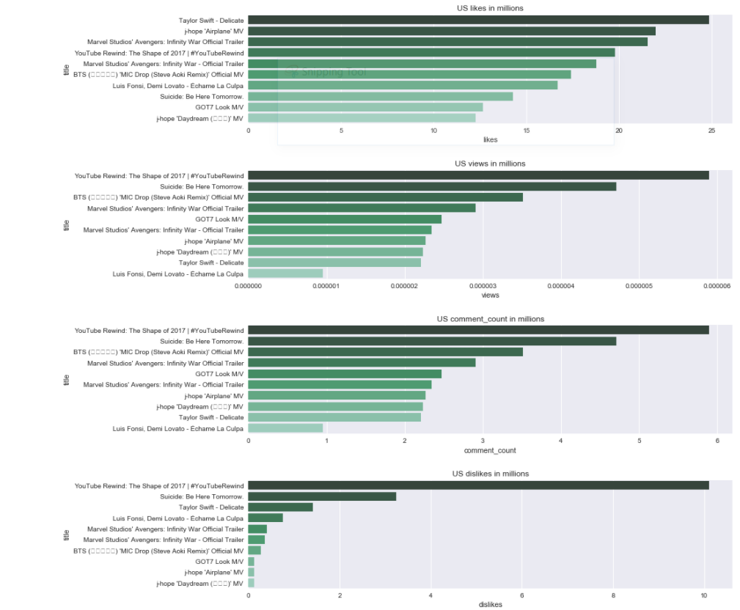
US Top Videos
The tenth video in likes has almost 1/4rth of videos compared to the most liked video for all countries, with the exception of the US there the diff in likes among the first 10 videos is not that big. Actually the tenth most liked video for the US has just half of the likes compared to the most liked one.

Slide 6
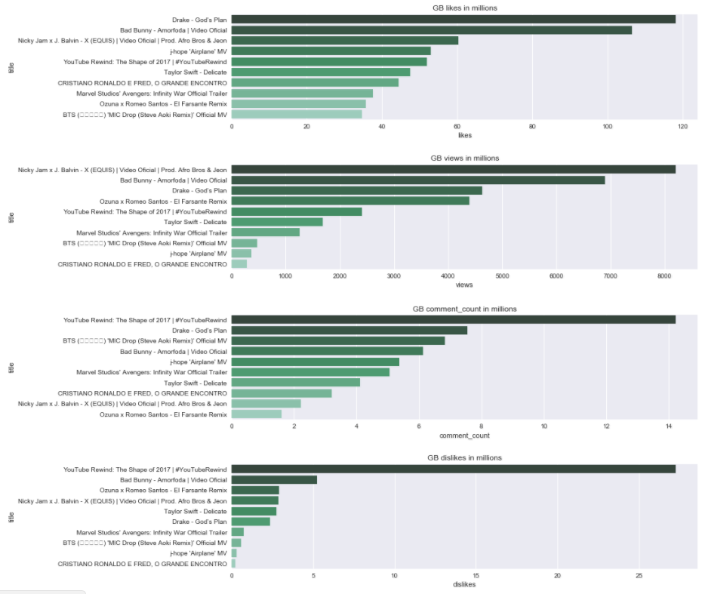
GB Top Videos
GB is the country with most likes, the most liked video has reached 120 mil likes, the second country in likes is the US, the most liked video only has 25 mil likes.

Slide 7
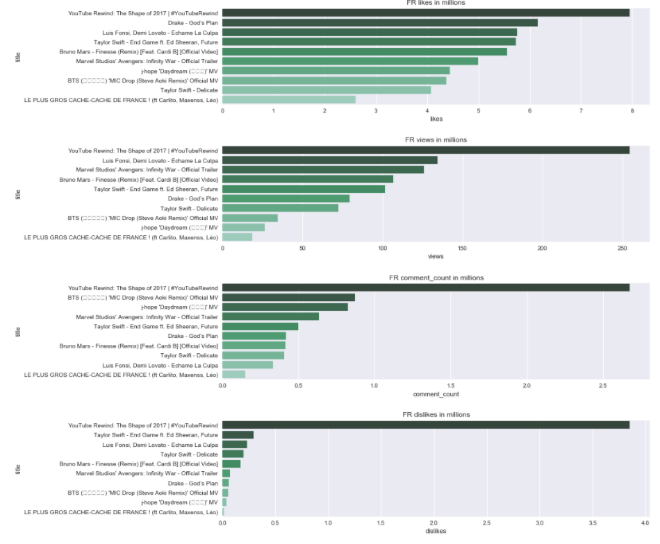
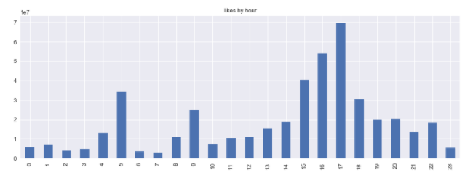
FR Top Videos
Likes for FR are significantly higher for videos published in evening hours

Slide 8
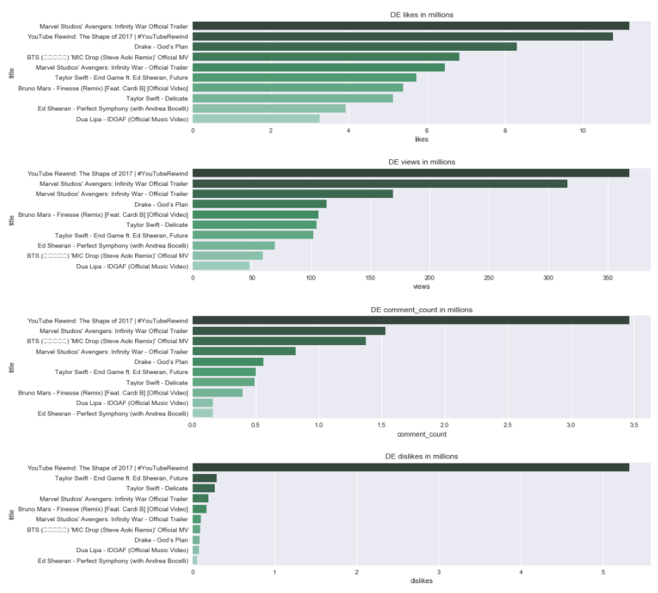
DE Top Videos
For CA and actually for all countries there is one prominent disliked video and for the rest 9 videos the number of dislikes is close to 0mil.

Slide 9
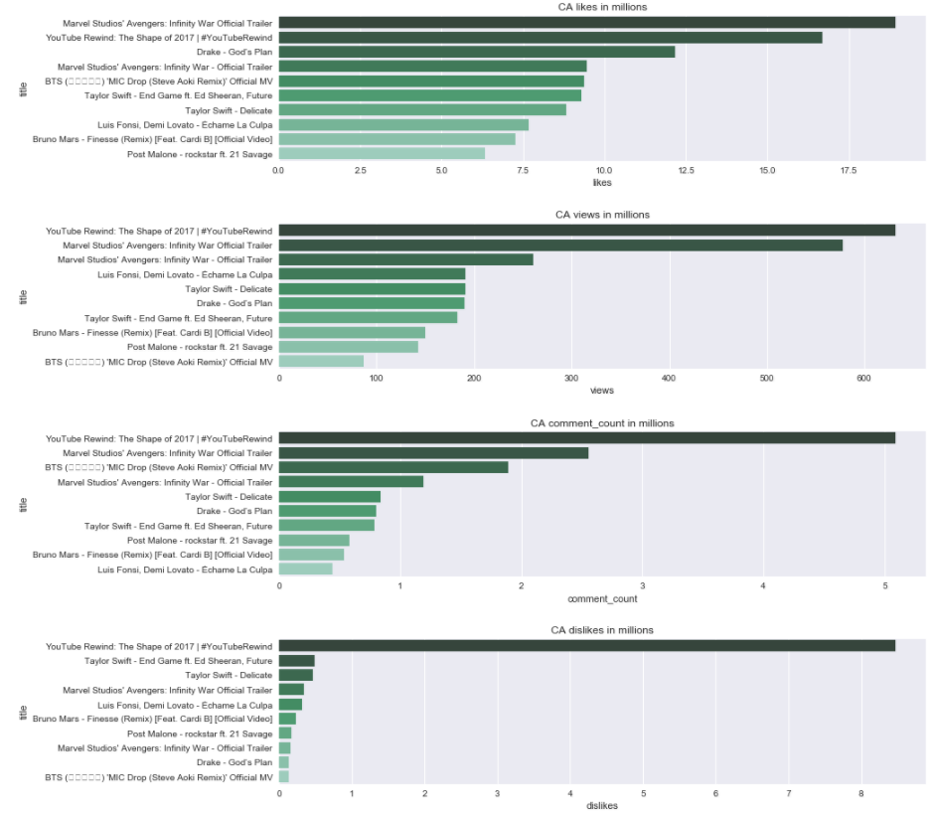
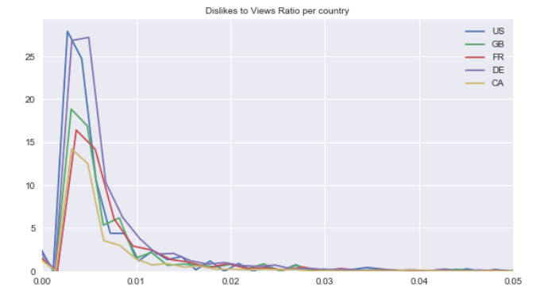
CA Top Videos
Canada is the country with the lower dislikes to views ratio

Slide 10
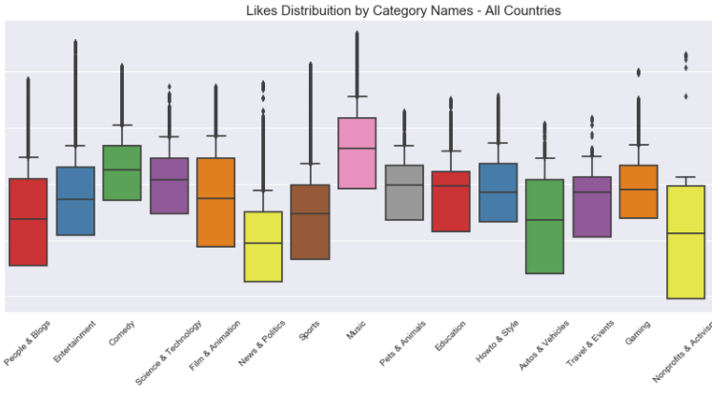
Likes Per Category
Music is the category with the most likes followed by Entertainment.
People have quite different opinions in terms of liking Nonprofits and Activism videos. Variation is quite high for People and Blogs, Autos and Film videos.
Pets and Animals and Education videos are left skewed in term of likes

Slide 11
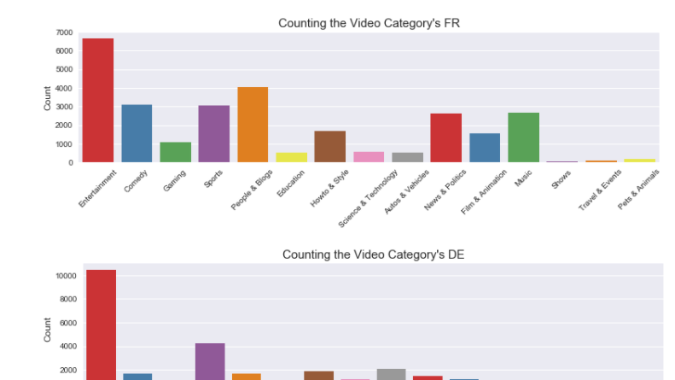
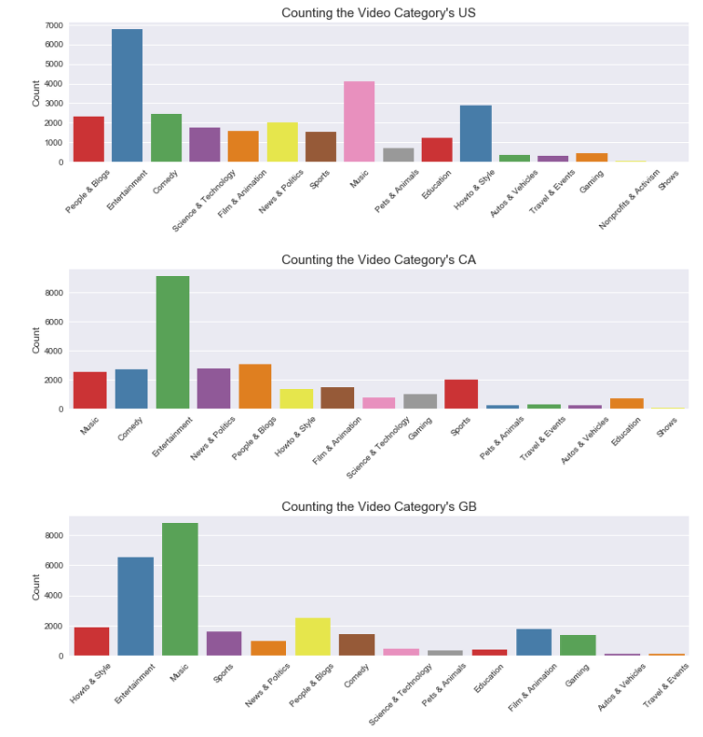
Analysis per category and Country
Top category of all countries except GB is Entertainment. For GB the top category is music
Music's videos ranked insignificantly in Canada, Germany and France compare to US and UK.
Sport's videos are more popular in Canada, Germany and France.
All top 8 categories in United Kingdom are entertainment-related. Show's and Activism's video get the bottom rank in all most countries.

Slide 12
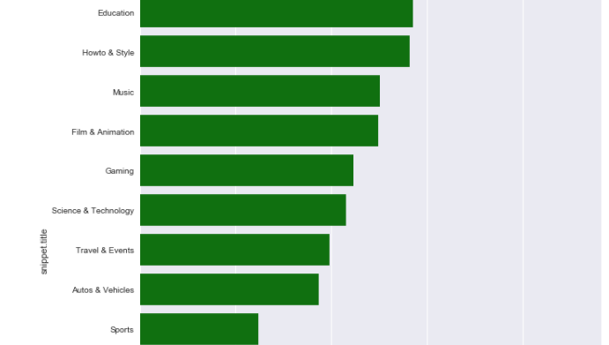
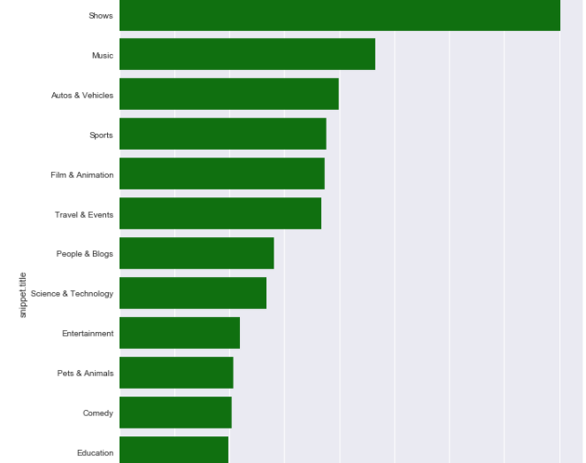
Engagement ratios per category
Pets & Animals videos have highest likes-dislikes ratio. Not surprisingly, people find difficult to hate pets and animals.
Nonprofit & Activism's videos have lowest likes-dislike ratio and views-comments ratio. Shows is the category with most comments-views ratio.
People still prefer implicit feedback than explicit. The ratio of views to comments is so large that only a comment written for hundreds of views.

Slide 13
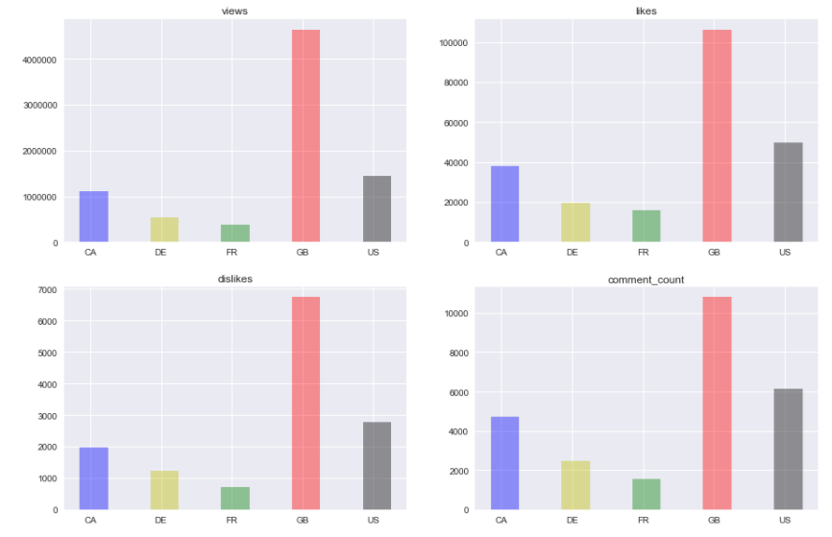
How many likes, dislikes, views and comments get different countries?
All countries share the similar trend in numbers for likes, dislikes, views and comments.
One possible reason to this is due to the video's trending duration.
Enduring trending videos have the advantages in getting more views, likes, dislikes and comments.

Slide 14
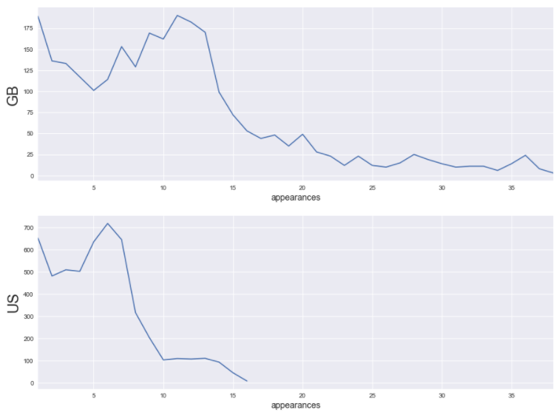
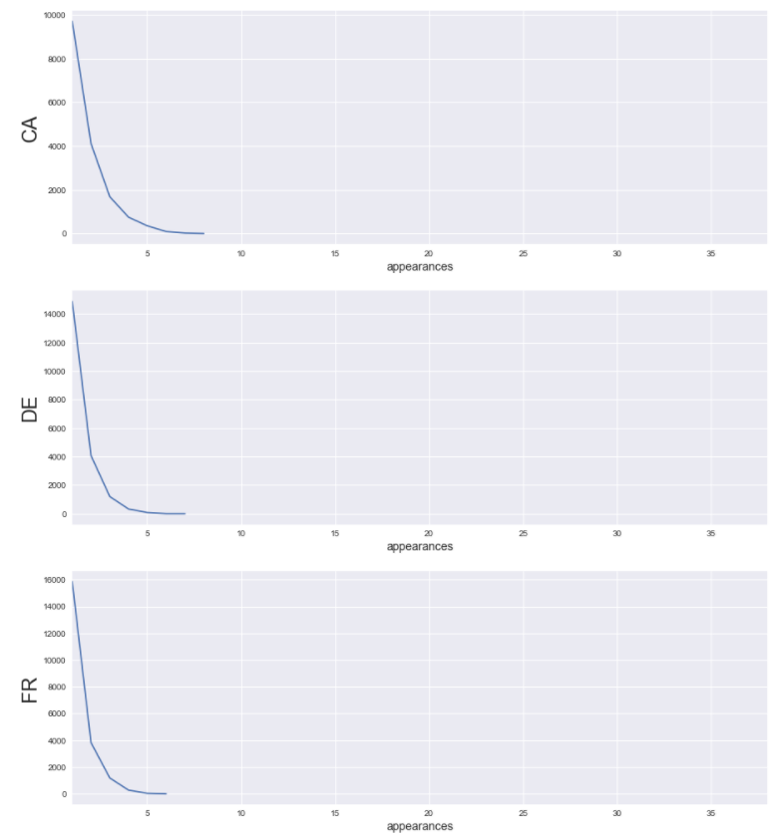
United Kingdom has the most long trended Youtube videos (The greater the number of appearances indicate the long-last the video trend is)

Slide 15
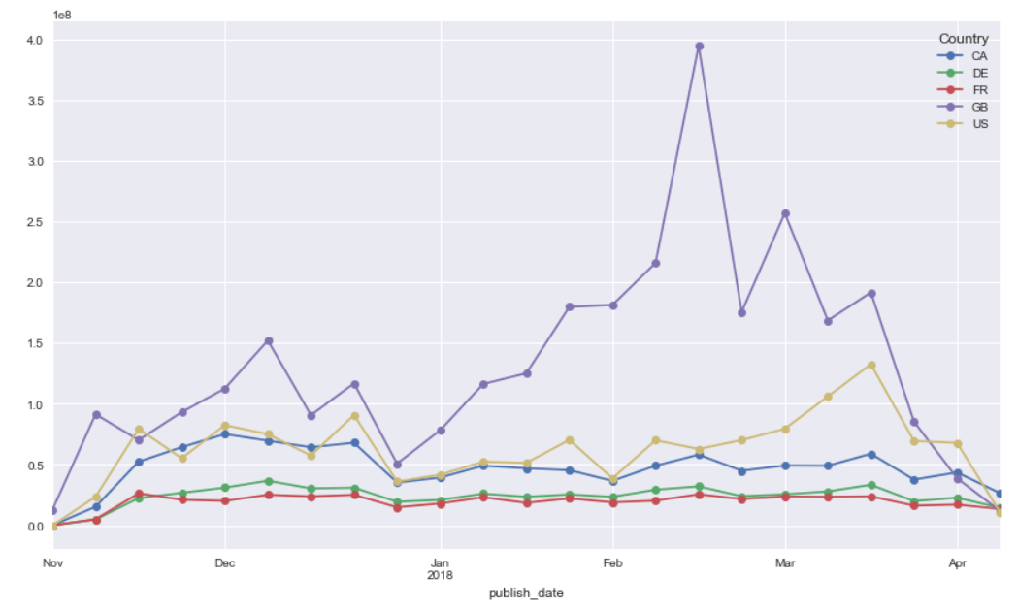
How are likes trending per country?
UK has been the country with the most likes.
There is a huge increase in likes for UK which might be due to data collection.
Canada has shown a decrease in likes for the first months of 2018 compared to November-December 2017.
US has shown a noticeable increase in likes in mid March 2018.
For France and Germany there are not big fluctuations in likes

