Slide 1
IMAGE RECOCNITION using neural network
Rooms of the house

Slide 2
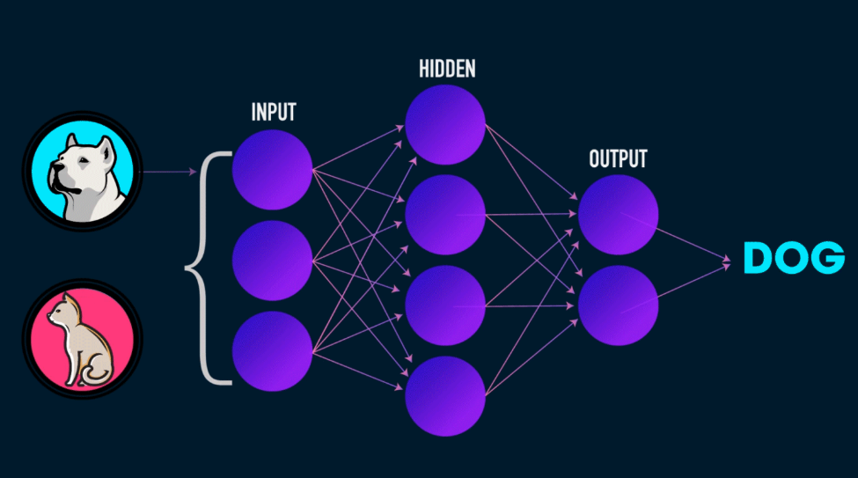
Neural Network
Artificial neural networks or connectionist systems are computing systems vaguely inspired by the biological neural networks that constitute animal brains. Such systems "learn" to perform tasks by considering examples, generally without being programmed with any task-specific rules.
For example, in image recognition, they might learn to identify images that contain specific rooms of a house by analyzing example images that have been manually labeled as various rooms and using the results to identify cats in other images.
Notes:
QuickStarter has created an outline to help you get started on your presentation. Some slides include information here in the notes to provide additional topics for you to research.
Summary:
Artificial neural networks or connectionist systems are computing systems vaguely inspired by the biological neural networks that constitute animal brains. Such systems "learn" to perform tasks by considering examples, generally without being programmed with any task-specific rules. For example, in image recognition, they might learn to identify images that contain cats by analyzing example images that have been manually labeled as "cat" or "no cat" and using the results to identify cats in other images. They do this without any prior knowledge about cats, e.g., that they have fur, tails, whiskers and cat-like faces. Instead, they automatically generate identifying characteristics from the learning material that they process.
More key facts:
Academic conference: IJCNN 2015, AI 2016, ICANN 2014, IEEE CEC 2015, ICONIP 2015, ICASSP 2016, GECCO 2016, ISCAS 2016, IEEE SMC 2016, MM 2015, ICCE 2015, AAAI 2016, WCCI 2016, ICCS 2014, BioMed 2014, IJCAI 2016, IROS 2015, ICPR 2016, ICME 2016, ICML 2016, ICT 2015, NIPS 2015, IGARSS 2016, RA 2014, ICC 2016, CP 2015, ICIP 2015, ICRA 2016, ISNN 2015, GLOBECOM 2015, CDC 2015, Interspeech 2015, CC 2015, ICIS 2015, ICARCV 2014, CCECE 2015, CHI 2016, ETFA 2016, IA 2014, European Conference on Artificial Intelligence (ECAI) 2016, SIN 2015, ECAL 2015, AMT 2014, ICAISC 2015, EUROCON 2015, ICDM 2015, KDD 2016, SEA 2015, DAS 2014

Slide 3
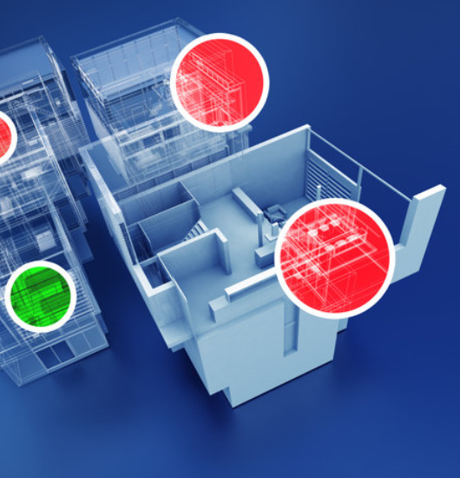
Image Recognition
Image recognition, in the context of machine vision, is the ability of software to identify objects, places, people, writing and actions in images. Computers can use machine vision technologies in combination with a camera and artificial intelligence software to achieve image recognition.
While human and animal brains recognize objects with ease, computers have difficulty with the task. Software for image recognition requires deep machine learning. Performance is best on convolutional neural net processors as the specific task otherwise requires massive amounts of power for its compute-intensive nature. Image recognition algorithms can function by use of comparative models appearances from different angles using edge detection or by components. Image recognition algorithms are often trained on millions of pre-labeled pictures with guided computer learning.

Slide 4
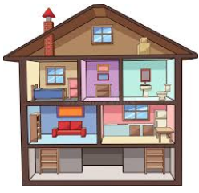
Capstone Project
Neural Network to be used to identify which room of a household collected images are depicting

Slide 5


Data Collection
To gather the images google image search engine was scraped for specific search queries like ‘kitchen’, ‘old kitchen’, ‘modern kitchen’, ‘bathroom’ etc

Slide 6
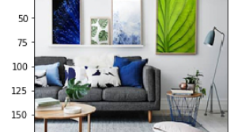
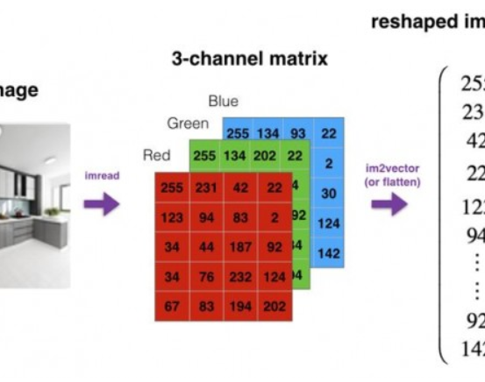
Data Processing
Resize the photos :
The size of the pictures varies a lot. In order to proceed with the analysis of the images have to have the same size. So all photos have been resized to 100x100.
Reshape the photos:
For every image we have stored convert the image to a vector of size x_pixels * y_pixels * 3

Slide 7
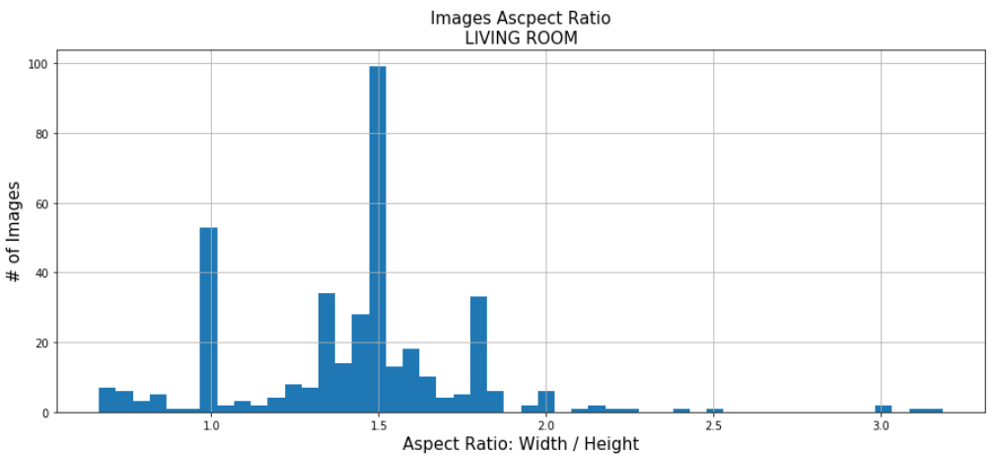
Limitation: Images are distorted when resizing Aspect ratio varies from 0.3 to 6

Slide 8

Predictive Models
Neural Network with no hidden layer - Logistic regression
Neural Network with hidden layer Neural Network with hidden layer
Convolution Neural Networks

Slide 9
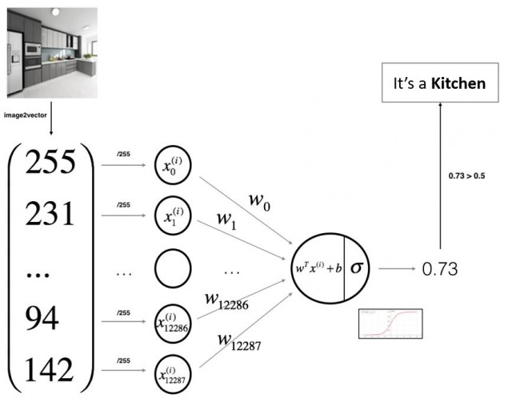
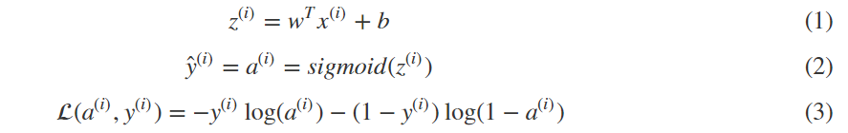
Neural Network with no hidden layer Logistic Regression (Binary Classification)

Slide 10
Key steps
Scope
We want to estimate the w and b (weights and bias respectively) that minimize the cost function. First we initialize them then recalculate them in order to minimize some loss (or cost) function we have defined.
Step 1: Initialize the parameters of the model
Firstly we initialize the weights and bias to some random values (or zeros)
Step 2: Forward propagation
Generate predictions using the parameters, that is we apply the weights and bias in our activation function to make our estimation Y_hat
Step 3: Gradient descent
Calculate the gradients by taking the derivative of the cost function on w and b
Step 4: Backward propagation
Apply our gradients in a backward manner to calculate the new weights and bias
Use the learned parameters to make predictions (on the test set)
Apply steps 2 – 4 for as many iterations we want
Step 5: Prediction accuracy
Apply the final weights and bias to our test set and calculate the accuracy metrics

Slide 11
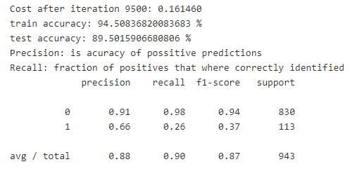
Results
The train accuracy varies from 87 to 94%
The test accuracy varies from 63 to 90%
The room with the worst results is kitchen
The room with the best results is bedroom

Slide 12
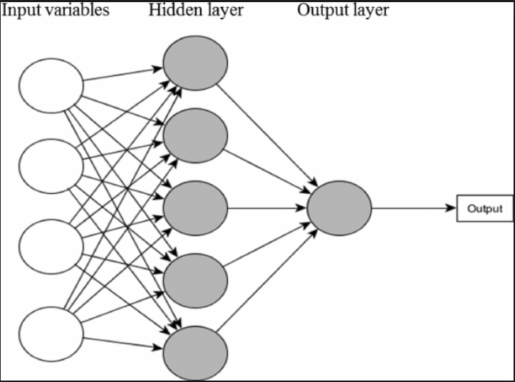
Neural Network with hidden layer

Slide 13
Analysis
A neural network is a collection of neurons connected by synapses.
This collection is organized into three main layers: the input layer, the hidden layer, and the output layer.
We can have many hidden layers, in our analysis we will add one hidden layer with 5 neurons.
In logistic regression we had:
X1 \ X2 ==> z = XW + B ==> a = Sigmoid(z) ==> l(a,Y)X3 /
In neural networks with one layer we will have:
X1 \ X2 => z1 = XW1 + B1 => a1 = Sigmoid(a1) => z2 = a1W2 + B2 => a2 = Sigmoid(z2) => l(a2,Y)X3 /
The activation function for the hidden layer is tanh and the activation function for the output will again be a sigmoid.

Slide 14
Results
The results are almost identical with the ones from logistic regression with n hidden layer.
The train accuracy varies from 87 to 94%
The test accuracy varies from 63 to 90%
The room with the worst results is kitchen
The room with the best results is bedroom

Slide 15
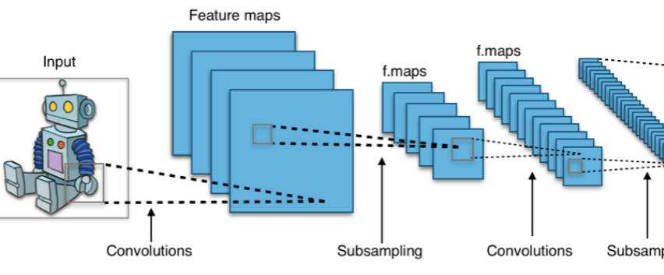
Convolution Neural networks

Slide 16
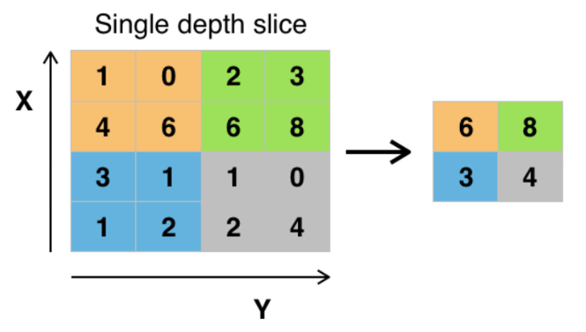
Method
The convolution layer computes the output of neurons that are connected to local regions or receptive fields in the input, each computing a dot product between their weights and a small receptive field to which they are connected to in the input volume. Each computation leads to extraction of a feature map from the input image. As a result, we 'll get a single number that represents all the values in that window of the images. You use this layer to filtering: as the window moves over the image, you check for patterns in that section of the image. This works because of filters, which are multiplied by the values outputted by the convolution.

Slide 17
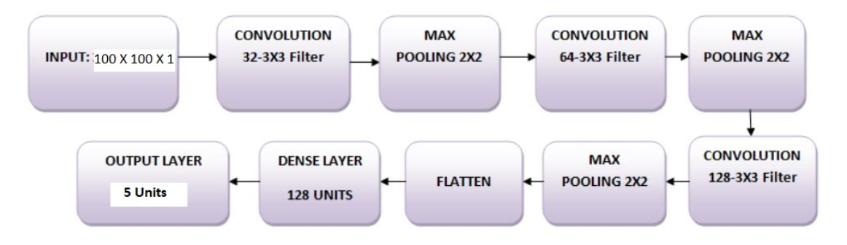
Architecture of the Model
We will use three convolutional layers:
The first layer will have 32-3 x 3 filters,
The second layer will have 64-3 x 3 filters and
The third layer will have 128-3 x 3 filters.
In addition, there are three max-pooling layers each of size 2 x 2
Leaky ReLU is used as the activation function
Input
Output

Slide 18
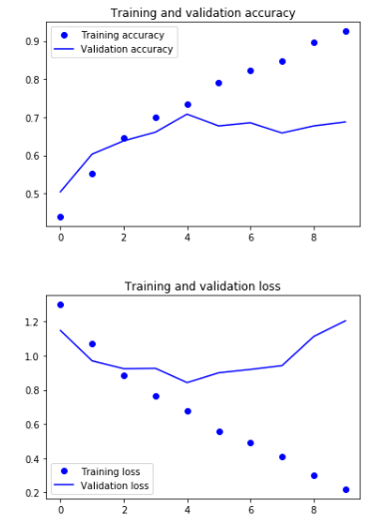
Results
Model Evaluation:
Test accuracy: 0.70
Test loss: 1.2
The model is overfitting.
Overfitting gives an intuition that the network has memorized the training data very well but is not guaranteed to work on unseen data, and that is why there is a difference in the training and validation accuracy.

Slide 19
Adding Dropout into the Network to overcome overfitting
Dropout randomly turns off a fraction of neurons during the training process, reducing the dependency on the training set by some amount. How many fractions of neurons you want to turn off is decided by a hyperparameter, which can be tuned accordingly. This way, turning off some neurons will not allow the network to memorize the training data since not all the neurons will be active at the same time and the inactive neurons will not be able to learn anything
Model Evaluation after adding dropout:
Test accuracy: 0.69
Test loss: 0.81
Looks like adding Dropout in our model worked, even though the test accuracy did not improve significantly but the test loss decreased compared to the previous results.

Slide 20
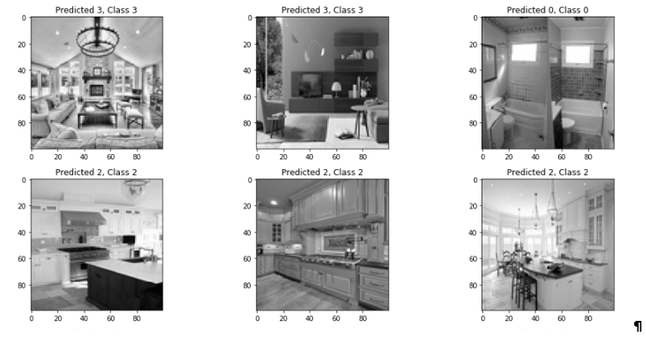
Adding Dropout into the Network, more apochs, smaller alpha
Model Evaluation final results:
Test accuracy: 0.73
Test loss: 0.80

Slide 21
Issues
We are distorting the images when resizing.
We greyscale the images used for the convolution network due to machine limitations (Linux VM machine 8GB RAM 4 core)
The number of images used is limited due to machine limitations.
Some google image searches do not align with the search keywords

