Slide 1
Bootcamp Day 4
Thursday, July 31 2014

Slide 2
Review Previous Day (animation)
x = x + 1;
Frame 1: x = 3
Frame 2: x = 4
x
x
Frame 3: x = 5
Frame 4: x = 6
x
x

Slide 3
Conditionals
Notes:
Conditional are probably the most fundamental bits of code necessary for making interactive sketches.

Slide 4
If I am hungry, then I will eat food.
Otherwise, I will not eat.
Notes:
We use them all the time in plain language.

Slide 5
"If" I am hungry, "then" I will eat food.
Otherwise ("else"), I will not eat.
Notes:
You will notice certain keywords are critical to the meaning of the statements.

Slide 6
If I am hungry, then I will eat food.
Otherwise, I will not eat.
Notes:
And in addition to those keywords, you will find two types of things: the condition to test.

Slide 7
If I am hungry, then I will eat food.
Otherwise ("else"), I will not eat.
Notes:
...and the actions that will be taken if the condition is true. Often times you will see a second statement, like above, that will specify the actions that will be taken if the condition is NOT true.

Slide 8
if (hungry){
EAT FOOD;
}
else {
DO NOT EAT;
}

Slide 9
If I am thirsty and I am hot, I will drink cold water.
Notes:
Sometimes we need to make an "If" statement that has multiple conditions. There are two ways to do this, with "AND" and "OR".

Slide 10
If I am thirsty and I am hot, I will drink cold water.
Notes:
This statement has an and, which means that I will only drink cold water if BOTH of the conditions are true.

Slide 11
if (thirsty && hot){
//if “thirsty” AND “hot” are both true, do the following:
DRINK COLD WATER;
}
if (thirsty && cold){
//if “thirsty” AND “cold” are both true, do the following:
DRINK HOT TEA;
}
//Note: if one is true and the other is false, then the if statement will not run
Notes:
Note here the double "&" sign is used to denote an AND condition.

Slide 12
If I am tired or it is late, I will go to sleep.
Notes:
Here is another statement. Notice a difference?

Slide 13
If I am tired or it is late, I will go to sleep.
(But not in Boot Camp)
Notes:
The "OR" condition means that if EITHER of the first conditions are true, the actions will be completed.

Slide 14
if (tired || late){
//if “tired” is true or “late” is true, then do the following:
GO TO SLEEP;
}
Notes:
The double "|" used here is located directly below the "delete" key on macs or the backspace key on PCs.
Vertical bar is called a "pipe," so || is called a "double pipe" (not that you will ever hear anyone say that).
Also, note that not all if statements need an "else" following them.

Slide 15
== vs. =
Notes:
This is a VERY important piece of syntax you need to learn, since it is a common pitfall and will save you loads of time debugging if you're careful

Slide 16
==
(Test)
=
(Assign)
Double equal sign compares
two values and returns true
if they are equal
Asks a question
if (x == 10) {
do this
}
"Is x equal to ten?"
Single equal sign sets a variable equal to a value.
Does not ask a question
x = 32;
"Set x equal to 32."
Notes:
Nuff said.

Slide 17
CORRECT INCORRECT
if(x == 10){ if(x = 10){
do this; do this;
} }
Notes:
The worst part is that if you use a single equal sign, processing will not give an error. This means your sketch will compile and it just won't run the way you want it to without giving you any feedback.

Slide 18
Other ways to compare...
Symbol Meaning Example
< “less than” if (x < 10) { //do something}
<= “less than or equal to” if (x >= 15) { //do something}
> “greater than” if (x > 3) { //do something}
>= “greater than or equal to” if (x >= 7) { //do something}
!= “not equal to” if (x != 100) { //do something}
Notes:
You WILL find yourself using these comparison operators so take a minute to look at the syntax

Slide 19
grade = 86;
if(grade >= 90){
//“Your grade is an A”;
}
else if (grade >= 80) {
//“Your grade is a B”;
}
else if (grade >= 70) {
//“Your grade is a C”;
}
else if (grade >= 60) {
//“Your grade is a D”;
}
else {
//“You are a failure”;
}
Notes:
There may be times when you want to have multiple conditions to perform multiple actions. In these cases you can use as many if/else combinations as you like. Note that immediately after "else" is an "if" with a new condition, except for the last one.
Can anyone tell me what the result of this pseudo code will be? Note the use of ">=" since we want to make sure the a grade of 80 will be a B. Without it, an 80 would yield a C.

Slide 20
grade = 98;
if(grade >= 60){
//“Your grade is an D”;
}
else if (grade > 70) {
//“Your grade is a C”;
}
else if (grade > 80) {
//“Your grade is a B”;
}
else if (grade > 90) {
//“Your grade is a A”;
}
else {
//“fail”;
}
Notes:
This code has been changed slightly. What changed? What will the new result be?
Note that the order here is very important. In this case the code will not run as it is supposed to.
Side note:
This might look a little annoying to write because it is so long. It is. In fact there is a slightly easier way to have multiple conditions like this but we do not have the time to cover it here. If you want to look it up, look in the processing reference for the "case" statement.

Slide 21
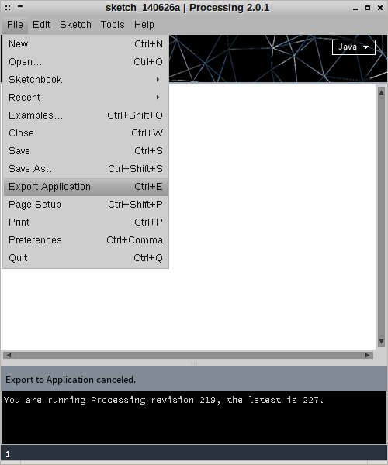
Export
Application

Slide 22

Collisions
Two objects collide when their positions overlap
x, y
mousex, mousey
x – size/2
x + size/2
We can use this logic to check if the mouse
is hovering over an object

Slide 23
y – size/2
x, y
mousex, mousey
y + size/2

Slide 24
y – size/2
x, y
mousex, mousey
y + size/2
x – size/2
x + size/2
If all these conditions are true,
the mouse is over the object

Slide 25
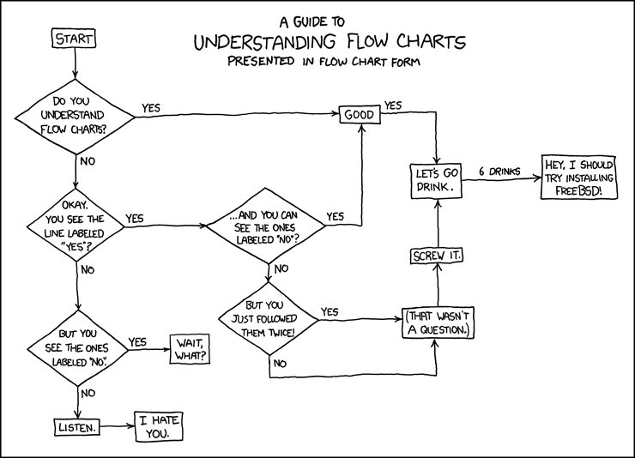
Homework

Slide 26
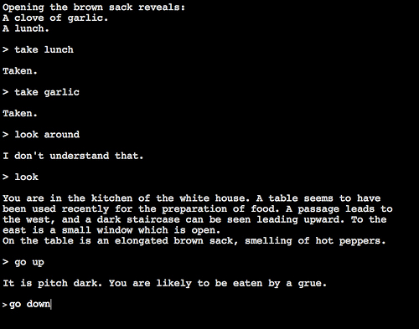

Slide 27
You are in the top-left.
You are in the top-right.
You are on the left.
You are on the right.
You are in the bottom-left.
You are in the bottom-right.
You are in the bottom-left corner.
You are in the bottom-right corner.

