Slide 1
RDD on NBA stats
Project for the exam of «Large Scale Computing», MSc. Computer Science, Genoa, a.y. 2020/21
Gian Paolo Bernardini
Muhammad Umair Yousuf
Mehrpuya Fathi Bonyadabad

Slide 2
Intro
The motivations is to work on a field (RDD) at the basis of the Map/Reduce pattern. Although RDD syntax is a low level one, it is the foundation for all the subsequent high level API like DataFrames and SparkSQL.
We asked ourselves some questions on behaviors of the teams in the decade 2010-2020, also respect to the teams that won a title. We have taken into consideration the regular season.
The starting point is at this link: https://www.nba.com/stats/teams/traditional/?sort=W_PCT&dir=-1

Slide 3
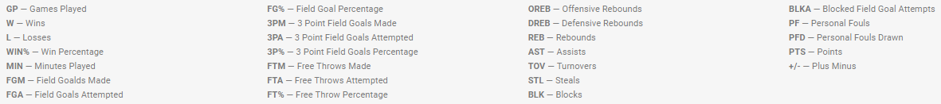
Glossary

Slide 4
Part 1
Gian Paolo Bernardini

Slide 5
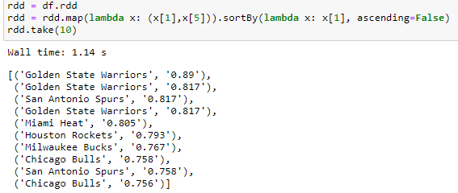
Q1 which is the most winning team in all the decade, based on WIN% (W/GP)?
Gathering the data
At first al the data have been gathered.
The main data frame has been persisted in memory in order not to load it anymore and redo calculations.
5

Slide 6
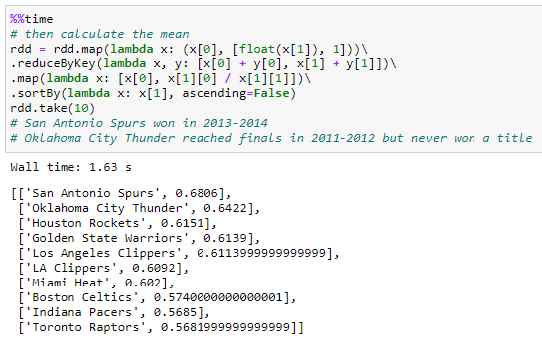
Q1 which is the most winning team in all the decade, based on WIN% (W/GP)?
Calculate the mean
The mean has been calculated based on a map reduce approach.
As it may be noticed only one on the first three teams that have the best % of winning, won a title, so having a great regular season, don’t assure the winning of a title.
6

Slide 7
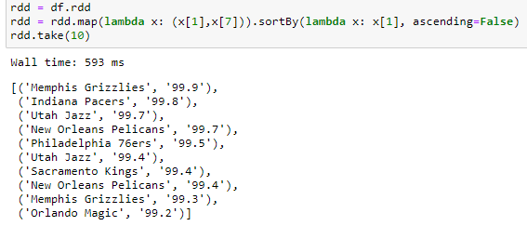
Q2 is scoring a lot of points important for the winning of a title?
Gathering the data
Again here have been gathered all the teams that in average have scored most points.
7

Slide 8
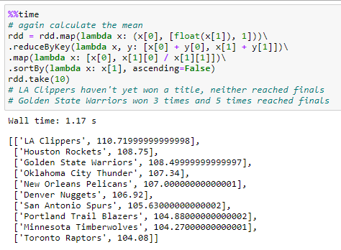
Q2 is scoring a lot of points important for the winning of a title?
Calculate the mean
The mean has been calculated based on a map reduce approach.
The team that in the decade has scored most points in average was LA Clippers which never won a title, but Golden State Warriors won 3 times and 5 times reached finals, so scoring a lot of points, could be a good indicator of a potential title winner.
8

Slide 9
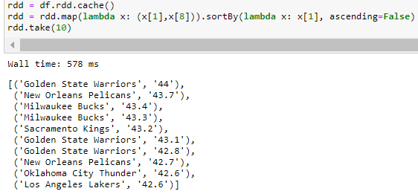
Q3 how the FGM (Field Goals Made) percentage influences the winning of a title? (Compared to the mean of those who have won a title)
The same policy is applied
The best FG makers of all the decade have been gathered.
.cache() permits to cache in memory the RDD in use and to load it quickly.
9

Slide 10
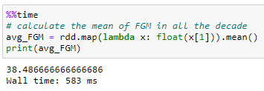
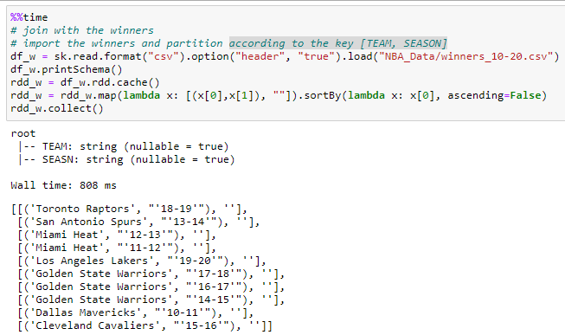
Q3 how the FGM (Field Goals Made) percentage influences the winning of a title?
Calculate the mean
The mean has been calculated based on the command .mean().
Join with the winners
Winners have been imported according to the key [TEAM, SEASON].
10

Slide 11
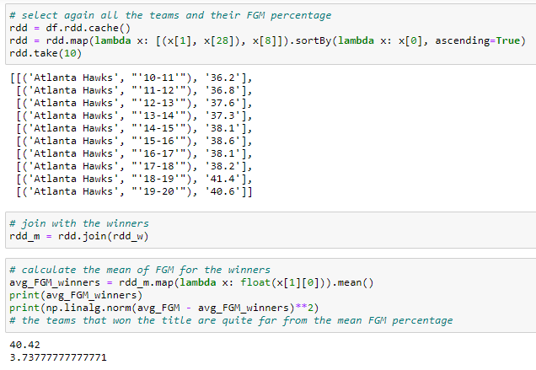
Q3 how the FGM (Field Goals Made) percentage influences the winning of a title?
Comparison with the regular season
the teams that won the title are quite far from the mean FGM percentage in all the decade.
11

Slide 12
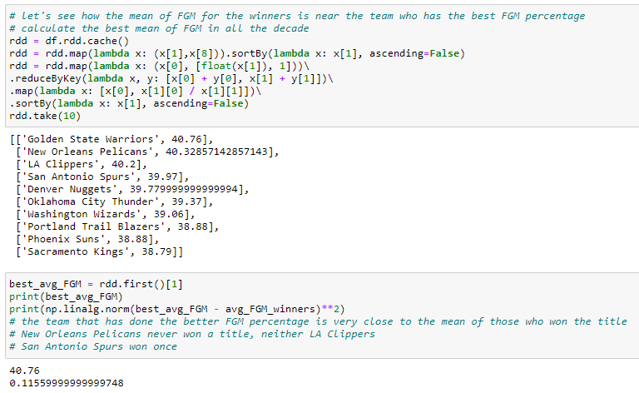
Q4 how the mean of FGM for the winners is near to the mean of the team who has the best FGM percentage?
Golden State Warriors has done the better FGM percentage, very close to the mean of those who won the title.
12

Slide 13
Part 2
Mehrpuya Fathi Bonyadabad

Slide 14
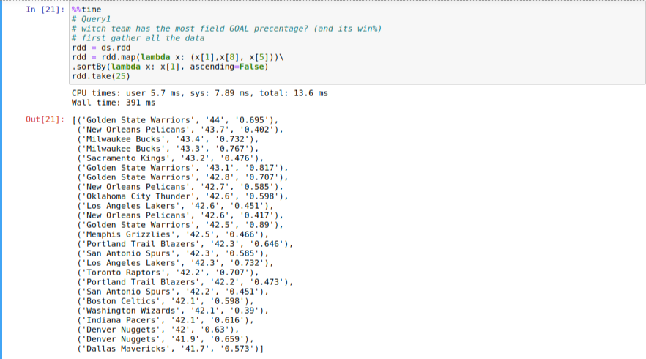
Q1 Which team has the most field GOAL percentage? (and its win%) (gathering part)
Gathering data. It gets name, FGP and win%
Then just a sort
14

Slide 15
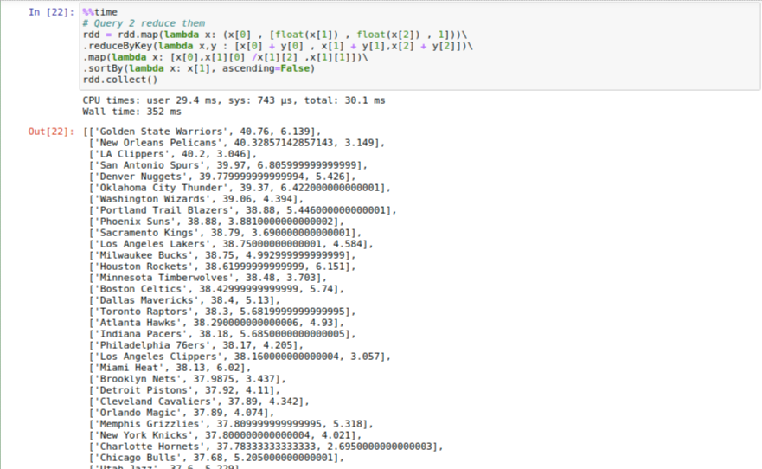
Q2 Which team has the most field GOAL percentage? (and its win%) (reduce part)
Reducing them by their key and calculation the average of them by reducing them by their keys . Last sort.
Best team is the team witch has most win
15

Slide 16
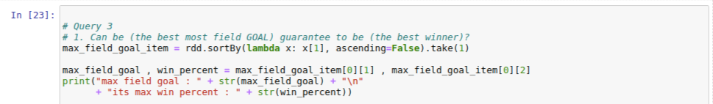
Q3 Can be (the best most field GOAL) guarantee to be (the best winner)?
Think about a coach who has focused on the amount of goals per match.(he thinks the team which has more goals, has more win)
Is he a successful coach?
First we gather the data of witch team has the most FGP in all the team.
Second we obtain the amount of goals and win% of that team
16

Slide 17
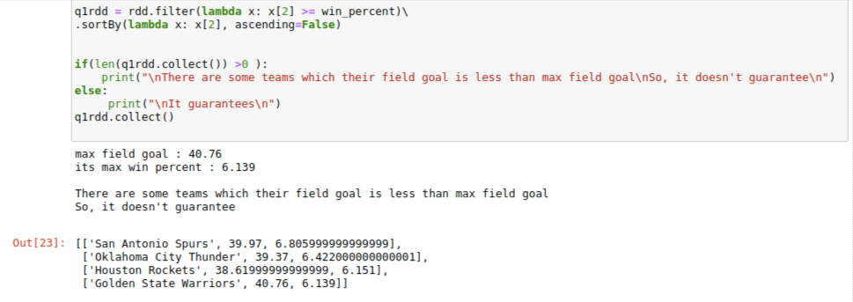
Q3 Can be (the best most field GOAL) guarantee to be (the best winner)?
Then filter the rows to the team that have more wins than the team witch had the max goals.
4 teams (San Antonio Spurs , ...)their goals is less than max but they are more successful . SO, coach thinks wrong
17

Slide 18
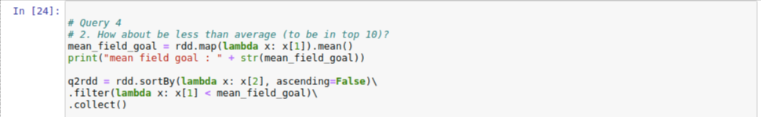
Q4 How about be less than average (to be in top 10)?
Some other coach believes that for being in top 10 , you must have goals more than average . For example if average is 35 , all the teams under 10 are definitely fewer than 35.
Is he right?
First, we get the average of FGP
Second we sort the teams order by win and filter the teams that they have FGP less than average.
18

Slide 19
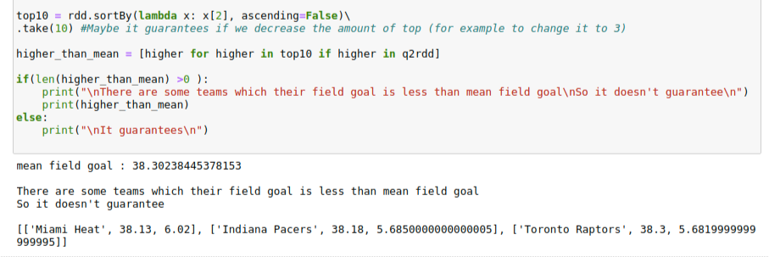
Q4 How about be less than average (to be in top 10)?
Then, we obtain all the teams in top 10.
Now we have 2 groups, and any intersection between them proves that coach is wrong .As a result, the result shows us that 3 teams with FGP fewer than average are in top 10 . Maybe, if we try top 3 , we see another result.
19

Slide 20
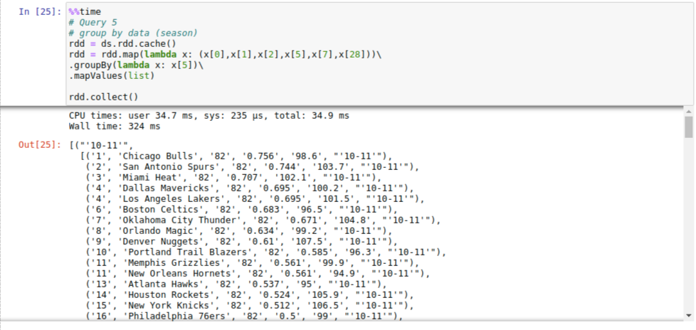
Q5 Group by data on their seasons
For a better view of the data, we must see the teams by their season.
20

Slide 21
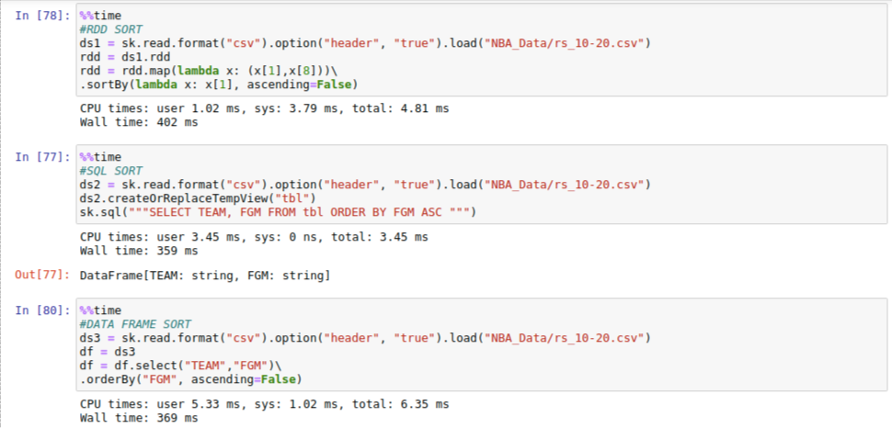
Q6 Whitch are faster (RDD,SQL,Data frame) in a (SELECT , SORT) problem?
If we had a Select and sort query, witch way is faster? SQL? DF? RDD?
3 codes are written in on way in 3 different ways but they do one thing. Actually, the amount of data is less than we can judge between these ways, But, It seems SQL is faster.
21

Slide 22
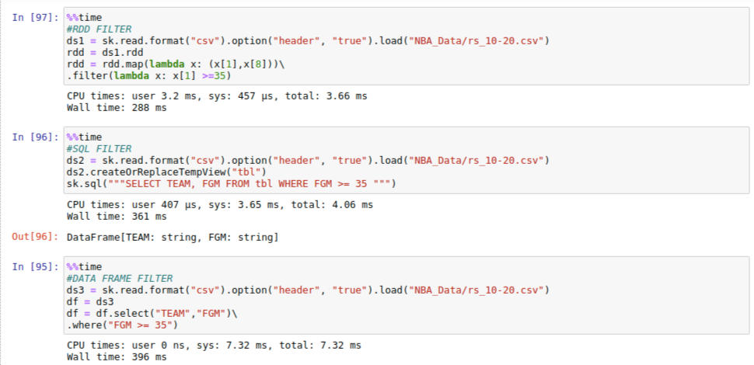
Q7 Whitch are faster (RDD,SQL,Data frame) in a (SELECT , FILTER) problem?
How about Filter?
Again all the codes are the same. With respect to the fact that the amount of data is not sufficient.
You Judge :)
22

Slide 23
Part 3
Muhammad Umair Yousuf

Slide 24
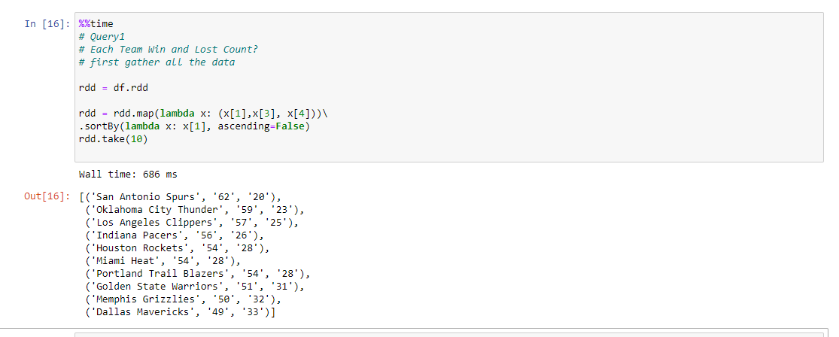
Q1 Each Team lost and Wining Matches Count?
In this rdd query I am using sort by function and map function for getting corresponding Results
24

Slide 25
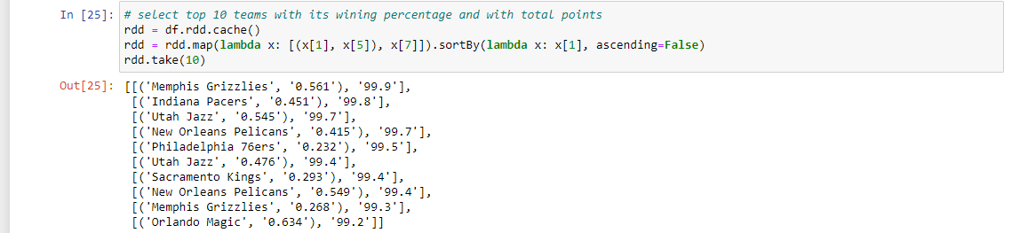
Q2 select top 10 teams with its wining percentage and with total points?
In this Query I am using again sort by function and map function for getting corresponding Results
25

Slide 26
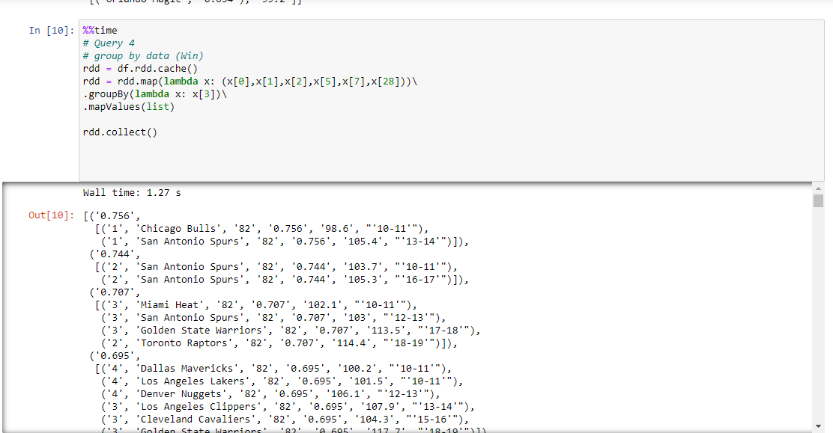
Q3 In this Query group data by wining percentage?
In this Query I am using group by function map by values function and map function for getting corresponding Results
26

Slide 27
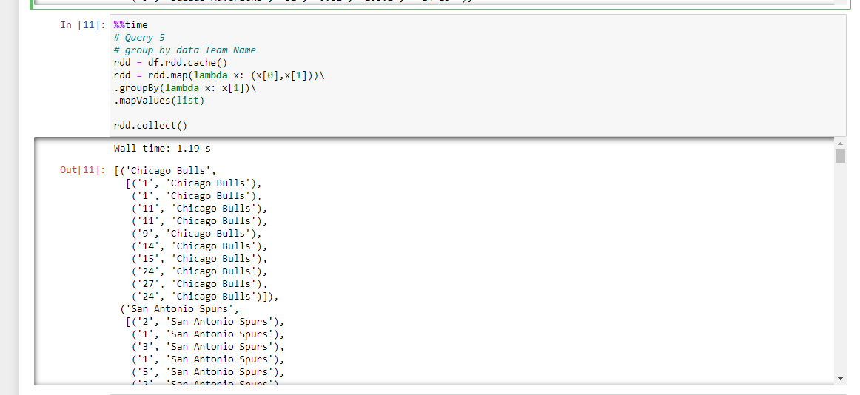
Q4 In this Query group data by Team Name?
In this Query I am using again group by function map by values function and map function for getting corresponding Results
27

Slide 28
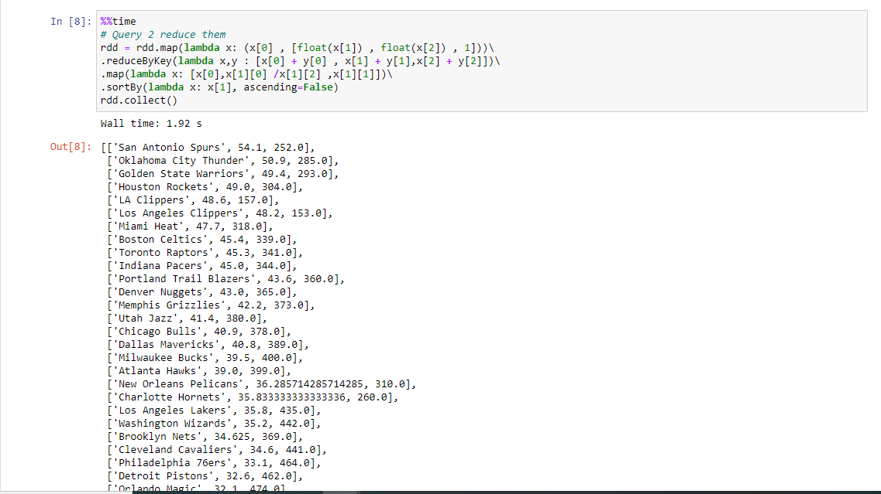
Q5 In this Query Reduce by key and calculate the average by the key?
In this Query I am using reduce by key function sortby function and map function for getting corresponding Results
28

