Slide 1
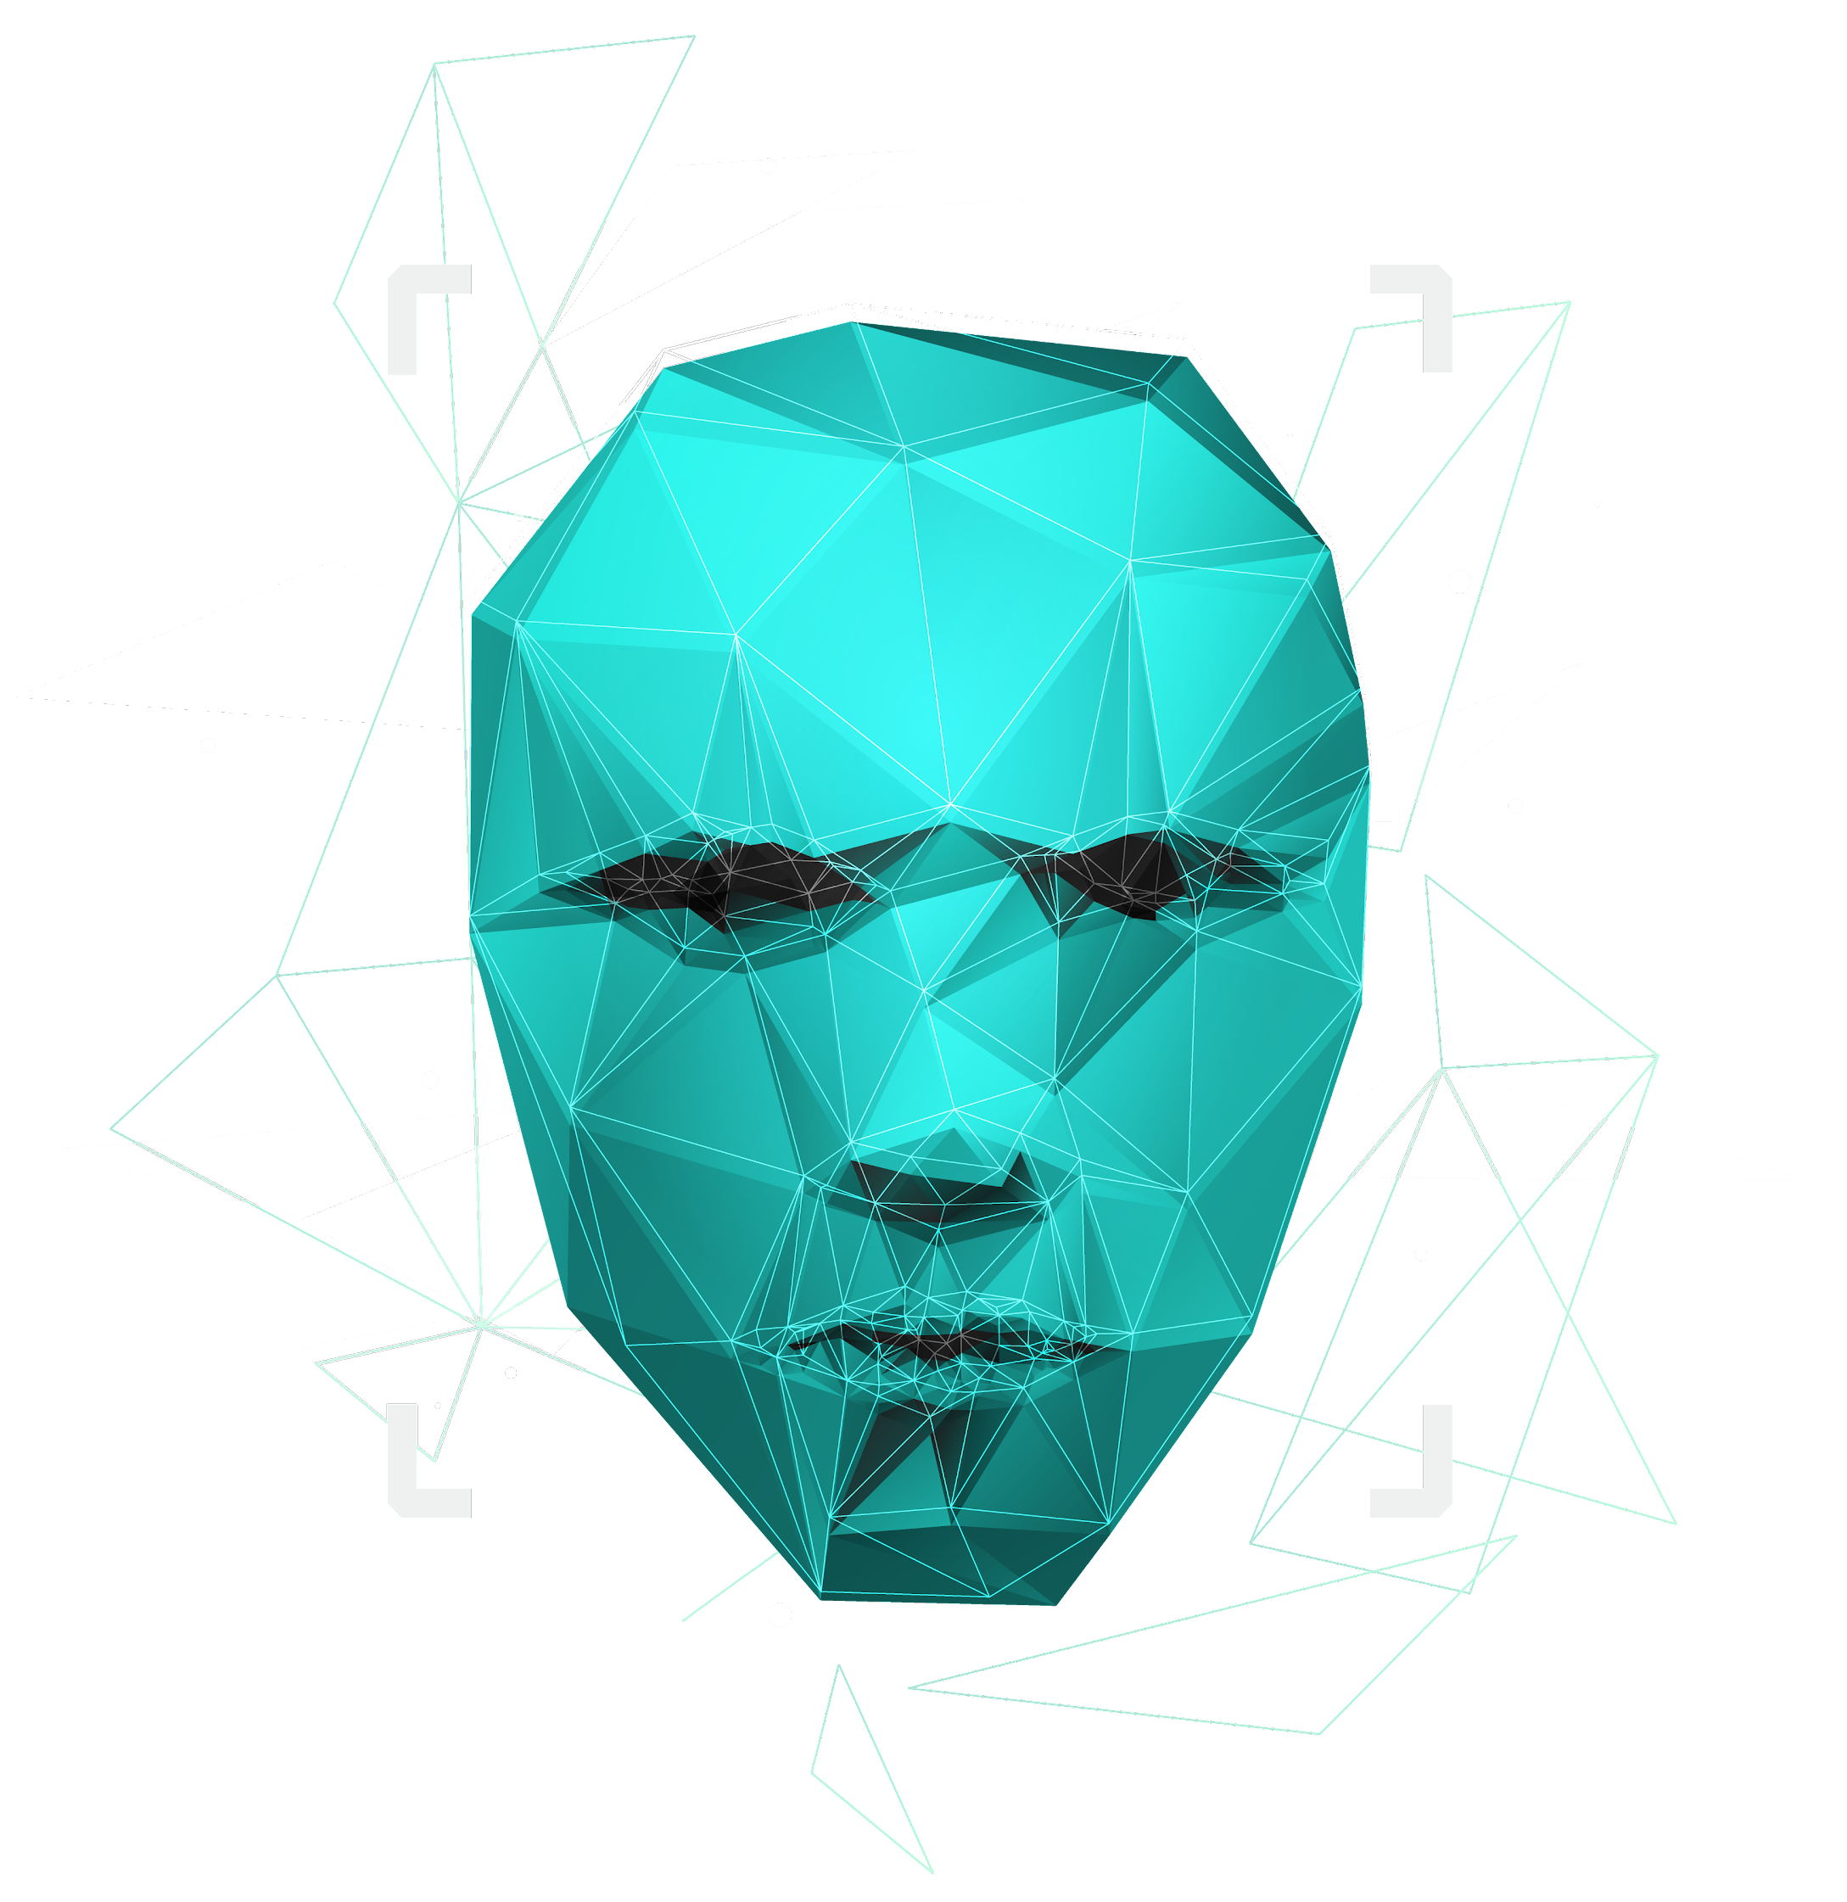
DynaTrack: Dynamic Memory-Enhanced Transformer with Deformable Attention for Robust Single Object Tracking
Weekly Report (29-08-2025)

Slide 2

CONTENTS :
Research Progress
References
Study Objective
Features in visual object tracking
Experimental analysis
Research Background and study objective
Research Schedule

Slide 3

Research Progress for Previous and upcoming weeks
Last week | Upcoming week
Last week, I have completed writing the manuscript of Dynatrack after updating results for got-10k and TrakingNet dataset. I have also proofread the entire manuscript and have checked plagiarism report for the manuscript. Finally, I have sent the completed manuscript to the Professor. | In this week, I will get corrections from Professor and will update and make corrections as per Professor suggestions. Once I get approval from Professor, I will submit the completed manuscript to the journal. And also, I will start doing literature survey for the next work which I am planning on doing using mamba or Vision Language models.

Slide 4
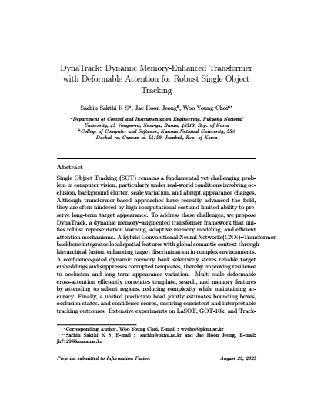
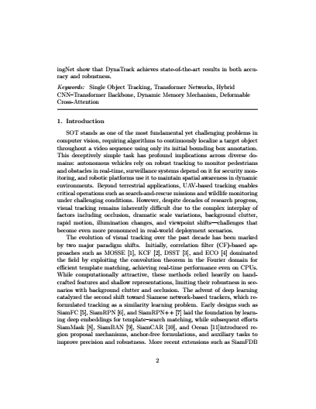
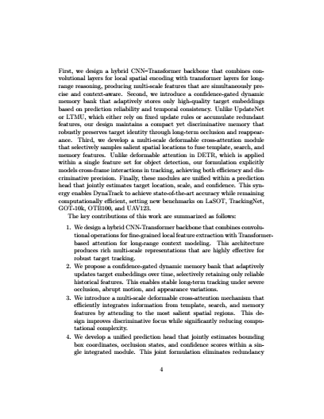
Weekly work progress- paper writing

Slide 5
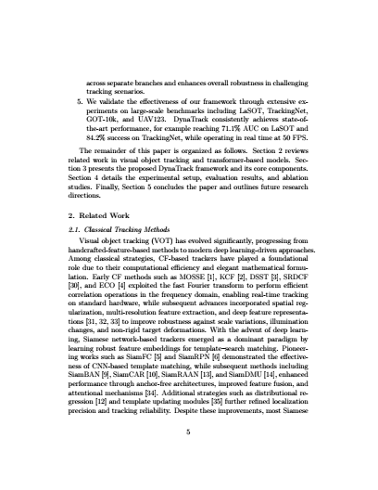
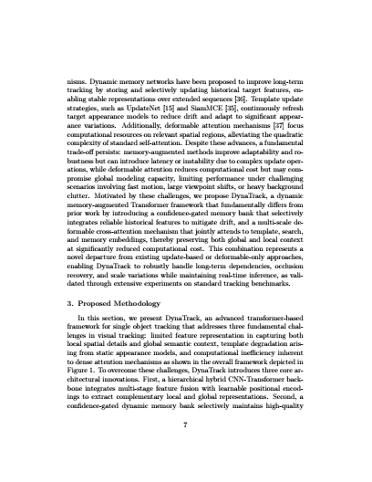
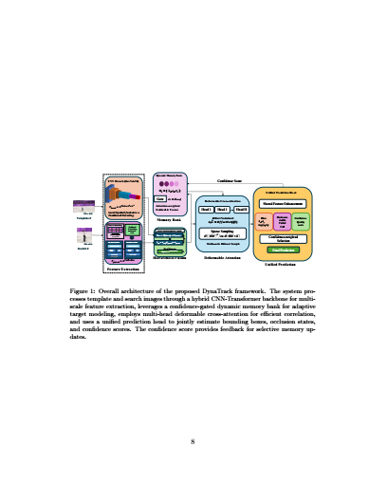
Weekly work progress- paper writing

Slide 6
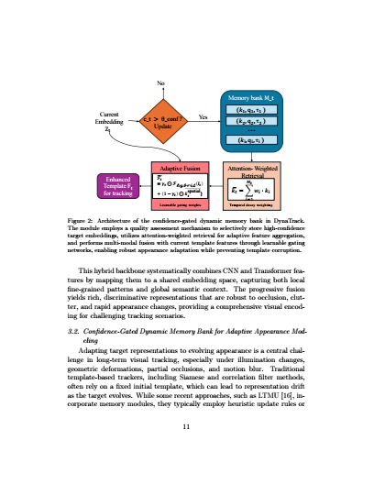
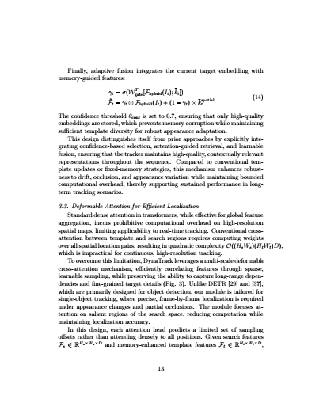
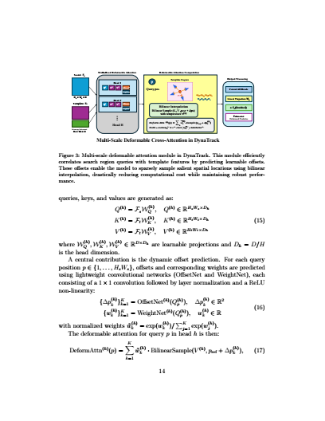
Weekly work progress- paper writing

Slide 7
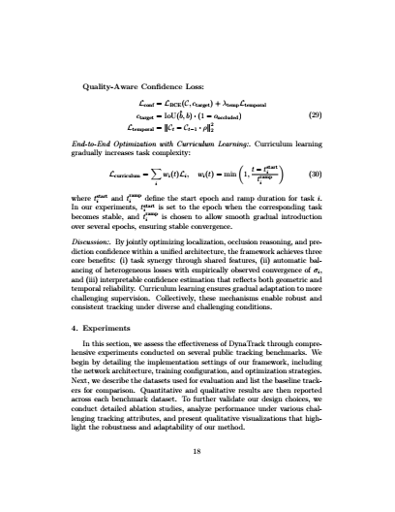
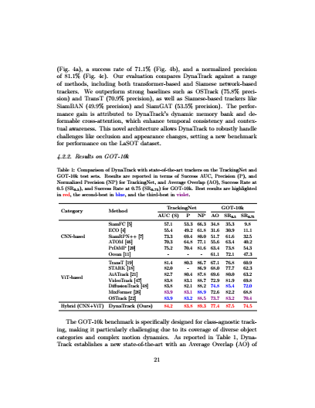
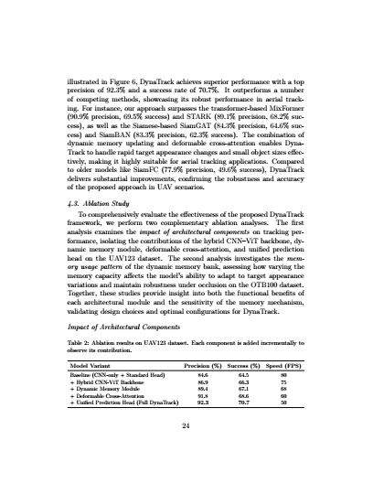
Weekly work progress- paper writing

Slide 8
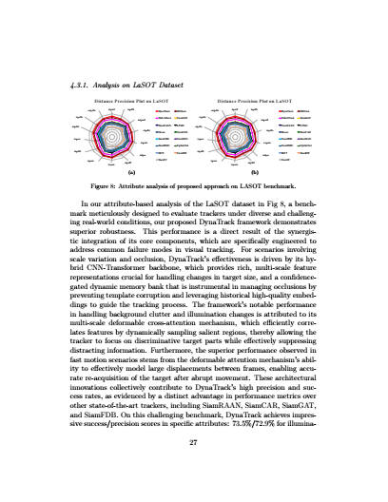
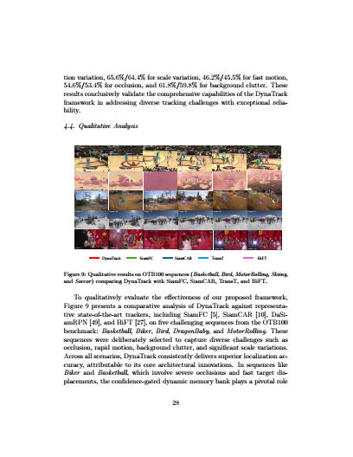
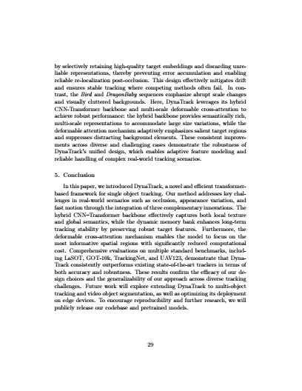
Weekly work progress- paper writing

Slide 9
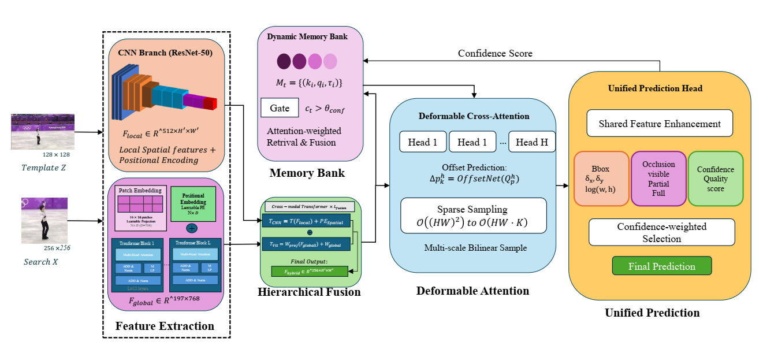
Weekly work progress-overall figure
Overview of the proposed DynaTrack architecture. The model extracts features using a hybrid CNN-Transformer backbone, enhances them via deformable cross-attention, integrates context through a dynamic memory bank, and produces predictions via a unified head for bounding box, occlusion, and confidence estimation.

Slide 10
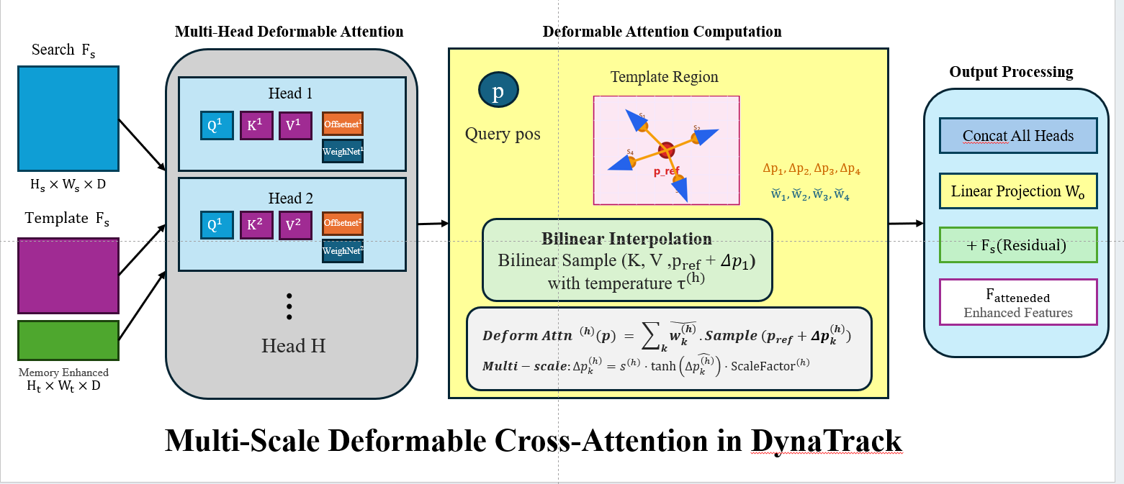
Weekly work progress- Deformable Cross Attention
Schematic illustration of deformable cross-attention in DynoTrack. The queryfeatures from the search region attend to dynamically selected, high-relevance locations inthe template or memory-enhanced feature map via predicted offsets and attention weights.

Slide 11
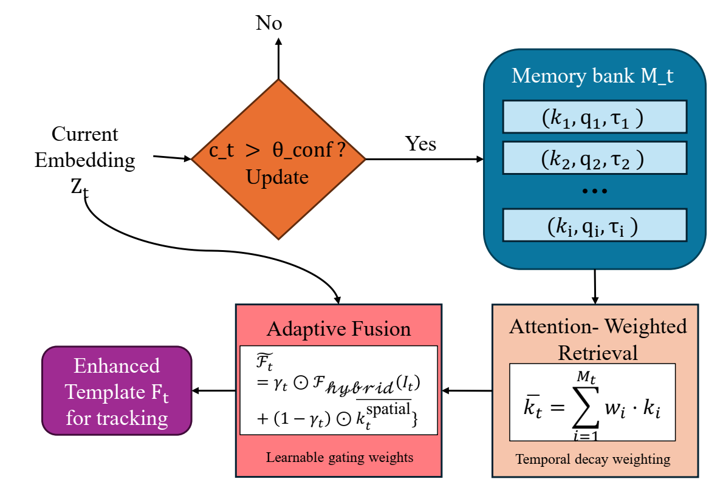
Weekly work progress- Dynamic Memory Bank Module
The figure illustrates the Dynamic Memory Bank Module, where frame embeddings are compared, updated, and fused with stored memory features to enhance robustness against appearance changes during tracking.

Slide 12
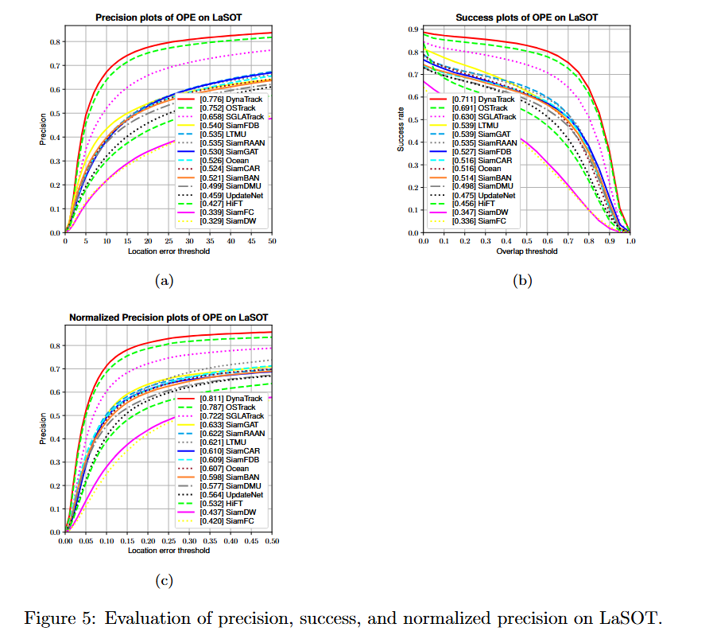
Weekly work progress- Results

Slide 13
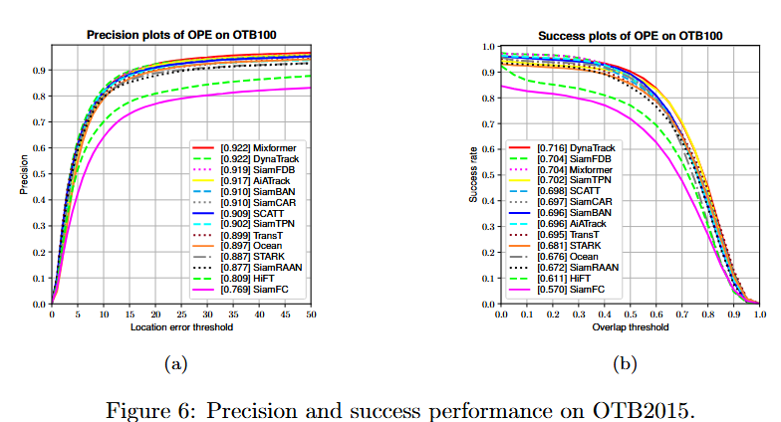
Weekly work progress- Results

Slide 14
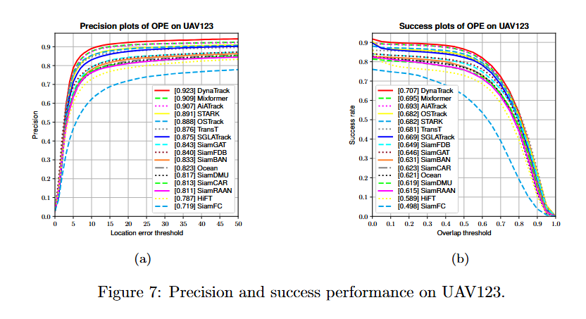
Weekly work progress- Results

Slide 15









Weekly work progress
Hybrid CNN-Transformer Backbone
Dynamic Memory Bank
Feature Extraction
Memory Bank Initialisation
Feature map flatening
Memory update after threshold
Transformer encoder
Deformable attention
Losses
Overall loss

Slide 16
Weekly work progress – proposed approach
Key Components:
Hybrid CNN-ViT Backbone:
DynaTrack utilizes a hybrid backbone combining convolutional neural networks (CNNs) and Vision Transformers (ViT) to extract rich multi-scale spatial and contextual features from both the initial template frame and subsequent search frames. This fusion improves the model's ability to represent complex target appearance and background context.
Dynamic Memory Bank:
Unlike traditional Siamese trackers that rely only on a fixed template, DynaTrack maintains a dynamic memory bank that stores multiple past feature embeddings of the target. This allows the tracker to adaptively reference diverse historical appearances, enhancing robustness to occlusion, deformation, and viewpoint changes.
Deformable Cross-Attention Module:
The transformer-based cross-attention module fuses features from the template memory bank and the search region, dynamically attending to spatially relevant regions. The deformable attention mechanism efficiently focuses on key locations, improving tracking precision without excessive computational cost.
Unified Prediction Head:
The model outputs bounding box coordinates, occlusion confidence, and tracking confidence scores via a unified prediction head. This joint modeling facilitates simultaneous localization and quality estimation, which helps suppress false positives and improves the reliability of the tracker.

Slide 17
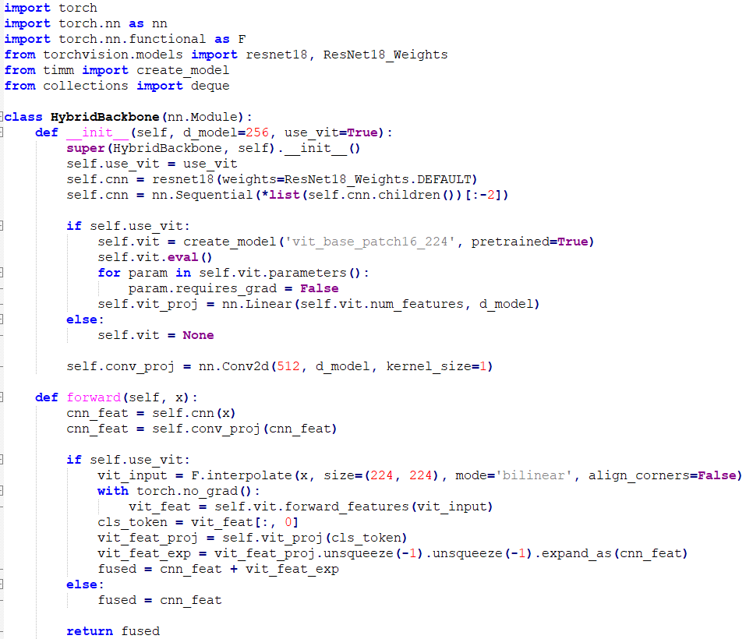
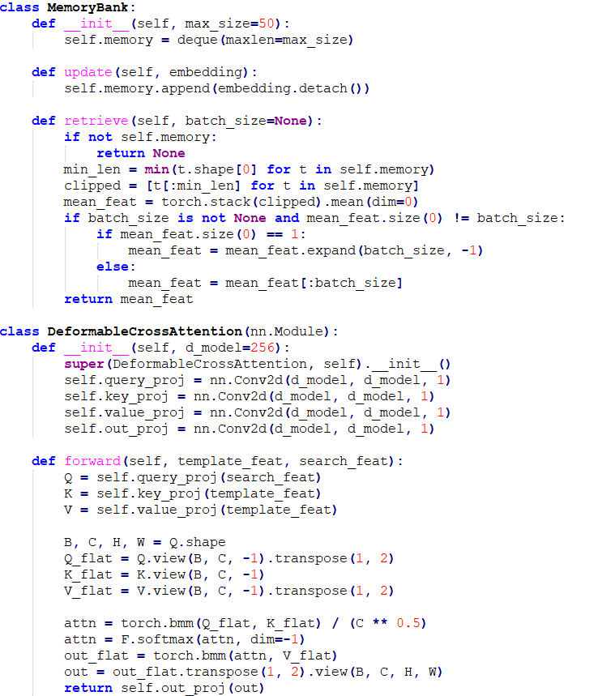
Weekly work progress-coding part
Hybrid backbone
Dynamic memory & deformable cross attention

Slide 18
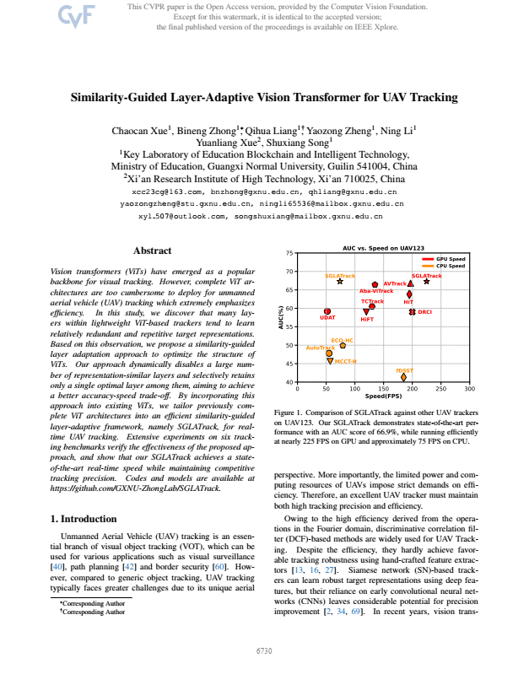
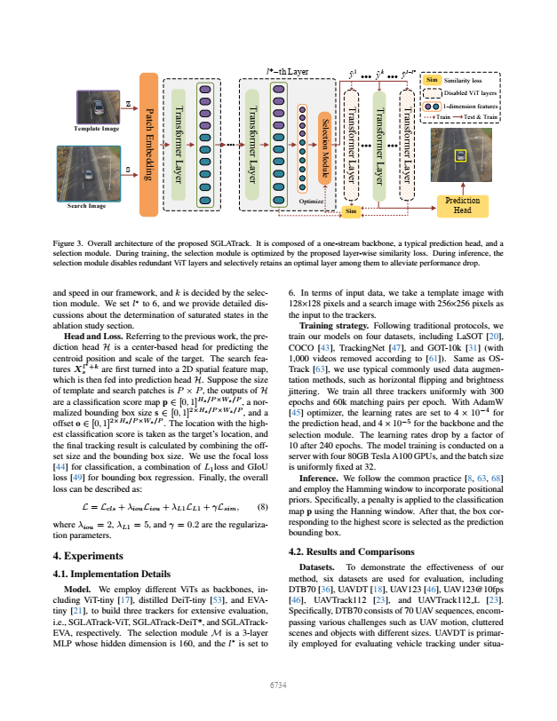
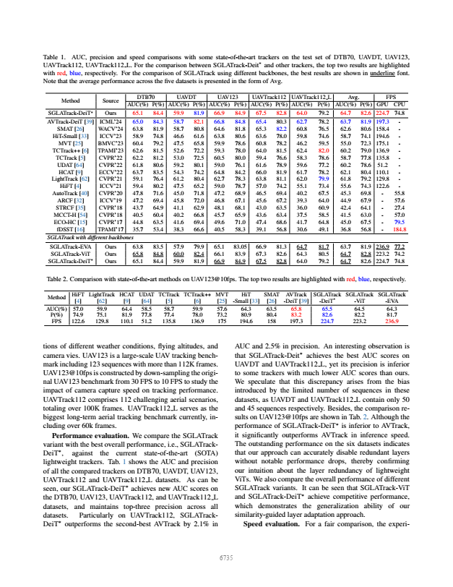
Weekly work progress-literature review

Slide 19
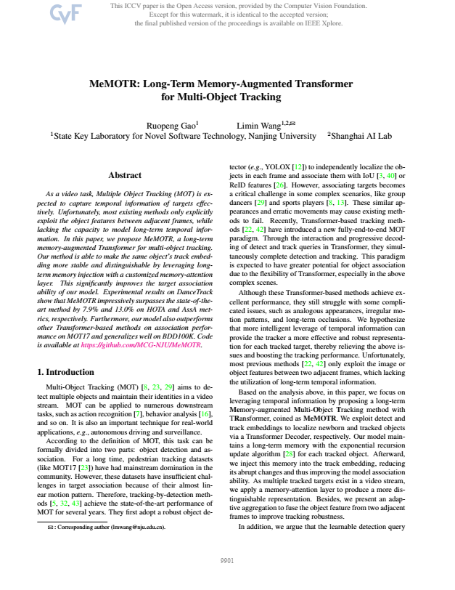
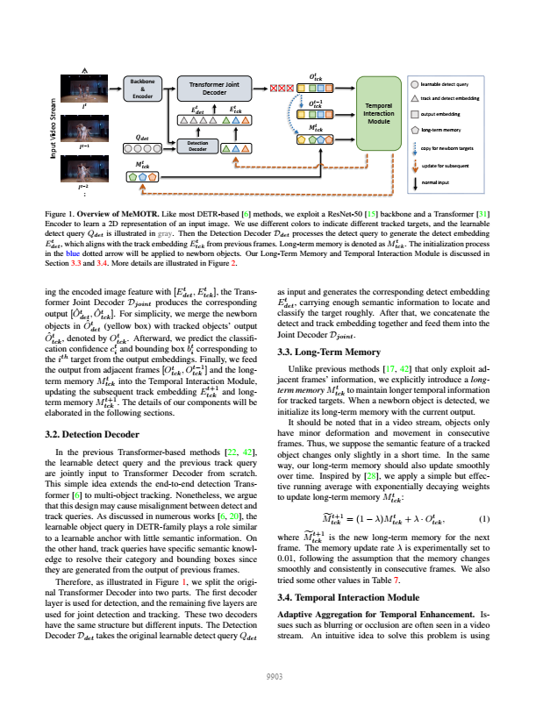
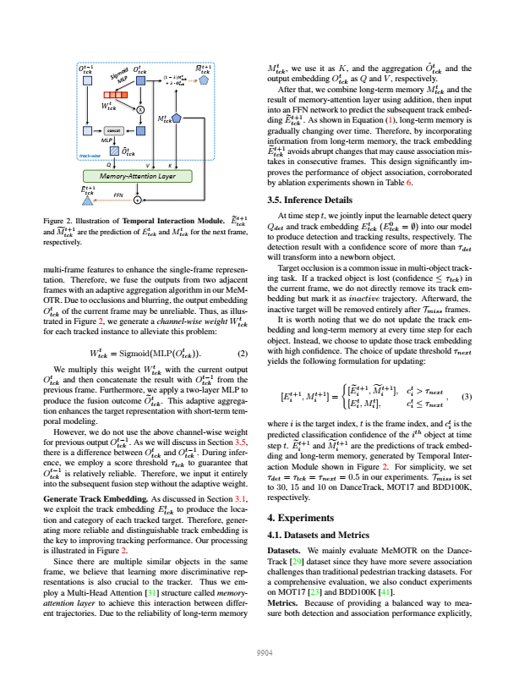
Weekly work progress-literature review

Slide 20
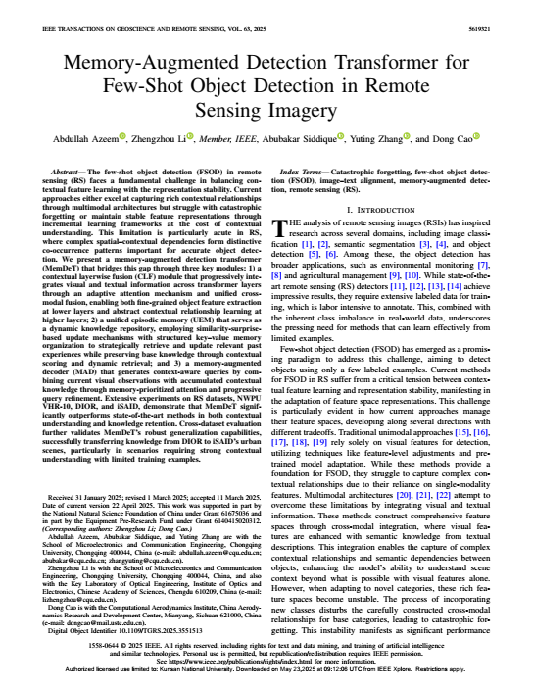
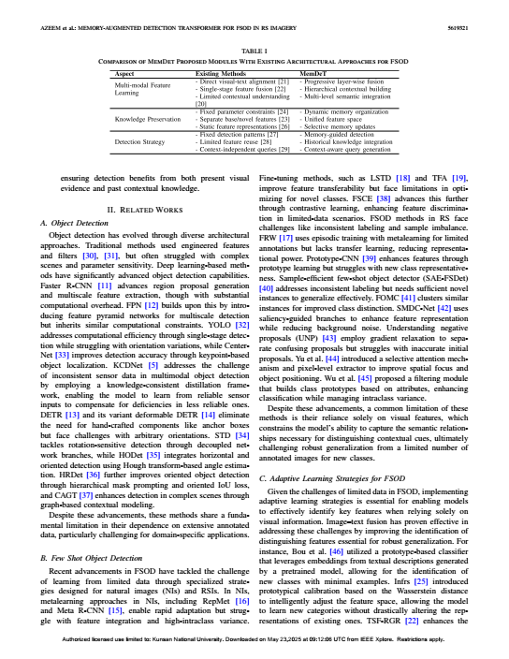
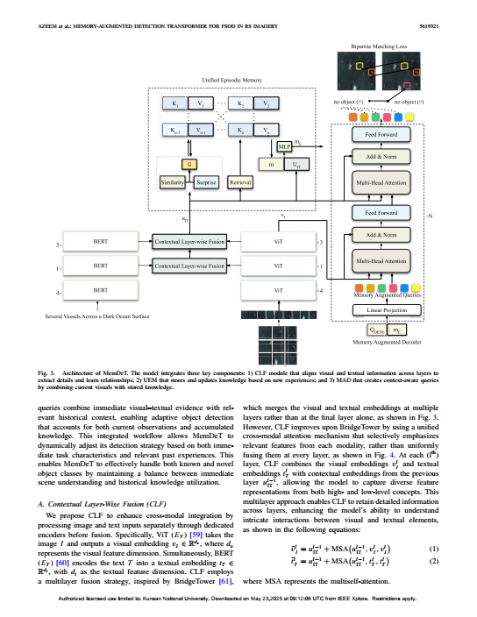
Weekly work progress-literature review

Slide 21
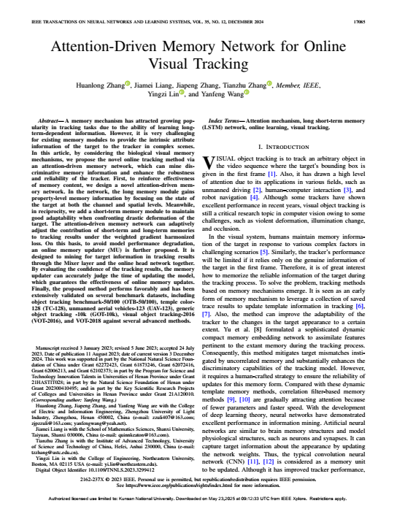
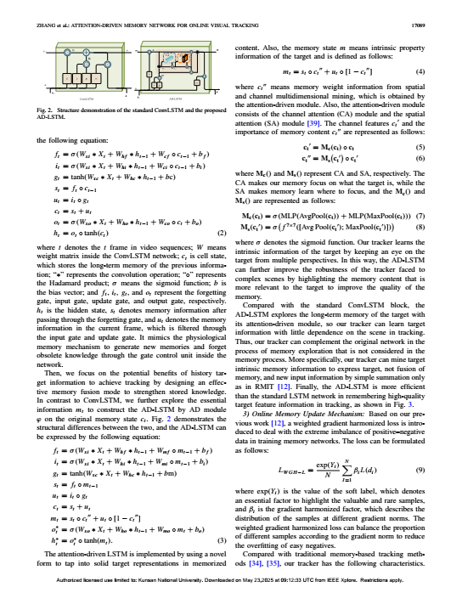
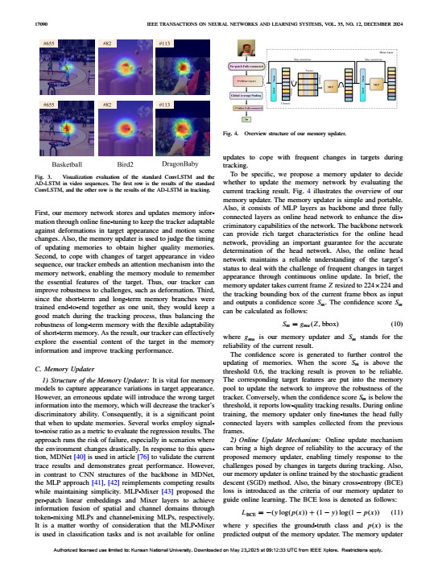
Weekly work progress-literature review

Slide 22
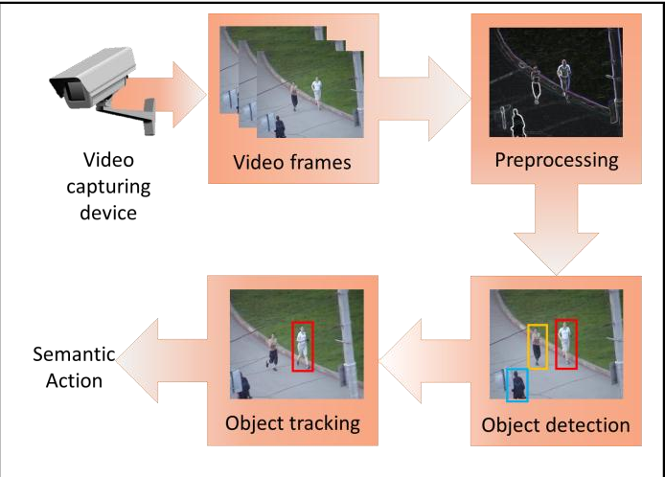
Research Background
Visual object tracking (VOT) is an important research topic in the field of computer vision, which is used in numerous applications, such as surveillance, human-machine interaction, robotics, etc,
Object tracking can be defined as the process of segmenting an object of interest from a video scene and keeping track of its motion, orientation and occlusion to extract useful information.

Slide 23
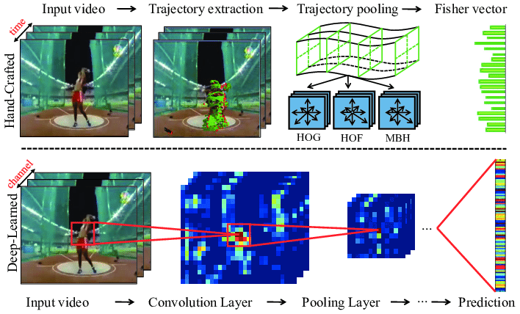
Features in visual object tracking
Features play an important role in the performance of a tracker.
Features are parts or patterns of an object in an image that help to identify it.
There are two broad categories of the features used by the tracking algorithms,
  Hand Crafted (HC) and
  Deep features.
HC features Histogram of Oriented Gradients (HOG), Scale-Invariant Feature Transform (SIFT), Local Binary Pattern(LBP), and color names(CN) | Deep feature extraction methods Recurrent Neural Networks (RNN), Convolutional Neural Networks (CNN), Residual Networks, and Auto-encoders. Deep Features ResNet, ImageNet, VGGNet

Slide 24
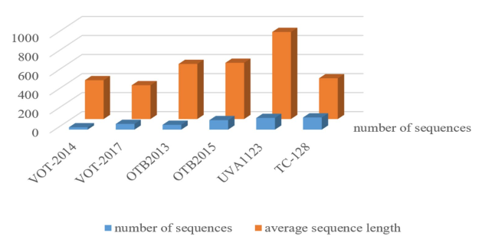
Experiment and analysis
-Datasets
Datasets are visual tracking benchmarks that are widely used to evaluate the performance of a visual tracking algorithm.
In single object tracking, there are many types of datasets. Among them, the most authoritative and widely used are VOT and OTB datasets.
Some of famous datasets are
Object Tracking Benchmark
Temple Color
Unmanned Aerial Vehicle
Visual Object Tracking
LASOT
TrackingNet
GOT
Fig. Comparison of the overall situation of each data set

Slide 25
Study Objective
The main purpose of object detection is to identify and locate one or more effective targets from still image or video data.
It comprehensively includes a variety of important techniques, such as image processing, pattern recognition, artificial intelligence and machine learning.
It has broad application prospects in such areas such as road traffic accident prevention, warnings of dangerous goods in factories, military restricted area monitoring and advanced human–computer interaction.
Numerous approaches have been proposed to solve this problem, mainly inspired by methods of computer vision and deep learning.

Slide 26
RESEARCH SCHEDULE
TIMELINE | May | June | July | Aug
Task
Literature Review
Regeneration Existing Work
Idea Generation and problem Formulation
Implementation (Coding)
Experimental Evaluation
Paper Writing

Slide 27
Status of Papers
S.No | Authors | Paper Title | Journal | Status
1. | Sachin Sakthi K S, Jae Hoon Jeong, Woo Young Cho. | Transformer-Augmented Dual-Branch Siamese Network with Adaptive Template Updating for Quality-Aware Visual Object Tracking | Multimedia Systems | Under Review
2. | Sachin Sakthi K S, Jae Hoon Jeong, Woo Young Cho. | DynaTrack: Dynamic Memory-Augmented Transformer for Robust Single Object Tracking | Information Fusion | -

Slide 28
REFERENCES
Yang, K., Li, Q., Tian, C., Zhang, H., Shi, A., & Li, J. (2024). DeforT: Deformable transformer for visual tracking. Neural Networks, 176, 106380.
Gao, R., & Wang, L. (2023). MeMOTR: Long-term memory-augmented transformer for multi-object tracking. In Proceedings of the IEEE/CVF International Conference on Computer Vision (pp. 9901-9910).
Chen, X., Yan, B., Zhu, J., Wang, D., Yang, X., & Lu, H. (2021). Transformer tracking. In Proceedings of the IEEE/CVF conference on computer vision and pattern recognition (pp. 8126-8135).
Lin, L., Fan, H., Zhang, Z., Xu, Y., & Ling, H. (2022). Swintrack: A simple and strong baseline for transformer tracking. Advances in Neural Information Processing Systems, 35, 16743-16754.
Ma, F., Shou, M. Z., Zhu, L., Fan, H., Xu, Y., Yang, Y., & Yan, Z. (2022). Unified transformer tracker for object tracking. In Proceedings of the IEEE/CVF conference on computer vision and pattern recognition (pp. 8781-8790).
Gao, S., Zhou, C., & Zhang, J. (2023). Generalized relation modeling for transformer tracking. In Proceedings of the IEEE/CVF conference on computer vision and pattern recognition (pp. 18686-18695).
Chen, X., Yan, B., Zhu, J., Lu, H., Ruan, X., & Wang, D. (2022). High-performance transformer tracking. IEEE Transactions on Pattern Analysis and Machine Intelligence, 45(7), 8507-8523.

Slide 29
Thank You

