Slide 1

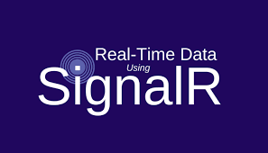
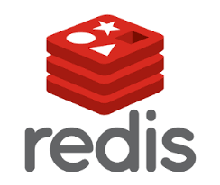
Asp.net signalr / REDIS
Gianpiero Rosanò
Introduction and basic concepts

Slide 2
Agenda
Gianpiero Rosanò
SignalR
Notions
Architecture
Transport Techniques
Connection Types
Scale-out SignalR
Redis
Demo

Slide 3



About ME
Gianpiero Rosanò
Gianpiero Rosanò
Software developer @ objectway
https://it.linkedin.com/in/rosanogianpiero
https://github.com/gianpierorosano

Slide 4
Asp.net signalr
Gianpiero Rosanò
ASP.NET SignalR is a new library for ASP.NET developers that makes developing real-time web functionality easy.
SignalR allows bi-directional communication between server and client. Servers can now push content to connected clients instantly as it becomes available.
SignalR supports Web Sockets, and falls back to other compatible techniques for older browsers. SignalR includes APIs for connection management (for instance, connect and disconnect events), grouping connections, and authorization.

Slide 5
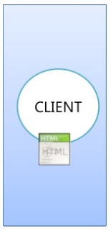
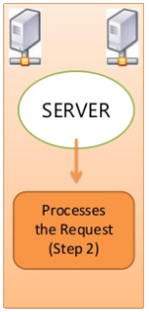
TRADITIONAL APPROACH
Gianpiero Rosanò
Sends a Request to the server (Step 1)
Response sent back to the client (Step 3)

Slide 6
REAL-TIME APPROACH
Gianpiero Rosanò
Sends a Request to the server
Creates a connection between them
Responses sent back to the client

Slide 7
Transport Techniques
Gianpiero Rosanò
WebSockets
HTML5 transport technique that works on top of TCP protocol
(Supported only on latest browsers)
Server-sent events
Uses Javascript API ‘EventSource’ and requires a single connection between Client-Server
(Server to client direction only / Not work in IE)
Forever Frame
Internally creates an IFrame with a script to fetch the data
(IFrames are loaded again and again)
Long Polling
The client sends a request for data at regular intervals
(Increase data traffic on the network)

Slide 8
Connection Types
Gianpiero Rosanò
Persistent Connections
Provides a raw / low level control
Events driven ( ‘Connect’, ‘Disconnect’, ‘Reconnect’ )
We can write our own logic in these events
Hubs
Provides a high-level API
Server calling clients / clients calling server
Broadcasting messages to all connected clients
Works in a similar way like a C# controller

Slide 9
Scale-Out Signalr
Gianpiero Rosanò
How do messages from one server get to the other servers in my web farm ?
?
Server A
Server B
Client
. . . . .
Client
Client
. . . . .
Client
Scale-Out is the ability to increase capacity by connecting multiple hardware or software entities so that they work as a single logical unit.

Slide 10
Scale-Out Signalr
Gianpiero Rosanò
SQL Server, Redis and Windows Azure Service Bus
Great for the server broadcast
Every message goes to every server, so as traffic increased you are limited by how fast any one web server can pull message off the backplane
BackPlane
Server A
Server B
Client
. . . . .
Client
Client
. . . . .
Client

Slide 11
REDIS
Gianpiero Rosanò
Redis is an open in-memory data structure store, used as database, cache and message broker.
It supports data structures such as strings, hashes, lists, sets, etc.
Redis has built-in replication, transactions and different levels of on-disk persistence

Slide 12
DEMO
Gianpiero Rosanò

Slide 13
References
Gianpiero Rosanò
Asp.Net SignalR : https://www.asp.net/signalr
Redis : http://redis.io
Materials
All material relating to this session is available on :
https://github.com/gianpierorosano/SignalRDemo.git

Slide 14
Gianpiero Rosanò
Thanks for Listening !!!

