Slide 1
Oscar’s best movie awarded directors by gender
Goya’s best movie awarded directors by gender
vs
Gian Romano

Slide 2

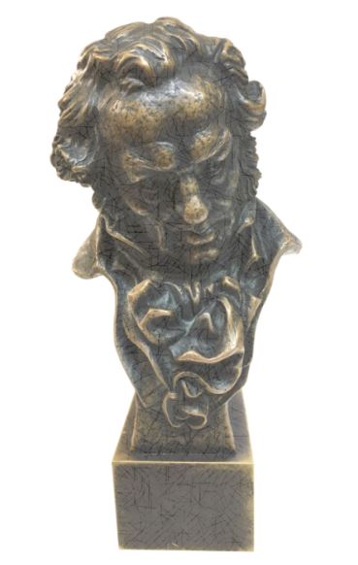
Best Movie Award -Director
Oscar Awards
Goya Awards
96 editions
38 editions

Slide 3
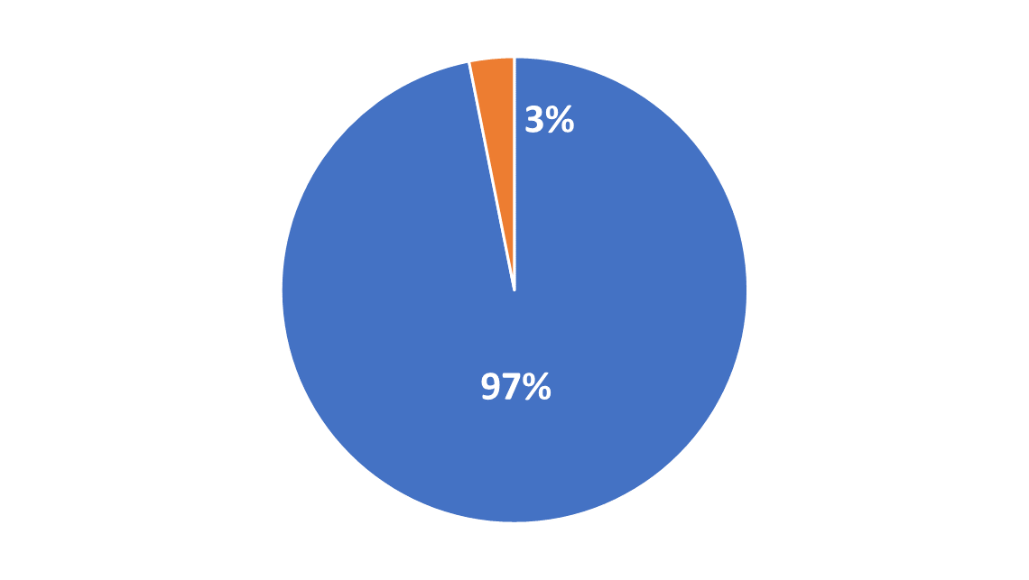
Oscar Awards (96 editions):
Male : 93
Female : 3

Slide 4
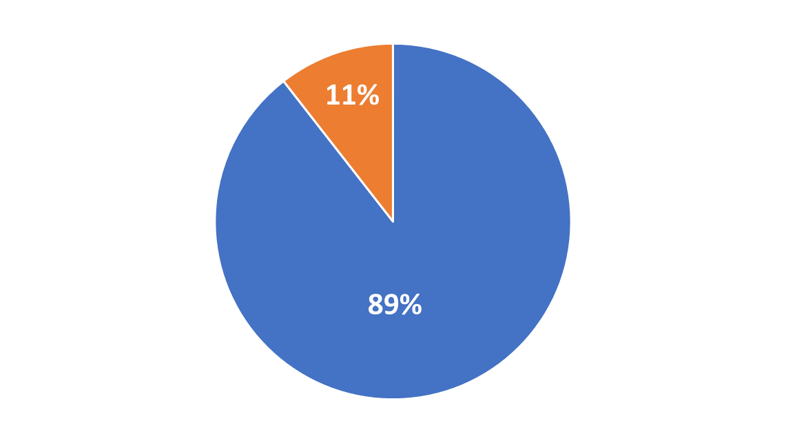
Goya Awards (38 editions):
Male : 34
Female: 4

Slide 5
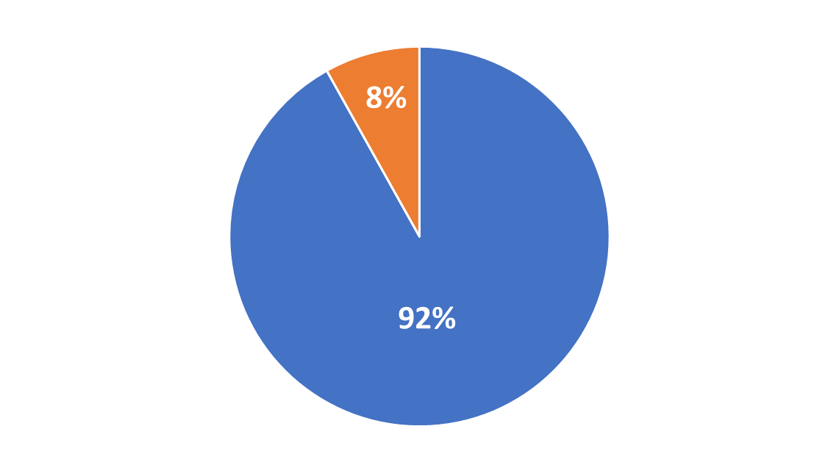
Last 38 Oscar editions
ALL 38 GOYA editions
Male : 35
Female : 3
Male : 34
Female : 4

Slide 6
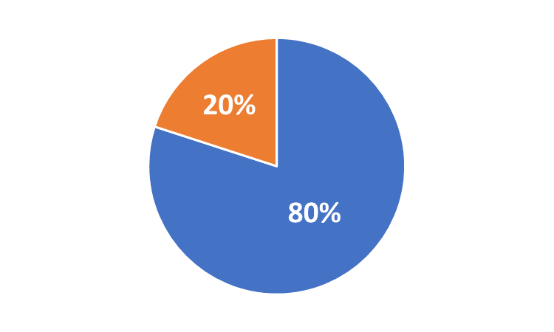
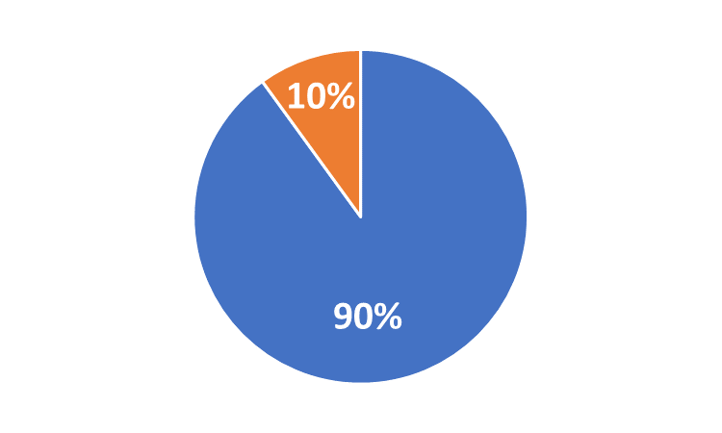
The last 10 years of both awards:
Oscar Awards
Goya Awards
Male : 8
Female : 2
Male : 9
Female : 1

Slide 7
Conclusions:
The film industry is still a man's world, but we see the evidence that these last years women are conquering more space.

