Slide 1

Improve Your App Ratings Using Machine Learning
(つ◕౪◕)つ━☆ﾟ.*･｡ﾟ
Gianluca Segato
founder & lead Android dev @ Uniwhere

Slide 2
Agenda
stuff we’re going to talk about

Slide 3
Agenda
Context – What you should expect
Stuff you’ll need
Problem – What are we addressing?
Workflow
High level solution – The architecture

Slide 4
Agenda
Let’s code!
Android
Python
Conclusions & Q&A

Slide 5
What you should expect
How to deploy a ML system in the context of mobile application infrastructure (client-backend)
An insight on how Firebase can partly get rid of a backend
What you shouldn’t expect
A production-level deliverable: more like a MVP
An academic-level Machine Learning implementation -> for that there’s a 2-year Master’s Degree in Statistics

Slide 6
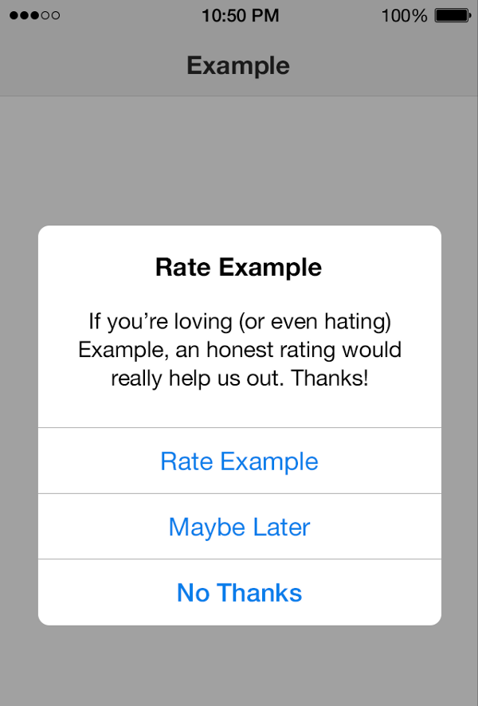
Do you want to rate my app?
Prompted after:
5 days of usage OR
12 app openings OR
5 days and 12 app openings
Never know when/to whom you should!
I would like to ask only those people that I know are more likely to say yes.

Slide 7
In Uniwhere
80,000 users, 30% iOS, 65% Android, 5% WP
Audience: University students
Given that:
Bad reviews happen because of issues
Good reviews must be asked… otherwise people forget about it
We wanted to improve our ratings by asking the right people at the right moment for a review

Slide 8
The problem
Whom should I ask for a review?
When should I ask for a review?
CLASSIFICATION PROBLEM

Slide 9
Machine Learning
Supervised learning: using labeled data, trying to predict values
Regression: real output (ie. a price)
Classification: predict categorical data (ie. 0 or 1)

Slide 10
Output
What are we going to build?

Slide 11
Is this going to work?
For Uniwhere, after 2 weeks in production: 88% accuracy
The results were outstanding!
Timing has little to no impact
Usage features have a lot instead!
And also does user profile data!

Slide 12
Feature Informativeness

Slide 13
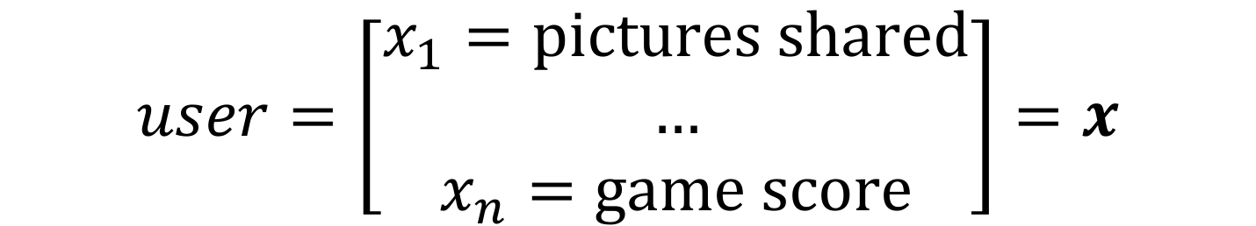
Formalization
We want to predict in advance whether a user will say yes to the question, based on his/her behavior and characteristics
$$function\left(user\right)=𝒫\left(user says yes \right| user, time)$$
$$user=\left[\begin{aligned}x_{1}=pictures shared \\ … \\ x_{n}=game score\end{aligned}\right]=x$$

Slide 14

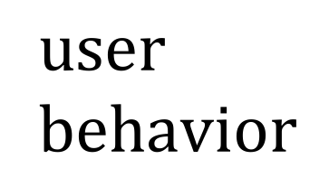
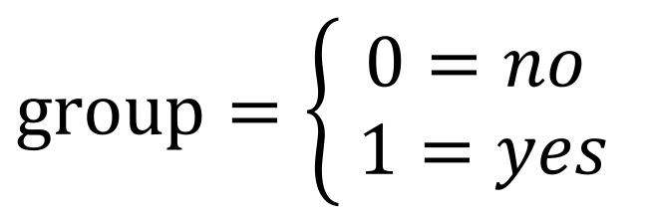
Classification Algorithms
Logistic Regression
SVM
Vanilla Neural Network
$$user \\ behavior$$
$$group=\left\{\begin{aligned}0=no \\ 1=yes\end{aligned}\right.$$

Slide 15
Workflow
Gather data
Pre-process
Features engineering
Training and evaluation
Deploy

Slide 16
A Two-Stage Process
First stage: Model training
gather data
build the model upon it
Second stage: Deployment of prediction model
deploy the model
adapt online (retraining at each step)

Slide 17
The System
architecture and stuff

Slide 18
Firebase
Store and sync data in real time
Both a:
storage layer
communication layer
NoSQL approach: you represent data as nodes, without tables -> JSON
Free up to a (high) point, and scalable

Slide 19
First Stage
Training

Slide 20
First Stage: Model Building
gather features from users
label data
TIME
user 1
y1 | user 1, timing 1
user 2
y2 | user 2, timing 2
user 3
y3 | user 3, timing 3

Slide 21


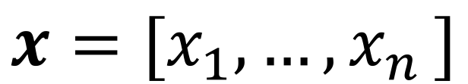

First Stage: Model Training
$$x=[x_{1},{…,x}_{n}]$$
$$y$$
(at a certain point)

Slide 22
Model Building
writes features on {userId}/x_...
observes RemoteConfig label_data
if label_data == true, writes on
{userId}/y_observed

Slide 23
Second Step
Deployed prediction model

Slide 24
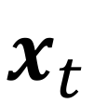
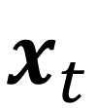
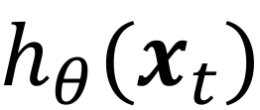
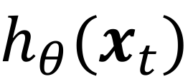

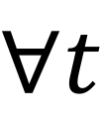
Architecture
$$x_{t}$$
$$x_{t}$$
$$∀t$$
$$h_{θ}(x_{t})$$
$$h_{θ}(x_{t})$$
$${when h}_{θ}\left(x_{t}\right)>threshold, ask$$
Notes:
Explain better the time component
Make the graphical representation better -> circle
Initial arrow: initial model

Slide 25


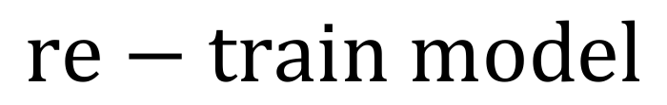
Online Prediction and Re-training
$$y$$
$$y$$
$$re−train model$$
Notes:
Updating the model with retraining

Slide 26
Implementation

Slide 27
Final System: Client Side
writes features on {userId}/x_...
observes {userId}/action
so that if action == 1 => ask

Slide 28
Final System: Backend Side
observes {userId}/x_...
in order to update {userId}/y_prediction and {userId}/action
observes {userId}/y_observed
in order to update the model

Slide 29
Final System: Recap
sends x_...
observes x_...
updates y_pred and action
observes action
observes y_obs
if 1, prompts & updates y_obs
updates the model

Slide 30
Stuff you’ll need
Starting App Rep:
http://bit.ly/gdg-android
Python backend Rep:
http://bit.ly/gdg-android-backend
https://pip.pypa.io/
pip install -r requirements.txt

Slide 31
Reference Slides

Slide 32
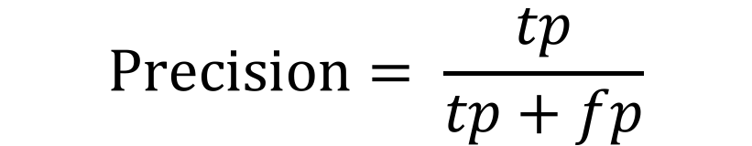

Issue: Precision and Recall
If we take no action when y_prediction < threshold, then the system will never correct the model in case of false negatives (Type II error)
In other words, the model update itself overtime just maximizing the precision by minimizing false positives (Type I errors), without touching the recall
$$Precision= \frac{tp}{tp+fp}$$
$$Recall= \frac{tp}{tp+fn}$$

Slide 33
Formalization

Slide 34
Sigmoid Function
$$h\left(z\right)=\frac{1}{1+e^{−z}}, z=θ^{T}x$$

Slide 35
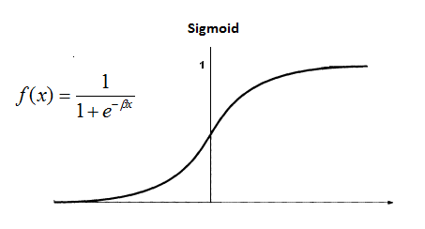
Sigmoid Function

Slide 36

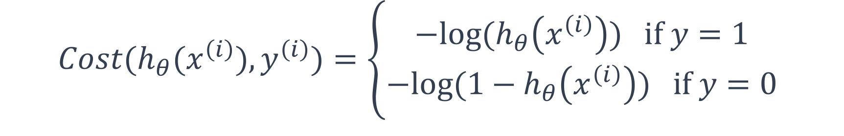
Sigmoid Function
$$J\left(θ\right)=\frac{1}{2m} \sum_{i=1}^{m}{{Cost(h}_{θ}(x^{\left(i\right)}),y^{(i)})}$$
$${Cost(h}_{θ}(x^{\left(i\right)}),y^{\left(i\right)})=\left\{\begin{aligned}−log⁡(h_{θ}\left(x^{\left(i\right)}\right)) if y=1 \\ −log⁡(1−h_{θ}\left(x^{\left(i\right)}\right)) if y=0\end{aligned}\right.$$

Slide 37
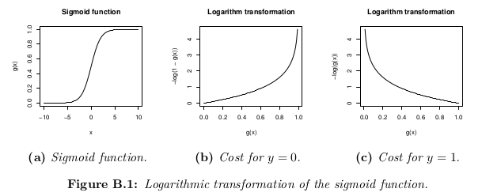

Slide 38
Firebase
It was:
Now:

