Slide 1
Local Sensitivity Analysis: Sensitivity Equations, Finite Differences and Complex-step Method
Ben Randall

Slide 2
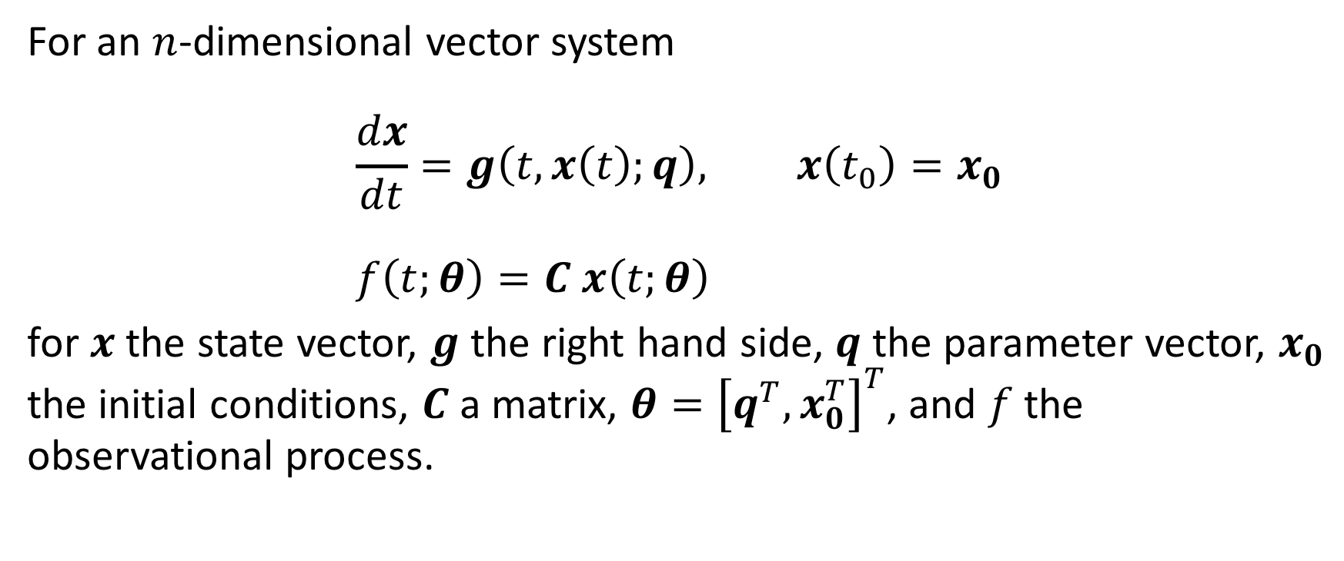
Local Sensitivity Analysis
For an $n$-dimensional vector system $$\frac{dx}{dt}=g\left(t,x\left(t\right);q\right), x\left(t_{0}\right)=x_{0} \\ f\left(t;θ\right)=C x\left(t;θ\right)$$
for $x$ the state vector, $g$ the right hand side, $q$ the parameter vector, $x_{0}$ the initial conditions, $C$ a matrix, $θ={\left[q^{T},x_{0}^{T}\right]}^{T}$, and $f$ the observational process.

Slide 3
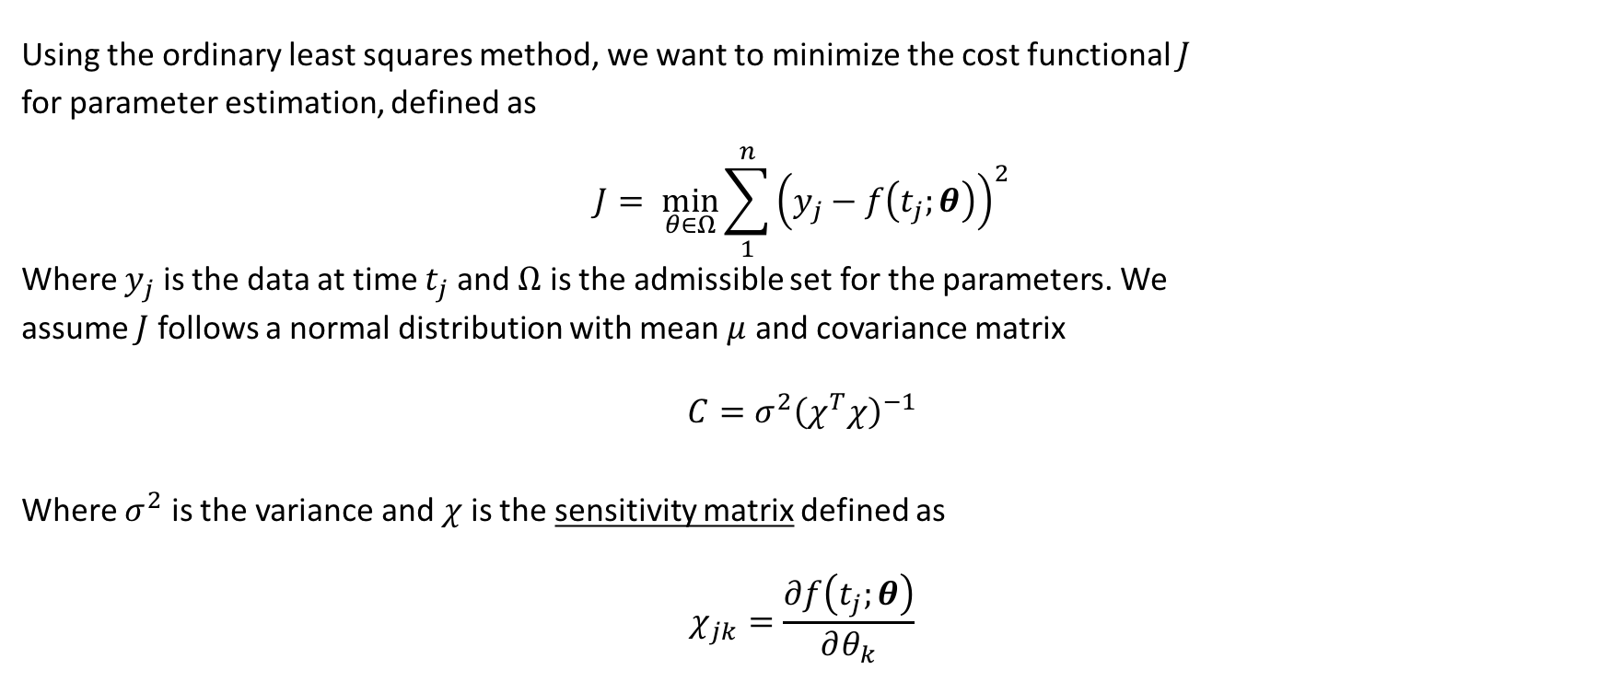
Local Sensitivity Analysis
Using the ordinary least squares method, we want to minimize the cost functional $J$
for parameter estimation, defined as
$$J= \min_{θ∈Ω}{\sum_{1}^{n}{{\left(y_{j}−f\left(t_{j};θ\right)\right)}^{2}}}$$
Where $y_{j}$ is the data at time $t_{j}$ and $Ω$ is the admissible set for the parameters. We
assume $J$ follows a normal distribution with mean $μ$ and covariance matrix
$$C=σ^{2}{\left(χ^{T}χ\right)}^{−1}$$
Where $σ^{2}$ is the variance and $χ$ is the sensitivity matrix defined as
$$χ_{jk}=\frac{∂f\left(t_{j};θ\right)}{∂θ_{k}}$$

Slide 4

Local Sensitivity Analysis
GOAL:
Compute the sensitivity matrix
$$χ_{jk}=\frac{∂f\left(t_{j};θ\right)}{∂θ_{k}}$$
as efficiently and accurately as possible

Slide 5
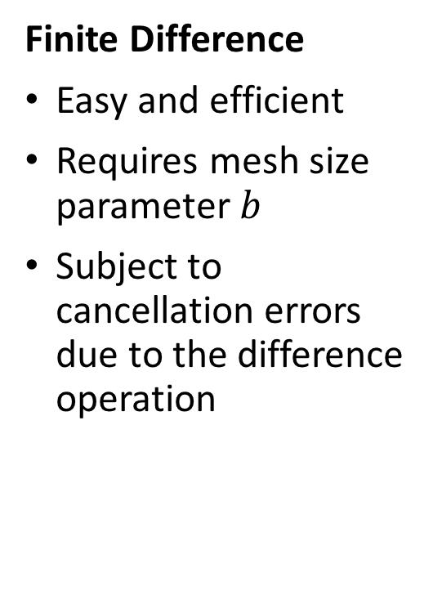
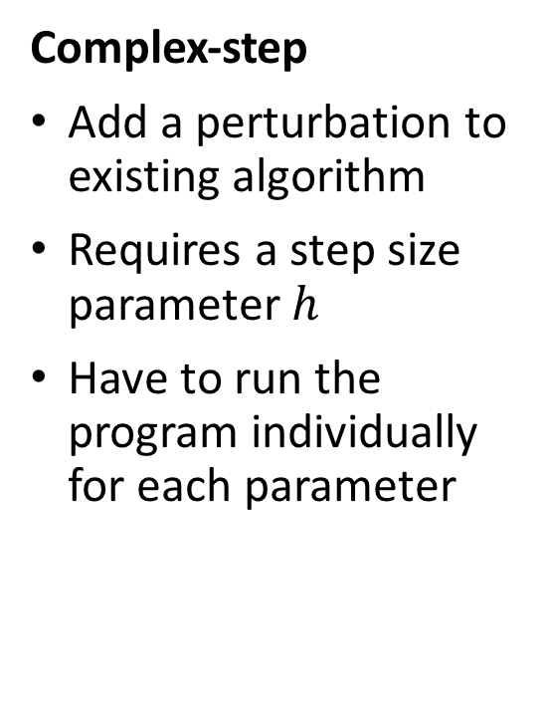
Comparison of Methods
Finite Difference
Easy and efficient
Requires mesh size parameter $b$
Subject to cancellation errors due to the difference operation
Sensitivity Equations
Accurate and computationally inexpensive for reasonably small problems
Have to solve a new set of equations for every problem
No step size parameter
Complex-step
Add a perturbation to existing algorithm
Requires a step size parameter $h$
Have to run the program individually for each parameter
Notes:
add forward and central differences
first and second order accurate
can cancel out certain things

Slide 6
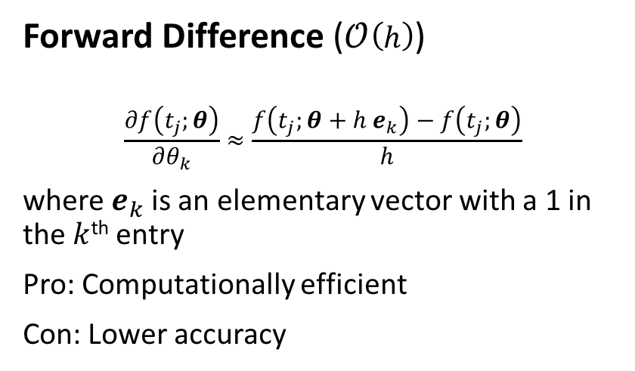


Finite Difference
Approximate a partial derivative of the observable function as a first-order approximation
We compute the directional derivative in the in the direction of the $k$^{th} parameter
Forward Difference ($𝒪\left(h\right)$)
$$\frac{∂f\left(t_{j};θ\right)}{∂θ_{k}}≈\frac{f\left(t_{j};θ+h e_{k}\right)−f\left(t_{j};θ\right)}{h}$$
where $e_{k}$ is an elementary vector with a 1 in the $k$^{th} entry
Pro: Computationally efficient
Con: Lower accuracy
Central Difference ($𝒪(h^{2})$)
$$\frac{∂f\left(t_{j};θ\right)}{∂θ_{k}}≈\frac{f\left(t_{j};θ+h e_{k}\right)−f\left(t_{j};θ−he_{k}\right)}{2h}$$
Pro: higher order of accuracy
Con: you may not have information about the past (i.e. if $f_{j}=f\left(t_{j};θ\right)$, you may not have information about $f_{−1}$)

Slide 7
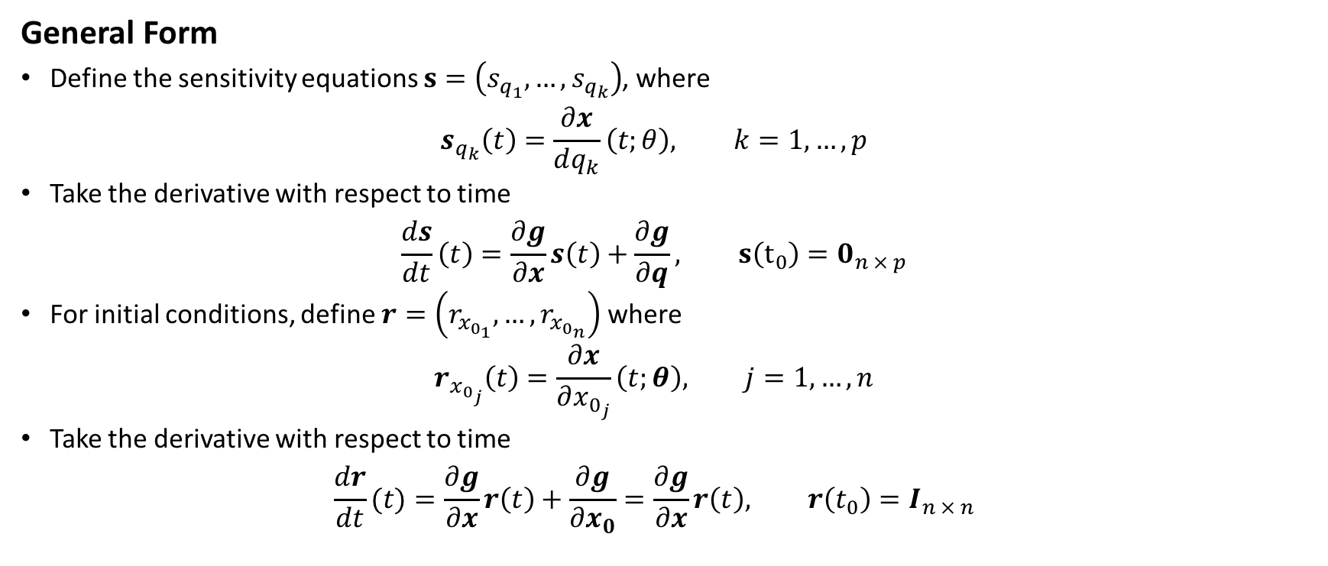
Sensitivity Equations
General Form
Define the sensitivity equations $s=\left(s_{q_{1}},…,s_{q_{k}}\right)$, where $s_{q_{k}}\left(t\right)=\frac{∂x}{dq_{k}}\left(t;θ\right), k=1, …, p$
Take the derivative with respect to time $\frac{ds}{dt}\left(t\right)=\frac{∂g}{∂x}s\left(t\right)+\frac{∂g}{∂q}, s\left(t_{0}\right)=0_{n × p}$
For initial conditions, define $r=\left(r_{x_{0_{1}}}, …, r_{x_{0_{n}}}\right)$ where $r_{x_{0_{j}}}\left(t\right)=\frac{∂x}{∂x_{0_{j}}}\left(t;θ\right), j=1, …, n$
Take the derivative with respect to time $\frac{dr}{dt}(t)=\frac{∂g}{∂x}r\left(t\right)+\frac{∂g}{∂x_{0}}=\frac{∂g}{∂x}r\left(t\right), r\left(t_{0}\right)=I_{n × n}$

Slide 8

Sensitivity Equations
So we then want to solve the new system
$$\frac{dx}{dt}=g\left(t,x\left(t\right);q\right), x\left(t_{0}\right)=x_{0} \\ \frac{ds}{dt}=\frac{∂g}{∂x}\left(t\right)+\frac{∂g}{∂q}, s\left(t_{0}\right)=0_{n × p} \\ \frac{dr}{dt}=\frac{∂g}{∂x}r\left(t\right), r\left(t_{0}\right)=I_{n × n}$$

Slide 9
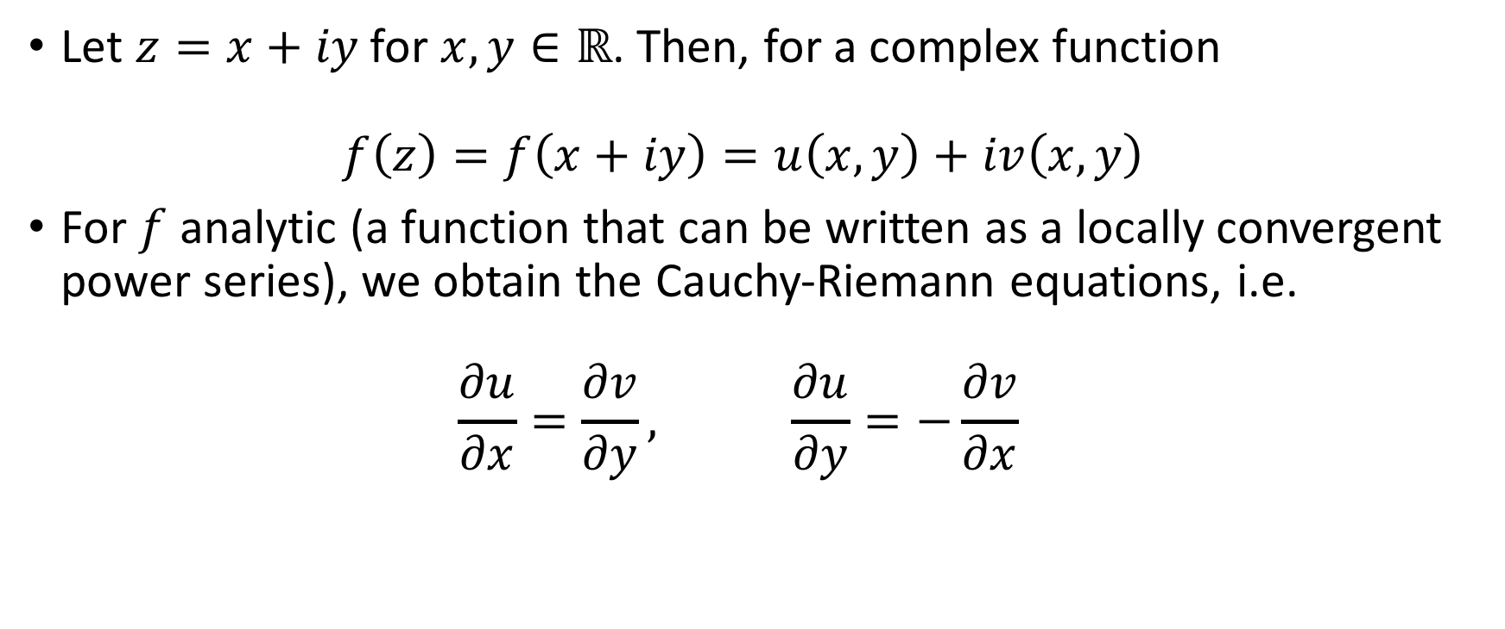
Complex-step Method
Let $z=x+iy$ for $x,y∈ℝ$. Then, for a complex function $f\left(z\right)=f\left(x+iy\right)=u\left(x,y\right)+iv\left(x,y\right)$
For $f$ analytic (a function that can be written as a locally convergent power series), we obtain the Cauchy-Riemann equations, i.e. $\frac{∂u}{∂x}=\frac{∂v}{∂y}, \frac{∂u}{∂y}=−\frac{∂v}{∂x}$

Slide 10
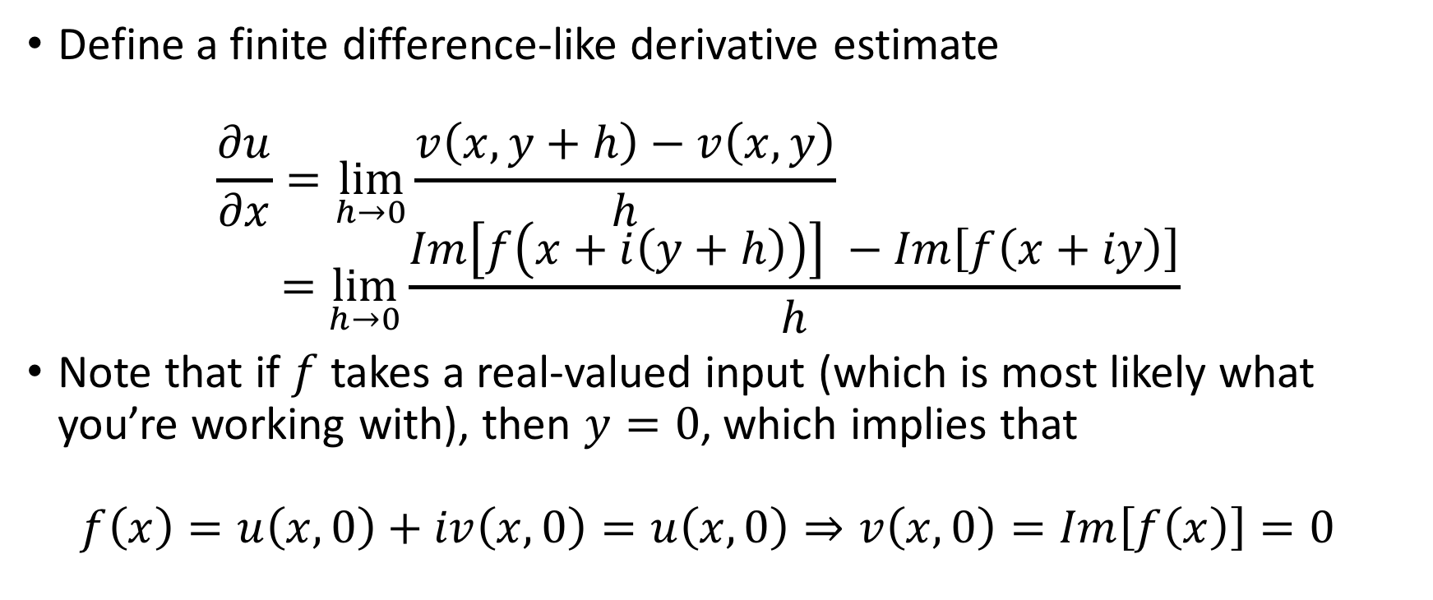
Complex-step Method
Define a finite difference-like derivative estimate $\frac{∂u}{∂x}=\lim_{h→0}{\frac{v\left(x,y+h\right)−v\left(x,y\right)}{h}}$ $=\lim_{h→0}{\frac{Im\left[f\left(x+i\left(y+h\right)\right)\right] −Im\left[f\left(x+iy\right)\right]}{h}}⁡$
Note that if $f$ takes a real-valued input (which is most likely what you’re working with), then $y=0$, which implies that $f\left(x\right)=u\left(x,0\right)+iv\left(x,0\right)=u\left(x,0\right)⇒v\left(x,0\right)=Im\left[f\left(x\right)\right]=0$

Slide 11
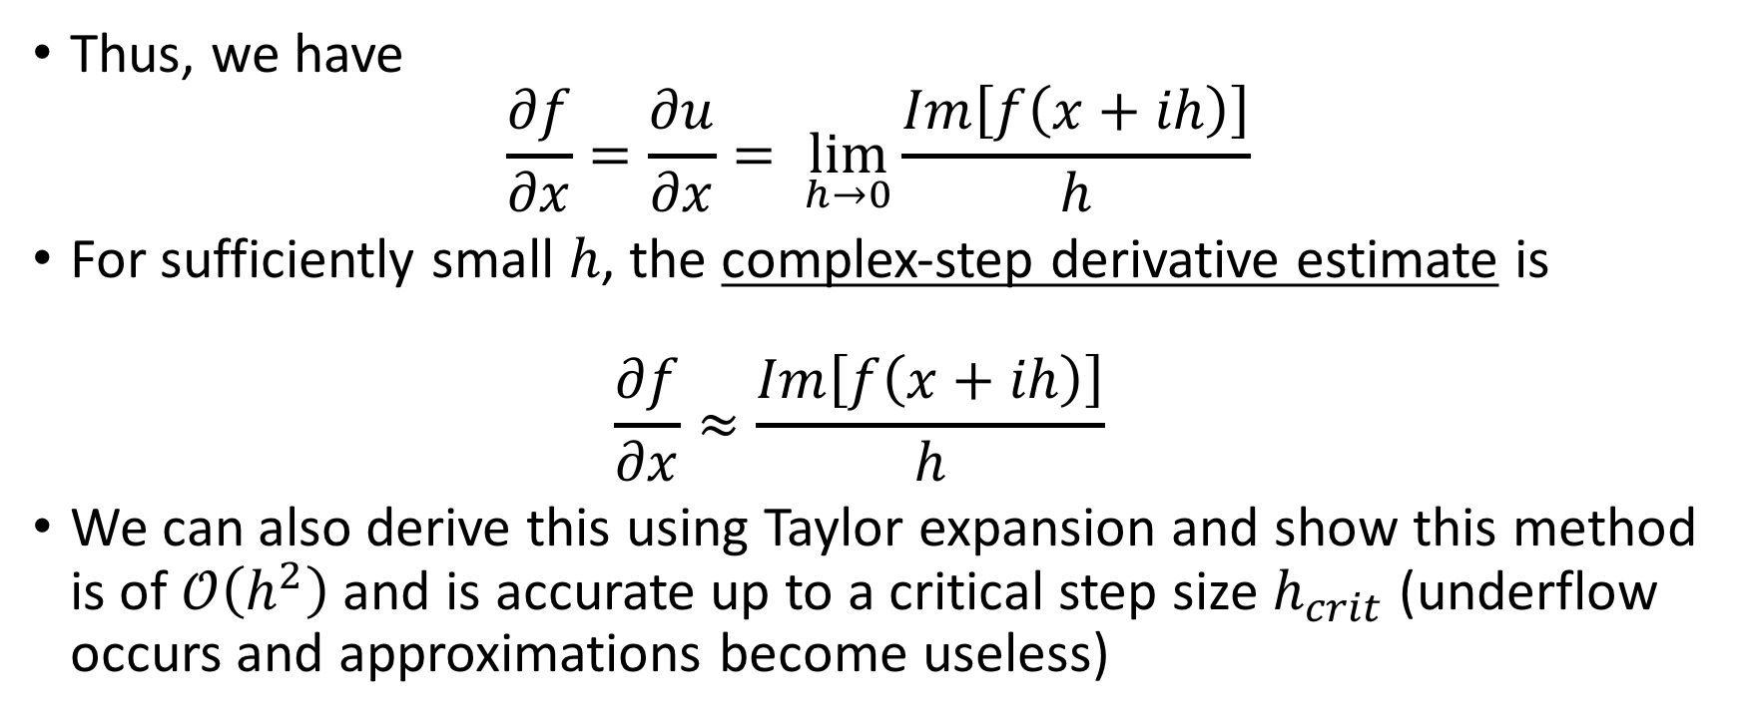
Complex-step Method
Thus, we have $\frac{∂f}{∂x}=\frac{∂u}{∂x}= \lim_{h→0}{\frac{Im\left[f\left(x+ih\right)\right]}{h}}$
For sufficiently small $h$, the complex-step derivative estimate is $\frac{∂f}{∂x}≈\frac{Im\left[f\left(x+ih\right)\right]}{h}$
We can also derive this using Taylor expansion and show this method is of $𝒪\left(h^{2}\right)$ and is accurate up to a critical step size $h_{crit}$ (underflow occurs and approximations become useless)

Slide 12
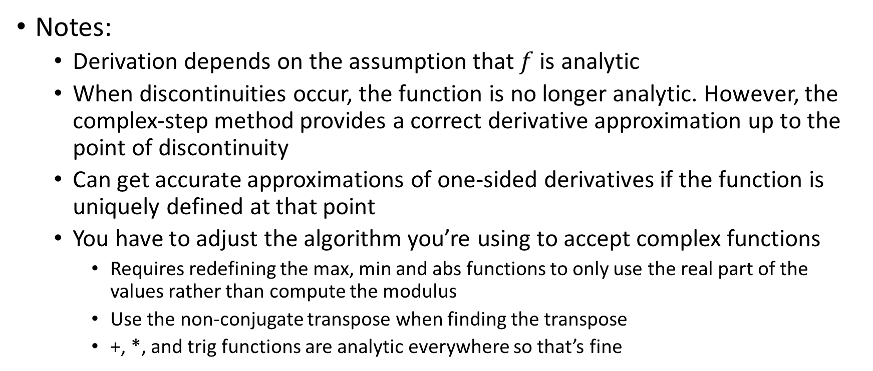
Complex-step Method
Notes:
Derivation depends on the assumption that $f$is analytic
When discontinuities occur, the function is no longer analytic. However, the complex-step method provides a correct derivative approximation up to the point of discontinuity
Can get accurate approximations of one-sided derivatives if the function is uniquely defined at that point
You have to adjust the algorithm you’re using to accept complex functions
Requires redefining the max, min and abs functions to only use the real part of the values rather than compute the modulus
Use the non-conjugate transpose when finding the transpose
+, *, and trig functions are analytic everywhere so that’s fine

Slide 13
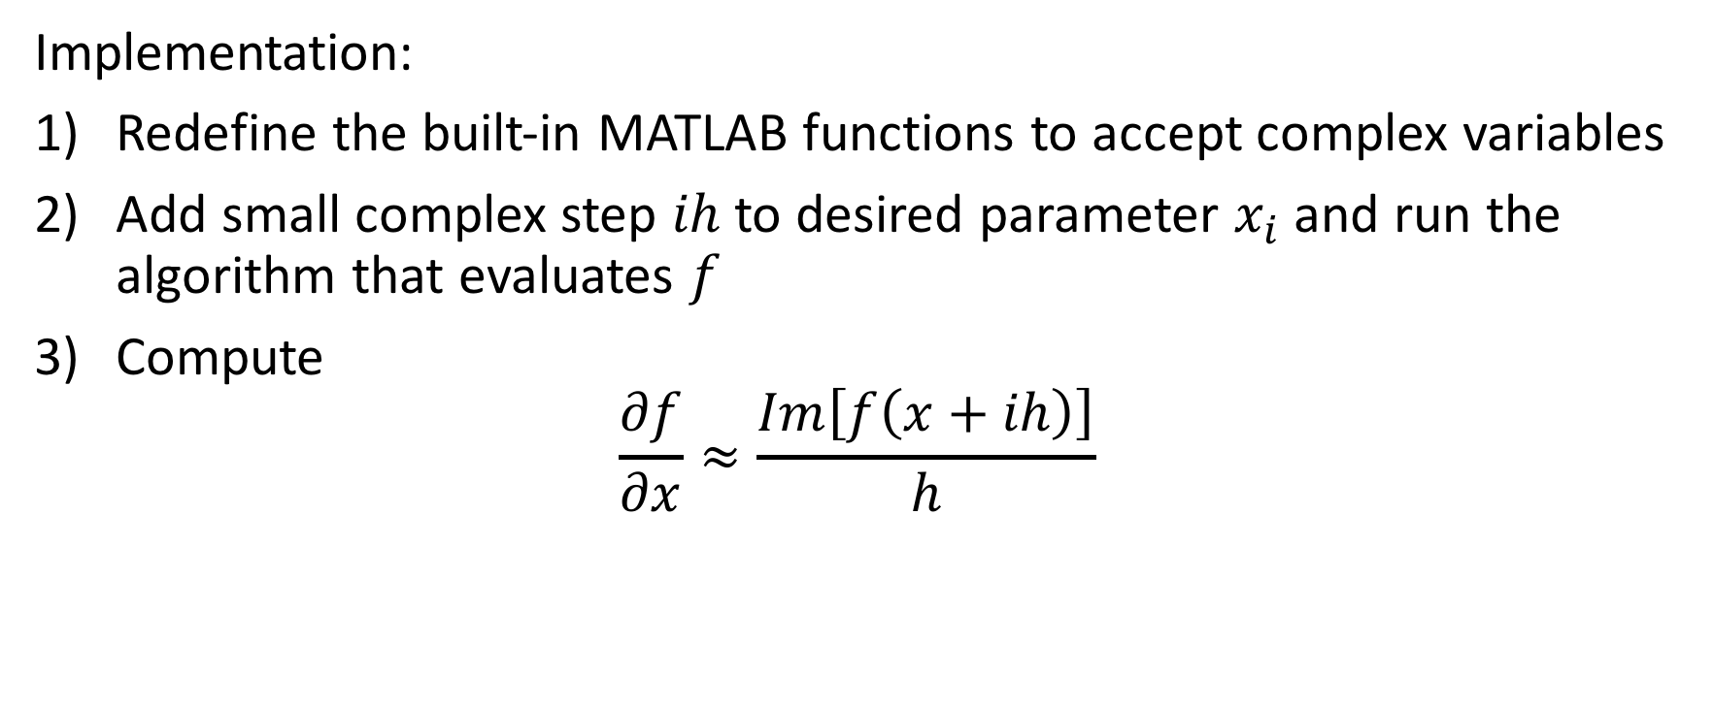
Complex-step Method
Implementation:
Redefine the built-in MATLAB functions to accept complex variables
Add small complex step $ih$ to desired parameter $x_{i}$ and run the algorithm that evaluates $f$
Compute $\frac{∂f}{∂x}≈\frac{Im\left[f\left(x+ih\right)\right]}{h}$

Slide 14
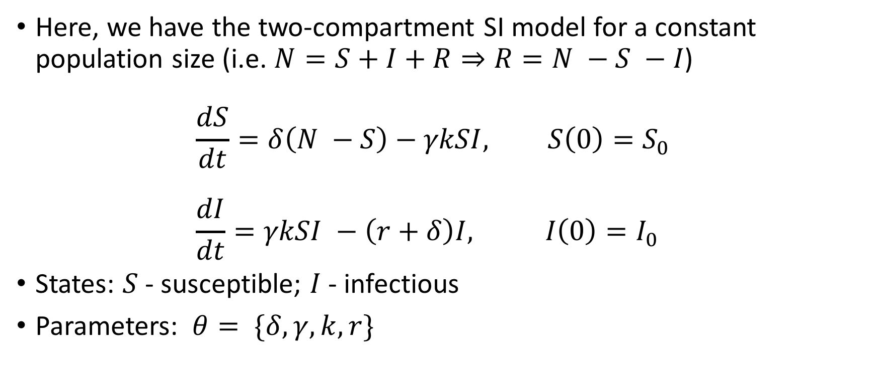
SI Model
Here, we have the two-compartment SI model for a constant population size (i.e. $N=S+I+R⇒R=N −S −I$) $\frac{dS}{dt}=δ\left(N −S\right)−γkSI, S\left(0\right)=S_{0}$ $\frac{dI}{dt}=γkSI −\left(r+δ\right)I, I\left(0\right)=I_{0}$
States: $S$ - susceptible; $I$ - infectious
Parameters: $θ= \{δ,γ,k,r\}$

Slide 15

SI Model
Initial parameter values $γ=0.2, k=0.1, r=0.6, δ=0.15$
Population size $N=1000$
Initial conditions $S_{0}=900, I_{0}=100$

Slide 16
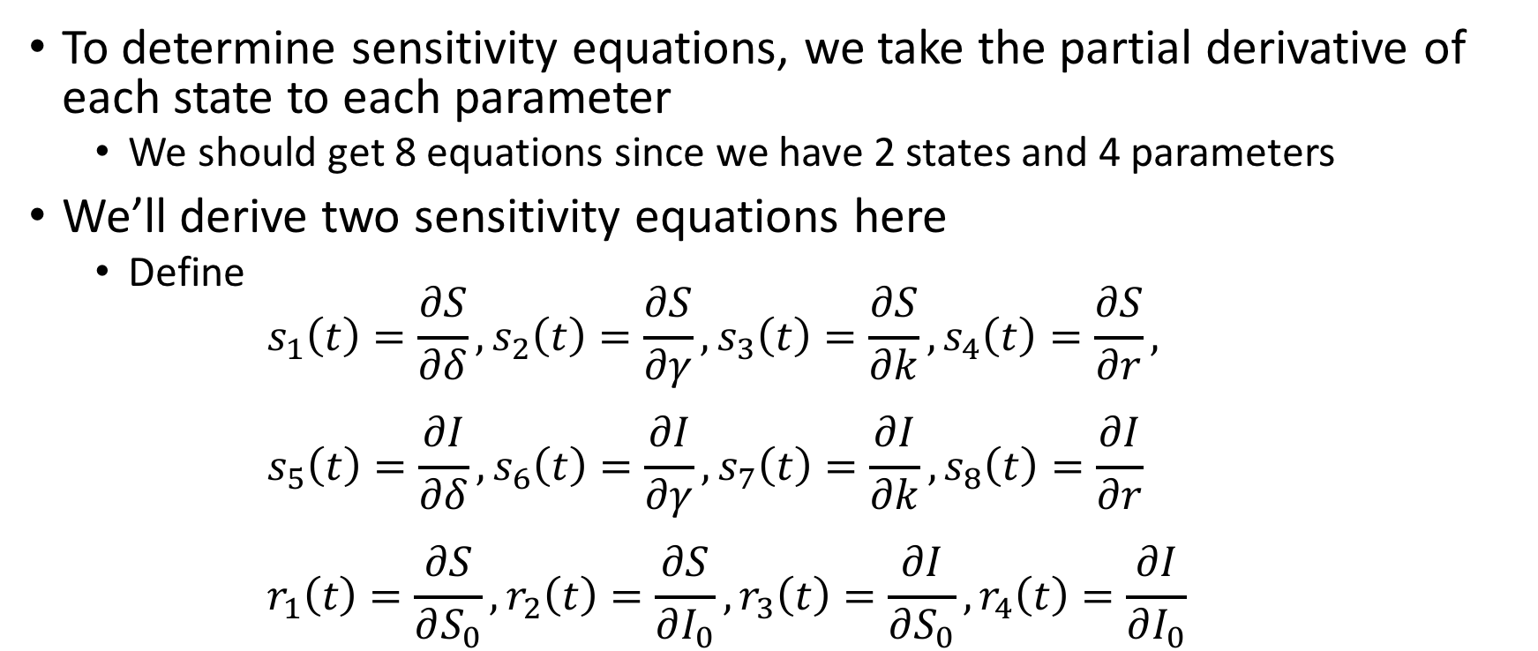
SI Model
To determine sensitivity equations, we take the partial derivative of each state to each parameter
We should get 8 equations since we have 2 states and 4 parameters
We’ll derive two sensitivity equations here
Define $s_{1}\left(t\right)=\frac{∂S}{∂δ}, s_{2}\left(t\right)=\frac{∂S}{∂γ}, s_{3}\left(t\right)=\frac{∂S}{∂k}, s_{4}\left(t\right)=\frac{∂S}{∂r},$ $s_{5}\left(t\right)=\frac{∂I}{∂δ}, s_{6}\left(t\right)=\frac{∂I}{∂γ}, s_{7}\left(t\right)=\frac{∂I}{∂k}, s_{8}\left(t\right)=\frac{∂I}{∂r}$ $r_{1}\left(t\right)=\frac{∂S}{∂S_{0}}, r_{2}\left(t\right)=\frac{∂S}{∂I_{0}}, r_{3}\left(t\right)=\frac{∂I}{∂S_{0}}, r_{4}\left(t\right)=\frac{∂I}{∂I_{0}}$

Slide 17
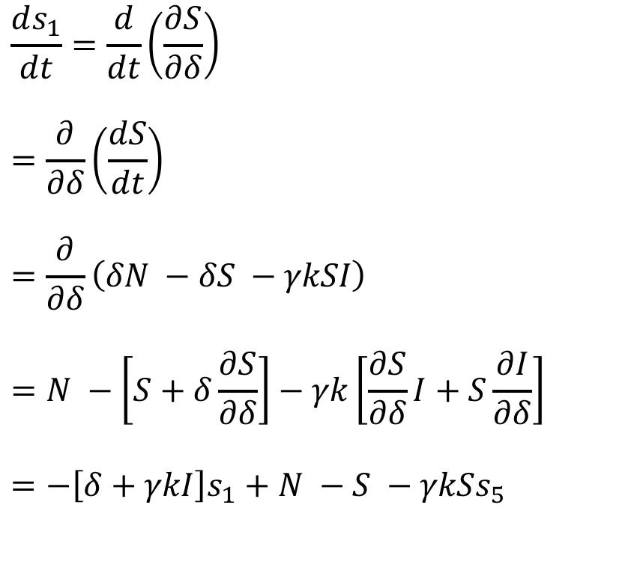
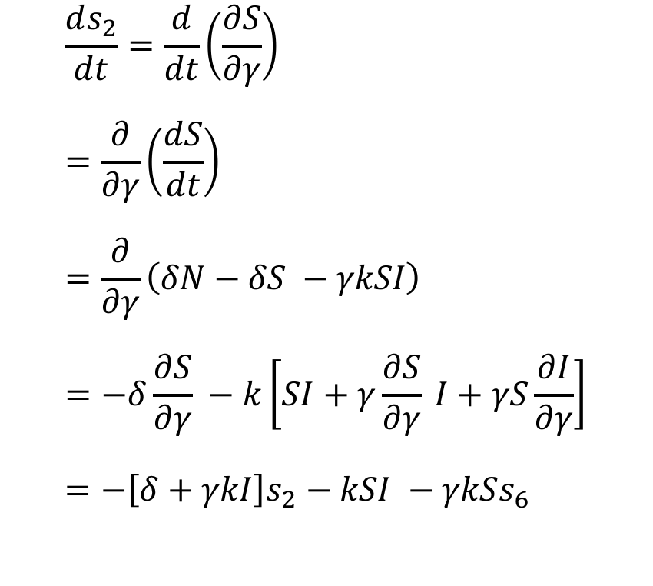
SI Model
$$\frac{ds_{1}}{dt}=\frac{d}{dt}\left(\frac{∂S}{∂δ}\right)$$
$$=\frac{∂}{∂δ}\left(\frac{dS}{dt}\right)$$
$$=\frac{∂}{∂δ}\left(δN −δS −γkSI\right)$$
$$=N −\left[S+δ\frac{∂S}{∂δ}\right]−γk\left[\frac{∂S}{∂δ}I+S\frac{∂I}{∂δ}\right]$$
$$=−\left[δ+γkI\right]s_{1}+N −S −γkSs_{5}$$
$$\frac{ds_{2}}{dt}=\frac{d}{dt}\left(\frac{∂S}{∂γ}\right) \\ =\frac{∂}{∂γ}\left(\frac{dS}{dt}\right) \\ =\frac{∂}{∂γ}\left(δN−δS −γkSI\right) \\ =−δ\frac{∂S}{∂γ} −k\left[SI+γ\frac{∂S}{∂γ} I+γS\frac{∂I}{∂γ}\right] \\ =−\left[δ+γkI\right]s_{2}−kSI −γkSs_{6}$$

Slide 18
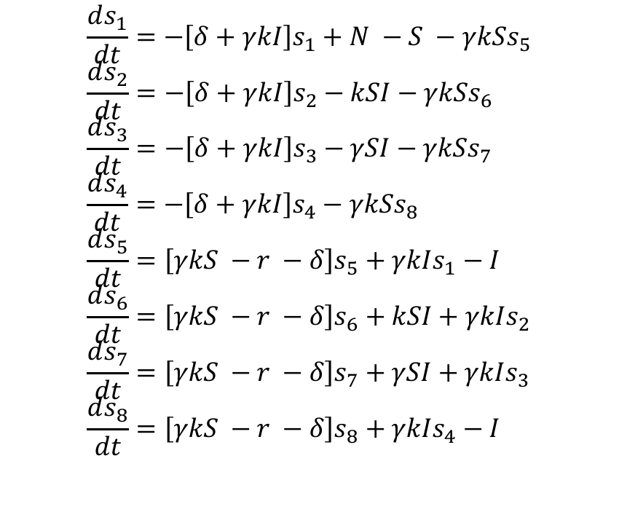
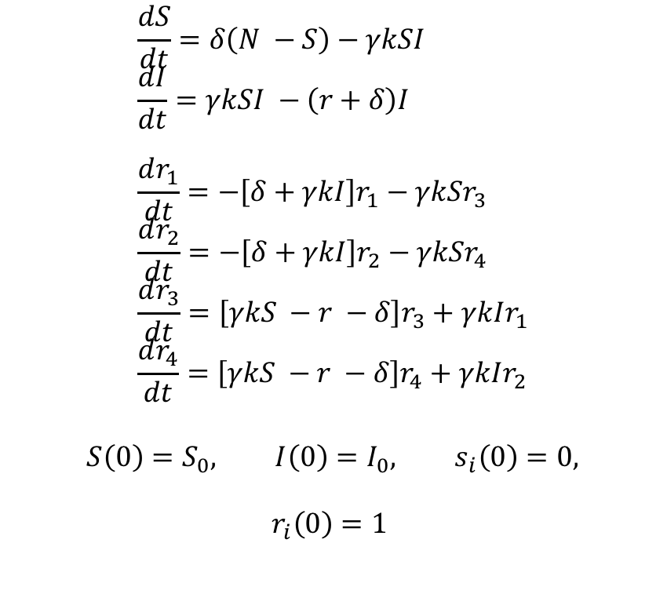
SI Model
$$\frac{ds_{1}}{dt}=−\left[δ+γkI\right]s_{1}+N −S −γkSs_{5} \\ \frac{ds_{2}}{dt}=−\left[δ+γkI\right]s_{2}−kSI−γkSs_{6} \\ \frac{ds_{3}}{dt}=−\left[δ+γkI\right]s_{3}−γSI−γkSs_{7} \\ \frac{ds_{4}}{dt}=−\left[δ+γkI\right]s_{4}−γkSs_{8} \\ \frac{ds_{5}}{dt}=\left[γkS −r −δ\right]s_{5}+γkIs_{1}−I \\ \frac{ds_{6}}{dt}=\left[γkS −r −δ\right]s_{6}+kSI+γkIs_{2} \\ \frac{ds_{7}}{dt}=\left[γkS −r −δ\right]s_{7}+γSI+γkIs_{3} \\ \frac{ds_{8}}{dt}=\left[γkS −r −δ\right]s_{8}+γkIs_{4}−I$$
$$\frac{dS}{dt}=δ\left(N −S\right)−γkSI \\ \frac{dI}{dt}=γkSI −\left(r+δ\right)I \\ \frac{dr_{1}}{dt}=−\left[δ+γkI\right]r_{1}−γkSr_{3} \\ \frac{dr_{2}}{dt}=−\left[δ+γkI\right]r_{2}−γkSr_{4} \\ \frac{dr_{3}}{dt}=\left[γkS −r −δ\right]r_{3}+γkIr_{1} \\ \frac{dr_{4}}{dt}=\left[γkS −r −δ\right]r_{4}+γkIr_{2}$$
$$S\left(0\right)=S_{0}, I\left(0\right)=I_{0}, s_{i}\left(0\right)=0,$$
$$r_{i}\left(0\right)=1$$

Slide 19
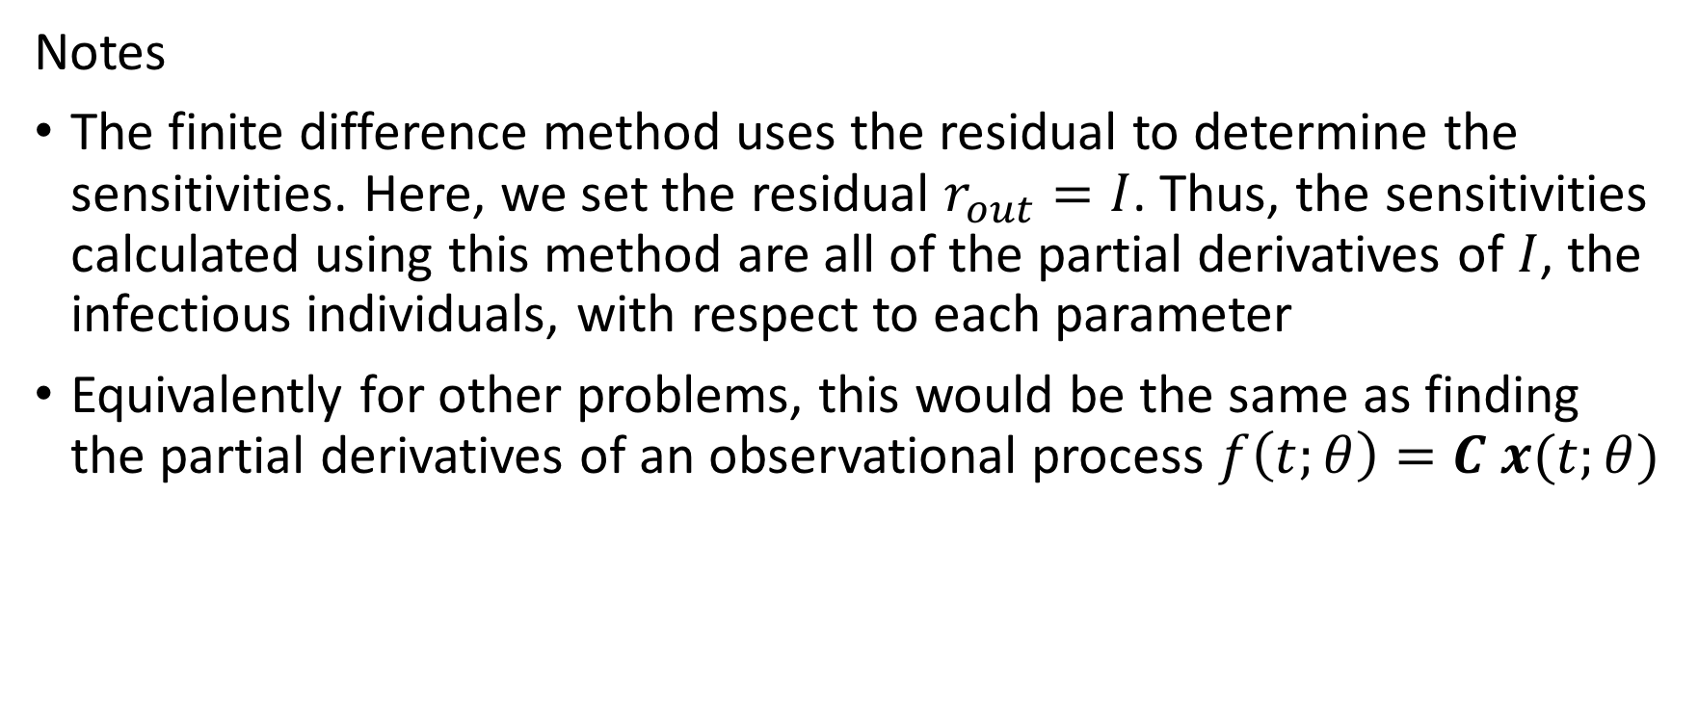
SI Model
Notes
The finite difference method uses the residual to determine the sensitivities. Here, we set the residual $r_{out}=I$. Thus, the sensitivities calculated using this method are all of the partial derivatives of $I$, the infectious individuals, with respect to each parameter
Equivalently for other problems, this would be the same as finding the partial derivatives of an observational process $f\left(t;θ\right)=C x(t;θ)$

Slide 20
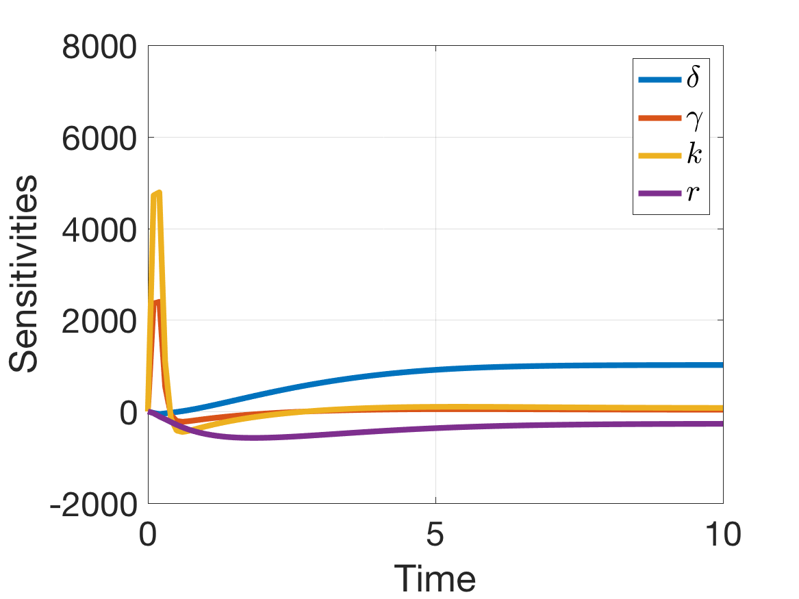
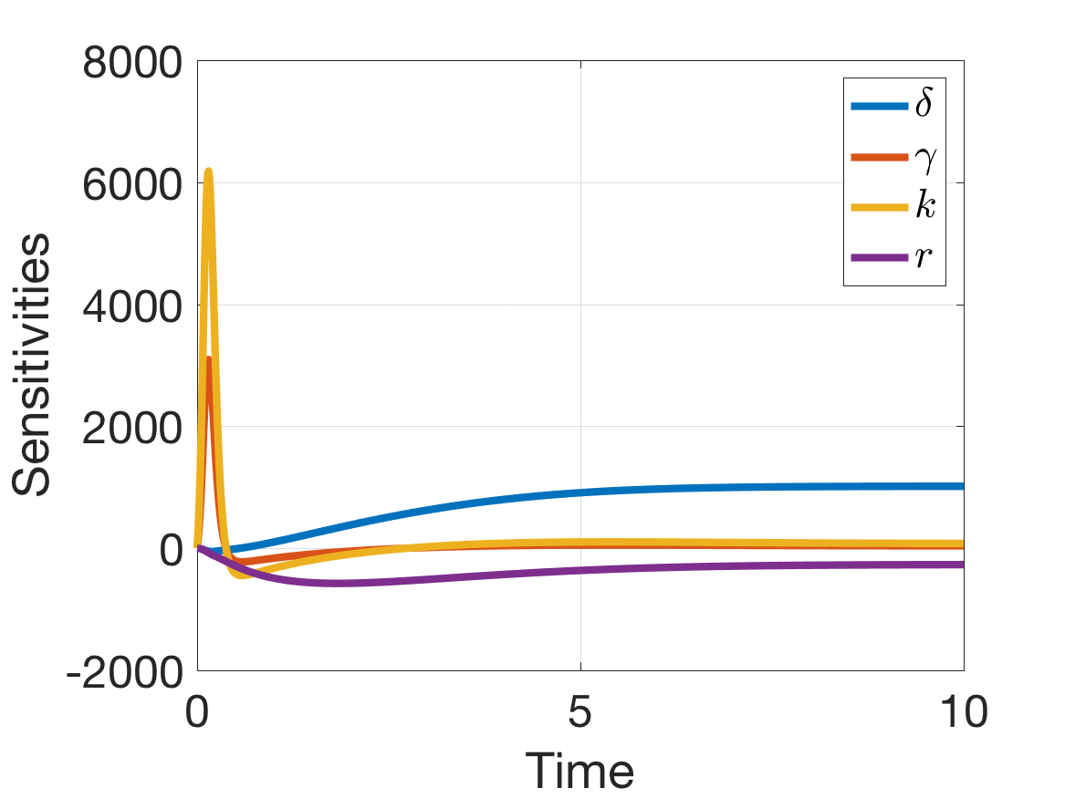


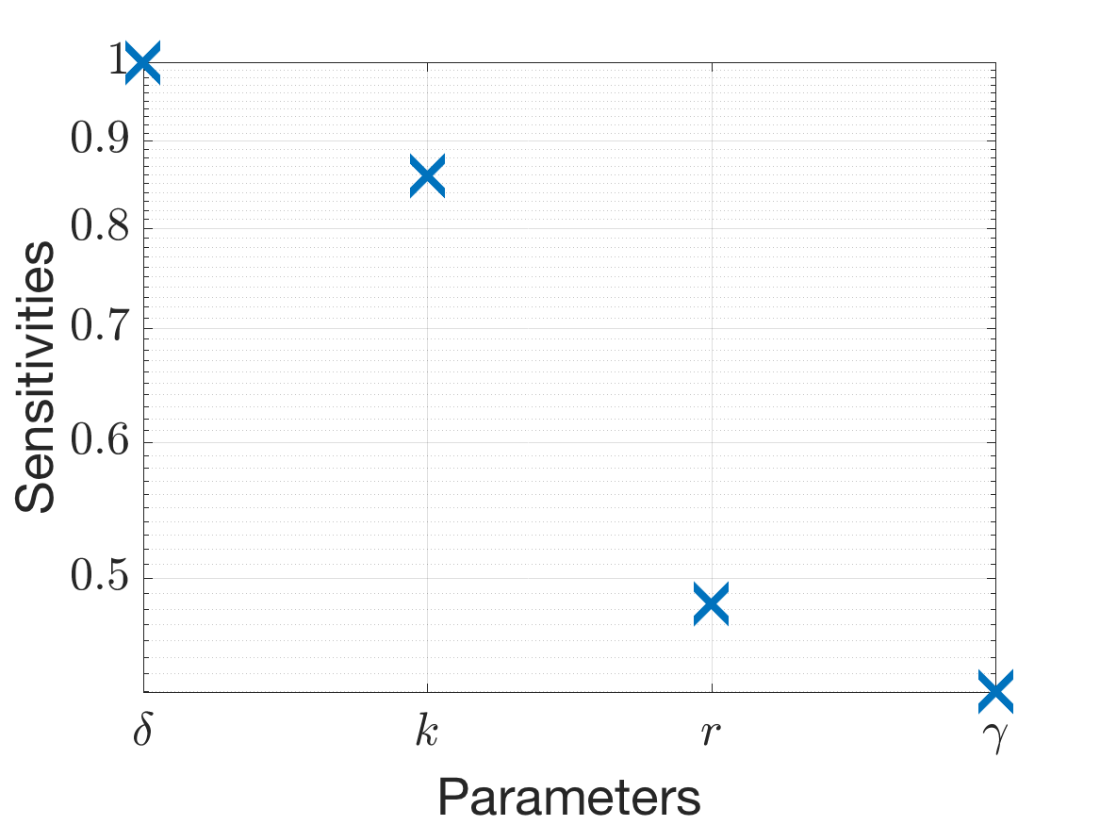
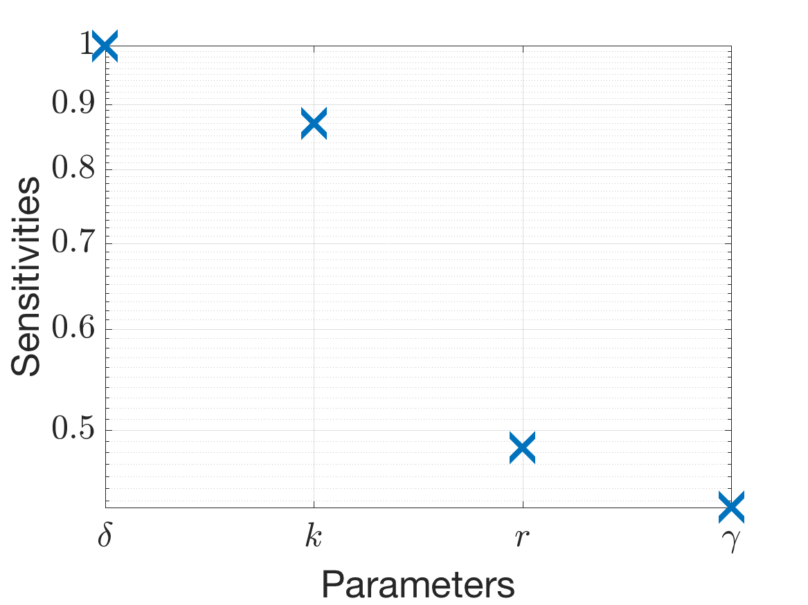





SI Model
Finite Forward Difference with mesh size $b$
Complex-step
Sensitivity Equations
$$b={10}^{−1}$$
$$b={10}^{−2}$$

Slide 21
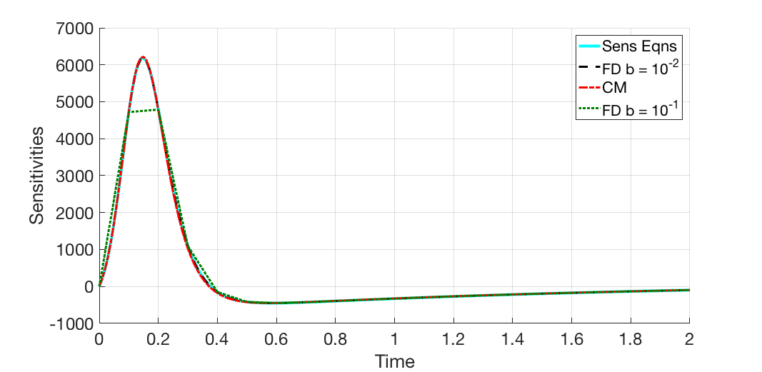
SI Model
Comparison of each method for parameter $k$

Slide 22
References
Banks, H.T.; Bekele-Maxwell, K.; Bociu, L.; Noorman, M.; Tillman, K. The complex-step method for sensitivity analysis of non-smooth problems arising in biology. Eurasian Journal of Mathematical and Computer Applications. 3. 16-68. 2015.
Banks, H.T.; Tran, H.T. Mathematical and Experimental Modeling of Physical and Biological Processes. CRC Press, Boca Raton, FL. 2009.

