Slide 1
Automated and intelligent Elderberry Collector Research Plan

Slide 2
How can we intelligently automate elderberry collection?
The following slides will showcase the steps (or algorithm, set of tasks) needed to be able to automate the elderberry collection task.

Slide 3
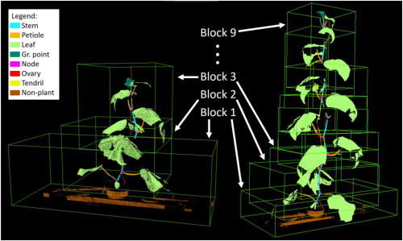
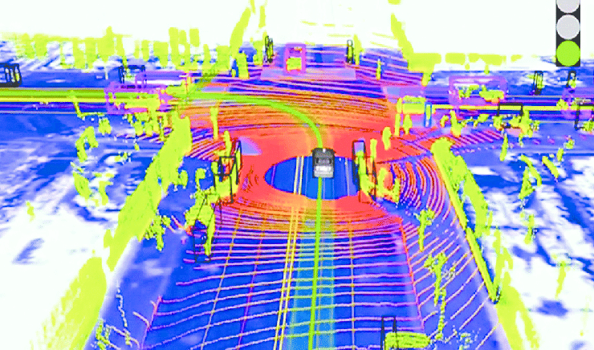
Step 1. Create real-time 3D point cloud of the plant
3D point cloud of the plant will create a digital environment in which the location of objects can be measured in space (Necessary for robot to interact with object!).
Determine which sensor is best to provide 3D point cloud data of elderberry plant (probably LiDAR)

Slide 4
Step 2. Point cloud object detection, detect and get position in space of elderberry chunks in the plant
Very challenging task. Second most important task, and the second thing needed to complete in order to make huge progress in this project (the first one is step 5).
CNN would have to learn how to identify an elderberry chunk in a point cloud environment.
Field work needed in order to collect data for the training of this CNN (very unlikely that there’s a dataset for this case available).
Data collection would involve creating 3D point cloud of several plants with the determined sensor, and then label all the chunks of elderberry in each point cloud.
Will most likely need to use data augmentation.

Slide 5
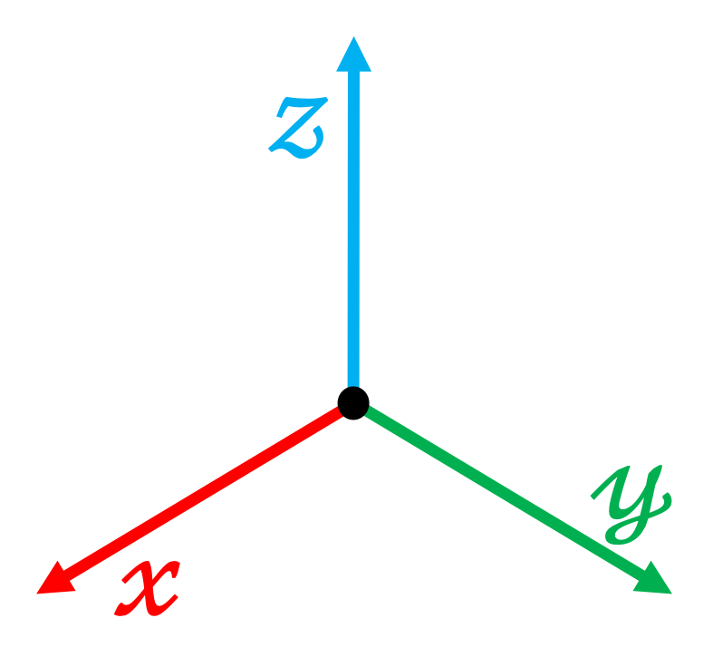
Step 3. Robot arm end-effector moves close to the nearest elderberry chunk not analyzed yet
Get position of all chunks, compare with robot’s initial position and record them.
Compare the distance of all chunks in order to select the nearest chunk.
Path planning by inverse kinematics with the location of the chunk provided by point cloud.
Set the final position of the end effector some centimeters before the position of the chunk (positive x direction) in order to take a good picture
Elderberry chunk
Plant

Slide 6
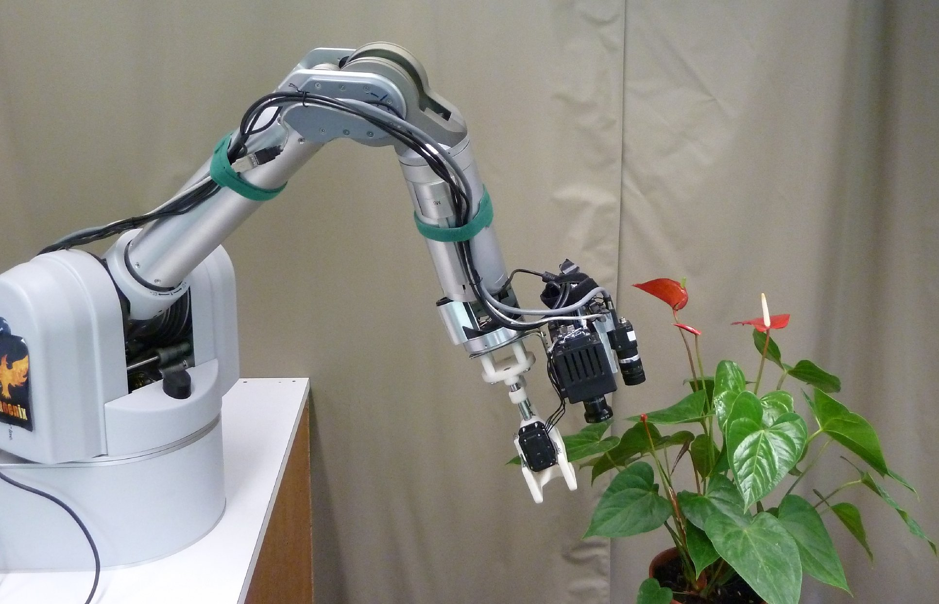
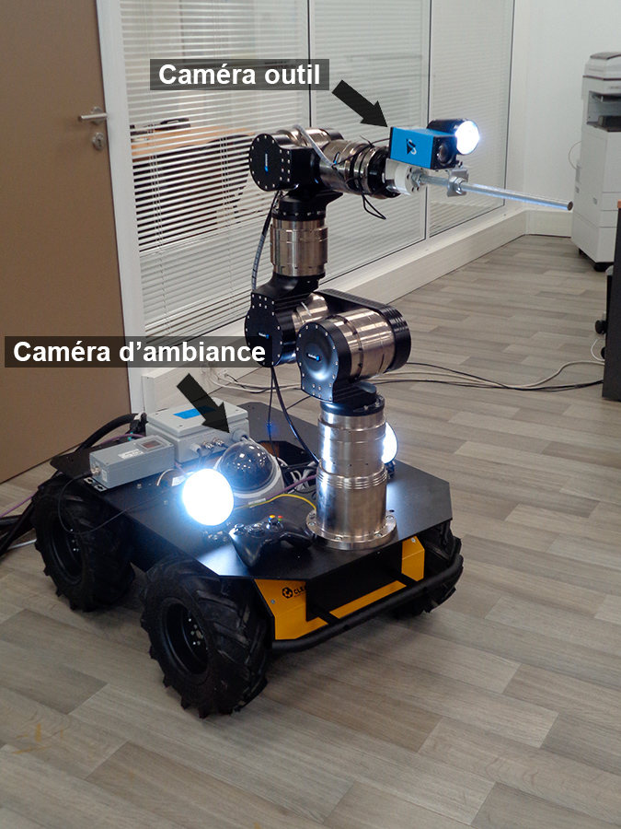
Step 4. High quality camera attached to robot’s end effector takes picture of the chunk then go back to robot’s initial position.
Straight forward task.

Slide 7
Step 5. Feed image taken to the cnn that will determine if the elderberry is ready for collection or not
Utilize object detection then image segmentation of the picture to isolate chunk from the background and eliminate noise.
Analyze if the chunk is ready for collection or not.
Research and understand features of a “ready” for collection elderberry and of a “not ready” for collection elderberry.
Possibly field work on data collection and label data according if it’s ready for collection or not.
Most important factor of the project, but probably the less challenging. Must be the first part to be done to have progress

Slide 8
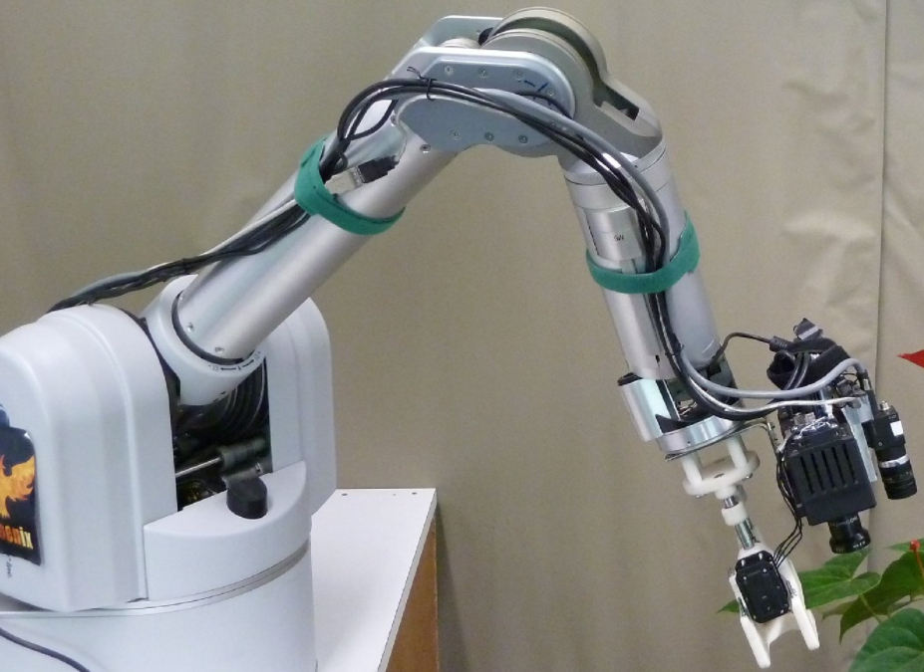
Step 6. If ready to collect, determine the position of the chunk with respect to the robot’s origin frame from the point cloud created (If not, set the chunk as analyzed and repeat step 3).
Get the specific chunk position recorded in step 3.
Elderberry chunk
Plant

Slide 9
Step 7. Path planning with inverse kinematics in order for the end effector to reach the chunk, then cut the chunk
The final position of the end effector should be some centimeters after the chunk (negative x direction) and some centimeters above (positive z direction). Very subjective, adjustments should be made in order to have the best spot to cut it.
Elderberry chunk
Plant

Slide 10
Step 8. Go back to initial position and repeat step 3 until all chunks have been analyzed.
Elderberry chunk
Plant

Slide 11
Things to be determined:
Best sensor or camera to develop the 3D point cloud of the plant (is photogrammetry an option?)
Robot Type.
Robot arm Degree of Freedom.
Robot operating system of choice. (ROS should be a great option)
Where will the robot arm be located (a tractor?)

Slide 12
Flowchart:
Build the CNN able to recognize if the elderberry is ready for collection or not
Determine the Robot Arm and create the path planning and decision making algorithms.
Create a CNN able to identify elderberry chunks in a point cloud
Link all the parts together!

Slide 13
Expectations:
For this summer:
To do after completing previous tasks:
Collect data:
Capture pictures of collectable and not collectable elderberry chunks and label them
Create 3D point clouds of elderberry plants and label the elderberry chunks
Write the code:
For the collectable and not collectable elderberry chunk CNN
For the elderberry chunk detection in the point cloud CNN
Train both CNN’s with the dataset collected until reach high efficiency
Implement the chunk detection CNN into the creation of the path planning of the robot arm (DoF tbd).
Implement the elderberry harvesting CNN into the decision making algorithm of the robot.
Integrate everything into an automated and intelligent elderberry harvesting system.

