Slide 1
Test automation course
Lesson 2

Slide 2
Table of contents
UML notations
Java basic data types
Access modifiers
Non-access modifiers
Java constructor
Keywords in Java
Creation of class instances (objects)

Slide 3
UML notations
UML is popular for its diagrammatic notations. We all know that UML is for visualizing, specifying, constructing and documenting the components of software and non software systems.
UML notations are the most important elements in modeling. Efficient and appropriate use of notations is very important for making a complete and meaningful model. The model is useless unless its purpose is depicted properly.

Slide 4
UML notations
Graphical notations used in structural things are the most widely used in UML. These are considered as the nouns of UML models. Following are the list of structural things.
Classes
object
Interface
Collaboration
Use case
Active classes
Components
Nodes

Slide 5
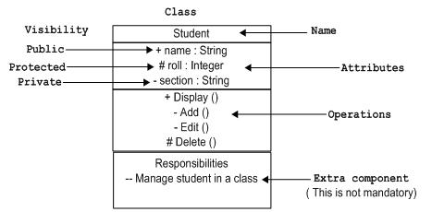
UML notations
Class Notation:
UML class is represented by the diagram shown below. The diagram is divided into four parts.
The top section is used to name the class.
The second one is used to show the attributes of the class.
The third section is used to describe the operations performed by the class.
The fourth section is optional to show any additional components.

Slide 6
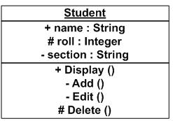
UML notations
Object Notation:
The object is represented in the same way as the class. The only difference is the name which is underlined as shown below.
As object is the actual implementation of a class which is known as the instance of a class. So it has the same usage as the class.

Slide 7
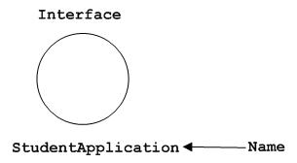
UML notations
Interface Notation:
Interface is represented by a circle as shown below. It has a name which is generally written below the circle.

Slide 8
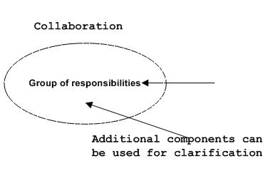
UML notations
Collaboration Notation:
Collaboration is represented by a dotted eclipse as shown below. It has a name written inside the eclipse.

Slide 9
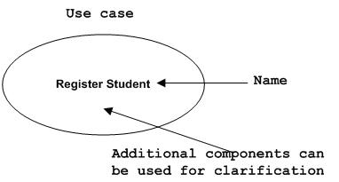
UML notations
Use case Notation:
Use case is represented as an eclipse with a name inside it. It may contain additional responsibilities.

Slide 10
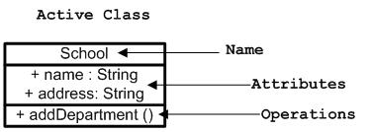
UML notations
Active class Notation:
Active class looks similar to a class with a solid border. Active class is generally used to describe concurrent behaviour of a system.

Slide 11
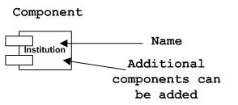
UML notations
Component Notation:
A component in UML is shown as below with a name inside. Additional elements can be added wherever required.

Slide 12
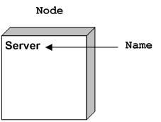
UML notations
Node Notation:
A node in UML is represented by a square box as shown below with a name. A node represents a physical component of the system.

Slide 13
UML notations
Relationships
A model is not complete unless the relationships between elements are described properly. The Relationship gives a proper meaning to an UML model. Following are the different types of relationships available in UML.
Dependency
Association
Generalization
Extensibility

Slide 14
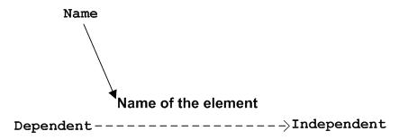
UML notations
Dependency Notation:
Dependency is an important aspect in UML elements. It describes the dependent elements and the direction of dependency.
Dependency is represented by a dotted arrow as shown below. The arrow head represents the independent element and the other end the dependent element.

Slide 15
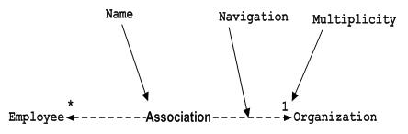
UML notations
Association Notation:
Association describes how the elements in an UML diagram are associated. In simple word it describes how many elements are taking part in an interaction.
Association is represented by a dotted line with (without) arrows on both sides. The two ends represent two associated elements as shown below. The multiplicity is also mentioned at the ends (1, * etc) to show how many objects are associated.

Slide 16

UML notations
Generalization Notation:
Generalization describes the inheritance relationship of the object oriented world. It is parent and child relationship.
Generalization is represented by an arrow with hollow arrow head as shown below. One end represents the parent element and the other end child element.

Slide 17
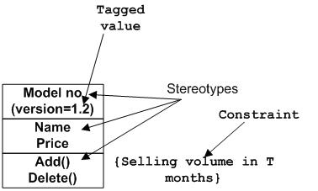
UML notations
Extensibility Notation:
All the languages (programming or modeling) have some mechanism to extend its capabilities like syntax, semantics etc. UML is also having the following mechanisms to provide extensibility features.
Stereotypes (Represents new elements)
Tagged values (Represents new attributes)
Constraints (Represents the boundaries)

Slide 18
Java basic data types
Variables are nothing but reserved memory locations to store values. This means that when you create a variable you reserve some space in memory.
There are two data types available in Java:
Primitive Data Types
Reference/Object Data Types

Slide 19
Java basic data types
Primitive Data Types:
There are eight primitive data types supported by Java. Primitive data types are predefined by the language and named by a keyword. Let us now look into detail about the eight primitive data types.
Byte (example values from -128 to 127 )
Short - (example values from -2^15 to 2^15 -1)
Int - (example values from -2^31to 2^31 -1)
Long - (example values from -2^63to 2^63 -1)
Float - data type is a single-precision 32-bit.
Double - data type is a double-precision 64-bit
Boolean - two possible values: true and false.
Char - data type is a single 16-bit Unicode character.

Slide 20
Java basic data types
Reference Data Types:
Reference variables are created using defined constructors of the classes. They are used to access objects. These variables are declared to be of a specific type that cannot be changed. For example, Employee, Puppy etc.
Class objects, and various type of array variables come under reference data type.
Default value of any reference variable is null.
A reference variable can be used to refer to any object of the declared type or any compatible type.
Example: Animal animal = new Animal("giraffe");

Slide 21
Access modifiers
Java provides a number of access modifiers to set access levels for classes, variables, methods and constructors. The four access levels are:
Visible to the package. the default. No modifiers are needed.
Visible to the class only (private).
Visible to the world (public).
Visible to the package and all subclasses (protected).

Slide 22
Access modifiers
Default Access Modifier - No keyword:
Default access modifier means we do not explicitly declare an access modifier for a class, field, method, etc.
A variable or method declared without any access control modifier is available to any other class in the same package. The fields in an interface are implicitly public static final and the methods in an interface are by default public.
Example :
String version = "1.5.1";
boolean processOrder(){
return true;
}

Slide 23
Access modifiers
Private Access Modifier - private:
Methods, Variables and Constructors that are declared private can only be accessed within the declared class itself.
Private access modifier is the most restrictive access level. Class and interfaces cannot be private.
Example :
public class Logger {
private String format;
public String getFormat() {
return this.format;
}
public void setFormat(String format) {
this.format = format;
}
}

Slide 24
Access modifiers
Public Access Modifier - public:
A class, method, constructor, interface etc declared public can be accessed from any other class. Therefore fields, methods, blocks declared inside a public class can be accessed from any class belonging to the Java Universe.
However if the public class we are trying to access is in a different package, then the public class still need to be imported.
Example:
public static void main(String[] arguments) {
// ...
}

Slide 25
Access modifiers
Protected Access Modifier - protected:
Variables, methods and constructors which are declared protected in a superclass can be accessed only by the subclasses in other package or any class within the package of the protected members' class.
Example :
class AudioPlayer {
protected boolean openSpeaker(Speaker sp) {
// implementation details
}
}
class StreamingAudioPlayer {
boolean openSpeaker(Speaker sp) {
// implementation details
}
}

Slide 26
Non-access modifiers
Java provides a number of non-access modifiers to achieve many other functionality.
The static modifier for creating class methods and variables
The final modifier for finalizing the implementations of classes, methods, and variables.
The abstract modifier for creating abstract classes and methods.
The synchronized and volatile modifiers, which are used for threads.

Slide 27
Non-access modifiers
The static Modifier:
Static Variables:
The static key word is used to create variables that will exist independently of any instances created for the class. Only one copy of the static variable exists regardless of the number of instances of the class.
Static Methods:
The static key word is used to create methods that will exist independently of any instances created for the class.

Slide 28
Non-access modifiers
The final Modifier:
Final Variables:
A final variable can be explicitly initialized only once. A reference variable declared final can never be reassigned to refer to an different object.
Final Methods:
The main intention of making a method final would be that the content of the method should not be changed by any outsider.
Final Classes:
The main purpose of using a class being declared as final is to prevent the class from being subclassed. If a class is marked as final then no class can inherit any feature from the final class.

Slide 29
Non-access modifiers
The abstract Modifier:
Abstract Class:
An abstract class can never be instantiated. If a class is declared as abstract then the sole purpose is for the class to be extended.
A class cannot be both abstract and final. (since a final class cannot be extended). If a class contains abstract methods then the class should be declared abstract. Otherwise a compile error will be thrown.
Abstract Methods:
An abstract method is a method declared with out any implementation. The methods body(implementation) is provided by the subclass. Abstract methods can never be final or strict.

Slide 30
Non-access modifiers
The synchronized Modifier:
The synchronized key word used to indicate that a method can be accessed by only one thread at a time. The synchronized modifier can be applied with any of the four access level modifiers.
The transient Modifier:
An instance variable is marked transient to indicate the JVM to skip the particular variable when serializing the object containing it.
This modifier is included in the statement that creates the variable, preceding the class or data type of the variable.

Slide 31
Non-access modifiers
The volatile Modifier:
The volatile is used to let the JVM know that a thread accessing the variable must always merge its own private copy of the variable with the master copy in the memory.
Accessing a volatile variable synchronizes all the cached copied of the variables in the main memory. Volatile can only be applied to instance variables, which are of type object or private. A volatile object reference can be null.

Slide 32
Java constructor
A java constructor has the same name as the name of the class to which it belongs. Constructor’s syntax does not include a return type, since constructors never return a value.
Constructors may include parameters of various types. When the constructor is invoked using the new operator, the types must match those that are specified in the constructor definition.

Slide 33
Java constructor
Java provides a default constructor which takes no arguments and performs no special actions or initializations, when no explicit constructors are provided.
The only action taken by the implicit default constructor is to call the superclass constructor using the super() call. Constructor arguments provide you with a way to provide parameters for the initialization of an object.
Here you can see examples :
http://www.wideskills.com/java-tutorial/java-constructors

Slide 34
Keywords in Java
In the Java programming language, a keyword is one of 50 reserved words that have a predefined meaning in the language; because of this, programmers cannot use keywords as names for variables, methods, classes, or as any other identifier.
Due to their special functions in the language, most integrated development environments for Java use syntax highlighting to display keywords in a different color for easy identification.
List of keywords :
https://docs.oracle.com/javase/tutorial/java/nutsandbolts/_keywords.html

Slide 35
Keywords in Java
this Keyword
Within an instance method or a constructor, this is a reference to the current object — the object whose method or constructor is being called. You can refer to any member of the current object from within an instance method or a constructor by using this.
Using this with a Field
The most common reason for using the this keyword is because a field is shadowed by a method or constructor parameter.
Examples :
https://docs.oracle.com/javase/tutorial/java/javaOO/thiskey.html

Slide 36
Keywords in Java
void Keyword
The void type, in several programming languages derived from C and Algol68, is the type for the result of a function that returns normally, but does not provide a result value to its caller. Usually such functions are called for their side effects, such as performing some task or writing to their output parameters.
A function with void result type ends either by reaching the end of the function or by executing a return statement with no returned value. The void type may also appear as the sole argument of a function prototype to indicate that the function takes no arguments.

Slide 37
Creation of class instances (objects)
Let us now look deep into what are objects. If we consider the real-world we can find many objects around us, Cars, Dogs, Humans, etc. All these objects have a state and behavior.
If we consider a dog, then its state is - name, breed, color, and the behavior is - barking, wagging, running
If you compare the software object with a real world object, they have very similar characteristics.

Slide 38
Creation of class instances (objects)
Software objects also have a state and behavior. A software object's state is stored in fields and behavior is shown via methods.
So in software development, methods operate on the internal state of an object and the object-to-object communication is done via methods.
A class is a blue print from which individual objects are created . In Java, the new key word is used to create new objects.

Slide 39
Creation of class instances (objects)
There are three steps when creating an object from a class:
Declaration: A variable declaration with a variable name with an object type.
Instantiation: The 'new' key word is used to create the object.
Initialization: The 'new' keyword is followed by a call to a constructor. This call initializes the new object.

Slide 40
Creation of class instances (objects)
There are three steps when creating an object from a class:
Declaration: A variable declaration with a variable name with an object type.
Instantiation: The 'new' key word is used to create the object.
Initialization: The 'new' keyword is followed by a call to a constructor. This call initializes the new object.

Slide 41
Creation of class instances (objects)
Example of creating an object is given below:
public class Puppy{
public Puppy(String name){
// This constructor has one parameter, name.
System.out.println("Passed Name is :" + name );
}
public static void main(String []args){
// Following statement would create an object myPuppy
Puppy myPuppy = new Puppy( "tommy" );
}
}

Slide 42
Thanks for watching

