Slide 1
Gian Antariksa Assignment – ETL Airflow

Slide 2
Assignment Create tables on mysql
Screenshot parameters:
-- Switch to your desired database
USE dibimbing_assignment;
-- Table 1
CREATE TABLE table1 (
id INT AUTO_INCREMENT PRIMARY KEY,
name VARCHAR(255) NOT NULL,
created_at DATETIME DEFAULT CURRENT_TIMESTAMP
);
-- Table 2
CREATE TABLE table2 (
id INT AUTO_INCREMENT PRIMARY KEY,
description TEXT,
status VARCHAR(50),
updated_at DATETIME DEFAULT CURRENT_TIMESTAMP ON UPDATE CURRENT_TIMESTAMP
);
-- Table 3
CREATE TABLE table3 (
id INT AUTO_INCREMENT PRIMARY KEY,
value DECIMAL(10,2),
quantity INT,
timestamp DATETIME DEFAULT CURRENT_TIMESTAMP
);
-- Table 4
CREATE TABLE table4 (
id INT AUTO_INCREMENT PRIMARY KEY,
user_id INT,
product_id INT,
purchase_date DATETIME DEFAULT CURRENT_TIMESTAMP
);
-- Table 5
CREATE TABLE table5 (
id INT AUTO_INCREMENT PRIMARY KEY,
category VARCHAR(100),
subcategory VARCHAR(100),
created_at DATETIME DEFAULT CURRENT_TIMESTAMP
);

Slide 3
Assignment Create tables on postgresql
Screenshot parameters:
-- Switch to your desired schema or create one if necessary
CREATE SCHEMA IF NOT EXISTS etl_schema;
SET search_path TO etl_schema;
-- Table 1
CREATE TABLE table1 (
id SERIAL PRIMARY KEY,
name VARCHAR(255) NOT NULL,
created_at TIMESTAMP DEFAULT CURRENT_TIMESTAMP
);
-- Table 2
CREATE TABLE table2 (
id SERIAL PRIMARY KEY,
description TEXT,
status VARCHAR(50),
updated_at TIMESTAMP DEFAULT CURRENT_TIMESTAMP
);
-- Table 3
CREATE TABLE table3 (
id SERIAL PRIMARY KEY,
value NUMERIC(10,2),
quantity INT,
timestamp TIMESTAMP DEFAULT CURRENT_TIMESTAMP
);
-- Table 4
CREATE TABLE table4 (
id SERIAL PRIMARY KEY,
user_id INT,
product_id INT,
purchase_date TIMESTAMP DEFAULT CURRENT_TIMESTAMP
);
-- Table 5
CREATE TABLE table5 (
id SERIAL PRIMARY KEY,
category VARCHAR(100),
subcategory VARCHAR(100),
created_at TIMESTAMP DEFAULT CURRENT_TIMESTAMP
);

Slide 4
Assignment assignment_etl_mysql_to_postgres.py
Screenshot parameters:
import logging
import os
import json
from airflow import DAG
from airflow.providers.mysql.hooks.mysql import MySqlHook
from airflow.providers.postgres.hooks.postgres import PostgresHook
from airflow.operators.python import PythonOperator
from airflow.utils.dates import days_ago
from datetime import datetime, timedelta
import pandas as pd
def load_config():
"""
Loads the ETL configuration from the etl_config.json file located in the resources folder.
:return: Dictionary containing configuration parameters.
"""
dag_folder = os.path.dirname(os.path.realpath(__file__))
config_path = os.path.join(dag_folder, 'resources', 'etl_config.json')
try:
with open(config_path, 'r') as config_file:
config = json.load(config_file)
logging.info(f"Configuration loaded successfully from {config_path}")
return config
except FileNotFoundError:
logging.error(f"Configuration file not found at {config_path}")
raise
except json.JSONDecodeError as e:
logging.error(f"Error parsing the configuration file: {e}")
raise
CONFIG = load_config()
def etl_task(table_name, mysql_conn_id, postgres_conn_id, target_schema, **kwargs):
"""
ETL task to extract data from MySQL and load it into PostgreSQL.
:param table_name: Name of the table to process.
:param mysql_conn_id: Airflow connection ID for MySQL.
:param postgres_conn_id: Airflow connection ID for PostgreSQL.
:param target_schema: Target schema in PostgreSQL.
"""
mysql_hook = MySqlHook(mysql_conn_id=mysql_conn_id)
postgres_hook = PostgresHook(postgres_conn_id=postgres_conn_id)
logging.info(f"Starting ETL for table: {table_name}")
try:
df = mysql_hook.get_pandas_df(sql=f"SELECT * FROM {table_name}")
logging.info(f"Extracted {len(df)} records from MySQL table '{table_name}'")
except Exception as e:
logging.error(f"Failed to extract data from MySQL table '{table_name}': {e}")
raise
if df.empty:
logging.warning(f"No data found in MySQL table '{table_name}'. Skipping load.")
return
target_table = f"{target_schema}.{table_name}"
try:
postgres_hook.insert_rows(
table=target_table,
rows=df.values.tolist(),
target_fields=df.columns.tolist(),
replace=True
)
logging.info(f"Successfully inserted {len(df)} records into PostgreSQL table '{target_table}'")
except Exception as e:
logging.error(f"Error inserting data into PostgreSQL table '{target_table}': {e}")
raise
def check_week(**kwargs):
"""
Ensures that the ETL runs only on the first and third Fridays of the month.
:param kwargs: Airflow context parameters.
"""
execution_date = kwargs['execution_date']
week_of_month = (execution_date.day - 1) // 7 + 1
logging.info(f"Execution date: {execution_date}, Week of month: {week_of_month}")
if week_of_month not in [1, 3]:
logging.info("Not the first or third week of the month. Skipping ETL tasks.")
raise ValueError("Not the first or third week of the month.")
default_args = {
'owner': 'airflow',
'depends_on_past': False,
'email': [CONFIG['email']['on_failure']],
'email_on_failure': True,
'email_on_retry': False,
'retries': CONFIG['retry_policy']['retries'],
'retry_delay': timedelta(minutes=CONFIG['retry_policy']['retry_delay_minutes']),
}
with DAG(
dag_id='assignment_etl_mysql_to_postgres',
default_args=default_args,
description='Dynamic DAG for ETL from MySQL to PostgreSQL for 5 tables',
schedule_interval='15 9-21/2 * * 5',
start_date=days_ago(1),
catchup=False,
tags=['mysql', 'postgres', 'etl', 'dynamic', 'weekly'],
) as dag:
check_week_task = PythonOperator(
task_id='check_week',
python_callable=check_week,
provide_context=True,
)
for table in CONFIG['tables']:
etl = PythonOperator(
task_id=f'etl_{table}',
python_callable=etl_task,
op_kwargs={
'table_name': table,
'mysql_conn_id': CONFIG['mysql_conn_id'],
'postgres_conn_id': CONFIG['postgres_conn_id'],
'target_schema': CONFIG['target_schema']
},
provide_context=True,
)
check_week_task >> etl

Slide 5
Assignment etl_config.json
Screenshot parameters:
{
"mysql_conn_id": "mysql_conn",
"postgres_conn_id": "postgres_conn",
"target_schema": "etl_schema",
"tables": [
"table1",
"table2",
"table3",
"table4",
"table5"
],
"email": {
"on_failure": "gian.antariksa@gmail.com",
"on_retry": "gian.antariksa@gmail.com"
},
"retry_policy": {
"retries": 1,
"retry_delay_minutes": 5
}
}

Slide 6
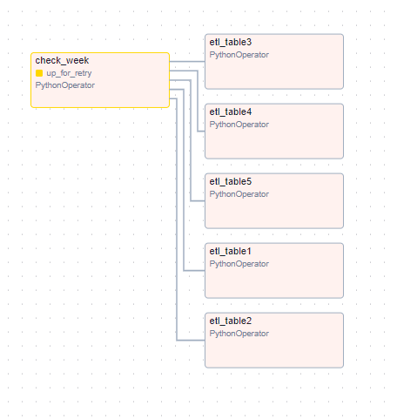
Assignment Graphs

Slide 7
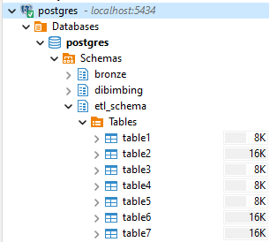
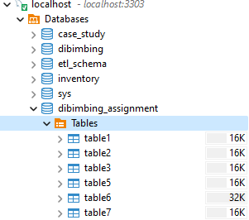
Assignment Folder Data

