Slide 1
Some Mathematical/Numerical Problems in the Study of Inhomogeneous Polymers
David (Qiang) Wang
Department of Chemical & Biological Engineering
and School of Biomedical Engineering
Colorado State University
q.wang@colostate.edu

Slide 2


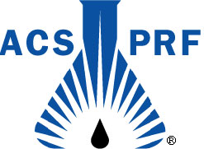

David (Qiang) Wang’s
Laboratory of Computational Soft Materials
Systems
Block copolymers, Polymer brushes, Polyelectrolytes, Nanocomposites, …
Tools
Molecular Simulations, Field Theory, Mesoscopic Simulations, …
Issues
Chain conformations, Thermodynamic behavior, Mechanical properties, …

Slide 3
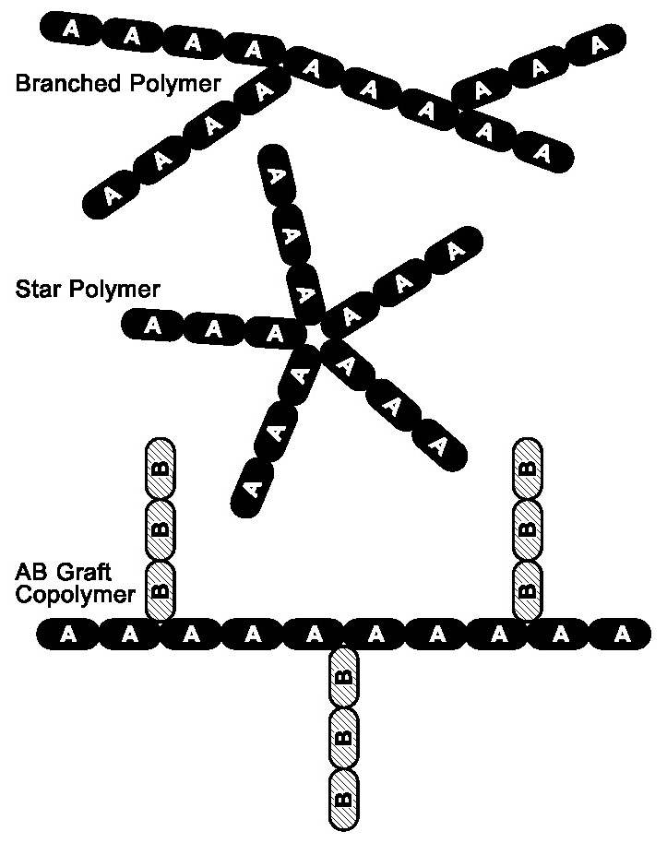
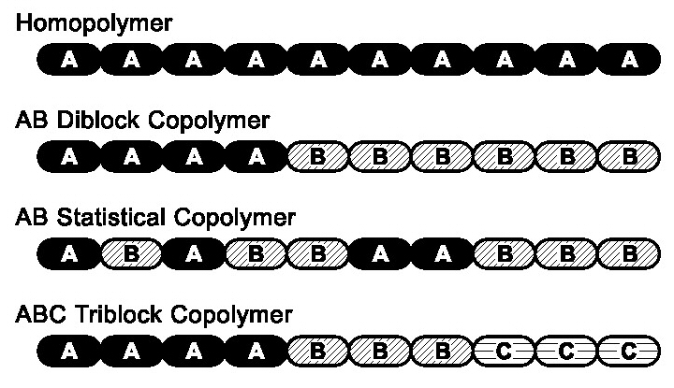
Introduction to Polymers
Large molecules made up of many (100) small chemical units (monomers) joined together by chemical bonds.
Properties of polymers depend on the properties of monomers, how monomers are connected, and how many monomers are connected.

Slide 4
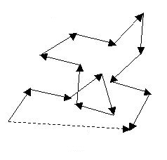
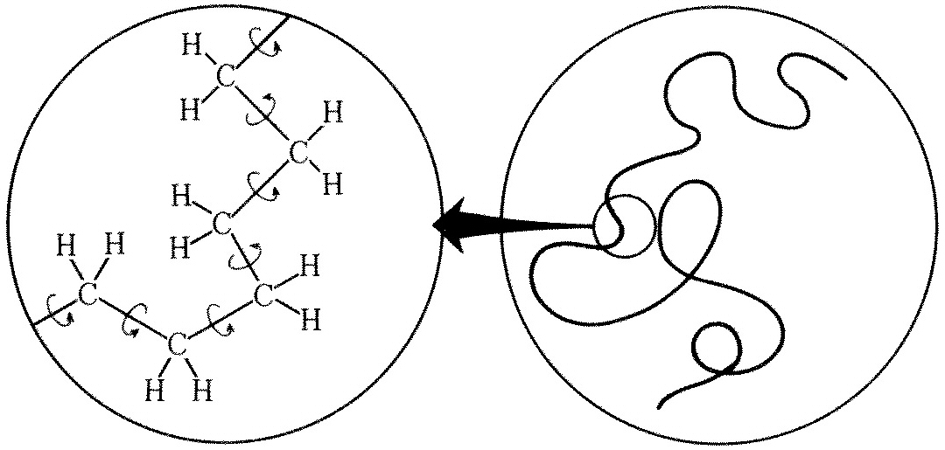
An Ideal-Chain Model – Freely Jointed Chain
N volumeless segments connected by N−1 randomly oriented bonds of fixed length b.
For large N, bond restrictions such as in bending and torsion angles only increase b to an effective value a. That is, one effective segment corresponds to several to tens of monomers.

Slide 5
Another Ideal-Chain Model – Gaussian Chain
Gaussian Chain in an External Field

Slide 6
Field Theory of Diblock Copolymers (DBC)
N_{A}
s=N
s=0
A
B

Slide 7
Self-Consistent Field (SCF) Theory of DBC
N_{A}
s=N
s=0
A
B
Modified diffusion equations:

Slide 8
Numerical Methods of Solving MDE
ADI with Finite-difference schemes (Crank-Nicolson, Douglas, …)
Spectral method (needs proper choice of basis functions)
Pseudo-spectral method (unconditionally stable, 2nd-order method in s)
Implicit-explicit method (4th-order method in s)
(Ascher et al., SIAM J. Numer. Anal., 32, 797 (1995))

Slide 9
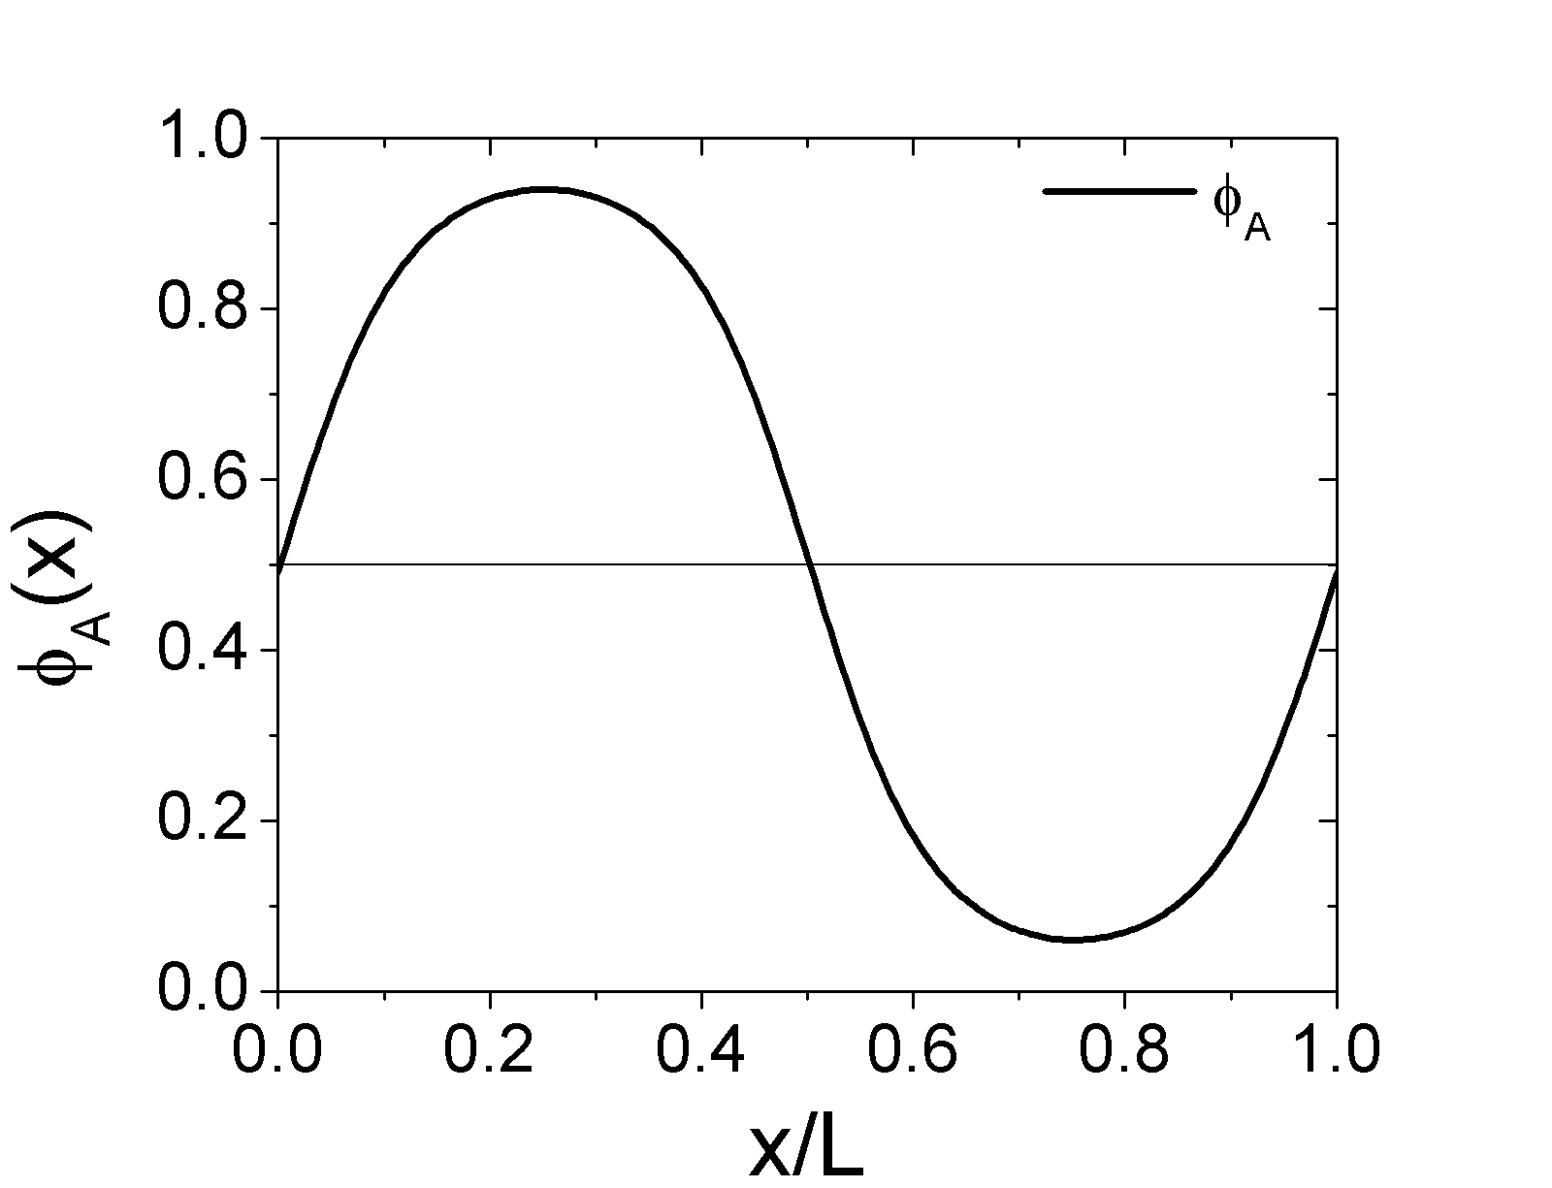
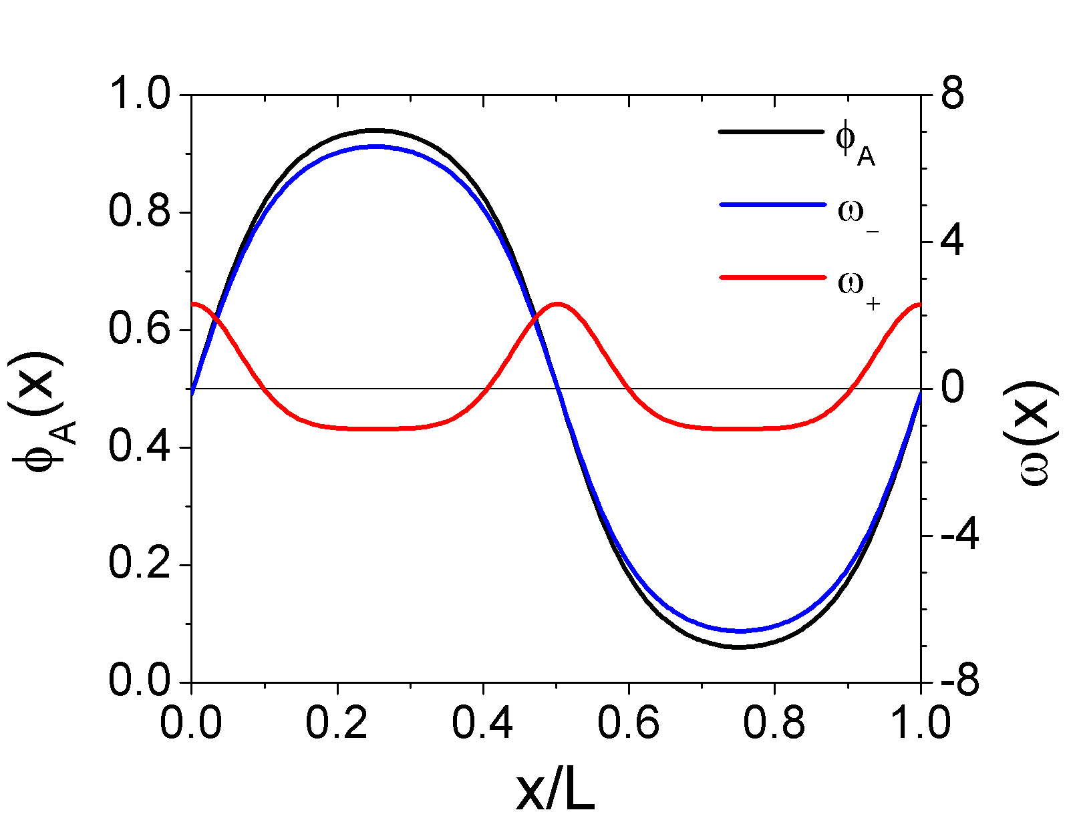
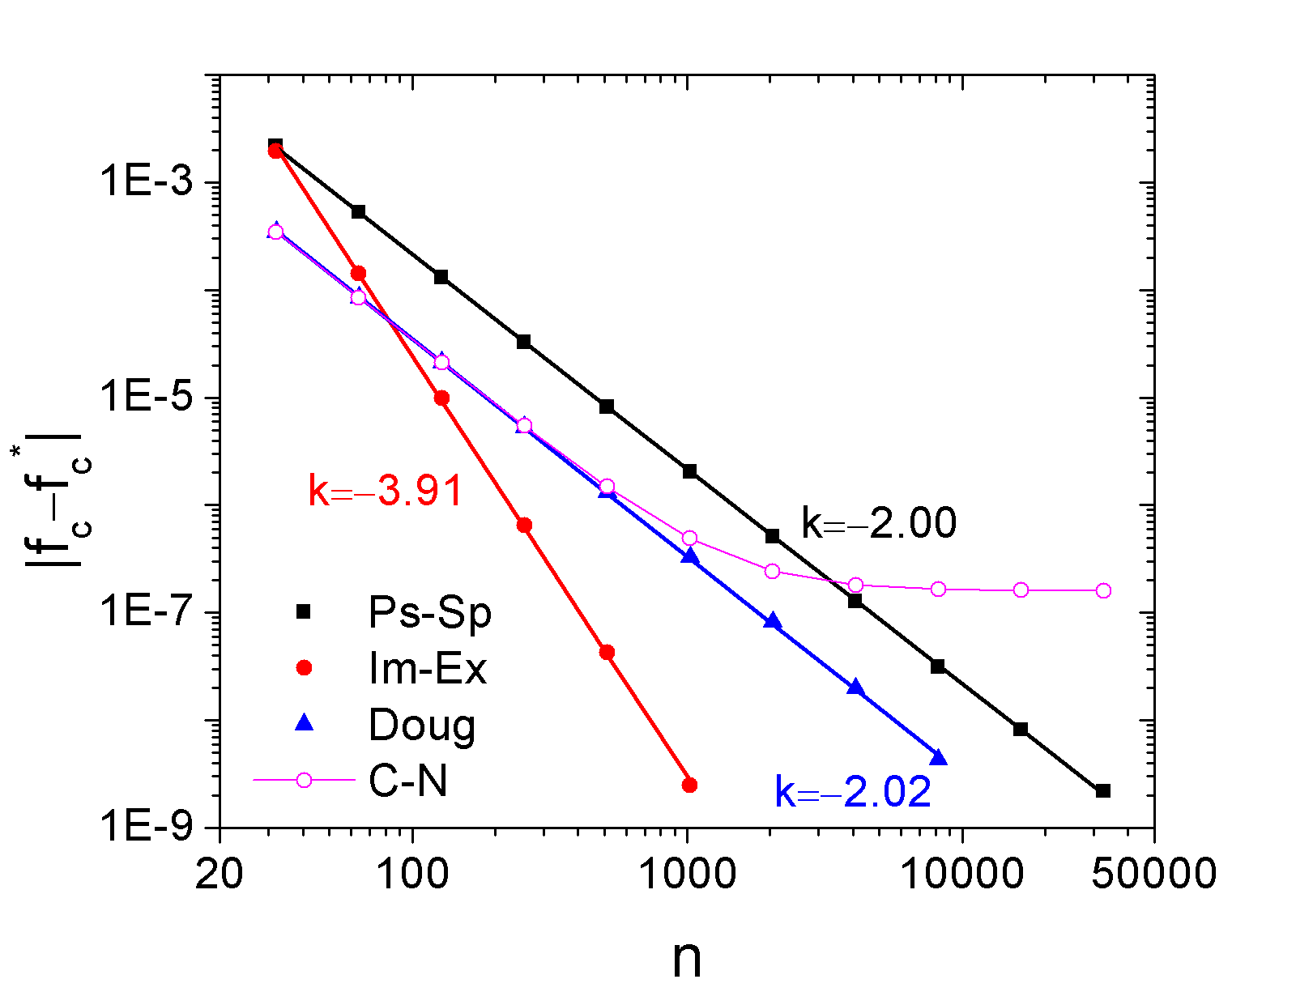
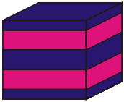
Numerical Methods of Solving MDE
f_{c}*=f_{c}^{Im-Ex}(m=512,n=2048)
m=256
χN=15
L=3.7R_{g}
x
L

Slide 10
Numerical Methods of Solving SCF Equations
(Ceniceros and Fredrickson, Multiscale Model. Simul., 2, 452 (2004))
Simple relaxation or Anderson mixing (difficult to converge)
λ0.1
Broyden method (O(m²) algorithm, applicable only in 1D)
Semi-implicit-Siedel scheme (O(mlnm) algorithm)
Random Phase Approximation

Slide 11
Saddle-Point Feature of Field Theory

Slide 12
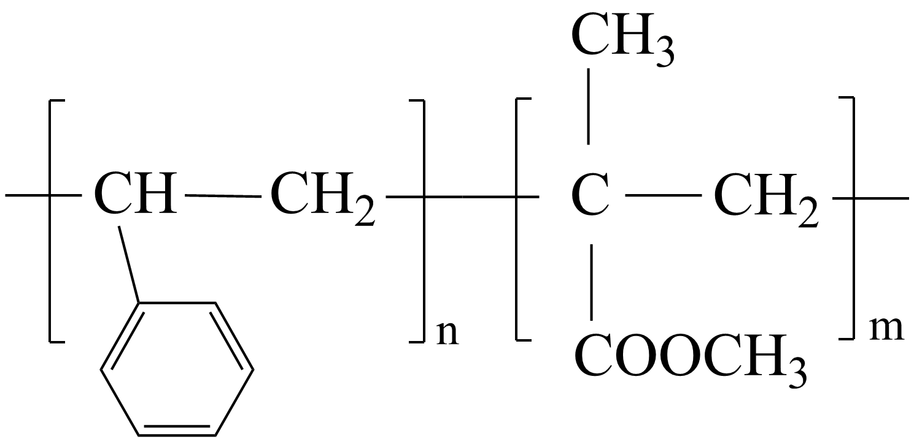
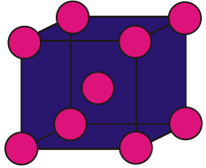
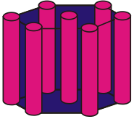
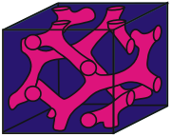
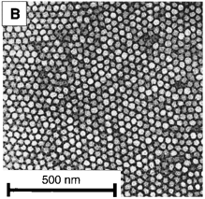
System I. – Block Copolymers
Diblock Copolymer (DBC)
Microphase Separation in Bulk
Molecular weight and composition control the domain size and shape, as well as the interfacial width between the domains.
Potential Applications:
A single layer of spheres obtained from DBC that form cylinders in bulk.
Nanowires
High-density storage media
Templates for nanolithography
Quantum dot or anti-dot arrays
Photonic band gaps
Nano-channels, …
“Block Copolymer Lithography: Periodic Arrays of ~10¹¹ Holes in 1 Square Centimeter”,
M. Park, et al., Science, 276, 1401 (1997)

Slide 13
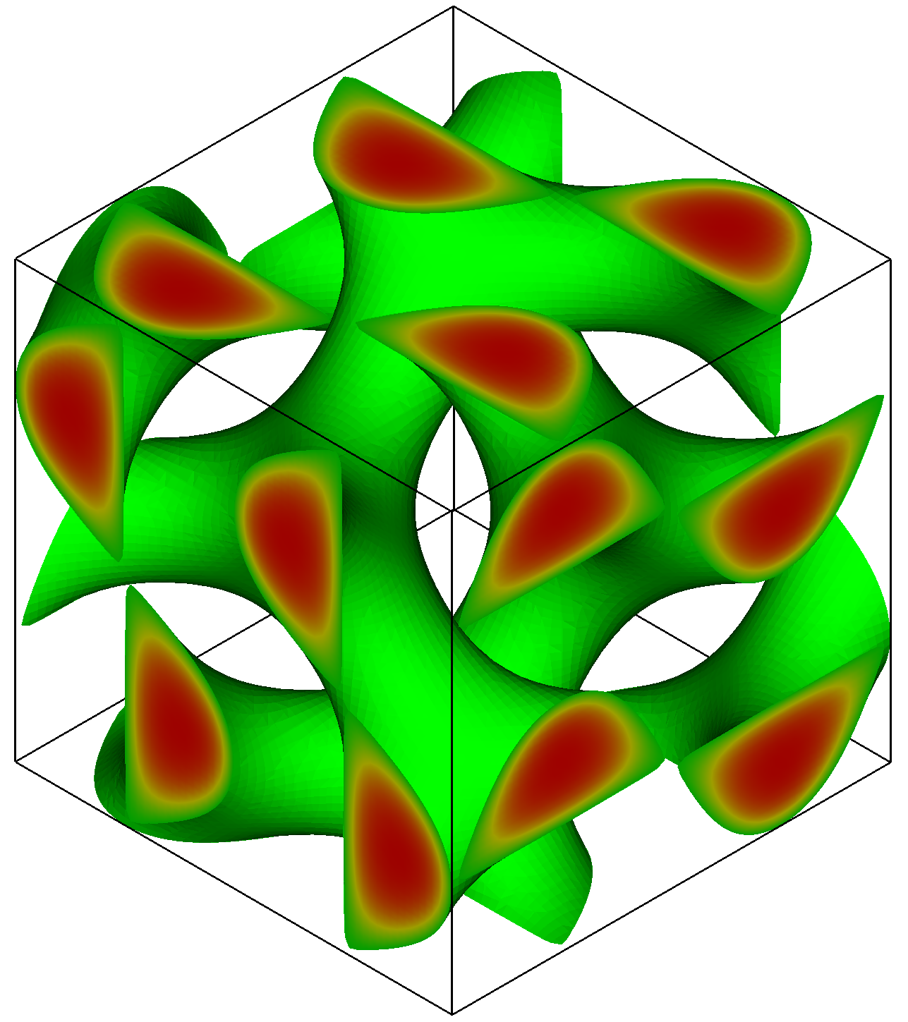
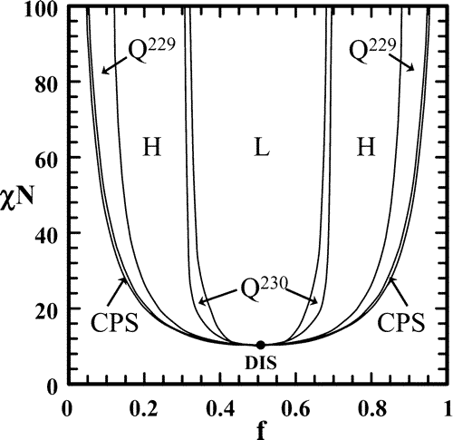
Self-Assembly of Block Copolymers
BCC (Q²²⁹)
HEX
GYR (O²³⁰)
LAM
A
B
(Cochran et al., MM, 39, 2449 (2006))
f_{A}

Slide 14
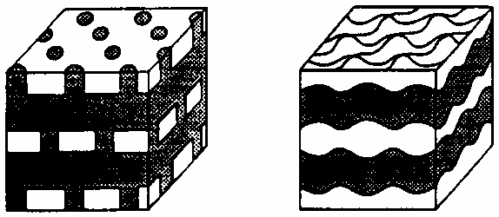
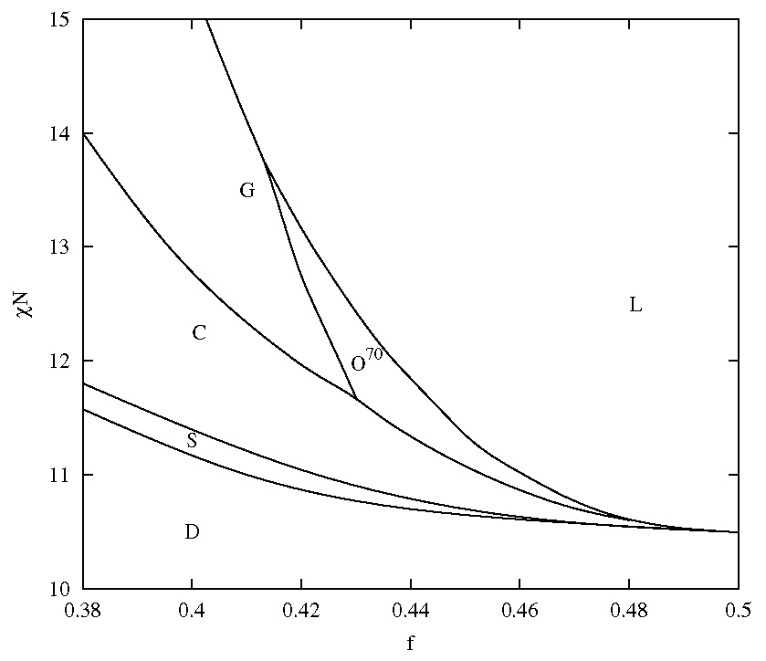
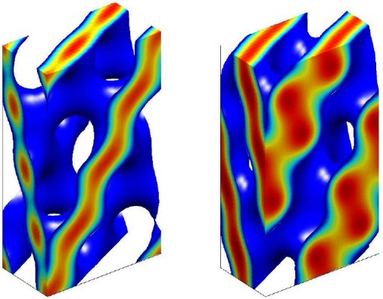
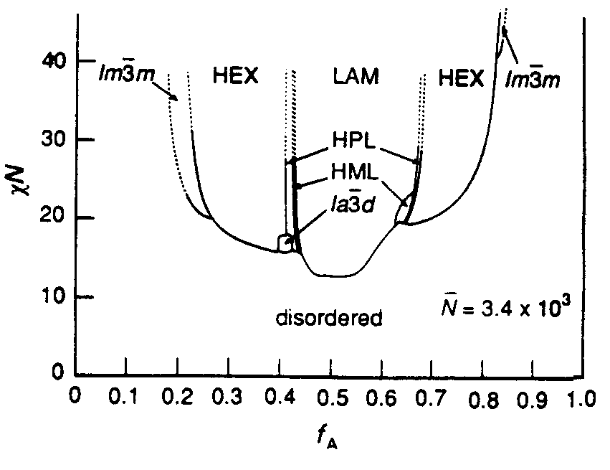
Self-Assembly of Block Copolymers
BCC (Q²²⁹)
HEX
GYR (O²³⁰)
LAM
HPL
HML
A
B
(Cochran et al., MM, 39, 2449 (2006))
(Tylor & Morse, PRL, 94, 208302 (2005))
(Adapted from Bates, et al., Faraday Discuss., 98, 7 (1994))
GYR
BCC
BCC
χN
O⁷⁰
HEX
GYR
LAM
BCC
DIS
f_{A}
f_{A}

Slide 15
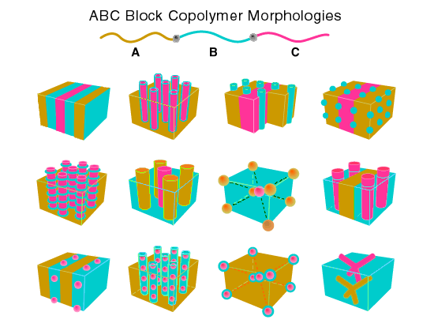
Self-Assembly of Block Copolymers
Block copolymers offer almost unlimited nanostructures.
Diblocks
Triblocks
Multiblocks and Blends
Theoretical guidance is needed to explore the large parameter space involved.
(Adapted from Bates and Fredrickson, Phys. Today, 52, 32 (1999))
Nano-confinement alters the self-assembled morphology of block copolymers, and can be used for morphological control.

Slide 16
Self-Assembly of DBC in Thin Films
Parallel Lamellae
Perpendicular Lamellae
D
x
L₀
L=2D/n
0
L=L₀
L₀: Bulk lamellar period.
L₀: Bulk lamellar period.
D: Film thickness.
L: Confined lamellar period.
n: Number of A-B chain layers.
f_{A}
s=1
s=0
A
B
Numerical Problem:
At surfaces, φ_{A} = φ_{B} = 0 ⇒ q(x=0,s) = 0 ⇒ ω(x=0) → ∞ unless ∇²q=0.
Incompressibility constraint: φ_{A}(r) + φ_{B}(r) = 1
Incompressibility constraint: φ_{A}(r) + φ_{B}(r) = φ₀(x)

Slide 17
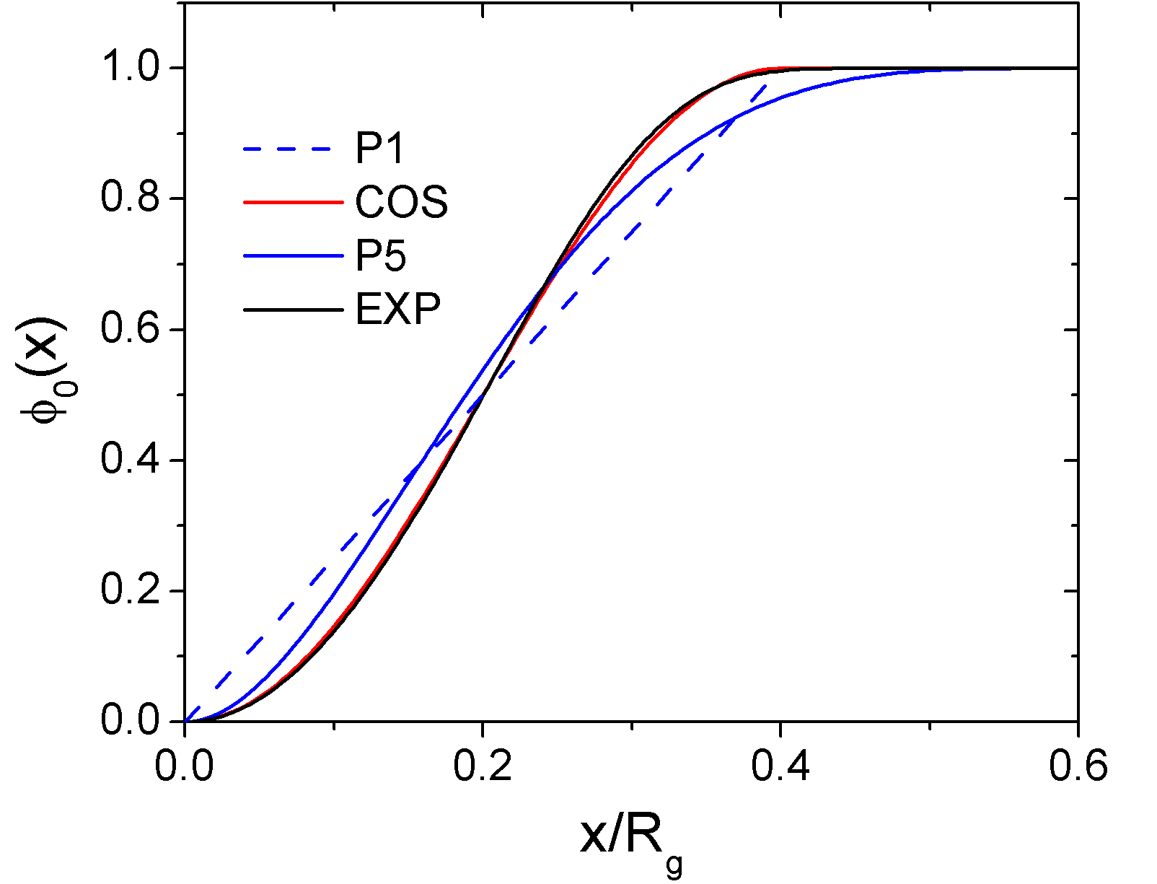
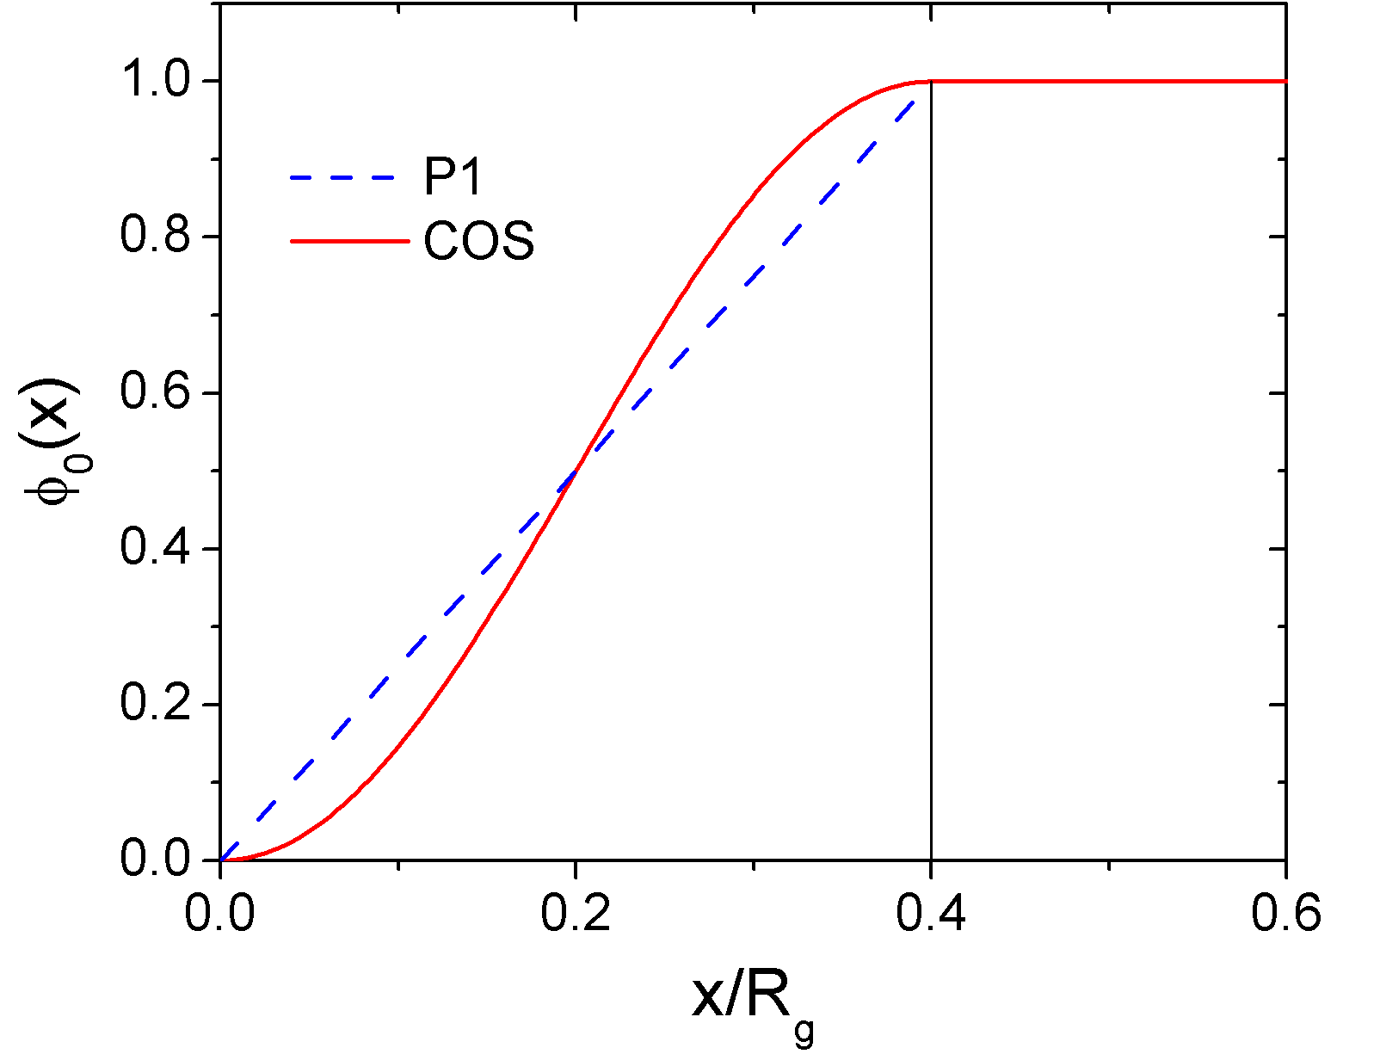
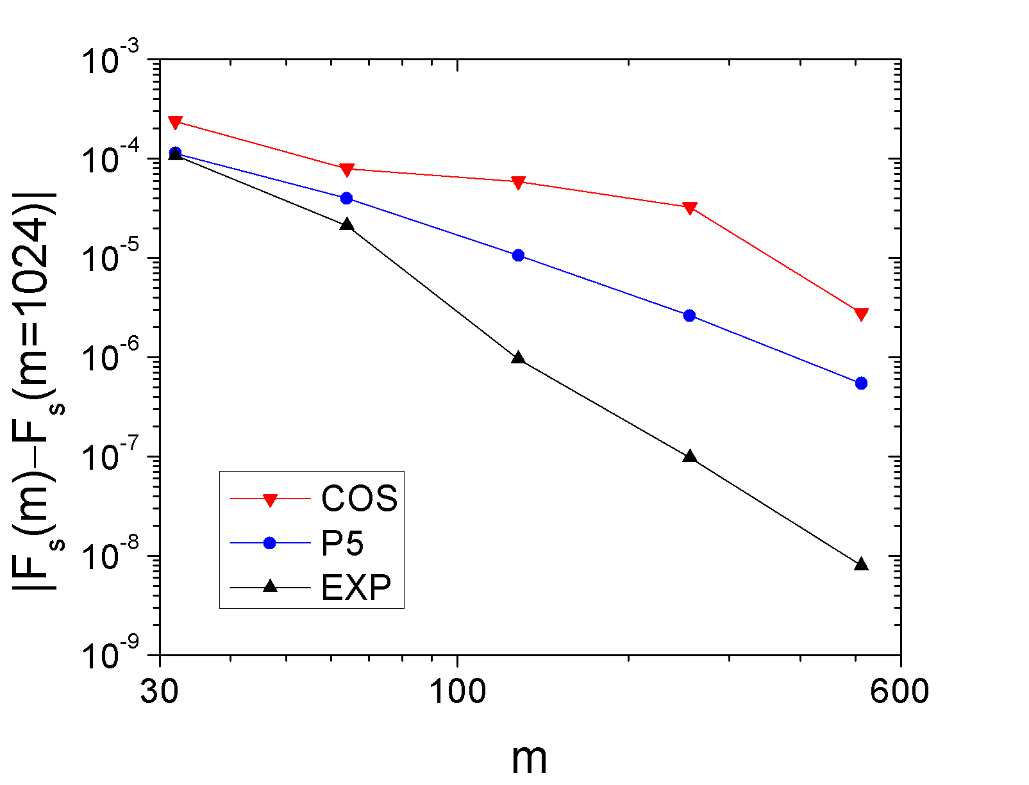
Effects of Boundary Layer
t/R_{g}
(Meng and Wang, JCP, 126, 234902 (2007))

Slide 18
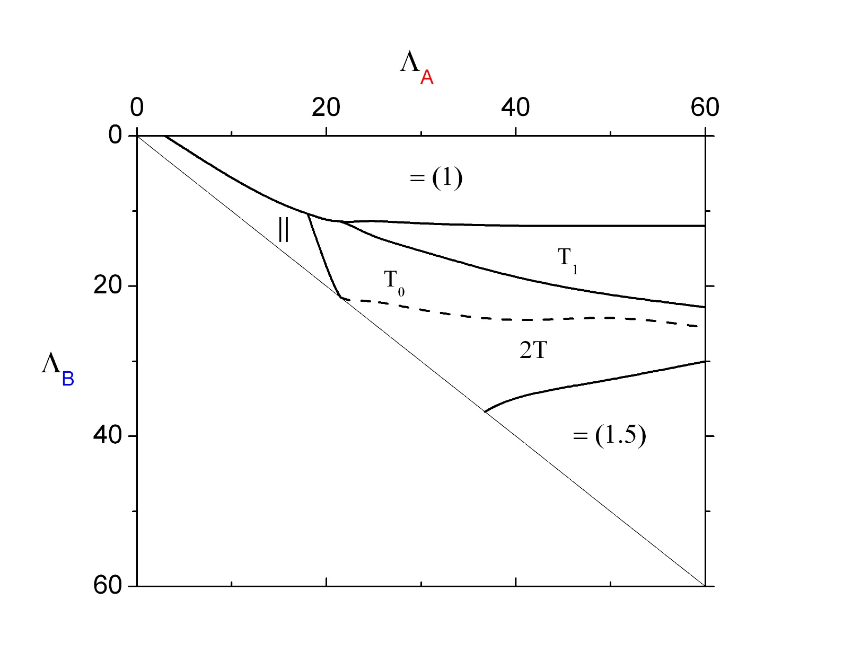
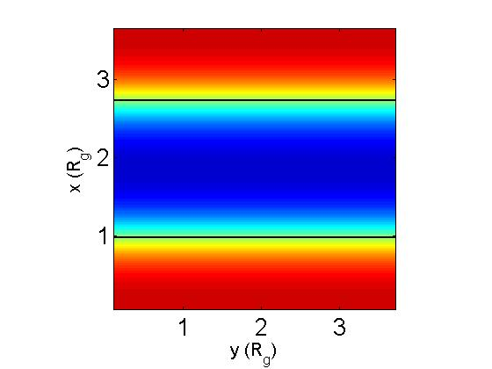
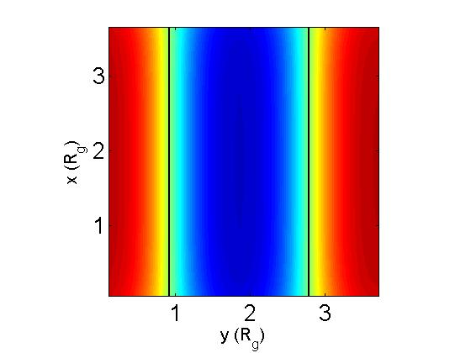
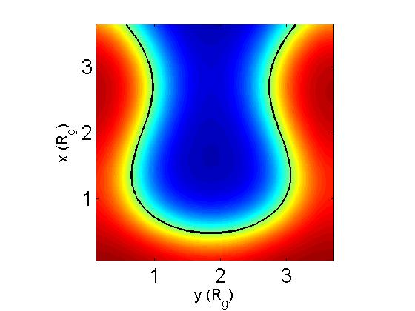
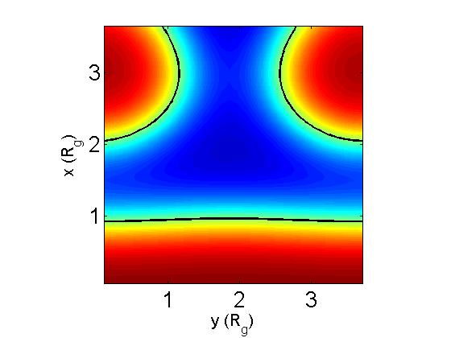
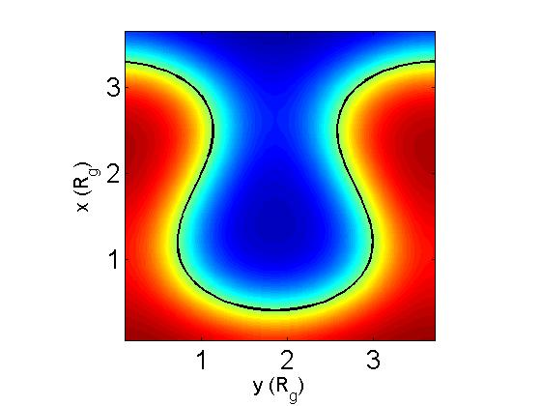
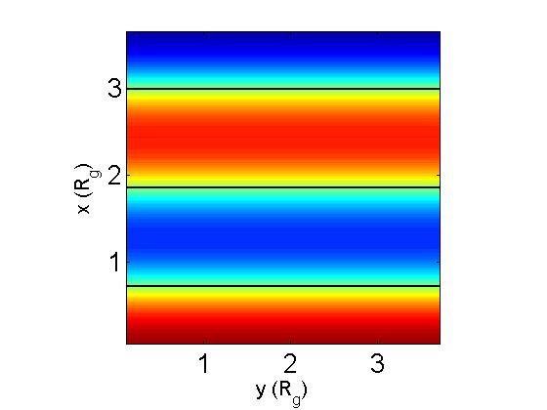
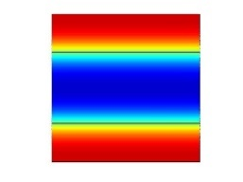
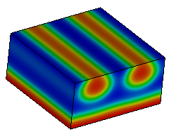
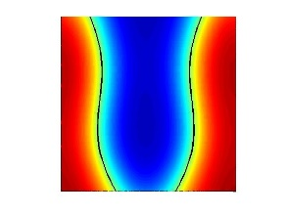
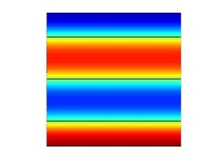
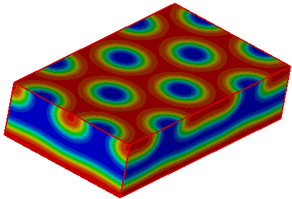
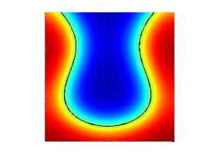
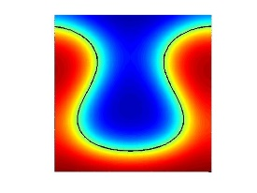
Phase Diagram of Thin-Film Morphologies
Λ_{B}
A
B
χN=15
D=L₀3.72R_{g}
Λ_{A}
= (1)
Without Boundary Layers
||
T₁ (2D)
T₀
2T
= (1.5)
||
x
z
y
2D Calculations with Boundary Layers
z
x
= (1.5)
y
T₀
2T

Slide 19
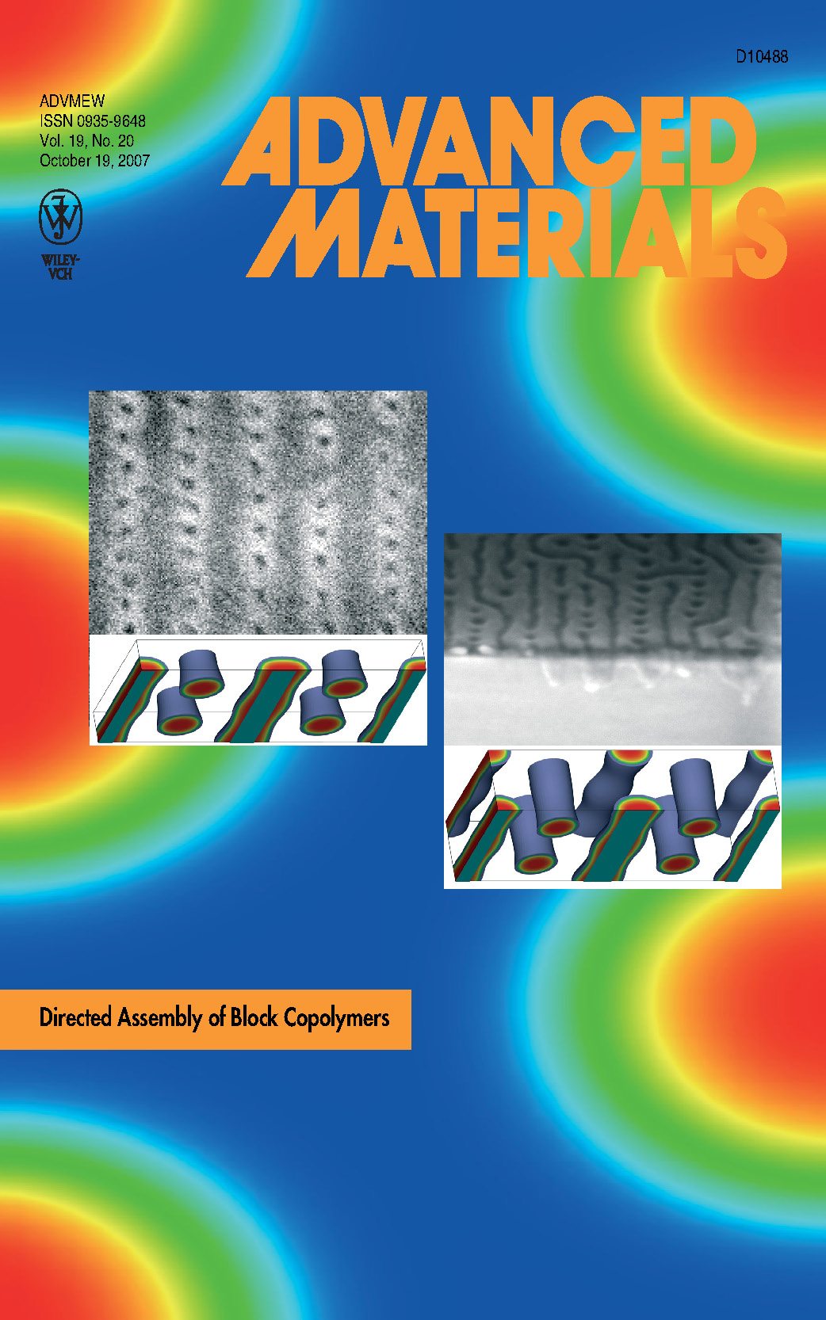
Directed Assembly of DBC on Nano-Patterned Substrates
(Kim et al., Adv. Mater., 19, 3271 (2007))

Slide 20
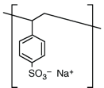
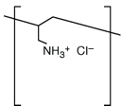
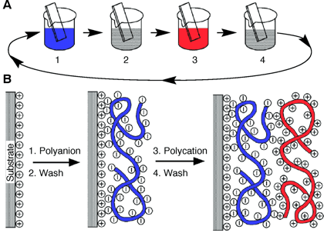
System II. – Polyelectrolyte (PE) Multilayer
Simple, fast, cheap
Versatile
PE Layer-by-Layer Assembly
PE are charged polymers
Synthetic PE: conducting & light-emitting polymers, reactive polymers, polymeric complexes, polymeric dyes, …
Natural PE: DNA, RNA, proteins, viruses, …
Charged nano-particles and platelets, …
PE are important materials
Can be soluble in water
Can be adsorbed onto charged surfaces
Potential Applications
(G. Decher, Science, 277, 1232 (1997))
PE are difficult to study
surface modification, enzyme immobilization, gene transfection, separation membranes, conducting or light-emitting devices, batteries, optical data storage, controlled particle and catalyst preparation, etc.
Both long-range (Coulomb) and short-range (excluded volume) interactions present in the system

Slide 21
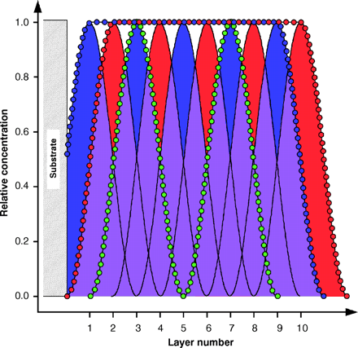
“Fuzzy Nanoassemblies:
Toward Layered Polymeric Multicomposites”
Decher, Science, 277, 1232 (1997)
Black curve: Concentration profile of each layer.
Blue (Red) dots: Total concentration profile of anionic (cationic) groups from all layers.
Green dots: Concentration profile of a labeling group applied to every fourth layer.

Slide 22
Model System for PE Adsorption
+
A
Parameters in the model:
σ_{SF} surface charge density;
d⁻¹ for short-range interactions between surface and polymers, >0 for repulsive and <0 for attractive surfaces;
p degree of ionization of PE;
smeared charge distribution;
χ Flory-Huggins parameter between PE and solvent;
φ_{A,b} bulk polymer concentration;
c_{s,b} bulk salt concentration;
l system size;
ε=80 dielectric constant.
+
φ_{A,b}
c_{s,b}
ψ_{b}=0
+
+
+
+
0
x
l
solvent molecule (S)
cation (+)
anion (−)
Monovalent, 1D system
Ions from salt = counterions from PE and substrate
Ions have no volume and short-rang interactions
Polymer segments have the same density ρ₀ as solvent molecules
All polymer segments have the same statistical segment length a

Slide 23
Field Theory of PE
j=A,S,+,−; M=S,+,−
(Wang et al., JPC B, 108, 6733 (2004))

Slide 24
Self-Consistent Field Theory of PE &
Ground-State Dominance Approximation
Self-Consistent Field Theory of PE

Slide 25
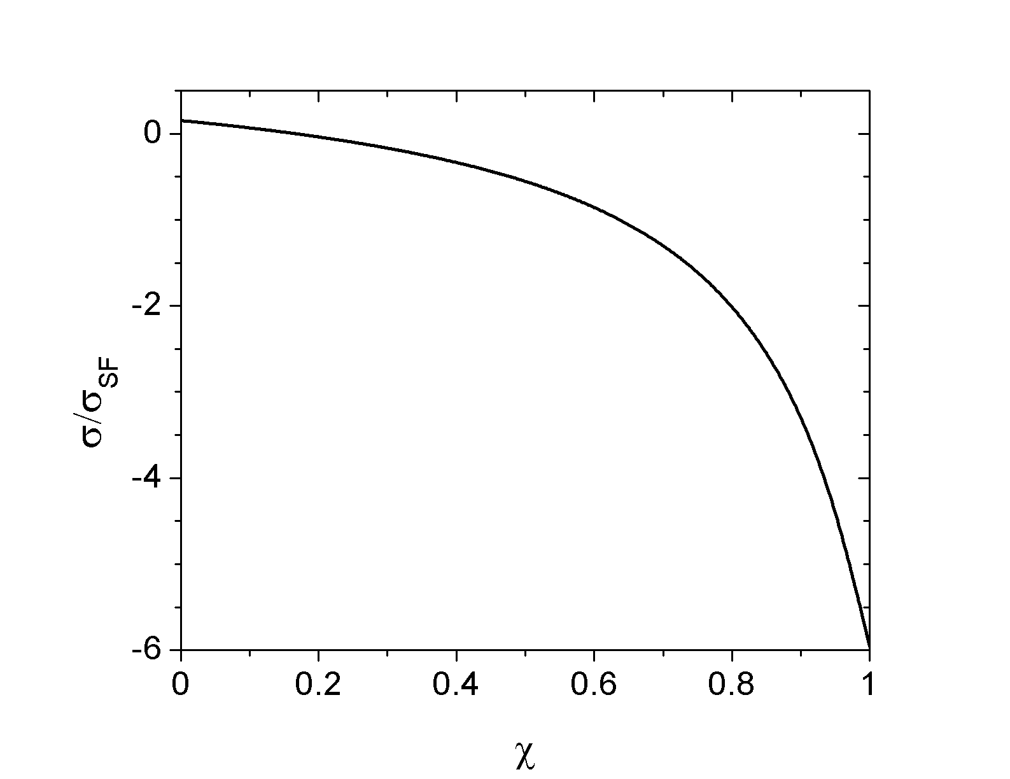
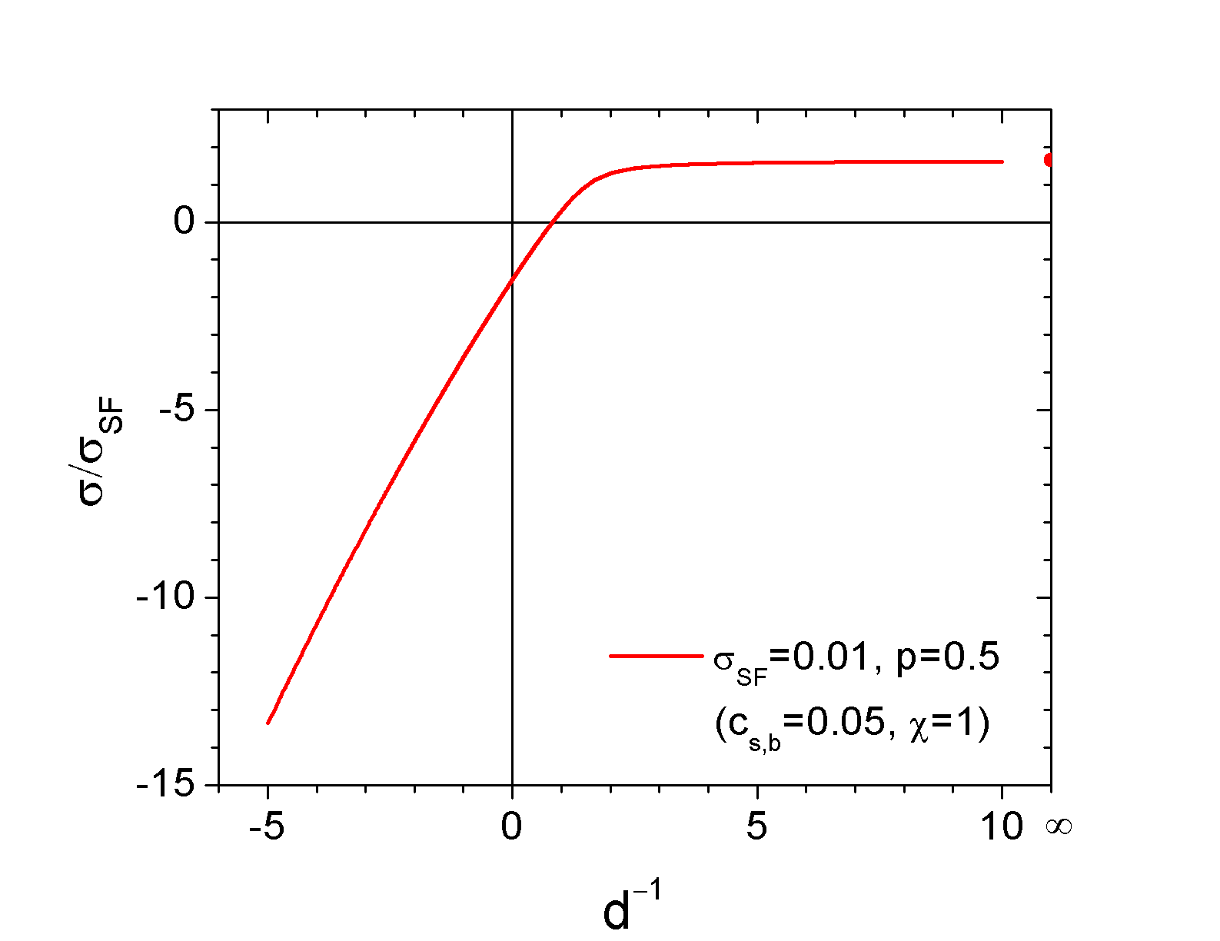
Conditions for Strong Charge Inversion
Attractive
Repulsive
d⁻¹=0, σ_{SF}=0.1, c_{s,b}=0.1
σ_{SF}=0.01, c_{s,b}=0.05, χ=1
p=0.5, φ_{A,b}=1.25×10⁻⁴
Poor solvent for polymers, high salt concentrations, attractive or indifferent surface for polymers, and oppositely charged surface and polyelectrolytes are all needed to obtain strong charge inversion.

Slide 26
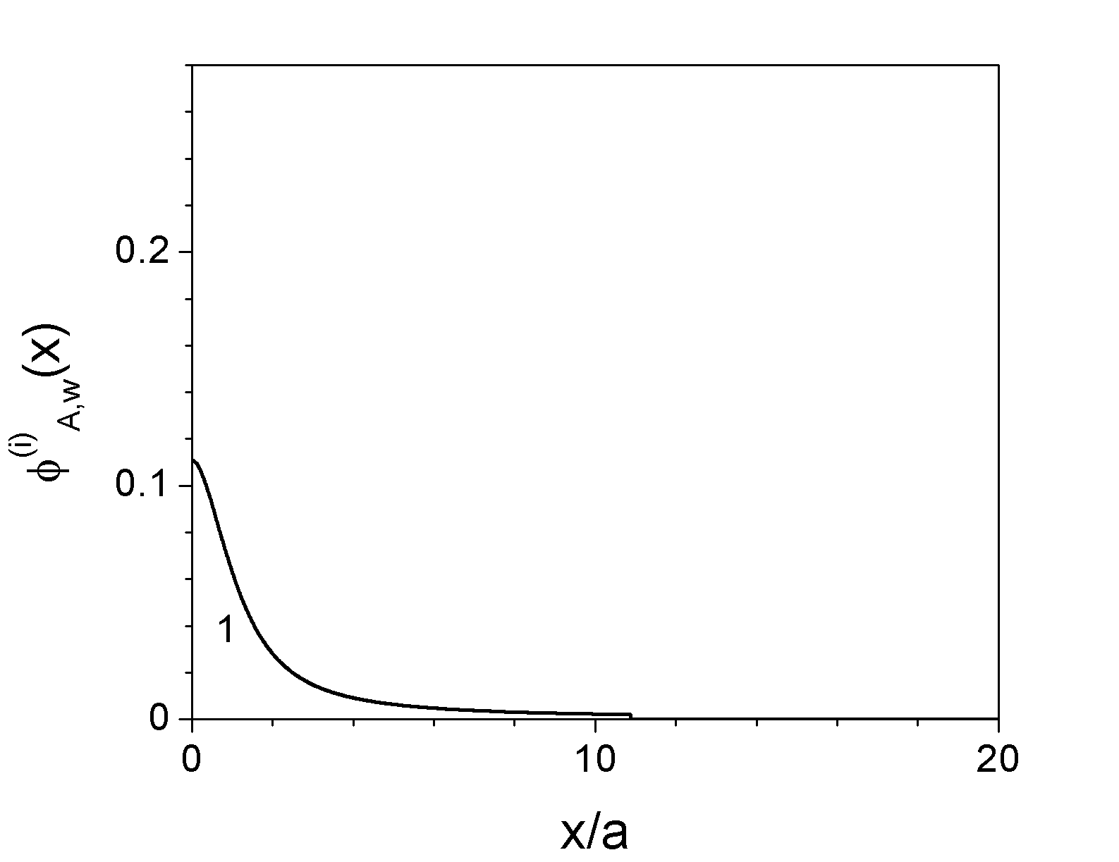
Layer Profiles – Symmetric, Smeared PE
σ_{SF}=0.1 (2.61mC/m²), v₁=−v₂=−1, p₁=p₂=0.5, χ_{1S}=χ_{2S}=1,
c_{s,b}=0.05 (0.667M), φ_{A,b}=7.5×10⁻⁴ (10mM) (with a=0.5nm and ρ₀=a⁻³)
x_{w}⁽¹⁾
(Wang, JPC B, 110, 5825 (2006))

Slide 27
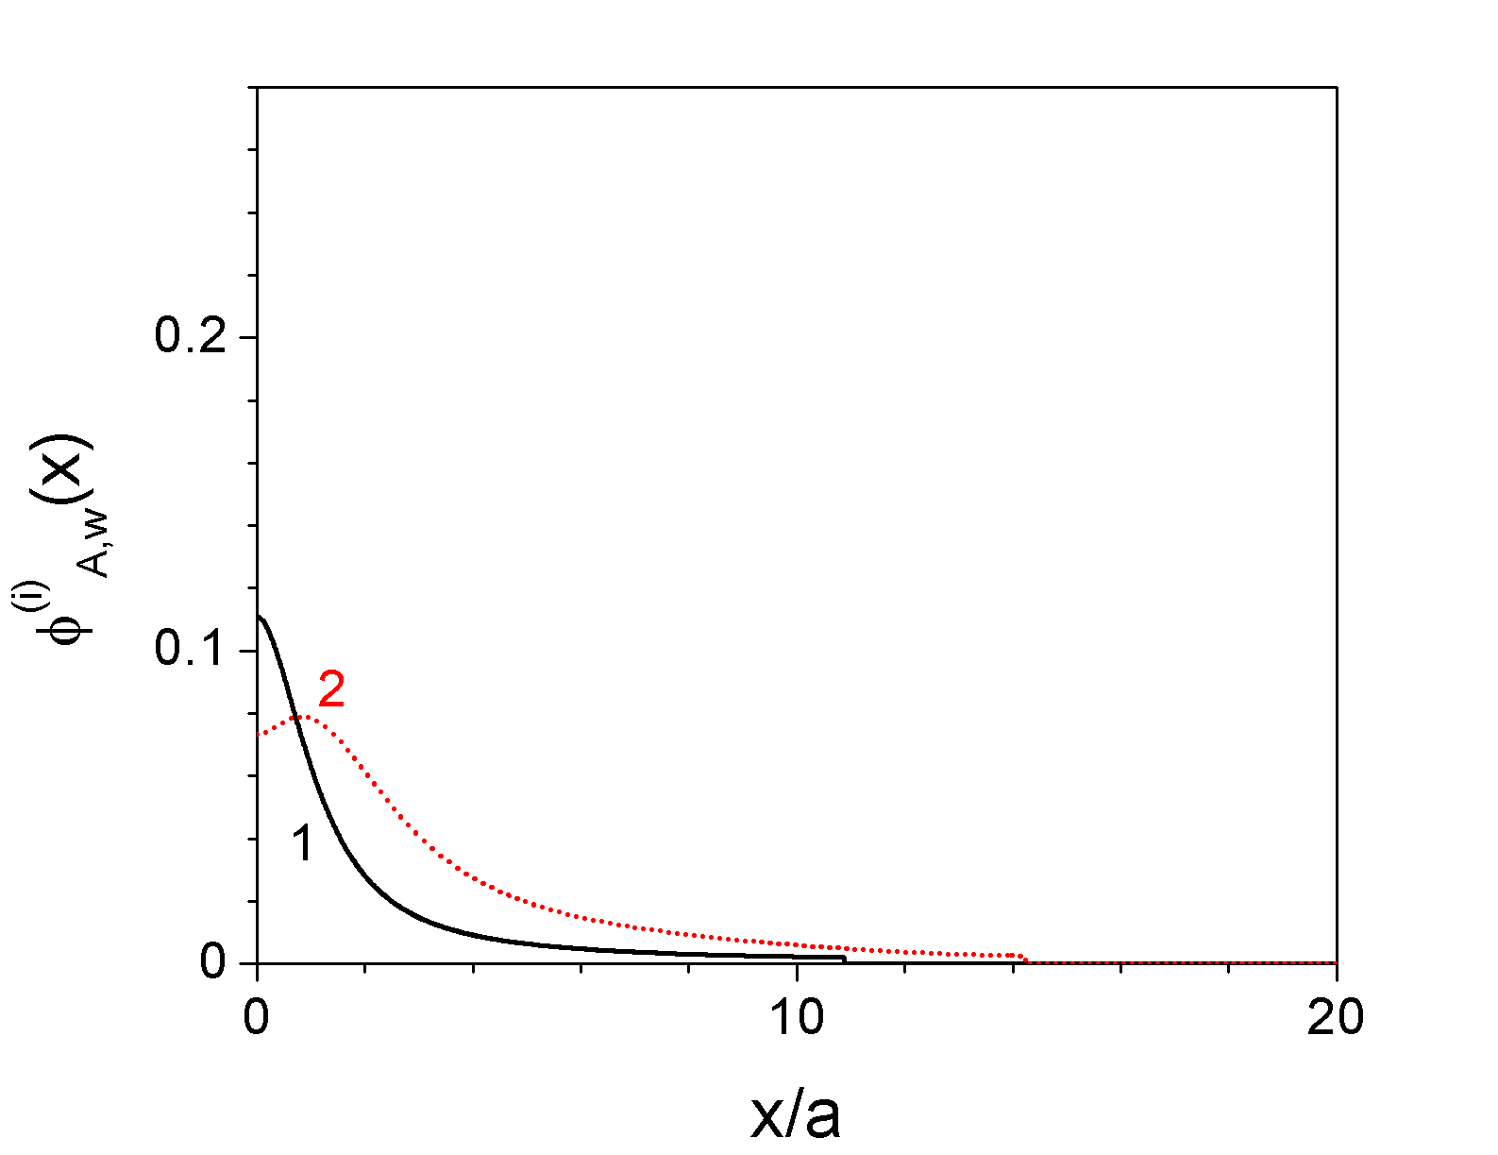
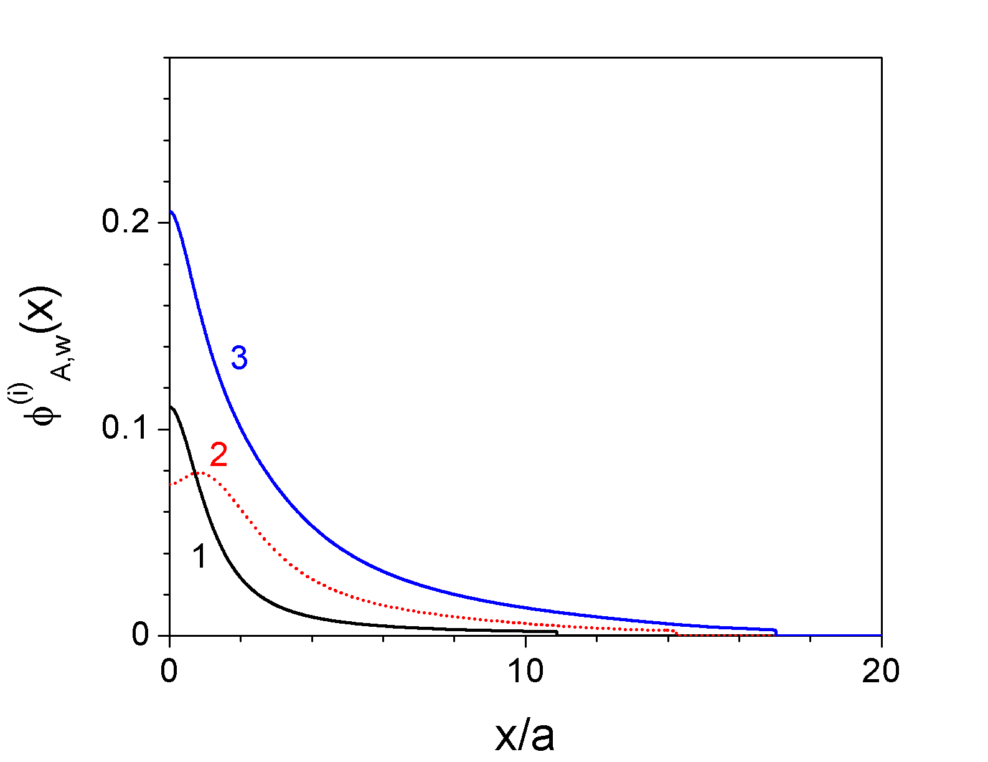
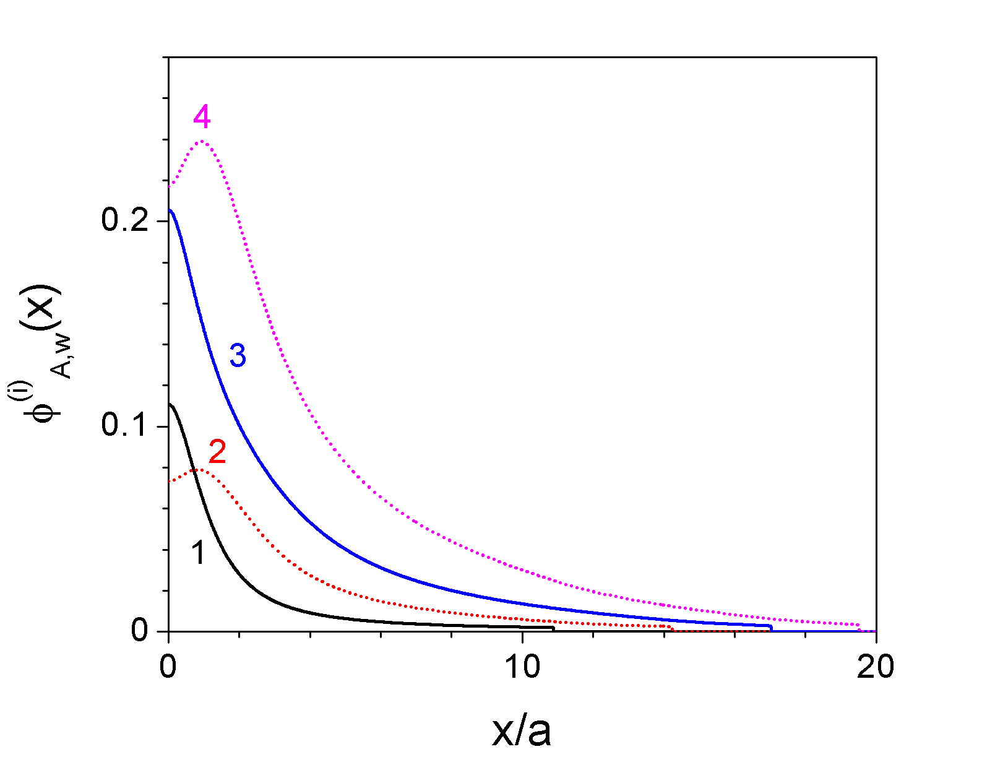
Layer Profiles – Symmetric, Smeared PE
σ_{SF}=0.1 (2.61mC/m²), v₁=−v₂=−1, p₁=p₂=0.5, χ_{1S}=χ_{2S}=1,
c_{s,b}=0.05 (0.667M), φ_{A,b}=7.5×10⁻⁴ (10mM) (with a=0.5nm and ρ₀=a⁻³)
(Wang, JPC B, 110, 5825 (2006))

Slide 28
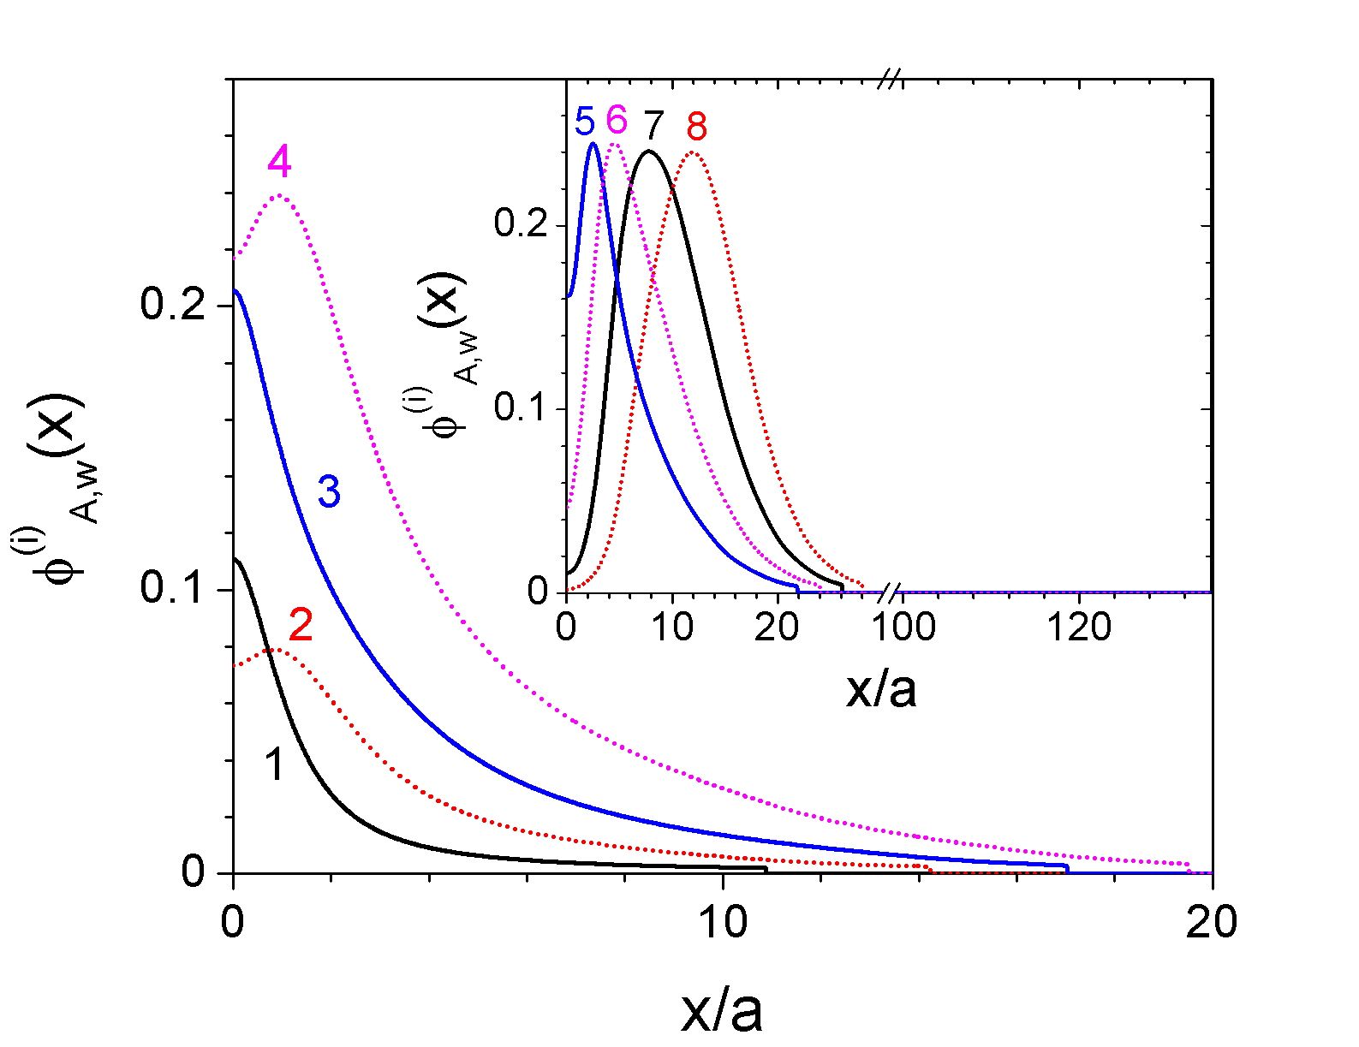

Layer Profiles – Symmetric, Smeared PE
σ_{SF}=0.1 (2.61mC/m²), v₁=−v₂=−1, p₁=p₂=0.5, χ_{1S}=χ_{2S}=1,
c_{s,b}=0.05 (0.667M), φ_{A,b}=7.5×10⁻⁴ (10mM) (with a=0.5nm and ρ₀=a⁻³)
(Wang, JPC B, 110, 5825 (2006))

Slide 29
Summary
Thank you ! ☺
Notes:
The first project is to study the self-assembly of block copolymers under nano-confinement. Here shows symmetric diblock copolymers confined between two surfaces preferring different blocks. Under certain conditions, the copolymers can form this 3D complex structure, which cannot be obtained under bulk conditions. One can therefore use nano-confinement to obtain novel morphologies and to control the self-assembly of block copolymers for their applications.
We also study the directed assembly of block copolymers by external fields, such as an electric or magnetic field, or sometimes combined with a chemically nanopatterned substrate. These external fields are used to produce 3D nanostructures well ordered over the length scale of microns or even millimeters, which are desirable for practical applications such as nanolithography.
The third project is to study the stimuli-response of diblock copolymer brushes. By immersing the brush in different solvents that like either the ungrafted or the grafted block, one can change the surface structure and properties as shown here. Such “smart” surfaces have wide applications in diverse fields such as chemical gates, drug delivery, biosensors, etc.
Another project is to study the structure and properties of block copolymer nanocomposites. Here the self-assembly of block copolymers is utilized to well disperse the nanoparticles, which can greatly enhance the mechanical properties of the polymer matrix. The inclusion of nanoparticles, on the other hand, could alter the self-assembled structure of block copolymers. It is therefore crucial to understand the structure of block copolymer nanocomposites and further relate it to their mechanical properties.
Finally, we are also interested in understanding the formation mechanism, internal structures, and molecular properties of polyelectrolyte multilayers. As shown here, you put, say, a positively charged substrate into a polyanion solution. As expected, you get an adsorbed layer of polyanions. An interesting phenomenon here, which is counter-intuitive, is that the surface charge can be inverted and this whole thing now is negatively charged. So you can then put it into a polycation solution to build-up another layer of polycations. There is a washing step in-between, to remove loosely adsorbed chains in order to avoid their contamination to the solution used in the next step. This process can be repeated for hundreds of times in experiments to produce the so-called polyelectrolyte multilayer film. This simple technique is quite robust and has many applications such as surface modification, enzyme immobilization, conducting or light-emitting devices, etc.

