Slide 1
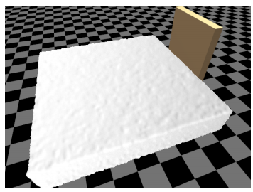
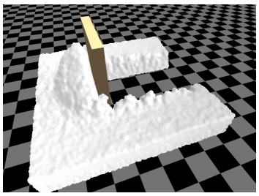
Real-time Particle-based Snow Simulation with Vulkan
Milestone 2
Qiaosen Chen, Haoyu Sui

Slide 2
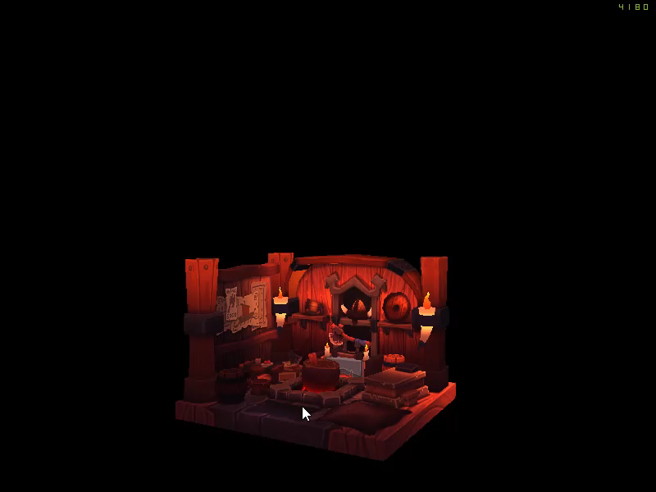
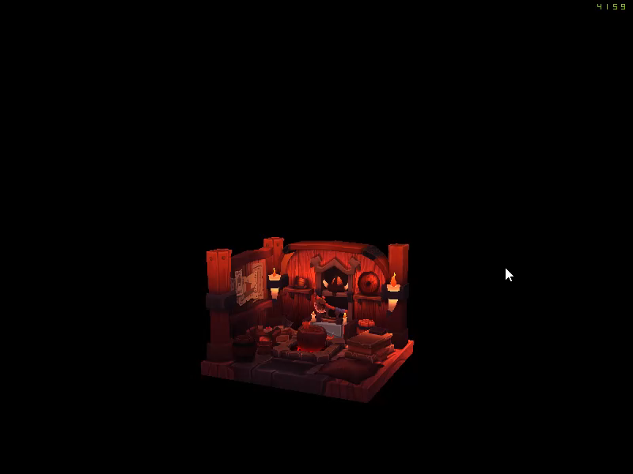
Progress
Vulkan : Add the camera, user interactive functions and mesh loading
Implemented camera rotation / zoom in / zoom out effect
Used tinyobjloader to load obj. mesh
Achieved texture mapping
Reference : Prashant Goswami, Christian Markowicz, Ali Hassan, Real-time particle-based snow simulation on the GPU

Slide 3
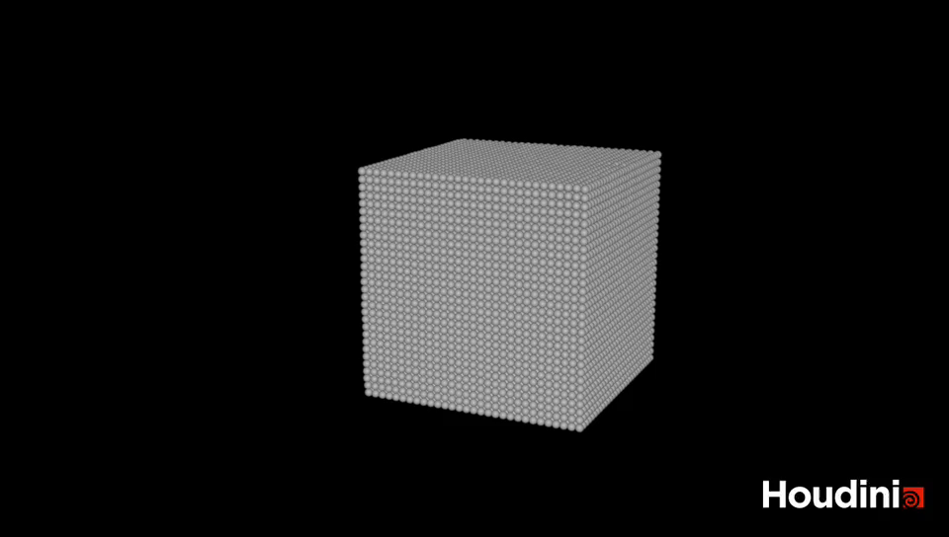
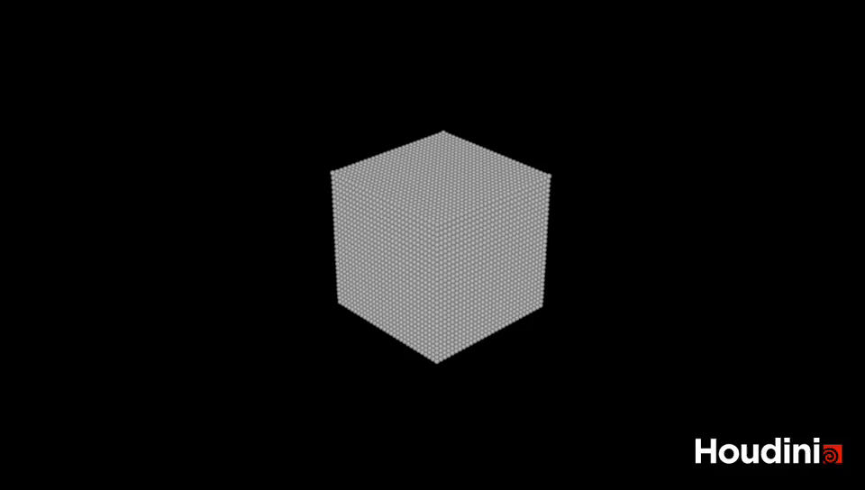
Progress
Implement the math and physics parts, achieve the basic particle-based snow simulation
Compression of soft snow (with walls and ground)
Compression of soft snow (only ground)
270k particles
270k particles
Average time for computing each frame: 2.14s
Average time for computing each frame: 2.23s
FPS: 24 frames per second
FPS: 24 frames per second
Reference : Prashant Goswami, Christian Markowicz, Ali Hassan, Real-time particle-based snow simulation on the GPU

Slide 4
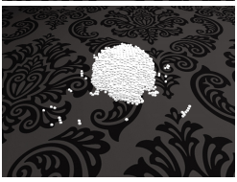
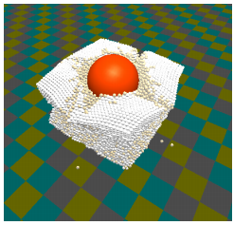
Progress
Implement the math and physics parts (Mostly achieved)
Achieve the basic simulation of snow (Achieved)
Work on Vulkan to visualize the snow particles, add camera and user interactive functions and mesh loading (Mostly achieved)
Goals for next milestone
Complete the remaining parts of math and physics and tune params to get better effects
Integrate the code of physics and Vulkan together
Use compute shader to accelerate the computation
Images from reference
Reference : Prashant Goswami, Christian Markowicz, Ali Hassan, Real-time particle-based snow simulation on the GPU

Slide 5
References
Real-time particle-based snow simulation on the GPU
https://www.diva-portal.org/smash/get/diva2:1320769/FULLTEXT01.pdf
Real-time particle-based snow simulation on the GPU
https://www.diva-portal.org/smash/get/diva2:1118073/FULLTEXT02
A material point method for snow simulation
https://www.math.ucla.edu/~jteran/papers/SSCTS13.pdf
Nvidia: use GPU to simulate fluid
https://developer.nvidia.com/gpugems/gpugems/part-vi-beyond-triangles/chapter-38-fast-fluid-dynamics-simulation-gpu
Vulkan Tutorial
https://vulkan-tutorial.com/Introduction
tinyobjloader
https://github.com/tinyobjloader/tinyobjloader

