Slide 1
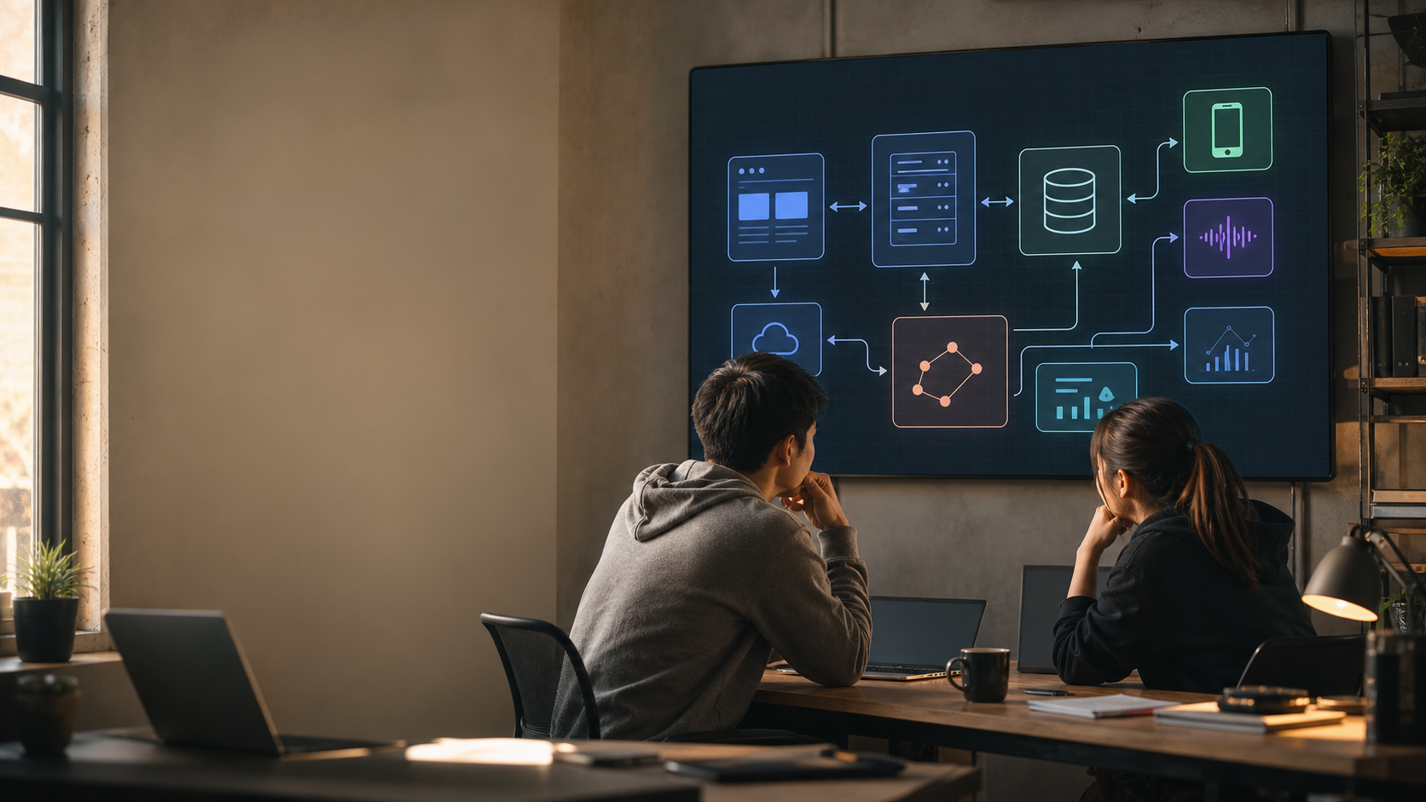
11:00-5:00 PT / FIRST DAY
Welcome To
PearlPortal
AI Engineering
Today you learn the system, set up Codex, and draw the architecture before touching code.
Codex first
Evidence
No code today

Slide 2
TODAY OUTCOME
By 5 PM, you should be able to explain the system without pretending.
01
02
03
04
Install the stack
Map the product
Read with Codex
Draw Excalidraw
Codex + Edward Agent Stack working on your Mac.
Know frontend, backend, database, and vendor boundaries.
Ask for file citations and verify against repo docs.
Make the first architecture diagram for review.
PearlPortal intern onboarding / 02

Slide 3
MACHINE SETUP
Your Mac is boring on purpose: local user, work accounts, repeatable tools.
1
Local macOS user
Skip personal iCloud. Work apps use BLI/work email.
Rule
2
Run install prompt
Login, key, GUI prompt, or license step appears: stop and report exact missing gate.
Agent installs Homebrew, Node, Bun, Python, GitHub CLI, Supabase, Vercel, Repowise.
3
Finish auth gates
Codex, GitHub, Vercel, Supabase, Exa. Stop when login/API key is missing.
4
Verify
`./scripts/verify.sh` and `./scripts/auth-doctor.sh` tell us what passed.
PearlPortal intern onboarding / 03

Slide 4
PEARLPORTAL IN ONE PICTURE
Most work is boundary work: product UI, API services, data ownership, vendor sync.
Vercel
Next.js / React
PearlPortal UI
GCP Cloud Run
Express / TypeScript
API server
Supabase
Postgres / Auth / RLS
Storage / Realtime
External systems
Salesforce / RingCentral
Velocity / AWS
>
>
>
Vercel crons
Inngest jobs
Migration CD
Webhook intake
Diagram rule: draw arrows in the direction data or control actually moves. Ambiguous arrows are bugs.
PearlPortal intern onboarding / 04

Slide 5
PRODUCT SURFACE
PearlPortal replaces messy broker work with one operating cockpit.
Leads
Deals
Calls/SMS
inbound, routing, ownership
pipeline, notes, follow-ups
RingCentral activity history
HOLP/AML
Admin
Real lesson
Velocity docs, credit data, AI reports
monitoring, users, sync health
UI bugs often start at data boundaries.
PearlPortal intern onboarding / 05

Slide 6
WHERE COMPLEXITY LIVES
Sync is not copy-paste. It is ownership, timing, retries, and source of truth.
INTAKE
CONTROL
RECORD
USE
External lead
>
Backend + Edge + Jobs
validate, map, retry
protect ownership
Supabase
Postgres / Auth / RLS
Storage / Realtime
Broker UI
shows current truth
not raw vendor noise
Salesforce
>
>
>
RingCentral
>
Velocity
>
When you diagram, mark: source of truth, overwrite risk, auth boundary, retry path.
PearlPortal intern onboarding / 06

Slide 7
AI ENGINEERING: NOW VS NEXT
Use the best agent now.
Build the control loop next.
Now
Next
Codex reads repo, cites files, edits, tests, opens PRs.
Cockpit captures raw sessions, attributes operator, scores work, improves training.
Raw first. Analysis second.
PearlPortal intern onboarding / 07

Slide 8
HOW YOU USE CODEX
Do not ask vague questions. Give Codex the repo, the task, and the proof standard.
Bad
How does this app work?
Good
Read the PearlPortal docs and source. Map frontend, backend, database, external integrations. Cite files.
Better
Find the exact data path for a lead from provider intake to broker UI. Show files, tables, auth boundary, failure modes.
Default loop: ask Codex -> inspect files -> make diagram -> explain back -> only then code.
PearlPortal intern onboarding / 08

Slide 9
EXCALIDRAW MISSION
Draw the architecture. Good diagram beats fake confidence.
Your diagram must show
Use this prompt
01
System boundaries
Read PearlPortal repo docs and source. Build an architecture map for a new intern. Cite files for every system box. Flag unknowns instead of guessing.
02
Data/control arrows
03
Source of truth by domain
04
Auth and secret boundary
05
One failure mode per integration
No code today
Cite files
Flag unknowns
PearlPortal intern onboarding / 09

Slide 10
END-OF-DAY BAR
You win today by becoming legible: to yourself, to Codex, and to the team.
OK
Stack installed
OK
Repo map drafted
or exact blocker written down
with file citations
OK
Architecture diagram
OK
Question list
review-ready in Excalidraw
specific, not vibes
Next session: small ticket, plan first, tests second, PR last.
PearlPortal intern onboarding / 10

