Slide 1
3U
15
2
3
1U
2U
1
7D
3D
6
7
6D
5D
4D
5
4

Slide 2
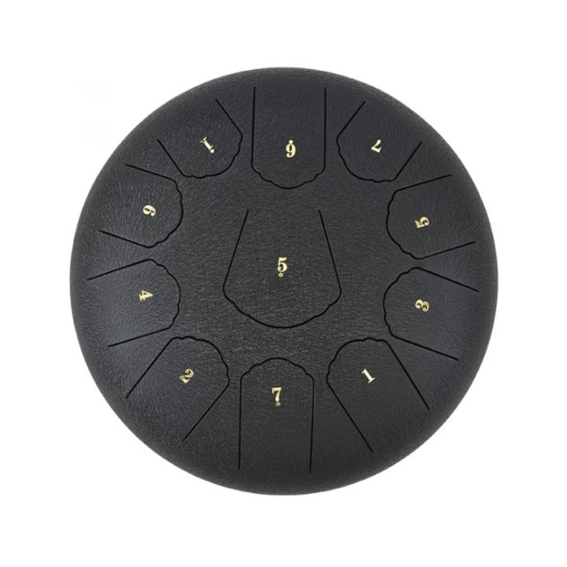
11
6D
1U
7
6
5
5D
4
3
2
1
7D

Slide 3
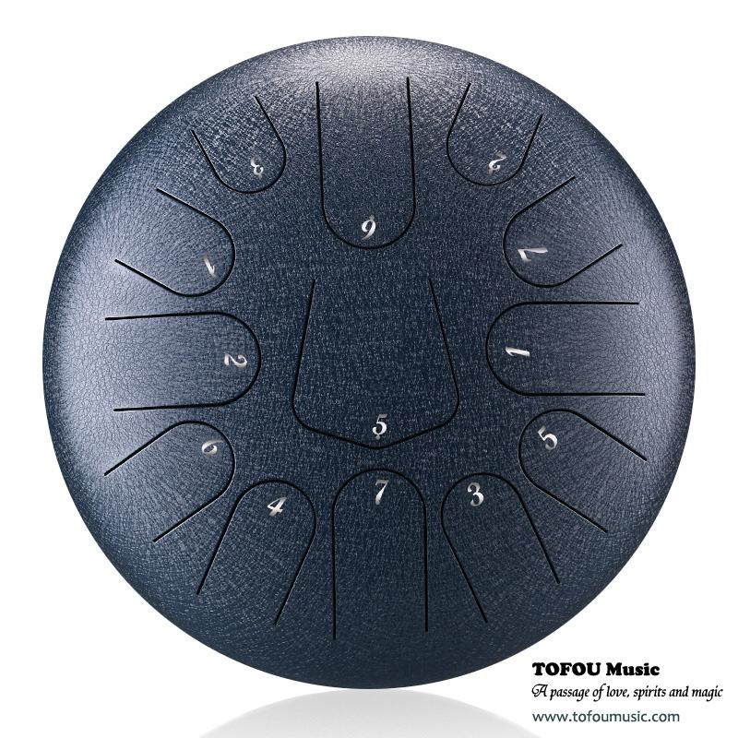
13
6D
3U
2U
7
1U
2
1
5D
6
5
4
7D
3

Slide 4
. 2
9
. 1
7
1
6
5
4
3
2

Slide 5
1
8
5
6
3
2
7
1U
4

