Slide 1
HTML & CSS
Author: Giau Le

Slide 2
References
https://developer.mozilla.org/en-US/docs/Learn/HTML
https://developer.mozilla.org/en-US/docs/Learn/CSS/First_steps/How_CSS_is_structured
https://www.w3schools.com/css
https://www.learn-html.org
https://techmaster.vn/posts/35050/co-gi-moi-trong-html5

Slide 3
Overview
Introdution to the web & HTML
Nesting elements
Head elements and scripts
Basic Elements
Links, Lists, Images
Form & Table
HTML <div> Tag
Intro HTML5

Slide 4
Intro to CSS
CSS Syntax & Cascade and inheritance
CSS Selectors
The box model - some basic properties
CSS layout
Debugging CSS
Organizing your CSS
Intro to Responsive
Intro to SCSS (optional)

Slide 5
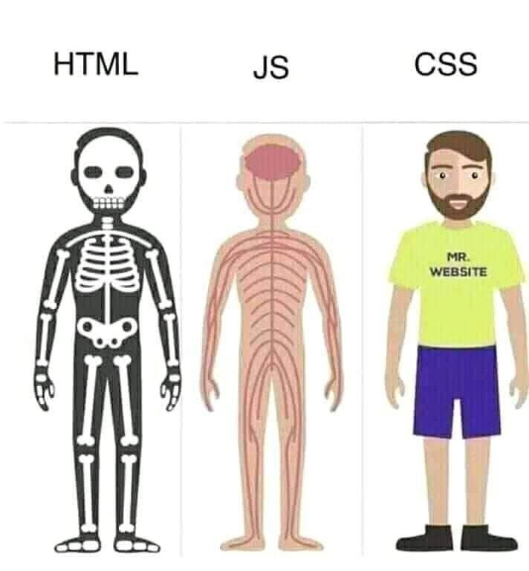
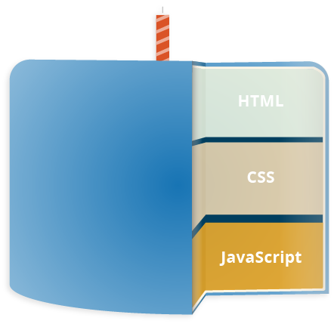
Introdution to Web

Slide 6
Introdution to Web
An HTML page is an HTML document that defines the content of the page by using a special markup similar to XML.
A CSS stylesheet defines the style of the HTML elements in the page. It is either embeded within an HTML page or loaded using the tag.
JavaScript is the programming language used to interact with the HTML page through an API called the DOM (Document Object Model) Bindings.

Slide 7
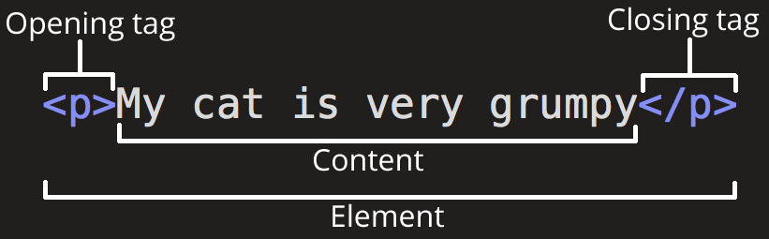
Introdution to HTML
HTML (Hypertext Markup Language) is not a programming language. It is a markup language that tells web browsers how to structure the web pages.
HTML consists of a series of elements, which you use to enclose, wrap, or mark up different parts of content to make it appear or act a certain way.
Tags in HTML are case-insensitive

Slide 8
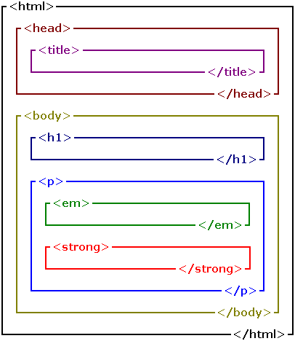
Nesting elements
Elements can be placed within other elements. This is called nesting.
<p>My cat is <strong>very</strong> grumpy.</p>

Slide 9
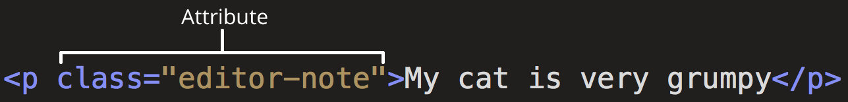
Attributes
An attribute should have:
A space between it and the element name. (For an element with more than one attribute, the attributes should be separated by spaces too.)
The attribute name, followed by an equal sign.
An attribute value, wrapped with opening and closing quote marks.
Boolean attributes
<input type="text" disabled="disabled">
<a href=https://www.mozilla.org/ title=The Mozilla homepage>favorite website</a>

Slide 10
Head elements and scripts
The head of an HTML document is the part that is not displayed in the web browser when the page is loaded.
The <title> element is metadata that represents the title of the overall HTML document (not the document's content.)
<!DOCTYPE html>
<html>
<head>
<meta charset="utf-8">
<title>My test page</title>
</head>
<body> <p>This is my page</p> </body>
</html>

Slide 11
Head elements and scripts
Metadata is data that describes data, and HTML has an "official" way of adding metadata to a document — the <meta> element.
<meta charset="utf-8">
Setting the primary language of the document
<html lang="en-US">
This is useful in many ways. Your HTML document will be indexed more effectively by search engines if its language is set

Slide 12
Head elements and scripts (d)
Adding custom icons to your site
Saving it in the same directory as the site's index page, saved in .ico format.
Adding the following line into your HTML's <head> block to reference it:
<link rel="icon" href="favicon.ico" type="image/x-icon">
Link to css, js
<link rel="stylesheet" href="my-css-file.css">
<script src="my-js-file.js" defer></script>

Slide 13
Basic Elements
A text header, denoted using the <h1>, <h2>, <h3>, <h4>, <h5>, <h6> tags.
A paragraph, denoted using the <p> tag.
A horizontal ruler, denoted using the <hr> tag.
A link, denoted using the <a> (anchor) tag.
A list, denoted using the <ul> (unordered list), <ol> (ordered list) and <li> (list element) tags.
An image, denoted using the <img> tag
A divider, denoted using the <div> tag
A text span, denoted using the <span> tag

Slide 14
Basic Elements (d)
Each element can also have attributes - each element has a different set of attributes relevant to the element. There are a few global elements, the most common of them are:
id - Denotes the unique ID of an element in a page. Used for locating elements by using links, JavaScript, and more.
class - Denotes the CSS class of an element.
style - Denotes the CSS styles to apply to an element.

Slide 15
Links, Lists, Images
A link ("anchor") is a small span of text that will direct you to a different section in the page, or to a different page.
<a href="https://www.google.com">A link to Google</a>
To create a link to a different section in the same page, you will need to use a hash sign along with the element ID to where you would like the browser to jump to. For example:
<a href="#faq">Click here to read the Frequently Asked Questions</p>

Slide 16
Links, Lists, Images (d)
To add an image, use the <img> tag along with the src attribute to specify the location of the image.
<img src="/static/img/code.jpg">
Ordered lists
To change the list style attributes, we can use the CSS attribute called list-style-type. The available types are:
disc
circle
square
none

Slide 17
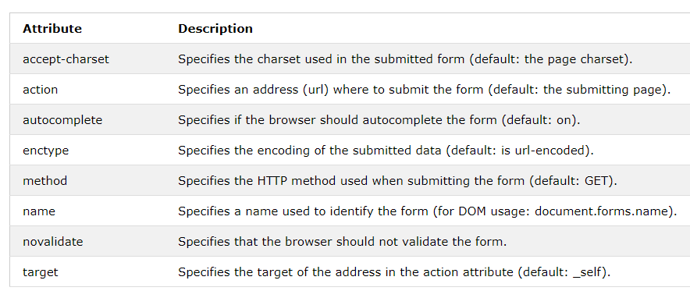
HTML Form
An HTML form is used to collect user input. The user input can then be sent to a server for processing.
<form action="/action_page.php">
<label for="fname">First name:</label><br>
<input type="text" id="fname" name="fname" value="John"><br>
<label for="lname">Last name:</label><br>
<input type="text" id="lname" name="lname" value="Doe"><br><br>
<input type="submit" value="Submit">
</form>

Slide 18
HTML Table
An HTML table is defined with the <table> tag.
Use the HTML <table> element to define a table
Use the HTML <tr> element to define a table row
Use the HTML <td> element to define a table data
Use the HTML <th> element to define a table heading
Use the HTML <caption> element to define a table caption
Use the CSS border property to define a border
Use the CSS border-collapse property to collapse cell borders
Use the CSS padding property to add padding to cells

Slide 19
HTML Table
Use the CSS text-align property to align cell text
Use the CSS border-spacing property to set the spacing between cells
Use the colspan attribute to make a cell span many columns
Use the rowspan attribute to make a cell span many rows
Use the id attribute to uniquely define one table

Slide 20
HTML <div> Tag
The <div> tag defines a division or a section in an HTML document.
The <div> tag is used as a container for HTML elements - which is then styled with CSS or manipulated with JavaScript.
The <div> tag is easily styled by using the class or id attribute.

Slide 21
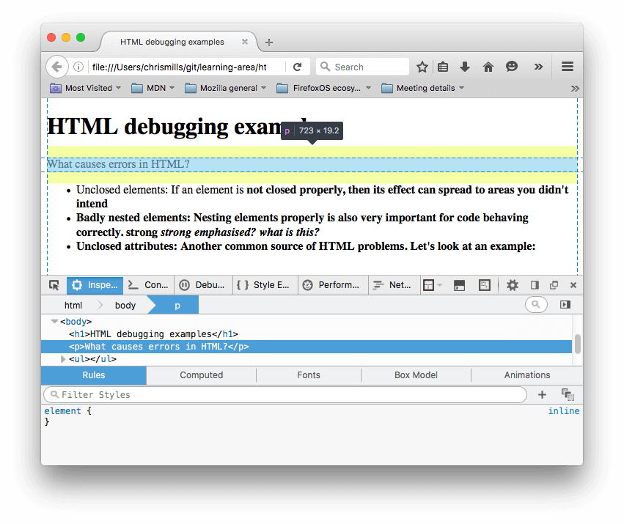
HTML and debugging
In the DOM inspector, you can see what the rendered markup

Slide 22
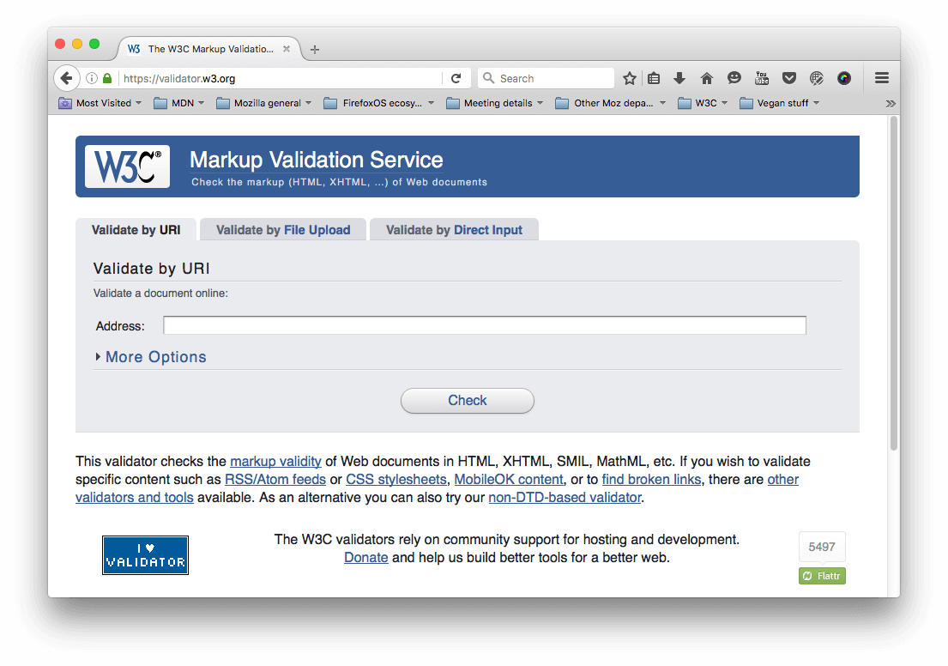
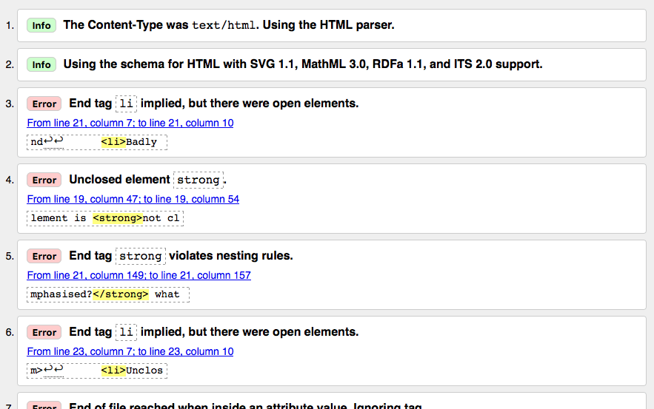
HTML and debugging
https://validator.w3.org/

Slide 23
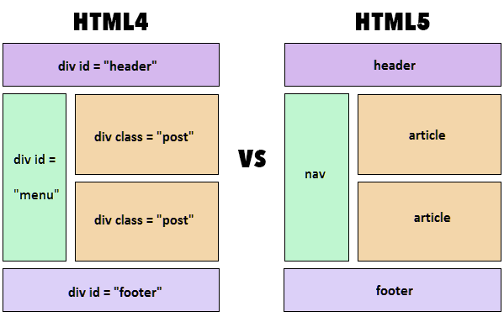
Intro to HTML5

Slide 24
Intro to CSS
CSS stands for Cascading Style Sheets
CSS describes how HTML elements are to be displayed on screen, paper, or in other media
CSS saves a lot of work. It can control the layout of multiple web pages all at once
External stylesheets are stored in CSS files

Slide 25
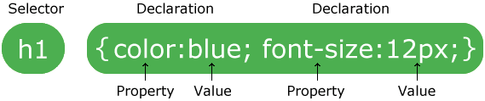
CSS Syntax

Slide 26
Cascade and inheritance
Stylesheets cascade
At a very simple level this means that the order of CSS rules matter;
when two rules apply that have equal specificity the one that comes last in the CSS is the one that will be used.
h1 {
color: red;
}
h1 {
color: blue;
}

Slide 27
Cascade and inheritance
Specificity
An element selector is less specific — it will select all elements of that type that appear on a page — so will get a lower score.
A class selector is more specific — it will select only the elements on a page that have a specific class attribute value — so will get a higher score.

Slide 28
Cascade and inheritance (d)
Inheritance
some CSS property values set on parent elements are inherited by their child elements, and some aren't.
Some properties do not inherit — for example if you set a width of 50% on an element, all of its descendants do not get a width of 50% of their parent's width. If this was the case, CSS would be very frustrating to use!

Slide 29
Note
Inherited properties — properties that affect their children.
Non-inherited properties — All the other natural properties, which affect only the element which they define.

Slide 30
Cascade and inheritance (d)
Controlling inheritance
Every CSS property accepts these values.
inherit
Sets the property value applied to a selected element to be the same as that of its parent element. Effectively, this "turns on inheritance".
initial
Sets the property value applied to a selected element to the initial value of that property.
unset
Resets the property to its natural value, which means that if the property is naturally inherited it acts like inherit, otherwise it acts like initial. https://developer.mozilla.org/en-US/docs/Web/CSS/unset
https://viblo.asia/p/ban-da-that-su-hieu-gia-tri-initial-inherit-va-unset-trong-css-RQqKLPwOK7z

Slide 31
!important (d)
We strongly recommend that you never use it unless you absolutely have to.
!important changes the way the cascade normally works, so it can make debugging CSS problems really hard to work out, especially in a large stylesheet.
One situation in which you may have to use it is when you are working on a CMS where you can't edit the core CSS modules, and you really want to override a style that can't be overridden in any other way. But really, don't use it if you can avoid it.
https://developer.mozilla.org/en-US/docs/Web/CSS/Specificity
https://css-tricks.com/when-using-important-is-the-right-choice/

Slide 32
Cascading!
HTML elements inherit their styles in a "cascading" manner, according to a very specific set of priorities, from lowest to highest:
The browser default
Styles defined in the page
Some styles will inherit a style to their childs, for example which font to use
The last rule to be defined in the loading order will be the one that will kick into effect
The element selector (for example, styling all <footer> elements)
The class selector (for example, styling all .main elements)
The ID selector, used to select a specific element in the page
Media type (explained in the Media Queries section)
Defining element specific CSS using an HTML "style" attribute
The !important CSS override directive (Use this directive only as a last resort)

Slide 33
CSS Selectors
A CSS selector is the first part of a CSS Rule. It is a pattern of elements and other terms that tell the browser which HTML elements should be selected to have the CSS property values inside the rule applied to them

Slide 34
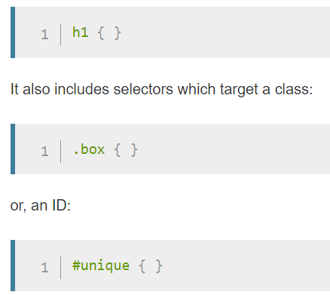
CSS Selectors
Types of selectors
Type, class, and ID selectors

Slide 35
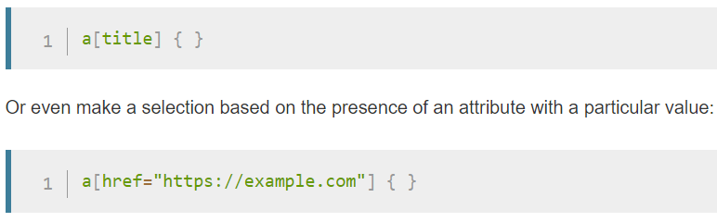
CSS Selectors
Attribute selectors:
This group of selectors gives you different ways to select elements based on the presence of a certain attribute on an element:

Slide 36
CSS Selectors
Pseudo-classes and pseudo-elements
This group of selectors includes pseudo-classes, which style certain states of an element.
a:hover { }
p::first-line { }
::first-line always selects the first line of text inside an element (a <p> in the below case), acting as if a <span> was wrapped around the first formatted line and then selected.
Combinators
article > p { }
selects paragraphs that are direct children of <article> elements using the child combinator (>)

Slide 37
The box model
Making up a block box in CSS we have the:
Content box: The area where your content is displayed, which can be sized using properties like width and height.
Padding box: The padding sits around the content as white space; its size can be controlled using padding and related properties.
Border box: The border box wraps the content and any padding. Its size and style can be controlled using border and related properties.
Margin box: The margin is the outermost layer, wrapping the content, padding and border as whitespace between this box and other elements. Its size can be controlled using margin and related properties.

Slide 38
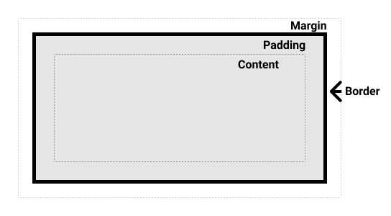
The box model (d)

Slide 39
The box model
By default, browsers use the standard box model. If you want to turn on the alternative model for an element you do so by setting box-sizing: border-box on it.
html {
box-sizing: border-box;
}
*, *::before, *::after {
box-sizing: inherit;
}

Slide 40
The box model
Demo
Include padding and border in the element's total width and height:
.box {
border: 5px solid rebeccapurple;
background-color: lightgray;
padding: 40px;
margin: 40px;
width: 300px;
height: 150px;
}
.alternate {
box-sizing: border-box;
}

Slide 41
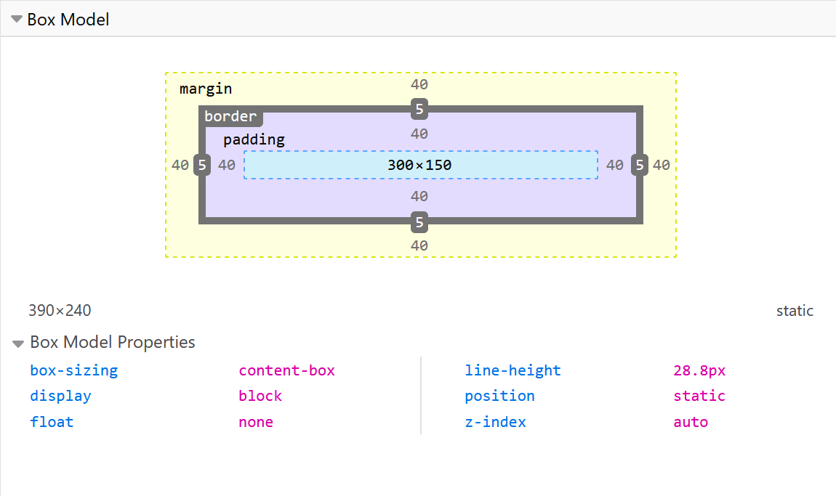
The box model
Use browser DevTools to view the box model

Slide 42
The box model
Using display
Inline: Displays an element as an inline element (like <span>). Any height and width properties will have no effect
Block: Displays an element as a block element (like <p>). It starts on a new line, and takes up the whole width
Inline-block: Displays an element as an inline-level block container. The element itself is formatted as an inline element, but you can apply height and width values
Demo
https://techtalk.vn/su-khac-nhau-giua-display-inline-block-va-inline-block.html

Slide 43
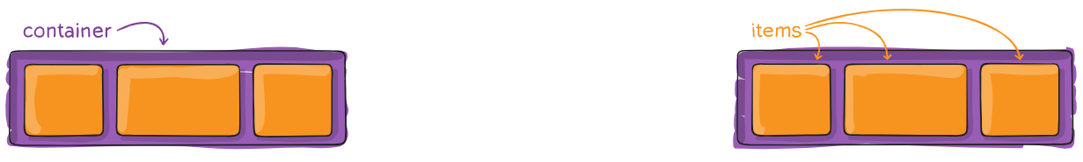
The box model
Dislay flex:
.container { display: flex; /* or inline-flex */ }
flex-direction: row | row-reverse | column | column-reverse;
.container { justify-content: flex-start | flex-end | center | space-between | space-around | space-evenly | start | end | left | right ... + safe | unsafe; }

Slide 44
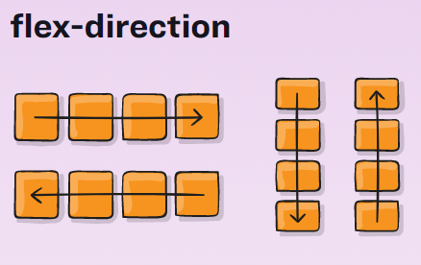
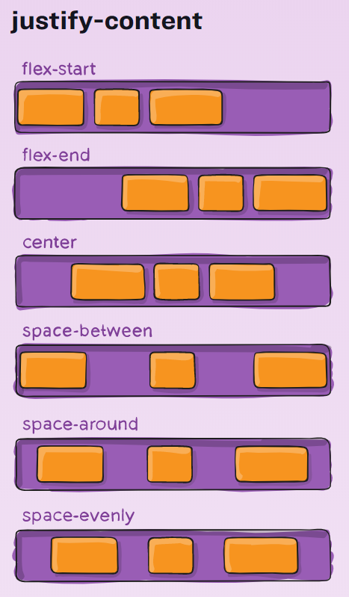
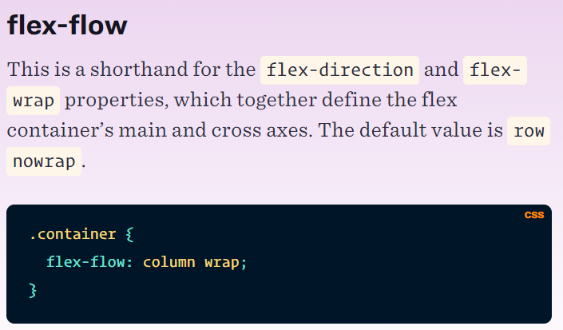
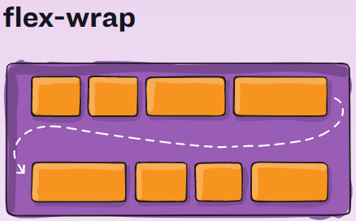
The box model(d)

Slide 45
CSS layout (d)
What is overflow?
Everything in CSS is a box. You can constrain the size of these boxes by assigning values of width and height (or inline-size and block-size).
Overflow happens when there is too much content to fit in a box. CSS provides various tools to manage overflow.
Unit
https://developer.mozilla.org/en-US/docs/Learn/CSS/Building_blocks/Values_and_units

Slide 46
CSS layout
The CSS float property
The CSS clear property specifies what elements can float beside the cleared element and on which side.
The float property can have one of the following values:
left - The element floats to the left of its container
right - The element floats to the right of its container
none - The element does not float (will be displayed just where it occurs in the text). This is default
inherit - The element inherits the float value of its parent
Demo
https://www.w3schools.com/css/tryit.asp?filename=trycss_layout_float2

Slide 47
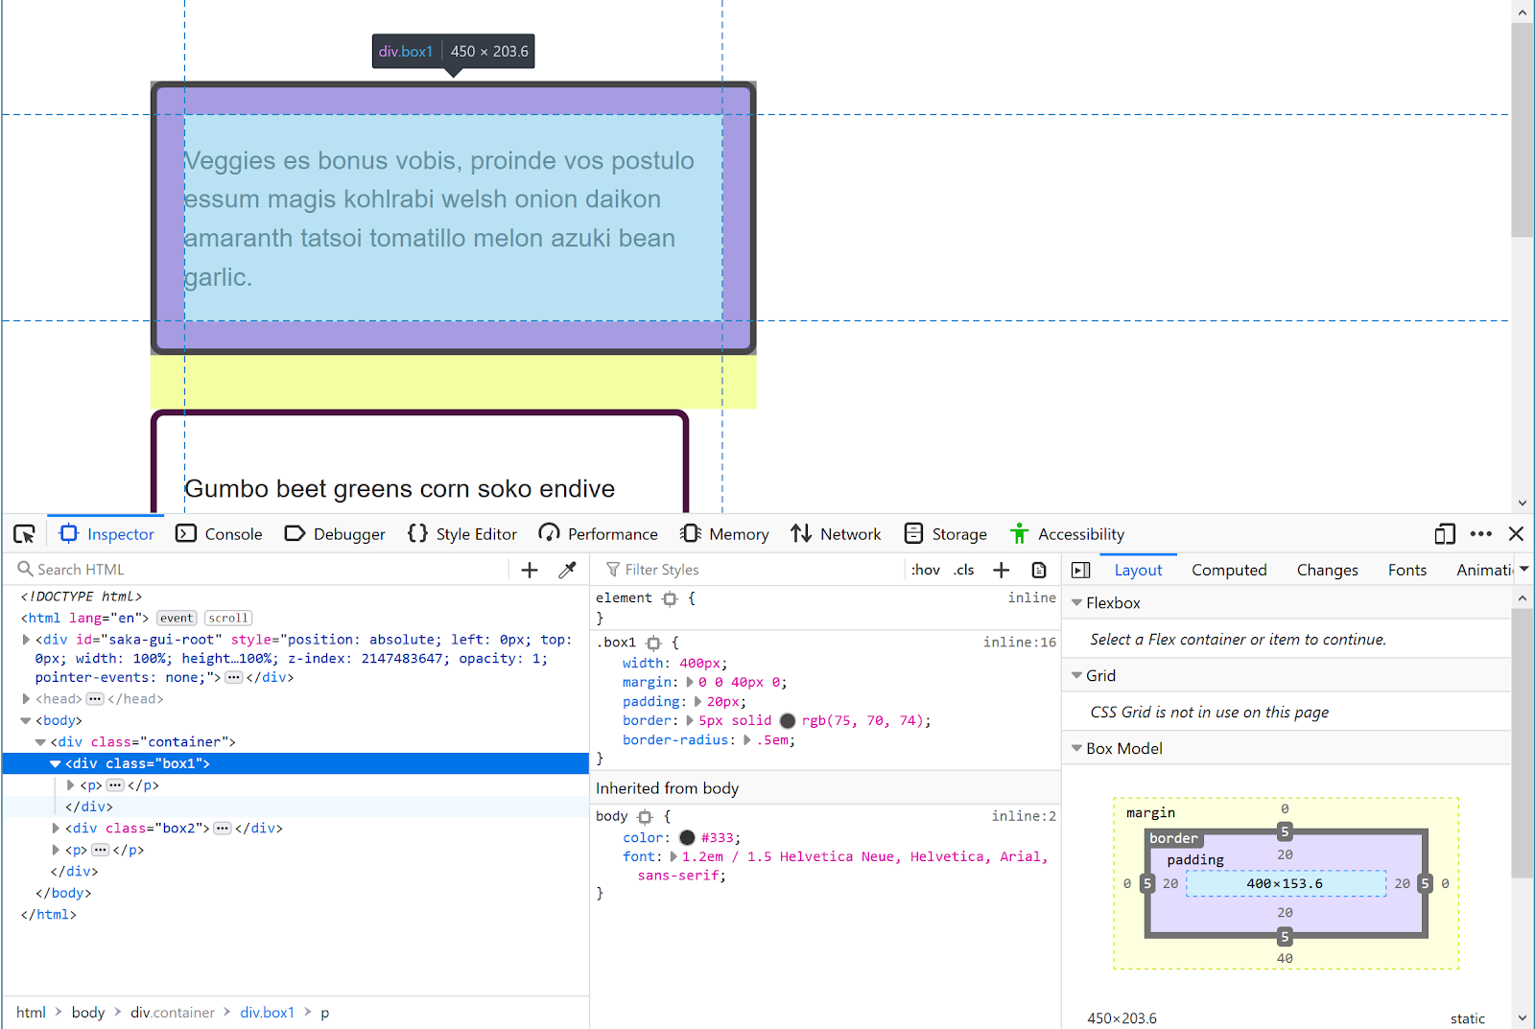
Debugging CSS
Sometimes when writing CSS you will encounter an issue where your CSS doesn't seem to be doing what you expect.

Slide 48
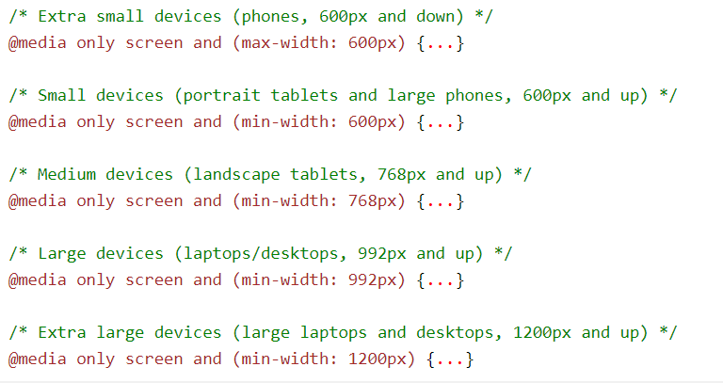
Intro to Responsive
Responsive web design makes your web page look good on all devices.
Responsive web design uses only HTML and CSS.
Responsive web design is not a program or a JavaScript.

Slide 49
Intro SCSS
Syntactically Awesome Style Sheet is the superset of CSS. SCSS is the more advanced version of CSS
SCSS contains all the features of CSS and contains more features that are not present in CSS which makes it a good choice for developers to use it.
SCSS offers variables, you can shorten your code by using variables.
SASS adds the feature of @import which lets you import your customized SCSS files
SASS allows us to use nested syntax.
https://sass-lang.com/guide

Slide 50
CSS Best Practice
References:
https://www.tothenew.com/blog/10-best-practices-in-css/
https://css-tricks.com/when-using-important-is-the-right-choice/

