Slide 1
HTML
Author: Giau Le

Slide 2
Overview
Front-end Roadmap
Introdution to the web & HTML
Nesting elements
Head elements and scripts
Basic Elements
Links, Lists, Images
Form & Table
HTML <div> Tag
Intro HTML5

Slide 3
References
https://developer.mozilla.org/en-US/docs/Learn/HTML
https://www.w3schools.com/html
https://www.learn-html.org
https://techmaster.vn/posts/35050/co-gi-moi-trong-html5

Slide 4
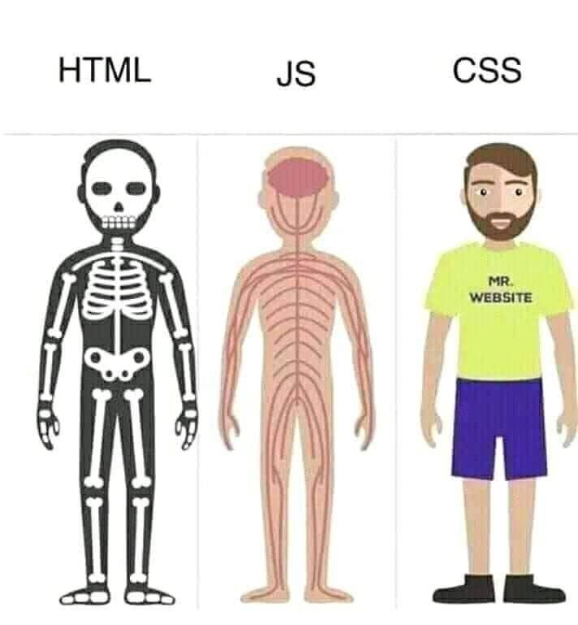
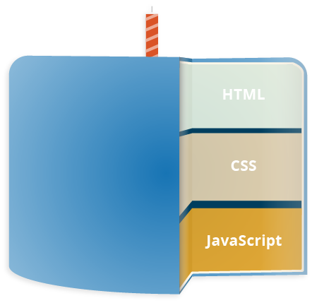
Introdution to Web

Slide 5
Introdution to Web
An HTML page is an HTML document that defines the content of the page by using a special markup similar to XML.
A CSS stylesheet defines the style of the HTML elements in the page. It is either embeded within an HTML page or loaded using the tag.
JavaScript is the programming language used to interact with the HTML page through an API called the DOM (Document Object Model) Bindings.

Slide 6

IDE
https://code.visualstudio.com/
Or https://www.sublimetext.com/

Slide 7
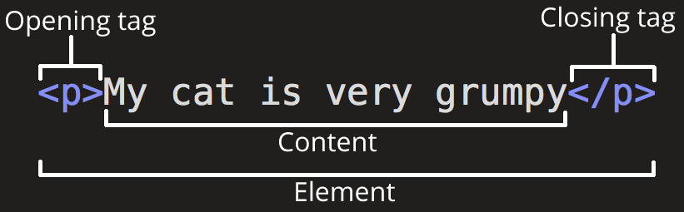
Introdution to HTML
HTML (Hypertext Markup Language) is not a programming language. It is a markup language that tells web browsers how to structure the web pages.
HTML consists of a series of elements, which you use to enclose, wrap, or mark up different parts of content to make it appear or act a certain way.
Tags in HTML are case-insensitive

Slide 8
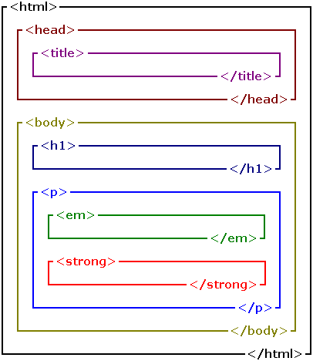
Nesting elements
Elements can be placed within other elements. This is called nesting.
<p>My cat is <strong>very</strong> grumpy.</p>

Slide 9
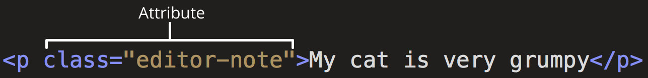
Attributes
An attribute should have:
A space between it and the element name. (For an element with more than one attribute, the attributes should be separated by spaces too.)
The attribute name, followed by an equal sign.
An attribute value, wrapped with opening and closing quote marks.
Boolean attributes
<input type="text" disabled="disabled">
<a href=https://www.mozilla.org/ title=The Mozilla homepage>favorite website</a>

Slide 10
Head elements and scripts
The head of an HTML document is the part that is not displayed in the web browser when the page is loaded.
The <title> element is metadata that represents the title of the overall HTML document (not the document's content.)
<!DOCTYPE html>
<html>
<head>
<meta charset="utf-8">
<title>My test page</title>
</head>
<body> <p>This is my page</p> </body>
</html>

Slide 11
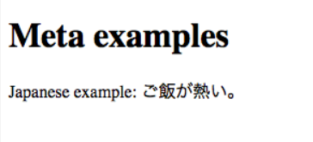
Head elements and scripts
Metadata is data that describes data, and HTML has an "official" way of adding metadata to a document — the <meta> element.
<meta charset="utf-8">
Setting the primary language of the document
<html lang="en-US">
This is useful in many ways. Your HTML document will be indexed more effectively by search engines if its language is set

Slide 12
Head elements and scripts (d)
Adding custom icons to your site
Saving it in the same directory as the site's index page, saved in .ico format.
Adding the following line into your HTML's <head> block to reference it:
<link rel="icon" href="favicon.ico" type="image/x-icon">
Link to css, js
<link rel="stylesheet" href="my-css-file.css">
<script src="my-js-file.js" defer></script>

Slide 13
Basic Elements
A text header, denoted using the <h1>, <h2>, <h3>, <h4>, <h5>, <h6> tags.
A paragraph, denoted using the <p> tag.
A horizontal ruler, denoted using the <hr> tag.
A link, denoted using the <a> (anchor) tag.
A list, denoted using the <ul> (unordered list), <ol> (ordered list) and <li> (list element) tags.
An image, denoted using the <img> tag
A divider, denoted using the <div> tag
A text span, denoted using the <span> tag

Slide 14
Basic Elements (d)
Each element can also have attributes - each element has a different set of attributes relevant to the element. There are a few global elements, the most common of them are:
id - Denotes the unique ID of an element in a page. Used for locating elements by using links, JavaScript, and more.
class - Denotes the CSS class of an element.
style - Denotes the CSS styles to apply to an element.

Slide 15
Links, Lists, Images
A link ("anchor") is a small span of text that will direct you to a different section in the page, or to a different page.
<a href="https://www.google.com">A link to Google</a>
To create a link to a different section in the same page, you will need to use a hash sign along with the element ID to where you would like the browser to jump to. For example:
<a href="#faq">Click here to read the Frequently Asked Questions</p>

Slide 16
Links, Lists, Images (d)
To add an image, use the <img> tag along with the src attribute to specify the location of the image.
<img src="/static/img/code.jpg">
Ordered lists
To change the list style attributes, we can use the CSS attribute called list-style-type. The available types are:
disc
circle
square
none

Slide 17
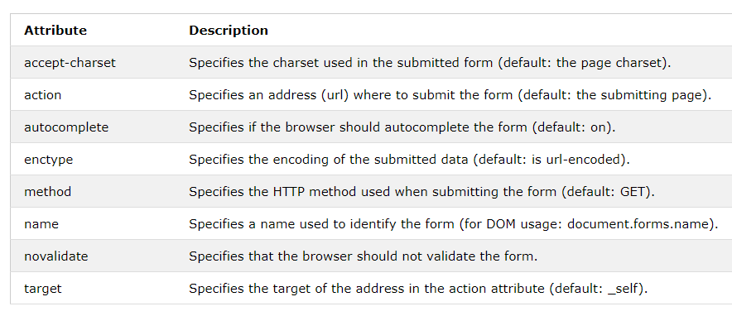
HTML Form
An HTML form is used to collect user input. The user input can then be sent to a server for processing.
<form action="/action_page.php">
<label for="fname">First name:</label><br>
<input type="text" id="fname" name="fname" value="John"><br>
<label for="lname">Last name:</label><br>
<input type="text" id="lname" name="lname" value="Doe"><br><br>
<input type="submit" value="Submit">
</form>

Slide 18
https://www.w3schools.com/html/html_forms.asp

Slide 19
HTML Table
An HTML table is defined with the <table> tag.
Use the HTML <table> element to define a table
Use the HTML <tr> element to define a table row
Use the HTML <td> element to define a table data
Use the HTML <th> element to define a table heading
Use the HTML <caption> element to define a table caption
Use the CSS border property to define a border
Use the CSS border-collapse property to collapse cell borders
Use the CSS padding property to add padding to cells

Slide 20
HTML Table
Use the CSS text-align property to align cell text
Use the CSS border-spacing property to set the spacing between cells
Use the colspan attribute to make a cell span many columns
Use the rowspan attribute to make a cell span many rows
Use the id attribute to uniquely define one table

Slide 21
HTML <div> Tag
The <div> tag defines a division or a section in an HTML document.
The <div> tag is used as a container for HTML elements - which is then styled with CSS or manipulated with JavaScript.
The <div> tag is easily styled by using the class or id attribute.

Slide 22
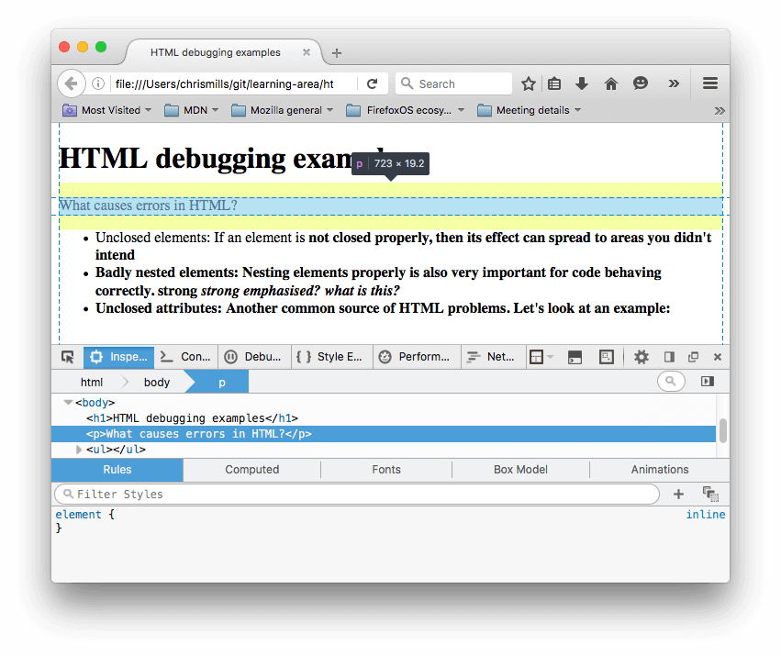
HTML and debugging
In the DOM inspector, you can see what the rendered markup

Slide 23
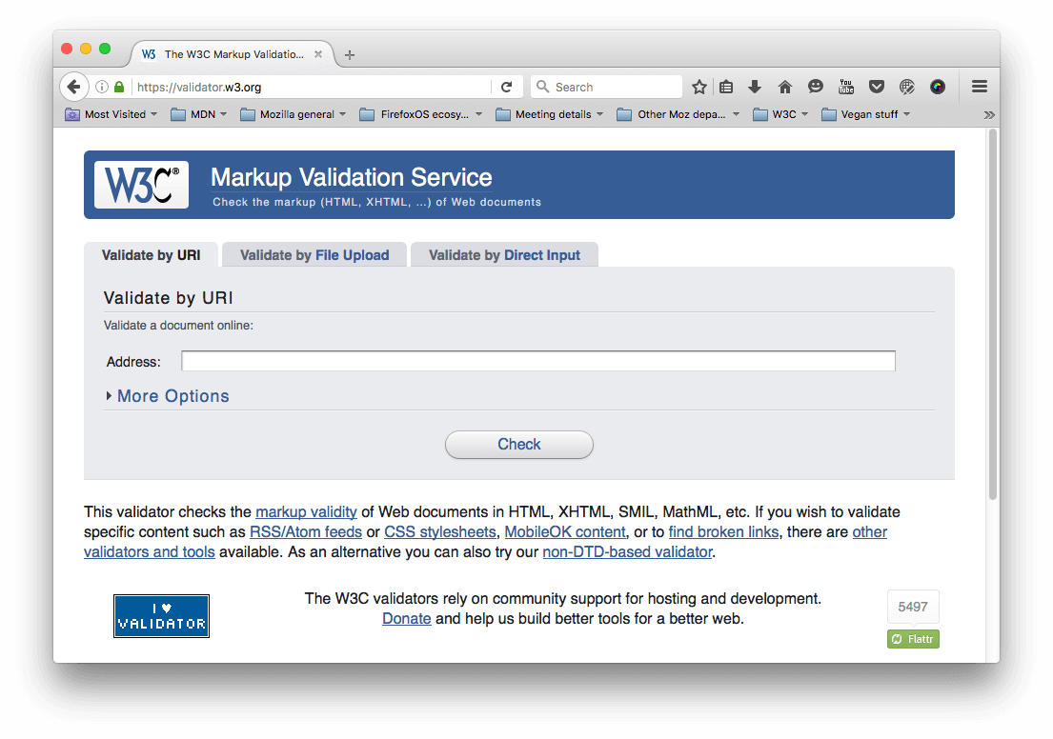
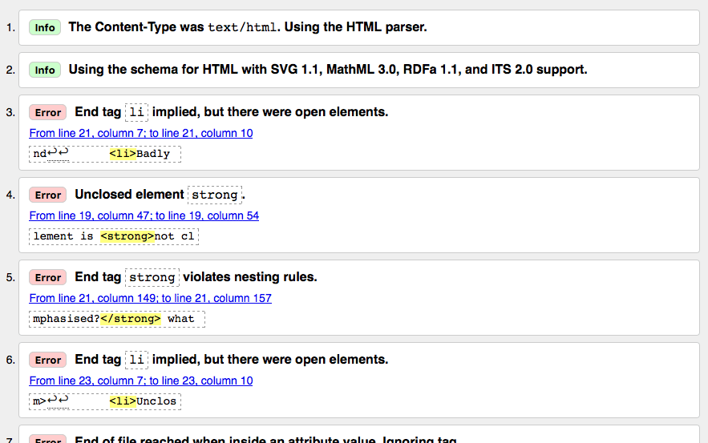
HTML and debugging
https://validator.w3.org/

Slide 24
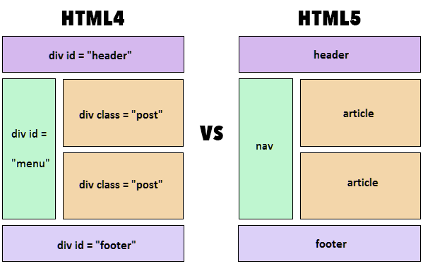
Intro to HTML5
Demo: https://github.com/giaule91/demo-html5.git

Slide 25
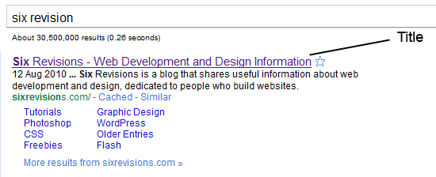
Best Practice
Always Declare a Doctype
<!DOCTYPE html PUBLIC "-//W3C//DTD XHTML 1.0 Strict//EN" "http://www.w3.org/TR/xhtml1/DTD/xhtml1-strict.dtd">
Use Meaningful Title Tags
The <title> tag helps make a web page more meaningful and search-engine friendly.

Slide 26
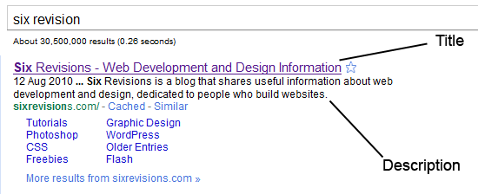
Best Practice
Use Descriptive Meta Tags
<meta name="description" content="Six Revisions is a blog that shares useful information about web development and design, dedicated to people who build websites." />

Slide 27
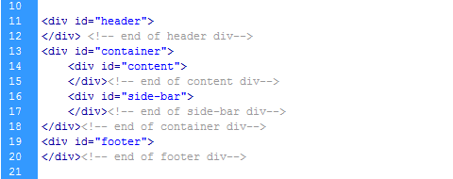
Best Practice
Use Divs to Divide Your Layout into Major Sections

Slide 28
Best Practice
Don't use inline styles
it makes it harder to update and maintain a website.

Slide 29
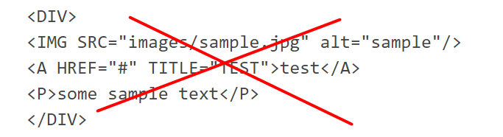
Best Practice
Don’t Use Divs for Everything
a <div> is a meaningless element that should be used “as an element of last resort, for when no other element is suitable.
Close Your Tags
Closing all your tags is a W3C specification.
Use Lower Case Markup

Slide 30
Best Practice
Use Alt Attributes with Images
Using a meaningful alt attribute with <img> elements is a must for writing valid and semantic code.
<img id="logo" src="images/bgr_logo.png" alt="Six Revisions Logo" />

Slide 31
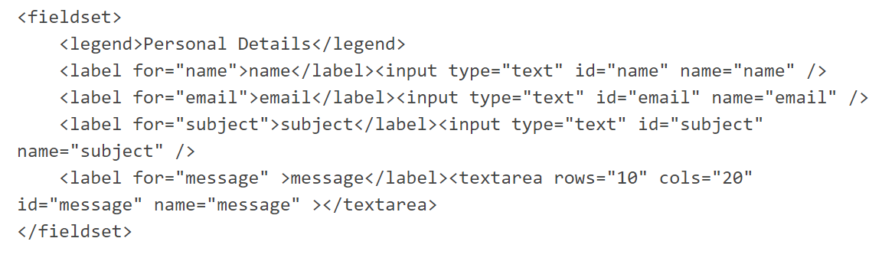
Best Practice
Use Fieldset and Labels in Web Forms

Slide 32
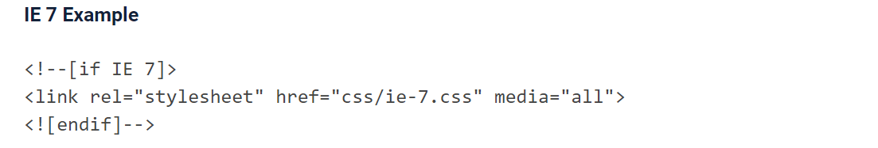
Best Practice
Use Modular IE Fixes
Avoid Excessive Comments

Slide 33
Excercise
Try it Yourself
https://www.w3schools.com/html/
Demo on Github
https://github.com/giaule91/basic-html.git

