Slide 1
CSS
Author: Giau Le

Slide 2
References
https://developer.mozilla.org/en-US/docs/Learn/HTML
https://developer.mozilla.org/en-US/docs/Learn/CSS/First_steps/How_CSS_is_structured
https://www.w3schools.com/css
https://www.learn-html.org
https://techmaster.vn/posts/35050/co-gi-moi-trong-html5

Slide 3
Overview
Intro to CSS
CSS Syntax & Cascade and inheritance
CSS Selectors
The box model - some basic properties
CSS layout
Debugging CSS
Organizing your CSS
Intro to Responsive
Intro to SCSS (optional)

Slide 4
Intro to CSS
CSS stands for Cascading Style Sheets
CSS describes how HTML elements are to be displayed on screen, paper, or in other media
CSS saves a lot of work. It can control the layout of multiple web pages all at once
External stylesheets are stored in CSS files

Slide 5
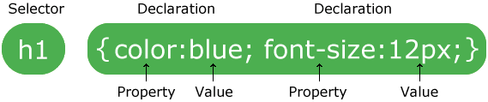
CSS Syntax

Slide 6
Cascade and inheritance
Stylesheets cascade
At a very simple level this means that the order of CSS rules matter;
when two rules apply that have equal specificity the one that comes last in the CSS is the one that will be used.
h1 {
color: red;
}
h1 {
color: blue;
}

Slide 7
Cascade and inheritance
Specificity
An element selector is less specific — it will select all elements of that type that appear on a page — so will get a lower score.
A class selector is more specific — it will select only the elements on a page that have a specific class attribute value — so will get a higher score.

Slide 8
Cascade and inheritance (d)
Inheritance
some CSS property values set on parent elements are inherited by their child elements, and some aren't.
Some properties do not inherit — for example if you set a width of 50% on an element, all of its descendants do not get a width of 50% of their parent's width. If this was the case, CSS would be very frustrating to use!

Slide 9
Cascade and inheritance
Note
Inherited properties — properties that affect their children.
Non-inherited properties — All the other natural properties, which affect only the element which they define.

Slide 10
Cascade and inheritance (d)
Controlling inheritance
Every CSS property accepts these values.
inherit
Sets the property value applied to a selected element to be the same as that of its parent element. Effectively, this "turns on inheritance".
initial
Sets the property value applied to a selected element to the initial value of that property.
unset
Resets the property to its natural value, which means that if the property is naturally inherited it acts like inherit, otherwise it acts like initial. https://developer.mozilla.org/en-US/docs/Web/CSS/unset
https://viblo.asia/p/ban-da-that-su-hieu-gia-tri-initial-inherit-va-unset-trong-css-RQqKLPwOK7z

Slide 11
!important (d)
We strongly recommend that you never use it unless you absolutely have to.
!important changes the way the cascade normally works, so it can make debugging CSS problems really hard to work out, especially in a large stylesheet.
One situation in which you may have to use it is when you are working on a CMS where you can't edit the core CSS modules, and you really want to override a style that can't be overridden in any other way. But really, don't use it if you can avoid it.
https://developer.mozilla.org/en-US/docs/Web/CSS/Specificity
https://css-tricks.com/when-using-important-is-the-right-choice/

Slide 12
Cascading!
HTML elements inherit their styles in a "cascading" manner, according to a very specific set of priorities, from lowest to highest:
The browser default
Styles defined in the page
Some styles will inherit a style to their childs, for example which font to use
The last rule to be defined in the loading order will be the one that will kick into effect
The element selector (for example, styling all <footer> elements)
The class selector (for example, styling all .main elements)
The ID selector, used to select a specific element in the page
Media type (explained in the Media Queries section)
Defining element specific CSS using an HTML "style" attribute
The !important CSS override directive (Use this directive only as a last resort)

Slide 13
CSS Selectors
A CSS selector is the first part of a CSS Rule. It is a pattern of elements and other terms that tell the browser which HTML elements should be selected to have the CSS property values inside the rule applied to them

Slide 14
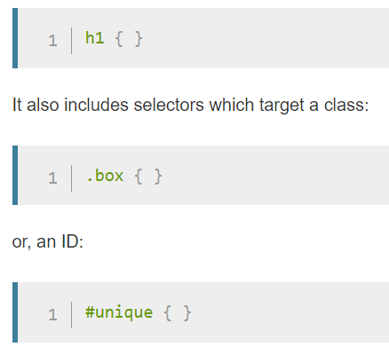
CSS Selectors
Types of selectors
Type, class, and ID selectors

Slide 15
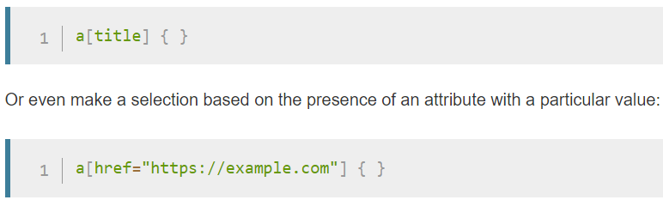
CSS Selectors
Attribute selectors:
This group of selectors gives you different ways to select elements based on the presence of a certain attribute on an element:

Slide 16
CSS Selectors
Pseudo-classes and pseudo-elements
This group of selectors includes pseudo-classes, which style certain states of an element.
a:hover { }
p::first-line { }
::first-line always selects the first line of text inside an element (a <p> in the below case), acting as if a <span> was wrapped around the first formatted line and then selected.
Combinators
article > p { }
selects paragraphs that are direct children of <article> elements using the child combinator (>)

Slide 17
The box model
Making up a block box in CSS we have the:
Content box: The area where your content is displayed, which can be sized using properties like width and height.
Padding box: The padding sits around the content as white space; its size can be controlled using padding and related properties.
Border box: The border box wraps the content and any padding. Its size and style can be controlled using border and related properties.
Margin box: The margin is the outermost layer, wrapping the content, padding and border as whitespace between this box and other elements. Its size can be controlled using margin and related properties.

Slide 18
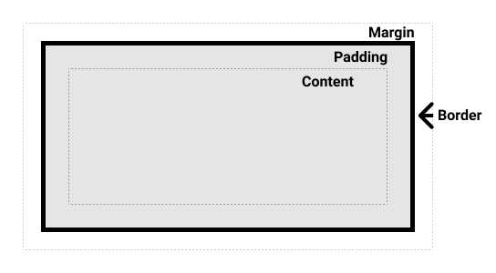
The box model (d)

Slide 19
The box model
By default, browsers use the standard box model. If you want to turn on the alternative model for an element you do so by setting box-sizing: border-box on it.
html {
box-sizing: border-box;
}
*, *::before, *::after {
box-sizing: inherit;
}

Slide 20
The box model
Demo
Include padding and border in the element's total width and height:
.box {
border: 5px solid rebeccapurple;
background-color: lightgray;
padding: 40px;
margin: 40px;
width: 300px;
height: 150px;
}
.alternate {
box-sizing: border-box;
}

Slide 21
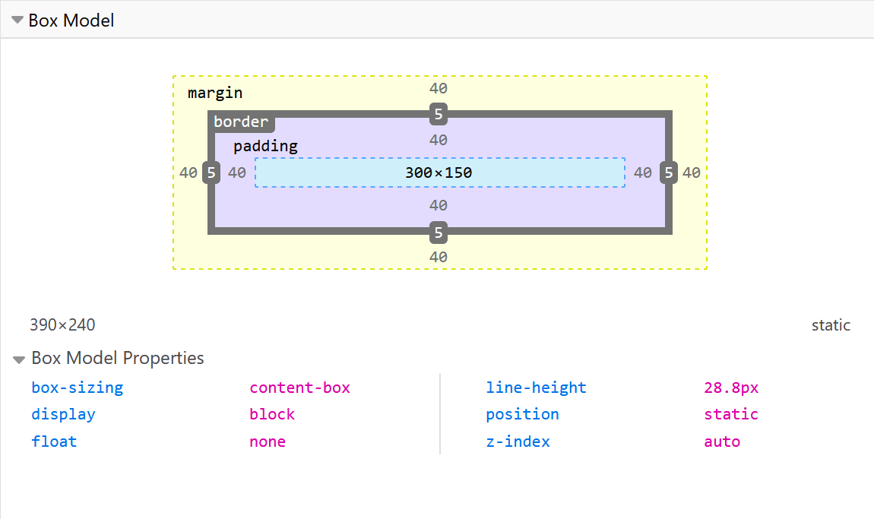
The box model
Use browser DevTools to view the box model

Slide 22
The box model
Using display
Inline: Displays an element as an inline element (like <span>). Any height and width properties will have no effect
Block: Displays an element as a block element (like <p>). It starts on a new line, and takes up the whole width
Inline-block: Displays an element as an inline-level block container. The element itself is formatted as an inline element, but you can apply height and width values
Demo
https://techtalk.vn/su-khac-nhau-giua-display-inline-block-va-inline-block.html

Slide 23
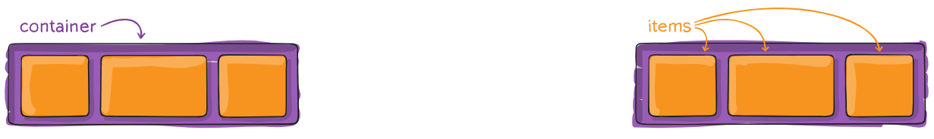
The box model
Dislay flex:
.container { display: flex; /* or inline-flex */ }
flex-direction: row | row-reverse | column | column-reverse;
.container { justify-content: flex-start | flex-end | center | space-between | space-around | space-evenly | start | end | left | right ... + safe | unsafe; }

Slide 24
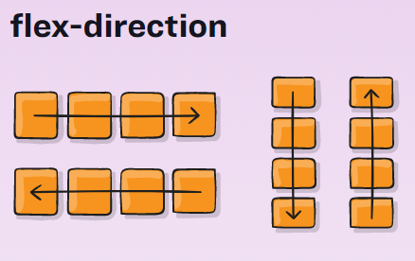
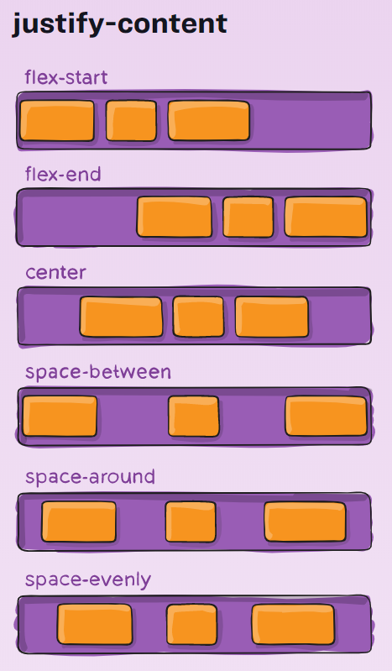
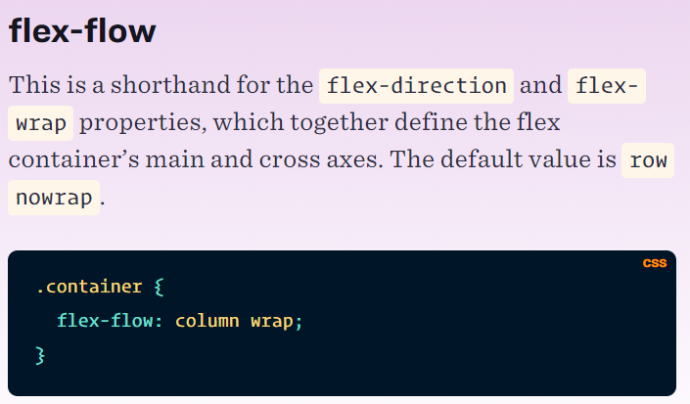
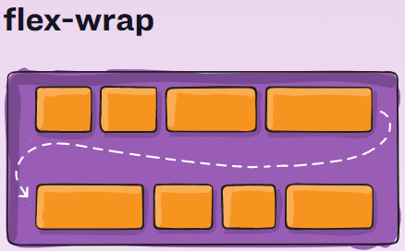
The box model(d)

Slide 25
CSS layout (d)
What is overflow?
Everything in CSS is a box. You can constrain the size of these boxes by assigning values of width and height (or inline-size and block-size).
Overflow happens when there is too much content to fit in a box. CSS provides various tools to manage overflow.
Unit
https://developer.mozilla.org/en-US/docs/Learn/CSS/Building_blocks/Values_and_units

Slide 26
CSS layout
The CSS float property
The CSS clear property specifies what elements can float beside the cleared element and on which side.
The float property can have one of the following values:
left - The element floats to the left of its container
right - The element floats to the right of its container
none - The element does not float (will be displayed just where it occurs in the text). This is default
inherit - The element inherits the float value of its parent
Demo
https://www.w3schools.com/css/tryit.asp?filename=trycss_layout_float2

Slide 27
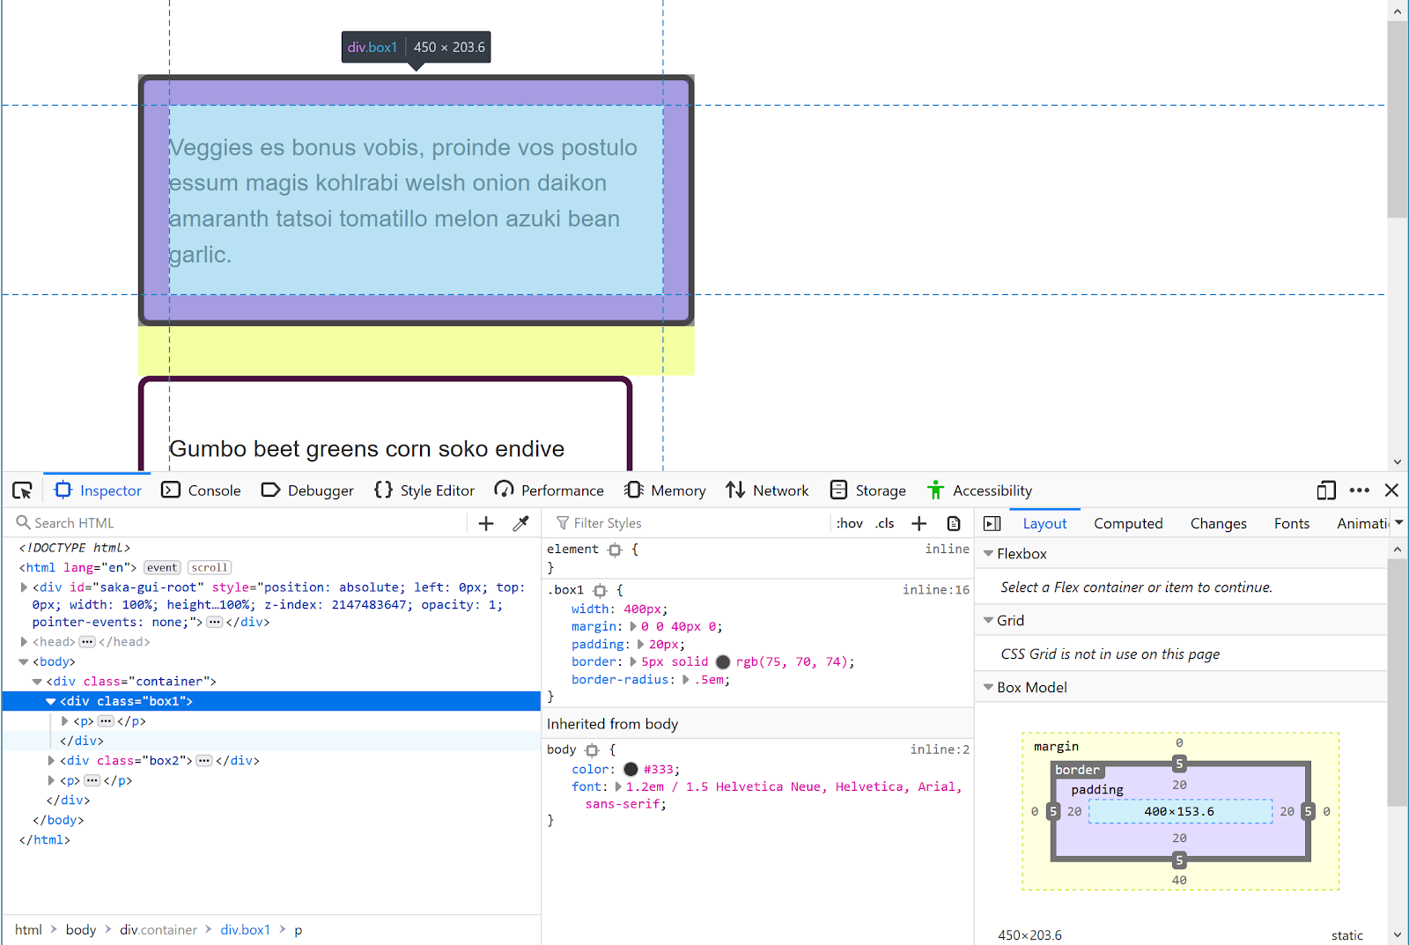
Debugging CSS
Sometimes when writing CSS you will encounter an issue where your CSS doesn't seem to be doing what you expect.

Slide 28
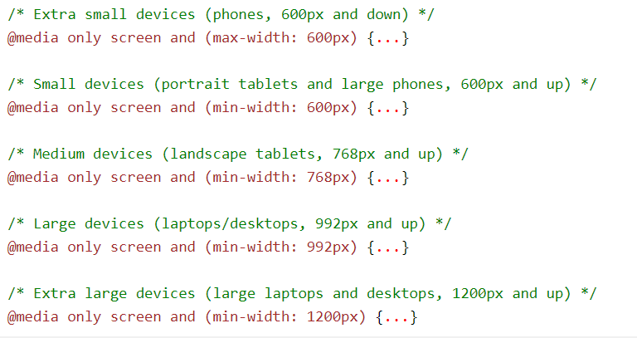
Intro to Responsive
Responsive web design makes your web page look good on all devices.
Responsive web design uses only HTML and CSS.
Responsive web design is not a program or a JavaScript.

Slide 29
Intro SCSS
Syntactically Awesome Style Sheet is the superset of CSS. SCSS is the more advanced version of CSS
SCSS contains all the features of CSS and contains more features that are not present in CSS which makes it a good choice for developers to use it.
SCSS offers variables, you can shorten your code by using variables.
SASS adds the feature of @import which lets you import your customized SCSS files
SASS allows us to use nested syntax.
https://sass-lang.com/guide

Slide 30
CSS Best Practice
References:
https://www.tothenew.com/blog/10-best-practices-in-css/
https://css-tricks.com/when-using-important-is-the-right-choice/

Slide 31
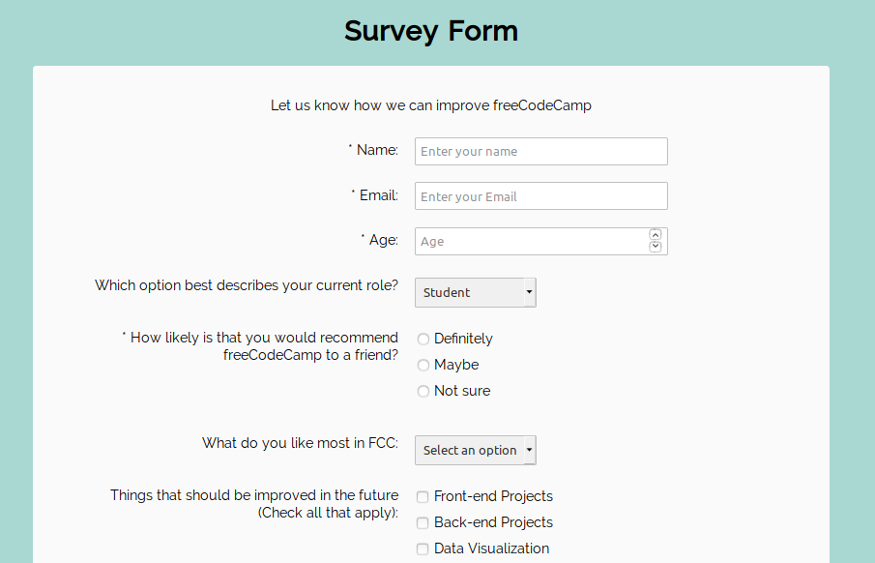
Excercise

