Slide 1
Database
Author: Giau Le

Slide 2
Overview
Introduction
Install My SQL & Workbench
Table Overview
DDL & SQL Constraints
DML & DQL
Keys
Normalization
Aggregate Function
Joins

Slide 3
References
https://www.w3schools.com/sql/
SQL Tutorials book

Slide 4
Giới thiệu
Databases:
Là bộ sưu tập dữ liệu có liên quan đến nhau được thiết kế để đáp ứng nhu cầu về thông tin của một tổ chức.
Một DB thường được thiết kế hợp lý chặt chẽ để phục vụ một mục đích cụ thể.
DB sẽ biểu diễn một thực thể trong thế giới thực.
Database Management System (DBMS):
Là một phần mềm giúp cho bạn dễ dàng tạo và vận hành database của bạn.
DBMS sẽ giúp bạn định nghĩa các kiểu dữ liệu của thông tin lưu trữ, xây dựng hệ thống lưu trữ và hỗ trợ các thao tác như truy vấn, cập nhật dữ liệu.

Slide 5
Giới thiệu
Database Users: Là những người trực tiếp thao tác với DB.
DB administrator: Là người quản lý và vận hành DB của bạn. Sử dụng các software và hardware để có thể điều khiển và kiểm soát tính khả dụng của hệ thống.
DB Designer: Trao đổi trực tiếp vs end-user để hiểu những thông tin họ cần. Từ đó thì có thể định nghĩa được các nội dung, cấu trúc, quan hệ và các chức năng của DB.
End-User: Người trực tiếp thao tác vs thông tin của DB( như là truy vấn, thay đổi, cập nhật dữ liệu...)

Slide 6
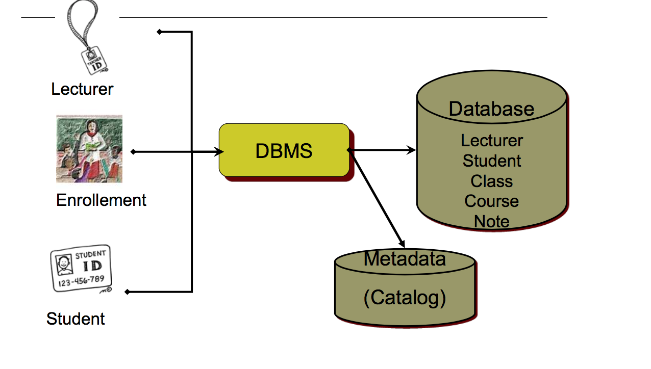
Giới thiệu

Slide 7
RDBMS
RDBMS stands for Relational Database Management System. RDBMS is the basis for SQL and for all modern database systems like MS SQL Server, IBM DB2, Oracle, MySQL, and Microsoft Access
A Relational database management system (RDBMS) is a database management system (DBMS) that is based on the relational model as introduced by E. F. Codd.
SQL, Structured Query Language
is a programming language designed to manage data stored in relational databases. SQL operates through simple, declarative statements. This keeps data ac…

Slide 8
Cài đặt
MYSQL and WORKBENCH
https://dev.mysql.com/downloads/installer/
Include in: mysql and workbenchs
Note: remember username and password to connect
Refer
https://www.youtube.com/watch?v=5fjU29PBzhQ&list=PL9RNrKqMr5vxRIOiTX_uzIydpBdNFlnxR

Slide 9
Create Database
Show databases;
Create database test;
Use test;
Show tables;
Drop database test;

Slide 10
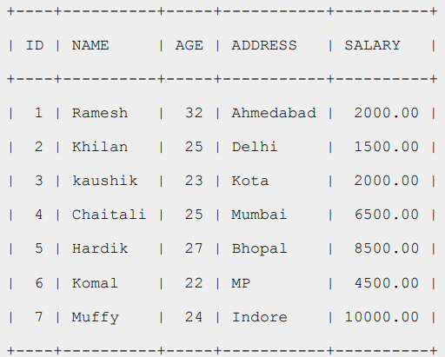
Table Overview
The data in RDBMS is stored in database objects called tables.
The table is a collection of related data entries and it consists of columns and rows
A table is the most common and simplest form of data storage in a relational database.
Example: CUSTOMERS table

Slide 11

Table Overview
What is field?
Every table is broken up into smaller entities called fields.
Ex: The fields in the CUSTOMERS table consist of ID, NAME, AGE, ADDRESS and SALARY.
What is record or row?
A record, also called a row of data, is each individual entry that exists in a table

Slide 12
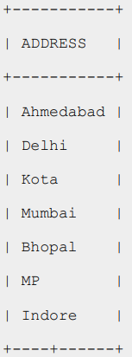
Table Overview
What is column?
A column is a vertical entity in a table that contains all information associated with a specific field in a table

Slide 13
DDL - Data Definition Language

Slide 14
Datatype
Int:
Float(M,D): Decimal number (appxi)
Decimal (M,D): Decimal number (precise)
Char(n): fixed leng chars
Varchar(n) varying leng chars
Enum: value from a defined list
Boolean
Data: Date (YYYY-MM-DD)
Datetime: date and time (YYYY-MM-DD HH-MM-SS)
Time
Year YYYY

Slide 15
Keys
PRIMARY Key
A primary key is a (Column or set of columns ) in a table which uniquely identifies each row/record in a database table.
Primary keys must contain unique values. A primary key column cannot have NULL values.
A table can have only one primary key, which may consist of single or multiple fields. When multiple fields are used as a primary key, they are called a composite key.
CREATE TABLE CUSTOMERS( ID INT NOT NULL, NAME VARCHAR (20) NOT NULL, AGE INT NOT NULL, ADDRESS CHAR (25) , SALARY DECIMAL (18, 2), PRIMARY KEY (ID) );

Slide 16
Keys
To create a PRIMARY KEY constraint on the "ID" column when CUSTOMERS table already exists
To create a PRIMARY KEY constraint on the "ID" and "NAMES" columns when CUSTOMERS table already exists
Delete Primary Key
ALTER TABLE CUSTOMER ADD PRIMARY KEY (ID);
ALTER TABLE CUSTOMERS ADD CONSTRAINT PK_CUSTID PRIMARY KEY (ID, NAME);
ALTER TABLE CUSTOMERS DROP PRIMARY K

Slide 17
Keys
FOREIGN Key:
A foreign key is a key used to link two tables together. This is sometimes called a referencing key.
Is a col whose values match the values of another table primary key col
Foreign Key is a column or a combination of columns whose values match a Primary Key in a different table.
A table can have multiple FK
The table with PK is called the reference (parent), table with FK is called child table

Slide 18
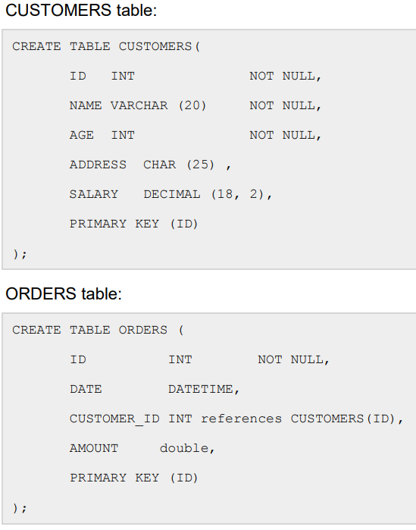
Keys

Slide 19
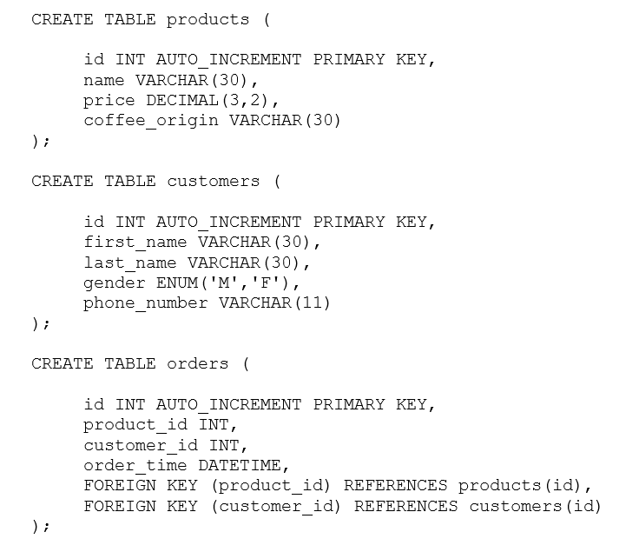
Create cf store DB
Create database coffee_store;
Use coffee_store;
Create 3 table:
Products, Customers, Orders

Slide 20
Table
CREATE TABLE table_name ( column1 datatype, column2 datatype, column3 datatype );
CREATE
Creates a new table, a view of a table, or other object in database
ALTER
Modifies an existing database object, such as a table
DROP
Deletes an entire table, a view of a table or other object in the database.
ALTER TABLE table_name ADD column_name datatype;
DROP TABLE table_name;

Slide 21
Index
Index
Indexes are used to retrieve data from the database more quickly than otherwise.
The users cannot see the indexes, they are just used to speed up searches/queries.
CREATE INDEX index_name ON table_name (column1, column2, ...);
Ex:
CREATE INDEX idx_pname ON Persons (LastName, FirstName);

Slide 22
SQL Constraints (P.20)
Constraints are the rules enforced on data columns on table.
To limit the type of data that can go into a table.
This ensures the accuracy and reliability of the data in the database.
• NOT NULL Constraint: Ensures that a column cannot have NULL value.
• DEFAULT Constraint: Provides a default value for a column when none is specified.
• UNIQUE Constraint: Ensures that all values in a column are different.
• PRIMARY Key: Uniquely identified each rows/records in a database table.
• FOREIGN Key: Uniquely identified a rows/records in any another database table.
• CHECK Constraint: The CHECK constraint ensures that all values in a column satisfy certain conditions.
• INDEX: Use to create and retrieve data from the database very quickly.

Slide 23
SQL Constraints
NOT NULL Constraint
By default, a column can hold NULL values. If you do not want a column to have a NULL value, then you need to define such constraint on this column specifying that
NULL is now not allowed for that column.
DEFAULT Constraint
UNIQUE Constraint
ALTER TABLE CUSTOMERS MODIFY SALARY DECIMAL (18, 2) NOT NULL;
ALTER TABLE CUSTOMERS MODIFY SALARY DECIMAL (18, 2) DEFAULT 5000.00;
ALTER TABLE CUSTOMERS MODIFY AGE INT NOT NULL UNIQUE;

Slide 24
Truncate
Delete all rows of table
TRUNCATE TABLE test;

Slide 25
Exercise
CREATE+TEST+DATABASE+SQL.rtf
SQL-0318-Solution-1.rtf

Slide 26
DML - Data Manipulation Language
SQL INSERT Query
The SQL INSERT INTO Statement is used to add new rows of data to a table in the database.
Syntax
Populate one table using another table
INSERT INTO TABLE_NAME (column1, column2, column3,...columnN)] VALUES (value1, value2, value3,...valueN);
INSERT INTO first_table_name [(column1, column2, ... columnN)] SELECT column1, column2, ...columnN FROM second_table_name [WHERE condition];

Slide 27
DML - Data Manipulation Language
SQL UPDATE Query
The SQL UPDATE Query is used to modify the existing records in a table
You can use WHERE clause with UPDATE query to update selected rows, otherwise all the rows would be affected.
SQL DELETE Query
The SQL DELETE Query is used to delete the existing records from a table
UPDATE table_name SET column1 = value1, column2 = value2...., columnN = valueN WHERE [condition];
DELETE FROM table_name WHERE [condition];

Slide 28
DML-Ex
\cf_store\DML
customers_table.rtf
orders_table.rtf

Slide 29
DQL - Data Query Language
SELECT
Retrieves certain records from one or more tables
Refer SQL Tutorial P.38
SELECT column1, column2....columnN FROM table_name WHERE CONDITION;

Slide 30
DQL - Data Query Language
SQL ORDER BY Clause
sort the result-set in ascending or descending order
SELECT column1, column2, ... FROM table_name ORDER BY column1, column2, ... ASC|DESC;

Slide 31
DQL - Data Query Language
SQL GROUP BY Statement
Groups rows that have the same values into summary rows
Often used with aggregate functions (COUNT, MAX, MIN, SUM, AVG)
SELECT column_name(s) FROM table_name WHERE condition GROUP BY column_name(s) ORDER BY column_name(s);

Slide 32
DQL - Data Query Language
SQL HAVING Clause
Added to SQL because the WHERE keyword could not be used with aggregate functions.
SELECT column_name(s) FROM table_name WHERE condition GROUP BY column_name(s) HAVING condition ORDER BY column_name(s);
What are differences between where and having?

Slide 33
Some Aggregate Function (P.168)
SQL COUNT Function
The simplest function and very useful in counting the number of records, which are expected to be returned by a SELECT statement
Ex: SELECT COUNT(*) FROM employee_tbl WHERE name="Zara";
SQL AVG Function
SELECT name, AVG(daily_typing_pages) FROM employee_tbl GROUP BY name;

Slide 34
SQL Joins (P.95)
The SQL Joins clause is used to combine records from two or more tables in a database.
A JOIN is a means for combining fields from two tables by using values common to each.
INNER JOIN: returns rows when there is a match in both tables.
LEFT JOIN: returns all rows from the left table, even if there are no matches in the right table.
RIGHT JOIN: returns all rows from the right table, even if there are no matches in the left table.
FULL JOIN: returns rows when there is a match in one of the tables.
SELF JOIN: is used to join a table to itself as if the table were two tables, temporarily renaming at least one table in the SQL statement.

Slide 35
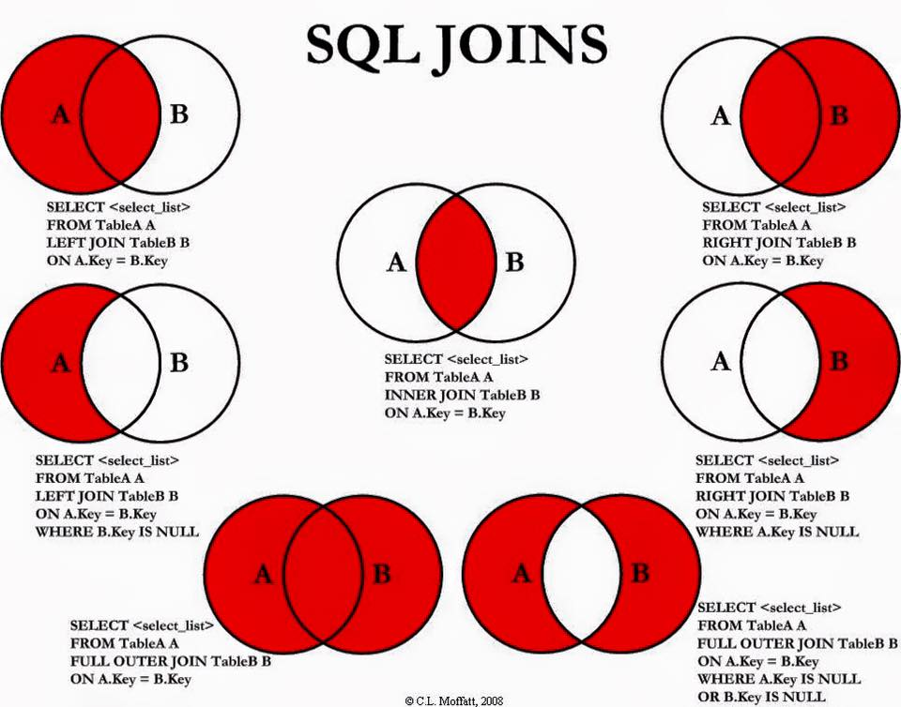
SQL Joins

Slide 36
DQL-Ex
Folder cf-store/SELECT

Slide 37
Database Normalization (P.28)
Database normalization is the process of efficiently organizing data in a database. There are two reasons of the normalization process
Eliminating redundant data, for example, storing the same data in more than one table.
Ensuring data dependencies make sense.
Reduce storage space, reduce insert, update, del anomalies
Ex: one update/ one delete for address
Improve query performance
Normal forms:
First Normal Form (1NF)
Second Normal Form (2NF)
Third Normal Form (3NF) -> Boyce and Codd Normal Form (BCNF)

Slide 38
Database Normalization
First Normal Form
Define the data items required, because they become the columns in a table. Place related data items in a table.
Ensure that there are no repeating groups of data.
Ensure that there is a primary key.
Create a primary key for each table which we have already created.

Slide 39
Database Normalization
Second Normal Form
there must be no partial dependences of any of the columns on the primary key-> every col that is not pk of table is depend on on the whole pk
CREATE TABLE CUSTOMERS( CUST_ID INT NOT NULL, CUST_NAME VARCHAR (20) NOT NULL, PRIMARY KEY (CUST_ID) );
CREATE TABLE ORDERS( ORDER_ID INT NOT NULL, ORDER_DETAIL VARCHAR (20) NOT NULL, PRIMARY KEY (ORDER_ID) );
CREATE TABLE CUSTMERORDERS( CUST_ID INT NOT NULL, ORDER_ID INT NOT NULL, SALE_DATE DATETIME, PRIMARY KEY (CUST_ID, ORDER_ID) );
CREATE TABLE CUSTOMERS( CUST_ID INT NOT NULL, CUST_NAME VARCHAR (20) NOT NULL, ORDER_ID INT NOT NULL, ORDER_DETAIL VARCHAR (20) NOT NULL, SALE_DATE DATETIME, PRIMARY KEY (CUST_ID, ORDER_ID) );

Slide 40
Database Normalization
Third Normal Form
It is in second normal form.
All nonprimary fields are dependent on the whole primary key.
CREATE TABLE CUSTOMERS( CUST_ID INT NOT NULL, CUST_NAME VARCHAR (20) NOT NULL, DOB DATE, STREET VARCHAR(200), CITY VARCHAR(100), STATE VARCHAR(100), ZIP VARCHAR(12), EMAIL_ID VARCHAR(256), PRIMARY KEY (CUST_ID) );
CREATE TABLE CUSTOMERS( CUST_ID INT NOT NULL, CUST_NAME VARCHAR (20) NOT NULL, DOB DATE, ZIP VARCHAR(12), EMAIL_ID VARCHAR(256), PRIMARY KEY (CUST_ID) ); CREATE TABLE ADDRESS( ZIP VARCHAR(12), STREET VARCHAR(200), CITY VARCHAR(100), STATE VARCHAR(100), PRIMARY KEY (ZIP) );

Slide 41
Relationship
Table are related through PK and FK
One to one
One to many
Many to many

Slide 42
One to One/Many
Where a key to one table appears no more than once as the key in another table and vice versa (one to zero or one )
Ex: Products and Product_Details
Capuchino – 10$ - “how to do”
Where a key to one table can be in multiple rows of a FK col of another table
Ex: Customers and Orders

Slide 43
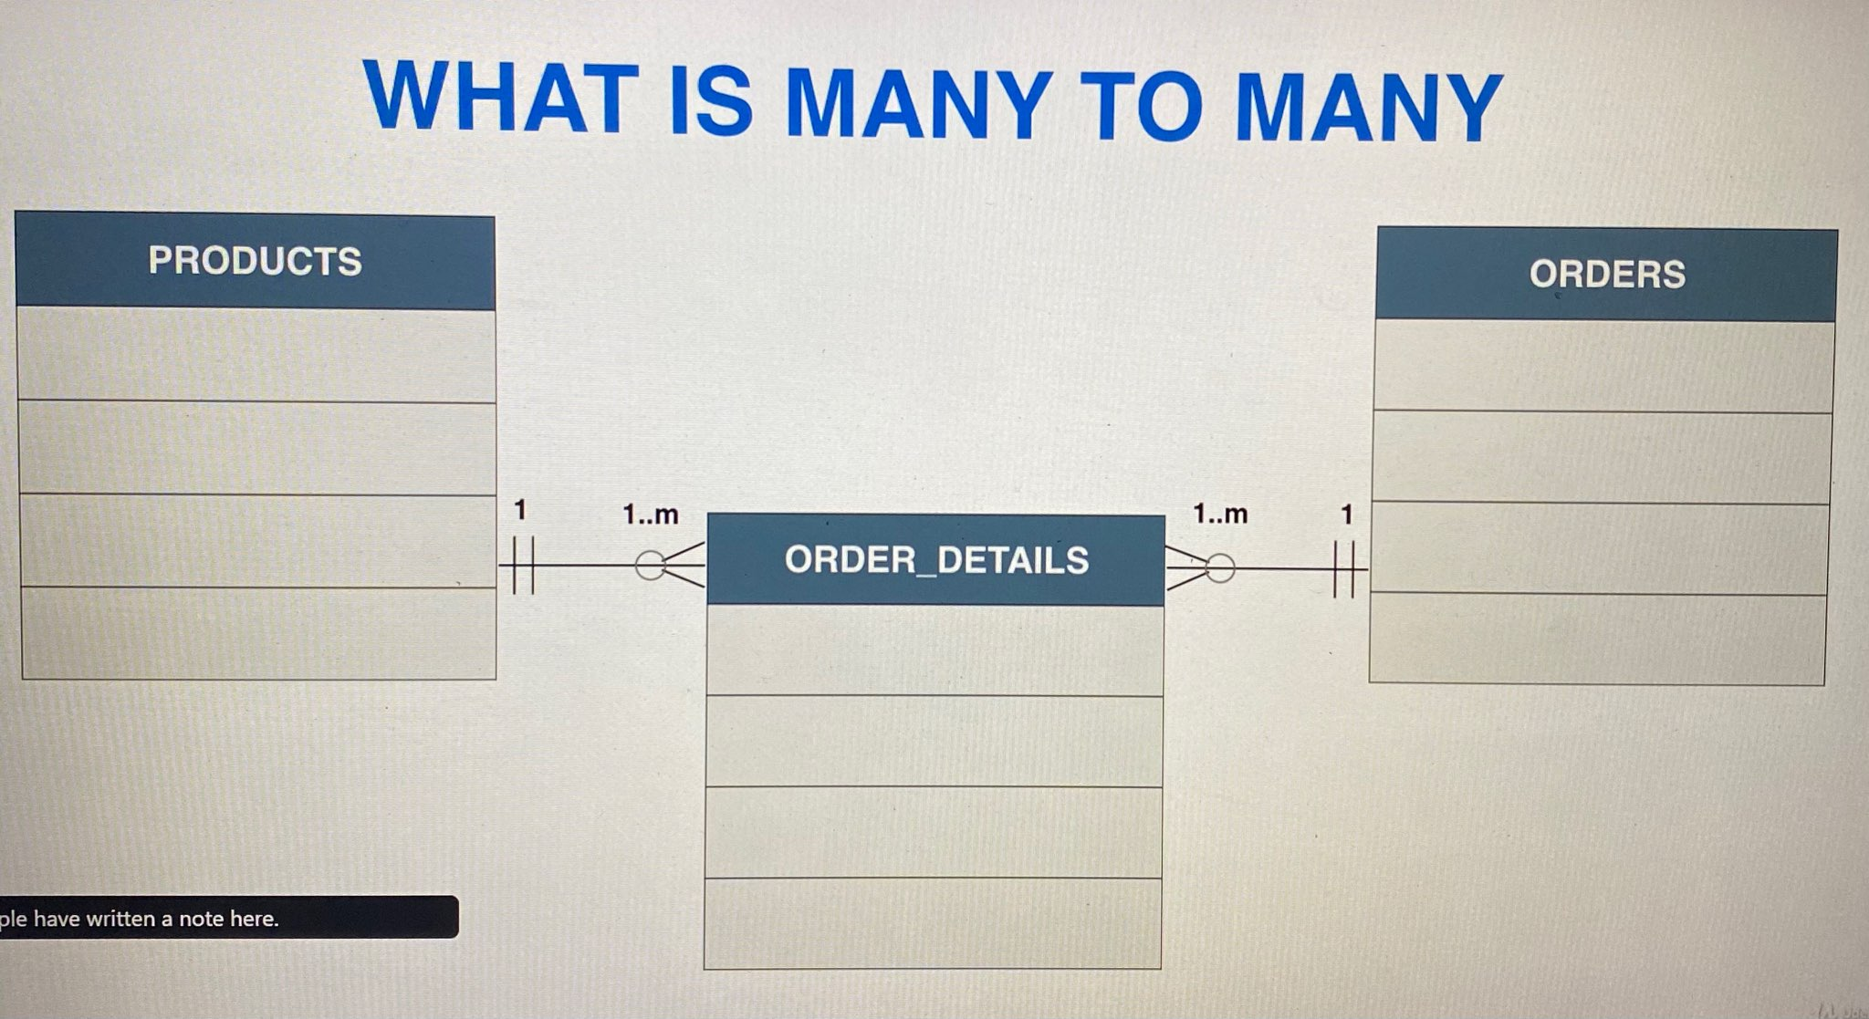
One to Many
Where 2 table can have many instances of each other -> more complicated
Ex: Products and Orders -> Junction table : Order_Details

Slide 44
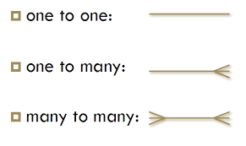
Diagram

