Slide 1
Java Core DAO, DTO
Author: Giau Le

Slide 2
References
https://viettuts.vn/java
https://www.w3schools.com/java/
https://o7planning.org/vi/12571/lich-su-cua-java-va-su-khac-biet-giua-oracle-jdk-va-openjdk
Github
https://github.com/giaule91/java-core-demo.git

Slide 3
Overview
Overview and setup
Rule & syntax
Object and Classes
Data Types
Operator, Decision Making, Loop
OOP
Collections
Exception
DAO, DTO

Slide 4
Overview and setup
Java programming language was originally developed by Sun Microsystems
Java built to suit various types of platforms.
For example: J2EE for Enterprise Applications, J2ME for Mobile Applications.
Java is guaranteed to be Write Once, Run Anywhere.

Slide 5
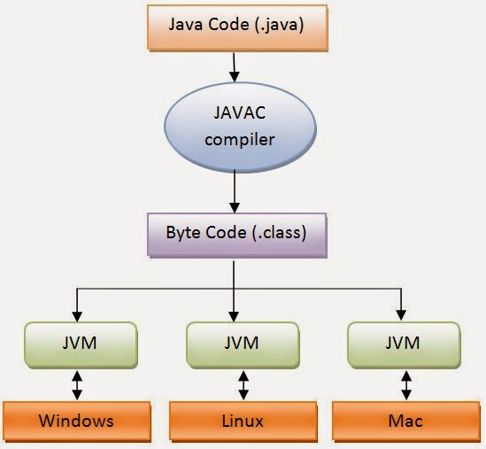
Overview and setup

Slide 6
Overview and setup
Jdk 8
https://www.oracle.com/java/technologies/javase/javase-jdk8-downloads.html
Install
Set JAVA_HOME:
Select Control Panel and then System.
Click Advanced and then Environment Variables.
Under System Variables, click New.
Enter the variable name as JAVA_HOME.
Enter the variable value as the installation path of the JDK
Ex: JAVA_HOME = C:\Program Files\Java\jdk1.8.0_251
Click OK.
Click Apply Changes.

Slide 7
Overview and setup
Update PATH:
In System variables, find PATH
Add: %JAVA_HOME%\bin;
To see if it worked, open up the Command Prompt and type java -version and see if it prints your newly installed JDK.
java –version

Slide 8
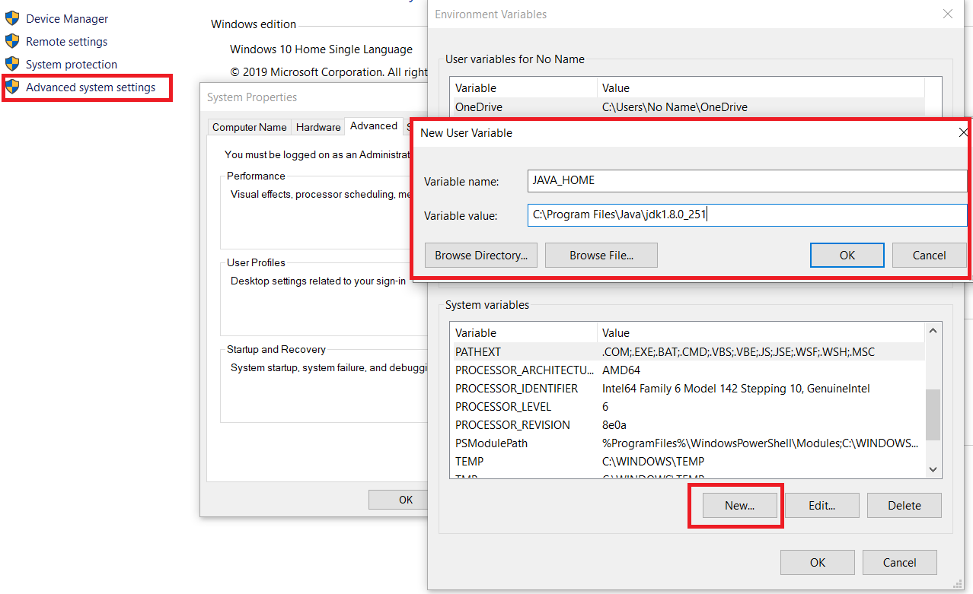
Overview and setup

Slide 9
Rule & syntax
Case Sensitivity: Hello and hello would have different meaning in Java
Class Names: For all class names the first letter should be in Upper Case. If several words are used to form a name of the class, each inner word's first letter should be in Upper Case.
Example: class MyFirstJavaClass
Method Names: All method names should start with a Lower Case letter. If several words are used to form the name of the method, then each inner word's first letter should be in Upper Case.
Example: public void myMethodName()

Slide 10
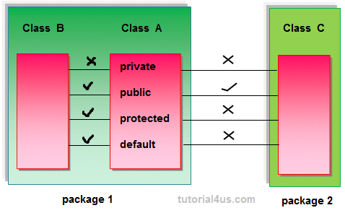
Rule & syntax
Access Modifiers − default, public, protected, private

Slide 11
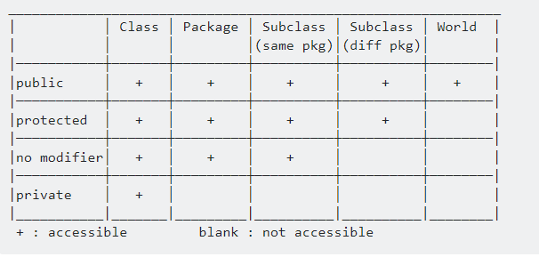
Rule & syntax

Slide 12
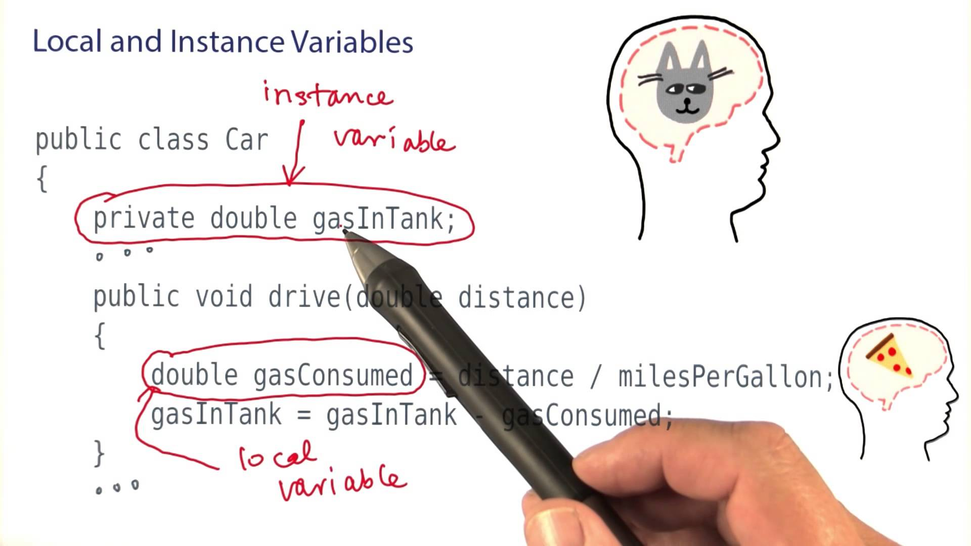
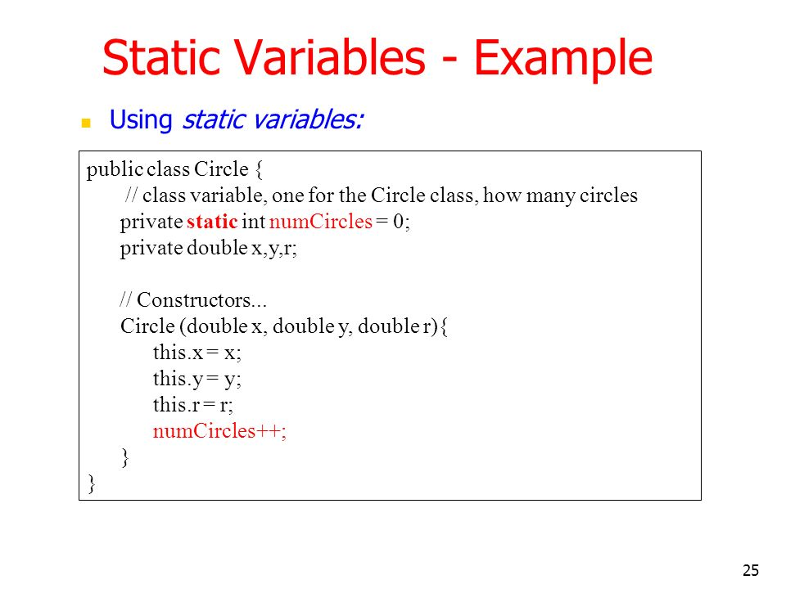
Rule & syntax
Local Variables
Class Variables (Static Variables)
Instance Variables (Non-static Variables)

Slide 13
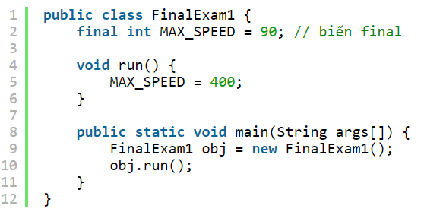
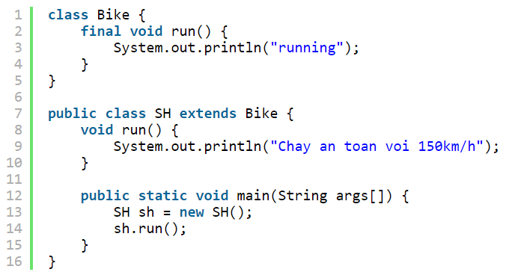
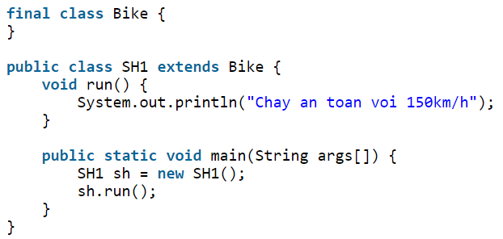
Rule & syntax
Từ khóa final
Biến final: bạn không thể thay đổi giá trị của biến final (nó sẽ là hằng số).
Phương thức final: bạn không thể ghi đè phương thức final.
Lớp final: bạn không thể kế thừa lớp final.

Slide 14
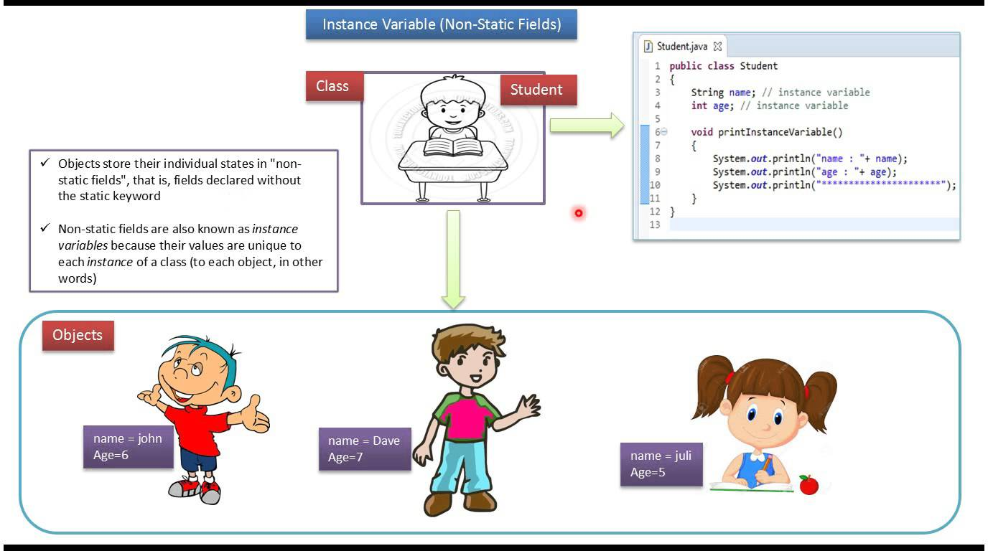
Object and Classes

Slide 15
Object and Classes
Object − Objects have states and behaviors.
Example: A dog has states - color, name, breed as well as behaviors – wagging the tail, barking, eating. An object is an instance of a class.
Class − A class can be defined as a template/blueprint that describes the behavior/state that the object of its type support.

Slide 16
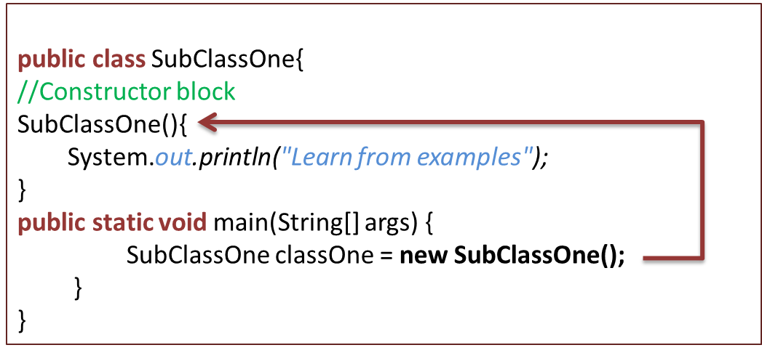
Object and Classes
Constructors
Each time a new object is created, at least one constructor will be invoked.
The main rule of constructors is that they should have the same name as the class.
A class can have more than one constructor.
Every class has a least of constructor.
If we do not explicitly write a constructor for a class, the Java compiler builds a default constructor for that class.

Slide 17
Data Types
There are two data types available in Java
Primitive Data Types
Reference/Object Data Types
https://www.w3schools.com/java/java_data_types.asp

Slide 18
Operator, Decision Making, Loop
Java provides a rich set of operators to manipulate variables
Arithmetic Operators
Relational Operators
Bitwise Operators
Logical Operators
Assignment Operators
Misc Operators
https://www.w3schools.com/java/java_operators.asp

Slide 19
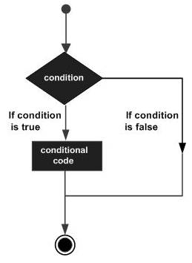
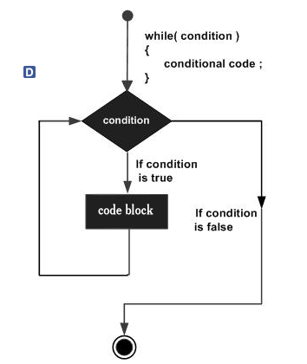
Operator, Decision Making, Loop

Slide 20
OOP
Inheritance
Overriding
Polymorphism
Abstraction
Encapsulation
Interfaces
Packages

Slide 21
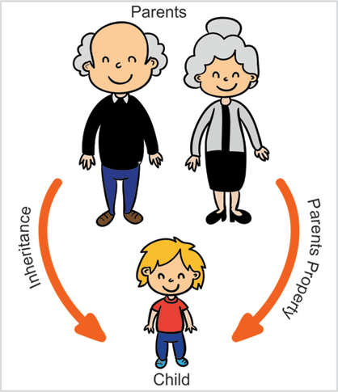
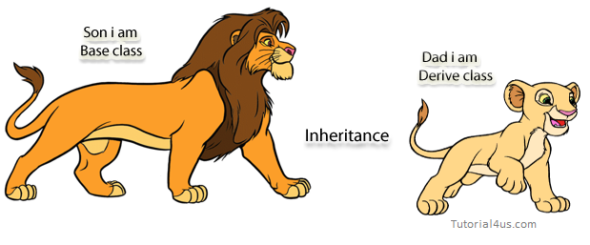
Inheritance

Slide 22
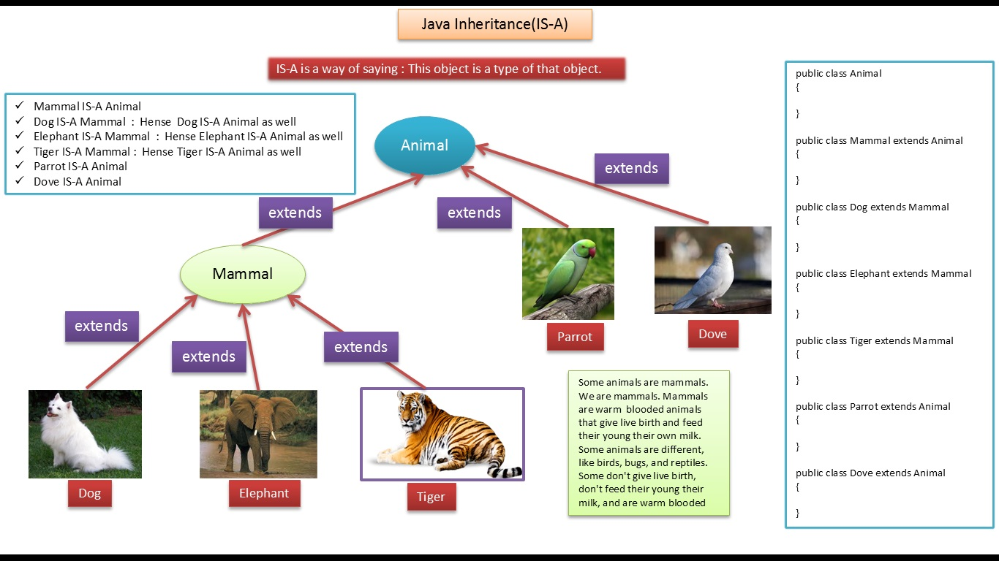
Inheritance
How to write Inheritance on java?
extends is the keyword used to inherit the properties of a class.

Slide 23
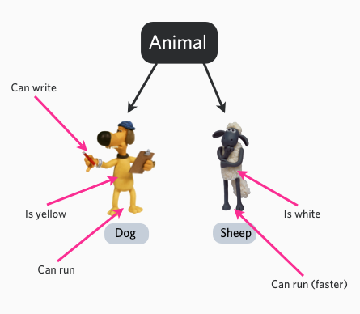
Inheritance
What is Overriding?
In object-oriented terms, overriding means to override the functionality of an existing method.

Slide 24
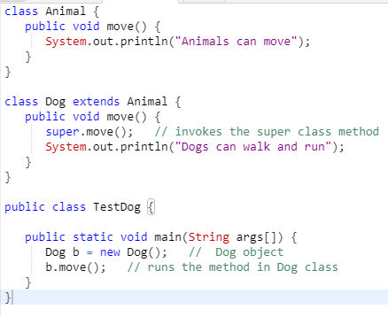
Inheritance

Slide 25
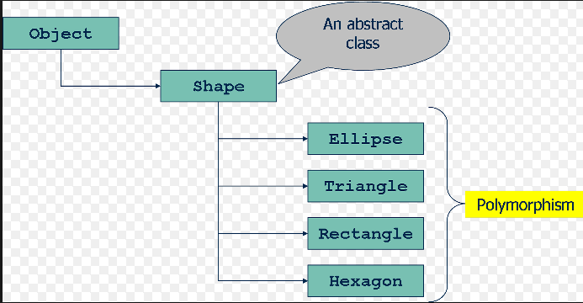
Polymorphism
Polymorphism is the ability of an object to take on many forms.
The most common use of polymorphism in OOP occurs when a parent class reference is used to refer to a child class object.

Slide 26


Polymorphism
For Requirement Example
A Deer IS-A Animal
A Deer IS-A Vegetarian
A Deer IS-A Deer
A Deer IS-A Object

Slide 27
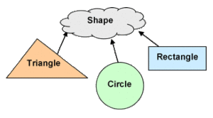
Abstraction
Abstraction is a process of hiding the implementation details from the user, only the functionality will be provided to the user.
The user will have the information on what the object does instead of how it does it.

Slide 28
Abstraction
Using abstract keyword
Abstract classes may or may not contain abstract methods, i.e., methods without body ( public void get(); )
if a class has at least one abstract method, then the class must be declared abstract.
To use an abstract class, you have to inherit it from another class, provide implementations to the abstract methods in it.
If a class is declared abstract, it cannot be instantiated.

Slide 29
Encapsulation
Encapsulation is one of the four fundamental OOP concepts. The other three are inheritance, polymorphism, and abstraction.
Encapsulation in Java is a mechanism of wrapping the data (variables) and code acting on the data (methods) together as a single unit
The variables of a class will be hidden from other classes, and can be accessed only through the methods of their current class. Therefore, it is also known as data hiding

Slide 30
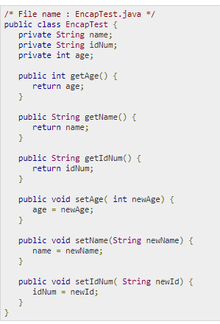
Encapsulation
Benefits of Encapsulation
The fields of a class can be made read-only or write-only.
A class can have total control over what is stored in its fields.

Slide 31
Interfaces
An interface is a reference type in Java. It is similar to class.
It is a collection of abstract methods. A class implements an interface, thereby inheriting the abstract methods of the interface.
Writing an interface is similar to writing a class. But a class describes the attributes and behaviors of an object.
And an interface contains behaviors that a class implements.
Unless the class that implements the interface, all the methods of the interface need to be defined in the class.

Slide 32
Interfaces
What is different with a class
You cannot instantiate an interface.
An interface does not contain any constructors.
All of the methods in an interface are abstract.
An interface cannot contain instance fields. The only fields that can appear in an interface must be declared both static and final.
An interface is not extended by a class; it is implemented by a class.
An interface can extend multiple interfaces.

Slide 33
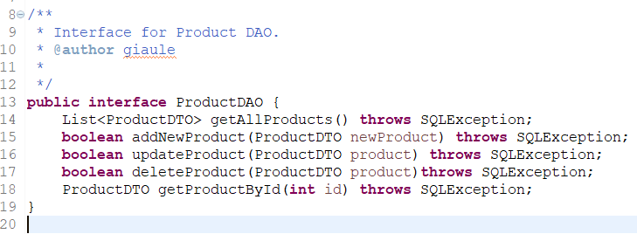
Interfaces
How to write Interfaces on Java?
interface keyword is used to declare an interface.
An interface is implicitly abstract.
Each method in an interface is also implicitly abstract, so the abstract keyword is not needed.
Methods in an interface are implicitly public.

Slide 34
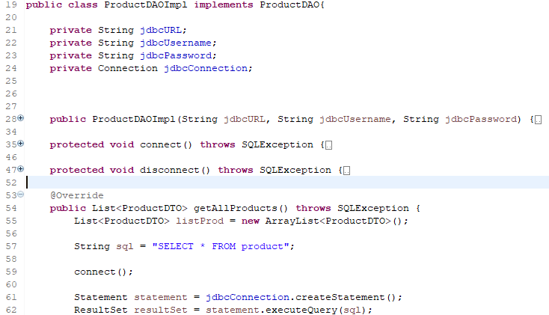
Interfaces
To access the interface methods, the interface must be "implemented" (kinda like inherited) by another class with the implements keyword (instead of extends)

Slide 35
Collections
Collections is set of standard interfaces.
The framework had to be high-performance.
Allow different types of collections to work in a similar manner

Slide 36
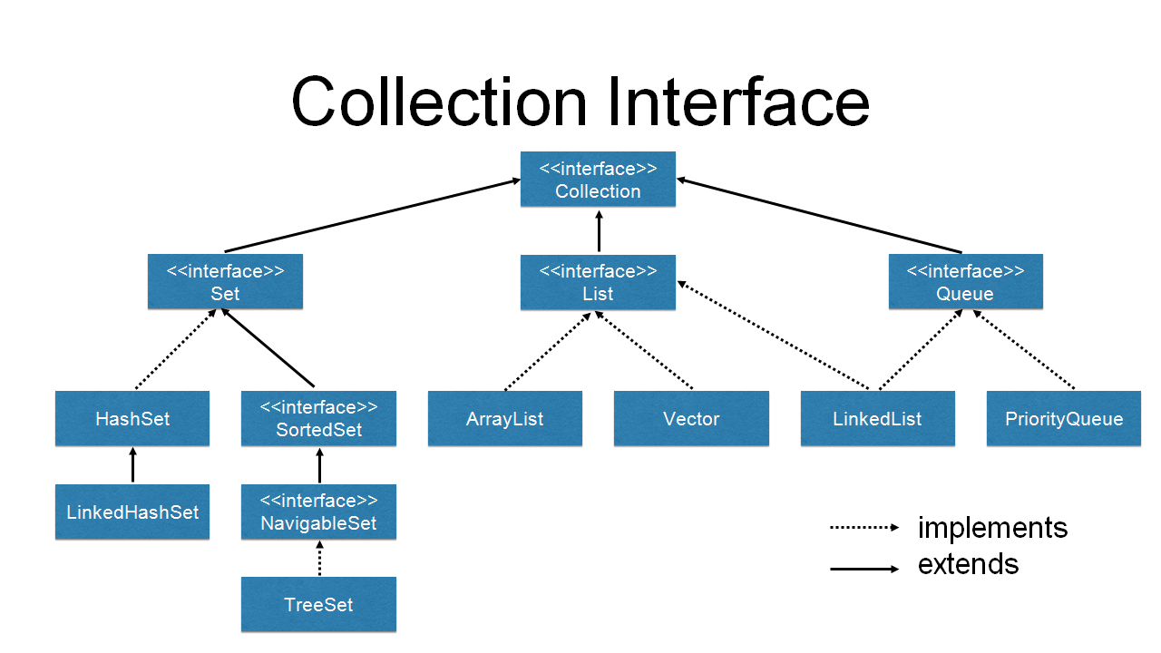
Collections

Slide 37
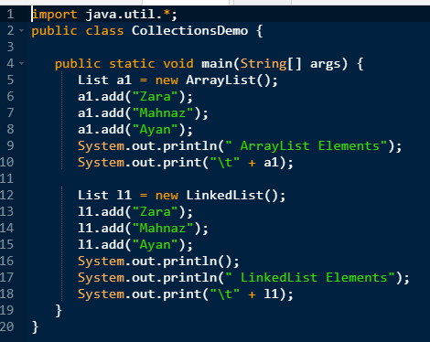
Collections
List
Elements can be inserted or accessed by their position in the list, using a zero-based index.
A list may contain duplicate elements.

Slide 38
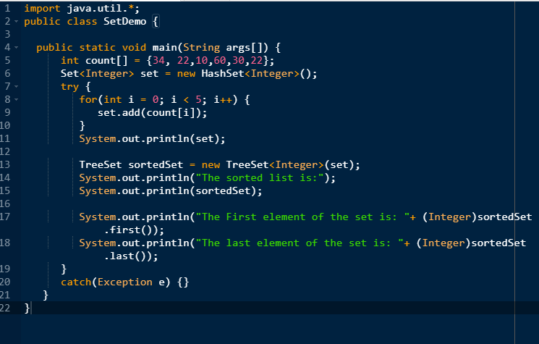
Collections
Set
A Set is a Collection that cannot contain duplicate elements. It models the mathematical set abstraction.

Slide 39
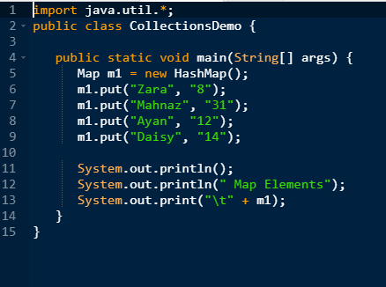
Collections
Map
Maps are not collections in the proper use of the term, but they are fully integrated with collections.
Maps store key/value pairs.

Slide 40
Exception
An exception (or exceptional event) is a problem that arises during the execution of a program.
When an Exception occurs the normal flow of the program is disrupted and the program/Application terminates abnormally, which is not recommended, therefore, these exceptions are to be handled

Slide 41
Exception
User case
A user has entered an invalid data.
A file that needs to be opened cannot be found.
A network connection has been lost in the middle of communications or the JVM has run out of memory.

Slide 42
Exception
What kind of Exception?
Checked exceptions − A checked exception is an exception that occurs at the compile time, these are also called as compile time exceptions
Unchecked exceptions − An unchecked exception is an exception that occurs at the time of execution. These are also called as Runtime Exceptions.

Slide 43
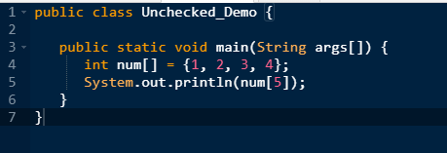
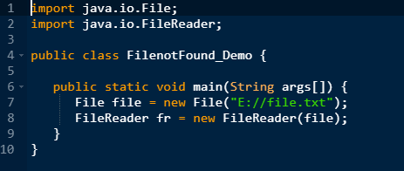
Exception
Un-Checked Exception
Checked Exception

Slide 44
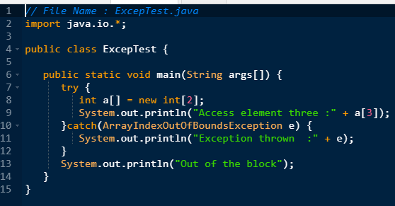
Exception
Catching Exceptions
A method catches an exception using a combination of the try and catch keywords
A try/catch block is placed around the code that might generate an exception.
Code within a try/catch block is referred to as protected code
Can using Multiple Catch Blocks

Slide 45
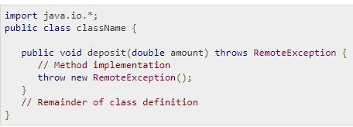
Exception
Throws/Throw exception
If a method does not handle a checked exception, the method must declare it using the throws keyword. The throws keyword appears at the end of a method's signature.
You can throw an exception, either a newly instantiated one or an exception that you just caught, by using the throw keyword.

Slide 46
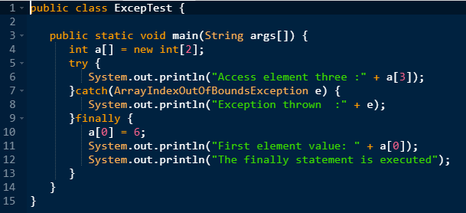
Exception
The Finally Block
The finally block follows a try block or a catch block. A finally block of code always executes, irrespective of occurrence of an Exception.
Using a finally block allows you to run any cleanup-type statements that you want to execute, no matter what happens in the protected code.

Slide 47
Exception
User-defined Exceptions
You can create your own exceptions in Java. Keep the following points in mind when writing your own exception classes
All exceptions must be a child of Throwable.
If you want to write a checked exception that is automatically enforced by the Handle or Declare Rule, you need to extend the Exception class.
If you want to write a runtime exception, you need to extend the RuntimeException class.

Slide 48

DAO & DTO
Data Access Object (DAO) Pattern là một trong những Pattern thuộc nhóm cấu trúc (Structural Pattern).
DAO Pattern dựa trên các nguyên tắc thiết kế abstraction và encapsulation. Nó bảo vệ phần còn lại của ứng dụng khỏi mọi thay đổi trong lớp lưu trữ
Trong Java, DAO được triển khai theo nhiều cách khác nhau như Java Persistence API, Enterprise Java Bean (EJB), Object-relational mapping (ORM) với các implement cụ thể như Hibernate, iBATIS, Spring JPA, …

Slide 49
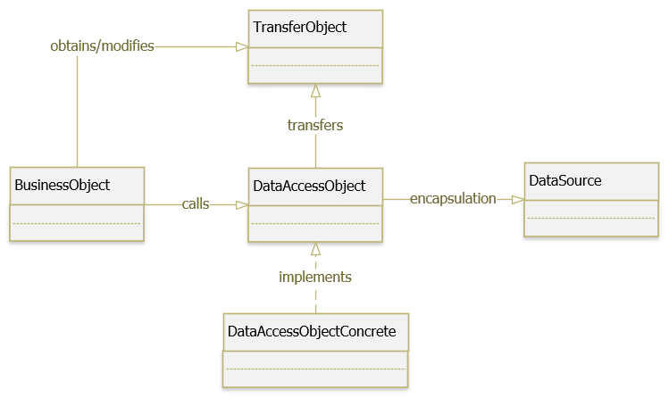
DAO & DTO
BusinessObject : đại diện cho Client, yêu cầu truy cập vào nguồn dữ liệu để lấy và lưu trữ dữ liệu.
DataAccessObject (DAO): là một interface định nghĩa các phương thức trừu tượng việc triển khai truy cập dữ liệu cơ bản cho BusinessObject để cho phép truy cập vào nguồn dữ liệu (DataSource).
DataAccessObjectConcrete : cài đặt các phương thức được định nghĩa trong DAO, lớp này sẽ thao tác trực tiếp với nguồn dữ liệu (DataSource).
DataSource : là nơi chứa dữ liệu, nó có thể là database, xml, json, text file, webservice, …
TransferObject : là một POJO (Plain old Java object) object, chứa các phương thức get/set được sử dụng để lưu trữ dữ liệu và được sử dụng trong DAO class.

Slide 50
DAO & DTO
Transfer Object/ Data Transfer Object Pattern là một dạng Architectural Design Pattern, được sử dụng khi chúng ta muốn truyền dữ liệu qua lại giữa các tầng trong ứng dụng, giữa Client – Server.
Data Transfer Object (DTO) còn được gọi là Value Object (VO).

Slide 51
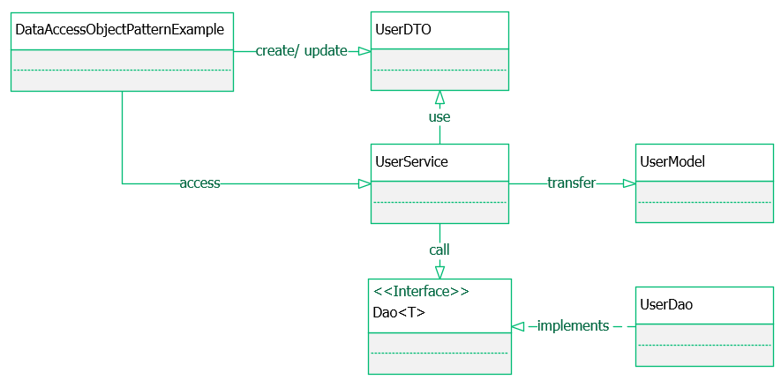
DAO & DTO

Slide 52
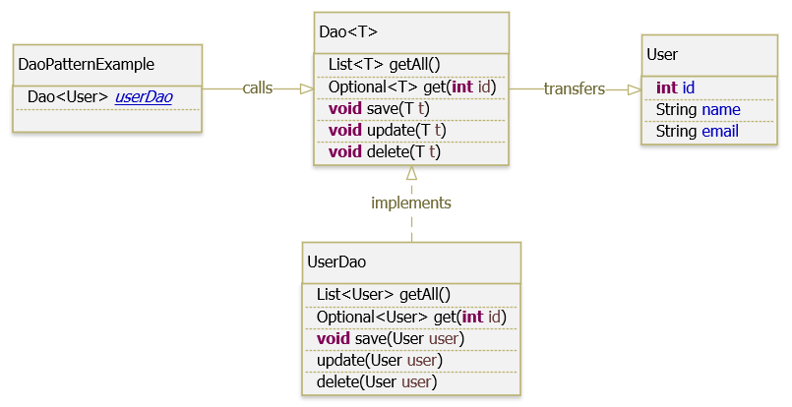
DAO & DTO

