Slide 1
Servlet
Author: Giau Le

Slide 2
References
https://o7planning.org/vi/10169/huong-dan-lap-trinh-java-servlet#a12951
https://viettuts.vn/servlet
https://javatutorial.net/java-servlet-example

Slide 3
Overview
Intro to MVC
Servlet Overview
Setup
Lifecycle
Servlet Requests and Responses
Cookie and Session Tracking
Intro to Maven
Filter and Servlet Communication
JSP Overview
JSP Standard Tag Library (JSTL)

Slide 4
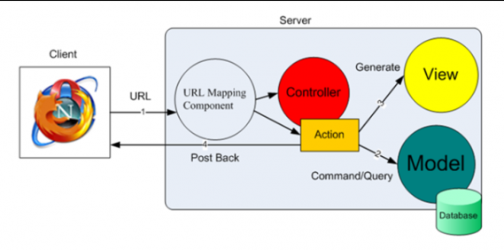
Intro to MVC
https://topdev.vn/blog/doi-dieu-ve-mo-hinh-mvc/

Slide 5
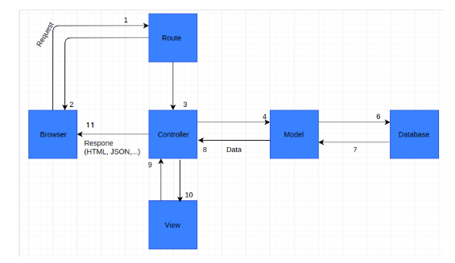
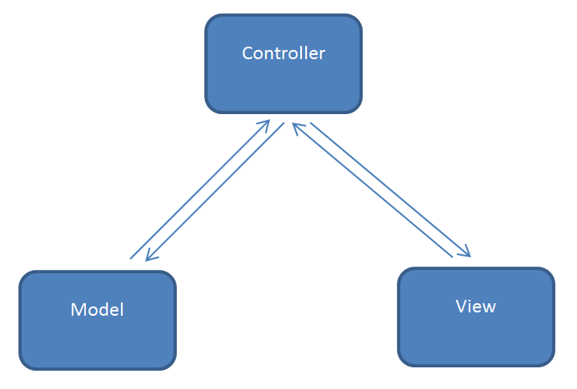
Intro to MVC

Slide 6
Overview
A servlet is a Java class that runs in a Java-enabled server.
An HTTP servlet is a special type of servlet that handles an HTTP request and provides an HTTP response, usually in the form of an HTML page.
Create dynamic Web pages that use HTML forms to get end-user input and provide HTML pages that respond to that input.
JDBC drivers
Session tracking

Slide 7
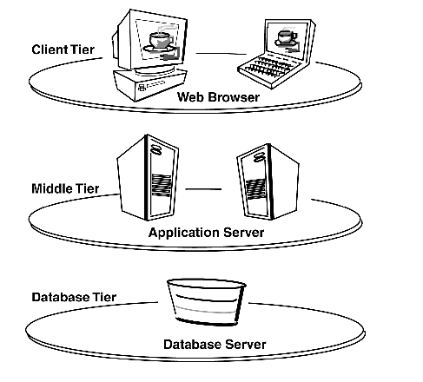
Overview
Programmers of HTTP servlets utilize a standard Java API, javax.servlet.http, to create interactive applications.
HTTP servlets can read HTTP headers and write HTML coding to deliver a response to a browser client.

Slide 8
Setup
Setup environment for Java Web application
1. JDK 8
Download and Install:
https://www.oracle.com/java/technologies/javase/javase-jdk8-downloads.html
2. Eclipse:
Download eclipse
https://www.eclipse.org/downloads/packages/release/Mars/2
Download zip file, extract and open eclipse
3. Install Tomcat 8 in Eclipse
https://tomcat.apache.org/
or for 8.0 https://archive.apache.org/dist/tomcat/tomcat-8/v8.0.46/bin/

Slide 9
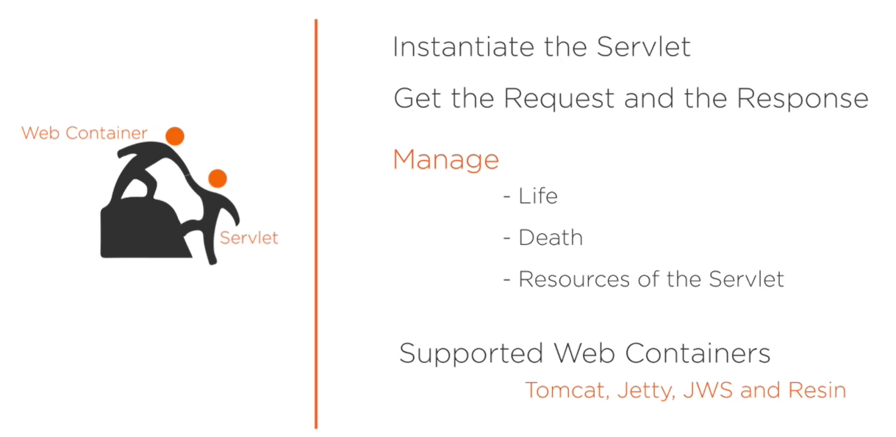
Architecture
The web container is a program that manages execution of servlets and JSP pages.
The web container takes requests from a web server and passes it to a servlet for processing. It maintains the servlet cycle.

Slide 10
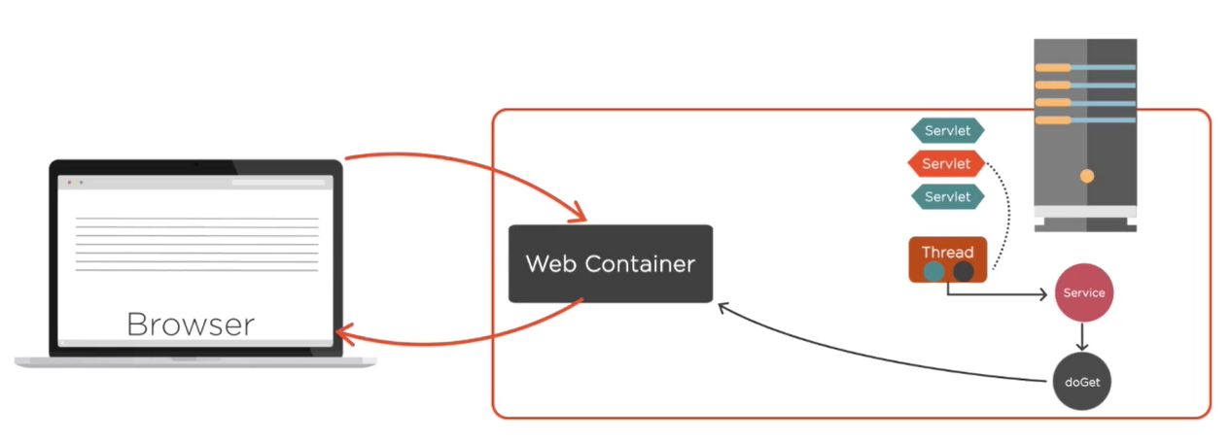
Architecture

Slide 11
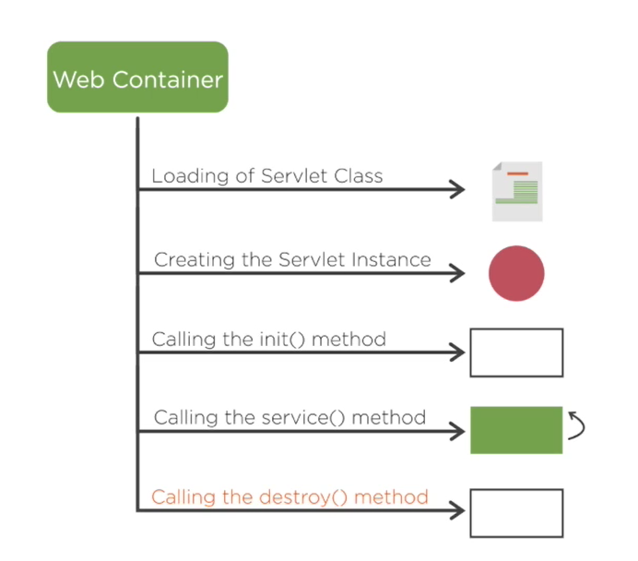
Lifecycle
Như vậy khi người dùng gửi yêu cầu một Servlet,
Servlet sẽ được tạo ra tại thời điểm có yêu cầu lần đầu tiên tới, đồng thời sẽ gọi phương thức init() của servlet để khởi tạo cho nó, init() được gọi duy nhất 1 lần.
Phương thức destroy() dùng để hủy servlet, nó sẽ được gọi một lần duy nhất khi bạn gỡ bỏ triển khai (undeloy) ứng dụng web hoặc tắt (shutdown) Web Server (Máy chủ web).

Slide 12
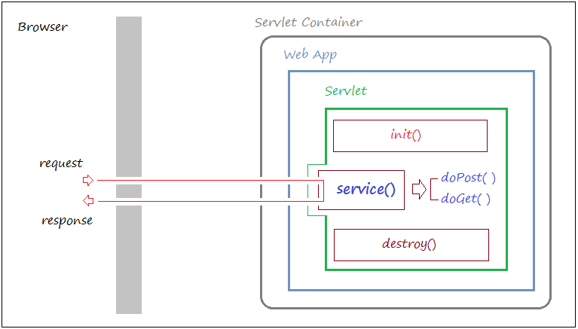
Servlet Requests and Responses
Khi yêu cầu (request) của người dùng gửi tới Servlet,
Servlet sẽ gọi phương thức service() để phục vụ yêu cầu của người dùng,
service() sẽ gọi một trong hai phương thức doGet() hoặc doPost().
Trong Servlet của bạn, bạn cần ghi đè và xử lý tại các phương thức này.

Slide 13
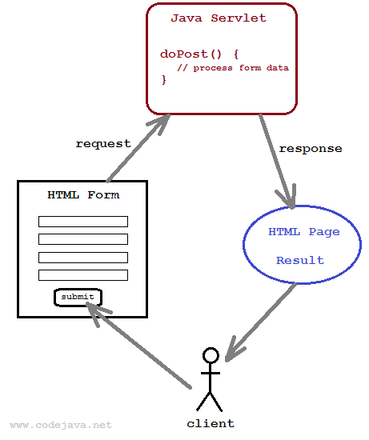
Servlet Requests and Responses

Slide 14
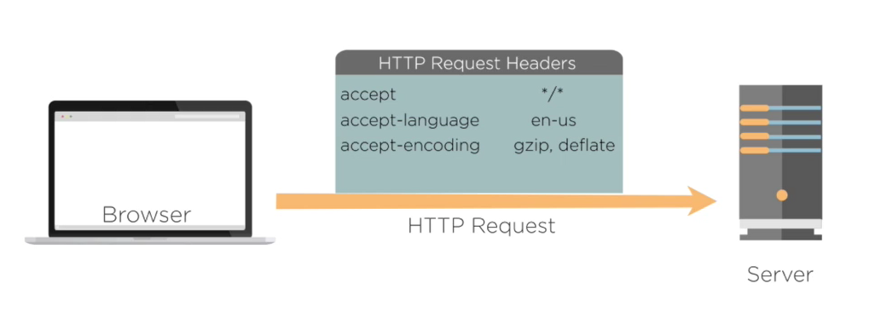
Servlet Requests and Responses
Servlets support a request and response programming model. When a client sends a request to the server, the server sends the request to the servlet. The servlet then constructs a response that the server sends back to the client.
The servlet first determines whether the request is a GET or POST operation. It then calls one of the following methods: doGet or doPost.

Slide 15
Servlet Requests and Responses
Sending request:
The life of a servlet begins when a client sends a req to Web Server and the servlet container creates an instance of the servlet.
The HttpServletRequest interface.
getParameter()
Sending Response:
The process of sending request can be understood by having a clear picture on the use of ServletResponse and HttpServletResponse interface.

Slide 16
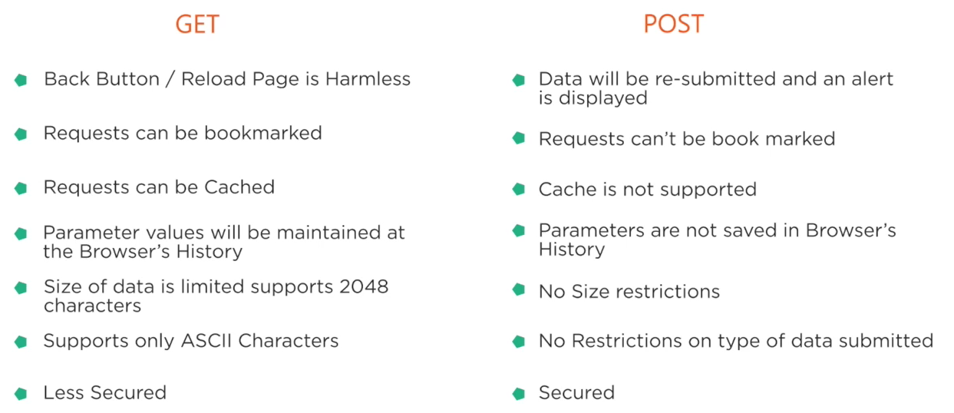
Servlet Requests and Responses

Slide 17
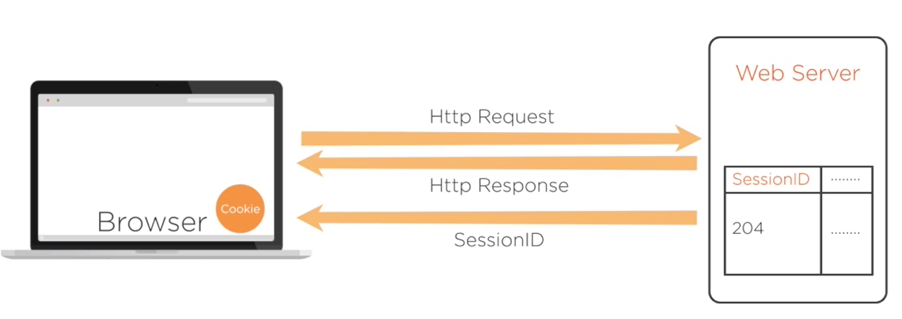
Cookie and Session Tracking
Session Tracking from a Servlet
Session tracking enables you to track a user's progress over multiple servlets or HTML pages, which, by nature, are stateless.

Slide 18
Cookie and Session Tracking
Tracking a Session with an HttpSession Object
HttpSession session = request.getSession();
session .getAttribute();

Slide 19
Cookie and Session Tracking
Cookies in Servlet
Cookie are used to store server side information at client system, such as the values can be used a cross servlet pages
Temporary cookie
Maintain within the memory allocated at web browser, the cookie data will be cleared implicit when we close browser
Permanent cookie
Maintain cookie data within a physical file at client system until expiration

Slide 20
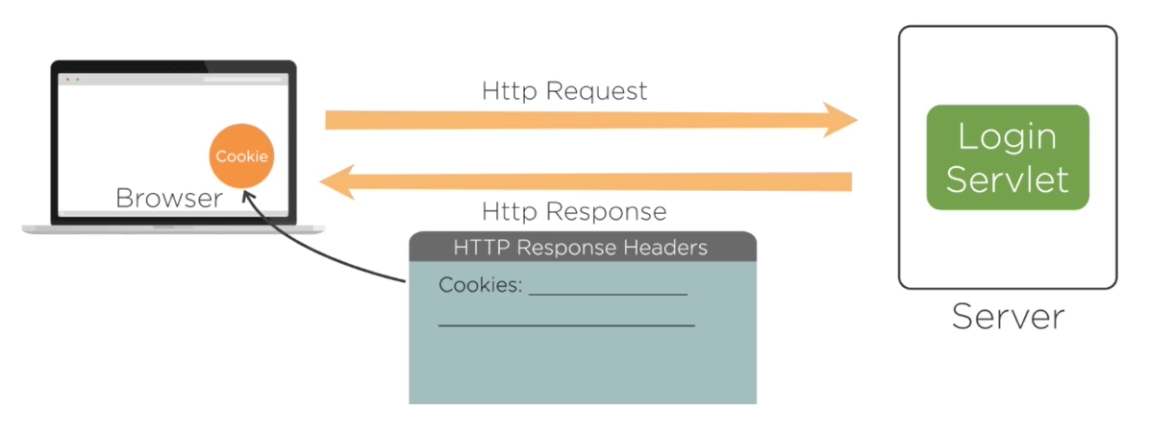
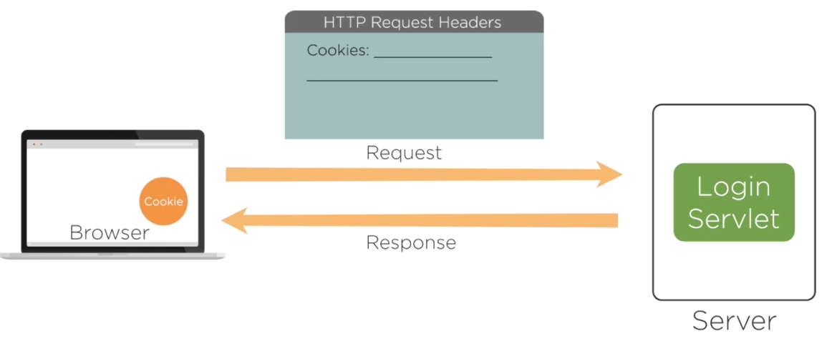
Cookie and Session Tracking

Slide 21
Cookie and Session Tracking
By default, each request is considered as a new request.
In cookies technique, we add cookie with response from the servlet. So cookie is stored in the cache of the browser.
After that if request is sent by the user, cookie is added with request by default. Thus, we recognize the user as the old user.
Cookie ck=new Cookie("user","sonoo jaiswal"); ck.setMaxAge(3000); // -1 -> deleted when exist browser response.addCookie(ck); request.getCookie();

Slide 22
Intro to Maven
Apache Maven is a software project management and comprehension tool. Based on the concept of a project object model (POM), Maven can manage a project's build, reporting and documentation from a central piece of information.
https://mvnrepository.com/
Ex:
https://mvnrepository.com/search?q=mysql
https://mvnrepository.com/artifact/mysql/mysql-connector-java/8.0.20
Research for Gradle …

Slide 23
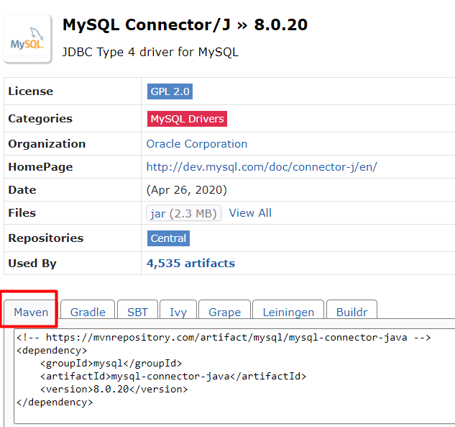
Intro to Maven

Slide 24
JSP Overview
JavaServer Pages (JSP) is a technology for developing Webpages that supports dynamic content.
This helps developers insert java code in HTML pages by making use of special JSP tags, most of which start with <% and end with %>.

Slide 25
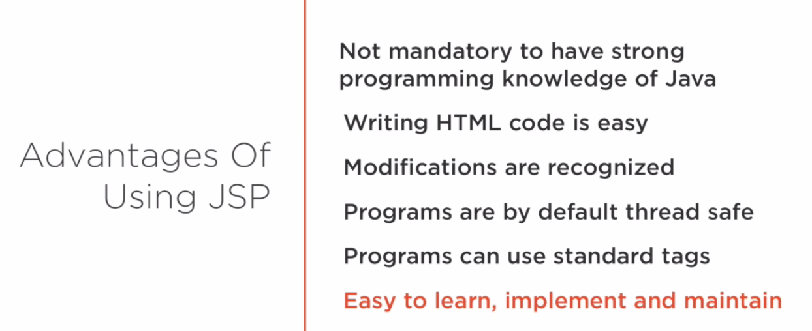
JSP Overview

Slide 26
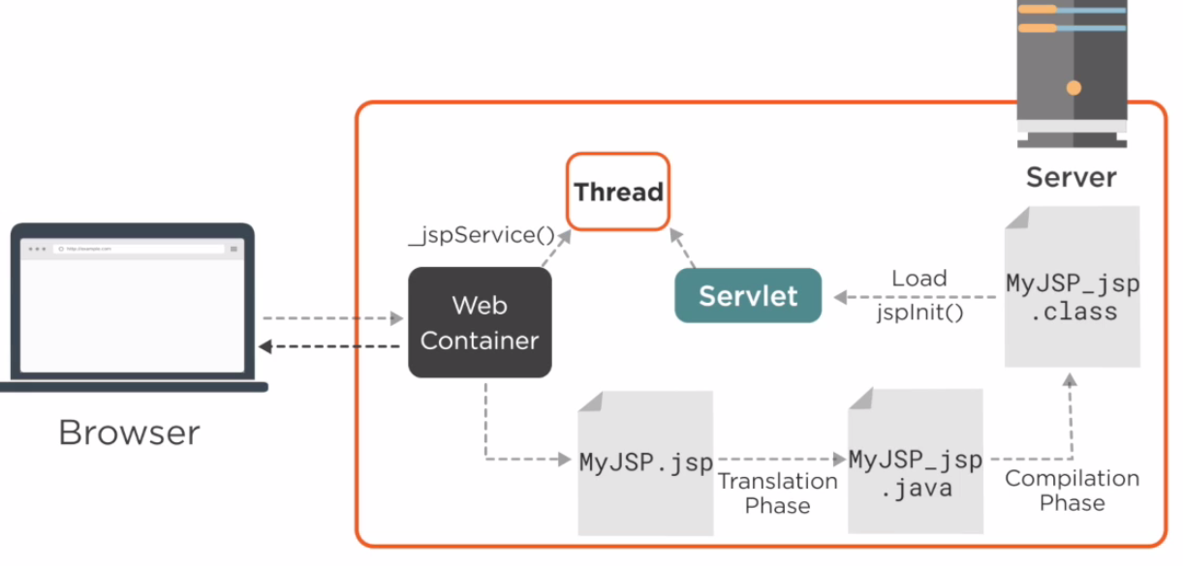
JSP Overview
JSP Lifecycle

Slide 27
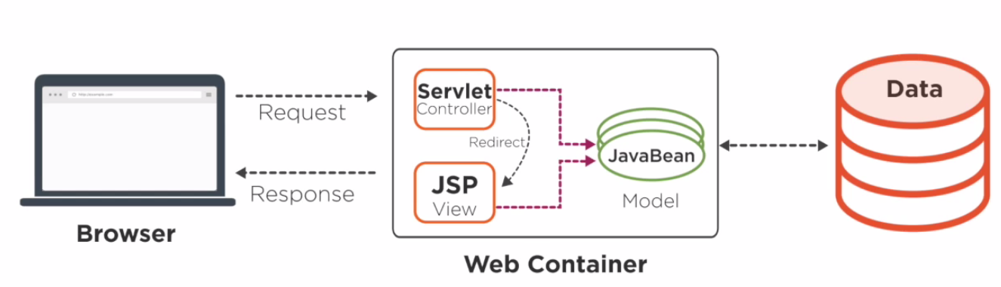
JSP Overview
JSP Development Model

Slide 28
JSP - Syntax
Expression include in HTML page
<% … %>
Ex:
Declaration Tag
<%! function %>
Directive
@page
<%@ page language="java" contentType="text/html; charset=ISO-8859-1"
pageEncoding="ISO-8859-1"%>
<body>
<p>Today's date: <%= (new java.util.Date()).toLocaleString()%></p> </body>

Slide 29
JSP - Standard Tag Library (JSTL)
Install JSTL Library
Download: https://tomcat.apache.org/taglibs/standard/
Copy the JAR files in the distribution's 'lib' directory to your application's webapps\ROOT\WEB-INF\lib directory.
OR include in Maven (pom.xml)
https://mvnrepository.com/artifact/javax.servlet/jstl/1.2

Slide 30
JSP - Standard Tag Library (JSTL)
Include a <taglib> directive at the top of each JSP
Core Tags
Formatting tags
SQL tags
XML tags
JSTL Functions
Example
<%@ taglib uri="http://java.sun.com/jsp/jstl/core" prefix="c" %>
<%@ taglib uri="http://java.sun.com/jsp/jstl/fmt" prefix="fmt"%>
Reference
https://www.tutorialspoint.com/jsp/jsp_standard_tag_library.htm

Slide 31
JSP - Standard Tag Library (JSTL)
Using example
For loop
<c:forEach var="item" items="${sessionScope.cart.items}">
...
</c:forEach>
The JSP EL variable or property can be set either from the attribute value:
<c:set var="foo" scope="session" value="..."/>
<c:if test="${!a}">

Slide 32
Filter and Servlet Communication
A filter is a Java class that is invoked in response to a request for a resource in a Web application. Resources include Java Servlets, JavaServer pages (JSP), and static resources such as HTML pages or images
You define filters in the context of a Web application. A filter intercepts a request for a specific named resource or a group of resources (based on a URL pattern) and executes the code in the filter

Slide 33
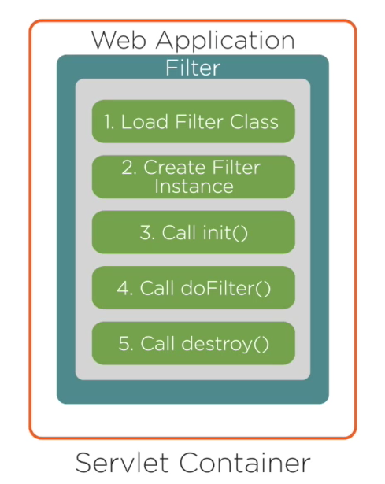
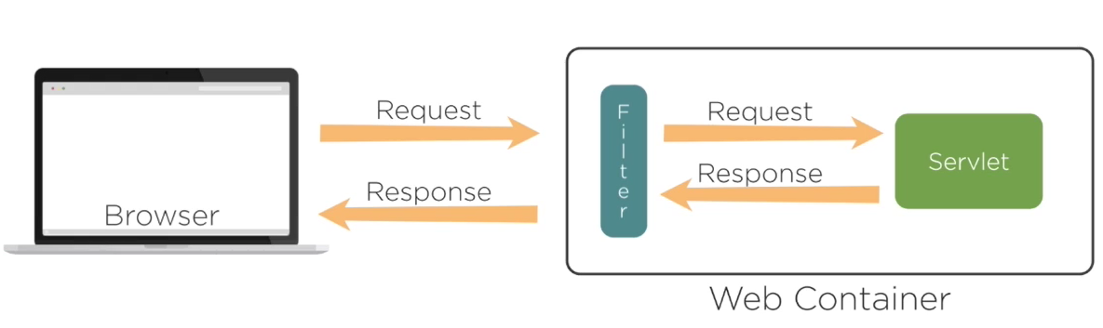
Filter and Servlet Communication

Slide 34
Filter and Servlet Communication
Writing a Filter Class
To write a filter class, implement the javax.servlet.Filter interface
You use the doFilter() method to examine and modify the request and response objects, perform other tasks such as logging, invoke the next filter in the chain, or block further processing.
Configuring a Filter
Open the web.xml deployment descriptor
Add a filter declaration.

Slide 35
Filter and Servlet Communication
Xml configuration
<filter>
<filter-name>myFilter</filter-name>
<filter-class>examples.myFilterClass</filter-class>
</filter>
Specify one or more initialization attributes inside a filter element.
<init-param>
<param-name>myInitParam</param-name>
<param-value>myInitParamValue</param-value>
</init-param>

Slide 36
Filter and Servlet Communication
Add filter mappings.
<filter-mapping>
<filter-name>myFilter</filter-name>
<url-pattern>/myPattern/*</url-pattern>
</filter-mapping>

Slide 37
Practice
Making a Simple CRUD Application Using Java Servlet/JSP

Slide 38
Practice
Tools
Eclipse IDE for Java EE Developers (one of the newer versions is recommended)
Apache Tomcat version 8
MySQL Community Server and MySQL Workbench (GUI Tool)

Slide 39
Practice
CRUD is an acronym for CREATE, READ, UPDATE and DELETE
Technology
Java Servlets and Java Server Pages (JSP)
JSP Standard Tag Library (JSTL)
Java Database Connectivity (JDBC), MySQL Connector for Java
MySQL database
Maven/Gradle

Slide 40
Practice
Create Database
Create Project with Maven
In Eclipse IDE, click File > New > Other and Maven Project/Dynamic Web. Name the project
Add dependency to pom.xml
Writing Model Class
Writing DAO Class/Service Class
Create View/Form file/Css

