Slide 1
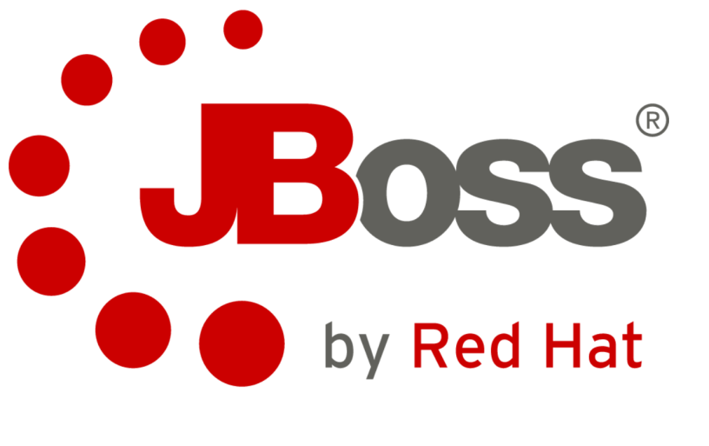
JBoss Enterprise Application Platform 6
Parte I
Gilberto A Lima a.limagilberto@gibati.com.br
30/12/2014

Slide 2
Agenda Parte 1
  Overview of Jboss EAP
  Standalone Mode Vrs Domain Mode
  Host vs. Server
  Use Cases for Standalone mode and Domain
  Install and run JBoss EAP 6
  Understanding Extensions, Subsystems and Profiles.
  Deploy applications to JBoss Enterprise Application Platform 6
  Conclusões
  Perguntas

Slide 3
Agenda Parte 2
  A brief review of the Jboss EAP6
  Configure Java™ Message Service (JMS) and HornetQ
  Configure the logging subsystem
  Configure the web subsystem
  Implement application security in JBoss Enterprise Application Platform 6
  Migrate JBoss Enterprise Application Platform 5 applications to JBoss Enterprise Application Platform 6
  Get an introduction to clustering
  Conclusões
  Perguntas

Slide 4

JBoss EAP6: Overview of JBoss EAP
Overview of JBoss EAP
Understanding EAP
- What’s New in EAP 6
Simplified Configuration Files:
  Standalone Mode / Domain mode
Modular
Domains
New Management Tools
  CLI/Console.

Slide 5
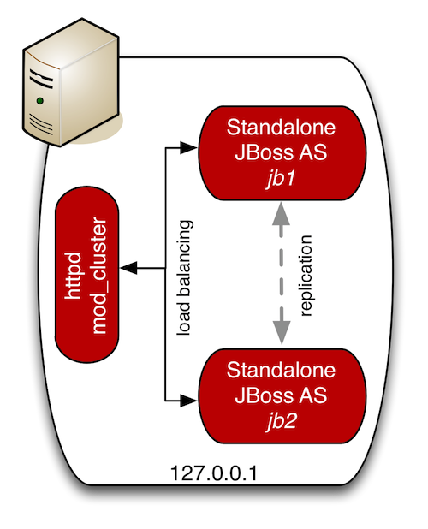
  JBoss EAP6: Standalone Mode Vrs Domain Mode
Standalone Mode
Single Server instance
Single Configuration file

Slide 6
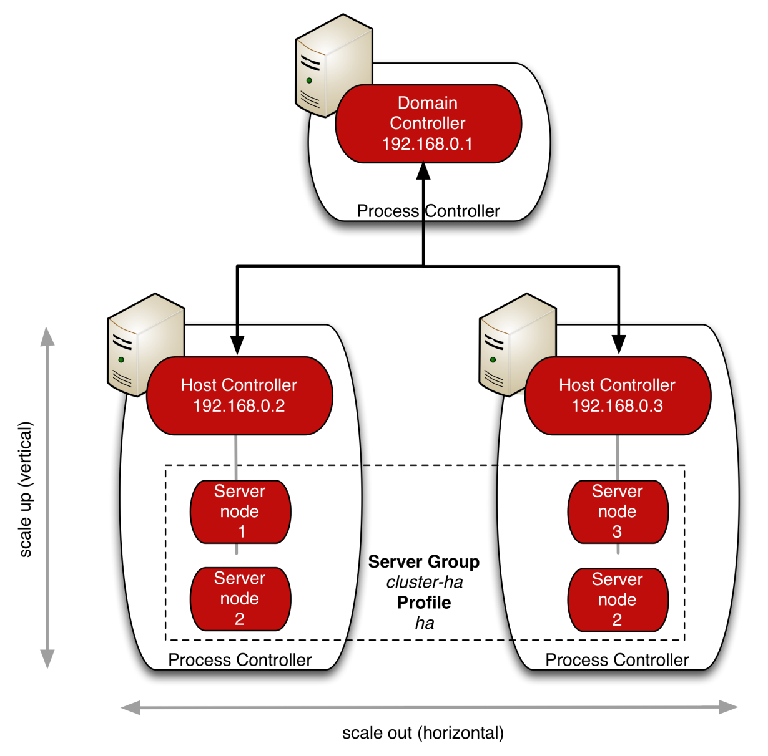
  JBoss EAP6: Standalone Mode Vrs Domain Mode
Domain mode:
Manage Multiple Hosts from a single location
Centralized Management capabilities

Slide 7
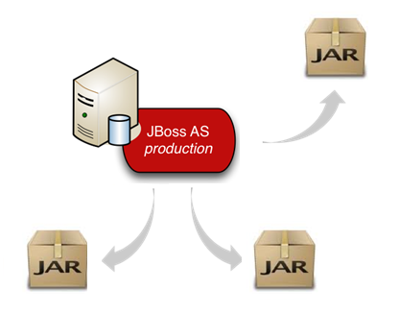
  JBoss EAP6: Host vs. Server
Host vs. Server
A Single host run Multiple EAP server Instances
Defined server groups
Single configuration file

Slide 8
  JBoss EAP6: Use Cases for Standalone/Domain
Standalone mode or Domain Mode ?
- A Single Java EE application is deployed on one EAP Server Instance.
- Your server topology requires EAP running in a cluster of four machines, each machine with a single EAP Server instance and each host having identical configurations.
- You have 12 EAP Servers that all need to be configured identically.

Slide 9
  JBoss EAP6: Install and run JBoss EAP 6
Installing EAP6
Extracting the Zip Download
RPM
The GUI installer
Console Installation
Automatic Installation

Slide 10
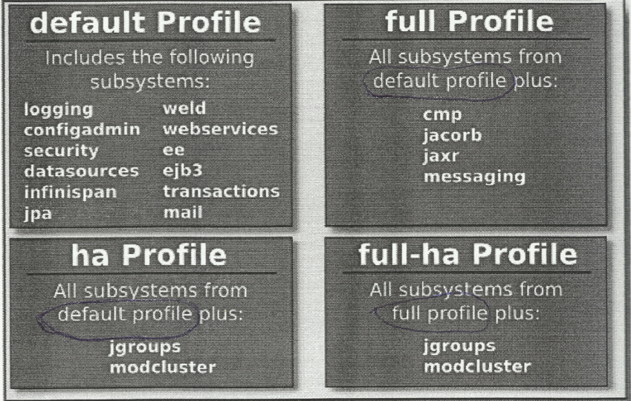
  JBoss EAP6: Understanding Extensions, Subsystems and Profiles.
Understanding Extensions, Subsystems and Profiles.
- Very Simple and LightWeight
- Subsystemas
- Extensões/Modules.
- Module.xml

Slide 11
  JBoss EAP6: Deploy applications to JBoss EAP6
Profiles
Deploy applications to JBoss EAP6
- Very Simple and LightWeight
- Subsystemas
- Extensões/Modules.
- Module.xml

Slide 12
JBoss EAP6: JBoss Enterprise Application Platform 6
Conclusão
Extracting the Zip Download
RPM
The GUI installer
Console Installation
Automatic Installation

Slide 13
JBoss EAP6: JBoss Enterprise Application Platform 6
Perguntas?

Slide 14
JBoss Enterprise Application Platform 6
Parte II
Gilberto A Lima a.limagilberto@gibati.com.br
30/12/2014

