Slide 1
CC-05 methods
54C cells were grown for 4 days in T175 (p22). Cells were ~85% confluent before trypsinisation in T175 flasks
54C cells (2.5x 10⁵ cells/5 mL) were plated in p60 dishes incubated for 20 h under oxia.
On the next day (20 h after plating) cells were ~25% confluent in p60 dishes (before drug treatment).
Cells were irradiated at 0 and 6Gy
Cell cycle assay (n=3 per treatment)
100 uM EdU solution was made in media and incubated in water bath (in 50 mL falcon tubes) before RT
0 h sample: Immediately after RT, media was removed and added 5 mL of 100 uM EdU in media. Plates were incubated at 37 °C for 0.5 h or 1 h before fixing cells (70% EtOH)
0.5, 1, 2, 3, 4, 24 h after RT, media was replaced with 100 uM EdU and incubated for 0.5 h at 37 °C before fixing cells
Cells were treated with PI just before FCM analysis
Cells were ~50% confluent at 24 h in p60 dishes after RT
Treatment time (hh:mm)
Samples: Time after RT | Radiation | EdU | fixing
0 h | 12:35 | 12:50 | 13:20
0.5 h | 15:15 | 15:59 | 16:29
1 h | 12:55 | 14:06 | 14:39
2 h | 13:43 | 15:59 | 16:29
3 h | 12:55 | 16:08 | 16:38
4 h | 12:35 | 16:50 | 17:29
24 h | 13:43 | 14:00 (next day) | 14:30 (next day)

Slide 2
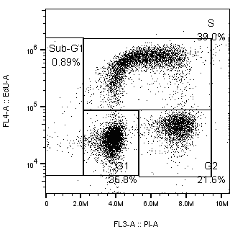
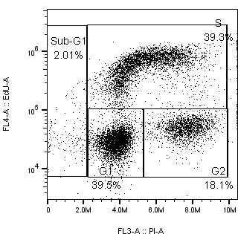
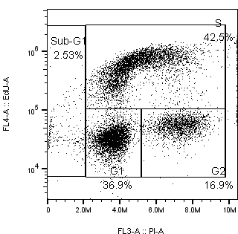
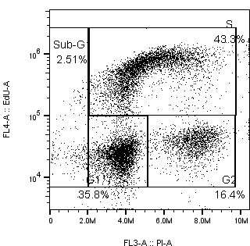
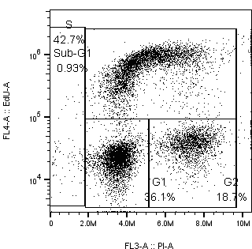
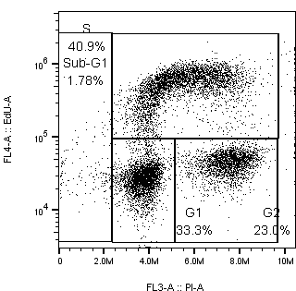
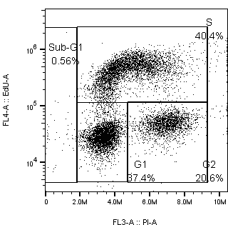
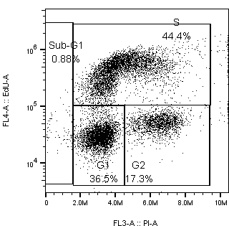
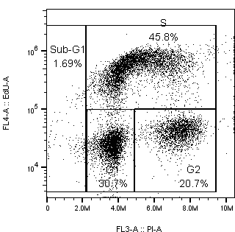
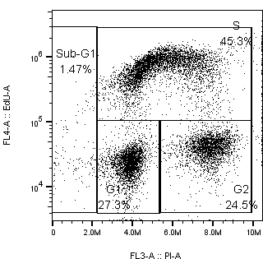
30 min EdU treatment (showing 1 sample/treatment but I did n=3)
 | 0 h | 0.5 h | 1 h | 2 h | 3 h
Control
6 Gy

Slide 3
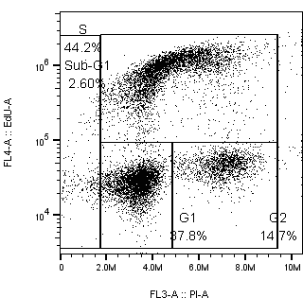
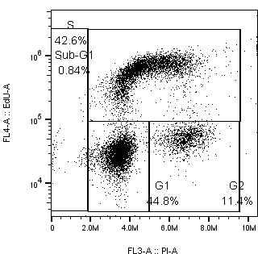

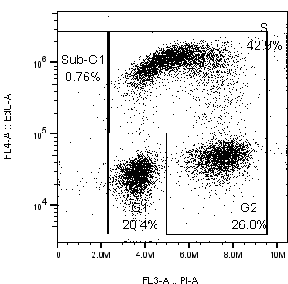
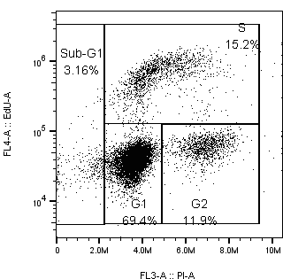
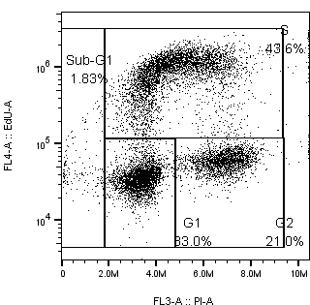
30 min EdU treatment (showing 1 sample/treatment but I did n=3)
 | 0 h | 4 h | 24 h | 0 h – 60 min EdU
Control
6 Gy

Slide 4
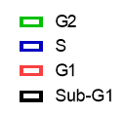
EdU treatment for 30 min vs 60 min
EdU was added at 0 h (immediately after RT)
EdU treatment for 30 min vs 60 min at 37 °C
Cell cycle %
Med EdU value
(EdU treatment)
%
%
 | Sub-G1 | G1 | S | G2
30 min | 1.7 | 38.1 | 37.7 | 21.1
60 min | 1.5 | 36.9 | 41.0 | 19.6
 | Sub-G1 | G1 | S | G2
30 min | 1.5 | 34.0 | 40.9 | 22.7
60 min | 1.8 | 33.2 | 43.1 | 21.4
Slight increase in S-phase cells (%) after 60 min treatment than 30 min treatment
0 Gy
6 Gy
Median EdU in S-phase cells after 60 min EdU treatment is ~2-fold higher than 30 min treatment
 | G1 | S | G2
30 min | 24322 | 523000 | 41145
60 min | 31187 | 1140000 | 54410
 | G1 | S | G2
30 min | 26764 | 496333 | 44114
60 min | 34426 | 939000 | 59409

Slide 5
Cell cycle % (EdU treatment: 30 min)
Cells were ~50% confluent in p60 dishes 24 h after RT.
24 h: higher G1 % but lower S and G2 %
(consistent with prev expt)
Time h | Sub-G1 | G1 | S | G2/M
0 | 1.7 | 38.1 | 37.7 | 21.1
0.5 | 1.7 | 39.8 | 39.0 | 18.4
1 | 1.2 | 37.6 | 43.4 | 16.8
2 | 1.8 | 37.6 | 43.1 | 16.1
3 | 1.2 | 36.1 | 43.2 | 18.0
4 | 1.9 | 38.0 | 44.7 | 14.6
24 | 1.1 | 44.8 | 42.4 | 11.5
Time h | Sub-G1 | G1 | S | G2/M
0 | 1.5 | 34.0 | 40.9 | 22.7
0.5 | 0.9 | 36.6 | 40.7 | 21.0
1 | 1.4 | 36.3 | 43.9 | 17.3
2 | 2.4 | 30.5 | 45.4 | 20.7
3 | 1.4 | 27.8 | 45.0 | 24.5
4 | 1.2 | 27.9 | 43.0 | 27.0
24 | 2.5 | 70.5 | 15.4 | 11.7
Need to repeat this expt with later time points (8, 18 h)

Slide 6
Median EdU values
0 Gy
6 Gy
Time | G1 | S | G2
0 | 24322 | 523000 | 41145
0.5 | 29890 | 616000 | 50615
1 | 31874 | 590000 | 54201
2 | 26077 | 631333 | 44340
3 | 24147 | 763667 | 41452
4 | 27071 | 929667 | 46173
24 | 34731 | 591000 | 57414
Time | G1 | S | G2
0 | 26764 | 496333 | 44114
0.5 | 27634 | 425333 | 46717
1 | 28239 | 421295 | 47227
2 | 24813 | 547667 | 42024
3 | 22446 | 642500 | 38703
4 | 26598 | 953333 | 45759
24 | 40576 | 683000 | 64434
I’m not sure why med EdU value increases over time…
I didn’t see this trend in last expt (CC-04)..
Median Edu at 6 Gy normalised to median EdU at 0 Gy
Didn’t do stats on G1 and G2 EdU
**
Median EdU % (6 Gy/ 0Gy)
**
Time | G1 | S | G2
0 | 110.9 | 95.6 | 108.0
0.5 | 92.6 | 69.4 | 92.5
1 | 74.4 | 71.5 | 87.1
2 | 96.1 | 87.7 | 96.0
3 | 93.4 | 84.3 | 93.6
4 | 98.4 | 102.7 | 99.2
24 | 109.5 | 118.2 | 106.4
Max inhibition of EdU incorporation in S-phase cells was observed at 0.5 and 1 h after RT

Slide 7
New expt: CC- 05 (2.5 x 10⁵ cells/5 mL)
G2 fraction is ~2-fold higher at 0 h when cell seeding density is reduced by half (CC-05 vs CC-04)
Time | Sub-G1 | G1 | S | G2
0 | 1.7 | 38.1 | 37.7 | 21.1
0.5 | 1.7 | 39.8 | 39.0 | 18.4
1 | 1.2 | 37.6 | 43.4 | 16.8
2 | 1.8 | 37.6 | 43.1 | 16.1
3 | 1.2 | 36.1 | 43.2 | 18.0
4 | 1.9 | 38.0 | 44.7 | 14.6
24 | 1.1 | 44.8 | 42.4 | 11.5
Time | Sub-G1 | G1 | S | G2
0 | 1.5 | 34.0 | 40.9 | 22.7
0.5 | 0.9 | 36.6 | 40.7 | 21.0
1 | 1.4 | 36.3 | 43.9 | 17.3
2 | 2.4 | 30.5 | 45.4 | 20.7
3 | 1.4 | 27.8 | 45.0 | 24.5
4 | 1.2 | 27.9 | 43.0 | 27.0
24 | 2.5 | 70.5 | 15.4 | 11.7
Lower G1 % compared to CC-04 (below) but still higher than 0 h
24 h: increased G1 fraction, consistent with CC-04
Prev expt: CC- 04 (5 x 10⁵ cells/5 mL)
Time | Sub-G1 | G1 | S | G2
0 | 0.7 | 42.5 | 47.4 | 9.6
4 | 1.7 | 39.1 | 48.3 | 10.7
8 | 3.7 | 42.8 | 43.0 | 10.2
24 | 3.8 | 57.3 | 32.2 | 6.6
Rad (Gy) | Sub -G1 | G1 | S | G2
0 | 0.7 | 42.7 | 47.6 | 9.0
4 | 2.1 | 30.1 | 53.4 | 14.4
8 | 2.7 | 33.3 | 41.0 | 23.0
24 | 3.5 | 78.6 | 8.6 | 9.3

Slide 8
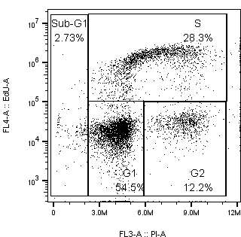
Another prev cell cycle expt (CA-121); standard 24-well plates format
At the time of RT
(5 h after trypsinisation)
18 h after radiation
18 h after RT: accumulation of G2 cells
Rad (Gy) | Sub-G1 | G1 | S | G2
0 | 2.36 | 41.8 | 43.8 | 13.3
2 | 4.35 | 31.1 | 53.3 | 15.7
4 | 4.94 | 20.5 | 54.6 | 24.8
6 | 3.96 | 15.0 | 49.6 | 35.3
8 | 4.31 | 12.3 | 31.7 | 56.0
%

Slide 9
Future plan
I will do cell cycle + clonogenic assay
2.5 x 10⁵ cells/p60/5mL on day 0 (treatment on the next day)
±SN39536? Add drug 30 min before RT?
EdU addition?
30 min treatment
Can’t replace media if SN39536 is added before RT
I added 100 uL EdU to 5 mL media in CC-04 (no need to replace media)
Clonogenic assay: 18 h after RT
Radiation: 0, 2, 4, 6, 8 Gy
Time points: 0, 8, 12, 18, 24 h (later time points needed to confirm G2 accumulation at 18 h post-RT (CA-121))
Samples: Time after RT | Radiation | EdU | fixing
0 h | 11am | 11am | 11:30am
8 h | 11am | 7pm | 7:30pm
12 h | 7pm | 7am (next day) | 7:30am
18 h | 2pm | 8am (next day) | 8:30am
24 h | 1pm | 1pm (next day) | 1:30pm
Clonogenic assay

