Slide 1
CC-04 methods
54C cells were grown for 4 days in T175 (p18). Cells were ~55-60% confluent before trypsinisation in T175 flasks
54C cells (5x 10⁵ cells/4.5 mL) were plated in p60 dishes incubated for 20 h under oxia.
This was necessary because cells were not attached 5 h after plating
On the next day (20 h after plating) cells were ~50% confluent in p60 dishes (before drug treatment).
Cells were treated with 1 uM SN39536 or <0.1% DMSO for 1 h before RT.
Cells were irradiated at 0,2,4,6 and 8 Gy
Cell cycle assay (n=2 per treatment)
Cells were treated with 100 uM EdU for 1 h before fixing them in 70% EtOH
E.g. 4 h points: EdU added 3 h after RT and fixed at 4 h after RT
Cells were treated with PI just before FCM analysis
Cells were ~100% confluent at 24 h after RT

Slide 2
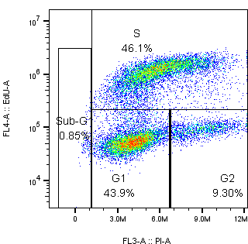
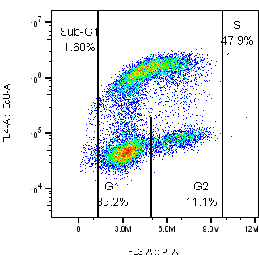
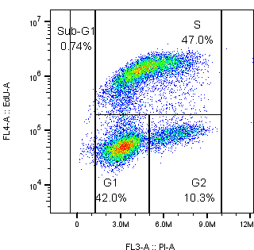
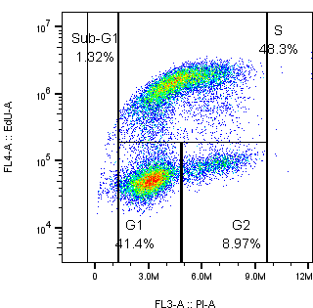
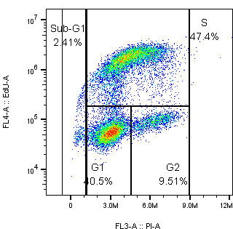
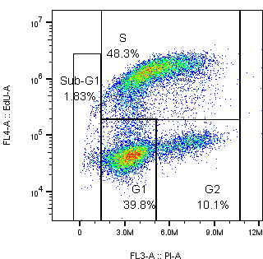
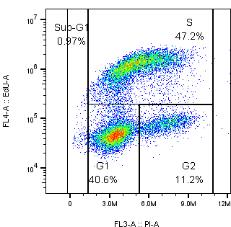

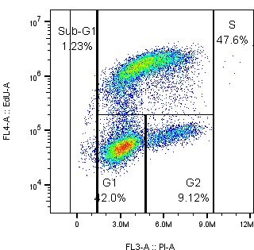
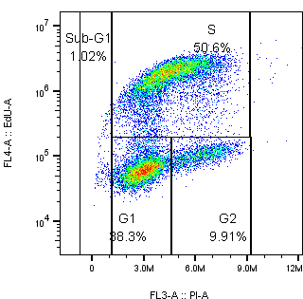
0 h (showing 1 sample/treatment but I did n=2)
 | 0 gy | 2 Gy | 4 Gy | 6 Gy | 8 Gy
Control
1 uM SN39536

Slide 3
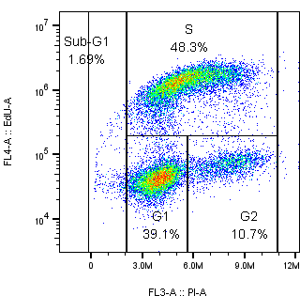
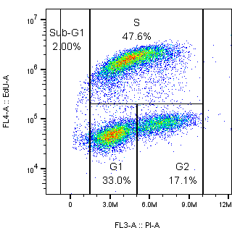
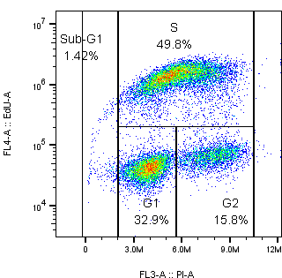
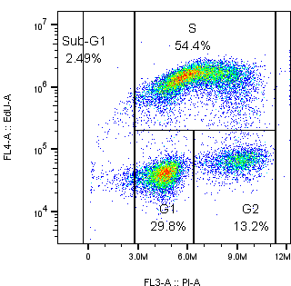
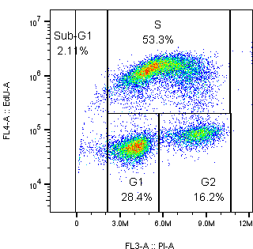
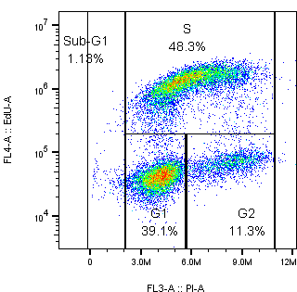
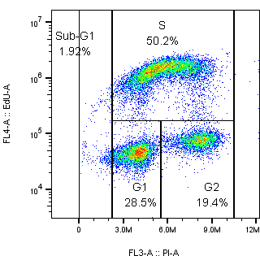
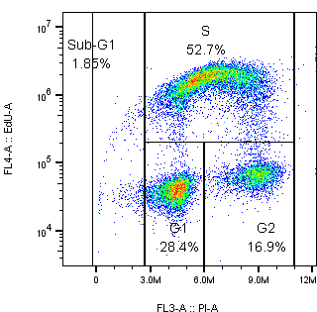
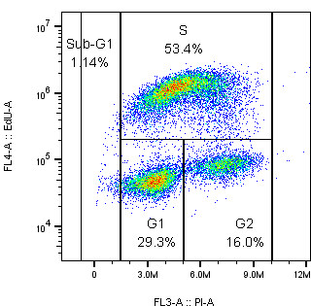
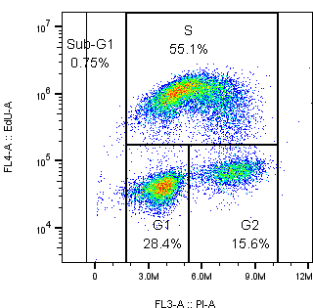
4 h
 | 0 gy | 2 Gy | 4 Gy | 6 Gy | 8 Gy
Control
1 uM SN39536

Slide 4
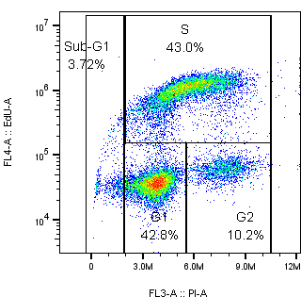
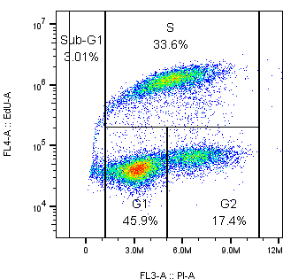
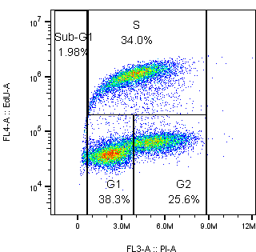
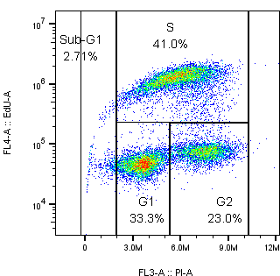
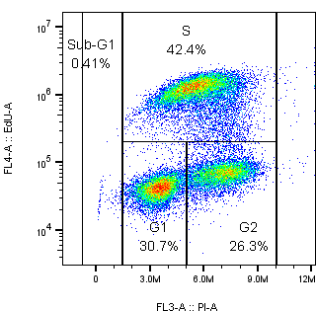
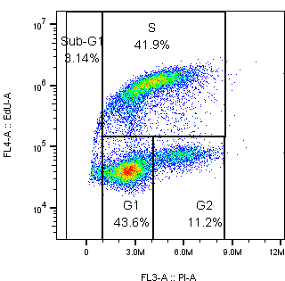
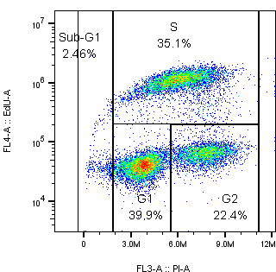
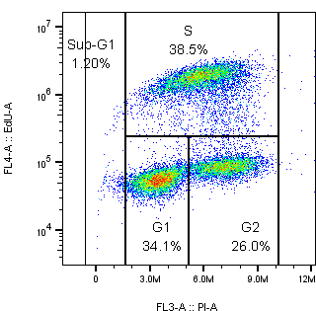
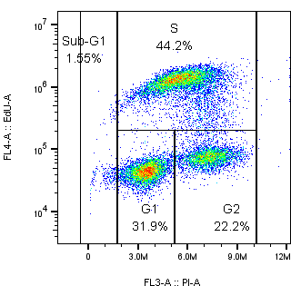
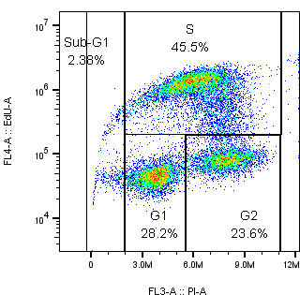
8 h
 | 0 gy | 2 Gy | 4 Gy | 6 Gy | 8 Gy
Control
1 uM SN39536

Slide 5
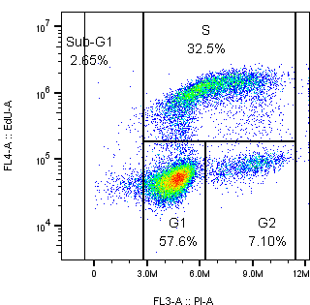
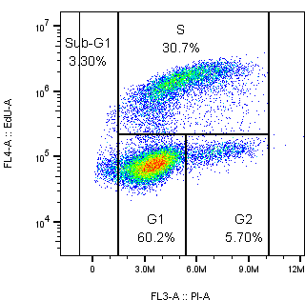
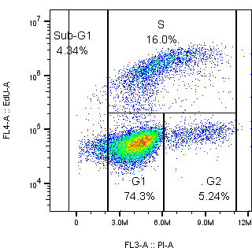
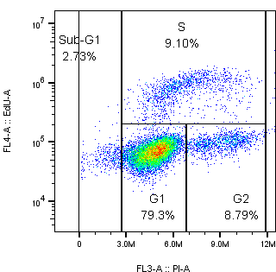
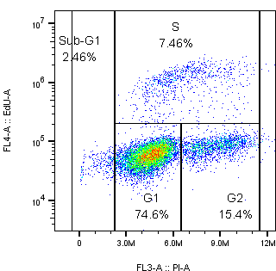
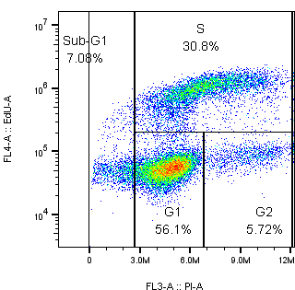
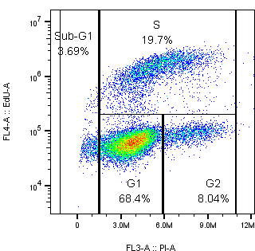
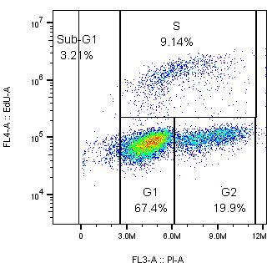
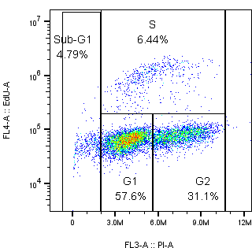
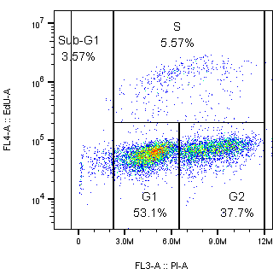
24 h
 | 0 gy | 2 Gy | 4 Gy | 6 Gy | 8 Gy
Control
1 uM SN39536

Slide 7
Raw data – average cell cycle (%), n=2
0 h 4 h 8 h 24 h
Rad (Gy) | Sub -G1 | G1 | S | G2
0 | 0.7 | 42.5 | 47.4 | 9.6
2 | 1.0 | 39.3 | 48.4 | 11.3
4 | 0.8 | 41.0 | 47.7 | 10.5
6 | 0.7 | 42.7 | 47.6 | 9.0
8 | 2.1 | 40.0 | 48.2 | 9.6
Rad (Gy) | Sub -G1 | G1 | S | G2
0 | 1.7 | 39.1 | 48.3 | 10.7
2 | 1.9 | 30.6 | 49.5 | 17.8
4 | 1.1 | 31.8 | 49.6 | 17.4
6 | 2.1 | 30.1 | 53.4 | 14.4
8 | 1.7 | 29.2 | 53.1 | 16.1
Rad (Gy) | Sub -G1 | G1 | S | G2
0 | 3.7 | 42.8 | 43.0 | 10.2
2 | 2.0 | 46.0 | 33.4 | 18.5
4 | 2.1 | 37.9 | 34.6 | 25.5
6 | 2.7 | 33.3 | 41.0 | 23.0
8 | 0.4 | 32.1 | 43.0 | 24.5
Rad (Gy) | Sub -G1 | G1 | S | G2
0 | 3.8 | 57.3 | 32.2 | 6.6
2 | 2.6 | 61.7 | 30.2 | 5.4
4 | 4.6 | 74.1 | 15.9 | 5.4
6 | 3.5 | 78.6 | 8.6 | 9.3
8 | 3.6 | 73.3 | 7.3 | 15.9
Control (DMSO)
0 h 4 h 8 h 24 h
Rad (Gy) | Sub -G1 | G1 | S | G2
0 | 1.3 | 39.1 | 48.2 | 11.5
2 | 1.3 | 40.9 | 47.0 | 10.8
4 | 1.2 | 42.5 | 46.1 | 10.2
6 | 1.3 | 41.4 | 47.8 | 9.5
8 | 0.6 | 40.2 | 50.1 | 9.1
Rad (Gy) | Sub -G1 | G1 | S | G2
0 | 1.1 | 38.6 | 49.0 | 11.2
2 | 2.1 | 29.3 | 50.3 | 18.2
4 | 2.0 | 29.4 | 51.8 | 16.7
6 | 1.7 | 29.7 | 52.8 | 15.8
8 | 1.1 | 28.8 | 54.8 | 15.2
Rad (Gy) | Sub -G1 | G1 | S | G2
0 | 2.8 | 44.8 | 41.5 | 10.8
2 | 3.0 | 39.5 | 35.5 | 21.8
4 | 1.8 | 34.5 | 38.3 | 25.2
6 | 1.6 | 31.9 | 44.2 | 22.2
8 | 1.9 | 27.7 | 46.3 | 23.8
Rad (Gy) | Sub -G1 | G1 | S | G2
0 | 4.7 | 57.2 | 31.6 | 6.3
2 | 3.3 | 69.6 | 19.1 | 8.0
4 | 3.7 | 66.6 | 9.3 | 20.1
6 | 4.8 | 55.2 | 6.1 | 33.9
8 | 4.0 | 52.0 | 5.7 | 38.2
1 uM SN39536

Slide 8
Median EdU

Slide 9
Raw data – median EdU, n=2
0 h 4 h 8 h 24 h
Rad (Gy) | G1 | S | G2
0 | 49674 | 1100000 | 85963
2 | 49995 | 1245000 | 85012
4 | 50744 | 1275000 | 84839
6 | 53057 | 1275000 | 92184
8 | 49297 | 1525000 | 83616
Rad (Gy) | G1 | S | G2
0 | 41115 | 1270000 | 70564
2 | 43590 | 1375000 | 72588
4 | 40434 | 1355000 | 55251
6 | 43473 | 1280000 | 72337
8 | 43406 | 1095500 | 75543
Rad (Gy) | G1 | S | G2
0 | 35506 | 1010000 | 60308
2 | 39400 | 1070000 | 64221
4 | 40975 | 1015000 | 65033
6 | 46712 | 1200000 | 73889
8 | 43337 | 1125000 | 72698
Rad (Gy) | G1 | S | G2
0 | 49589 | 860000 | 80694
2 | 75544 | 1425000 | 117369
4 | 60623 | 1335000 | 91820
6 | 62228 | 935500 | 90880
8 | 55957 | 1039500 | 80477
Control (DMSO)
0 h 4 h 8 h 24 h
Rad (Gy) | G1 | S | G2
0 | 40987 | 1260000 | 69060
2 | 45938 | 1155000 | 76496
4 | 41209 | 1066500 | 69480
6 | 49689 | 1470000 | 85286
8 | 54109 | 1540000 | 94631
Rad (Gy) | G1 | S | G2
0 | 40302 | 1265000 | 68239
2 | 42348 | 1320000 | 70017
4 | 38856 | 1395000 | 66619
6 | 45850 | 1095000 | 80140
8 | 40231 | 929000 | 70000
Rad (Gy) | G1 | S | G2
0 | 40260 | 976000 | 69105
2 | 40181 | 1090000 | 64828
4 | 50156 | 1435000 | 80990
6 | 43685 | 1200000 | 75137
8 | 47293 | 1115000 | 86098
Rad (Gy) | G1 | S | G2
0 | 52251 | 1031500 | 70652
2 | 60630 | 1320000 | 91296
4 | 73512 | 1270000 | 96049
6 | 70817 | 1052500 | 85455
8 | 61482 | 1160000 | 74556
1 uM SN39536

Slide 10
Prev cell cycle expt (CA-121)
54C cells were grown for 4 days in T175 (p23). Cells were ~85-90% confluent in T175 flasks
54C cells (1x 10⁵ cells/0.5 mL) were plated in 24-well plates and incubated for 5 h under oxia before RT. No drug treatment.
Cells were irradiated at 0-12 Gy (1 rad dose/plate).
Cell cycle assay (0 and 18 h after RT)
Cells were treated with 100 uM EdU for 1 h before fixing them in 70% EtOH
Before radiation (4 h after cell attachment: cells were treated with EdU for 1 h before fixing cells in EtOH)
18 h after radiation (0, 2, 4, 6, 8 Gy): EdU added 17 h after RT and fixed at 18h
Cells were treated with PI just before FCM analysis
Clonogenic assay: cells were trypsinised and plated in p60 dishes after 18 h incubation (post-rad)

Slide 11
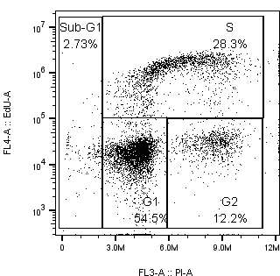
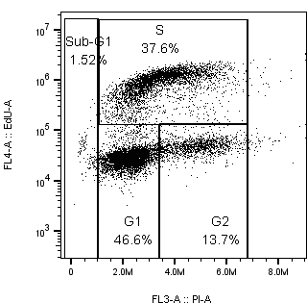
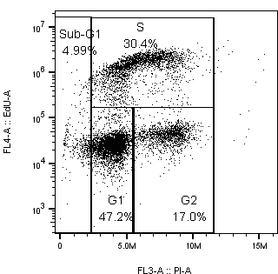
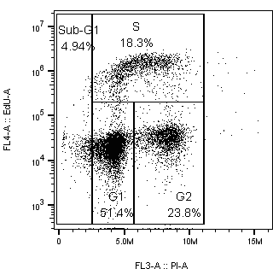
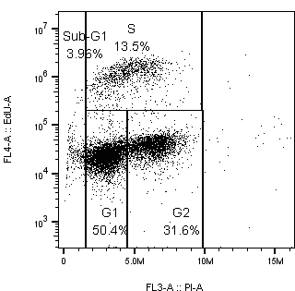
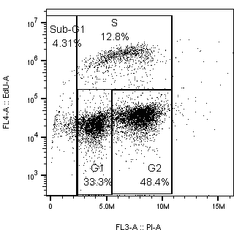
Prev cell cycle expt (CA-121)
Before radiation
(5 h after plating)
%
Rad (Gy) | Sub-G1 | G1 | S | G2
0 | 2.36 | 41.8 | 43.8 | 13.3
2 | 4.35 | 31.1 | 53.3 | 15.7
4 | 4.94 | 20.5 | 54.6 | 24.8
6 | 3.96 | 15.0 | 49.6 | 35.3
8 | 4.31 | 12.3 | 31.7 | 56.0
18 h after radiation
0 Gy 2Gy 4 Gy 6 Gy 8Gy

Slide 12
Discussion
Cell cycle distribution is different at the time of radiation between two different expt formats (cells plated in p60 dishes for a day vs cells in 24-well plates incubated for 5 h before RT). Below shows cell cycle before RT
2. (CC-04, new expt): accumulation of G2 cells at higher rad doses at 4 and 8 h after RT (higher G2 % after 8h). There was no difference between control and SN39536 treated cells up to 8 h.
3. Cells were ~100% confluent 24 h after RT (CC-04, new expt): 0 Gy cells showed accumulation of cells in G1
4. Prev cell cycle expt (CA-121: 24-well plates format) demonstrated accumulation of cells in G2 at 18 h after RT (slide#9). Cells treated with RT alone at 24 h after RT (CC-04, new expt) showed accumulation in G1 (and G2 at 6 and 8 Gy). Cells treated with RT+ SN39536 showed higher G2 population after 24 h.
Cells in p60 incubated over a day cells in 24-well plates incubated for 5 h before RT
(standard clonogenic assay format)

