Slide 1
Introduction to Programming
Anthony Gibbons
21/6/2024

Slide 2
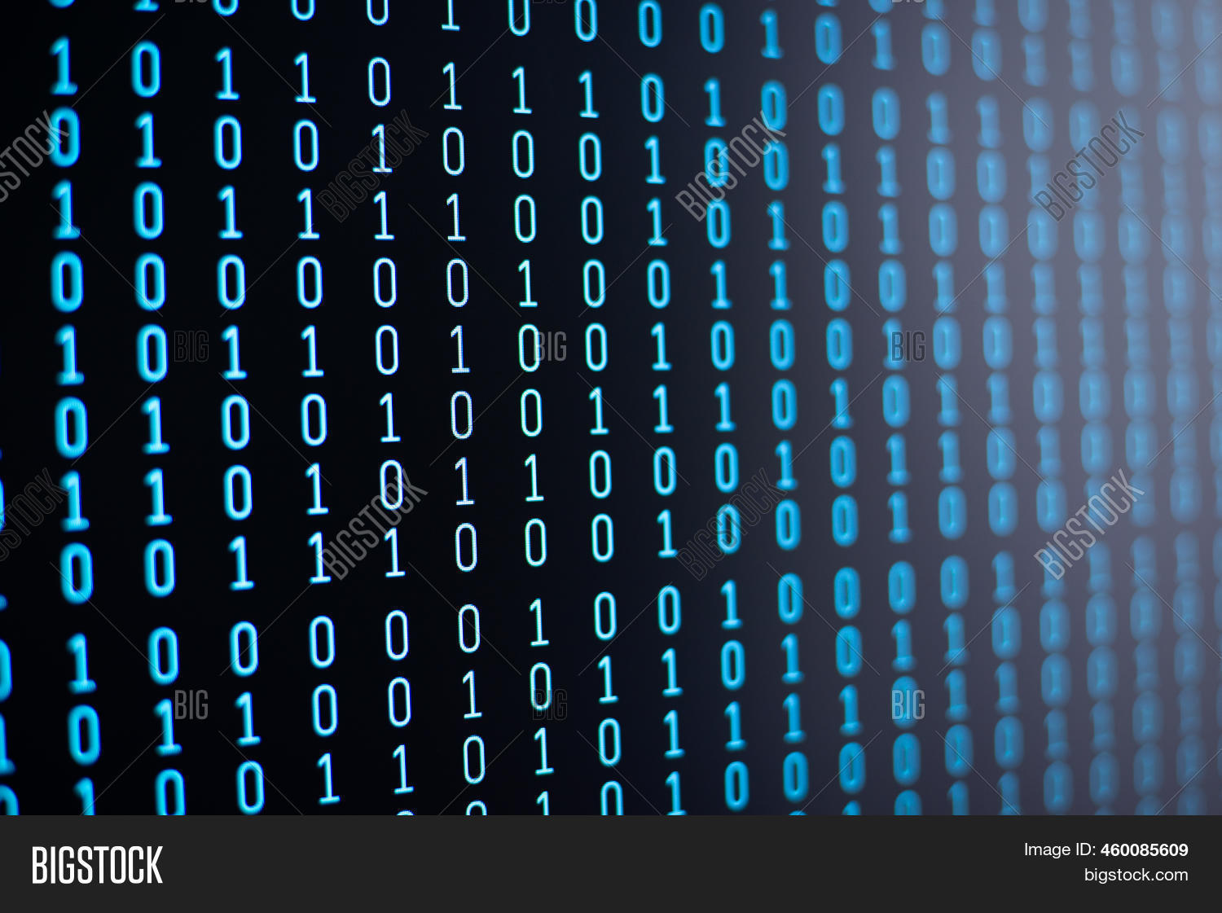
What is Programming
Programming is a series of instructions given to a computer to perform tasks
These instructions must be written in a way computers can understand
Programming languages are used to write these programs (closer to English) and then “translate” to machine code.

Slide 3
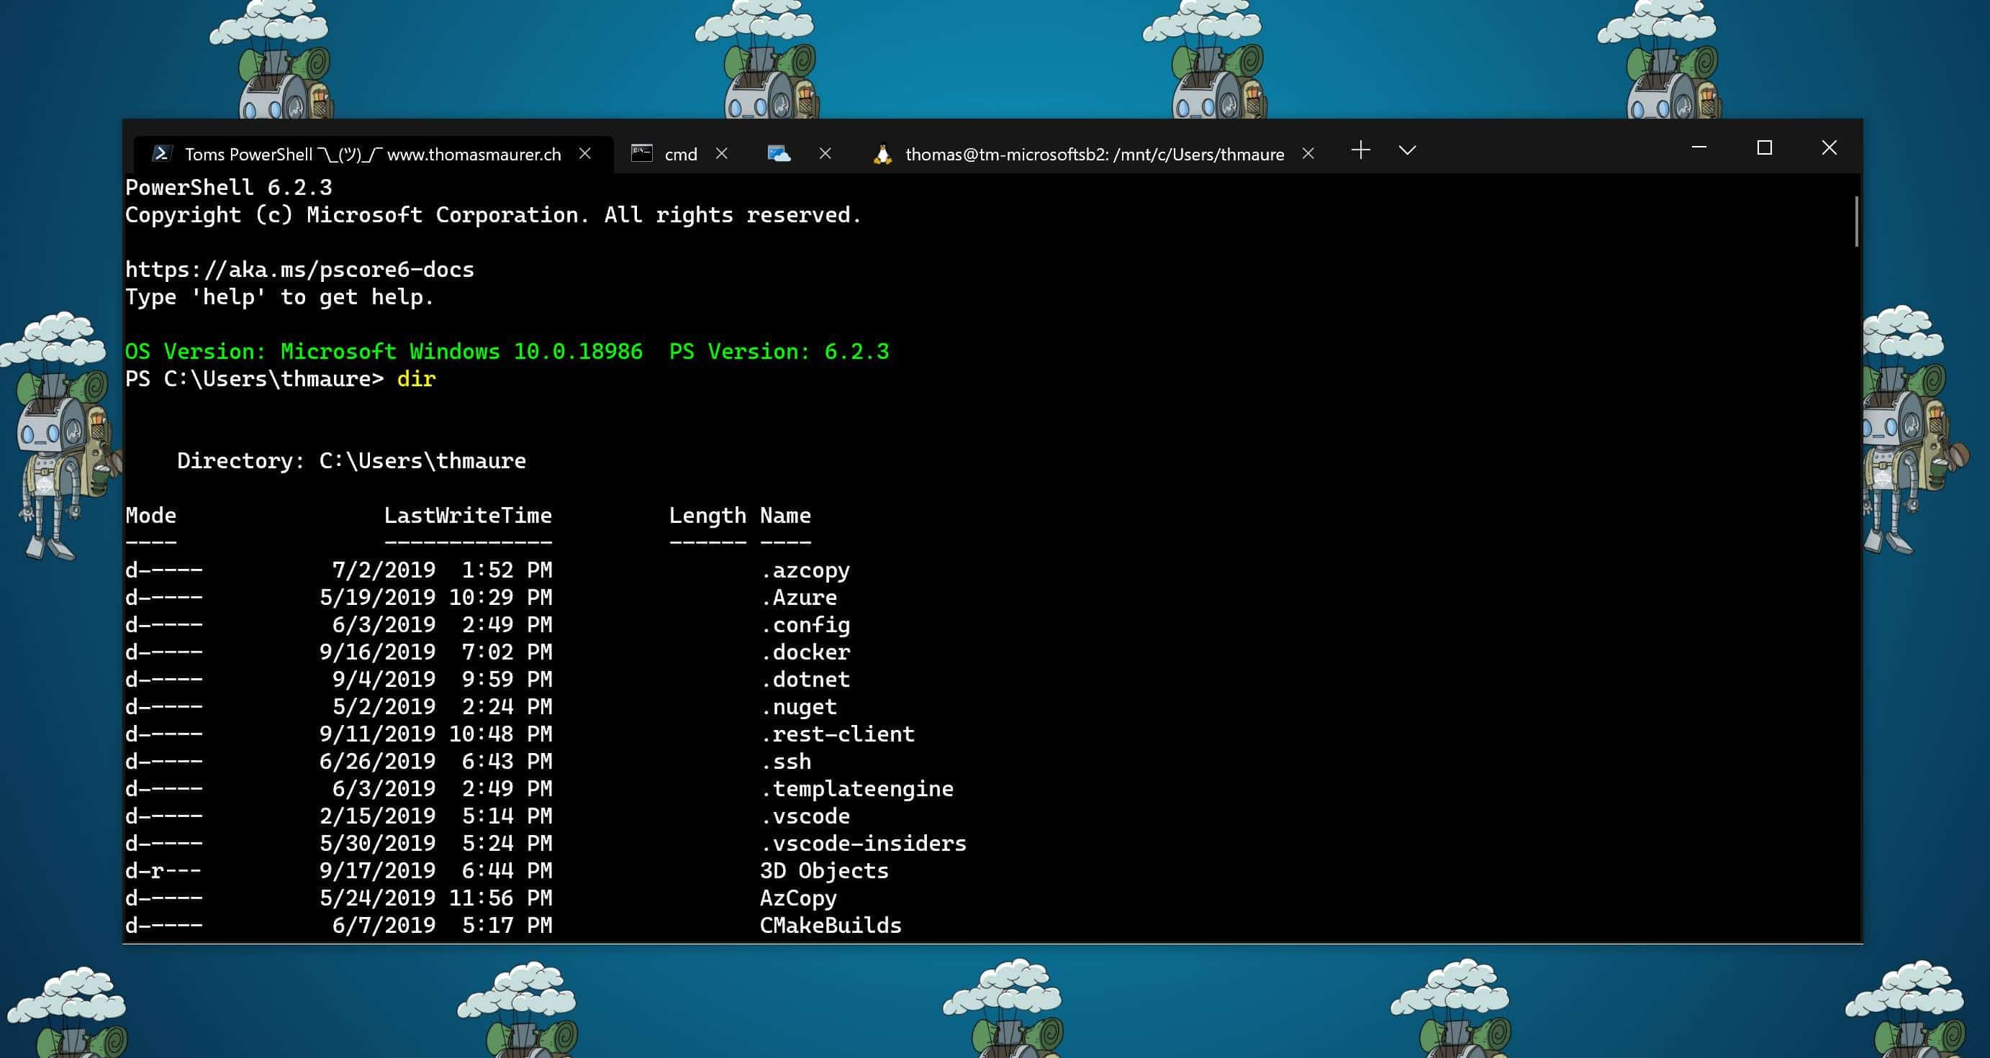
What is Programming
Once code is written, it has to be “run”, i.e. the translated steps are executed
Usually this is written in the “terminal”
E.g. my_program.exe python my_program.py

Slide 4
Get Started
For now, we will write programs using an online interpreter
https://www.online-python.com/

Slide 5

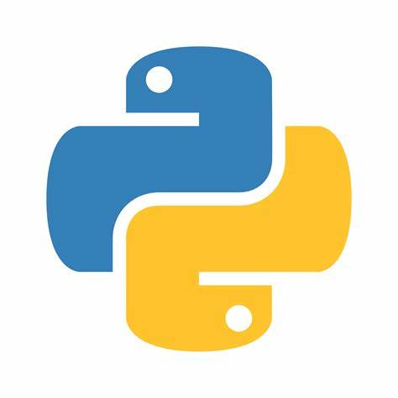

For next week…
Install the following software so you can write and manage code locally on your computer
Visual Studio Code
Python (latest version, 3.12.4)
GitHub

