Slide 1


Biset
REGEX
VCV Rack manual

Slide 2
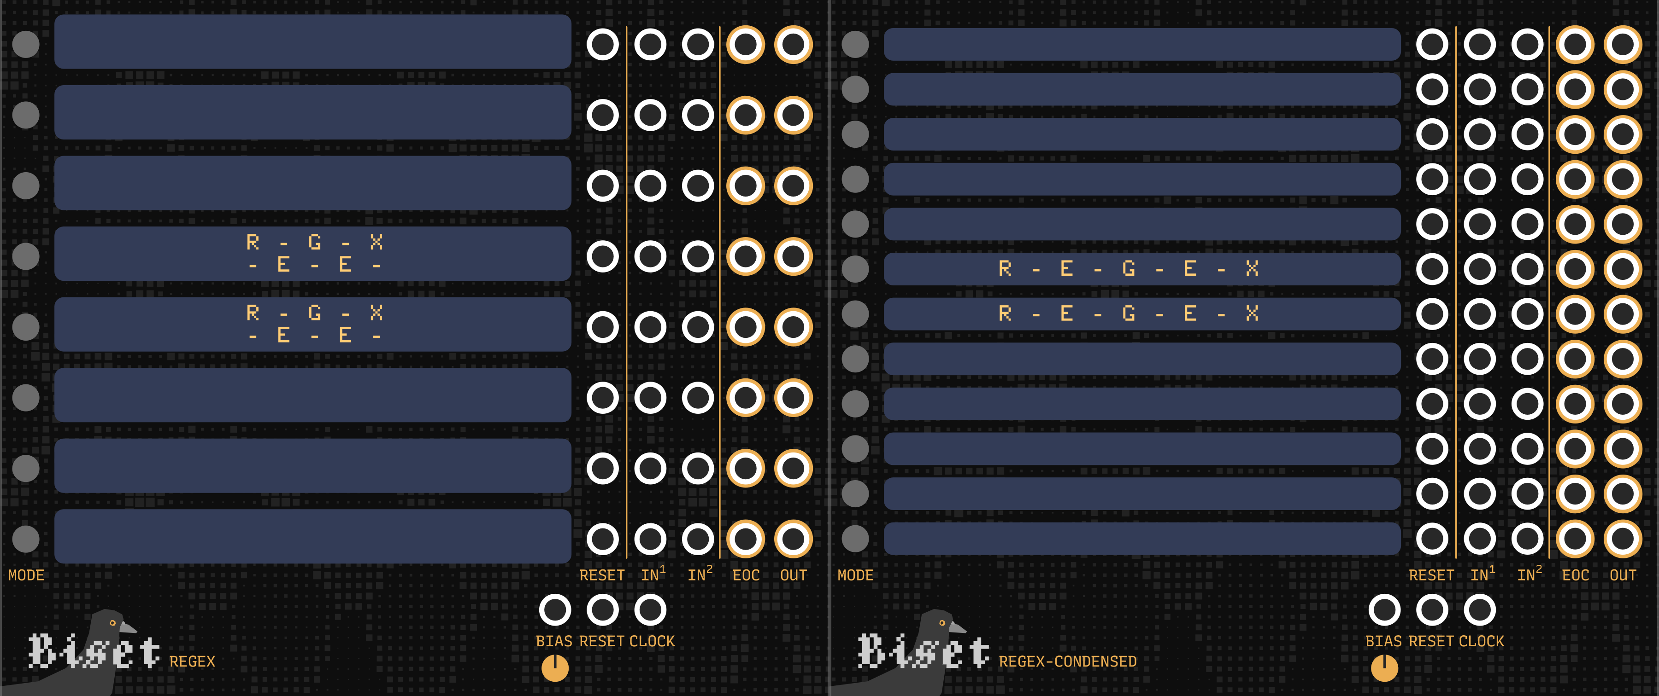
Biset
REGEX
Regex is a text based pattern sequencer. It can generate both clock (rythm) and pitch (or modulation) sequences.
It has been thought for performance as a live coding device. You can easily build sequences, rythm and/or pitch/cv and connect them.
Regex-Condensed is simply the condensed version of Regex with less readability but more lines and connection options.
1

Slide 3
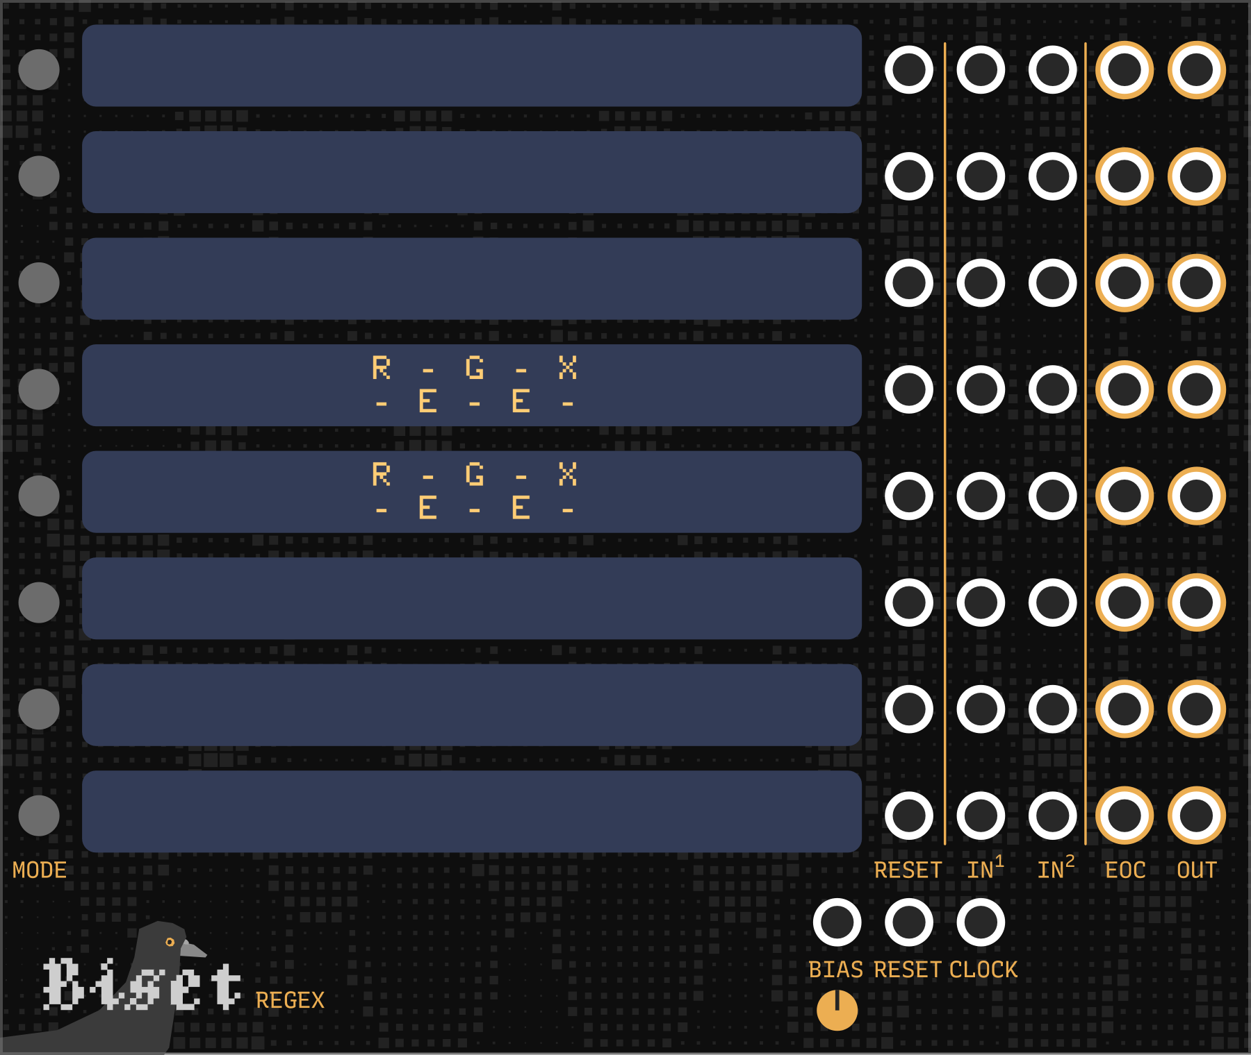
Biset
REGEX
C
D
E
F
A
B
A Mode switch
B Expression editor
C Individual reset input
D Individual inputs
E Individual EOC output
F Individual output
G Bias knob and input
H Global reset input
I Global clock input
H
I
G
Regex is made of 8 or 12 lines. A line is made of an expression editor where all the code is written, a switch allowing you to change the expression type (clock or pitch), inputs and outputs.
Inputs and outputs behavior depends on the expression type.
2

Slide 4
Biset
REGEX / clock mode
The clock mode generates rythm. It uses the master clock input
or the individual input 1 as main clock and can use the expression
Input 2 as additional clock for more complex rythms.
The sequence values acts as clock dividers on the input clock. The reset input resets and restarts the flow of the expression. Everytime the expression loops, the EOC outputs a trigger.
The main output outputs triggers according to the expression.
Here are a few clock valid expressions
>1,2 ••-|
<1,2 •-•|
^1,2 ••-•-•|
>1,2,3 ••-•--|
>1,2,3%8 ••-•--|••|
>1,2,3%16 ••-•--|••-•--|••-•|
>(1,2,((3,4))%1)%16 ••-•--|••-•---|••-|
3

Slide 5
Biset
REGEX / pitch mode
The pitch mode generates pitch on each trigger received via the
master clock input or the individual input 1.
The expression input 2 allows you to combine pitch sequences. It acts as an offset to the output pitch. The reset input resets and restarts the flow of the expression. Everytime the expression loops, the EOC outputs a trigger.
The main output outputs pitch (cv) according to the expression.
Here are a few pitch valid expressions
>c,b,d,e,f,g,a,b Outputs major scale
>(c,c,d#,?(f,g)%1) Outputs c,c,d#,f or c,c,d#,g
?(0,0,0,12,12,24) Outputs c4 or c5 or c6, useful to offset another expression by an octave
c,d#,>((f,g,g#))%1 Outputs c,d#,f then c,d#,g then c,d#,g#
4

Slide 6
Biset
REGEX / expression anatomy
An expression is a string defining a pattern generating clock (rythm) or pitch (or CV).
It is based on sequences that are made of :
Type The sequence type (foreward, backward, pingpong, etc.), optional (foreward by default)
Values A series of values (number, pitch, another sequence) that can be enclosed in brackets for clarity
Modulator Defining the sequence behavior through time, optional
To run an expression, you should press Enter while focusing the corresponding display. You can also press Ctrl + Enter to run all expressions. If an expression is already running, it will waits for its end to update to the new expression. An expression can be stopped by pressing Escape. You can use Ctrl + Arrow to jump between expressions.
5

Slide 7
Biset
REGEX / expression anatomy / sequence type
By default, a sequence is set to the foreward type.
Here are the available sequence types
> Foreward, read the sequence foreward
< Backward, read the sequence backward
^ Ping-pong, read the sequence foreward and then backward
@ Shuffle, shuffle the sequence before reading it
? Random, pick a random item of the sequence
! X-Random, pick a random item of the sequence avoiding the last picked element
$ Walk, random walk in the sequence
6

Slide 8
Biset
REGEX / expression anatomy / sequence values
Expressions values can be numbers or pitch (with optionnal octave).
You can also use other sequences as values, allowing you to build complex patterns.
In pitch mode, values follow the v/oct rule, even for numerical values.
0 returns 0 volt while 12 returns 1 volt.
c4 returns 0 volt while c3 returns -1 volt.
In clock mode, pitch notation are accepted (though they do not really make sense). Values less than or equal to 0 will be considered as a rest (wait for 1 triggers in input without outputting any trigger).
Here are a few valid values
C c4
c c4
c# c4 sharp
cb c4 flat
c5 c5
3 b4 or +3
16 e5 or +16
-5 g3 or -5
7

Slide 9
Biset
REGEX / expression anatomy / sequence modulator
Modulator define the sequence behavior through time.
When no modulator is used, the sequence is read once (expressions are always looped).
xN - Read the sequence N times
%N
  Clock mode - Loops the sequence until N clock triggers have been reached on the input, allowing you to easily build "regular" rythms.
  Pitch mode - Loops the sequence until N values have been output.
*N
  Clock mode – Advance (and potentially loops) the sequence for N steps.
  Pitch mode – Acts like %N modulator.
Inline multiplication - The xN modulator can also be used with single values to multiply them in a sequence (ex: ?(0x3,1x5) will be translated ?(0,0,0,1,1,1,1,1)). Single values cannot be multipled more than 64 times
8

Slide 10
Biset
REGEX / expression anatomy
A bias knob and input are available on the bottom of the module (G).
Bias is a variable that impacts random sequences (?, ! and $). Moving bias knob left or right makes these sequences tend to choose random values on the corresponding directions. This can be used to add spice or, at the oposite, regularity, to your sequences by connecting it to an LFO. As an example, I like to have a random pitch sequence with notes sorted in pitch. By moving the bias knob on the left, the sequence will tend to play lower notes while moving it the right will tend to play higher notes.
9

Slide 11
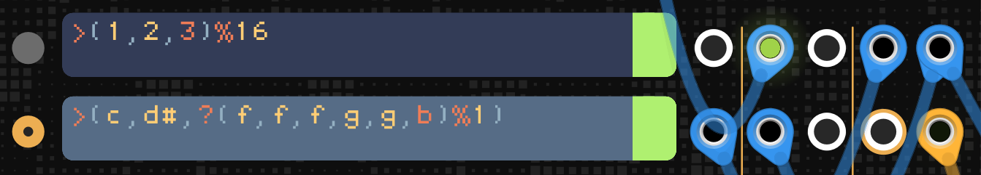
Biset
REGEX / examples
Here, the 1st expression is a clock expression while the 2nd is a pitch sequence. A clock generator is connected to the individual input 1 of the clock expression to make it run. Its output is connected to the input 1 of the pitch expression, thus, connecting them. Its EOC output is also connected to the reset input of the pitch expression, thus, making them reset at the same time and loop together.
Clock cables are blue
Pitch cables are yellow
Modulation cables are green
10

Slide 12
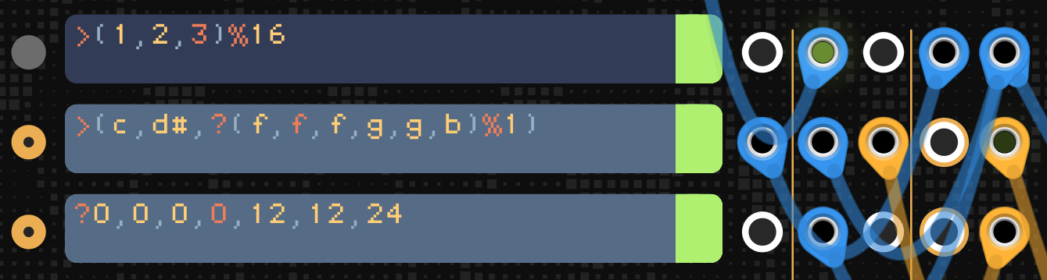
Biset
REGEX / examples
Bias
Here, the first two expressions are the same. We introduce a 2nd pitch expression to make the sequence more interesting. This expression is also driven by the clock expression but its output is connected to the 1st pitch expression input 2, thus, offseting its pitch value. As this expression outputs random octaves (+0 semitone, +12 semitones or +24 semitones), it will offset the 1st pitch expression to build a pitch sequence that varies more.
11

Slide 13
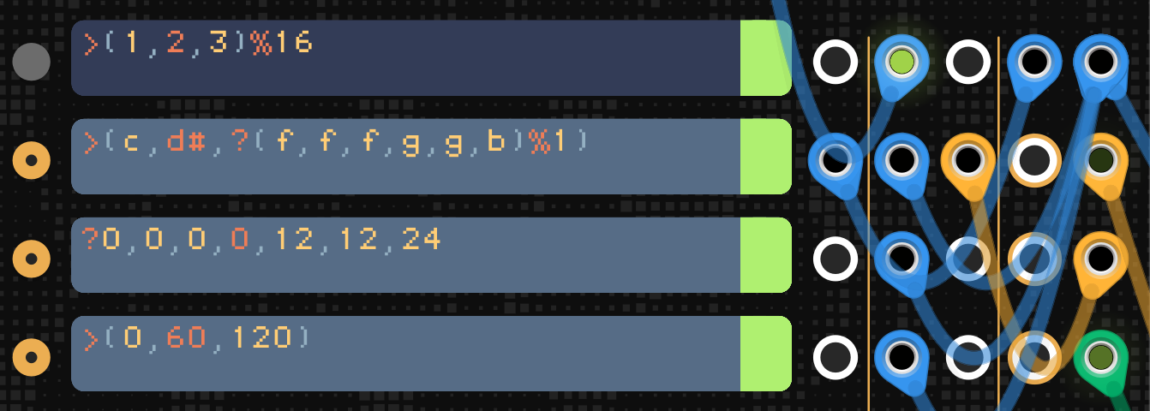
Biset
REGEX / examples
Bias
This time, we introduce a 3rd "pitch" expression also driven by the clock expression. But, as we can see, this new "pitch" sequence outputs a forward sequence of really high values. It is here used as a modulation sequence to add spice to the melody. As said above, pitch is in Volt Per Octave, meaning that a value of 12 will result in a CV of 1 volt and while value of 120 a CV of 10 volt, this can then really easily be used to produce any modulation sequences !
12

Slide 14
Biset
REGEX / tricks
Nice arpegios – It’s important to notice that a sequence restarts only when it reached its own end and not when its parent its end. You can play with that trick to create nice pitch sequences.
Ex: >(c,c#,>(>(e,f,g,g#))%1) – Outputs c,c#,e, | c,c#,f, | c,c#g, | c,c#,g#
Here, the >(>(e,f,g,g#))%1 sequence is a foreward sequence of length 1 containg an other foreward sequence of length 4. If the %1 modulator will stop the parent sequence every 1 item pulled, the children sequence will only be paused but not reset and will continue, step by step, every time the whole sequence loops !
- - -
Nice rhythm – You can use the *N modulator to create changing rhythms.
Ex: >(1,2,?(3,(1x3))*1) – Outputs ••-•-- or ••-•••
Ex: >(1,2,?(3,2)*1)%8 – Outputs ••-•--|•• or ••-•-|••- (even funnier with %16)
- - -
Drums ! - You can use inline multiplication to create nice drum patterns with a shuffle sequence.
Ex: @(0x3,1x5)x8 – Outputs a random drum sequence made of hits and rests that will loop 8 times before reseting and changing to another random drum sequence !
13

