Slide 1


Biset
VCOs
VCV Rack manual

Slide 2
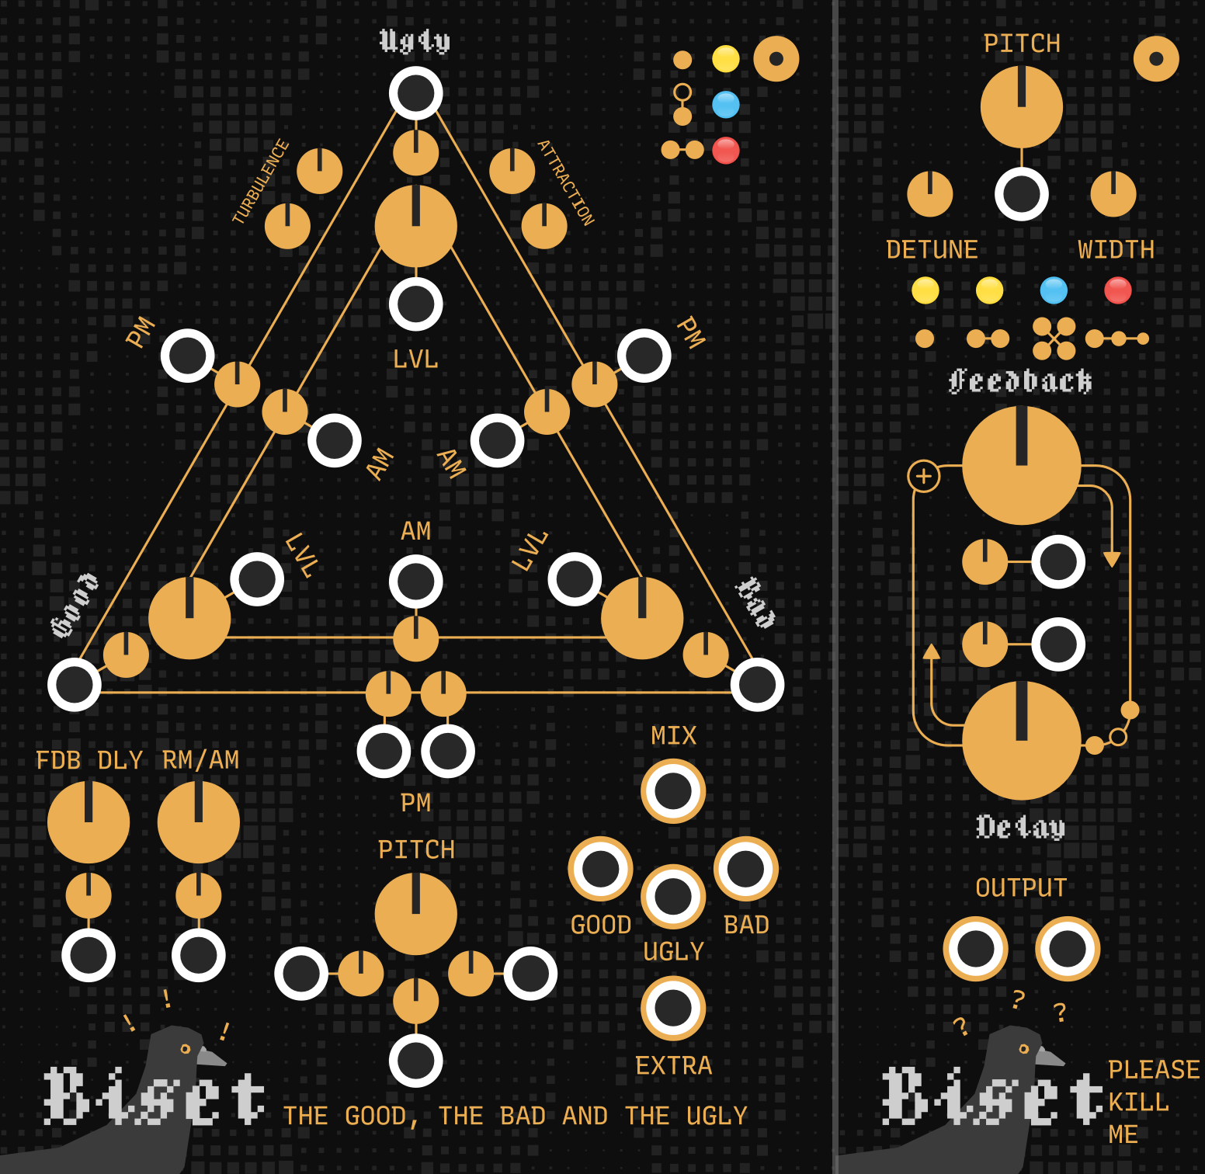
Biset
VCOs
Biset VCOs are designed to add some spring and inertia to sound. Both The Good, the Bad and the Ugly (GBU) and Please Kill Me (PKM) are based on feedbacked sine waves with this unusual feature that is the feedback delay parameter adding a lot of character and instability to the sound (even more when modulated !).
1

Slide 3
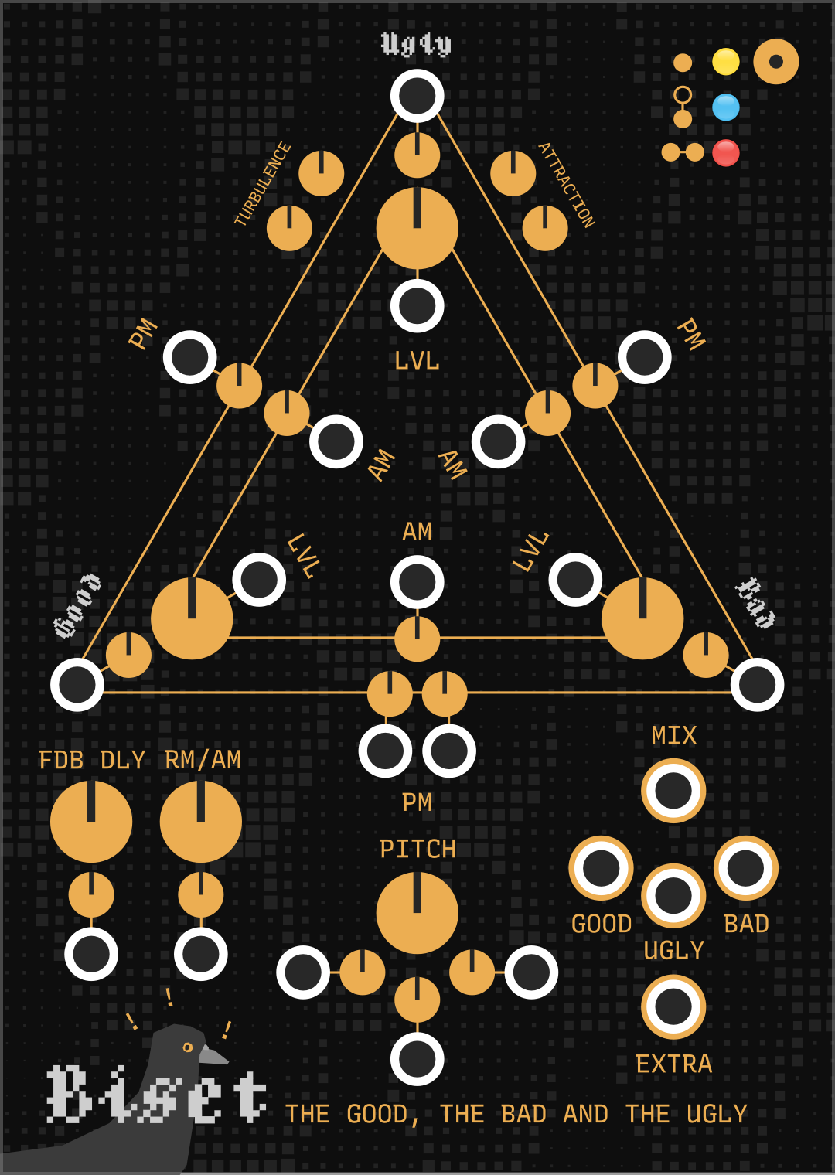
Biset
The Good, the Bad and the Ugly
J
A Oscillator level (VCA)
B Oscillator feedback
C Cross modulation (phase or amplitude modulation)
D Ugly oscillator pitch attraction
E Ugly oscillator pitch turbulence
F Oscillators feedback delay
G Oscillators Ring / Amplitude modulation mix
H Pitch input
I VCO output
J Ugly oscillator mode
E
D
GBU is good for lead voices, weird chords and heavy basses.
It’s probably not ideal for arp voices but feel free to test !
A
B
C
I
F
G
H
The Good, the Bad and the Ugly (GBU) is made of 3 oscillators (1 oscillator by corner) that can modulate each other via phase modulation, amplitude modulation, ring modulation and feedback modulation. The Good and the Bad oscillators are « regular » oscillators while the Ugly is a bit special. The Ugly oscillator cannot be modulated and is designed to modulate the other oscillators. Its pitch is unstable (E) and is being pulled by desired pitch with inertia (D), adding, when modulation other oscillators, a nice and weird character to the sound.
2

Slide 4
Biset
The Good, the Bad and the Ugly
Level, feedback, phase and ring modulations have dedicated knobs and inputs. Unconnected, knobs will define the level of the modulation. Connected, knobs will define the maximum level of modulation (reached with 10V).
The Feedback delay knob controls every oscillators feedback delay, adding inertia to the waveform through time with pitch change.
The RM / AM knob controls the Ring modulation / Amplitude modulation mix of every oscillator.
Each oscillator has its own pitch knob and input (H). If not connected, the Bad and the Ugly oscillators will read their pitch from the Good oscillator.
GBU has 4 outputs. The mix output will sum every oscillator depending on their levels. Each oscillator has its own individual output where its level has no impact. The extra output is not an audio signal but a modulation signal following the distance from the Ugly oscillator real pitch from its desired pitch. This signal can be used to modulate GBU itself but also other modules parameters.
3

Slide 5
Biset
The Good, the Bad and the Ugly
The Ugly oscillator has 4 knobs dedicated to its pitch attraction and turbulence. The pitch attraction section will define how fast the oscillator pitch will move to try to reach desired pitch (attraction knob) and the friction happening on its movement inertia (friction knob). The pitch turubulence section will define how fast and how much the pitch will be affected by turbulence.
Ugly oscillators has 3 modes (J) changing its behaviour.
Ugly mode – Classic weirdo inertia stuff
Weird mode – The Ugly is made of 2 oscillators. The first modulating the Good and the Bad, the second modulating the Good the same way the first is modulating the Good. Got it ?
Queen mode – The Ugly is made of 2 oscillators detuned a bit and sumed to modulate the Good and the Bad
Tricks
I like to use it with multiple enveloppes modulating other stuff than the level (PM, feedback, etc). Having different enveloppes on these modulations can create really interesting sounds.
The Ugly oscillator pitch and the Feedback delay movements have more effects with big pitch variation.
One nice trick would be to have the Good and the Bad oscillators identical but detune a bit (H) and get their output individually, the Good being the left channel and the Bad the right channel to have a nice stereo effect. If doing so, you will need to use an external VCA to control its level as individual outputs are not affected by level.
4

Slide 6
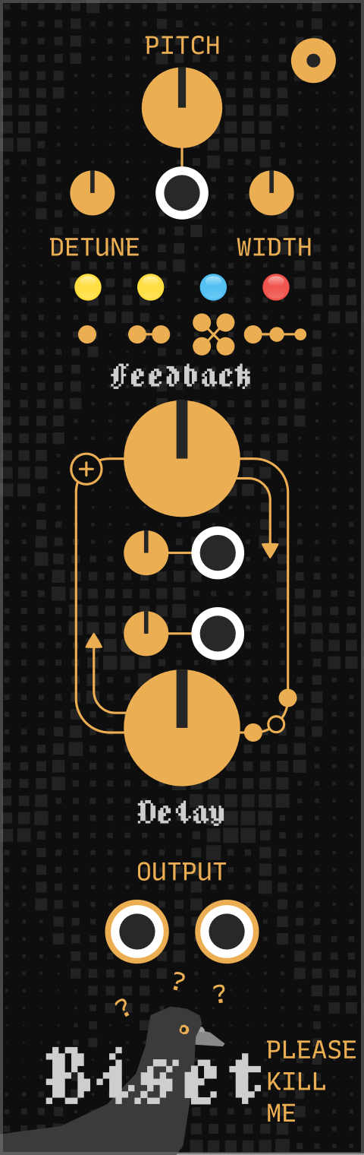
Biset
Please Kill Me
E
C
F
D
A Feedback level
B Feedback delay
C Voices detuning
D Voices detuning stereo width
E Oscillators mode
F Pitch
G VCO stereo output
A
PKM is particularly good for drones and heavy basses. It’s also quite nice for weird lead voices
B
G
Please Kill Me (PKM) is made of 4 stacked oscillators. These oscillators feedback depending on the dedicated knob (A) with the Feedback delay control adding inertia and changing completely their waveform behaviour. The unusual sound made from the feedback delay is increased even more when oscillators are detuned as the feedback delay is constant in time but the oscillators waveform cycle depending on their pitch which will make every oscillator sounds differently.
5

Slide 7
Biset
Please Kill Me
Please Kill Me has 4 different modes
Simple mode – Default 4 oscillators
Double mode – 8 oscillators !
Entangled mode – The 4 oscillators cross feedback
Echo mode – The 4 oscillators feedback with feedback echo. Why ? Dunno.
PKM provides additional stereo options in the context menu. These allows you to rotate oscillators through stereo. The nice but weird thing here is that it’s not the final output that is rotated but the oscillators pitch thenselves ! As each oscillator has a different waveshape depending on their detuning, rotating their pitch will create an even more interesting waveshape / pitch stereo effect.
Tricks
Slowly modulate feedback delay and rotate oscillators pitch to create an ever evolving sound.
Modulate Feedback with one of the output !
Input pitch with a bit of white (or filtered) noise and have fun.
6

