Slide 1


Biset
IT’S GOOD CHOLESTEROL
AND OMEGA FRIENDS
VCV Rack manual

Slide 2
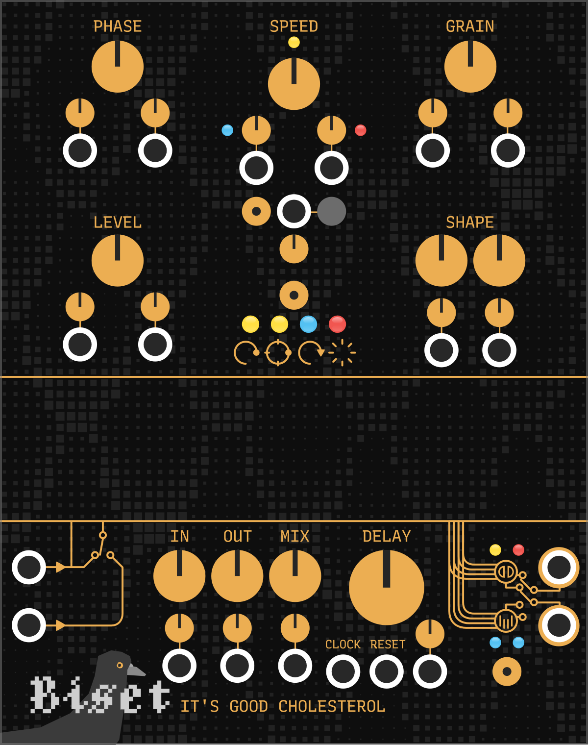
Biset
It’s good cholesterol
A Stereo / Mono input
B Stereo output
C Input / output level + mix controls
D Delay time control
E Mode selector
F Output mode selector
G Buffer display
H Phase control
I Speed / Pitch control + speed reverse switch + speed slew limiter + speed round switch
J Grain length control
K Level control
L Level shape controls
H
J
I
IGC is a sound design sanbox. You can create modulatable tap delays, chorus, vibrato, reverse delays, granular effects and even use it as a polyphonic VCO.
K
L
E
G
A
C
D
B
F
It's good cholesterol (IGC) takes a stereo (or mono) input, records it into a buffer and allows you to read this buffer in different ways with multiple playheads via polyphony. It really is a sandbox.
1

Slide 3
Biset
It’s good cholesterol
Igc has 4 different output modes (E)
Phase mode – Set the playheads position relative to writing playhead. Fixed position means reading buffer at normal speed.
Absolute phase mode – Set the playheads position relative to buffer.
Fixed position means readding buffer at speed 0 (silence). Can be used with CV as input.
Speed mode – Set the playheads speed.
Granular mode – Set both position and speed of the playhead grains. Position and speed will be « sampled » at grain start and won't change until grain end. Grain length can also be set.
About speed (I)
The main speed knob and speed inputs can be quantized to octave to keep the input pitch. It can quantize only the main knob or the knob and the 1st input or everything. This allows you play with octave while beeing able to use the speed as a pitch input as it follows the 1v/oct standard.
A switch, allong with its corresponding input allows you to reverse the speed.
You can also limit the speed change to get tape like effects !
About shape (L)
Unlike Level section that allows you to set playhead individual levels, the Shape sections allows you to control playhead levels depending on their position on the buffer. The 1st knob controls to force of the effect while the 2nd controls the shape (saw to triangle to reverse saw).
2

Slide 4
Biset
It’s good cholesterol
Igc has 4 different modes to move the playheads (F)
Stereo mode – Playheads are reading the buffer and outputing directly into the output.
Polyphonic stereo mode – Each playhead is a channel output. Useful when using Igc as a VCO in speed mode !
Stereo spread mode – Useful when inputing mono input (but can be used in stereo too !), spread the playheads across the stereo field. First playhead being fully left and last playhead being fully right.
Stereo spread ping-pong mode – Same but ping-pong from left to right. First and last playheads being fully left and middle playhead being fully right.
About delay length (D)
The delay controls the buffer length. If the clock input is connected, the delay knob will act as a multiplier / divider. It’s important to notice that delay time is aligned to a 48000hz samplerate.
3

Slide 5
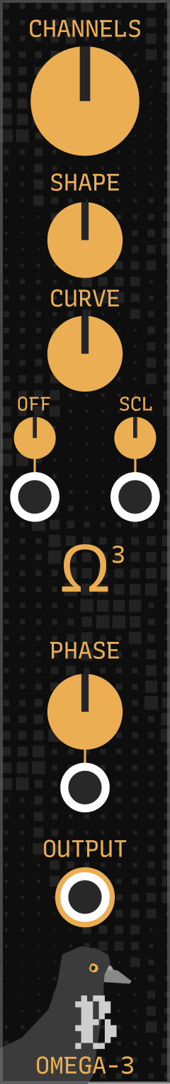
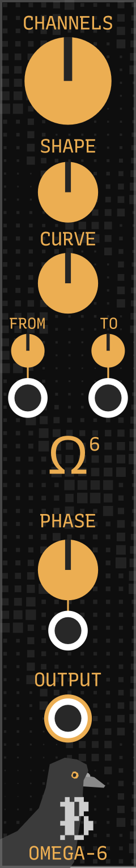
Biset
It’s good cholesterol
A
Omega modules are utility modules that output polyphonic constant voltage that can be easily shaped.
They are Igc best friends as they allow you to really easily and quikly set playhead positions, levels and speed.
The shape controls the voltages shape in "space", from saw to triangle to reverse say while the curve controls the voltages shape in "time".
Omega3 and Omega6 are working the same way. The only difference is how to define the voltage range. Omega3 is based on range and offset while Omega6 is based on starting voltage to ending voltage.
B
C
D
A Polyphonic channel count
B Shape control
C Curve control
D Range controls
E Phase control
E
4

Slide 6
Biset
It’s good cholesterol
Tap delay
Connect Omega3 to Igc position in Phase mode so that the playhead are spread evenly through the buffer. Put the shape force knob to maximum and shape to minimum to get a falling saw shape.
Reverse delay
Just change the shape knob to maximum !
Bouncing delay
Change Omega curve control to change how playhead are spaced !
Digital tape fx
Connect a LFO to position to make the playhead wobble slowly. Open the context menu (right click) to disable the HD mode. Enjoy.
Home made VCO !
Input a synth you like into Igc. It’s pitch should be constant (C being easier). Go to speed mode and connect a sequencer or your midi module to the speed input. You can play with the delay length to get different results. The level section can be used as a polyphonic VCA.
The input does not need to be the direct output of a synth, it can pass through distortion, filtering or even reverb before going to Igc !
Advanced VCO !
You can use the shape section to create tremolo effect.
You can also disable HD mode in context menu to get lo-fi artifacts.
You can connect a polyphonic random lfo to speed reverse input (I) with a bit of speed slew (I) to add some weird tape effect.
Even more ? You can give the input synth some vibrato. That way, the playhead will get vibrato depending on their pitch (speed) !
Want to filter the polyphonic voices after Igc ? Select the Polyphonic stereo output mode (F) !
5

