Slide 1


Biset
TRACKER
VCV Rack manual

Slide 2
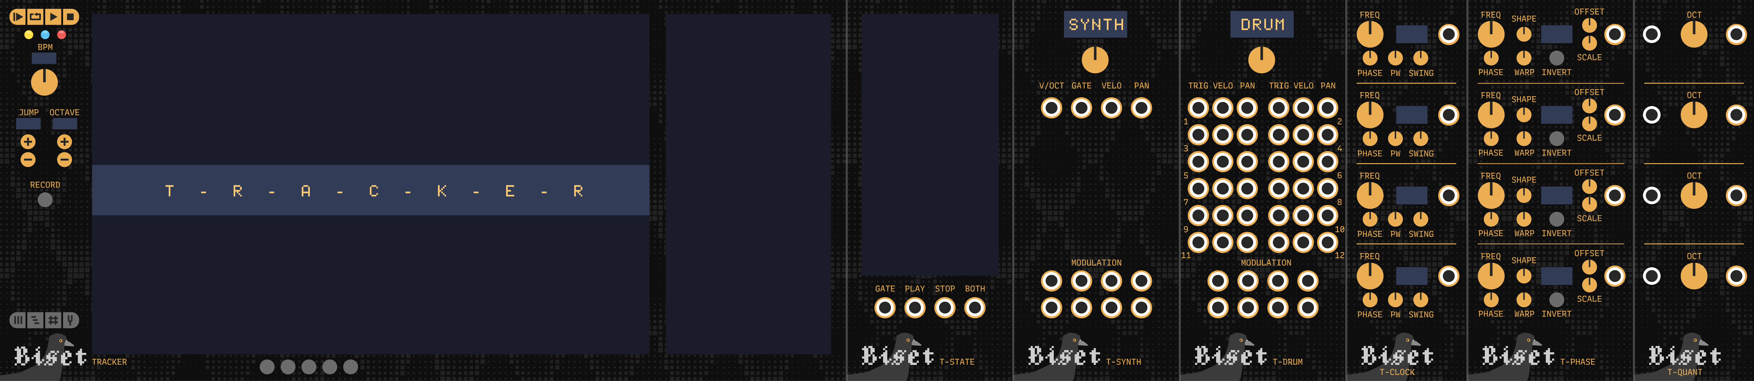
Biset
TRACKER
The Tracker suite is a set of VCV modules working together to create an advanced sequencer. It is based on a timeline on which you arrange patterns.
The suite is made of Tracker, the main composition module and a set of side modules outputing your track informations (pitch, gate, modulations, clock, etc.).
1

Slide 3
Biset
TRACKER
Tracker suite modules
Tracker The main composition module where you edit your timeline, patterns, synths, tuning and play your track
T-Synth Synth / instrument module asigned to a synth of your track. Outputs pitch, gate, velocity, panning and modulations
T-Drum Drum module asigned to a synth of your track. Works like T-Synth but split synth notes into 12 channels to easility use it as a drum trigger generator
T-Clock Clock generator module based on playing track. Allows clock division / multiplication (from /96 to x96), phase offset, pulse width and swing
T-Phase Synced LFO module with beat division / multiplication (from /32 to x32), different wave shapes, phase offset, wave warping and invert and editatable range
T-Quant Quantizer / tuner module allowing you to tune other modules pitch output to be tuned to your track
T-State Visualizer module with some playing track informations such as playing gate, trigger, etc.
2

Slide 4
Biset
TRACKER
Overview
The modules of the suite are implicitly interconnected. Tracker, at the center of this connection, should only be present once in the patch.
A track is made of patterns and synths. Patterns can be edited and arranged in a timeline from the Tracker module. A pattern is a sequence of notes and modulations made throughout synths. Synths are created and edited from the Tracker but their outputs are made through 2 other modules, T-Synth and T-Drum. These modules outputs notes (via pitch, gate, velocity and panning) and modulations (free range CV also mappable to other modules knobs). The Tracker can handle up to 100 synths and 1000 patterns. Each T-Synth and T-Drum modules is assigned to a specific synth of the track. Modulations can be synth modulations or BPM modulation and perhaps even more later.
As a patch would be boring without a clock generator and a set of LFOs, the tracker suite provides T-Clock, a clock generator synced with your track with beat division and multiplication (up to /96 and x96), phase offset and swing and T-Phase a synced LFO with beat division and multiplication (up to /32 and x32), different wave shapes, phase offset, wave warping and invert and with easily editable range.
For mad scientists and musicians wanting to annoy their pitch perfect friends, the Tracker also allows you to work with a different temperement and reference frequency (440hz). You can specify each of the 12 notes a pitch in cents. Common temperement presets are provided such as Just or Pythagorean. It can also be used as a quantizing tool with a lot of common scales available as presets. T-Quant is available to allow you to quantize your other modules pitch outputs.
3

Slide 5
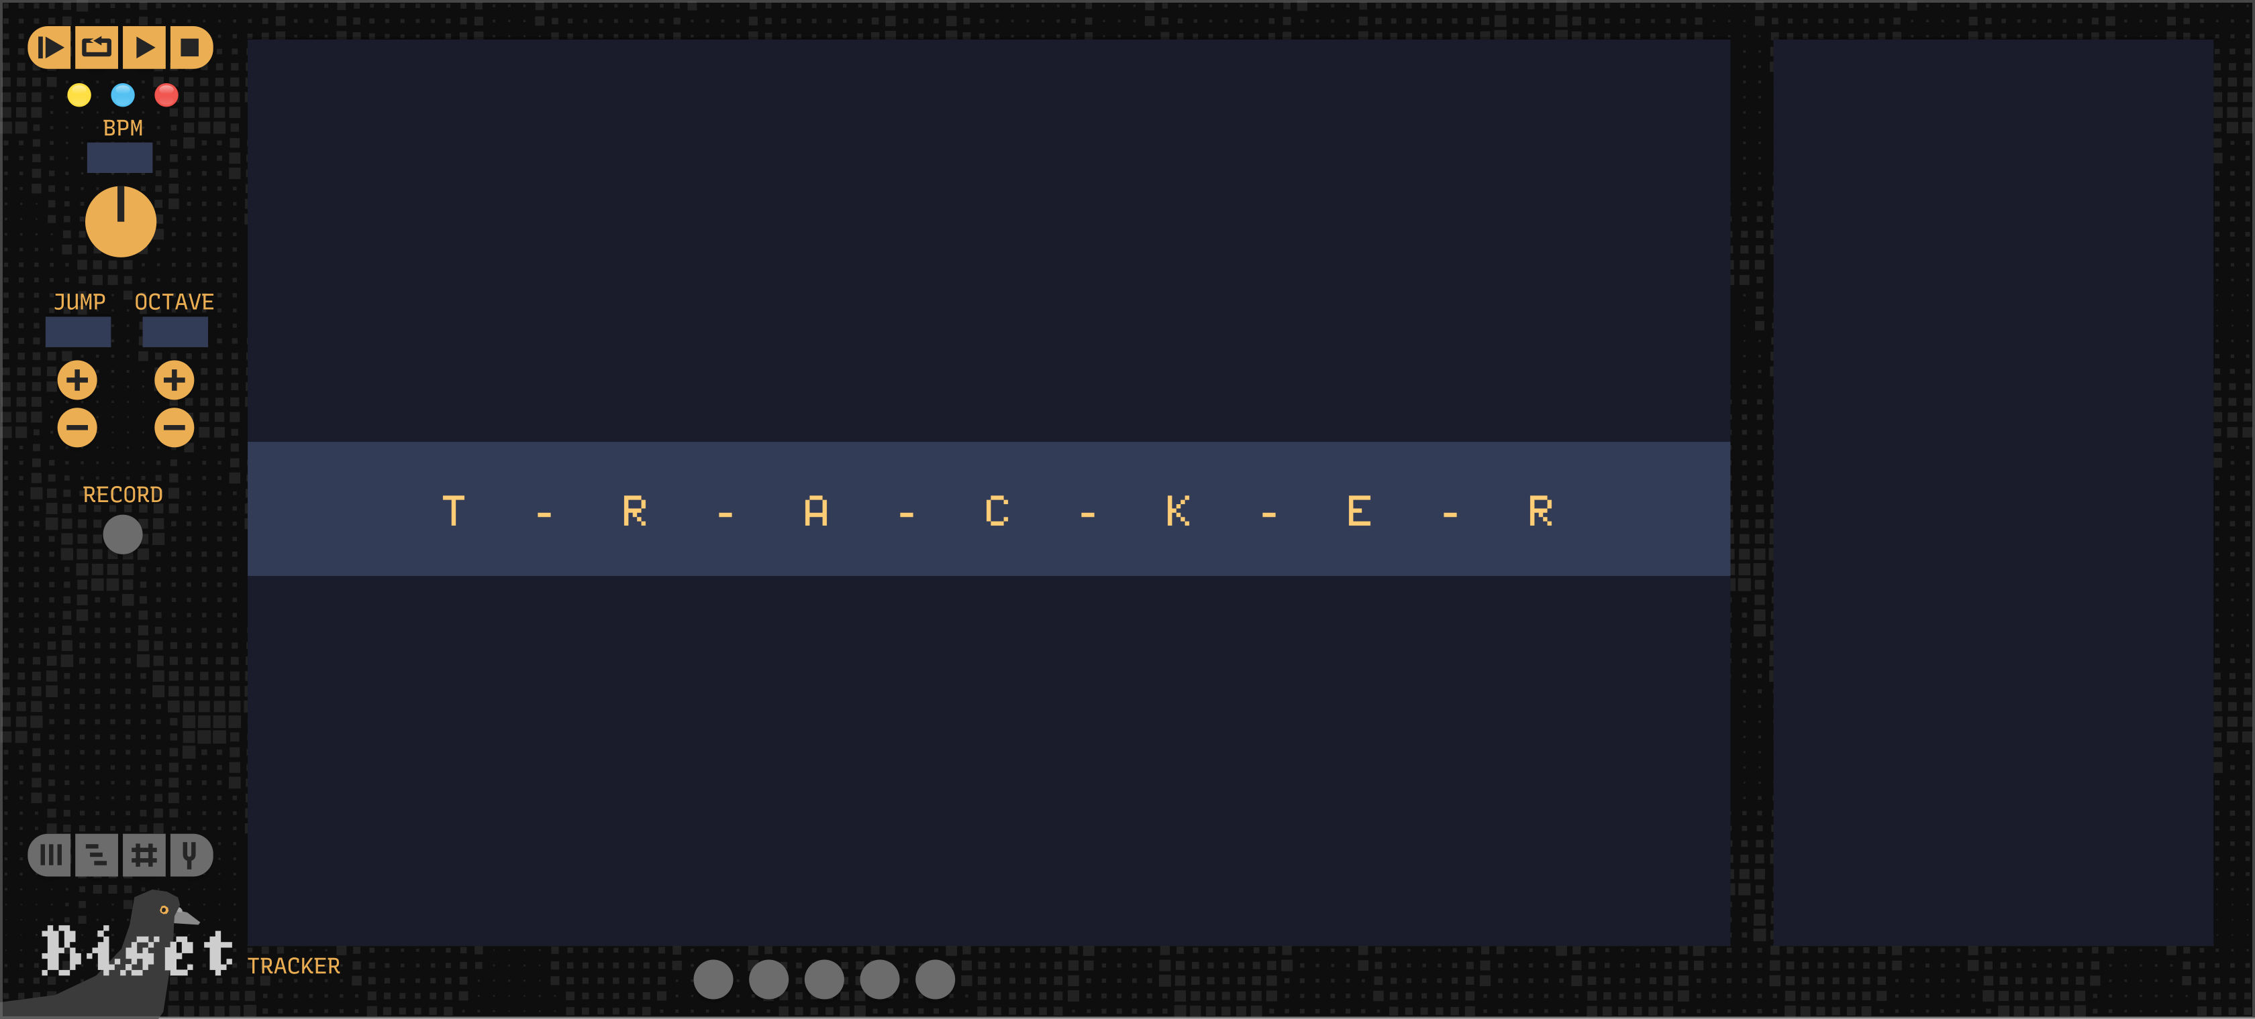
Biset
TRACKER / Tracker
C
D
E
A Main display
B Side display
C Play controls
D State lights
E BPM control
F Write controls
G Record switch
H Pattern views
I Pattern views
F
G
A
B
H
I
Tracker is the module from which you edit your timeline, patterns, synths, tuning and play your track.
4

Slide 6
Biset
TRACKER / Tracker
Tracker has 4 views accessible with the buttons on the bottom-left (H) :
Pattern view View to edit the selected pattern and add/remove/edit synths
Timeline view View to edit the timeline and add/remove patterns
Matrix view Live oriented view - Not handled yet
Tuning view View showing current tuning settings
5

Slide 7
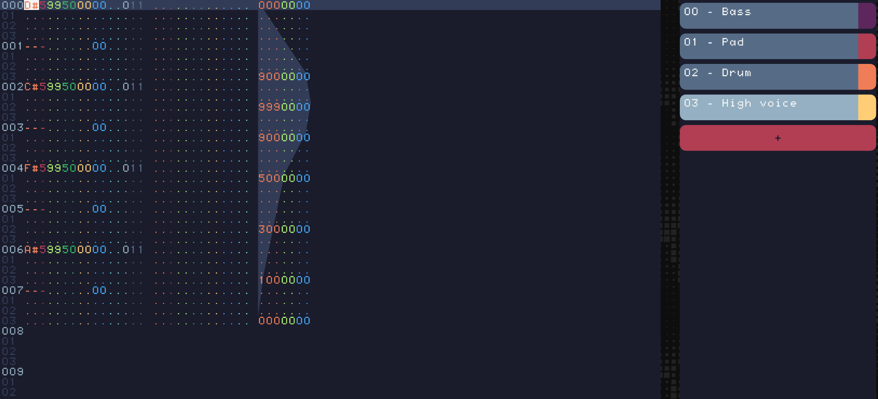
Biset
TRACKER / Tracker / View Pattern
The pattern view is divided into the tracker screen (main display, A) and the synth screen (side display, B).
6

Slide 8
Biset
TRACKER / Tracker / View Pattern
The tracker screen allows you to edit the pattern. A pattern is made of note columns and cv columns each made of lines. The pattern length (in beats) and the time signature (number of lines per beat) can be edited with a right click.
Note columns are the main place you create your melodies, chords, etc. Each line represents a beat division. A line can contain a note start, a note stop or a note glide. Notes are made of the pitch, octave, velocity, panning, synth id, delay, glide and effects. Some of these properties can be hidden for clarity via the "eye" switches on the module bottom (I).
A pattern can also contain CV columns. Where you can draw modulations. Unlike notes columns, cv columns are assigned to a specific synth and a specific "channel" editable with a right click.
A note is formatted PPOVVPPSSDDGG(FXX) :
Pitch noted with the note letter, a sharp if necessary.
Octave in the range 0 to 9.
Velocity in the range 0 to 99, 0 being 0v and 99 being 10v.
Panning in the range 0 to 99, 0 being left (-5v), 50 being center and 99 being right (5v).
Synth in the range 0 to 99. It defines which synth to use by the note.
Delay in the range 0 to 99, 0 being no delay and 99 being delay up to just before next line start.
Glide allows you to glide from a note to another. It interpolates pitch, velocity and panning. It is in the range 0 to 99. 0 beeing 1 beat long glide and 99 being almost instant glide.
Effect type is a letter indicating the type
Effect value is a number. Depending of the effect type, it can be a 2 digits number or two 1 digit number.
A CV line is formatted VVVCCDD :
Value in the range 0 to 999, 0 being minimum and 999 maximum (real CV range is editable from T-Synth and T-Drum)
Curve is not handled yet
Delay in the range 0 to 99, 0 being no delay and 99 being delay up to just before next line start.
7

Slide 9
Biset
TRACKER / Tracker / View Pattern
To edit the pattern with your keyboard, you need to check that Tracker is selected. To do so, you can simply check the leftmost yellow light (D) indicating that the module has the focus. You can navigate through lines and columns with the arrow keys and edit values with the digit keys (independent of your layout, azerty users don't need to press Maj). Effects types are letters and thus can be edited depending of your keyboard layout. To add or edit a note, you need to put your cursor on the note line pitch and either press a key on your keyboard, with the classic VCV 2 octaves layout or a key on your midi keyboard (connection can be made via the main Tracker context menu with right click). To add a note stop, use the '`' key (top left of your keyboard).
When a synth is selected but the Tracker does not have the focus (in pattern mode), you can play the synth with your keyboard without writing anything.
When the record switch is on, the pattern cursor follows the playhead and allows you to play and write at the same time.
Note effects
Axx Amplitude random, 0 being no change and 99 being possibility to decreasing volume down to 0
Pxx Panning random, 0 being no change and 99 being possibility to move panning in any direction up to 50%
Dxx Delay random, 0 being no change and 99 being possibility to delay note up to 1 line
Oxy Octave random, x defining the mode (0: bipolar, 1: unipolar +, 2: unipolar -) and y being maximum octave offset
Mxy Note choose, choose between original note, note + x and note + y. Can be combined with other Mxy
Vxy Vibrato, x being speed and y being amplitude
vxy Vibrato random, x being maximum speed and y being maximum amplitude
Txy Tremolo, x being speed and y being amplitude
txy Tremolo random, x being maximum speed and y being maximum amplitude
Cxx Chance, chance to play note. 0 being no chance and 99 full chance. If not played, does not stop previous voice
cxx Chance, chance to play note. 0 being no chance and 99 full chance. If not played, stops previous voice
8

Slide 10
Biset
TRACKER / Tracker / View Pattern
The synth screen allows you to add, remove and edit your track synths. Synths are shared by all patterns. You can edit synth name, color, number of polyphonic channels and gate mode. You can add up to 100 synths.
Gate modes :
Mode gate where a note requires a start and a stop to stop its gate
Mode trigger where a note only requires a start
Mode drum where a note only requires a start and each note is assigned to its corresponding polyphonic channel (drum mode always have 12 polyphonic channels). Should be used with T-Drum.
9

Slide 11
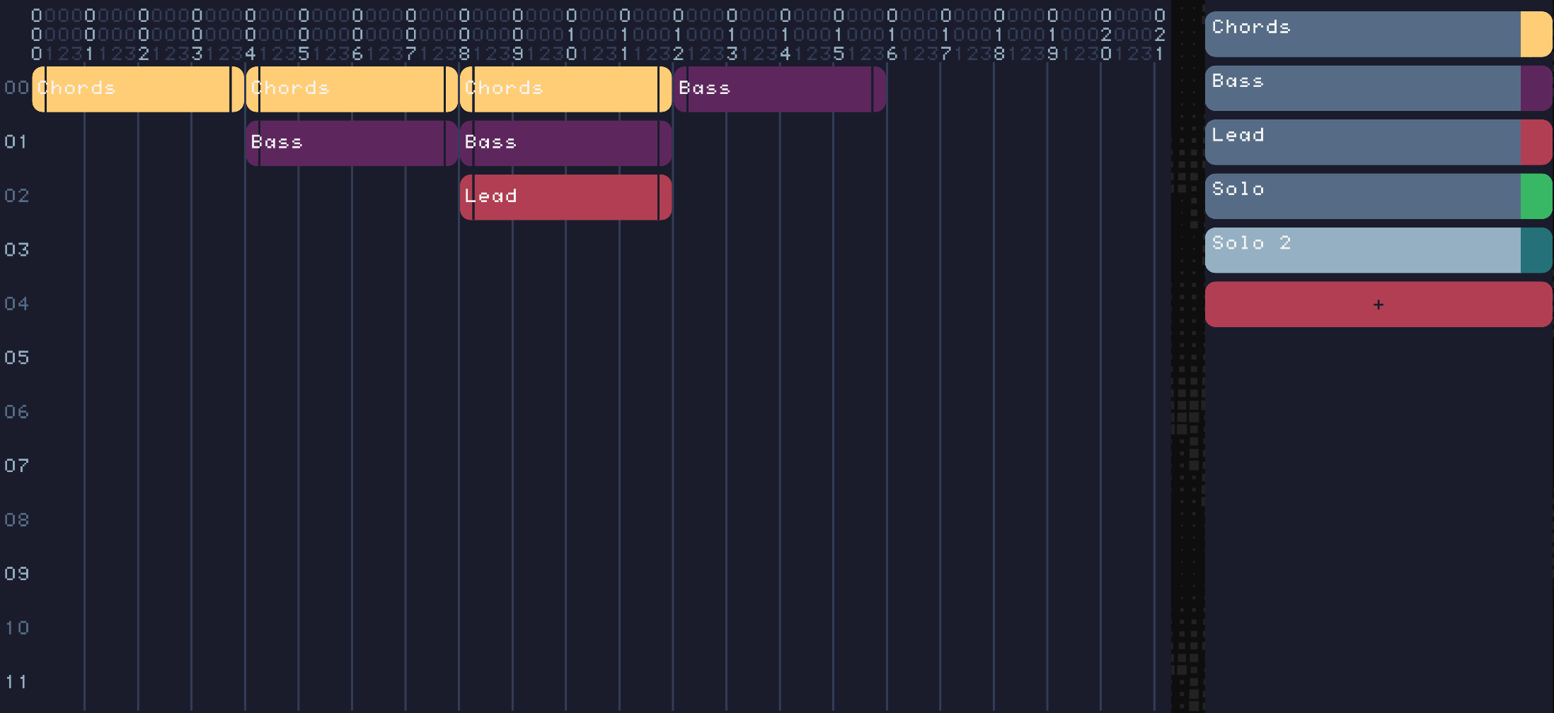
Biset
TRACKER / Tracker / View Timeline
The timeline view is divided into the timeline screen (main display, A) and the pattern screen (side display, B).
10

Slide 12
Biset
TRACKER / Tracker / View Timeline
The timeline screen allows you to arrange your patterns into a complete track or a live set.
The X axis of the timeline represents the time in beats while the Y axis of the timeline is only designed to let you organize your pattern more easily.
To add an instance of a specific pattern to the timeline, you simply have to select the pattern from the pattern screen or an instance of this pattern on the timeline and click where you want it to be placed. Patterns can be shrinked or expanded thanks to left and right handles. A doted line help you to know when a expanded pattern is repeated.
You can remove or mute an instance with a right click.
11

Slide 13
Biset
TRACKER / Tracker / View Timeline
The pattern screen allows you to add, remove or edit your track patterns. You can edit pattern name, color, length and time signature. You can add up to 1000 patterns.
Pattern length and time signature can also be edited on pattern view with a right click.
A small arrow is added to the sliders to open a text box to more easily edit the value.
Once sliders set you need to click on the update button below.
Pattern length in beats, from 1 beat to 999 beats
Pattern lbp is the pattern lines per beat to change pattern time signature or precision
Pattern note columns is the number of note columns (up to 32)
Pattern cv columns is the number of cv columns (up to 32)
12

Slide 14
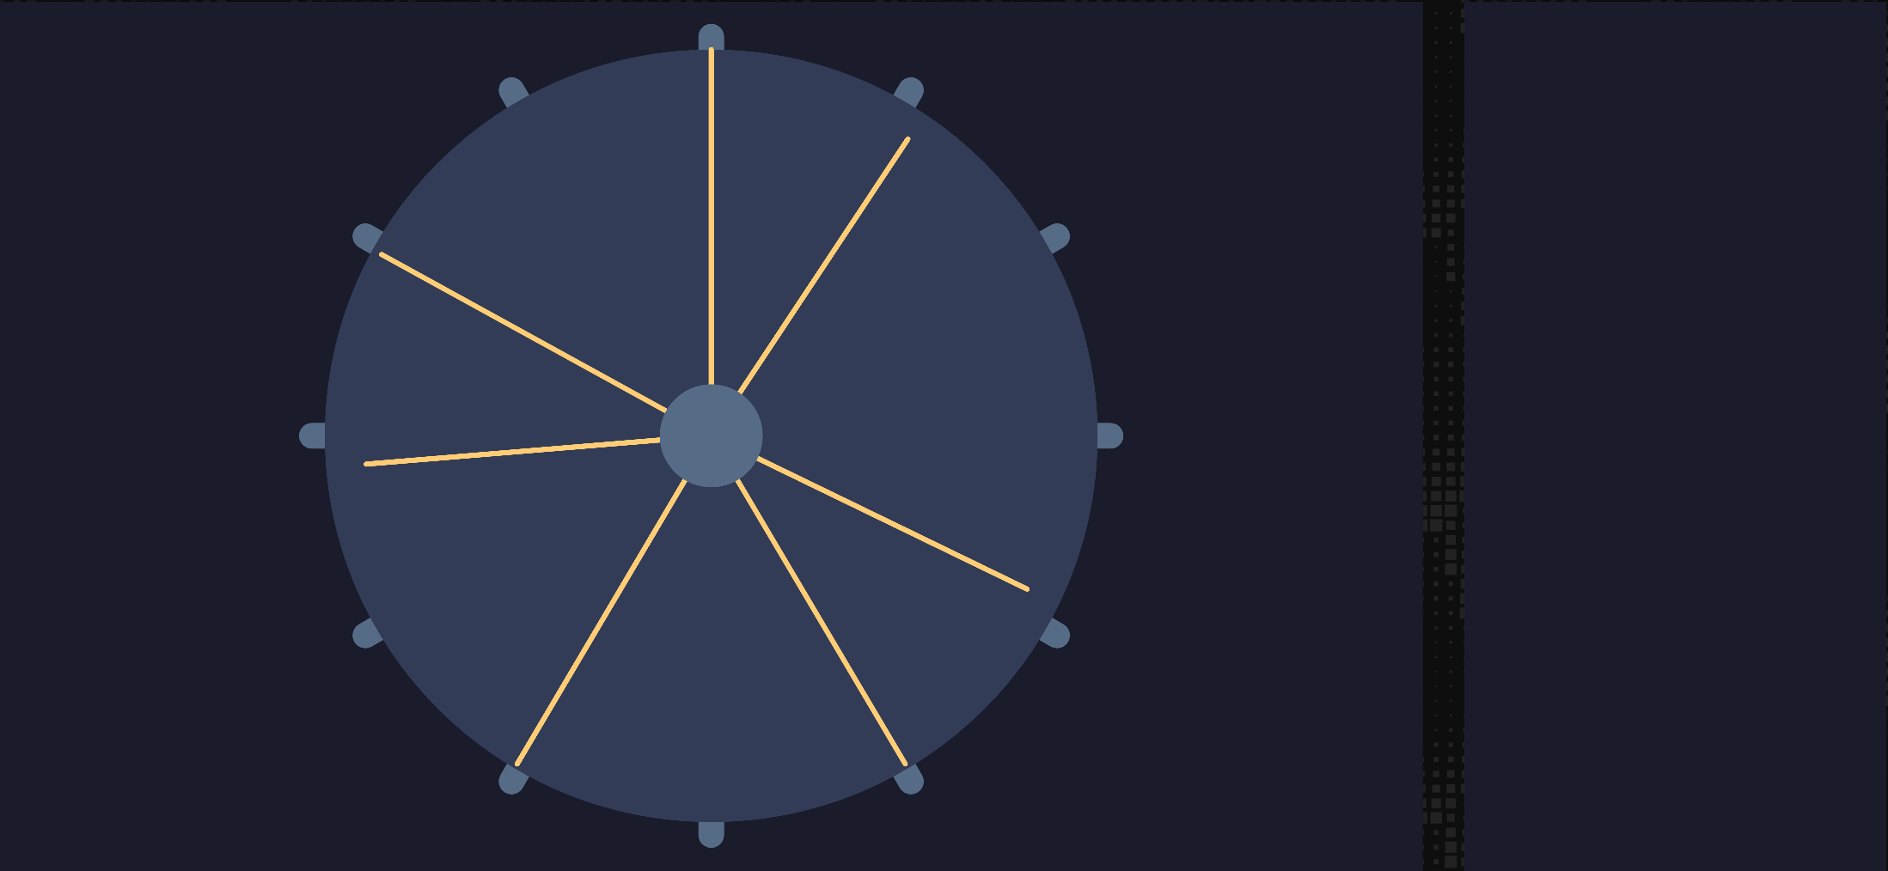
Biset
TRACKER / Tracker / View tuning
The tuning view is divided into the visualizer screen (main display, A) and the tuning screen (side display, B). This view is in construction. You can edit tuning / temperament / scale with a right click on Tracker. The reference frequency (default 440hz) and each note tuning (in cents) can be edited. A few temperament and scale presets are available.
The visualizer screen aims to give you a circular representation of your tuning. The circle represents an octave, each yellow line being a note pitch. By default, each yellow line is aligned to its corresponding light blue dot on the edge of the circle, corresponding to the equal temperament (octave perfecly splitted into 12 notes).
Here you can see 7 lines, meaning that I use the tuning as a quantizer by merging adjacent notes. Some lines are a bit out of line meaning that I use a different temperament where the octave is not perfectly divided into 12 notes.
The tuning screen will be used to list the 12 notes pitch with cents and nearest ratio allowing you to more easily edit your tuning. You won’t be able to add or remove notes. Notes can only be "removed" by merging them (setting 2 or more notes to the same pitch).
13

Slide 15
Biset
TRACKER / Tracker
C
D
E
F
G
A
B
H
I
Along with the BPM knob are the jump and octave screens. Octave, is simply the octave used when notes are inserted with your computer keyboard. Jump is the number of lines jumped after a note or a value is inserted.
Lights indicate the Tracker states. The 1st light (yellow) is on when the module is selected and, thus, when you can edit a pattern with your keyboard. The 2nd light (blue) is on when the module is playing, whatever the playing mode. The 3rd light (red) is on when you are in recording mode (not available yet !).
14

Slide 16
Biset
TRACKER / Tracker
There are 4 play buttons (C)
Play track Plays the track from the beginning, loops at the end (rightmost module)
Play pattern in pattern view, plays and loops the selected pattern. In timeline view, plays and loops the selected pattern instance with other instances present on the same beat range. While playing, you can select another instance which will be looped at the end of the previous pattern. Useful for live performances.
Play Plays the track from where it was stopped
Stop Stops playing
15

Slide 17
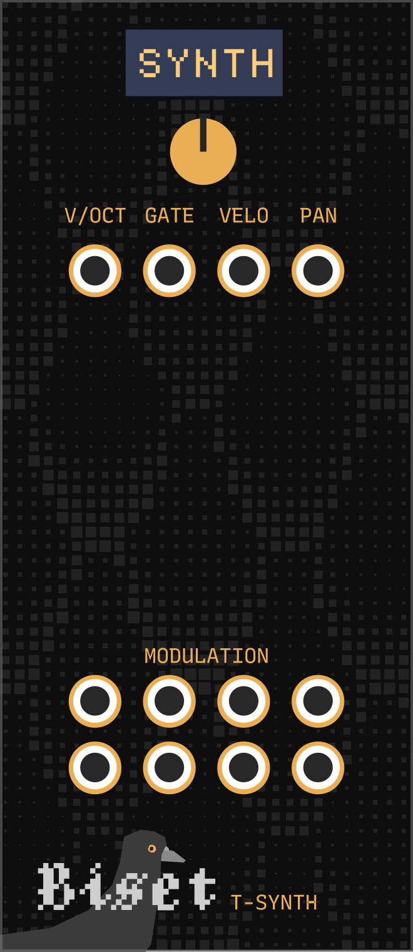
Biset
TRACKER / T-Synth
A
B
A Synth selection
B Voices pitch / gate / velocity / panning output
C Voices modulations output
C
T-Synth is the module that outputs a synth pitch, gate, velocity, panning and modulations.
16

Slide 18
Biset
TRACKER / T-Synth
You can select the synth with the top knob (A) or simply click on the small display and select the synth by its name.
The main outputs (pitch, gate, etc.) are polyphonic. The number of channels can be edited in the Tracker pattern view on the synth list with a right click along with the gate mode. You need to press the update synth button from the context menu to confirm the change of channels and mode.
A synth can handle up to 8 modulations. T-Synth allows you to set the CV range of these modulation with a right click. You can also map a modulation to up to 4 other modules knobs.
If you can have only one Tracker module, you can have more than one T-Synth module assigned to the same synth if you need to have different cv range from the same modulation.
17

Slide 19
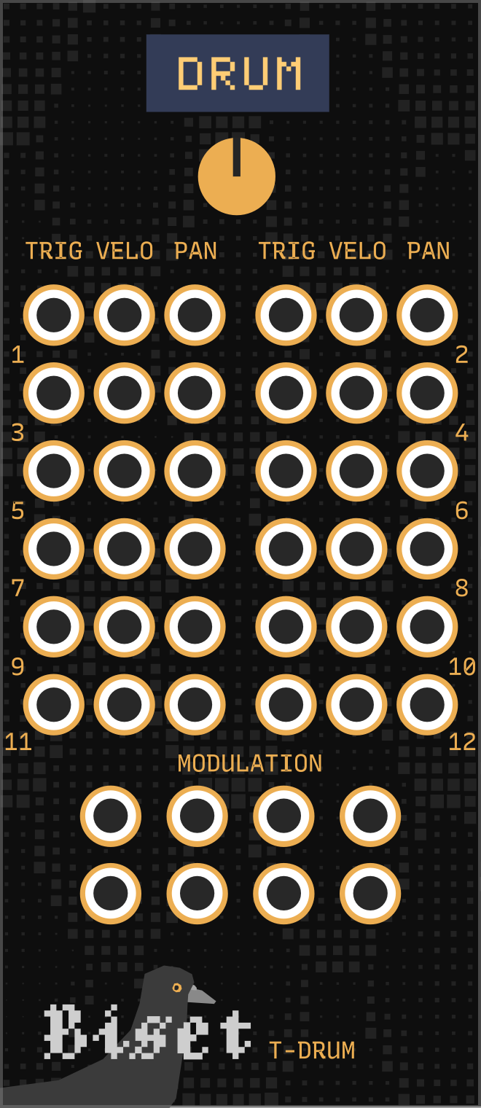
Biset
TRACKER / T-Drum
A
A Synth selection
B Voices gate / velocity / panning output
C Voices modulations output
B
C
T-Drum is the T-Synth alternative for drum triggers. It works the exact same way except that outputs are monophonic and are distributed over 12 differents output lines, one for each note (octave independent).
C triggers the 1st line, C# the 2nd one, D the 3rd one and so on.
18

Slide 20
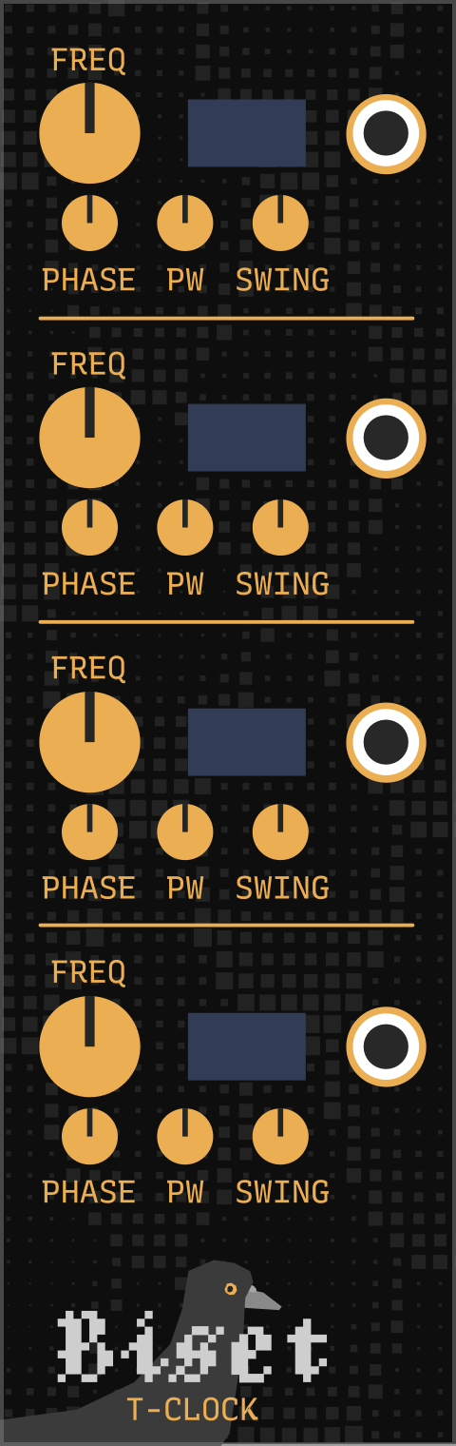
Biset
TRACKER / T-Clock
A
E
B
C
D
A Clock division / multiplication
B Clock phase offset
C Clock pulse width
D Clock swing
E Clock output
T-Clock is the clock generator module of the suite. It allows you to output 4 different clock signals. Clock division / multiplication can go up to /96 and x96 based on the Tracker playing beats.
You can also modify clock signal phase offset and pulse width. Swing can be added, based on Tracker beats.
19

Slide 21
Biset
TRACKER / T-Clock
T-Clock provides 2 sync algorithm, available from the context menu
Fixed Track oriented, restarts clock division / multiplication at the end of a pattern
Looped (Not handled yet !) Live oriented, keeps clock division / multiplication at the end of a pattern
20

Slide 22
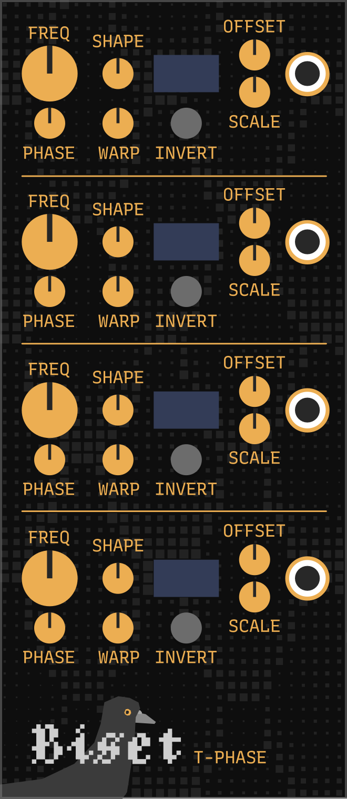
Biset
TRACKER / T-Phase
B
A
G
F
C
D
E
A Phase frequency division / multiplication
B Phase shape
C Phase phase offset
D Phase wave warping
E Phase wave inverting
F Phase range (offset + scale)
G Phase output
T-Phase is a synced LFO module. It allows you to output 4 different signals. Frequency division / multiplication can go up to /32 and x32 based on the Tracker playing beats. T-Phase provides the same sync algorithms as T-Clock.
Available wave shapes are saw, triangle, sine and square. Wave shapes can be phase offset, warped and inverted. Their range can be set with the offset and scale knobs.
21

Slide 23
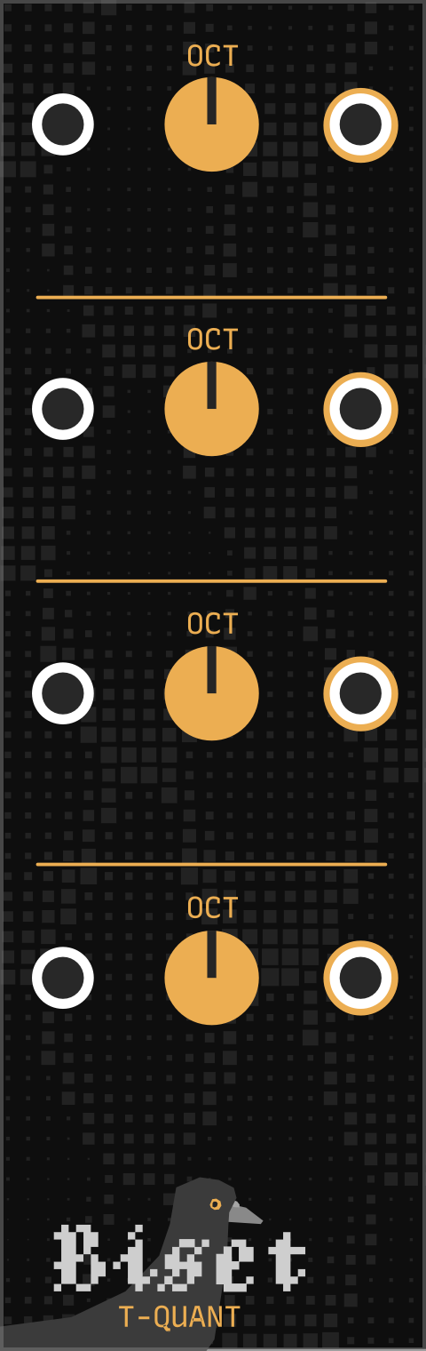
Biset
TRACKER / T-Quant
A
B
C
A Quant input
B Quant output
C Octave offset
T-Quant allows you to quantize other modules (not from the suite) pitch signals to fit your track tuning / temperament and reference frequency.
22

Slide 24
Biset
TRACKER / T-Quant
T-Quant provides 4 quantizing algorithms, each line can have its own algorithm
Index down looks for the corresponding note pitch, rounded down
Index up looks for the corresponding note pitch, rounded up
Index round looks for the corresponding note pitch, rounded
Nearest looks for the nearest note pitch
23

Slide 25
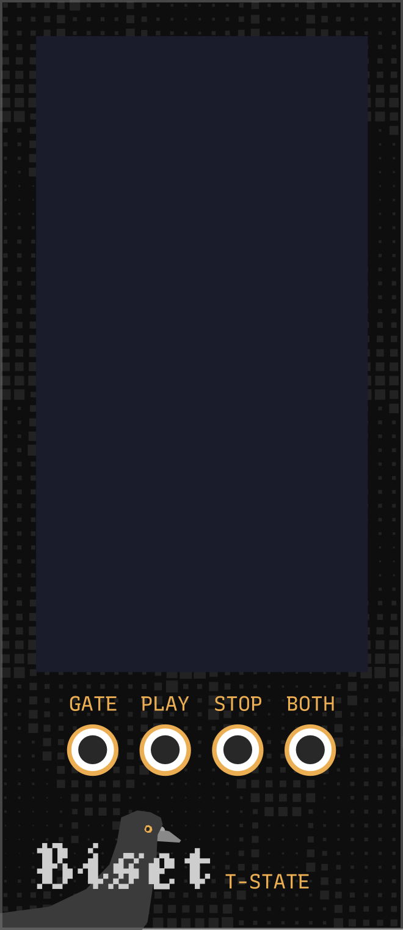
Biset
TRACKER / T-State
A
A Visualizer display
B Outputs
B
T-State outputs playing state and display a visual representation of the different voices playing. Voices are reprensented as dots. Their color, size, x axis and y axis depends respectively on the synth color, the voice velocity, panning and pitch.
Gate is on whenever Tracker is playing, play triggers on start, stop triggers on stop while both triggers on both events.
24

Slide 26
Biset
TRACKER / T-State
A
B
T-State outputs playing state and display a visual representation of the different voices playing. Voices are reprensented as dots. Their color, size, x axis and y axis depends respectively on the synth color, the voice velocity, panning and pitch.
Gate is on whenever Tracker is playing, play triggers on start, stop triggers on stop while both triggers on both events.
24

