Slide 1


Biset
TREE + SEED
VCV Rack manual

Slide 2
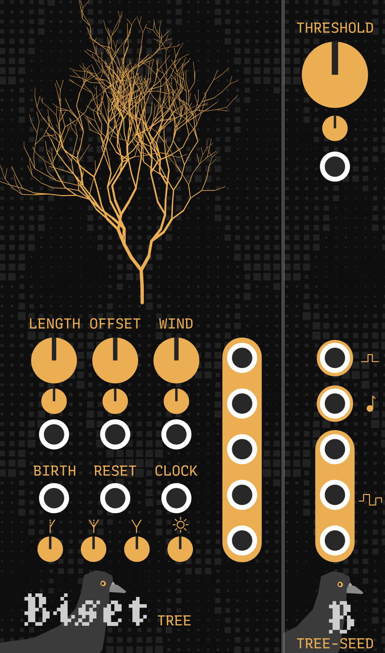
Biset
TREE + SEED
Tree is a random sequencer based on tree growth and wind simulation. It can generate sequences up to 64 steps long. The sequences generated by Tree can be influenced by wind force, allowing sequences to evolve continuously while keeping the same dynamics.
Seed is a Tree expander allowing to easily create evolving melodies from Tree outputs.
1

Slide 3
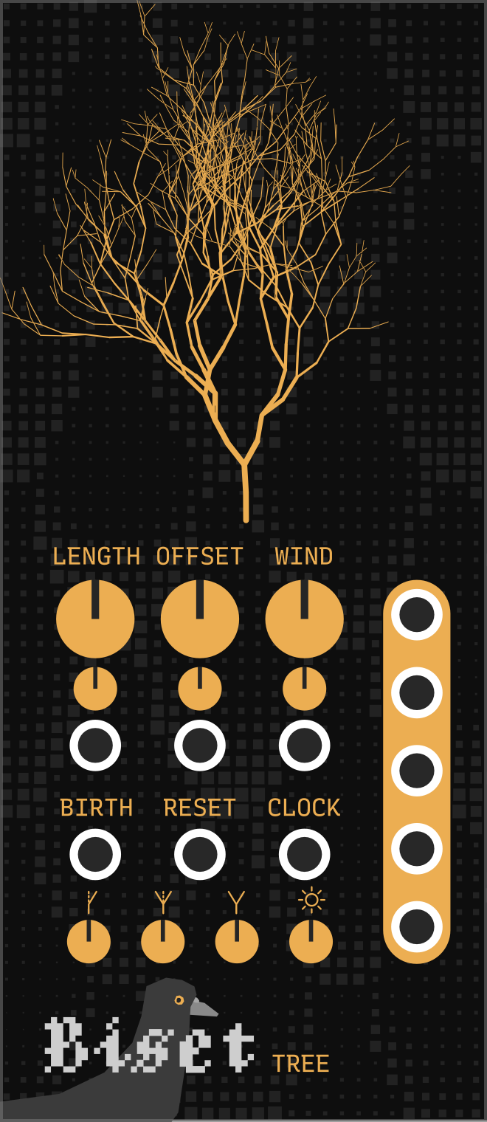
Biset
TREE
It's quite easy to create sequences with Tree. You simply need to define a sequence length (A) and provide a clock input (F). Tree will then output a randomly generated sequence for each of it’s 5 bipolar outputs (-5v/+5v).
A set of 5 random values is assigned to each branch of the tree. A sequence is simply made by visiting neighboring branches and getting their values. The offset control allows you to scan the tree from a different starting point, thus getting new sequences. The wind control allows you to add the wind force currently on the visited branch to its values, thus making the sequence less repetitive.
Wind effect is stronger on small branches which means that by moving the offset control, you will also potentially change the wind effect on the sequence.
A Sequence length control
B Sequence offset / scan
C Wind force on sequence
D New tree trigger
E Reset sequence trigger
F Sequence clock trigger
G Tree controls
H Outputs
A
B
C
H
D
E
F
G
Tree growth controls (G) allows you to define how the tree will grow. These controls will probably only have a negligible effect on the sequences.
Tree also includes a mutation control in it’s context menu (right click). This controls define the chance for each branch to generate new random values each time it is read. With some wind force, a really small chance of mutation is enough to create really interesting sequences (ex: 2%).
2

Slide 4

Biset
SEED
Seed is made to create an always evolving melody from the outputs of it’s connected Tree.
The Tree 1st output is used to define the melody gate state. If the value is greater than Seed threshold (A), the gate will be on, otherwise, it will be off. The 2nd output will be used to define the melody pitch. The pitch range can be set via the context menu (right click). The other outputs can be used for CV modulation.
Gate mode can be set via the context menu (gate or trigger).
Polyphony can be set via the context menu. The sequence will only output one note at a time but polyphony allows the potential envelope generators used with the sequencer to end last note while triggering the next one.
It’s important to note that the Seed threshold control is not a density control. Even at 50%, the melody can still have more or less than 50% of the sequence notes active.
A
A Sequence gate threshold
B Gate / trigger output
C Pitch output
D CV outputs
B
C
D
3

