Slide 1
Internet Of Things
SBIM: A Smart Building’s Interactive Map
Bruno Cataldi
Gabriele Sirico
Rishiraj Singh Salam
March-2022

Slide 2
Abstract
Smart Building Interactive Map is an Environmental monitoring system that provides user real-time information about space occupancy of workspace , energy port availability, and parking space availability using IoT technology through sensors and actuators connected to the internet.
Object
Our goal is to develop a small, relatively inexpensive, portable device that can be deployed at big corporate buildings that could potentially reduce time-consuming of daily search for workspace or conference room or parking spot.
End Users
Corporate Employees, People working in coworking space, etc.

Slide 3
Questions
1. What is the problem and why do you need IoT?
The problem is the time consuming search for available workspace or conference room or available energy ports or available parking space in big corporate buildings by the people who visits the building frequently. With IoT in smart building users can monitor the environmental data and take decision faster and potentially save a lot of time.

Slide 4
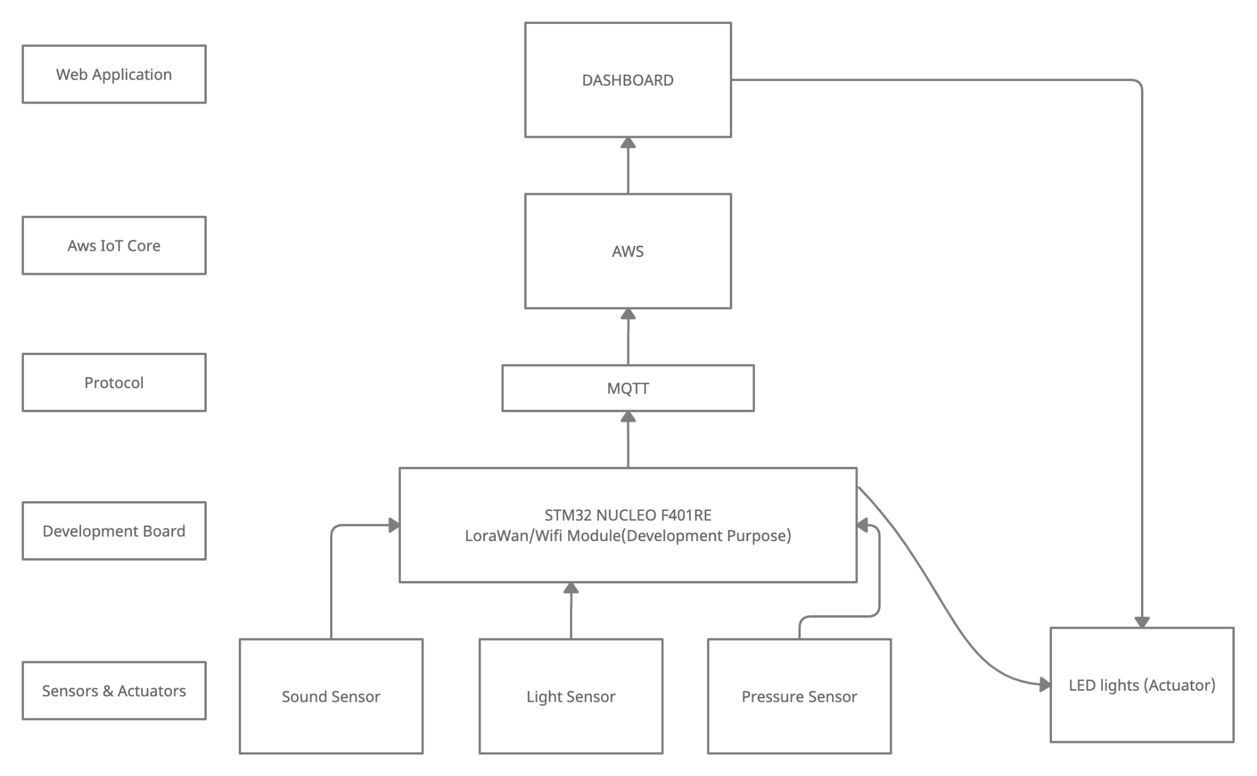
Questions
2. What are the connected components, the protocols to connect them and the
Overall IoT architecture ?

Slide 5
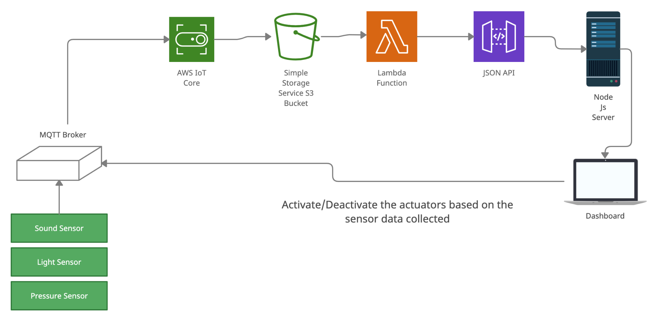
System Architecture

Slide 6
3. What data are collected by which Sensors?
Sound Sensor : Collects noise level data.
Motion Sensor : Collects motion detection data (Under consideration)
LDR Light Sensor : Collects light intensity data.
Pressure Sensor : Collects pressure level data.

Slide 7
4. What kind of collective intelligence do you expect will emerge?
Workspace Availability
Based on the value of noise sensor and motion sensor we can determine the crowdedness of a specific area.
Parking Space Availability
Based on the light intensity and pressure level from light and pressure sensors we can determine the availability of space in parking lot. LED lights can be used as Feedback indicator
Statistical Data
Based on historical data we can have an estimate prediction of which area is likely to be occupied more and also in which day and time.

Slide 8
5. What are you going to learn and how will you act into the environment by
what actuators?
We are going to monitor the noise level with motion sensor for the workspaces inside the building. LED feedback indicators can be used to indicate whether the space is available for occupancy.
Also by measuring light intensity and pressure level of each parking space in the parking lot an overhead LED light indicator indicating available space area can be used as a feedback indicator.

Slide 9
6. What are the constraints? How often? Bandwidth? Latency? Energy? Duty Cycle?
In our proposed solution we could face mainly inaccurate noise level and motion detection data from the neighboring space and people passing through the available area that could lead to false occupancy detection.
7. What is the plan and what are the metrics (quantitative, not qualitative) to evaluate
the performance?
There are mainly two limits:
A (lenient) real time constraint
A power management constraint

