Slide 1
Internet Of Things
SBIM: A Smart Building’s Interactive Map
Bruno Cataldi
Gabriele Sirico
Rishiraj Singh Salam
March-2022

Slide 2
Abstract
Smart Building Interactive Map is an Environmental monitoring system that provides user real-time information about space occupancy of workspace, using IoT technology through sensors and actuators connected to the internet.
Object
Our goal is to develop a small, relatively inexpensive, portable device that can be deployed at big corporate buildings that could potentially reduce time-consuming of daily search for workspace or conference room.
End Users
Corporate Employees, People working in coworking space, Students etc.

Slide 3
Questions
1. What is the problem and why do you need IoT?
The problem is the time consuming search for available workspace in big corporate buildings or academic libraries by the people who visits the building frequently. With IoT in smart building users can monitor the environmental data and take decision faster and potentially save a lot of time.

Slide 4
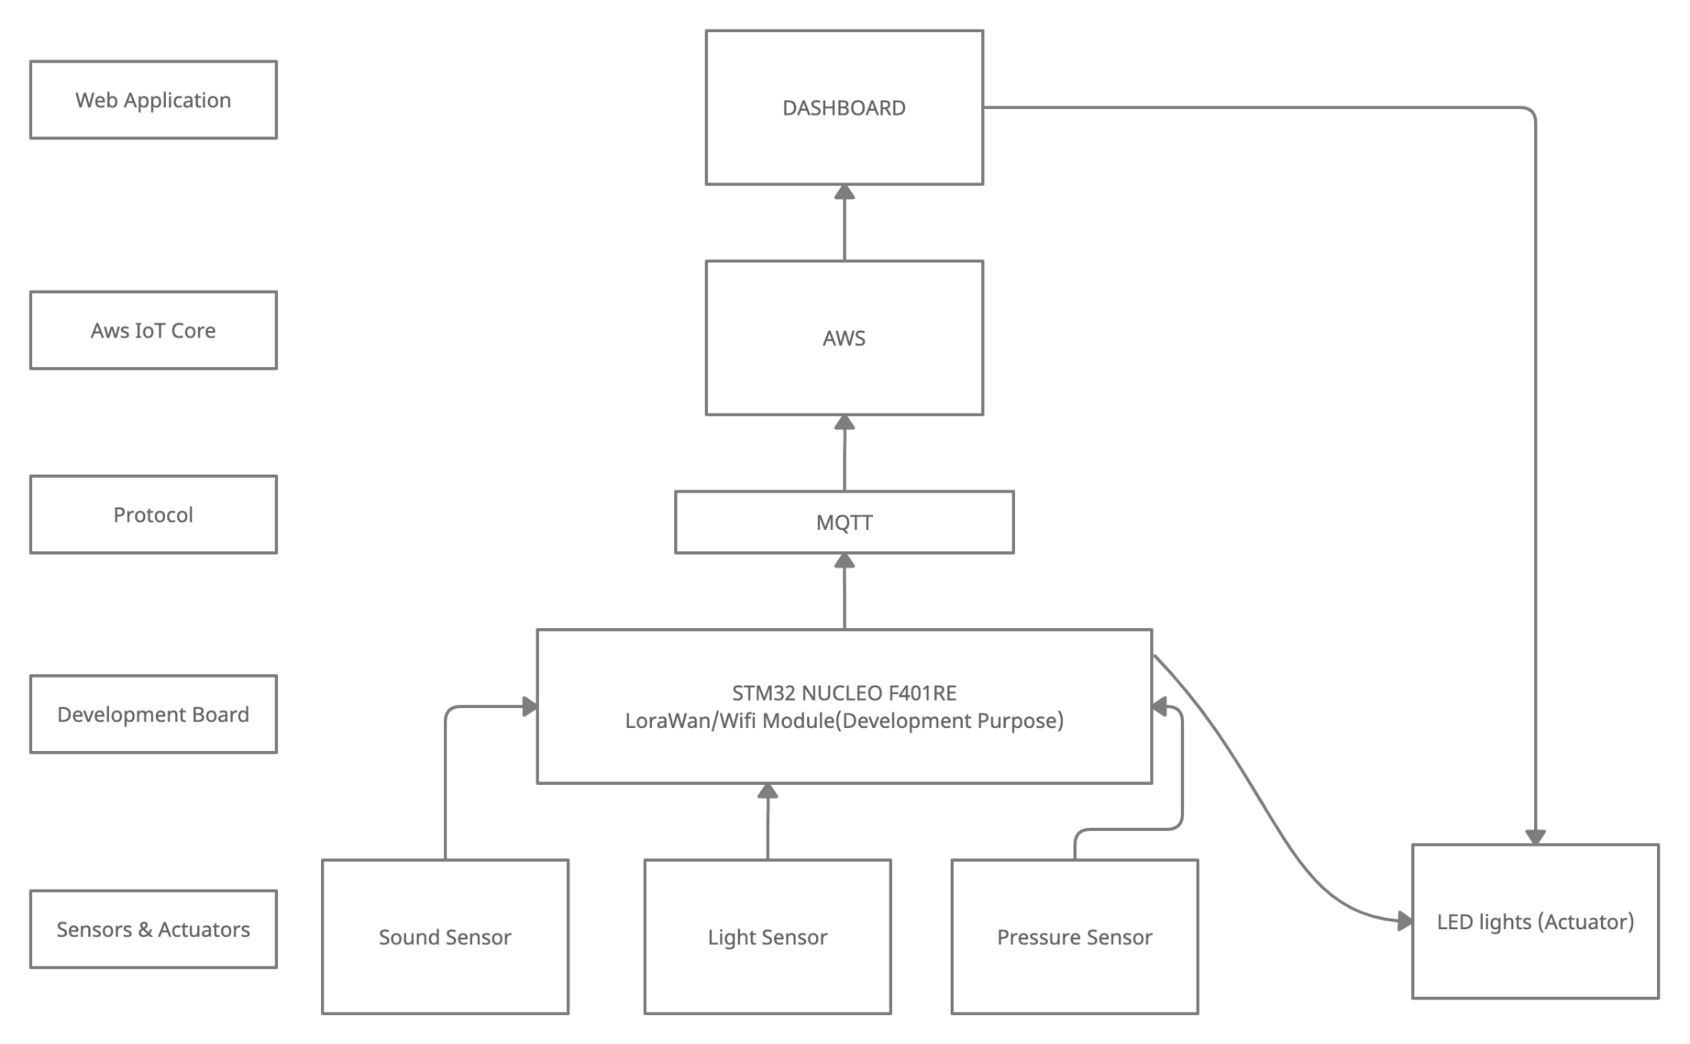
Questions
2. What are the connected components, the protocols to connect them and the
Overall IoT architecture ?

Slide 5
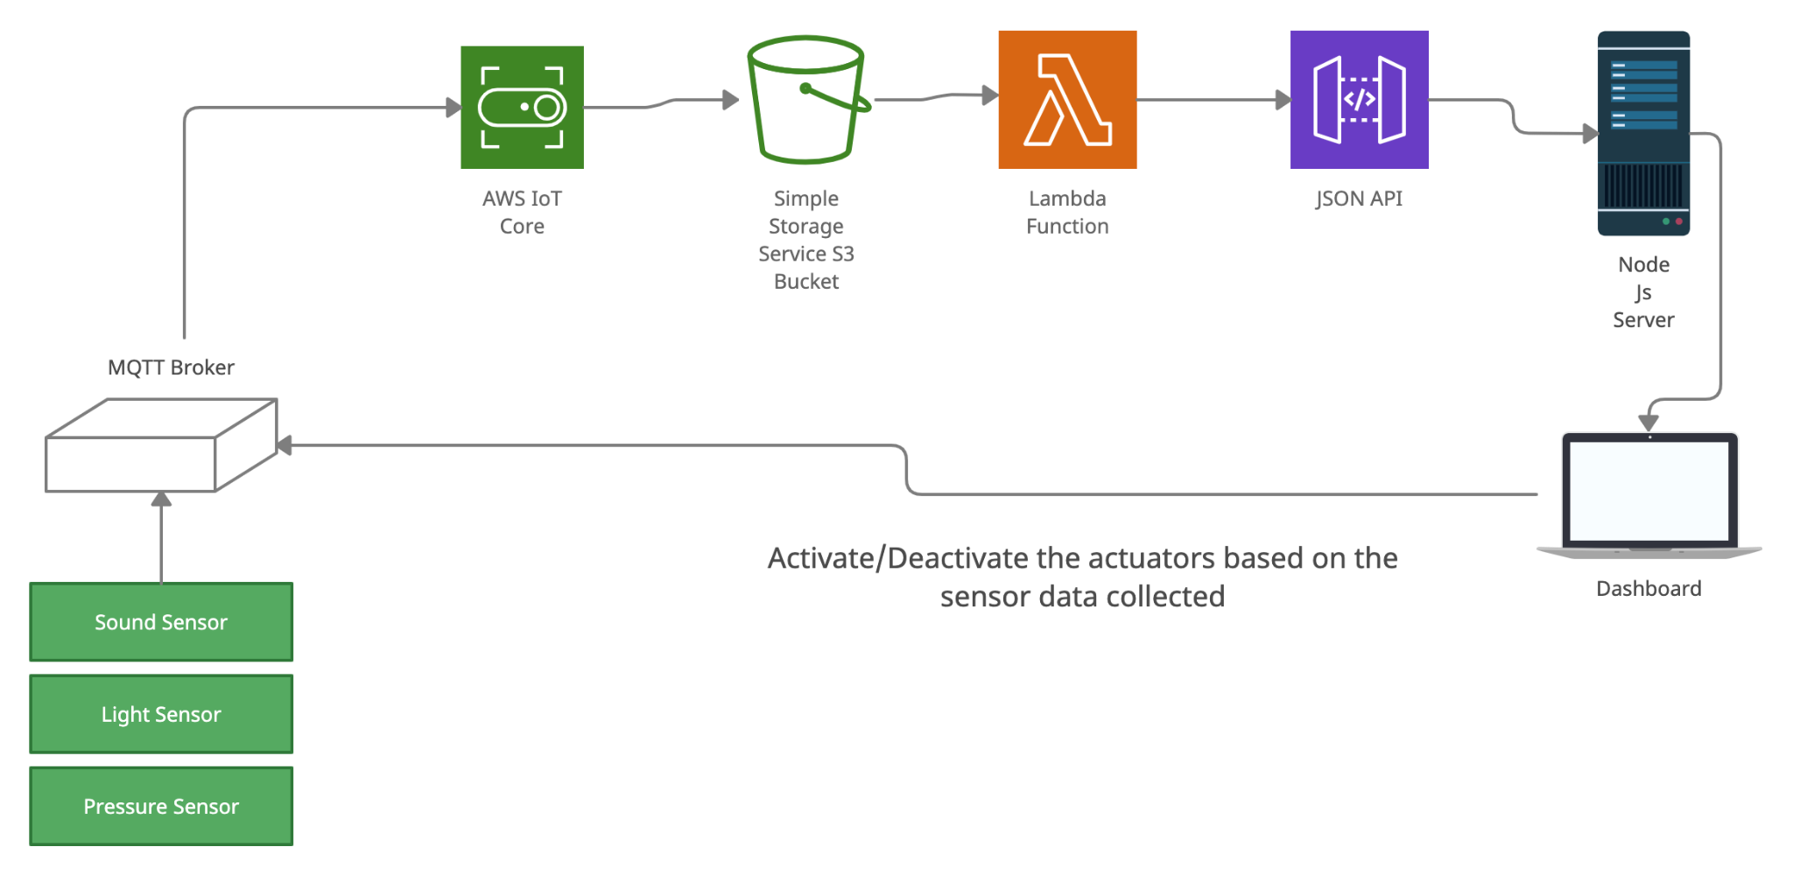
System Architecture

Slide 6
3. What data are collected by which Sensors?
Passive Infrared Sensor (PIR) : Collects motion detection data.
Ultrasonic Transducer Sensor: Detects objects and track their position.
LDR Light Sensor : Collects light intensity data.

Slide 7
4. What kind of collective intelligence do you expect will emerge?
Workspace Availability
Combining on the data collected by the motion sensors we can determine the crowdedness of a specific area.
Statistical Data
Based on historical data we can have an estimate prediction of which area is likely to be occupied more and also in which day and time.

Slide 8
5. What are you going to learn and how will you act into the environment by
what actuators?
We are going to monitor the noise level with motion sensor for the workspaces inside the building. LED feedback indicators can be used to indicate whether the space is available for occupancy.

Slide 9
6. What are the constraints? How often? Bandwidth? Latency? Energy? Duty Cycle?
In our proposed solution we could face mainly inaccurate noise level and motion detection data from the neighboring space and people passing through the available area that could lead to false occupancy detection.
7. What is the plan and what are the metrics (quantitative, not qualitative) to evaluate
the performance?
There are mainly two limits:
A (lenient) real time constraint
A power management constraint

