Slide 1
What’s in a name?
Respect and Status Recognition in U.S. Government Mentions of Kim Jong Un

Slide 2
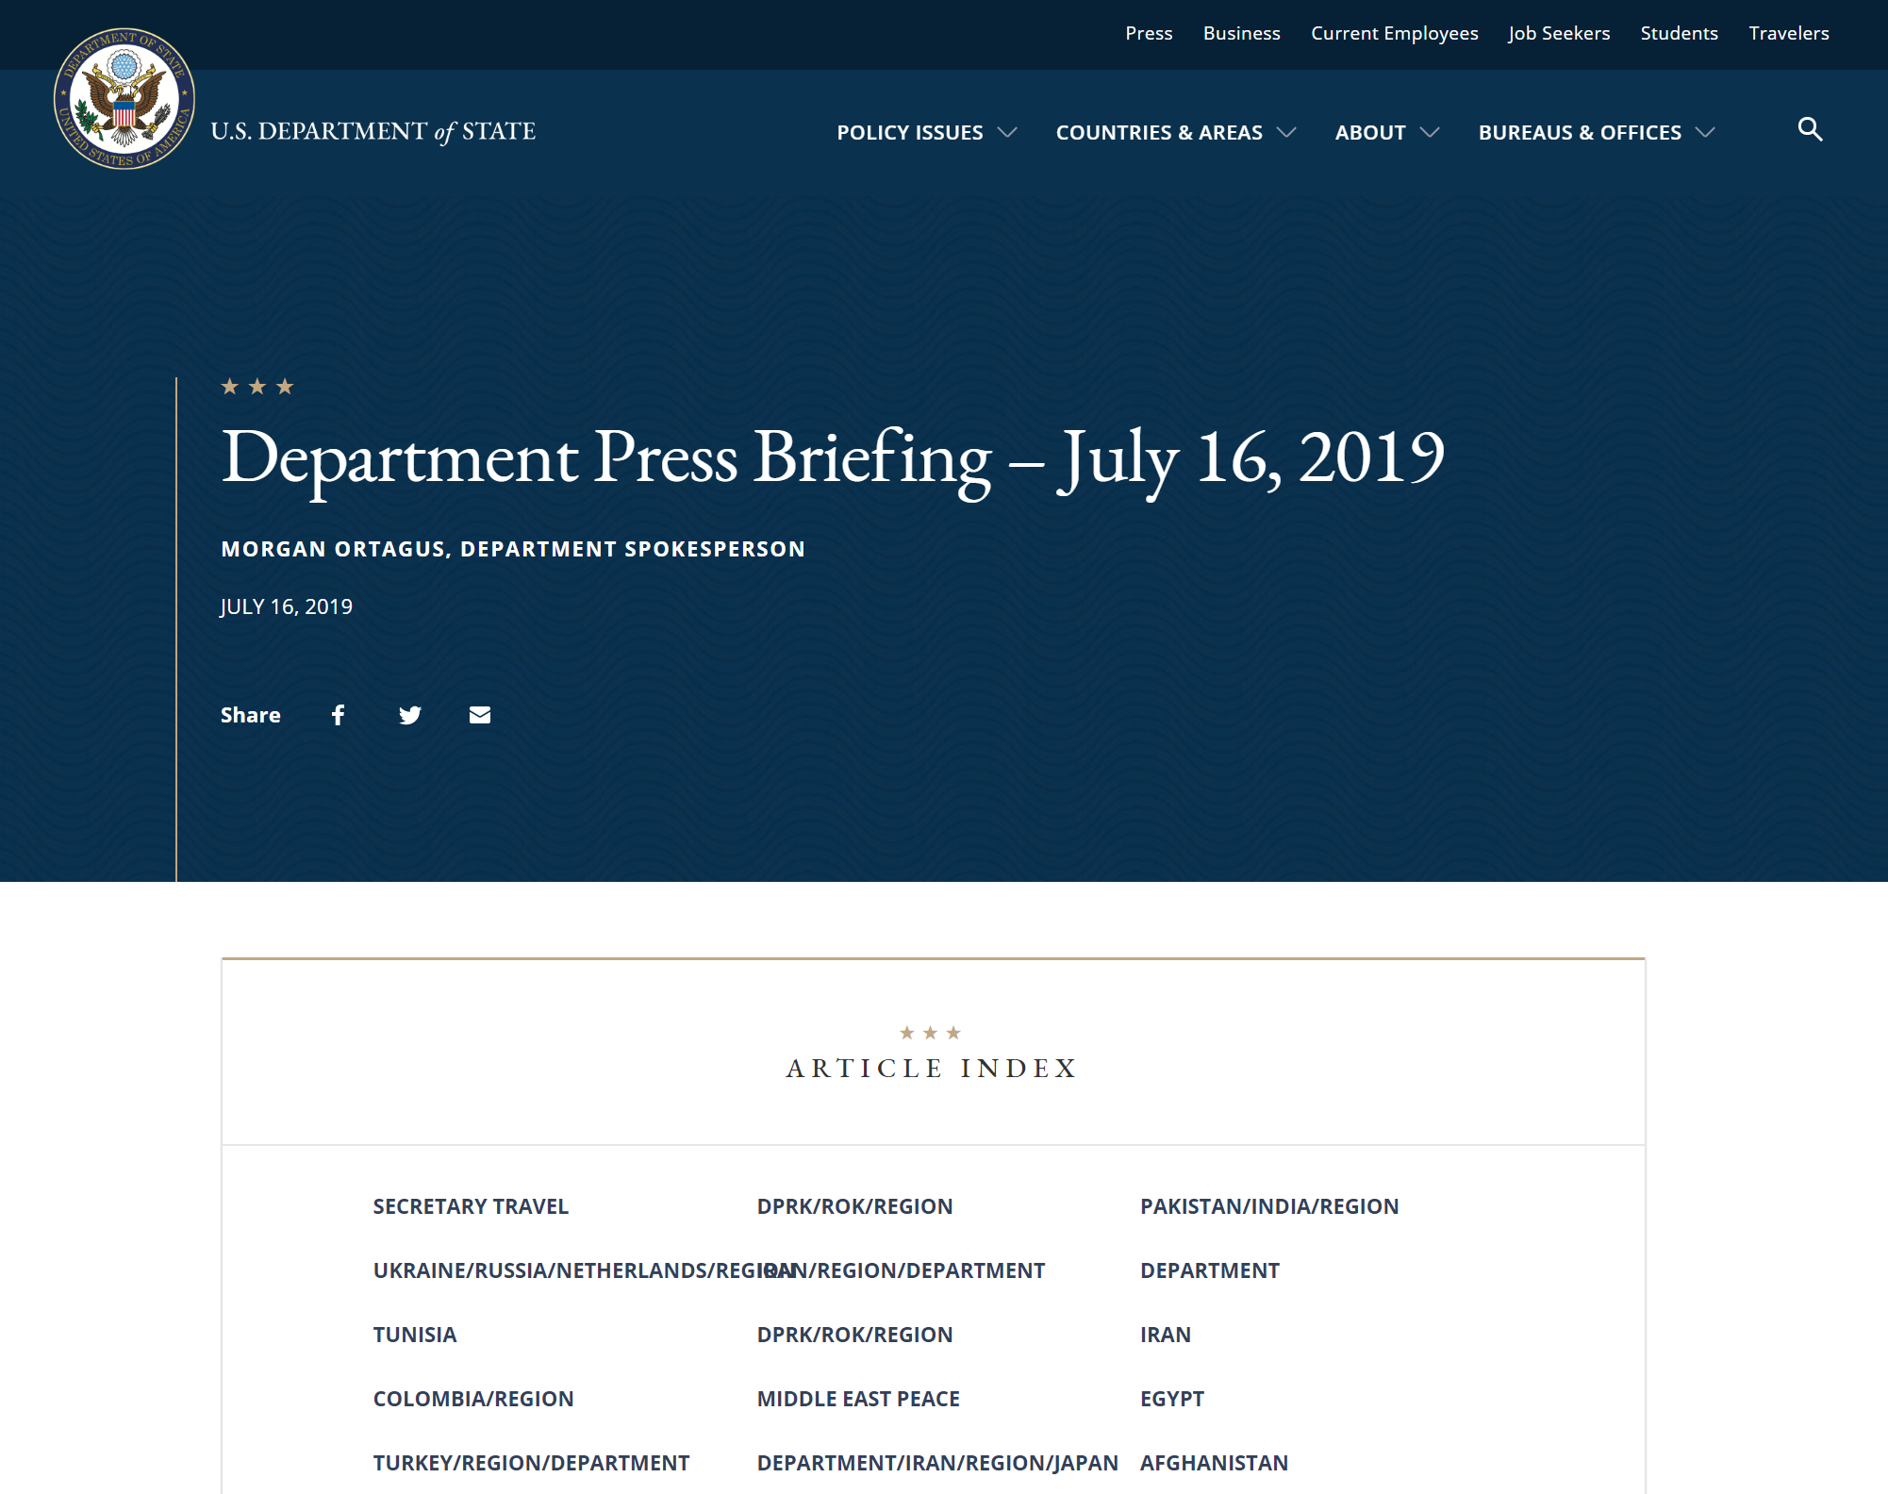
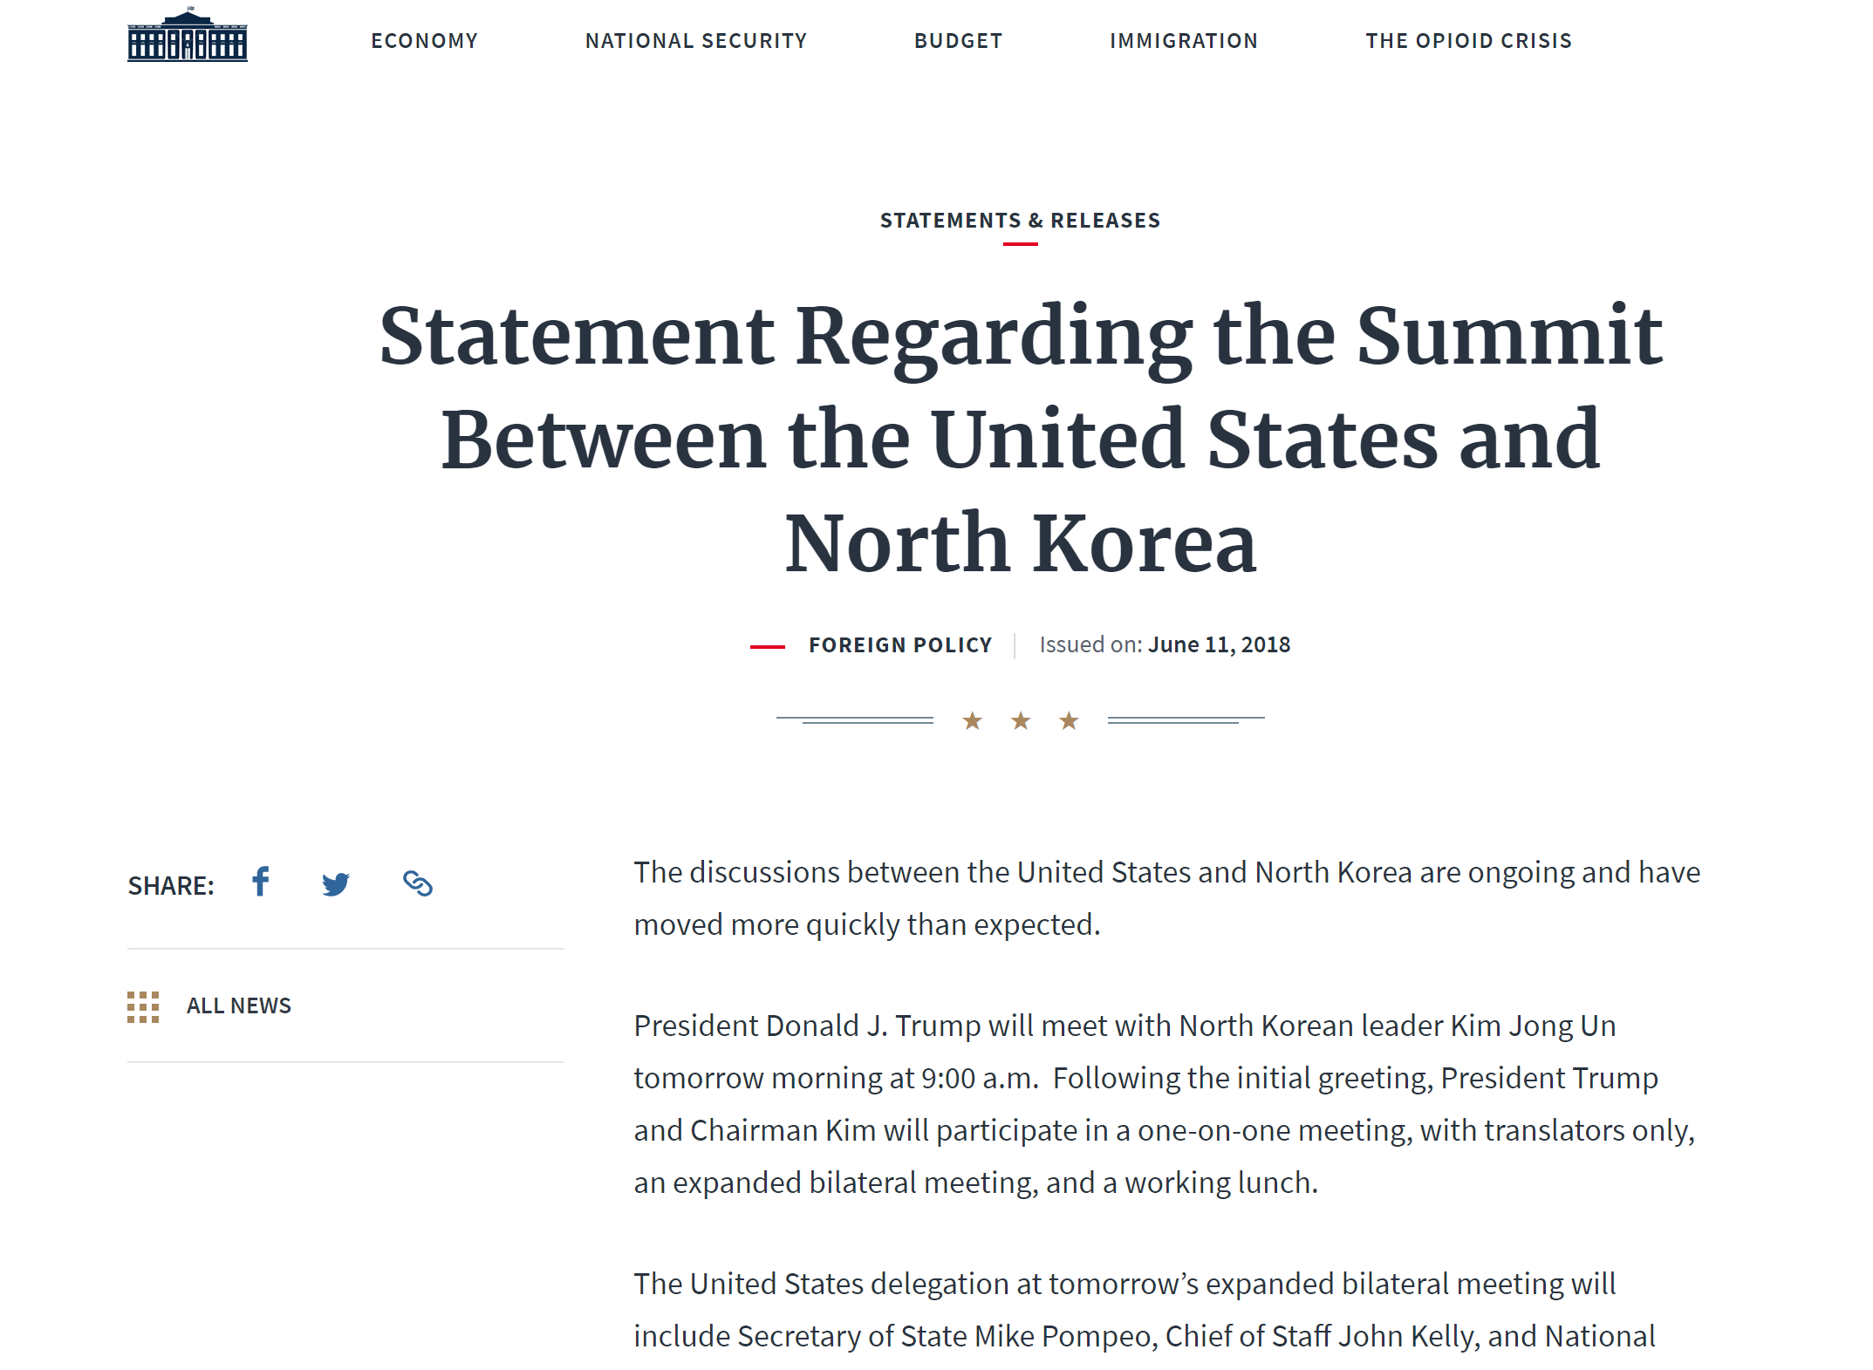
Documents

Slide 3
Steps
Get all URLs (146 for State, 1,509 for White House)
Scrape html
Filter for mentions of “Kim”
Group by title
Visualize

Slide 4
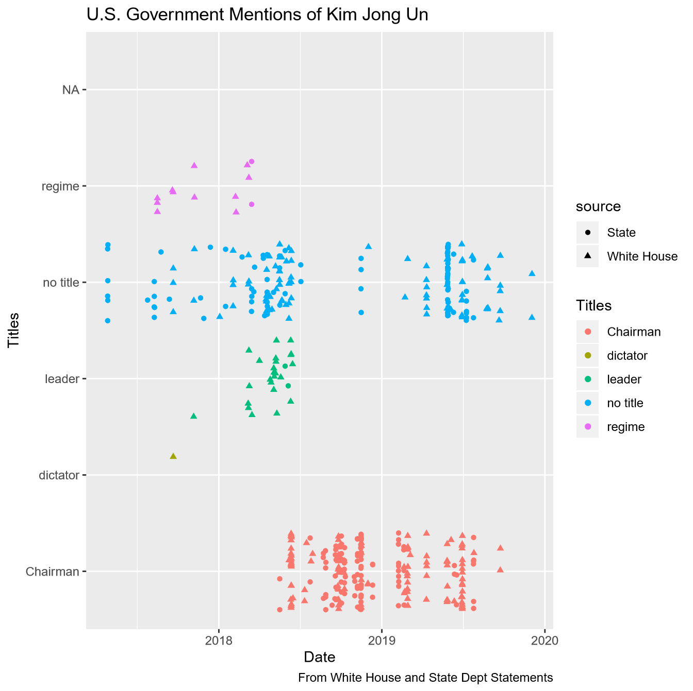
results
Number of Mentions
 | Chairman | Dictator | Leader | Regime | No Title
WH | 117 | 1 | 24 | 11 | 87
State | 107 | 0 | 2 | 2 | 97
Total | 224 | 1 | 26 | 13 | 184

Slide 5
Difficulties
Converting from lists -> vectors -> dataframes
State Department forgot dates on many documents
Multiple different “Kim”s and multiple mentions per paragraph
Large dataset – took forever to map

