Slide 1

Gibson Wong

Slide 2
Agenda
Overview
Main Features
Data binding
Digest Loop
Angular Components
Controller
Views and Routes
Directives
Services
Unit Testing
Final Thoughts

Slide 3
Overview
Developed 2009 as part of GetAngular, a larger commercial product
Eventually sponsored by Google and became an open-source project
Main purpose is to separate declarative programming from imperative programming

Slide 4
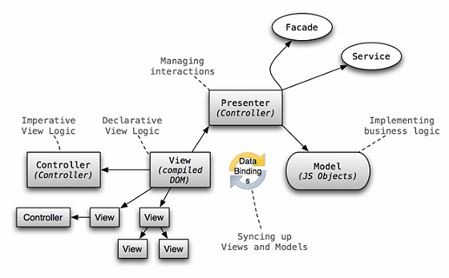
overview
Declarative: “What you want to happen”
Imperative: “What you would like to happen”

Slide 5
Main Features
Two-way Data-Binding
Extend the HTML language
Embeddable
Dependency injection
Testing!

Slide 6
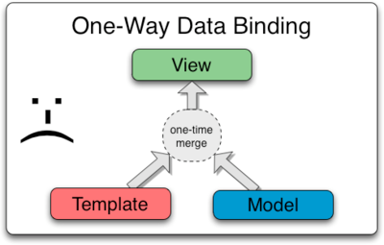
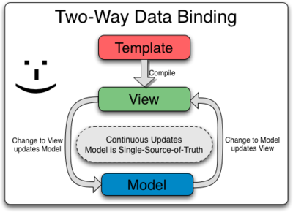
Data-Binding
Typically, the template is bound by the model and then merged to view
AngularJS automatically synchronize models with views

Slide 7
Data-Binding (Cont’)
Templates is first compiled on the browser which then produces a live view
Changes to view updates the model
Changes to model updates the view
How does the two-way data-binding work?

Slide 8
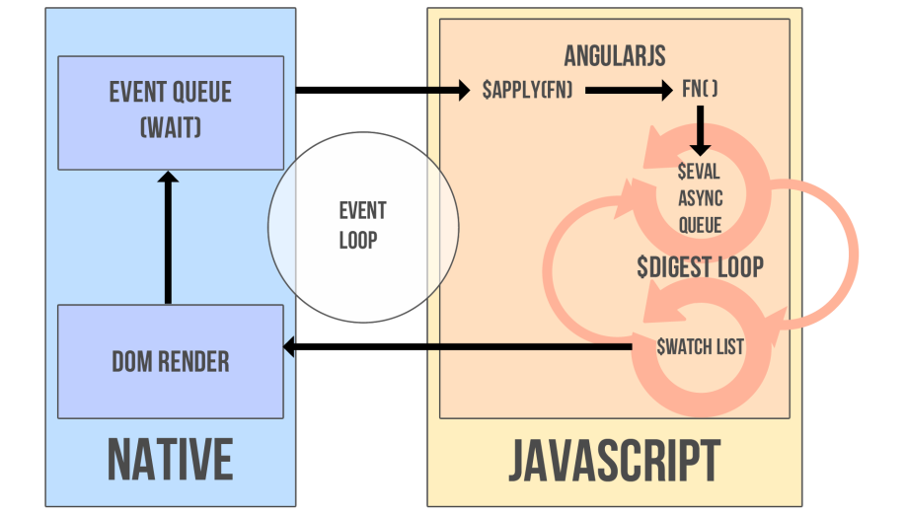
Digest Loop
Bindings (ng-bind or the {{ }} ) are tracked with a watch function and added to the $watch list
$watch list is then resolved in the $digest loop (Angular’s event loop)

Slide 9
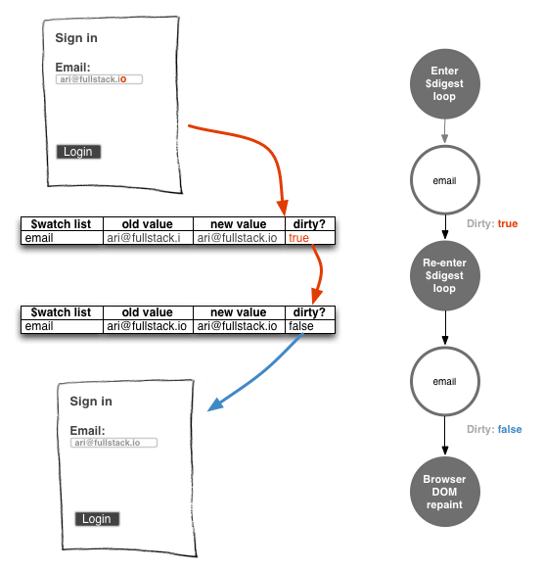
Digest Loop
Dirty Checking!
Checks if value changed
General Rule: No more than 2000 bindings

Slide 10
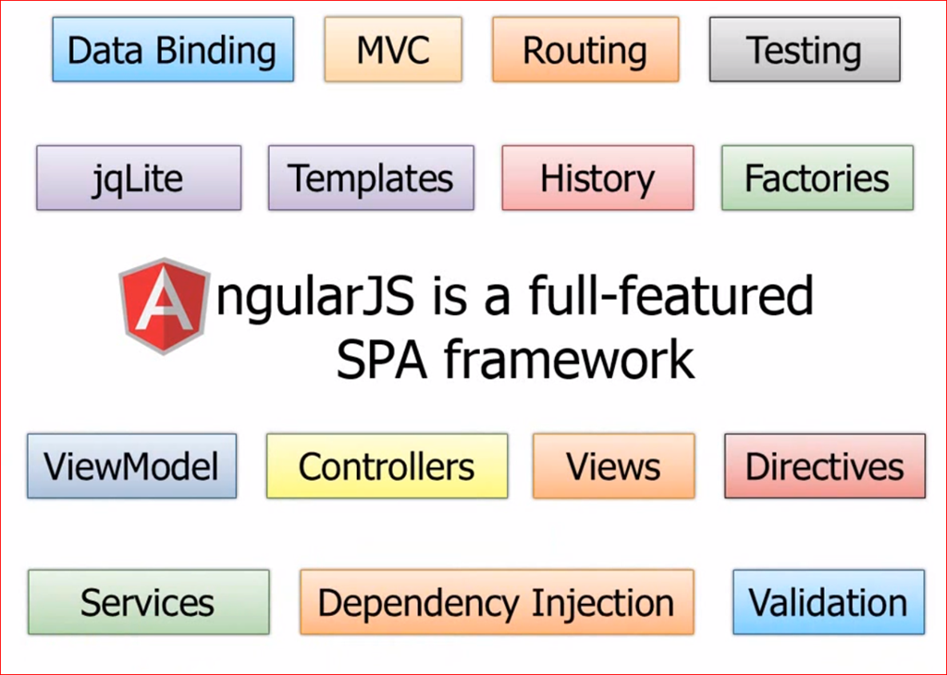
Angular Components

Slide 11
Controllers
ngController
Constructor function used to augment $scope (you can think of it as the view model)
When to use controller:
Use controllers to set initial state of $scope
Add behaviors to $scope
This is where your imperative logic belongs to!
Simple example of controllers

Slide 12
Views and ROutes
Views (ngView)
No templating engine
Just HTML!
Routes (ngRoute)
Very much similar to Backbone’s router
ngRoute only allows one view per page
In summary, no support for multiple views and nested views
Use 3rd party library instead (UI-Router)

Slide 13
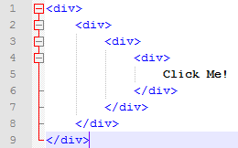
Directives
Markers of DOM elements
Example: datePicker is matched by
Element: <date-picker></date-picker>
Attribute: <input type=“text” date-picker>
Class: <input type=“text” class=“date-picker”>
No more of this:

Slide 14
Directives (Cont’)
Functionality associated to these elements are declared in the directive
Templates can also be included here
We can create nested views using directives
Declarative logic placed here
DOM manipulation as well!
Example of Directive

Slide 15
Services
Functions that isn’t involved with the MVC
It’s where you put code that doesn’t fit in Controllers or Directives
Use it for shared code across application
Simply inject the service into your components

Slide 16
Unit Testing
Dependency Injection
Everything is managed through DI
Controllers are injected with $scope
To test modules, we can just inject mock data, on a test by test basis
Tools for Unit testing
Karma
CLI tool that spawns web server and load application’s source code to execute tests
Jasmine
Test drive framework for Javascript

Slide 17
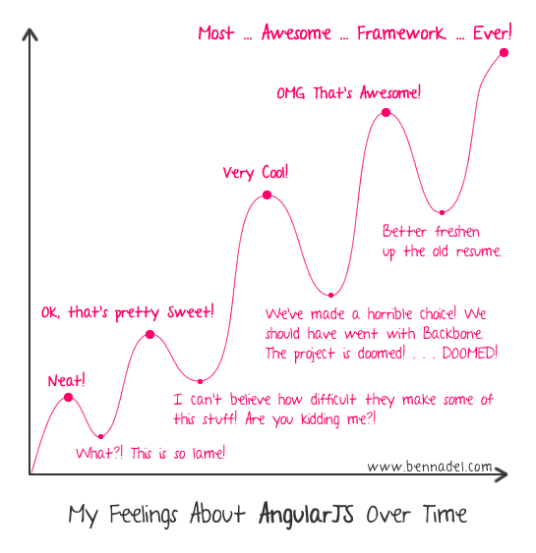
Final Thoughts
Good separation of concerns
Two-way data-binding!!!
Dependency Injection makes testing easy
High learning curve

Slide 18
Thank you!
Useful Links and Articles
Comparison between AnuglarJS, Backbone.js and Ember.js
Nesting Directives
Example of incorporating jQuery Dialogs into AngularJS
A bit more information on the Digest Loop

Slide 19
More Links!
Creating directives (there’s a broken link for the topic Isolate Scope. It can be found here)
Testing directives
A good read on using jQuery in Angular
Angular Seed Project (quick way to set up a project)
Experiment on digest loop runtime

