Slide 1
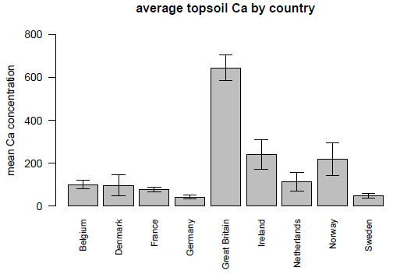
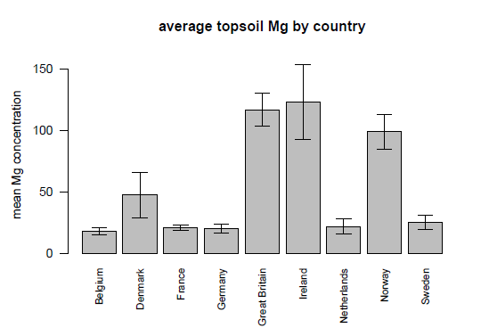
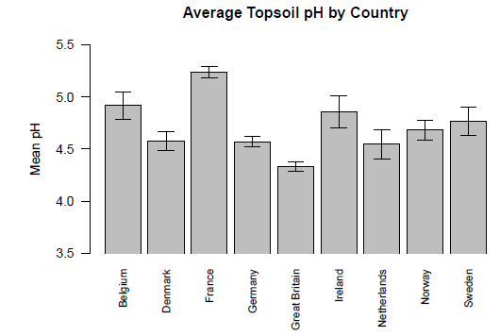
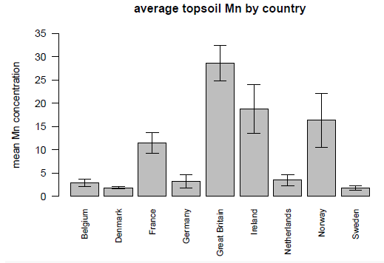
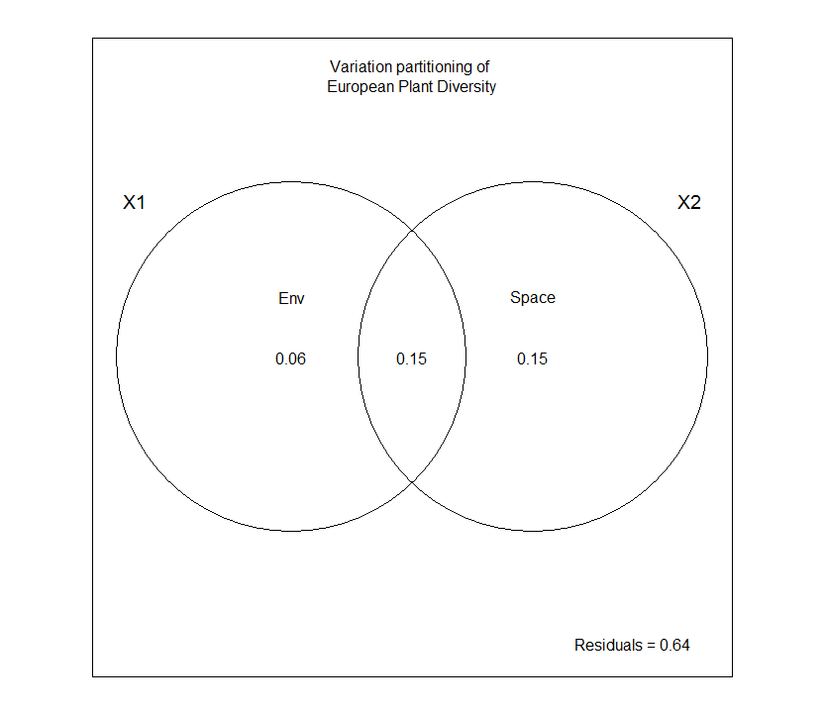
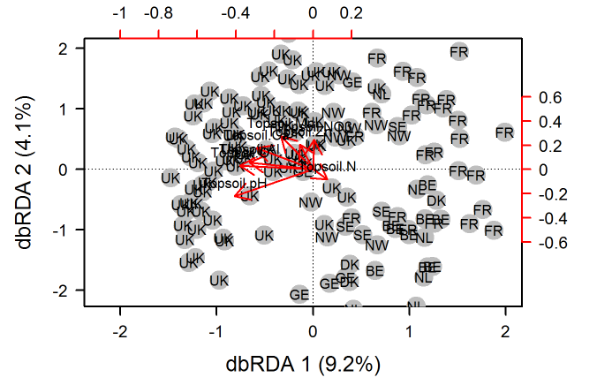
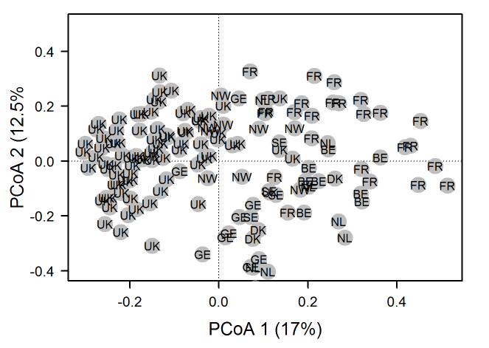
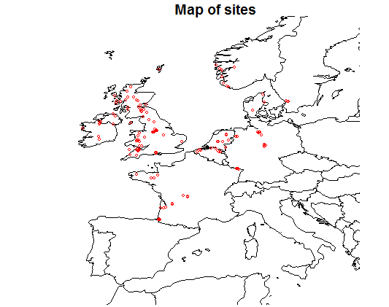
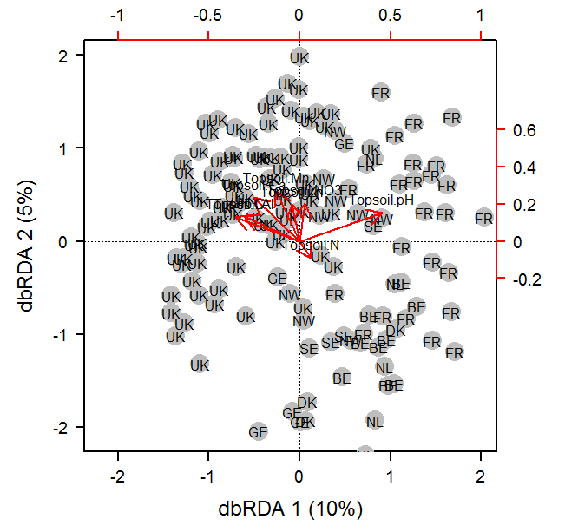
Relative Effects of Environment and Space in the Distribution of Plant Diversity
spec.db ~ TopsoilpH + Ca + Mn + Mg + Fe + C + NO3 + N + Zn + Al
Permutation tests
Nutrient | P-val
pH | .001
Zn | .001
NO3 | .001
Ca | .001
Mn | .001
Mg | .001
Notes:
Categorical spatial effects (PCoA)

