Slide 1
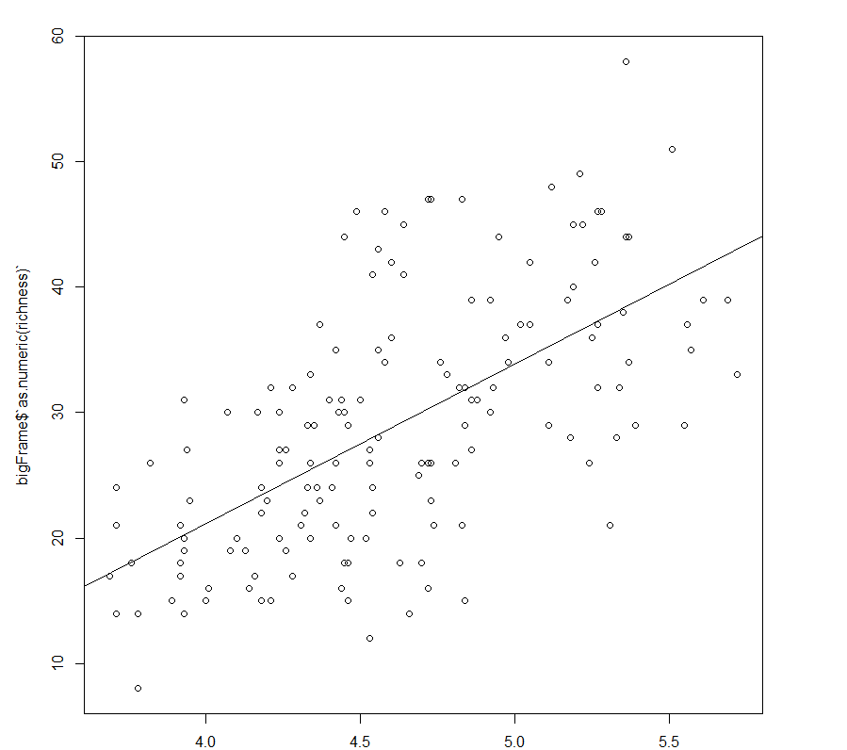
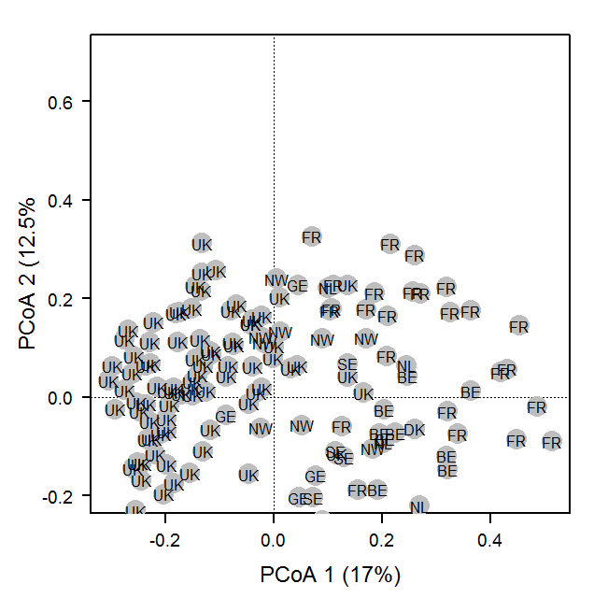
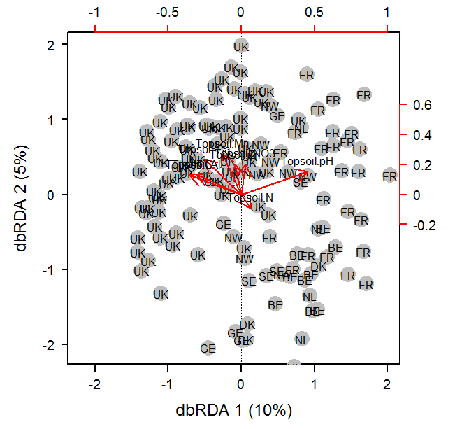
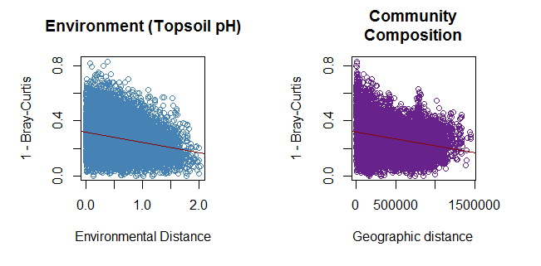
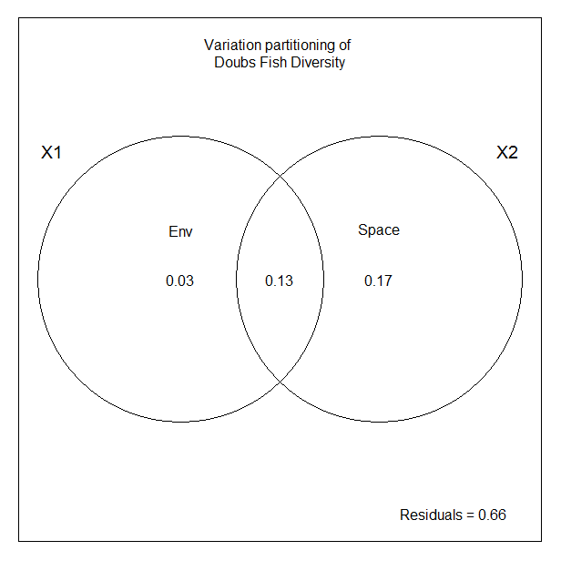
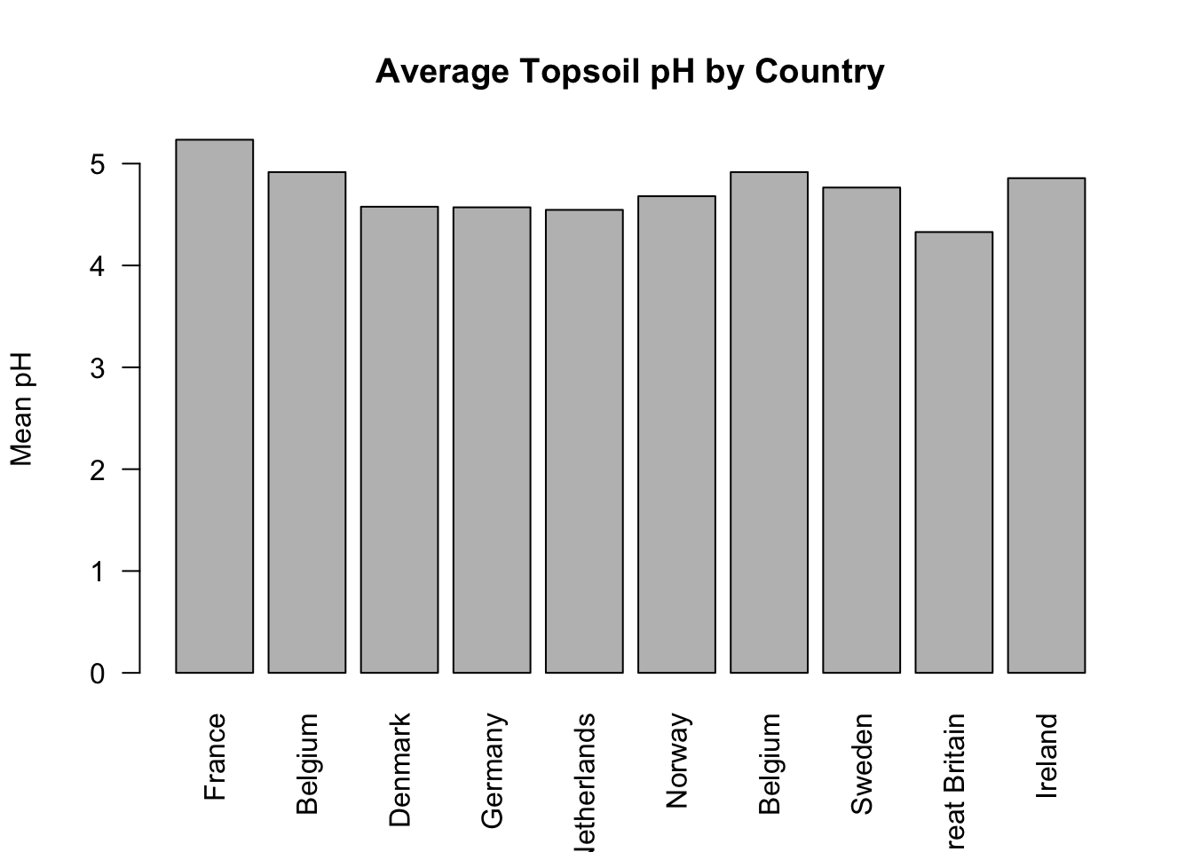
r² = .62
Richness
Topsoil pH
spec.db ~ TopsoilpH + Ca + Mn + C + NO3 + N + Zn + Al
Permutation tests
Nutrient | P-val
Ca | .001
Mn | .001
Mg | .001
Notes:
Read from left to right
#The Effects of Soil Chemistry on European Plant Diversity
-Initial correlations with richness showed a significant correlation between pH and richness.
-Ordination analyses revealed grouping by country (as expected)
-Redundancy analysis using all environmental chemicals identified a model
-Constrained ordination showed an effect of pH in the direction of france with the rest of the variables having smaller effects on the UK.
-Permutation tests for the correlation of these variables along the constrained axes did not identify pH as significant—but rather Ca, Mn, and Mg.
-Despite pH showing a negative relationship with Bray Curtis similarity
-Perhaps unsurprisingly, the effects of space on diversity were much higher than the effects of environment though their combined effect is substantial.
-The final thing we are going to do is look at how these variables identified in the permutation tests vary by country.
-Also, we are going to test for linearity among our environmental variables to assay the accuracy of the variance partitioning.
-But, as of right now, it seems clear that distance rather than environment is driving diversity. Isolation-by-distance rather than local adaptation.

