Slide 1

NATIONALS PLAYER
STATS ANALYSIS
2019 Season · Excel & Access Database Project
Ben Gibson

Slide 2
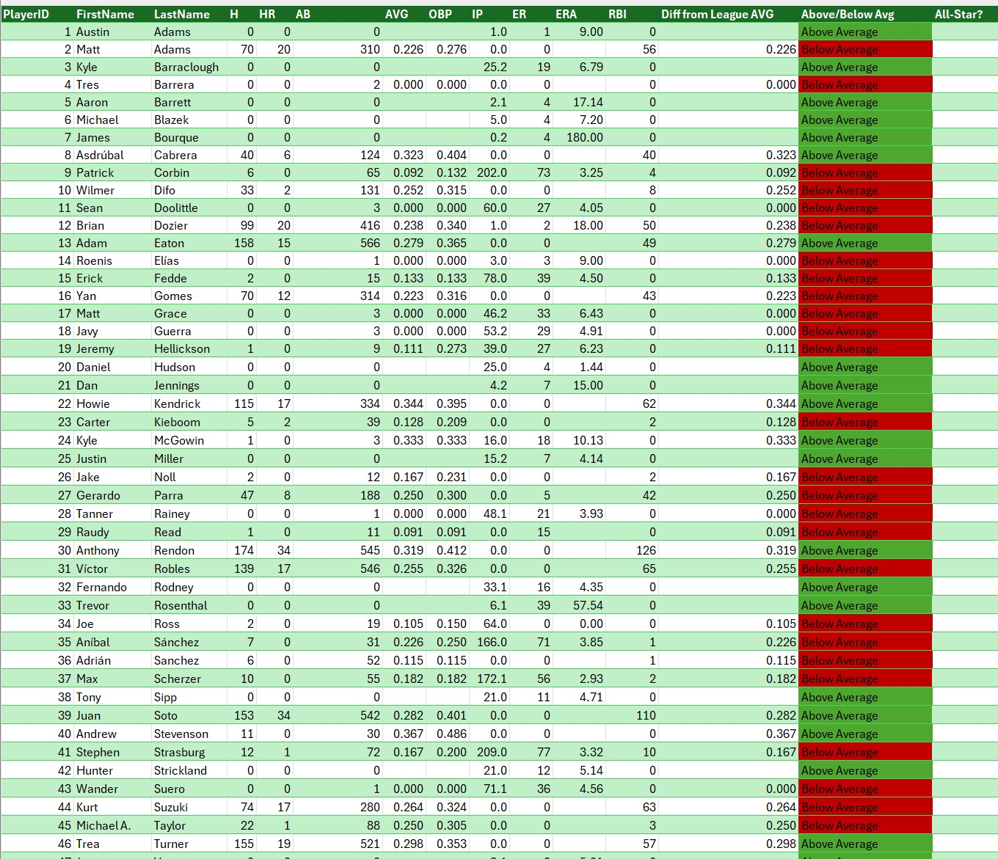
PROJECT OVERVIEW
Dataset
50 Washington Nationals players — 2019 season batting and pitching stats
Tools Used
Microsoft Excel for calculations and visualization
Microsoft Access for database design and queries
Key Metrics Analyzed
Batting AVG, Home Runs (HR), RBIs
ERA and Innings Pitched
Comparison to league average (.275 AVG)

Slide 3
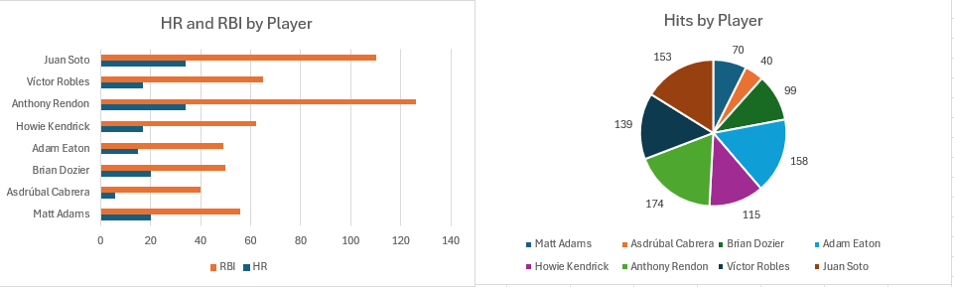
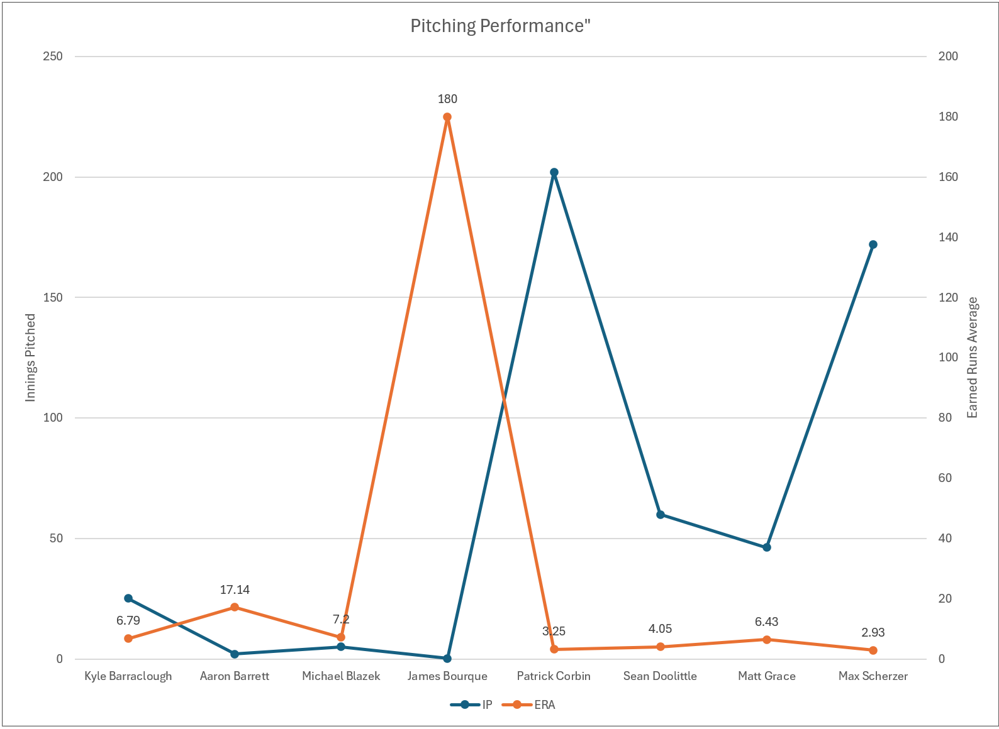
EXCEL ANALYSIS
Calculations
Batting AVG, ERA, and difference from league average for each player
Conditional formatting: green = above average, red = below average
Functions Used
VLOOKUP, IF, Absolute References, Data Validation
Charts Built
Bar chart: HR & RBI by player
Pie chart: Batting distribution
Line chart: Pitchers' ERA by player

Slide 4
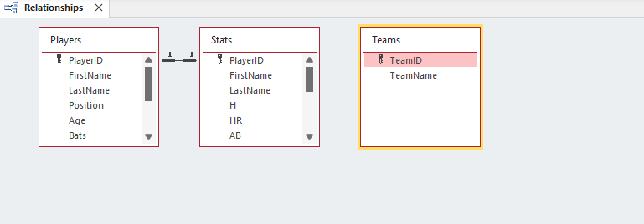
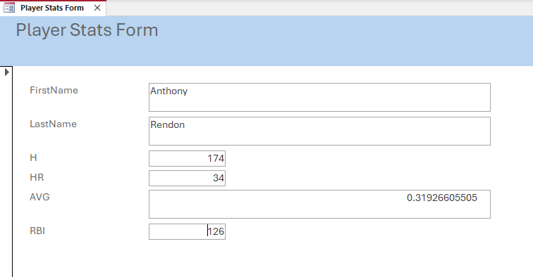

ACCESS DATABASE — TOP PLAYERS ANALYSIS
Database Structure
3 tables: Players, Stats, Teams
Relationship: PlayerID → PlayerID (Players ↔ Stats)
Queries
Filtered players with >20 HRs and AVG above .275 (league average)
Forms & Reports
Built input forms and summary reports to organize and display player data

Slide 5
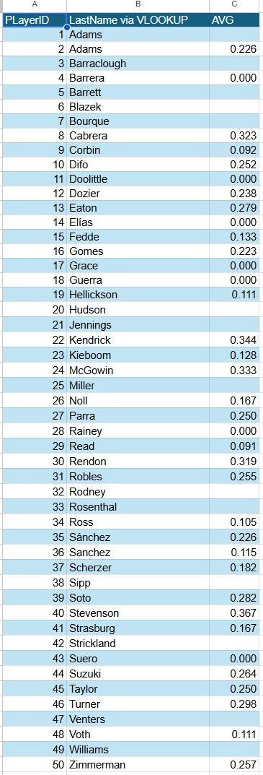
SUMMARY & KEY FINDINGS
Key Findings
Juan Soto and Anthony Rendon led the team with 34 HRs each, both exceeding the .275 league batting average
Pitching data revealed Max Scherzer as the top performer with the lowest ERA among starters
Skills Demonstrated
Excel: VLOOKUP, IF, conditional formatting, data validation, charting
Access: table design, relational keys, query building, forms, reports
Integrated both tools to move from raw data to structured insights

