Slide 1
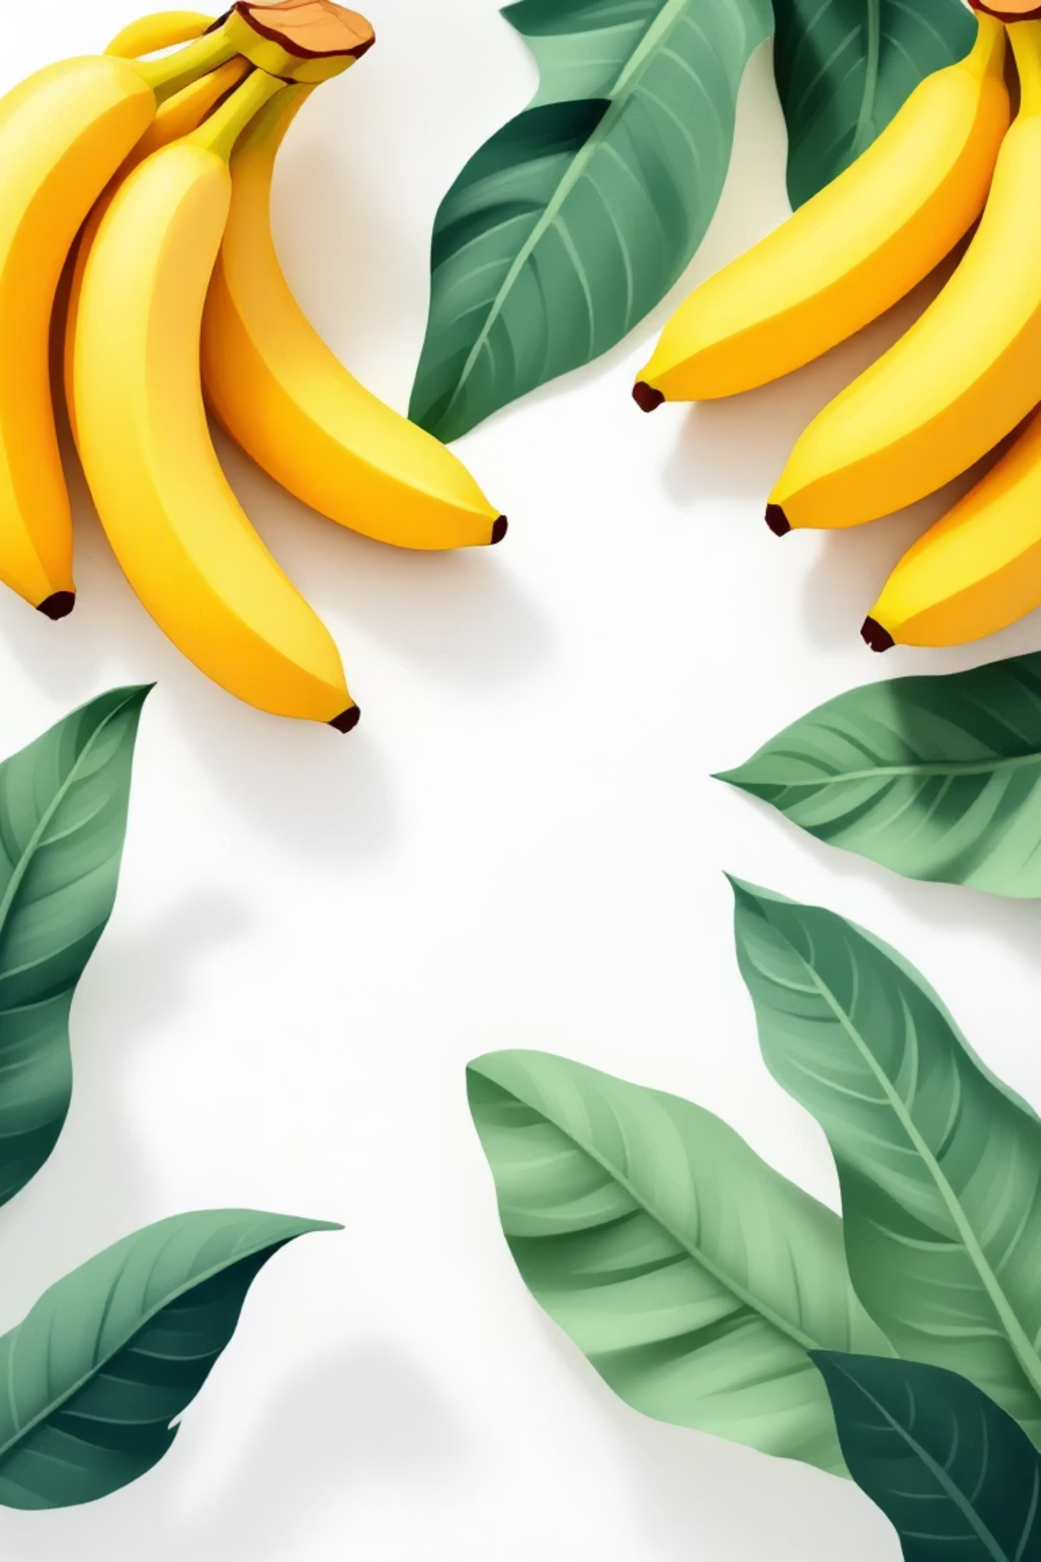
Banana Ripeness Detection Using CNN
Deep Learning Classification Project

Slide 2
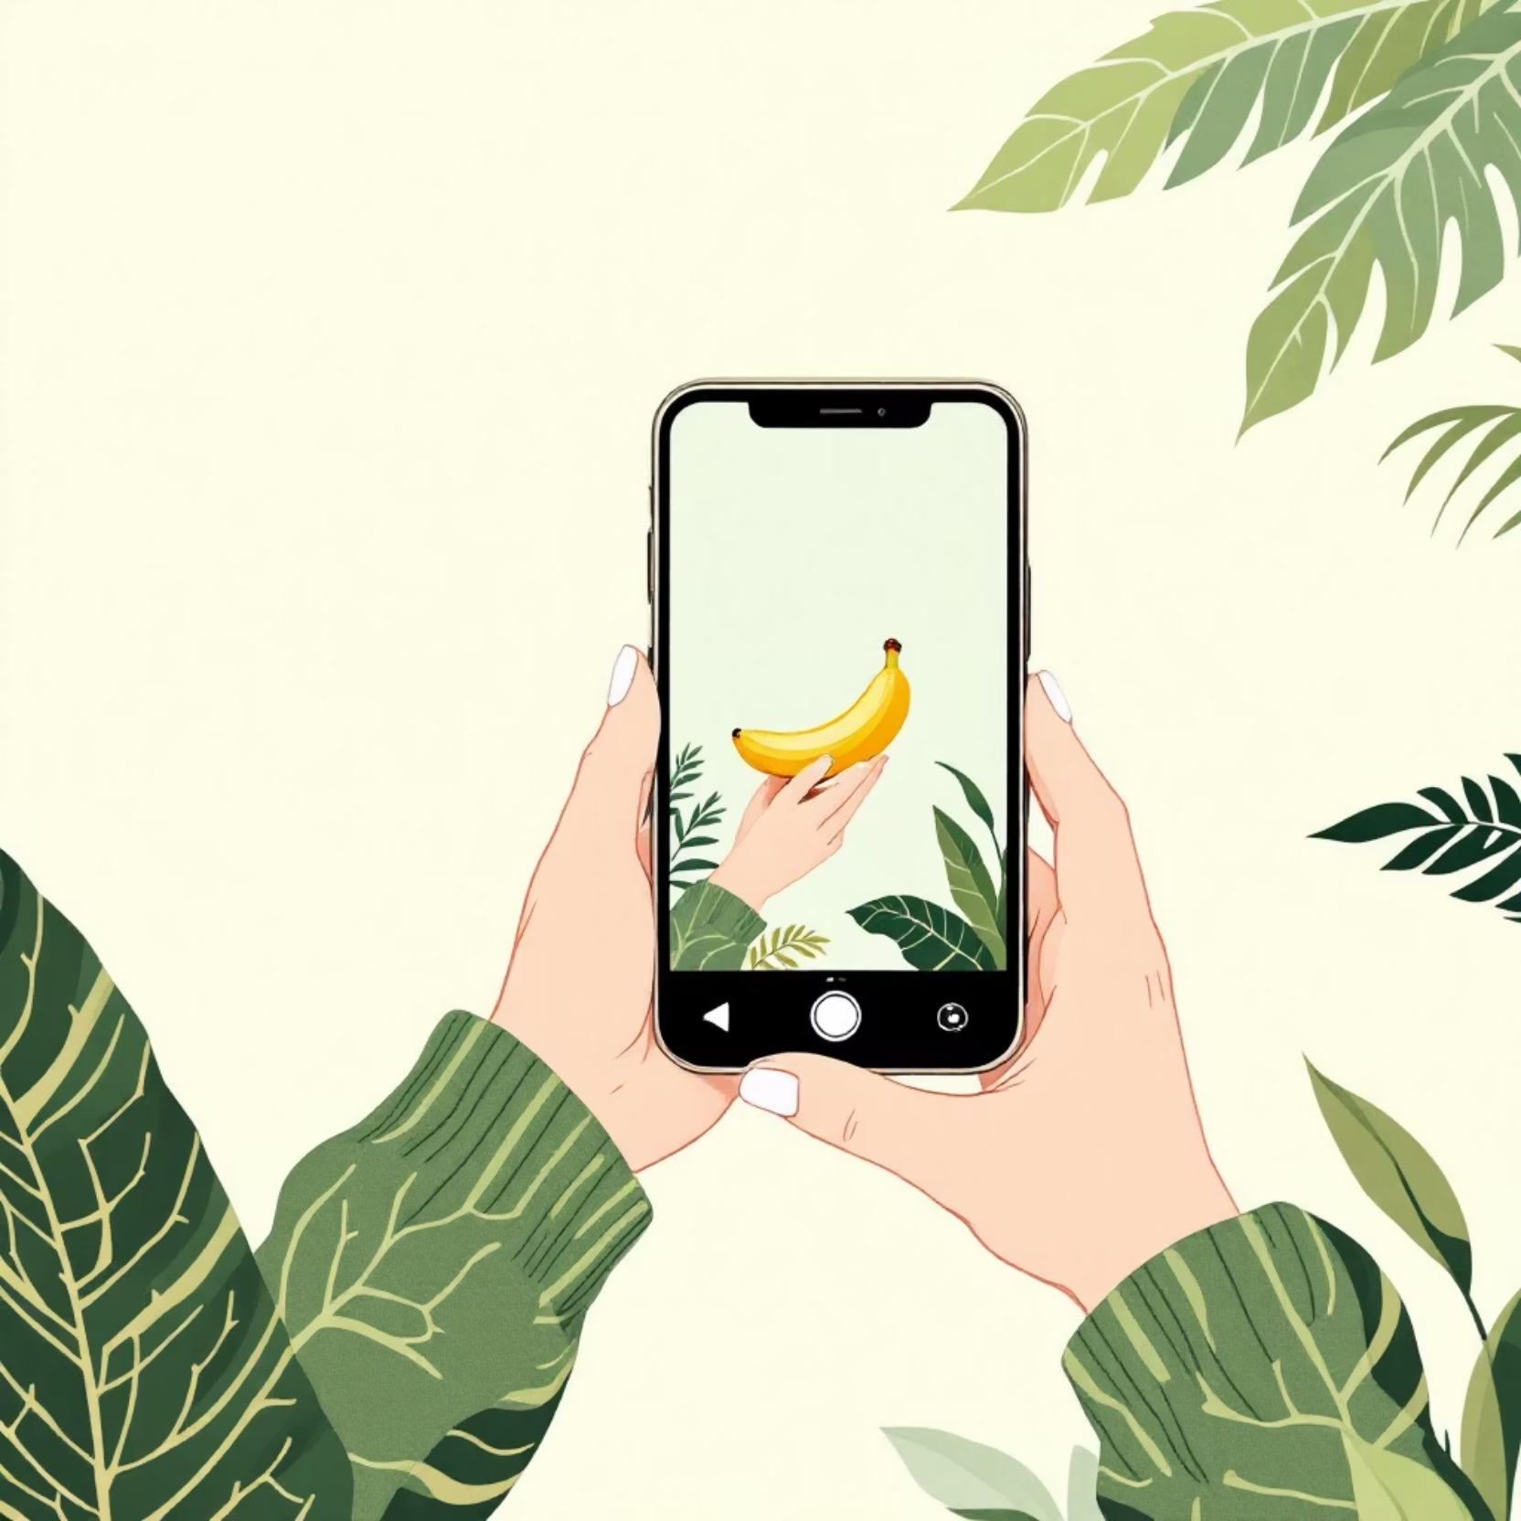
About This Project
This project demonstrates how deep learning can be applied to solve a real-world fruit-quality assessment problem with high accuracy. It pioneers a practical and accessible method for determining banana ripeness using computer vision.
Users can upload a banana image and instantly understand its freshness and remaining shelf life. The model analyzes the image and predicts whether it is Overripe, Ripe, Rotten, or Unripe.

Slide 3

Project Overview
4 Ripeness Stages
Storage Predictions
Classifies bananas as Overripe, Ripe, Rotten, or Unripe with precision
Estimates storage duration at room temperature and in the fridge
13,478 Images
Cloud-Deployed
Comprehensive dataset sourced from Kaggle for robust training
Model trained in Google Colab, deployed using Streamlit for accessibility

Slide 4
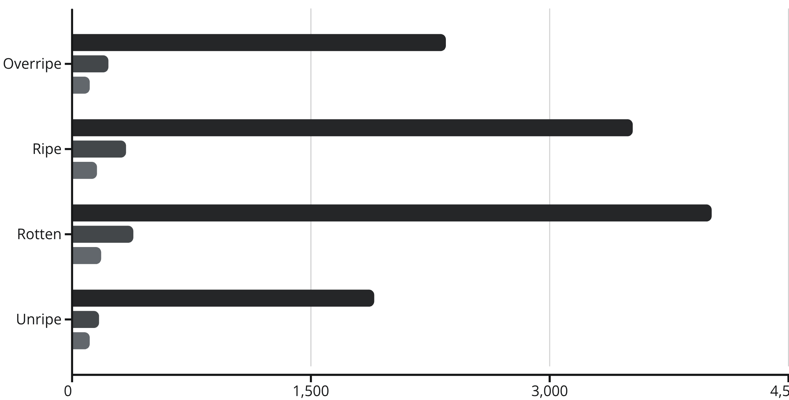
Dataset Summary
The dataset is strategically split across training, validation, and test sets to ensure model robustness and generalization. Each ripeness category is well-represented across all phases.
Training
Validation
Test

Slide 5
CNN Architecture
01
02
03
Input Layer
Convolutional Blocks
Global Pooling
224×224×3 image with pixel rescaling for normalization
Three Conv2D + MaxPooling2D + Dropout layers for feature extraction
GlobalAveragePooling2D reduces spatial dimensions while preserving key features
04
05
Dense Layers
Optimization
Dense(32, ReLU) followed by Dense(4, Softmax) for classification
Adam optimizer with Sparse Categorical Crossentropy loss function

Slide 6
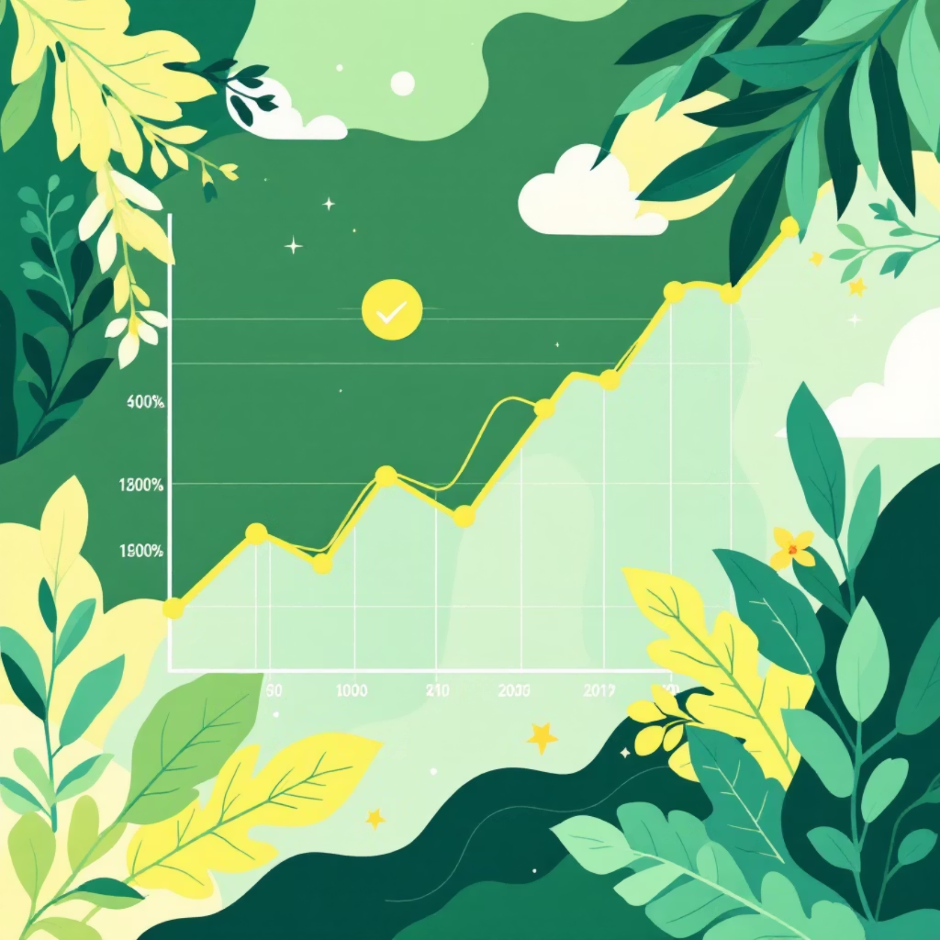
Model Performance
20
Training Epochs
Sufficient iterations for convergence
92.66%
Training Accuracy
Strong learning on training data
93.77%
Validation Accuracy
Excellent generalization capability
The model demonstrates minimal overfitting with validation accuracy exceeding training accuracy. Final model saved as banana_model.keras for deployment.

Slide 7
Banana Storage Guide
Each ripeness stage has specific storage recommendations to maximize freshness and minimize waste.
Unripe
Room Temp: 5–7 days
Fridge: Not recommended (stops ripening process)
Ripe
Room Temp: 2–3 days
Fridge: 5–7 days (skin darkens but fruit stays fresh)
Overripe
Room Temp: 1–2 days
Fridge: 3–5 days (ideal for baking)
Rotten
Unsafe to eat – discard immediately

Slide 8
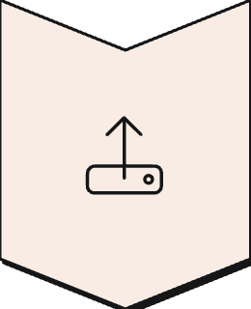



Deployment
Upload Image
User uploads a banana photo through the Streamlit interface
CNN Prediction
Model analyzes the image and classifies ripeness stage
Storage Advice
App provides personalized storage recommendations
The Streamlit deployment makes the model accessible to anyone with an internet connection, transforming complex computer vision into a user-friendly tool.

Slide 9

Conclusion
Successful Implementation
High Accuracy
Built a robust CNN architecture for accurate banana ripeness detection
Achieved 93.77% validation accuracy, demonstrating strong generalization
Practical Value
Scalable Solution
Provides real-world storage guidance to reduce food waste
Ready for deployment and expansion to other fruits and quality metrics

